Slide 1
On the Post-Quantum Security on (Ring) Signatures
Rohit Chatterjee, Kai-Min Chung, Xiao Liang, Giulio Malavolta

Slide 2
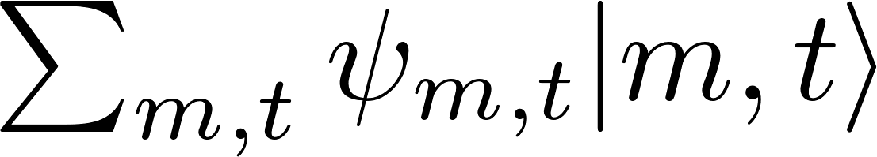
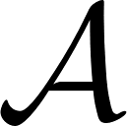


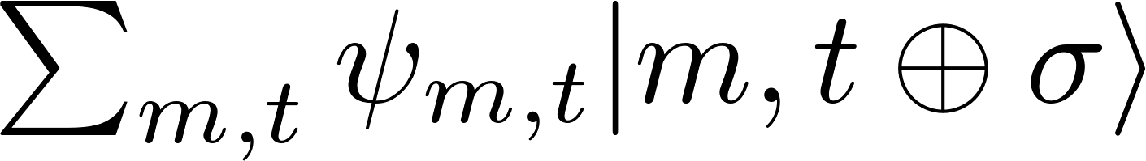

Post-Quantum Signatures: Security
Signing oracle
Classical case: queries are individual messages
Quantum case: queries are quantum states
(i.e., superpositions over messages)
Works as long as challenge message is not queried
In this case, cannot define ‘queried messages’
-> cannot define how to win unforgeability game!

Slide 3
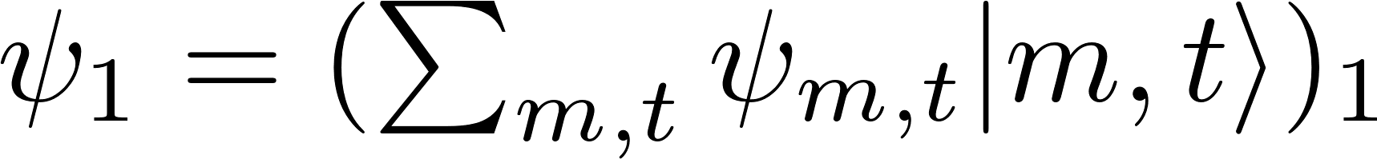

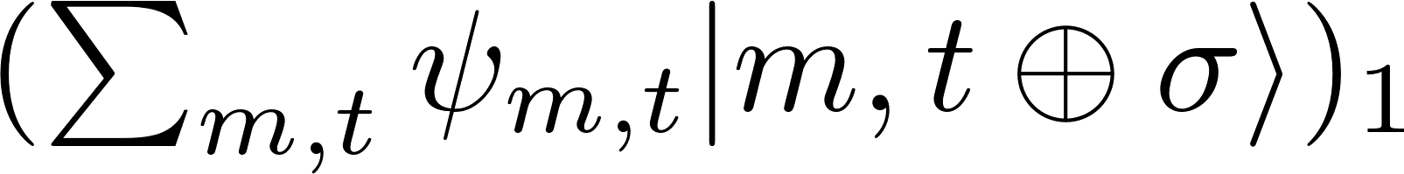


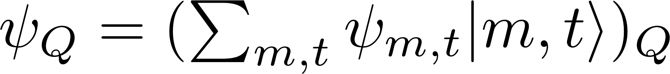
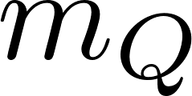
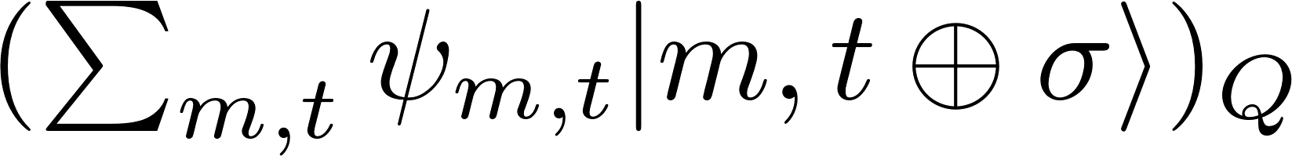
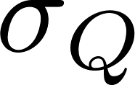
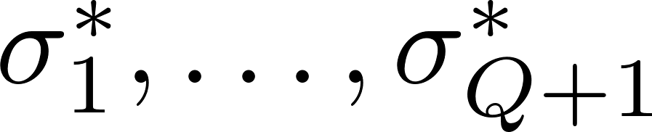
One-More Unforgeability
Given in [BZ’13]
Easy to see that superpositions do not help.
Equivalent to the standard definition classically.

Slide 4
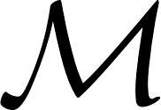


One-More Unforgeability: Issues
Disagrees somewhat with the intuitive understanding of quantum unforgeability.
E.g: Adversary can produce (<q) forgeries where queries are made from a subset S of message space, while the forgery is in the complement of S.
Not unrealizable: [AMRS’20] present an example of this kind that satisfies one-more unforgeability.

Slide 5
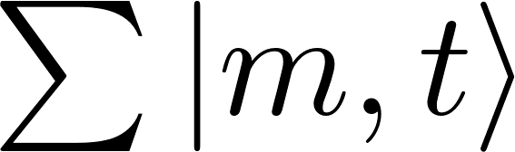

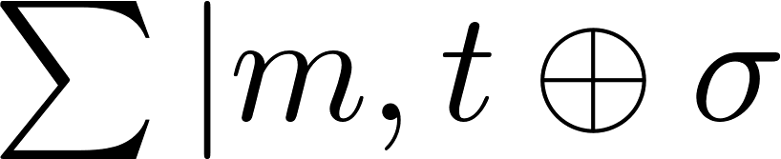
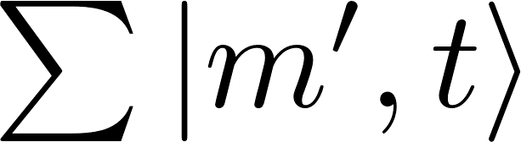
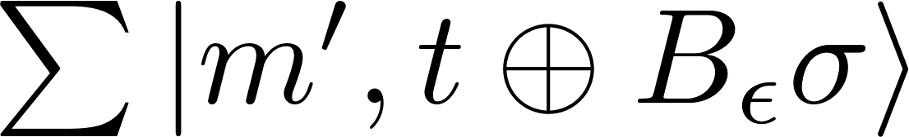
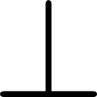
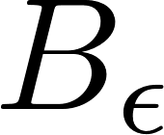
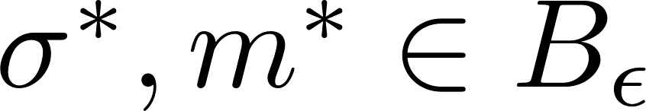
Alternative: Blind Unforgeability
Given in [AMRS’20]
Challenger chooses an uniform `blindset’ of density ϵ (ϵ can be chosen adversarially).
Signing oracle only signs on messages not in blindset.
Adversary’s forgery must be on a message in the blindset.
Equivalent to the standard definition classically.
(Currently) incomparable to one-more unforgeability

Slide 6
Our Results & Previous Work
Broadly, we describe signature schemes that satisfy blind unforgeability.
Before our work, the only signature schemes that were known to satisfy this definition were one-time signature schemes (e.g. Lamport).
We show a scheme based on QPRFs and the hardness of SIS that is blind-unforgeable in the Quantum Random Oracle model.
We give another scheme based also on QPRFs and the hardness of SIS that is blind-unforgeable in the plain model.
Both schemes are compact, i.e., the signature size can be made independent of the message length.

Slide 7
Our Results (Continued)
We also develop a meaningful extension of blind unforgeability to the ring signature setting.
Further, we present a construction of ring signatures satisfying this new definition, based on the template of [CGKL+’21].
The previous known ring signature unforgeability definition from [CGKL+’21] was based on one-more unforgeability and suffered from drawbacks.

Slide 8
Signature in the QROM

Slide 9
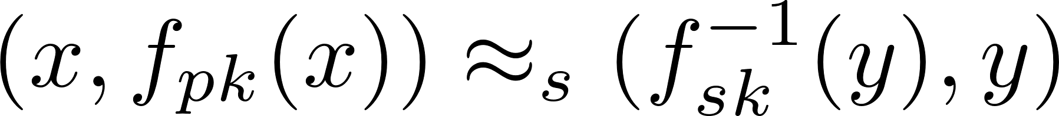
The GPV Signature Scheme
We show that the GPV signature scheme [GPV’08] is blind-unforgeable in the QROM.
Relies on Preimage Sampleable Function (PSF) families.
Allows for evaluating a PSF f using a public key, and for sampling a preimage (given an image) using a secret key.
(x,y sampled uniformly)
For any given image, the corresponding preimages have superlogarithmic minentropy.
Also have collision resistance: hard to find two different preimages for the same image.
Known from the hardness of SIS.

Slide 10
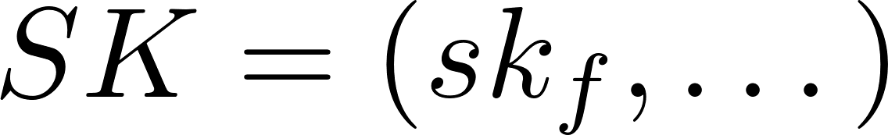

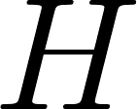
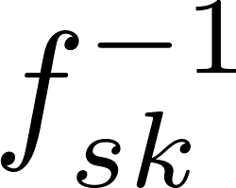
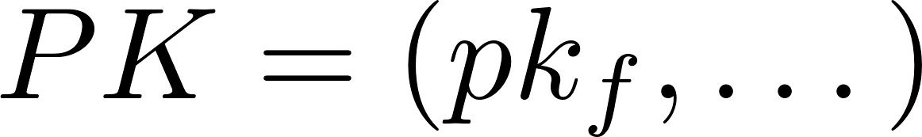
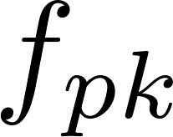
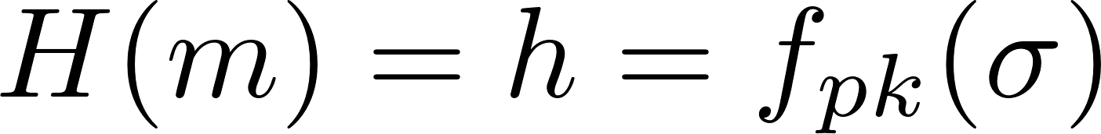
QROM: The GPV Signature
Deterministic (derandomized using QPRF)
‘Hash-and-sign’ signature scheme: sample an inverse for the digest (H = RO).
To verify, compare the output of f on the signature with digest.
Compact: Signature size can be made independent of message size.

Slide 11
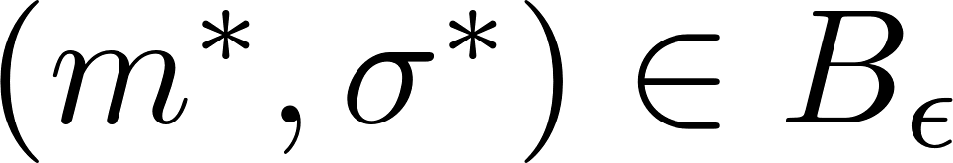
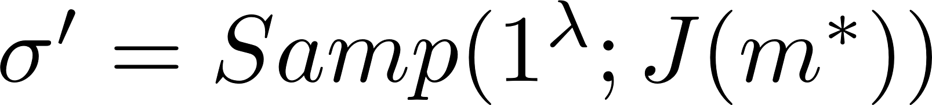
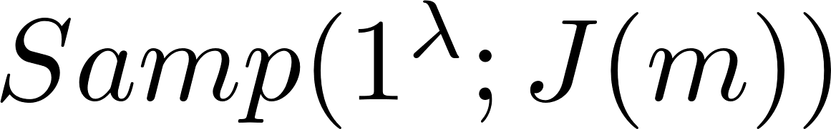
GPV Scheme: Security Sketch
Hybrid: sample a signature using message-dependent randomness (J() is an RF)
(Introducing J can be handled by QPRF techniques)
Joint dist. (H(m),σ(m)) statistically close to real experiment
Note that adversary never sees signatures for messages in B_{ϵ}
Either σ*= σ’: violates preimage minentropy
Or σ*≠ σ’: violates collision resistance

Slide 12
Signature in the Plain Model

Slide 13

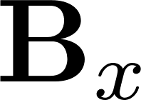


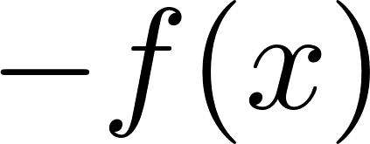




Plain Signature: Components
We use a combination of the left-right trapdoor paradigm [ABB’10] and key-homomorphic evaluation techniques [BV’14].
G: Gadget matrix

Slide 14
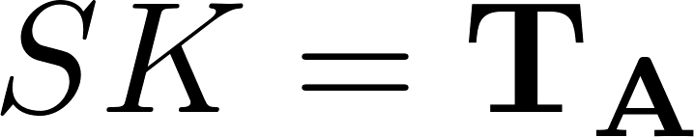
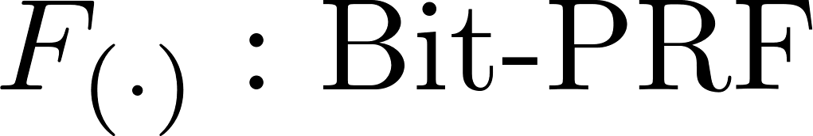
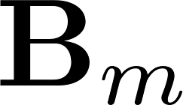
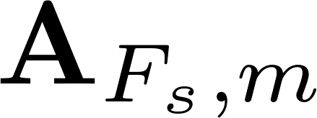

Plain Signature: Scheme
Combination of techniques are similar to [BL’16].
Signature: vector in (modular) nullspace of B_{m}.
Compact: Signature size is not dependent on message length.

Slide 15
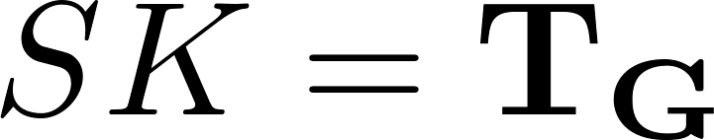
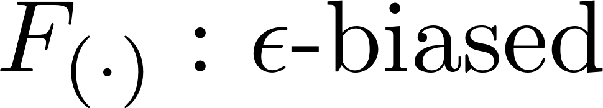


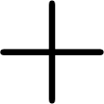
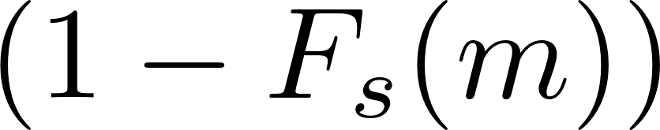
Plain Signature: Security Sketch
Low-norm matrix
F_{s}(m)=1: Hybrid can sign
F_{s}(m)=0: Cannot sign; any signature can also be used to generate SIS solution

Slide 16
Quantum Security of Ring Signatures

Slide 17
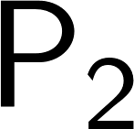
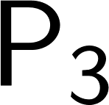
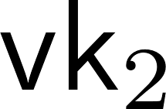
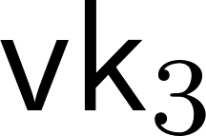
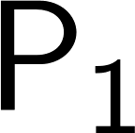
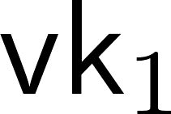
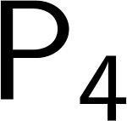
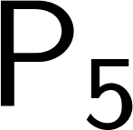
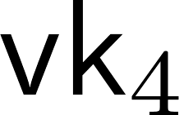
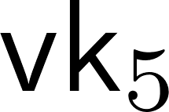
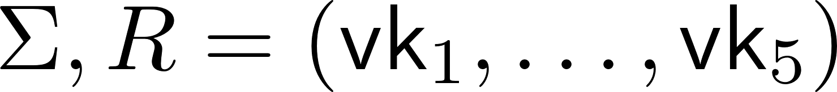
Ring Signatures
Unforgeability
Anonymity
Ring of users
No interaction!
Whistleblowing
Blockchains

Slide 18

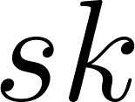








BDHKS Ring Signature: Template
(SK has in addition)
Verification key for Sig
Public key for Enc
ZAP Verifier message
Contains encrypted signature generated using vk, pk bound to by
(Actually must use 2 blocks to rely on WI)

Slide 19






Classical Unforgeability
Challenger generates universe of q public keys.
A can make signing queries with a ring and message of its choice.
Can also corruption queries where it gets the signing key for an user.
Finally adversary outputs a forgery
Valid if it is a valid signature w.r.t. a ring with only uncorrupted members.

Slide 20






Classical Anonymity
Challenger generates q public keys and provides these to A, along with the generating randomness.
A sends a message and a ring containing at least two public keys from the universe, with their indices.
The challenger prepares a ring signature using the signing key for one of the two users.
The adversary has to correctly guess which key was used to sign

Slide 21

[CGKL⁺] Ring Signature
Compactness
Unforgeability
Size = O(log(|R|))
Anonymity
Either forge or violate soundness of
Follows from a [NY’90] style argument (uses the ‘dummy block’)

Slide 22


Quantum Unforgeability
Signing queries allow superpositions over the message and the ring.
Natural generalization.
We follow the blind-unforgeability style (blinded signing oracle)
Blind set is over both messages and rings.
Corruption queries remain classical.
Forgery must be in blindset.
As before, R* must be uncorrupted.

Slide 23


Quantum Anonymity
Follows the classical definition.
We allow superpositions over rings and messages, but not over identities.
(Def. is unsatisfiable otherwise)
Challenger evaluates the signature over the superposition, using one of the indices.
Previous definition didn’t allow superpositions over R.

Slide 24


Quantum Unforgeability: Challenges
Sig must be blind-unforgeable
ZAP must be sound against (efficient) quantum provers
Can remove SPB hash key as well
Need to sign ring to ensure ‘consistency’ between blindsets in reduction
Our construction is not compact

Slide 25


Quantum Anonymity: Challenges
Have to show indistinguishability of components when signed by i₀ and i₁.
But signature is in superposition – need quantum techniques.
Generate encryption & proof randomness using P.I. hashing.
Also need statistical indistinguishability from encryption and proof –
Use special lossy encryption.
ZAP scheme is already statistically WI.

Slide 26
Open Problems
Compact ring signatures under our definitions?
More efficient standard signatures/ signatures based on other assumptions
Exploring quantum definitions further: more tailored and meaningful definitions may be possible

Slide 27
Thank you for watching!
Please see full paper:
https://eprint.iacr.org/2021/1616.pdf

