Slide 1
Plausibly Deniable Storage
Chen Chen¹, Xiao Liang¹,
Bogdan Carbunar², and Radu Sion¹
¹ Stony Brook University
² Florida International University

Slide 2

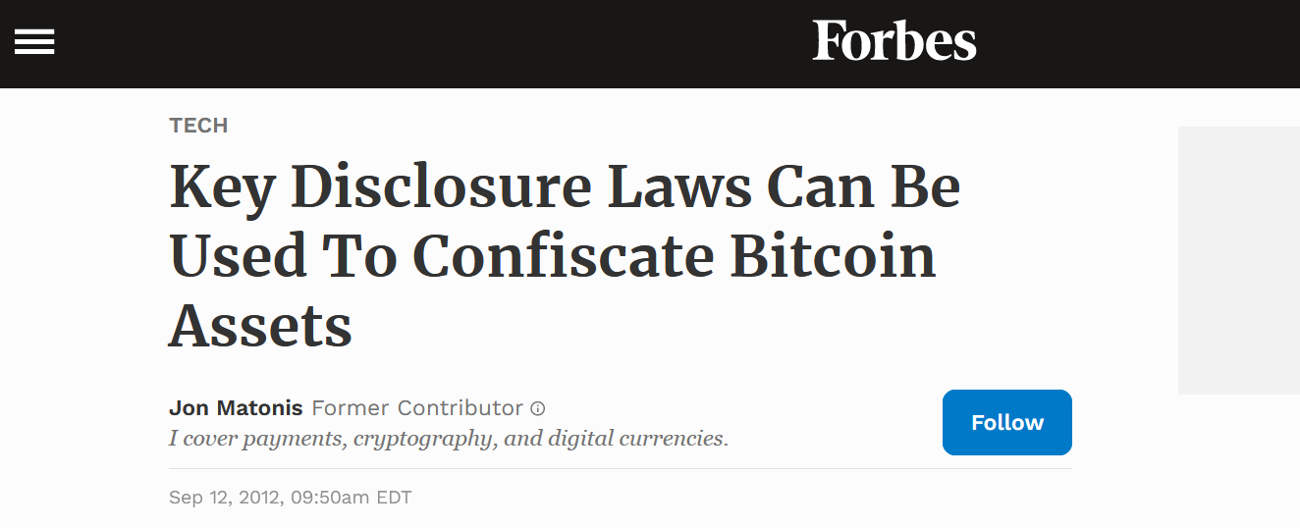
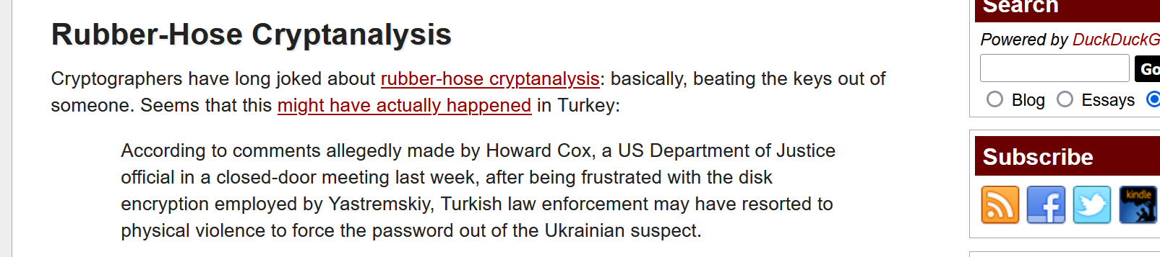
Motivation
Encryption for Data privacy.
Sufficient? Not really.
Coercive adversaries (e.g, Oppressive governments, anti-encryption laws …)
Real-life examples:

Slide 3







Plausible Deniability
KEY OR TORTURE!
EMMM… OK,
YOU’RE GOOD.
Mr. Smith
Big Brother
Faked mechanism
Hard drive: sensitive data
Real behavior
Faked explanation
Single-Snapshot:
The above game happens only once.
Multi-Snapshot:
It happens whenever Big Brother wants (i.e., Unannounced Inspection)
Comparison between different snapshots to extract more information
Non-sensitive data or
random bits

Slide 4
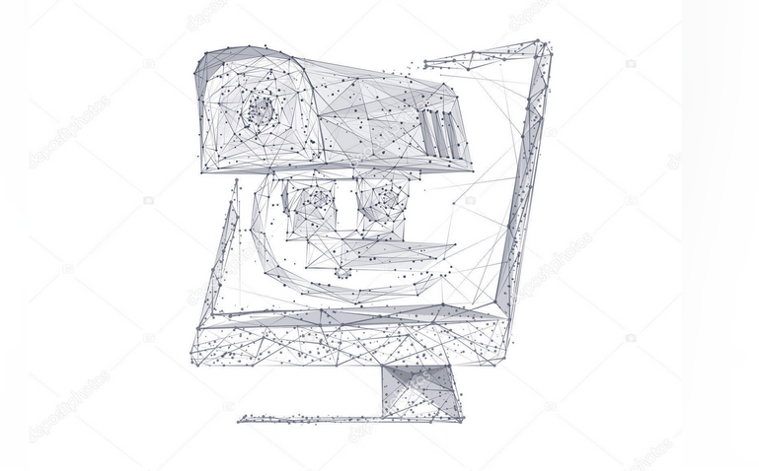
Assumptions about Adversaries
Big Brother can:
Access to the design of system
Access to device.
Be Coercive
But he is:
Computationally bounded (i.e., polynomial-time)
No access to passwords/keys
No access to run-time system state (e.g., DRAM, caches)
No malicious code injection
Rational: No further coercion if it cannot prove the existence of any unrevealed data

Slide 5
Challenges
Security-Efficiency Trade-Off:
Single-snapshot: Fast. Unsatisfactory security.
Multi-snapshot: Good security guarantee. Not as fast.
Relying on write-only ORAM, or
Making heuristic assumptions, or
Relaxing security requirements
Dependency on System Layers
E.g., File System, LVM, Block-Device, FTL …
PD solutions are layer-specific
Complicated and ad hoc security analysis
Broken once (real-life) adversaries access more layers in the system.
Lack of Unified Security Framework
Customized definitions in different works
Hard to perform comparative analysis of security

Slide 6
Contributions
1. Dependency on System Layers
Propose “trace-oriented security”
Can reduce/eliminate the dependence on layers
It comes with a price --- equivalent to wORAM
2. Lack of Unified Security Framework.
Propose a unified framework
Flexibility to capture restricted adversaries
Allows comparison between existing works
3. Other Insights:
Approaches to hiding access patterns to hidden data
How to achieve “invisibility”
Future direction

Slide 7

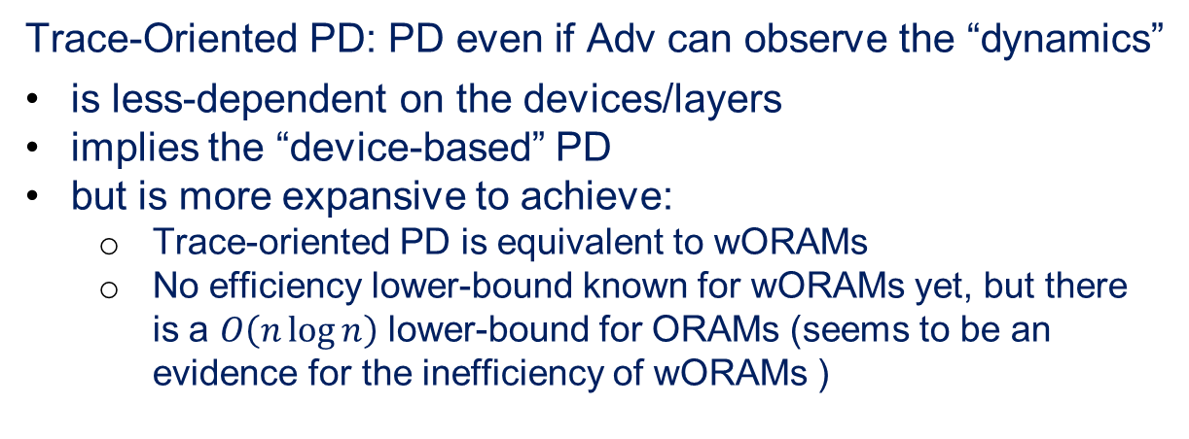
Trace-Oriented PD
Application
Known PD definitions assumes Adv checks the device
the last layer in the storage system stack
Containing physical status of data
Not containing the “dynamics”: the logical Write/Delete commands that cause the current status of the device
File System
Device Mapper
Trace-Oriented PD: PD even if Adv can observe the “dynamics”
is less-dependent on the devices/layers
implies the “device-based” PD
but is more expansive to achieve:
Trace-oriented PD is equivalent to wORAMs
No efficiency lower-bound known for wORAMs yet, but there is a $O\left(n\log{n}\right)$ lower-bound for ORAMs (seems to be an evidence for the inefficiency of wORAMs )
or

Slide 8






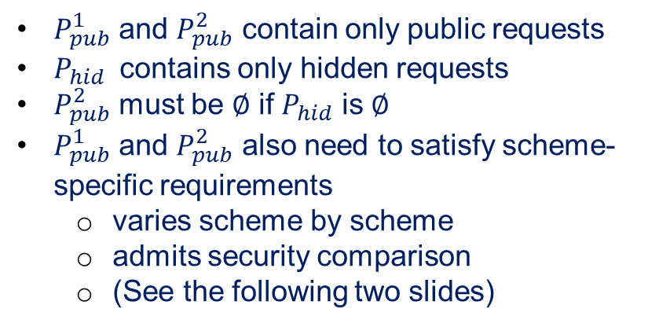

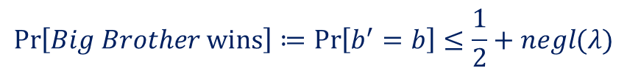
Unified Definition
$P_{pub}^{1}$ and $P_{pub}^{2}$ contain only public requests
$P_{hid}$ contains only hidden requests
$P_{pub}^{2}$ must be $∅$ if $P_{hid}$ is $∅$
$P_{pub}^{1}$ and $P_{pub}^{2}$ also need to satisfy scheme-specific requirements
varies scheme by scheme
admits security comparison
(See the following two slides)
Pick a random bit
$$b ←\{0,1\}$$
$$P_{0}$$
$$P_{1}$$
Setup the device
$P_{0}≔$ $P_{pub}^{1}$ ꓴ $P_{pub}^{2}$
Repeat r times
$P_{1}≔$ $P_{pub}^{1}$ ꓴ $P_{hid}$
Device’
Device’ $←$Execute($P_{0}$, Device)
To define Trace-Oriented PD:
Replace Device’ by “operation traces”
I.e., the sequence of logical Read/Write commands
Guess $b′$
PD if:
A negligible function on security parameter
$$\operatorname{Pr}\left[Big Brother wins\right]≔\operatorname{Pr}\left[b^{′}=b\right]≤\frac{1}{2}+negl(λ)$$
r = 1: single snapshot PD
r = arbitrary polynomial: multi-snapshot PD

Slide 9
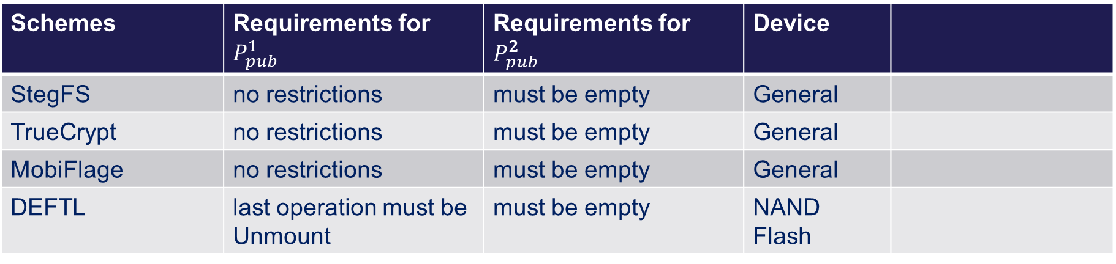
Security comparison – Single-Snapshot Schemes
Schemes | Requirements for $P_{pub}^{1}$ | Requirements for $P_{pub}^{2}$ | Device
StegFS | no restrictions | must be empty | General
TrueCrypt | no restrictions | must be empty | General
MobiFlage | no restrictions | must be empty | General
DEFTL | last operation must be Unmount | must be empty | NAND Flash

Slide 10
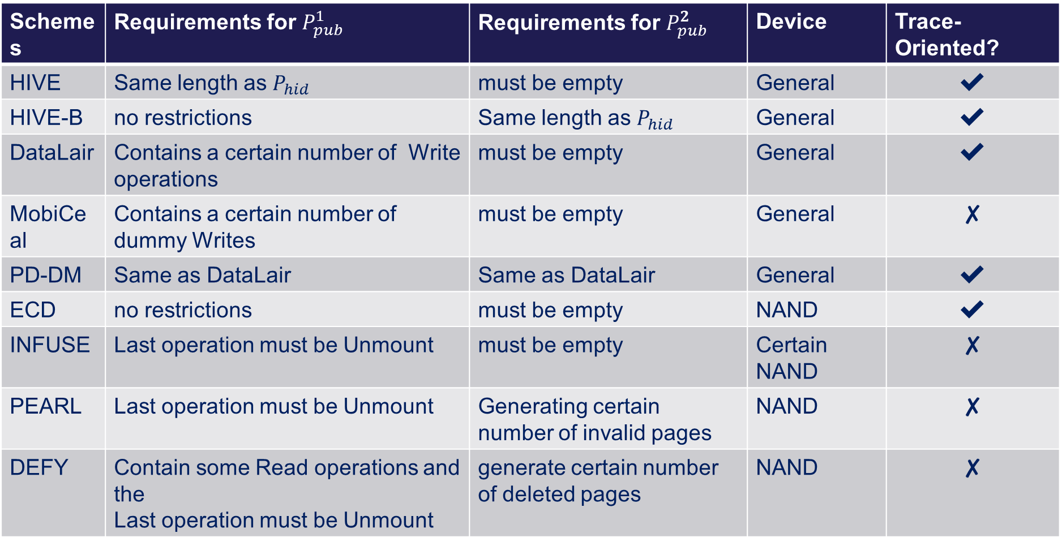
Security comparison – Multi-Snapshot Schemes
Schemes | Requirements for $P_{pub}^{1}$ | Requirements for $P_{pub}^{2}$ | Device | Trace-Oriented?
HIVE | Same length as $P_{hid}$ | must be empty | General | ✔
HIVE-B | no restrictions | Same length as $P_{hid}$ | General | ✔
DataLair | Contains a certain number of Write operations | must be empty | General | ✔
MobiCeal | Contains a certain number of dummy Writes | must be empty | General | ✘
PD-DM | Same as DataLair | Same as DataLair | General | ✔
ECD | no restrictions | must be empty | NAND | ✔
INFUSE | Last operation must be Unmount | must be empty | Certain NAND | ✘
PEARL | Last operation must be Unmount | Generating certain number of invalid pages | NAND | ✘
DEFY | Contain some Read operations and the Last operation must be Unmount | generate certain number of deleted pages | NAND | ✘

Slide 11
Hiding Access Patterns
PD lies in concealing users’ hidden data access.
Using ORAMs
E.g., HIVE, DataLair, and MobiCeal
achieving the strongest security requirement
inefficient due to the inherently heavy randomization machinery
Alternative approaches to hide access patterns:
1. Use canonical form:
E.g., PD-DM, ECD, DEFY
Explain hidden access as “canonical patterns”
preserves data locality
is friendly to locality-optimized systems (caching, read-ahead mechanisms)
2. Exploit specific device properties:
E.g., INFUSE (voltage variation), PEARL (WOM encoding)
Efficient: performance comparable to the non-PD baseline
Require device-specific ideas. Not generic.

Slide 12
Future Directions (1/2)
Trace-oriented PD schemes with better efficiency
More light-weight solutions exploiting specific device properties
Only two known solutions (INFUSE and PEARL)
This seems to be a power approach deserving further exploration
Explore Adversary Model Changes
A stronger model capturing more adversarial behaviors:
cold boot attacks, access swap files and core dumps,
Extending PD to other parts of the system stack:
caches, DRAM

Slide 13
Future Directions (2/2)
Invisible PD
Try to hide that the system in use is PD?
Gain more credibility in the face of coercive authorities
E.g., making the scheme look indistinguishable to a off-the-shelf storage system
E.g., StegFS is similar to EXT2, except for a bitmap. Try to remove bitmap
Synthetic Operations
Known PD solutions: match hidden operations to public ones
More active approaches?
E.g., generate synthetic public operations whenever the user wants to perform hidden operations making use of AI/ML solutions

Slide 14
Thanks!
Q & A
See the full version for more details:
arXiv:2111.12809 or
ia.cr/2021/1547

