Slide 1



Almost-Total Puzzles and Their Applications
Xiao Liang
Yuhao Tang
Omkant Pandey
Takashi Yamakawa

Slide 2
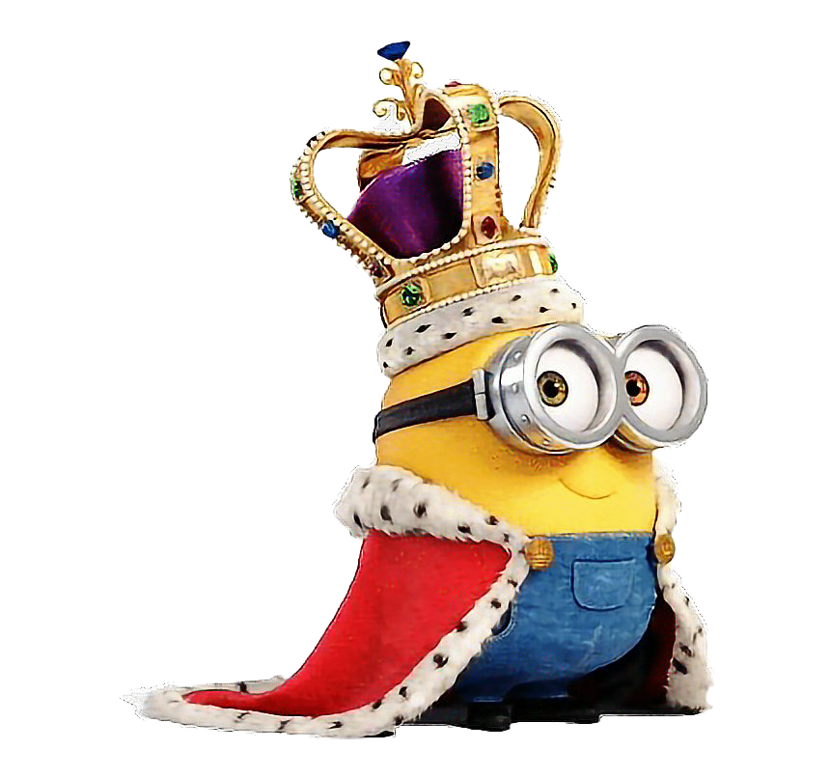

Public-Coin Interactive Protocols
Our focus: Public-Coin
All of Bob’s messages are random bits
…
Why public-coin protocols?
soundness amplification via parallel repetition for interactive arguments [BIN97, HPWP10]
Fiat-Shamir transform [FS87]
“Impossible trinity” [GK90] among
constant rounds,
black-box simulation,
public-coin
(composable) MPC with low round complexity
Examples:
Commitments (with optional properties):
extractable
equivocal
non-malleable …
Interactive proofs (with optional properties):
sigma protocols (i.e., special soundness)
witness-indistinguishable/witness-hiding
zero-knowledge …
Secure two-party computation

Slide 3
State of the Art for Public-Coin Protocols: Classical
Classical Setting:
We know public-coin constructions for:
Extractable commitments [PasWee09]
Non-malleable commitments [GoyRic19]
WI proofs (of knowledge) [FeiSha90]
All are round-optimal (i.e., 3 rounds) from the (almost) minimal assumptions of injective OWFs.
Post-quantum setting?
i.e., honest parties are classical; but secure against quantum (polynomial-time) adversaries.

Slide 4
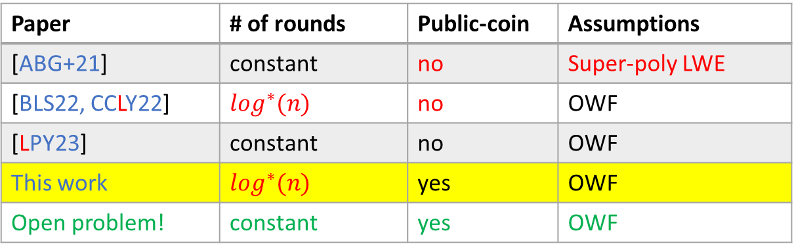
State of the Art for Public-Coin Protocols: Post-Quantum
Post-Quantum Setting:
Paper | # of rounds | Public-coin | Assumptions
[LMS22] | 4 | yes | collapsing hash
[LMS22] | 4 | yes | super-poly OWF
[LMS22] | 3 | yes | super-poly NI Com
[LMS22, CCLY22] | 12 | no | OWF
This work | 5 | yes | OWF
Open problem! | 4 (resp. 3) | yes | OWF (resp. injOWF)
For both ExtCom
&
WIAoK
All of our results are obtained via a new primitive:
Almost-Total Puzzle
Paper | # of rounds | Public-coin | Assumptions
[ABG+21] | constant | no | Super-poly LWE
[BLS22, CCLY22] | $$\log^{∗}(n)$$ | no | OWF
[LPY23] | constant | no | OWF
This work | $$\log^{∗}(n)$$ | yes | OWF
Open problem! | constant | yes | OWF
Non-malleable Com

Slide 5
A New Primitive: Almost-Total Puzzle
1. An interactive protocol:
Properties:
1. Almost-total:
Generator
Receiver
…
a puzzle:
2. Hard:
Denote this procedure by:
3. Public-coin (optional)
2. a verification algorithm:

Slide 6

Our Results
PQ-ExtCom (five-round, public-coin)
[also a classical ExtCom without overextraction]
(post-quantum)
OWF
[Rom90]
([AarChr12] in PQ setting)
PQ-WIAoK (five-round, public-coin)
Delayed-input non-uniform
ZKAoK
(five-round, public-coin)
Delayed-input
Strong WI/WH-AoK
(five-round, public-coin)
(post-quantum)
Universal One-Way Hash function (UOWHF)
Our work
Preprocessing
PQ-ZKAoK
(five-round, public-coin)
Preprocessing
Strong PQ-WI/WH-AoK
(five-round, public-coin)
(post-quantum)
Almost-Total Puzzle
two-round,
public-coin
Our work
PQ non-malleable Com ($\log^{∗}(n)$-round, public-coin)

Slide 7
Construction of ATP from UOWHF
Generator
Receiver
Def. of UOWHF :
Solution:
An (s, i) pair such that
, namely:
Known from (PQ-)OWF
Proof of security:
Almost-total:
Properties: two-round, public-coin, public-verifiable
- half of the preimages have collision (by compressing)
- make n large enough; union bound.
Hardness: simply reduction to security of UOWHF

Slide 8
Preprocessing PQ-ZKAoK: Definition
Two-stage simulation:
P
V
unbounded
V*
Preprocessing Stage
- No need for (x, w)
…
Preprocessing Stage
…
Prove Stage
- P gets (x, w)
- V gets x
…
poly-time
Prove Stage
…
- Similarly, we can define preprocessing strong-WI and strong-WH
- Easy to see that
Preprocessing
(PQ-)ZKAoK
Preprocessing
Strong PQ-WI/WH-AoK

Slide 9


Preprocessing ZKAoK from ATP
Proof of Security
AoK:
P
V
Follows from the hardness of ATP and the AoK of WIAoK
ATP
Preprocessing Stage
(preprocessing) ZK:
puzzle
puzzle
$S_{0}$ brute-forces the puzzle solution s;
$S_{1}$ uses s in place of $w$;
Prove Stage:
ZK then follows from:
(non-uniform) hiding of Com, and
(non-uniform) WI of WIAoK
- P gets (x, w)
- V gets x
WIAoK
Round complexity:
; or
WIAoK is in 3-round, public-coin (1st msg parallelable with Com);
The total construction is 5-round, public-coin

Slide 10
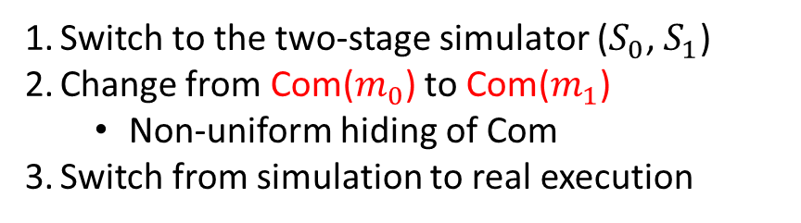
ExtCom from Preprocessing ZKAoK (PP-ZKAoK)
Committer(m)
Receiver
Proof of Security
Stat. binding:
Preprocessing
Stage (of PP-ZKAoK)
By stat.-binding of Com
Extractability:
By AoK property of PP-ZKAoK
Computational hiding:
Prove Stage (of PP-ZKAoK)
By non-uniform comp-hiding of Com, and the preprocessing ZK property of PP-ZKAoK:
I know the value committed in c
Switch to the two-stage simulator ($S_{0}$, $S_{1}$)
Change from Com($m_{0}$) to Com($m_{1}$)
Non-uniform hiding of Com
Switch from simulation to real execution

Slide 11

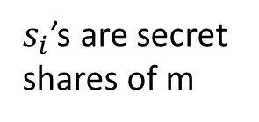
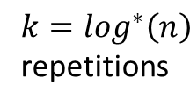

Public-Coin PQ-NMCom in O($\log^{∗}$𝑛)-round (Rough Idea)
Starting point: [BLS22]
Our construction:
C(m)
R
C(m)
R
Preprocessing
Stage of PP-ZKAoK
ExtCom($s_{1}$)
${k=log}^{∗}\left(n\right)$ repetitions
… …
const.-round,
but private-coin
ExtCom($s_{k}$)
Change to our
public-coin ExtCom
… …
$s_{i}$’s are secret shares of m
ZKAoK for
“consistency”
To prove non-malleability:
- delicate modification to [BLS22] proofs, and
- careful non-uniform arguments
Prove stage of PP-ZKAoK

Slide 12
Thank You!
Q&A
Full version available at: https://ia.cr/2025/949

