Slide 1




Round-Efficient Composable Two-Party Quantum Computation
Vipul Goyal
Xiao Liang
Omkant Pandey
Takashi Yamakawa
Yuhao Tang
&

Slide 2








Definition for Secure MPC
Simulator
Real world:
Ideal world:

Slide 3

Composable MPC
Concurrent Internet Environment:
Several protocols running at the same time
Different protocols may share the same parties
Highly desirable to have MPC secure in the concurrent Internet environment
…
…

Slide 4
Existing Results
In the Classical World:
In the Quantum World:
Impossibilities [Lin03, Lin04, BPS06]
Composable MPC is impossible (in the standard, plain model)
Impossibilities
Composable quantum MPC is impossible [GLM23]
Alternative Solutions:
Set-up assumptions e.g. CRS [CLOS02,…]
Bounded self-composition [Lin03,…]
Super-polynomial Simulation [Pas03,…]
and more …
Alternative Solutions:
Classical CRS-based MPC extends to quantum setting
Bounded self-composition [GLM23]
Super-polynomial simulation?
Less-understood. Our focus.

Slide 5
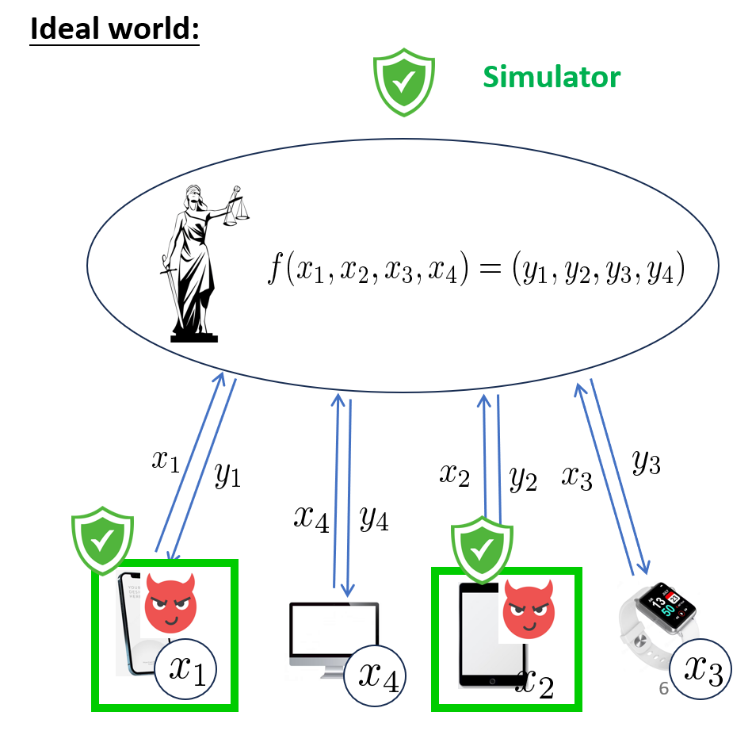
Super-Polynomial Simulation (SPS)
What is SPS MPC?
Same as standard MPC except that the ideal-world simulator could run in super-poly time
Note that the real-world adversary is still poly-time
The rationale behind SPS:
The ideal-world functionality is information-theoretical secure.
SPS ZK implies WI; SPS MPC implies input-indistinguishable MPC [MPR06]

Slide 6
State of the Art for SPS Quantum MPC
Paper | Primitive | # of rounds | Concurrency model | Assumptions
[ACL21] | ZK for NP | poly | Bounded self-concurrent | PQ-OWF
[GLM23] | MPC | poly | Bounded self-concurrent | PQ semi-honest OT
[ABF+23] or [BGI+17] + [BD18] | 2PC | constant | SPS | super-poly hardness of LWE
This work | 2PC | constant | SPS | PQ semi-honest OT
This work | ZK for NP ∩ coNP | 2 | SPS | Standard LWE
Interesting open problems for future research:
SPS quantum MPC from PQ semi-honest OT?
Two-round SPS ZK for NP from standard LWE?

Slide 7
Overview of [GGJS12]
Skeleton of [GGJS12] SPS concurrent 2PC:
It follows from the GMW paradigm
The key step is to make Phase 1 “concurrently SPS secure.”
Phase 1: Trapdoor Generation
Set up a “WI trapdoor” for Phase 3 later
Phase 2: Input Commitment
Commits to inputs and random tape
Our focus:
How [GGJS12] makes it concurrently SPS secure
How we can do it in the quantum setting
Phase 3: Secure Computation
Run a semi-honest 2PC with step-wise WI arguments proving the honest behavior
WI trapdoor is set up in Phase 1

Slide 8
Phase 1 of [GGJS12] (simplified)
P_{A}
P_{B}
Step 1
ExtCom(τ_{A})
Step 2
ExtCom(τ_{B})
WI trapdoor:
This non-malleable commitment commits to τ_{B}
Step 3
NMCom(0)
Step 4
NMCom(0)

Slide 9
Rough Idea for Simulation (against Malicious P_{B})
Simulator
P_{B}
…
…
ExtCom(τ_{A})
Unacceptable --- Recursive rewinding leads to exponential simulation time!
τ_{B}
ExtCom(τ_{B})
ExtCom(τ_{B})
ExtCom(τ_{B})
NMCom(0)
…
NMCom(0)
…
Session i
…
Session j
…
Session k

Slide 10
Main Ideas behind [GGJS12] (1/4)
1. Order all the concurrent sessions by the ending moment of ExtCom (of the corrupted party):
ExtCom(τ_{A})
ExtCom(τ_{A})
ExtCom(τ_{A})
ExtCom(τ_{A})
ExtCom(τ_{B})
l-1_{th}
ExtCom(τ_{B})
…
l_{th}
ExtCom(τ_{B})
ExtCom(τ_{B})
…
…
l+1_{th}
…
l+2_{th}
…
…
Session r
Session y
Session k
Session i

Slide 11
Main Ideas behind [GGJS12] (2/4)
2. In hybrid H_{l}, rewind the first l sessions:
ExtCom(τ_{A})
ExtCom(τ_{A})
ExtCom(τ_{A})
ExtCom(τ_{B})
ExtCom(τ_{B})
ExtCom(τ_{B})
l_{th}
Rewinding
threads
l+1_{th}
…
…
Main thread with td
…
l+2_{th}
…
Proactive rewinding!
Reactive rewinding:
use the real execution (with real inputs to each party)

Slide 12
Main Ideas behind [GGJS12] (3/4)
Observe that in the final hybrid:
Every session’s ExtCom are rewound due to two reasons:
Reactive rewinding: using real execution with true inputs
Proactive rewinding: using the extracted trapdoor
This strategy:
Avoids “nested rewinding”
But the final hybrid cannot serve as a valid Simulator yet:
still use true inputs in reactive rewinding threads.
Final step:
Get rid of reactive rewinding by brute-force extraction

Slide 13
Main Ideas behind [GGJS12] (4/4)
For each session in the final hybrid:
ExtCom(τ_{A})
ExtCom(τ_{A})
Change to
Brute forcing
td
ExtCom(τ_{B})
ExtCom(τ_{B})
l_{th}
Rewinding
threads
Main thread with td
Main thread with td
…
…
Key observations:
Eliminating proactive rewinding will eliminate all reactive rewinding! (Thus, no need for true inputs)
Brute-force extraction is statistically-close to rewinding-based extraction.
This allows the final switch from all-session rewinding to all-session brute-forcing (aka the SPS simulator)

Slide 14
Our New Ideas (1/5)
Key idea: we don’t do proactive rewinding at all: even in the intermediate hybrids, we do brute-force extraction directly!
In hybrid H_{l}, brute-forcing the first l-th session:
ExtCom(τ_{A})
ExtCom(τ_{A})
ExtCom(τ_{A})
Brute-forcing td
ExtCom(τ_{B})
ExtCom(τ_{B})
ExtCom(τ_{B})
l_{th}
Rewinding
threads
l+1_{th}
…
…
Main thread with td
…
l+2_{th}
…

Slide 15
Our New Ideas (2/5)
An issue:
Intermediate hybrids in [GGJS12] are efficient
But ours are not --- we have alternative ideas to argue indistinguishability:
Thanks to the ordering of the session by the ending moment of the ExtCom of the corrupted party, we can do non-uniform arguments
Stronger requirements for other primitives (e.g., NMCom)
P_{A}
Adv
P_{B}
Easy scheduling:
Using PQ non-malleability of NMCom
ExtCom(τ_{A})
ExtCom(τ_{A})
Brue force
ExtCom(τ_{B})
τ_{B}
ExtCom(τ_{B})
NMCom(0)
NMCom(0)
Mauling attack
NMCom(0)
NMCom(0)

Slide 16
Our New Ideas (3/5)
Hard Scheduling 1:
The right NMCom starts earlier than the brute-forcing line
Use “first-message” binding
P_{A}
ExtCom(τ_{A})
Adv
P_{B}
ExtCom(τ_{A})
ExtCom(τ_{B})
Brue force
ExtCom(τ_{B})
τ_{B}
NMCom(0)
NMCom(0)
Mauling attack
NMCom(0)
NMCom(0)

Slide 17
Our New Ideas (4/5)
Hard Scheduling 2:
Mauling attack happens between other primitive (e.g., WI argument) and NMCom
Use “r-robustness” of NMCom:
roughly, it means NMCom is non-malleable against any r-round protocols (not necessarily another NMCom)
P_{A}
ExtCom(τ_{A})
Adv
P_{B}
…
ExtCom(τ_{B})
τ_{B}
WI argument
Mauling attack
NMCom(0)
…
NMCom(0)

Slide 18
Our New Ideas (5/5)
In summary:
We avoid intermediate rewindings in [GGJS12]
Start brute-forcing directly
Use non-uniform arguments + strengthened NMCom to establish indistinguishability between intermediate, inefficient hybrids
Fortunately, it follows from [LPY23] that:
PQ-NMCom with first-message binding and r-robustness can be constructed from PQ-OWFs, in constant rounds!

Slide 19
Thank You!
Q&A
Full version available at: https://ia.cr/2025/1595

