Slide 1



Post-Quantum Simulatable Extraction with Minimal Assumptions: Black-Box and Constant-Round
Nai-Hui Chia
Kai-Min Chung
Xiao Liang
Takashi Yamakawa

Slide 2


Extractable Commitment
A stat.-binding commitment is extractable if for any PPT (malicious) committer C*, there exists an extractor SE such that the following two games are comp.-indistinguishable.
Real
SimExt
…
…
Potential rewindings

Slide 3
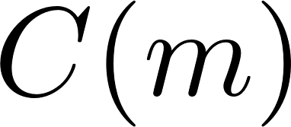
Typical Construction [PRS02,PW09]
…
…
…
Why this construction is popular (in classical setting)?
Black-box usage of (only) OWFs
Constant-round
Simulatable post-extraction state
For efficiency
For protocol Composition

Slide 4
Existing Results in Quantum Setting
Desired Properties:
- Black-Box, Const.-Round, Classical-Comp., Minimal Assumptions, Simulatable
Table 1: Existing Results for PQ-ExtCom
 | Black-Box | # of Rounds | Comp.&Comm. | Assumptions
[HSS11,LN11] | NO | Polynomial | Classical | OTs
[BS20] | NO | O(1) | Classical | QFHE+LWE
[GLSV21] | NO | Polynomial | Quantum | PQ-OWFs
[BCKM21] | YES | Polynomial | Quantum | PQ-OWFs
Hard even if we only require: Const.-Round & Simulatable
Reason: Such an ExtCom => Const.-Round ZK
Impossible by [CCLY21] (unless nBB security reduciton or $NP⊆BQP$ )

Slide 5


Relaxing to $ε$-Simulation
The Sim-Extractors takes an additional para. $ε$. For any noticeable function $ε\left(λ\right)$:
Real
SimExt
Still Useful: $ε$-simulation security => IND-based Security (e.g., $ε$-ZK => WI)
Desired Properties: Black-Box, Const.-Round, Classical-Comp., Minimal Assumptions, $ε$-Simulation
Question: Is such an ExtCom possible?

Slide 6
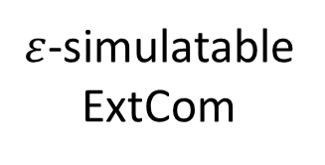
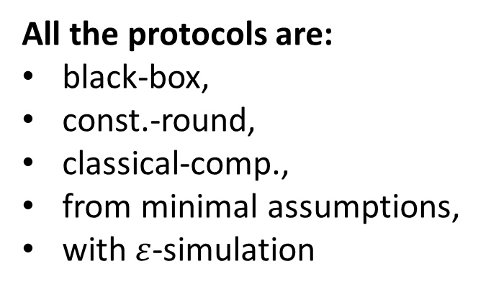
Our New Results (in Post-Quantum Setting)
2-Party Coin-Flipping (simulation for both parties)
ZK Arguments of Knowledge for NP
$ε$-simulatable
ExtCom
ZK Arguments for QMA
Secure 2PC
(for classical functionalities)
All the protocols are:
black-box,
const.-round,
classical-comp.,
from minimal assumptions,
with $ε$-simulation
Classical comp.: need semi-honest OTs
Quantum comp&comm: only need PQ-OWFs

Slide 7
Weak ExtCom (1/4)
…
…
With Overwhelming Prob.:
[CCY21] SimExt Lem.
New Challenges in Our Setting:
1. Main thread + rewinding thread to learn m;
2. Well-formedness. Over-extraction. Uniqueness of m
Unclear how to use [CCY21]

Slide 8
Weak ExtCom (2/4)
…
…
With Overwhelming Prob.:
Weak ExtCom with restrictions:
C*’s first message is well-formed
Don’t require anything if it is not well-formed
Still unclear how to use [CCY21]
Main difference: C* won’t tell us the value m (if we don’t enter the Decom state)
Spoiler:
The techniques behind [CCY21] help.

Slide 9
Weak ExtCom (3/4)
Main Idea behind [CCY21]’s :
the power of “un-computing”
[CCY21] SimExt Lem.
due to [CCY20,NWZ09], Jordan’s Lem
Main Take-Away:
Jordan decomposition
Amplification
Real extraction
Un-compute

Slide 10
Weak ExtCom (4/4)
Main Take-Away:
Jordan decomposition
Amplification
Real extraction
Un-compute
…
…
In classical setting: Ext extract and simulate
In PQ setting: even how to extract is unclear
[Unruh12,Unruh16]

Slide 11
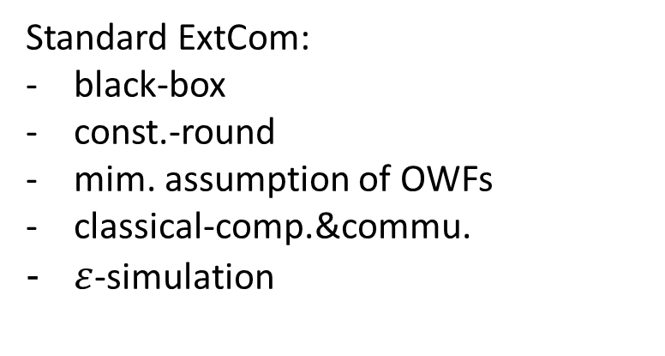
Weak ExtCom to Standard ExtCom
Weak ExtCom with restrictions:
C*’s first message is well-formed
Don’t require anything if it is not well-formed
Add a ZK: C proves the well-formedness of its first message
Caveat:
Require parallel exec. of ExtCom
Our ExtCom only weakly-parallelable
  If one session aborts, the whole exec. is considered aborts
  suffices for MPC-in-the-Head compiler
  since only a single committer
Standard ExtCom, but:
Non-black-box due to ZK on Com
MPC-in-the-Head [IKOS07,GLOV12]
Standard ExtCom:
black-box
const.-round
mim. assumption of OWFs
classical-comp.&commu.
$ε$-simulation
Warn:
don’t use our ExtCom in the multi-committer parallel setting. (E.g., parallel ε-ZK)

Slide 12
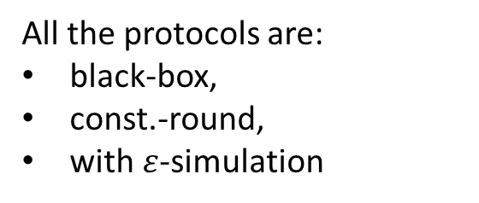
Application to Black-Box 2PC
Our ExtCom
Abstraction due to [GLSV21]
Special commitment Functionality
Maliciously-Secure OT (supporting bounded-parallel sessions between 2 parties)
+
2PC
[CDMW09]
[IPS08]
semi-honest OT
All the protocols are:
black-box,
const.-round,
with $ε$-simulation
Can be achieved by:
PQ-OWFs + Quantum Communication

Slide 13


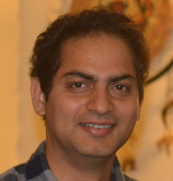

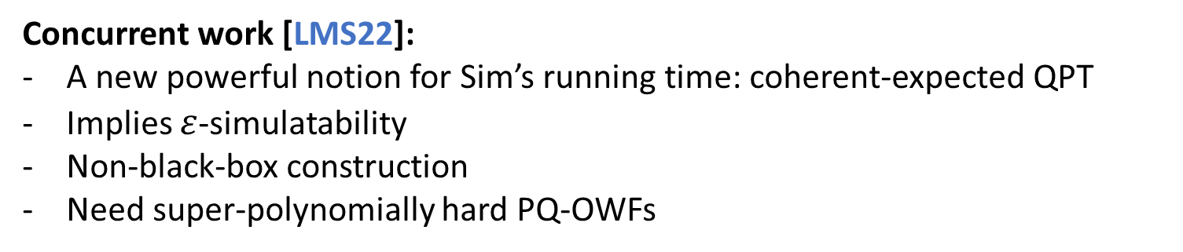
Discussion
Concurrent work [LMS22]:
A new powerful notion for Sim’s running time: coherent-expected QPT
Implies $ε$-simulatability
Non-black-box construction
Need super-polynomially hard PQ-OWFs
Other Application:
Our ExtCom + [BLS21] => The first O(log*(λ))-round PQ-NMCom from OWFs
Our $ε$-simulatable PQ-ExtCom suffices
A New Approach to Post-Quantum Non-Malleability
By Xiao Liang, Omkant Pandey, Takashi Yamakawa
Const.-round PQ-NMCom from PQ-OWFs
Link: ia.cr/2022/907
Time for Commercials:
Is const.-round PQ-NMCom possible?

Slide 14
Thank you!
Q&A
For more details, see the full version: ia.cr/2021/1516

