Slide 1


A New Approach to Efficient Non-Malleable Zero-Knowledge
Allen Kim
Xiao Liang
Omkant Pandey

Slide 2
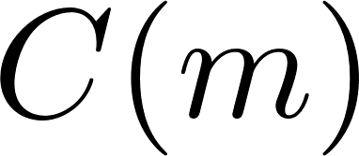

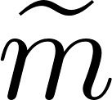
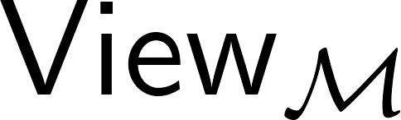
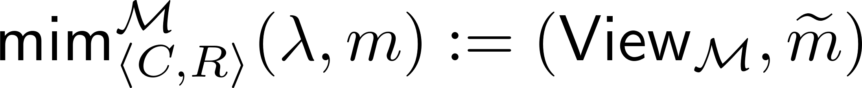

Defining NMCom and NMZK (1/2)
Goal:
Remove the dependence between M’s com and C’s
Efficient (Expected PPT)
Doesn’t know m
Real (MIM)
Simulated
Simulator
…
…
…
The value committed by M (the value bound in the right transcript)
The view of during this MIM execution
Conditioned on

Slide 3
Defining NMCom and NMZK (2/2)
For Zero-Knowledge Protocols:
MIM adversary cannot prove statements that he cannot prove originally:
Real
Simulated
Prover
Verifier
Simulator
Verifier
Conditioned on

Slide 4
State of the Arts
Applications:
NMCom: reduce round-complexity of MPC [KOS03,Wee10,Goyal11,BGJ+18,…]
NMZK: better concurrent security for MPC [CLOS02,Pass03,PS04,LPV09,…]
In Theory (for both NMCom and NMZK):
Const.-round from OWFs (thanks to [DDN91,Barak02,PR05,Wee10,Goyal11,LP11,GRRV14 ,…])
In Practice:
NMCom: DDH-based [BGRRV15]
NMZK: no reported implementations with practical efficiency
A standard transform from NMcom to NMZK:
P first NMCom to the witness: Fast (e.g., [BGRRV15])
Then, P ZK-proves to V the committed value is a valid witness: Slow (> 3 min) due to large circuit size of NMCom.

Slide 5
Our Results
A fast NMZK protocol
Without setups
Achieving real-world efficiency
From symmetric-key assumptions (e.g. AES and SHA256)
The first practical NMCom that is:
Without setups
From symmetric-key assumptions

Slide 6
Organization
A NMZK protocol
(template)
Identify Efficiency Bottleneck
New Ideas
Efficient Simulation-Sound ZK
Efficient NMZK
Efficient NMCom

Slide 7
Our NMZK​ Template
Extractable Commitment.
From any OWF
Non-Malleable Extractable Commitment
From any OWF
Statistical WI argument of Knowledge
From any CRHF

Slide 8
Proof of Non-Malleability (Sketch)

Slide 9
Efficiency Bottlenecks (1/2): sWIAoK
Two potential efficiency bottlenecks
The ENMC protocol
The sWIAoK
We’ll address them one-by-one
sWIAoK Stage in Our Protocol:
Need to prove R(x,w)=1. Can’t avoid a general purpose ZK/WI-AoK system
Frist Attempt:
Fast general-purpose ZKAoK (e.g. Ligero [AHIV17])
Use Ligero for sWIAoK
The statement has a large circuit => slow
Idea:
OR composition of sigma protocols [CraDamSch94]

Slide 10

Speeding Up the sWIAoK
Sigma Protocols
3-round public-coin
Honest Verifier Zero-Knowledge
Witness-Indistinguishable
α
β
γ
OR Composition [CraDamSch94] :
Simulate the x’ part
Do real execution on x part
α
α'
$$\hat{\text{β}}$$
γ
γ'
Caveat:
Ligero is NOT a Sigma protocol
See our paper for details
Our Strategy:
Use Ligero [AHIV17] as the base Sigma protocol
honest execution for R(x,w) = 1,
fake the proof for σ’ = σ (the only overhead, negligible)

Slide 11
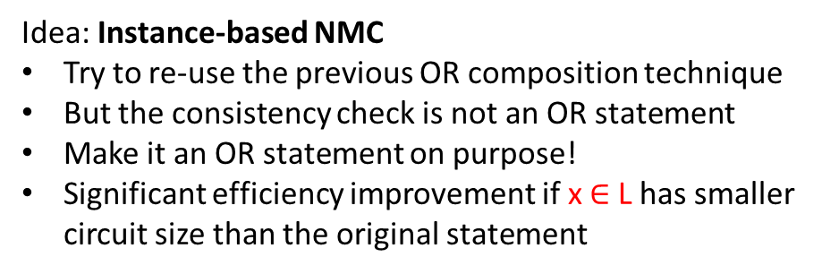
Efficiency Bottlenecks (2/2): ENMC
State-of-the-Art ENMC [BGRRV15]:
Commitment: El Gamal
ZK (for inner products): Schnorr suffices
However, we want to rely only on symmetric-key primitives
Frist Attempt:
Use AES-based Com to replace El Gamal
Use Ligero for ZKArg stage
Again, slow
Idea: Instance-based NMC
Try to re-use the previous OR composition technique
But the consistency check is not an OR statement
Make it an OR statement on purpose!
Significant efficiency improvement if x $∈$ L has smaller circuit size than the original statement
OR
Composition
Still Secure?
Not non-malleable anymore!
But it is simulation-sound

Slide 12
Upgrade It to Full Non-Malleability
What do we get so far?
A fast simulation-sound ZK (SSZK) from only symmetric primitives
Use rather standard transformations to build fully NMZK and NMCom
Our SSZK:
Our SSZK:
sWIAoK
Speed up using our OR-composition execution of Ligero
sWIAoK

Slide 13
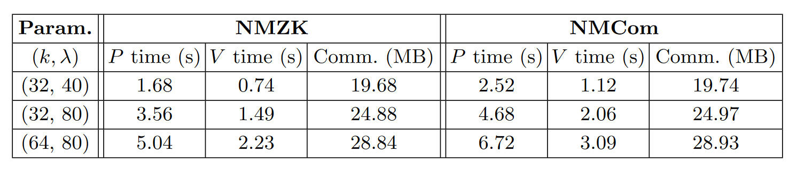
Empirical Results

Slide 14
Thank you!
Q&A
For more details, see the full version: ia.cr/2022/767

Slide 15
Security Proof (1/2)
Completeness, Soundness and ZK property follow from standard technique
We focus on non-malleability
Man-in-the-middle (MIM) Exec.:
Our Protocol
Our Protocol
Goal: show a simulator Sim such that:
convinces
with same prob. as
did in the MIM exec.
Unlike ZK simulators, Sim can’t rewind V

Slide 16
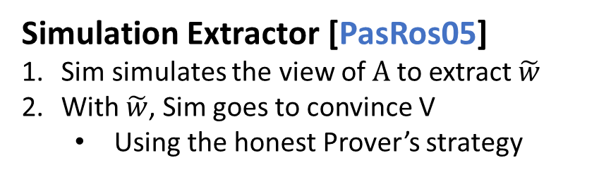
Security Proof (2/2)
Our Protocol
Our Protocol
Simulation Extractor [PasRos05]
Sim simulates the view of A to extract $\tilde{w}$
With $\tilde{w}$, Sim goes to convince V
Using the honest Prover’s strategy
Our Protocol
Our Protocol
Next, we focus on the Simulation-Extraction step
Only the synchronizing case
For the non-synchronizing case, see our paper
Rewind to
extract
Our Protocol

Slide 17
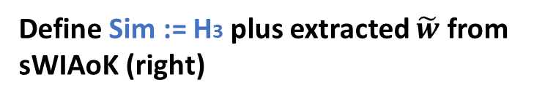
Simulation Extractor
H0: the real exec.
Output of the hybrid: view of A
Invariant Condition (InvCon):
Due to hiding of ExtCom (right)
H1: extract σ from the left
IND: due to extractability of ExtCom (left)
InvCon: nothing changes
H2: set in the left
IND: hiding of ENMC (left)
InvCon: non-malleability of ENMC
H3: switch witness in the left sWIAoK
IND: WI of sWIAoK (left)
InvCon: nothing changes
Define Sim := H3 plus extracted $\tilde{w}$ from sWIAoK (right)

Slide 18




Non-Malleability [DDN91]
Man-in-the-Middle (MIM) Attack for Commitments:
Typical MIM Attack:
…
…
Alice: $100
Bob: $101
Auctioneer
Bob won!
Some Observations:
B* just mauls Alice’s ciphertext to generate his price in committed form
This does not violate the hiding property security of the commitment scheme (A’s price is still hidden from B*)
Goal:
Remove the dependence between B*’s com and A’s
Non-malleability is designed for this purpose [DDN91]
Bidder A
Bidder B*

