Slide 1

ProCSA: Protecting Privacy in Crowdsourced Spectrum Allocation
Max Curran, Xiao Liang,
Himanshu Gupta, Omkant Pandey, Samir Das

Slide 2
Background and Motivation
Radio Frequency is a limited resource.
More and more demand recent years (e.g. mobile devices).
A Solution: Shared Spectrum Paradigm
There might be unused spectrum bands (primary user absent).
Allow secondary user to use these bands.
Implemented with Crowdsourced Sensing Model

Slide 3

Traditional model
Attenuation between sender and receiver
Path-loss function: how attenuation is affected by different types of factors (e.g. distance, geographic condition, temperature, weather …)
Traditional model: measure those factors and then use a propagation model to compute the path-loss function
Tow propagation models:
Log distance, Longly-Rice
Primary User (PU)
Primary User’s reciever (PUR)

Slide 4
Crowdsourced Sensing Model
Sensor (SS)
Primary User’s reciever (PUR)
Primary User (PU)
SU
SM

Slide 5
Security Challenges
Crowdsourced sensing is faced with serious security challenges due to:
The presence of many independent entities (PU/PUR/SS/SU)
Spectrum Manager (SM) collects sensitive information: locations, transmit power, sensing reports, requested spectrum, etc.
The goal of our work:
Make the allocation procedure as secure as possible
Without sacrificing efficiency too much

Slide 6
Potential Ideas
Fully Homomorphic Encryption (FHE)
Introduce a key sever
Let SM do the computation on encrypted data
Secure Multi-Party Computation (MPC)
Introduce more SM instances
Distribute the computation among them
No proper subsets of SMs can collude to learn confidential info

Slide 7

FHE-Based Solution?
FHE is very powerful
However, far from being practical
Relax the requirement:
Linear homomorphism. E.g. $f\left(m\right)=a+b∙m$
Paillier’s crytosystem achieves this [Pai99]
P2-SAS: state-of-the-art approach [DZL+17]
Traditional model: assume a propagation model, prefix the path-loss function.
express the core part of allocation algorithm as a linear function. Use Paillier.
provide Yes/No answers.

Slide 8
MPC-Based Solution
Also not practical.
Fast implementation for 2PC/3PC in the semi-honest model.
As we will show in our work, this approach enjoys the following advantages:
Capture general spectrum allocation algorithm (not limited to linear functions).
Use up-to-date parameters, do the allocation dynamically.
Output directly the allocated spectrum value (not Yes/No)
More efficient.

Slide 9
Outline
In the remaining part of this talk:
Our plain algorithm (i.e. without security concerns)
How to make it secure using 2PC
Empirical results

Slide 10
A Dynamic Spectrum Allocation
Sensor (SS)
Primary User’s Recievor (PUR)
Primary User (PU)
(3) update
SU
(1) path-loss estimation
(2) allocation
SM

Slide 11
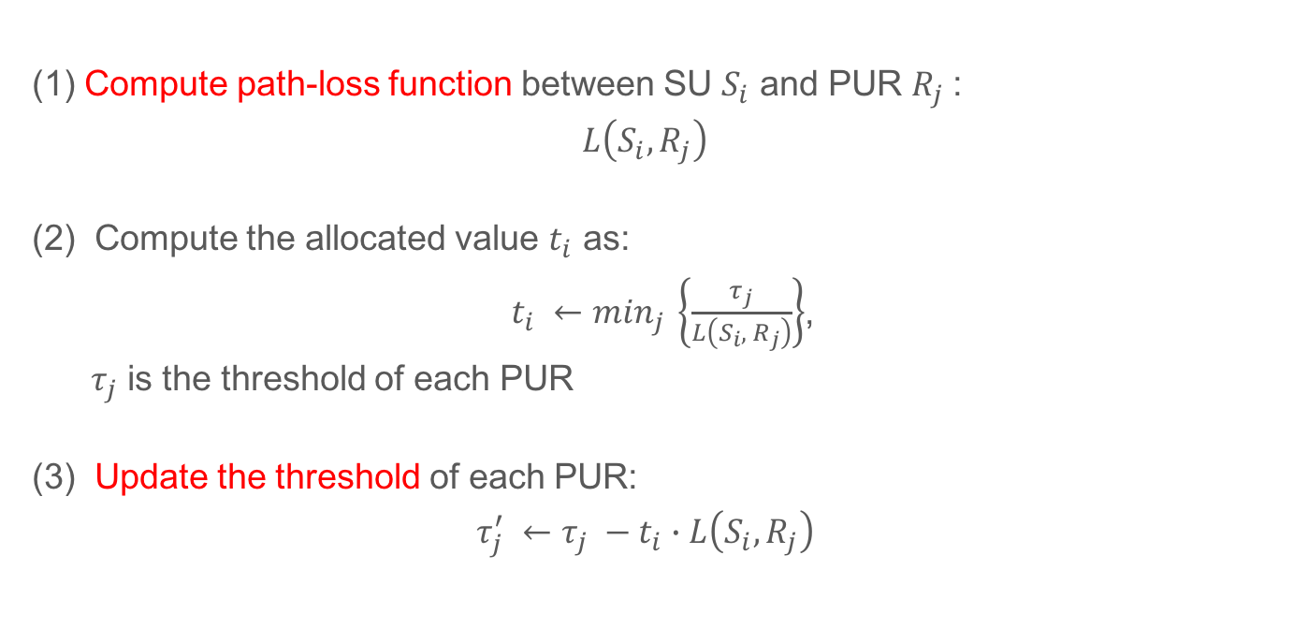
A Dynamic Spectrum Allocation
(1) Compute path-loss function between SU $S_{i}$ and PUR $R_{j}$:
$$L\left(S_{i}, R_{j}\right)$$
(2) Compute the allocated value $t_{i}$ as:
$t_{i} ←\min_{j}{ \left\{\frac{τ_{j}}{L\left(S_{i}, { R}_{j}\right)}\right\}}$,
$τ_{j}$ is the threshold of each PUR
(3) Update the threshold of each PUR:
$$τ_{j}^{′} ←τ_{j} −t_{i}∙L\left(S_{i}, R_{j}\right)$$

Slide 12
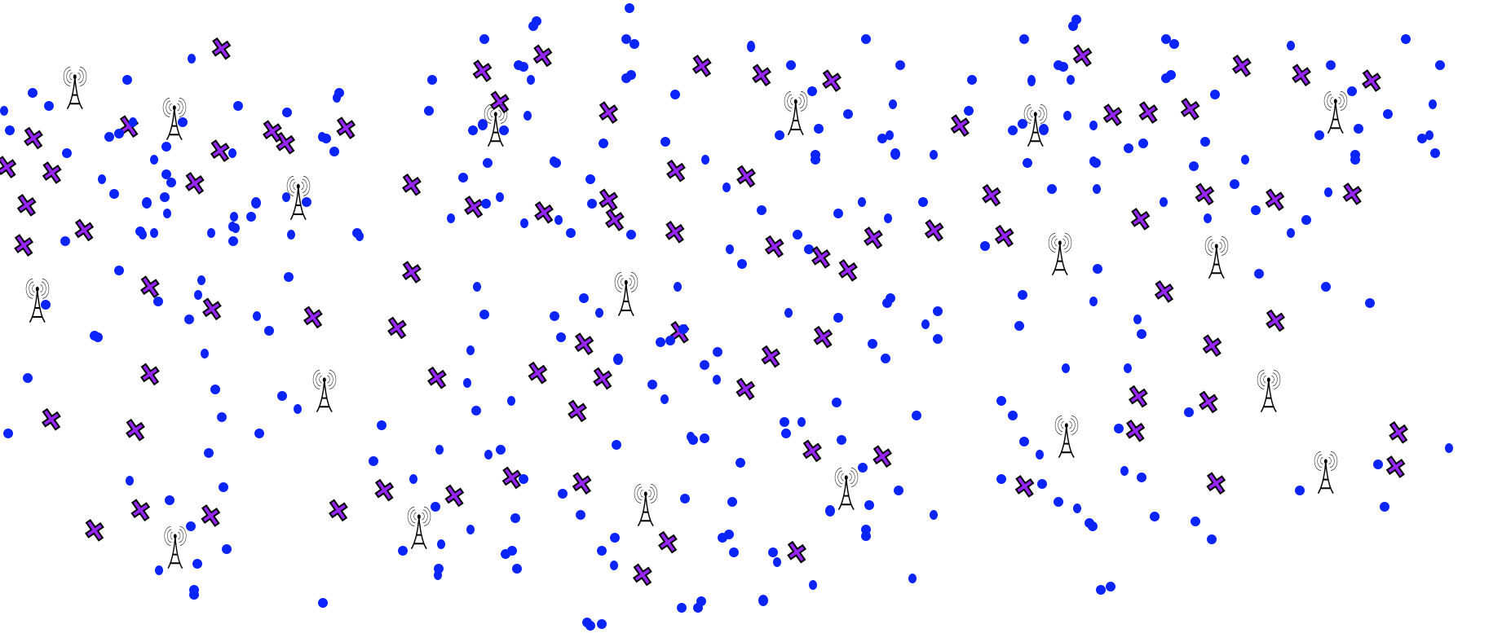
Grid-Based Optimization
Path-loss estimation
Compute the allocated value
Threshold updating

Slide 13
Are We Done?
Our plain algorithm seems efficient (only involves the most related nodes)
2PC is efficient.
So use a fast 2PC library to implement our plain algorithm.
Wait ...
2PC is only practical if the circuit description of the algorithm is not huge.
Our algorithm maintains an array.
Using Circuits to describe arrays would be prohibitively inefficient.

Slide 14
MPC for Oblivious RAM
RAM-MPC
e.g. Gorden et al. [GKK+12]: A framework that conbines any 2PC and ORAM.
Implementation Issues:
There exist different packages maintained by different teams/researchers
incompatible with each other
Our algorithm switches between Boolean/Arithmetic operations
We design a new oblivious read/write method
Simple (no need to deal with eviction or storage structure etc.)
Perfect correctness
Works well with our algorithm

Slide 15




Oblivious Read: A toy example
[2]
Addition (Mod 5)
[1]
[3]
0 | 0 | 1 | 0 | 1
1 | 0 | 0 | 1 | 0
1 | 0 | 1 | 1 | 1
Output: Both parties learn a secret-share of 1

Slide 16
[2]
[1]
[3]
0 | 0 | 1 | 0 | 1
1 | 0 | 0 | 1 | 0
1 | 0 | 1 | 1 | 1
Rotate by 3
Rotate by 1
1 | 0 | 1 | 0 | 0
0 | 1 | 0 | 0 | 1
[2], 3
[1], 1
2PC
[4]
[1]
Mask by 11011
Mask by 10100
0 | 1 | 1 | 1 | 1
Oblivious Transfer
1 | 0 | 1 | 0 | 1
1
2PC
1 = (1 - 0) + (1 - 1)
re-share: 1 = 1 + 0
1
1
0
1
0

Slide 17
Oblivious Write
The technique is different from our Oblivious Read
But it is of the same flavor
See our paper for details

Slide 18
Empirical Results
Main factors affecting the performance:
Number of selected nodes (SSs and PUs) in the interpolation step
Size of the grid
Settings of our simulation:
A geographic area of 10km × 10km;
400 PUs and 40000 SSs, randomly distributed;
5 PURs for each PU, located at 100m around the PU;
Ground Truth Generator: log-distance (Log) and Longley-Rice (L-R)

Slide 19
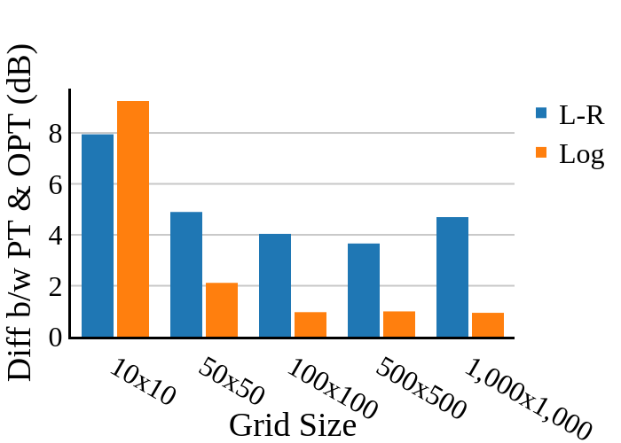
Effects of Different Grid Size: Accuracy

Slide 20
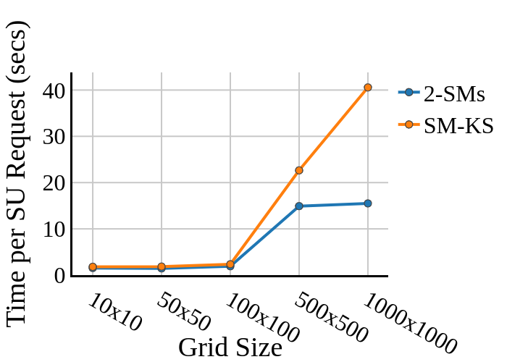
Effects of Different Grid Size: Efficiency

Slide 21
Empirical Performance and Comparison
 | Time | Error Rate | Comm. Cost
P2-SAS | 7 seconds | 2.72% | 5 MB
ProCSA | 2 seconds | 1 dB (Log Distance) 4 dB (Longley-Rice) | 0.15 MB

Slide 22
Conclusion and Future work
Summary:
A new method to conduct fast Spectrum Allocation.
Crowdsourced sensing model, up-to-date data
Make it secure using a special purpose 2PC.
Without sacrificing efficiency too much.
Potential Directions:
Improve the efficiency and accuracy further.
Secure in the malicious model.

Slide 23
Thank you!
Q & A

Slide 24

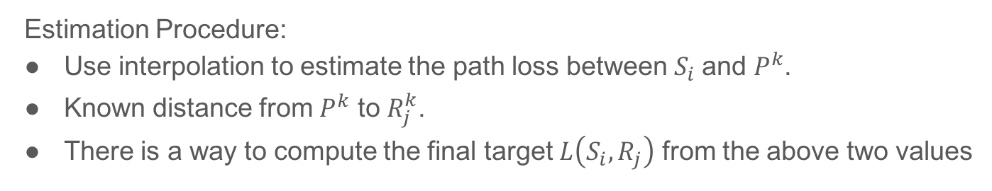
Path-Loss Estimation
Final goal: path-loss between $S_{i}$ and all PUR $R_{j}$: $L\left(S_{i}, R_{j}\right)$
Notation: Use $R_{j}^{k}$ to denote the PUR of PU $P^{k}$.
Estimation Procedure:
Use interpolation to estimate the path loss between $S_{i}$and $P^{k}$.
Known distance from $P^{k}$ to $R_{j}^{k}$.
There is a way to compute the final target $L\left(S_{i}, R_{j}\right)$ from the above two values
Highlight: the effective coverage of Si’s signal is limited
Optimization:
Grid the area
Just do all the above in the area that contains S.

Slide 25
PU’s “coverage” region
(1a) Split the sensed
aggregate power
x
x
PURs
x
PU
x
PU
(2) Compute SU-PUR path loss
PU
x
x
SS
SS
PU
(1b) Estimate PU-SU path-loss from PU-SS’s by interpolation
SS
SU

Slide 26
