Slide 1

Random Walks and Concurrent Zero Knowledge
Anand Aiyer, Xiao Liang, Nilu Nalini, Omkant Pandey
ACNS 2020

Slide 2
Motivation
Zero-Knowledge (ZK) proofs [GMR85]
Prover convinces Verifier that a statement is true
In short: verifier learns nothing other than the correctness of the statement.
Concurrent ZK (cZK): many instances running simultaneously
Numerous applications in both theory and practice:
MPC, IND-CCA, etc.
Important to:
Understand the round complexity of ZK/cZK protocols
Build efficient ZK/cZK protocols

Slide 3


Definition of ZK (1/2)
- language L ∈ NP
- x ∈ L and w is the witness for x
Completeness:
if x ∈ L, V is convinced by P.
Soundness:
if x is not in L, no P* can fool V to accept its proof (with high prob.)
…
Zero-Knowledge:
∀ x ∈ L, V* learns nothing from P’s proof, except that x ∈ L.
Prover (P)
Verifier (V)
(x, w)
x
How to formalize it???

Slide 4


Definition of ZK (2/2)
Real:
Simulation Paradigm
View of V*:
- x
- random tape
- all messages received by V*
P(x,w)
V*(x)
Simulated:
Simulated View:
Prob. Poly. Time (PPT) Machine S
“fakes” a view.
…
V*(x)
Zero-Knowledge:
Simulator S(x)

Slide 5
Blum’s Hamiltonicity Protocol [B86, GK96] (1/3)
x: a graph
w: the Ham. cycle in x
P(x,w)
V(x)
Permute the graph: σ (x)
c ← {0,1}
If c = 0:
- decom the graph and send σ
If c = 1:
- decom a Ham cycle for V
Check accordingly

Slide 6
Blum’s Hamiltonicity Protocol [B86, GK96] (2/3)
x: a graph
w: the Ham. cycle in x
P(x,w)
V(x)

Slide 7
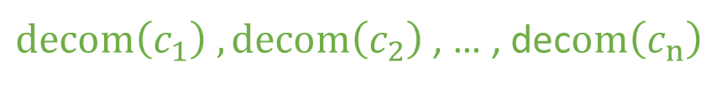
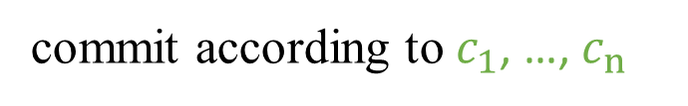

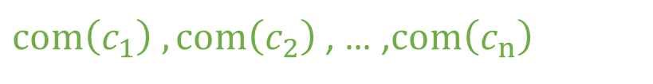
Blum’s Hamiltonicity Protocol [B86, GK96] (3/3)
How to do simulation: Rewinding
S(x)
V*(x)
$com\left(c_{1}\right) ,com\left(c_{2}\right)$ , … ,$com\left(c_{n}\right)$
commit according to $c_{1}$, …, $c_{n}$
Rewinding
$decom\left(c_{1}\right) ,decom\left(c_{2}\right)$ , … , dec$om\left(c_{n}\right)$
$$c_{1},…,c_{n}$$

Slide 8
Concurrent Composition (1/2)
The Ham. Protocol
- Secure in its standalone setting.
- Internet is complicate env.
Example: A server proves to many clients
- Each connection is call a Session.
- Each session consists of Ham. protocol
- Message scheduling is controlled by the adversary
- Nested in arbitrary way
ZK requires a Simulator to
- sim. the views of all clients all at once
Client 1
Session 1
Session 2
…
…
Server
Session n
Client n

Slide 9




Concurrent Composition (2/2)
P(x,w)
Session 1
Session 2
Session 3
S(x)
V*(x)
$${M\text{sg}\text{ 1}}_{}$$
Re-do!
Time complexity for Simulator
$${\text{Msg}\text{ 2}}_{}$$
Not polynomial!
Not ZK!
$${\text{Msg}\text{ 3}}_{}$$
$${\text{Msg}\text{ 4}}_{}$$

Slide 10
Concurrent Zero-Knowledge (1/2)
The idea from [RK99] [KP01] [PRS02]:
give simulator more chances to rewind.
Preamble
slot 1
every slot can be rewound
enough to “win” on one slot
…
slot
Main body
(Ham. Protocol)

Slide 11
Concurrent Zero-Knowledge (2/2)
…
Session i
……
Session j
Intuition
Don’t do rewinding recursively
Rewind only “free” slots
Sim succeeds with high prob.
…
…
……
Preamble
main
…

Slide 12
Optimistic cZK
Canonical Protocol
[CKPR01] sets the bound as
[PRS02] achieves
Nothing left to be done?
Preamble
slots
Optimistic cZK [RS10]
P can monitor the schedule of messages
Make decisions dynamically
efficiency can be improved on average.
main

Slide 13
Rosen-Shelat Protocol
Rosen-Shelat Protocol
Follow the same canonical structure
Terminate preamble stage once a footer-free slot appears
start the main body directly (no need to exec. remaining slots in the preamble)
Footer-free slot
A preamble slot which doesn’t have a main body nested from other sessions.

Slide 14
Our Work
Rosen-Shelat protocol
experimental results.
~122,000 TCP sessions, 79% sessions have their first slot footer-free.
Our work:
A framework to analyze performance of cZK protocols
Apply it on RS: Rigorous bounds for communication complexity
Propose a cZK protocol with better average-case performance

Slide 15
Bounds for RS
Modeling the Network (1-slot p-FIFO schedule)
Each session only has 1 slot.
- V opens a new session or answers an existing one by Binomial dist.
Flip a coin, get head with prob. p, get tail with prob. (1-p)
If Head, open a new session
If Tail, answer an existing session
- V answers in FIFO order
Our metric: fraction of optimal session
Optimal Session: the session ended with only 1 preamble slot.
In 1-slot setting, it means the first slot is footer-free.
We focus on the fraction of optimal sessions in a concurrent execution of RS.

Slide 16
On 1-Slot FIFO (1/5)
P
Session 1
Session 2
Session 3
Session 4
V
1
2
3
4
5
6
Observations:
Once a closing happens, all currently-active sessions cannot be optimal
Only new sessions have the chance to be optimal

Slide 17
On 1-Slot FIFO (2/5)
Relation to random walk
1
2
3
0
1
2
3
4
5
6
4
5
6

Slide 18
On 1-Slot FIFO (3/5)
… …
0
2
4
6
8
10
12
14
Proposition
Every return to the line gives us exactly one optimal session.

Slide 19
On 1-Slot FIFO (4/5)
Proposition
Every return to the line gives us exactly one optimal session.
Relates the round complexity to random walks with reflection at the origin.
To bound the fraction of optimal sessions:
Derive expected ratio of returns.
Chernoff doesn’t apply since variables are not i.i.d. here
Doob’s martingale + Azuma Inequality
Bound the fraction of optimal session
independent
interest

Slide 20
On 1-Slot FIFO (5/5)
For 1-slot p-FIFO setting, the fraction of optimal session up-to time t is
Similar approach works for 1-slot LIFO:

Slide 21
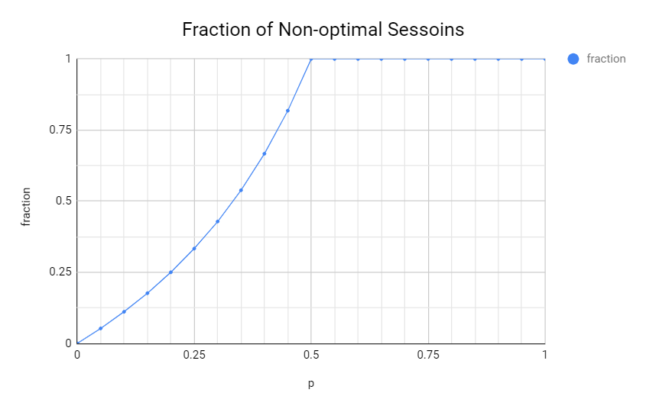
A Generalized Protocol of RS
Recall Rosen-Shelat protocol
Proposed to achieve better average-case performance
According to our bounds, not satisfactory. E.g. 1-slot p-FIFO
Our protocol:
Generalize the footer-free condition
Better performance

Slide 22
Our Protocol
Preamble
Follow the canonical form of cZK protocols [RK, KP, PRS, RS]
RS terminates a session earlier once a footer-free slot appears
terminates a session earlier once a slot has depth < d
…
Advantages:
Parameterized by a depth variable d: More flexibility
Correctness, soundness and ZK proved in a similar way as RS
Better average case performance
main

Slide 23
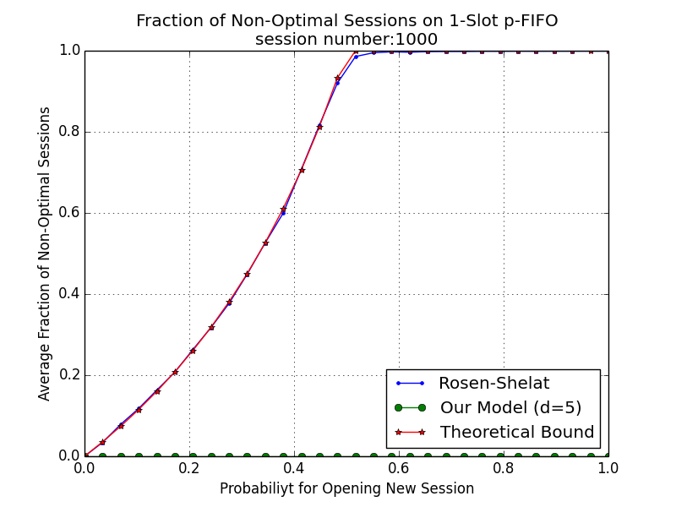
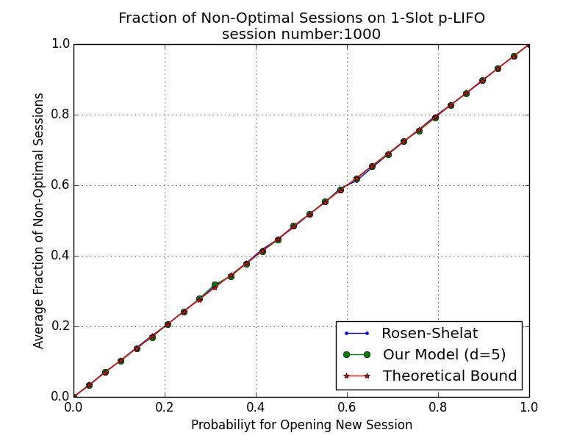
Simulation Results (1/2)

Slide 24
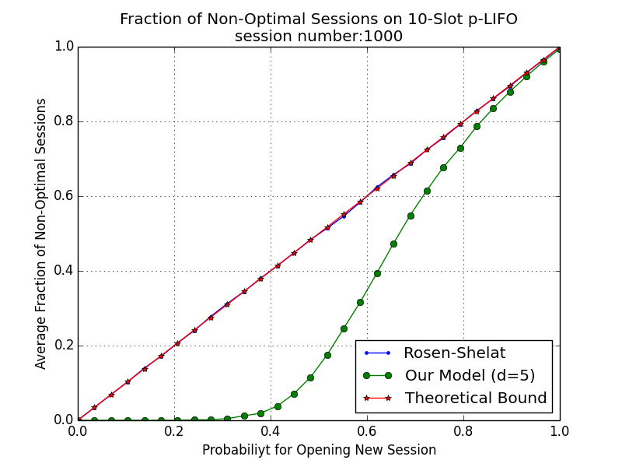
Simulation Results (1/2)

Slide 25
Future Research Directions
Better protocols/lower bounds in more complicate network model
V* may behaves following other dist. (Exponential, Poisson …)
More than 1-slot

Slide 26
Thank You!
Q&A
Full version of our paper: ia.cr/2020/082
Cartoons are taken and modified from Freepik: www.freepik.com

