Slide 1
Improved Black-Box Constructions of Composable Secure Computation
Speaker: Rohit Chatterjee
(Based on work with Xiao Liang and Omkant Pandey)

Slide 2
Part I
Definitions and Objectives

Slide 3


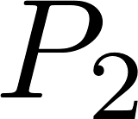

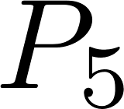

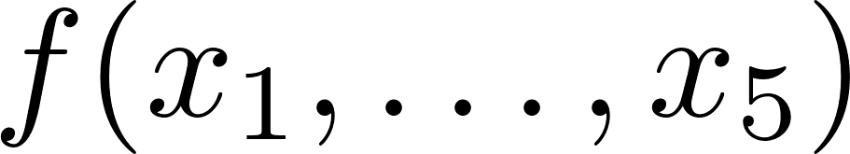



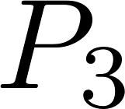

(Secure) Multi-Party Computation
Interactive protocol! N parties, N inputs.
Correctness: At the end of interaction, parties obtain the actual output of the function.
Privacy/Security: No party learns any information (apart from that which is given away by function output)

Slide 4




















Multiparty computation: Uses
Example: Several millionaires come together to find out who is the richest, without revealing their individual net worth [Yao’s Millionaire Problem]
More current examples: Computing on shared data on the cloud, internet market transactions and auctions, cryptocurrency-related usage. Pretty much any sensitive online multi-user interaction.
Auctions
Cloud Computing
Trading

Slide 5
MPC: Formalization
Basics: Can describe the protocol as an interactive protocol among multiple parties [the protocol is a system of randomized algorithms that communicate].
We assume secure, authenticated communication between each pair of parties.
Malicious behaviour is captured by (distributed) algorithms called adversaries that can corrupt some subset of parties.
Corrupted parties may deviate from normal protocol behaviour.

Slide 6
Motivating security in MPC
Want an intuitive `gold standard’ to judge things against.
The best we can hope for is that the function is computed honestly and faithfully.
One way to imagine this is to consider an outside authority which we can trust, that computes the function on behalf of the parties.
There is really no better we can do!
MPC security: Compare things against this gold standard.

Slide 7
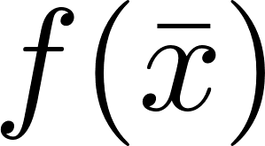


MPC: Security
Involves the Real/Ideal paradigm
REAL
IDEAL
TTP

Slide 8
More details
The outcome can be thought of as a function of the adversary’s internal state and what it sees in the protocol.
This defines a random variable (remember that the parties all run randomized algorithms).
Can now compare distributions obtained from the adversary vs that obtained from the simulator.
Similarity can be of three kinds: perfect, statistical or computational.
Computational similarity refers to similarity with respect to computationally bounded algorithms (usually, all algorithms running in polynomial time in input size).

Slide 9
MPC: Model
What we have defined
More relevant/realistic:
Common use cases in modern settings are likely to involve several concurrent (and asynchronous) executions of different protocols.
Another common situation is when a certain protocol is invoked within another .
We want security against multiple concurrent executions of the protocol, and against composition of multiple instances of a protocol.
Different functions may be computed in different instances.

Slide 10
MPC: Model (contd.)
The properties we want are not available in the plain model (no additional assumptions).
Reason: Simulation barriers! Not hard to see why.
Need extra/different assumptions. Also need definitions to support what we want, which is:
A definition for several MPC executions of a protocol, occurring concurrently.
A composition lemma: if two protocols P and Q are secure, then P composed with (or run within) Q is also secure.

Slide 11
Angel-Based Security
Angel-based security, or security with superpolynomial helpers, describes a model where the simulator may have access to certain oracles called angels.
In fact, the adversary also gets access to the angels.
These angels perform some pre-specified superpolynomial time task.
This model offers both features we want; i.e.:
We can develop protocols in this model that are secure in concurrent settings.
There is also a composition theorem.

Slide 12


Round Complexity
The total number of rounds (i.e., distinct points where some parties send messages to other parties) in the protocol.
Of significant practical interest. Practical runtime of an MPC protocol is tied to round complexity (latency etc).
It is also of theoretical interest.

Slide 13
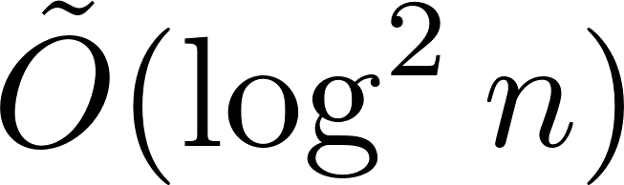
Previously Known Results
The Angel-Based security model was introduced by Prabhakaran and Sahai [STOC `04].
Canetti, Lin and Pass [STOC `10] slightly recast the definition to obtain a polynomial-round protocol under standard and polynomial time assumptions.
Finally, Goyal et al. [TCC `15] gave a protocol that requires only rounds, under the same assumptions as the previous work. This is the best known protocol in terms of round complexity.

Slide 14
The Black Box issue
The notion of `black-box’ behaviour describes how a program invokes another. This is black-box if the caller program uses only the input-output behaviour of the called program (and nothing besides).
Fully black-box algorithms represent a (meaningfully) restricted computational model, hence of theoretical interest.
Also much more efficient in practice (avoid Karp reductions of instances, and implementation details of subprotocols).
Further, such protocols are not based on specific assumptions.

Slide 15
Previously Know Results [Black-Box]
The previously described works are not fully black-box.
The first such general MPC protocol in this setting was given by Lin and Pass [CRYPTO `12], with polynomial round complexity.
Kiyoshima [CRYPTO `14] gave a construction that brought the round complexity down to . This is the `cheapest’ protocol known to date.

Slide 16
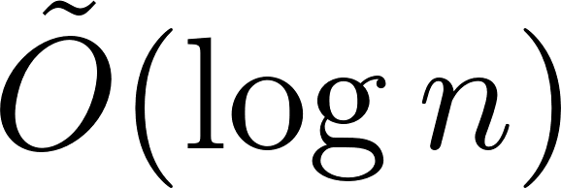
Our Results
Can we get a fully black-box protocol with lower round complexity?
In particular, can we eliminate the discrepancy between the round complexities of the best known fully black-box protocol ( ) and the non-fully-black-box one ( )?
Our result: yes, and yes!
We give a fully-black-box MPC protocol in the Angel-Based security setting that uses only rounds.
In doing so, we close the gap between best known black-box and non-black-box MPC constructions for such security.

Slide 17
Part 2
Relevant Notions and Primitives

Slide 18


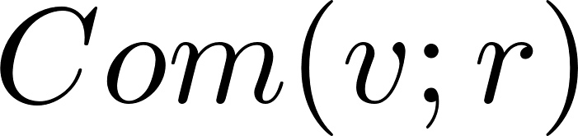




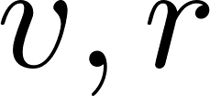
Commitment schemes
We want two properties:
Hiding: The commitment reveals nothing about the value committed to the receiver (in the commit phase).
Binding: In the reveal phase, the sender cannot decommit to two different values (i.e., to a value other than that it committed).

Slide 19




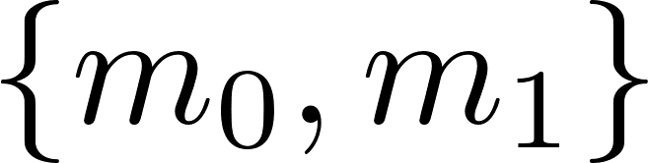

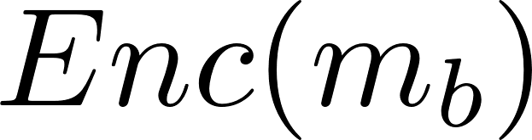


CCA Security: for Encryption
Adversary has access to both encryption and decryption oracles.
Very strong definition (e.g.: implies non-malleable encryption)
Security definition: adversary cannot guess b with probability much different from half.
Motivated by scenarios such as lunchtime attacks

Slide 20




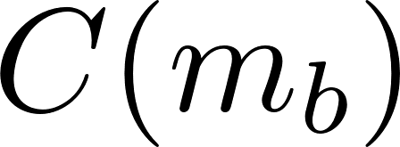
CCA Security: For Commitments
Similar principle to CCA-secure encryption.
Security: adversary cannot guess with probability much different from half.
Also similar to non-malleable commitments (discussed next).

Slide 21



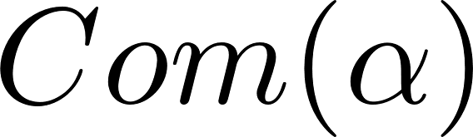
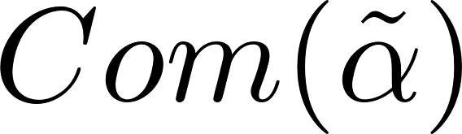
Non-Malleable Commitments
Man-in-the-middle adversary .
Security condition: `not related’ to .
Not implied by hiding! Adversary can `maul’ commitments.
E.g., consider an adversary that can change Com(x) to Com(x+1). Can cheat in bids.
Left session
Right session

Slide 22


1-1 CCA Commitments
A restriction of CCA commitment scheme where security is only defined for an experiment with exactly 1 left and 1 right session.
The security condition is that the adversary cannot distinguish between an experiment where the honest committer commits to vs one where it commits to , with more than negligible probability.
Note that the decommitment oracle may possibly be only implementable in superpolynomial time.

Slide 23
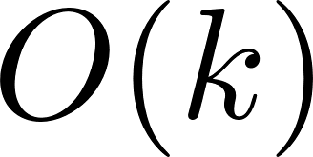

Roadmap to Result
[CLP`10] proved that an - round black-box MPC protocol can be obtained given a - round protocol for CCA commitments.
[Kiyoshima`14] showed a black-box transformation from 1-1 CCA commitments to full-fledged CCA commitments, with a logarithmic overhead in no. of rounds.
Consequently, we can achieve an - round black-box MPC protocol given a constant-round black-box protocol for 1-1 CCA commitments (by plugging this in into the existing framework).
The latter was an open problem till now.

Slide 24
Part 3
Basic Protocol: Construction and Proof Sketch

Slide 25




Component Primitives Used
Want to build a constant-round 1-1 CCA Commitment scheme. We will describe a transformation to make this fully black-box later.
We will need the following component schemes. All but the last have known fully black-box constructions.
A standard commitment scheme, .
An extractable commitment scheme, .
An extractable non-malleable commitment scheme, .
A witness indistinguishable argument of knowledge, .

Slide 26



Extractable commitments
A commitment scheme with the standard hiding and binding properties.
Also enjoys extractability: There exists a machine that given black-box access to , can extract the committed value while acting as the honest receiver (usually by rewinding).

Slide 27


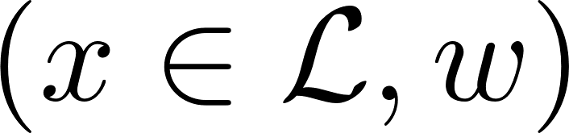




Witness Indistinguishable Arguments of Knowledge
An IP protocol satisfying the following:
Witness indistinguishability: The verifier cannot tell apart which witness was used in the proof.
Argument of Knowledge: There exists an algorithm K that can extract a valid witness.

Slide 28
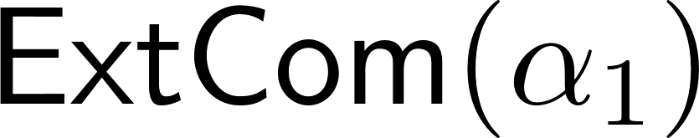

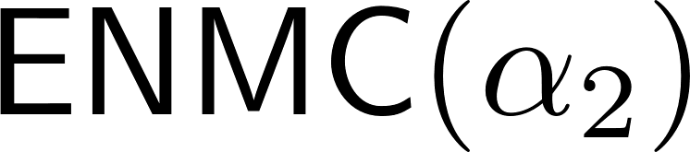

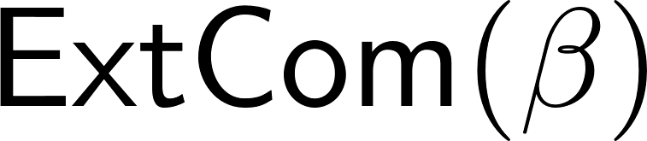
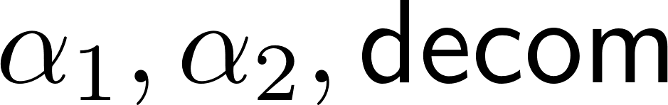
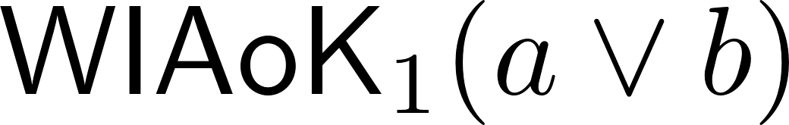

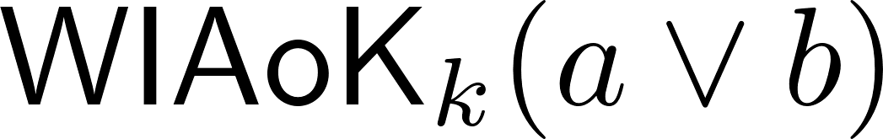
The Protocol
Pick uniformly from message space.
Set:
is referred to as the trapdoor value
Prove ( times):
(a) is computed correctly
OR
(b) (trapdoor cond.)

Slide 29
That’s a lot! Let’s try again!

Slide 30
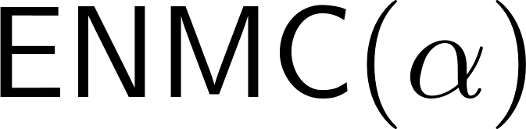
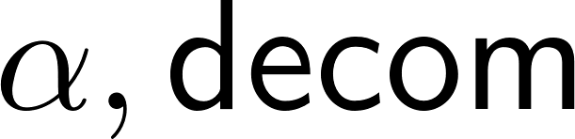
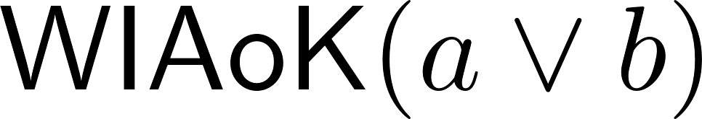
Toy Protocol
Trapdoor Phase
Proof Phase

Slide 31





Security Condition: Closer Look
As described before, consider an adversary interacting with an honest committer and a decommitment oracle in separate sessions.
The security condition roughly says that the adversary cannot tell apart the value committed to by the honest committer.

Slide 32
Security Condition (contd.)
Formally, the adversary outputs a value at the end of the interaction (can think of this as its guess).
This will depend on internal state, protocol messages etc.
Security guarantee: the distribution of the adversary’s output (as a function of the value committed by the honest committer) is computationally indistinguishable for any two messages in the message space.

Slide 33
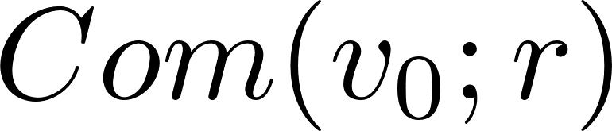

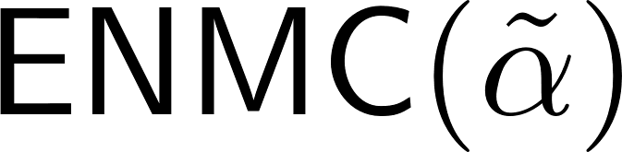

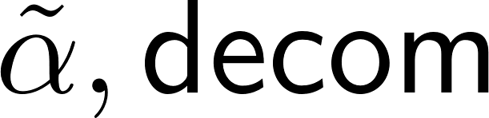
Want to go from ….

Slide 34

To….

Slide 35
Proof of Security
We will make a series of changes to move to the desired situation. For each such change, we will show that the adversary’s output distribution changing would imply breakage of a cryptographic assumption. This is known as a hybrid argument.
We focus on the argument for the synchronous case (keep in mind that adversary controls message schedules!)
Notation: Output of a hybrid = Output of adversary in that hybrid.

Slide 36
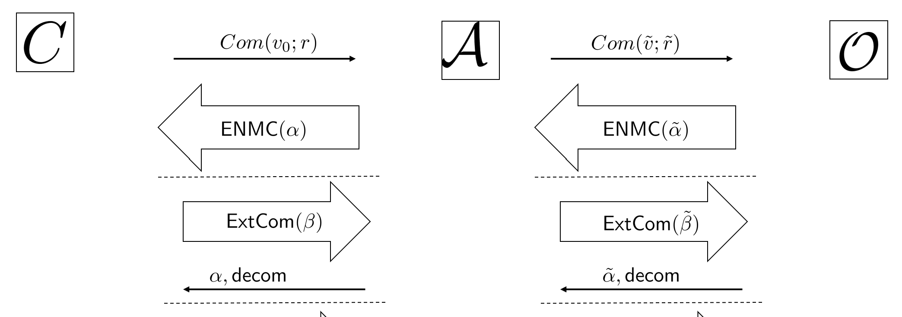

Proof Sketch: Step 1.
Start by extracting and recording this value.
Extraction can be thought of as performed separately from original execution
Original thread of execution unaffected
Adversary cannot detect this change
Output is identical!
Extract
& Store as

Slide 37
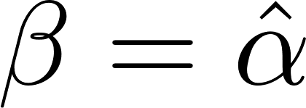
Proof Sketch: Step 2.
Set .
Suppose adversary’s output was noticeably different from prev. hybrid.
Then this entire experiment serves to tell apart commitments to two different values.
Breaks hiding property of ExtCom
Get
Set

Slide 38
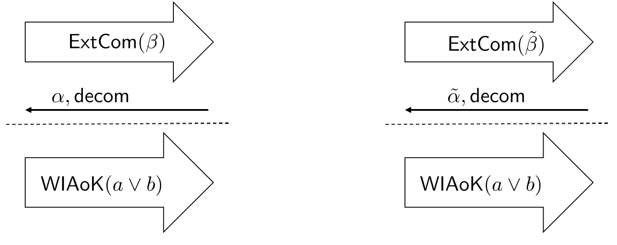
Proof Sketch: Step 3
We switch to proving statement (b) in this hybrid.
As before, adversary’s output cannot change noticeably.
Otherwise, we violate witness indistinguishability of WIAoK.
Set
Replace
witness

Slide 39
A Problem!
Remember how the decommitment oracle was supposed to run in superpolynomial time?
Note that our component protocols are only secure against polynomial time adversaries.
Our described reductions involve the oracle, thus they do not go through.

Slide 40
A `Prequel’ Hybrid
Replace the decommitment oracle.
Proof has the committed value! (Hopefully)
Use extractor for WIAoK to get decommitment value.

Slide 41
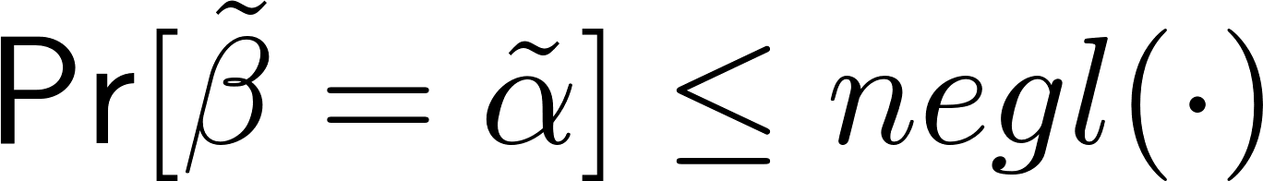
But what if…
…adversary actually proves statement (b) on the right?
We show that this happens only with negligible probability in each of our hybrids.
Specifically, we show that:
We call this the invariant condition.

Slide 42

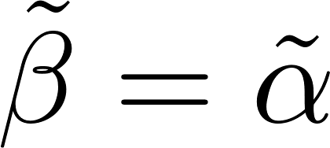

Invariant Holds Initially
Consider the right side execution.
If invariant condition does not hold, then we have with non-negligible probability.
We can extract with probability close to 1.
Contradicts the hiding property of ENMC.
Extract

Slide 43
Invariant holds in Hybrids 1 and 3
For hybrid 1, recall that original thread of execution was identical to the initial experiment.
Thus, invariant condition has the same probability in this hybrid.
Suppose that invariant holds in hybrid 2.
Note that invariant is `set’ by end of trapdoor stage.
Now the only change between hybrids 2 and 3 is in the proof stage, so invariant must also hold in hybrid 3.

Slide 44
Invariant in Hybrid 3
Roughly, if invariant is violated, then is `blindly’ changing 2nd ExtCom on the right in response to change in the left one.
But since , this means that must also be changing the left ENMC in response to the right one.
Breaks non-malleability of ENMC.
Q: Why not use ENMC directly from the committer’s side?
A: Not compatible with black-box transformation

Slide 45
So far
Get
Replace
witness

Slide 46

Observe that
At this point, we note that there is no part of the protocol (apart from the first message) that actually depends on the committer’s input.
We could have gotten to this last experiment starting from a committer committing to using the same sequence of hybrids.

Slide 47
From the other side
Get
Replace
witness

Slide 48

Finishing the Argument
Finally, we can switch the initial commitment to with one to . By the hiding of , this change is undetectable by the adversary.
In summation, we conclude that the experiment in which the honest committer uses is computationally indistinguishable from one in which the committer uses (for synchronous adversaries).

Slide 49
Nonsynchronous Case
The first half of the argument (up till setting the trapdoor) is actually easier in this setting – intuitively, if the messages are not synchronized, there is a `free’ slot of execution that allows us to extract the trapdoor value on the left.
Changing the witnesses becomes a little trickier, but can be done – this is why we need multiple WIAoK executions.
Instead of switching the witness extraction in the right at the very end, we have to possibly repeat the `detour’ argument for every change of witness.

Slide 50
Part 4
Black-box Transformation and Conclusions

Slide 51
The Barrier
Our protocol is almost fully black-box, apart from the WIAoK protocol.
The standard such protocol is in terms of a fixed NP-complete language, therefore requires Karp reductions of instances – not black-box!
Black-box WI arguments exist, but there are not many such protocols. Further the best-known relevant protocols have a specific form.
However, adapting these to our purposes is tricky!

Slide 52
Black-Box Commit & Prove protocols
In our proofs, we can directly use an archetype known as a commit and prove protocol: this allows a committer to commit to a value and subsequently prove some statement about the committed value.
Developed as a separate primitive due to heavy use in MPC schemes.
Black-box commit and prove protocols are known (due to research in black-box protocols for different primitives). Most recent such protocol requires only 4 rounds!
However, we cannot use this protocol. Other requirements (mainly, being able to prove multiple statements for the same commitment, and proving statements involving multiple committed values) emerge.

Slide 53
Our Approach
We develop a black-box commit and prove protocol (partly inherent in [GLOV `12]) that satisfies all our requirements.
This involves the (insanely cool) MPC-in-the-head paradigm [IKOS `07], originally used for building black-box zero knowledge proof systems.
Roughly, this involves the prover using an MPC protocol with milder security properties `in its head’ with virtual parties, and sending committed versions of their views to the verifier, which does a `consistency check’.
Ensure that if the prover `cheats’, it is caught in the checks with very high probability.
Plugging our commit-and-prove protocol into the original construction gives us our constant round, black box, 1-1 CCA commitment scheme.

Slide 54
Conclusions
Our 1-1 CCA commitment construction is new and may find several uses in developing round optimal black-box protocols for other primitives. Our assumptions are also very modest (we require only the existence of one-way functions).
Our protocol template offers an innovative method to introduce non-malleability in a roundabout way, without requiring the argument system to have non-malleability. This approach may also be of independent interest.

Slide 55
Thank you!

Slide 56
Part 5
Auxiliary Slides

Slide 57
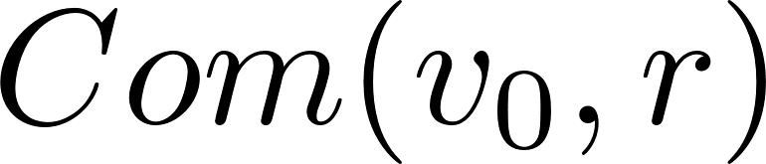

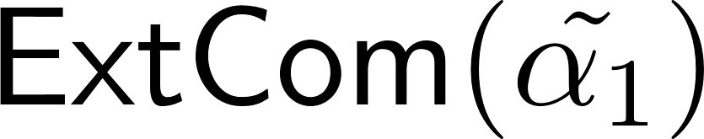
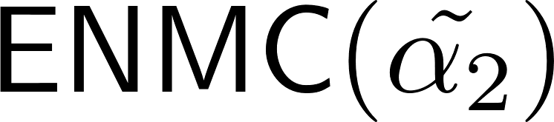
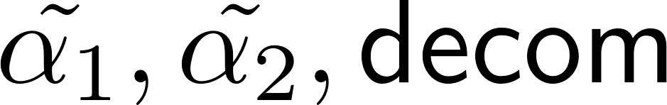

Slide 58
Proof of Security
We will move from the setting shown in the last slide to one where the honest committer commits to a different value , while making sure that the adversary’s output distribution does not change noticeably.
We will make a series of changes to move to the desired situation. For each such change, we will show that the adversary’s output distribution changing would imply breakage of a cryptographic assumption. This is known as a hybrid argument.
We focus on the argument for the synchronous case (keep in mind that adversary controls message schedules!)
Notation: Output of a hybrid = Output of adversary in that hybrid.

Slide 59
Preparatory Step
We will make the changes by changing the experiment in which the adversary participates. We will go from the original experiment in which is used to one where used, but all other steps are identically performed.
Our intermediate (or hybrid) experiments will however differ significantly from these end experiments. We emphasize however that the adversary cannot tell the difference even when in the hybrid experiments (except with negligible probability).
Thus, our starting hybrid can be thought of as one where the experiment subsumes the functionality of the left committer and the right oracle, performing the necessary steps faithfully.

Slide 60
An Invariant Condition
To show similarity of outputs, we will maintain an invariant condition in each intermediate/hybrid experiment. The condition is simply:
I.e. the adversary cannot `set’ the trapdoor with more than negligible probability.
Crucial, since we will soon eliminate the decommitment oracle by extracting from the WI proofs on the right. If invariant is not true, then adversary will be able to tell apart this experiment by checking the `decommitment’.

Slide 61

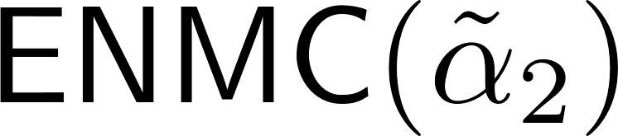
Invariant Holds Initially
Consider the right side execution.
If invariant condition does not hold, then we have with non-negligible probability.
We can extract with probability close to 1.
Contradicts the hiding property of both ENMC and ExtCom.
Extract

Slide 62
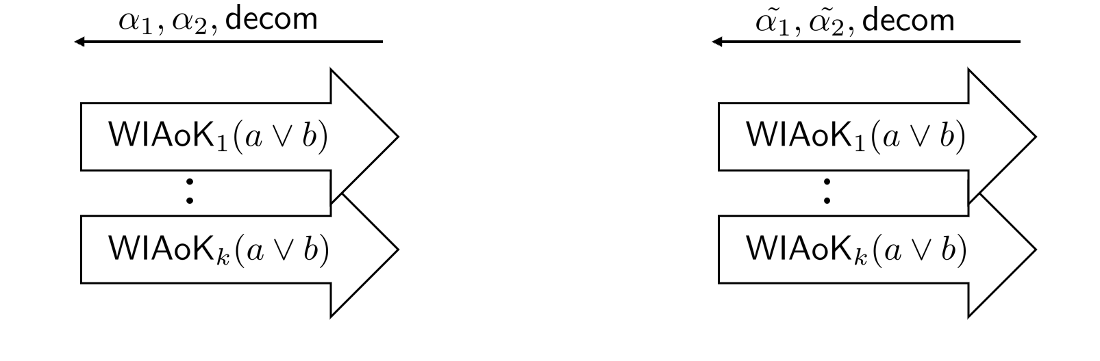
Step 1
Note that invariant is set before the section of the protocol illustrated.
Previous sections identical to previous hybrid – invariant still holds.
We extract a witness for statement (a) with probability almost 1.
Output is statistically close to that from previous hybrid (differs only when extraction fails).
Extract witness

Slide 63
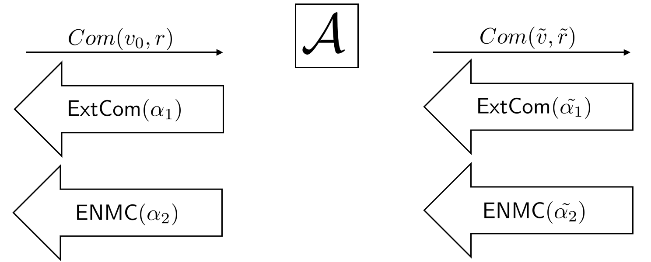

Step 2
Note that we have black-box access to .
We can thus freeze the state of at the indicated point and invoke extractor of ENMC.
Note that this does not affect the original or main thread of execution.
Invariant holds by above.
Output of is distributed identically to last step.
Extract
& Store as

Slide 64
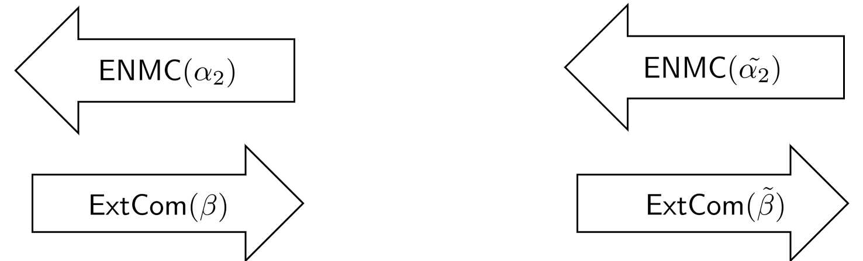
Step 3
As before, have to argue indistinguishability of views as well as invariance.
Indistinguishability of views is immediate from hiding of ExtCom – note that this is the only difference between these experiments.
Invariant condition is much trickier to nail.
Get
Set

Slide 65
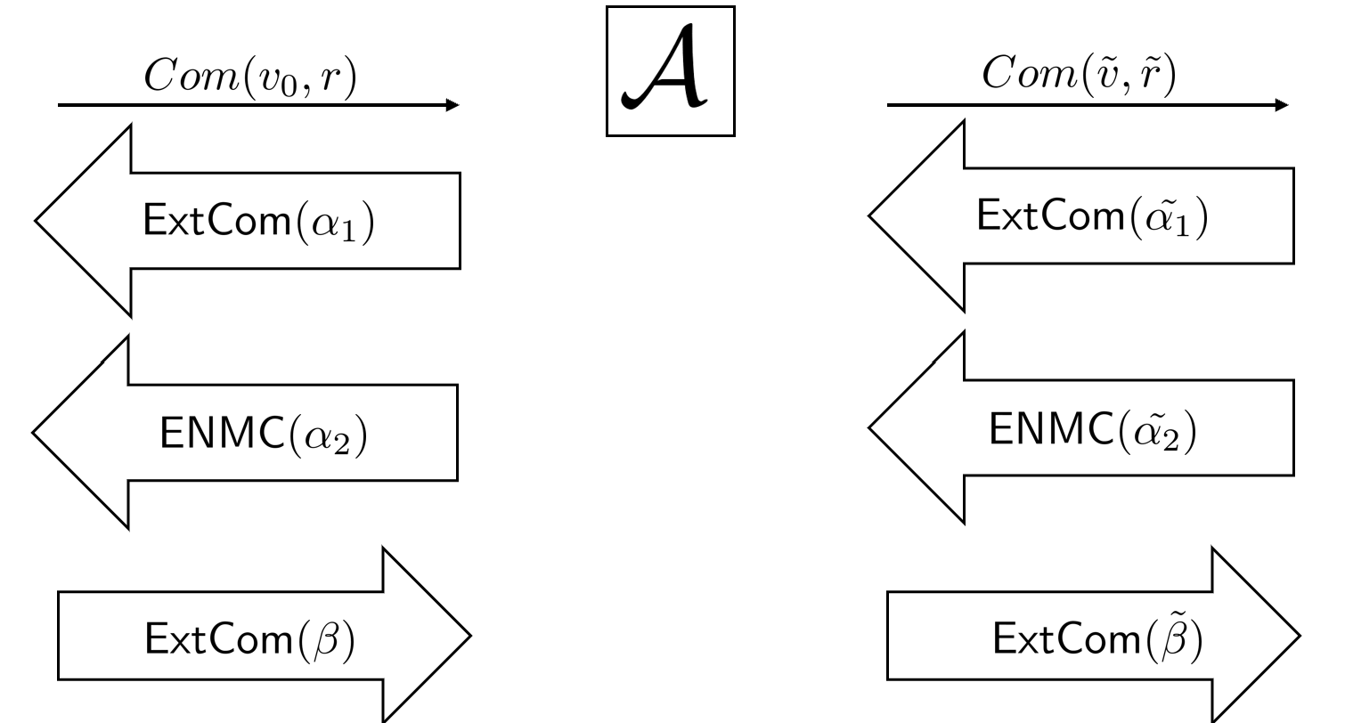
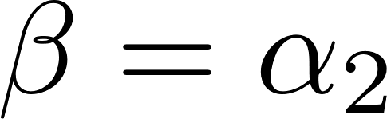
Invariant in Hybrid 3
Roughly, if invariant is violated, then is `blindly’ changing 2nd ExtCom on the right in response to change in the left one.
But since , this means that must also be changing the left ENMC in response to the right one.
Breaks non-malleability of ENMC.
Q: Why not use ENMC directly from the committer’s side?
A: Not compatible with black-box transformation

Slide 66
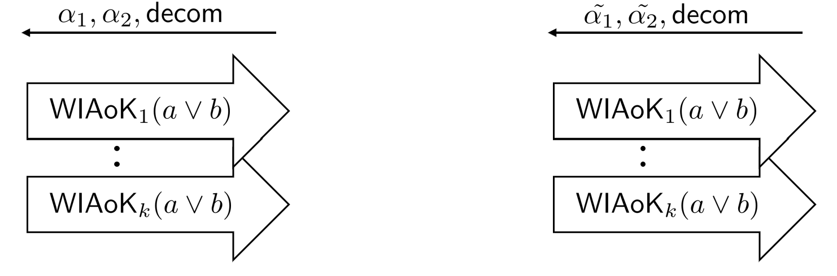
Step 4
Sequence of hybrids: in each, switch the i-th WIAoK to proving the trapdoor statement.
Invariant holds because no change before decommitment step (so this is same as prev. hybrids).
Cannot change witness directly for the k-th WIAoK.
Add additional hybrid that switches to extracting from 1st WIAoK on the right (a sort of detour).
Replace
witness

Slide 67
Extract
& Store as
Set
Replace
Witnesses in each WIAoK
execution
Extract witness

Slide 68
Finishing the argument
At this point, we note that there is no part of the protocol (apart from the first message) that actually depends on the committer’s input.
We could have gotten to this last experiment starting from a committer committing to using the same sequence of hybrids.
Finally, we can switch the initial commitment to with one to . By the hiding of , this change is undetectable by the adversary.
In summation, we conclude that the experiment in which the honest committer uses is computationally indistinguishable from one in which the committer uses (for synchronous adversaries).

