Slide 1
Black-Box Constructions of Bounded-Concurrent Secure Computation
Sanjam Garg¹, Xiao Liang², Omkant Pandey², Ivan Visconti³
University of California, Berkeley
Stony Brook University
University of Salerno

Slide 2


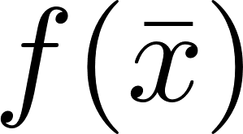
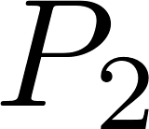
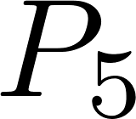







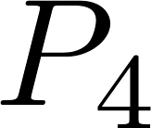
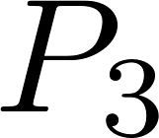

MPC: Standalone Security
REAL
IDEAL

Slide 3
MPC: Concurrent Security​
Highly-desired in complex environment, e.g. the Internet​
Stand-alone security does not imply concurrent security​

Slide 4
UC Security and Relaxation​
Universal Composability [Can01]​
Impossible without setup assumptions​
Impossible even for "self composition" (composition of the same protocol)​
Alternative Notions for Secure MPC without Setup
​Bounded concurrency
Super-polynomial simulation
Angle-based Security/Shield Oracles
This work
[GKP18]

Slide 5
Our Contribution
A bounded-concurrent MPC Protocol
“Minimal” assumptions: semi-honest OT + CRHF
Black-box
Constant-round
Black-box version of [Pas04], with better assumptions
[Pas04] assumptions: enhanced TDP + CRHF

Slide 6
Starting Point
[GKP18] protocol
Super-polynomial simulation (SPS security)
Black-box
Constant-round
Standard assumptions: semi-honest OT + CRHF
Our Approach:
Identify the super-polynomial work (of the simulator)
Make it polynomial time
Do not incur extra assumptions or non-black-box access

Slide 7
Reviewing the [GKP18] Protocol
High-level idea for [GKP18] SPS protocol
Build a UC-SPS OT (we will call it GKP-OT)
black-box
O(1)-round
semi-honest OT + CRHF
Plug it into [IPS08]
[IPS08]: UC-secure protocol in OT-hybrid model
No composition theorem for SPS security
Proof can be done from scratch

Slide 8
Reviewing GKP-OT
--- simplified

Slide 9
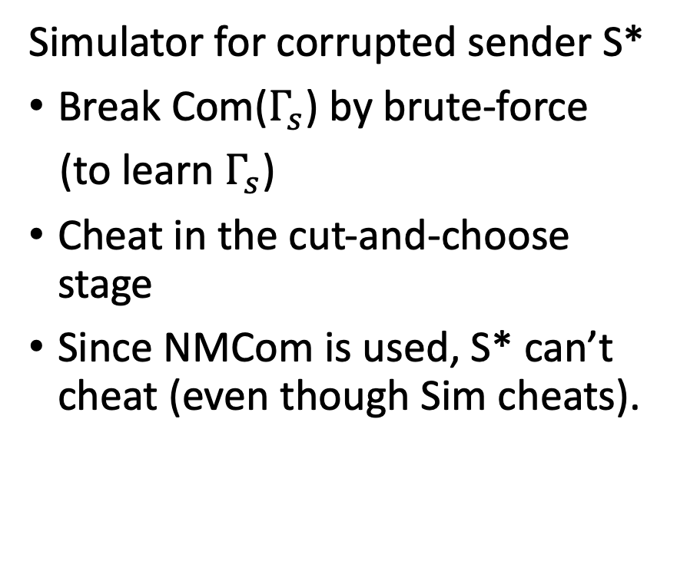
Security for GKP-OT
The only super-polynomial work
Simulator for corrupted sender S*
Break Com($Γ_{s}$) by brute-force
(to learn $Γ_{s}$)
Cheat in the cut-and-choose stage
Since NMCom is used, S* can’t cheat (even though Sim cheats).

Slide 10
Our Approach
Replace Com with a new commitment:
Extractable in straight-line
In the present of bounded-concurrently many other protocols
Constant-round
Assumptions: semi-honest OT + CRHF
Black-box
Claim:
Constructing black-box bounded-concurrent MPC reduces to the construction of such a commitment.

Slide 11
Starting Point: [BL02] Extractable Commitment

Slide 12
[BL02] Extractable Commitment
1. TDP should be avoid
2. Non black-box access to Com

Slide 13
Removing TDP
. . .

Slide 14
Black-Box (1/2)
Make it Black-Box?
Commit-and-Prove
Straight-line simulation
. . .
Solution:
[GOSV14] Commit-and-Prove
Are we done?
No.
--- bounded concurrency

Slide 15
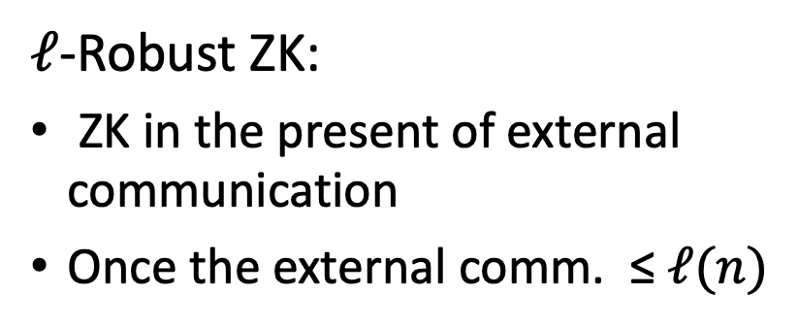
Black-Box (2/2)
Make GOSV-Prove a concurrent ZK?
Not enough
cZK is (only) self-composable
. . .
$ℓ$-Robust ZK:
ZK in the present of external communication
Once the external comm. ≤$ℓ(n)$

Slide 16
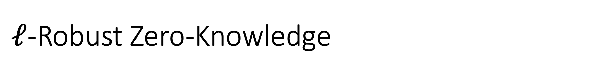
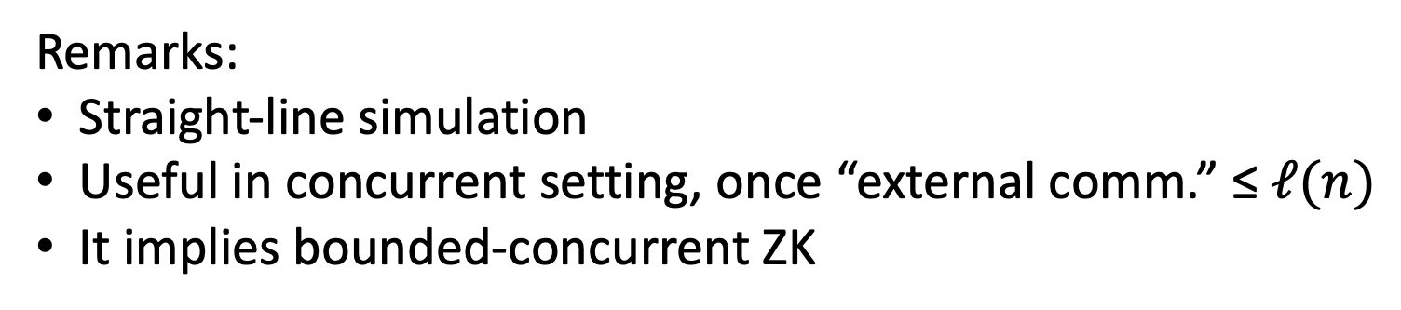
$ℓ$-Robust Zero-Knowledge
Real World:
Simulation:
Remarks:
Straight-line simulation
Useful in concurrent setting, once “external comm.” ≤$ℓ(n)$
It implies bounded-concurrent ZK

Slide 17

Building $ℓ$-Robust ZK
Can be constructed by a slight modification of [Bar01]
[Bar01] Makes non-black-box use of CRHFs
Can be fixed by techniques in [GOSV14]
Details in our paper

Slide 18

Building $ℓ$-Robust ZK (1/3)
Recall [Bar01, BG02]: nBB ZK
Over-simplified. We ignored:
Encrypted execution of Univ. Arg
ECC and PCP components

Slide 19
Building $ℓ$-Robust ZK (1/3)
Recall [Bar01, BG02]: nBB ZK
Over-simplified. We ignored:
Encrypted execution of Univ. Arg
ECC and PCP components

Slide 20

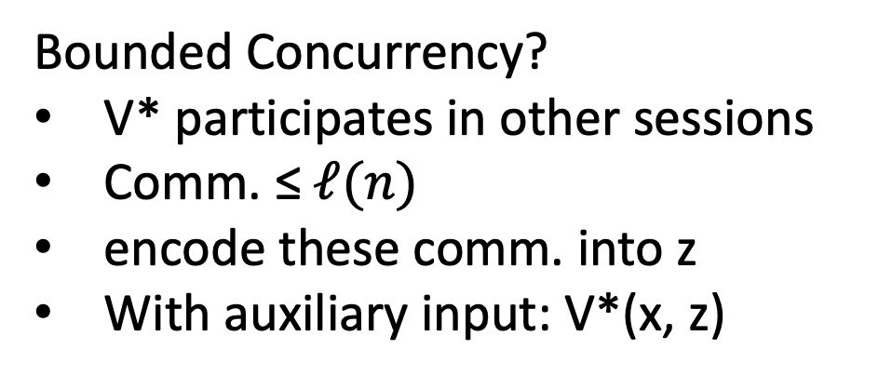
Building $ℓ$-Robust ZK (2/3)
Bounded Concurrency?
V* participates in other sessions
Comm. ≤$ℓ(n)$
encode these comm. into z
With auxiliary input: V*(x, z)

Slide 21
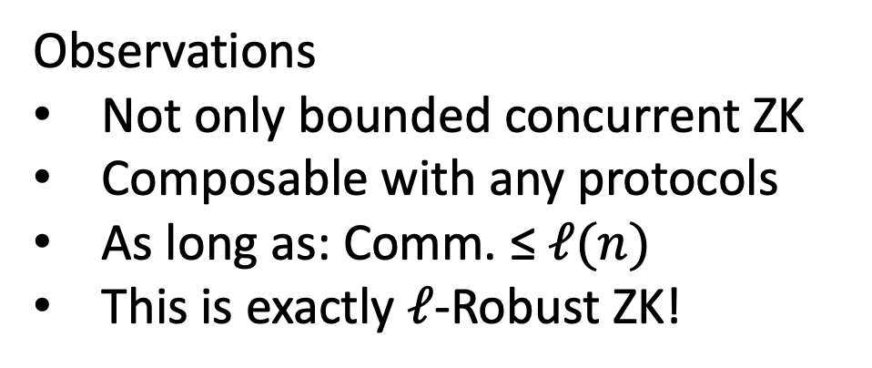

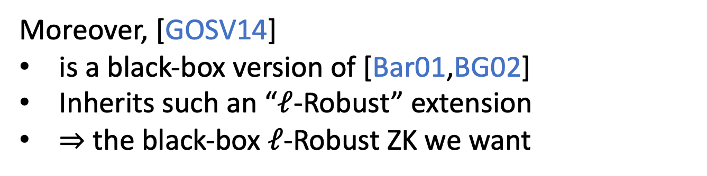
Building $ℓ$-Robust ZK (3/3)
Observations
Not only bounded concurrent ZK
Composable with any protocols
As long as: Comm. ≤$ℓ(n)$
This is exactly $ℓ$-Robust ZK!
Moreover, [GOSV14]
is a black-box version of [Bar01,BG02]
Inherits such an “$ℓ$-Robust” extension
⇒ the black-box $ℓ$-Robust ZK we want

Slide 22
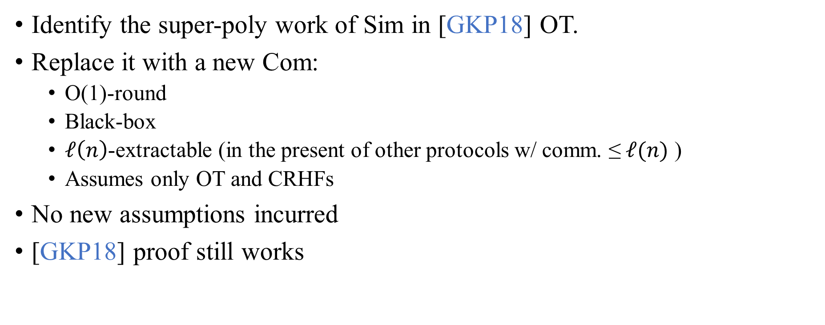
Summary (1/2)
Identify the super-poly work of Sim in [GKP18] OT.
Replace it with a new Com:
O(1)-round
Black-box
$ℓ\left(n\right)$-extractable (in the present of other protocols w/ comm. ≤$ℓ(n)$ )
Assumes only OT and CRHFs
No new assumptions incurred
[GKP18] proof still works

Slide 23
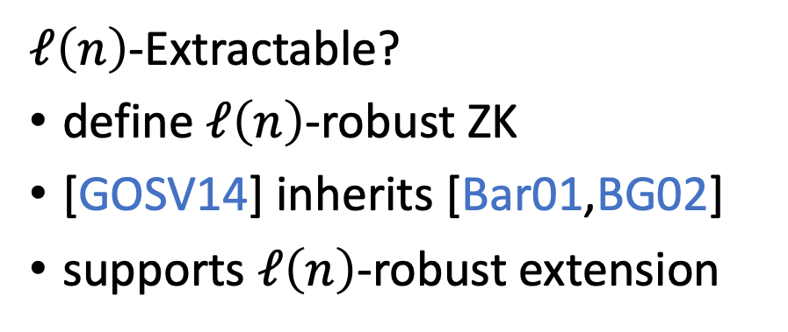
Summary (2/2)
Black-Box?
[GOSV14] BB commit-and-prove
. . .
$ℓ\left(n\right)$-Extractable?
define $ℓ\left(n\right)$-robust ZK
[GOSV14] inherits [Bar01,BG02]
supports $ℓ\left(n\right)$-robust extension

Slide 24
Thank you!
Q&A

Slide 25
Bibliography​
[Can01] Ran Canetti. Universally composable security: A new paradigm for cryptographic protocols.​
​[GKP18] Sanjam Garg, Susumu Kiyoshima, and Omkant Pandey. A new approach to black-box concurrent secure computation.
[Pas04] Rafael Pass. Bounded-concurrent secure multi-party computation with a dishonest majority.
[IPS08] Yuval Ishai, Manoj Prabhakaran, and Amit Sahai. Founding cryptography on oblivious transfer- efficiently.
[GOSV14] Vipul Goyal, Rafail Ostrovsky, Alessandra Scafuro, and Ivan Visconti. Black-box non-black-box zero knowledge.
[BL02] Boaz Barak and Yehuda Lindell. Strict polynomial-time in simulation and extraction.
[Bar01] Boaz Barak. How to go beyond the black-box simulation barrier.
[BG02] Boaz Barak and Oded Goldreich. Universal Arguments and their Applications.

