Slide 1




UWB初步调研
汇报人：赵鹏
2022/3/13

Slide 2
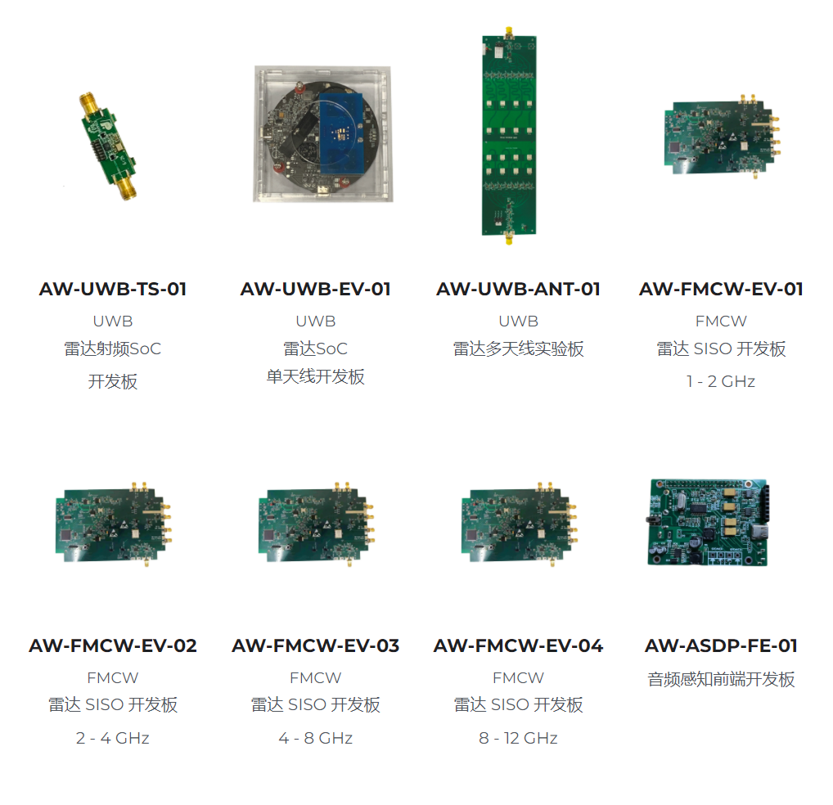
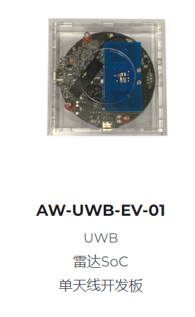
01
Device
2

Slide 3
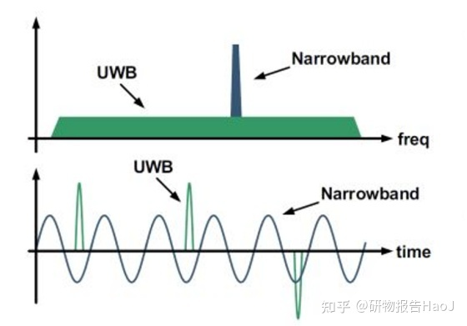
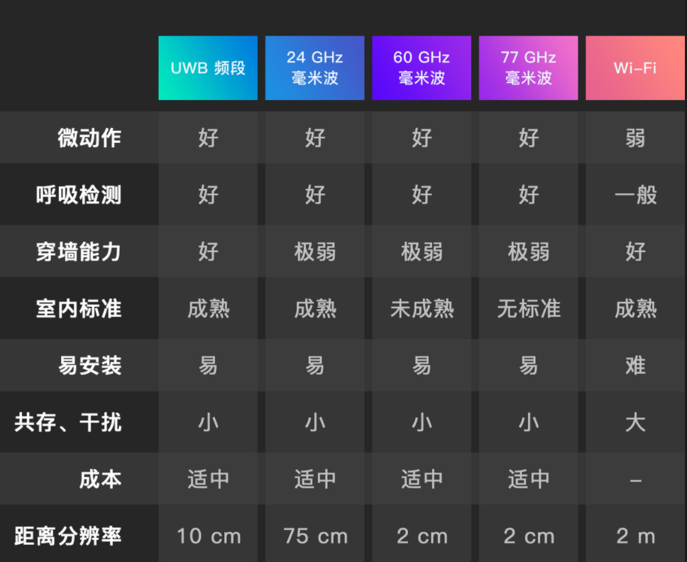
02
Brief Introduction
Ultra-Wideband，利用纳秒(ns)至皮秒(ps)级的非正弦波窄脉冲传输数据进行通信
抗多径能力强
穿透能力较强（宽频谱）
定位精度高（厘米级）
能效高
抗干扰（占空比极小0.01~0.001）
3

Slide 4
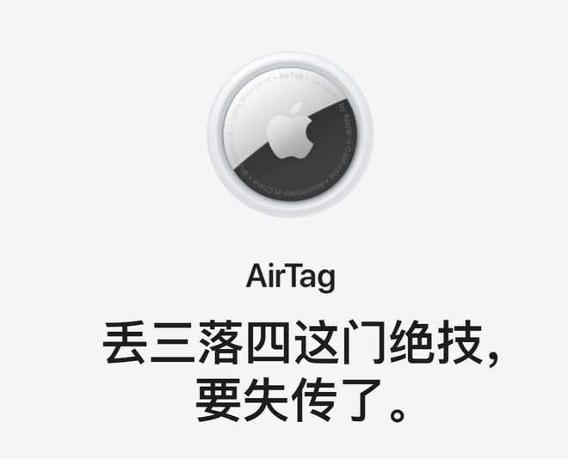
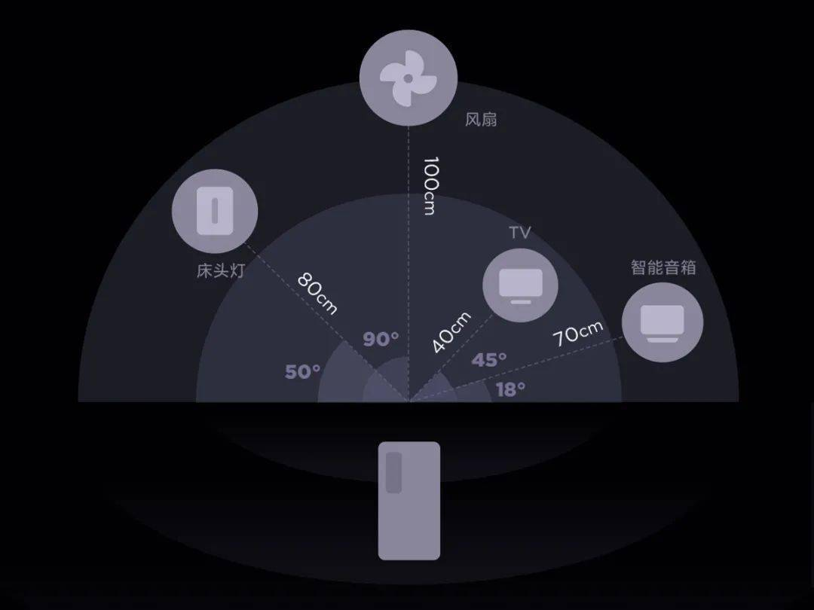
02
Brief Introduction
iphone11就开始引入uwb，三星galaxy note 20 ultra，小米mix4等陆续引入
在手机查找app中显示大概位置，走到近场后，利用UWB进行精准查找。
通过Siri或者手机界面中的按钮操作，让AirTag发声，从而快速发现设备。
通过NFC贴近AirTag，可以看到联系人信息，相当于电子工牌。
小米uwb一指连（指向任意智能设备都可直接控制，角度测量精度可达±3°）
4

Slide 5
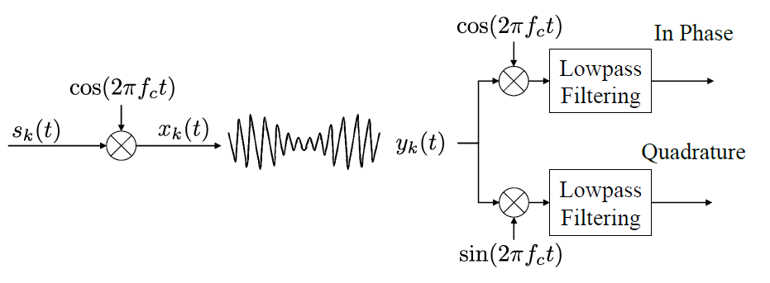
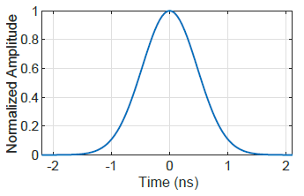
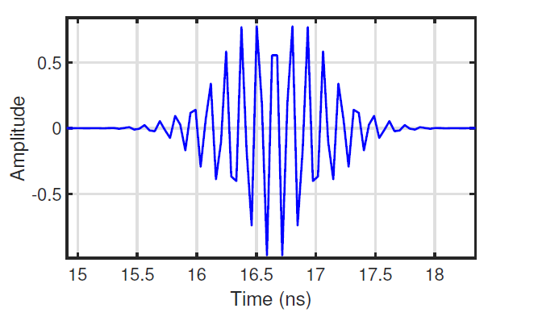
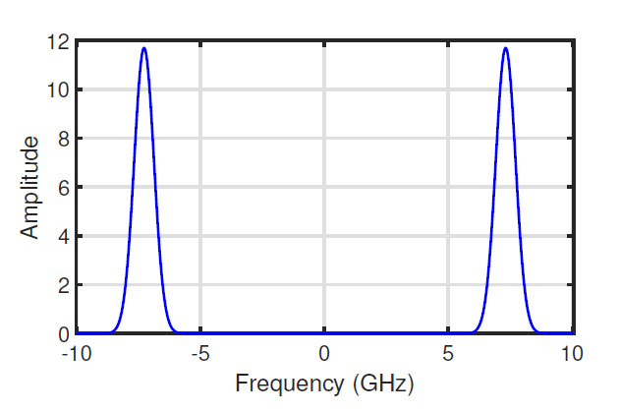

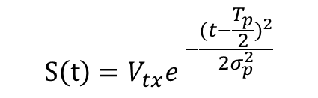
03
vital signals
IQ upconversion and downconversion
$$S\left(t\right)=V_{tx}e^{ −\frac{{(t−\frac{T_{p}}{2})}^{2}}{2σ_{p}^{2}}}$$
carrier frequency is 7.3GHz,
and bandwidth is 1.4GHz
5

Slide 6
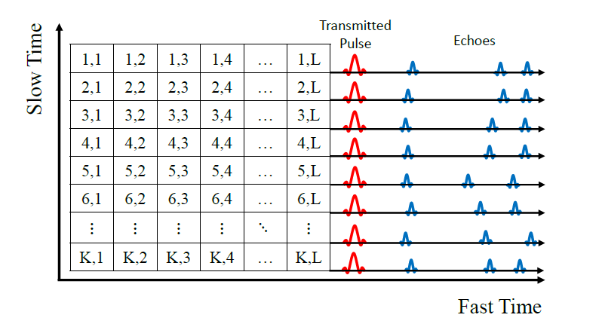




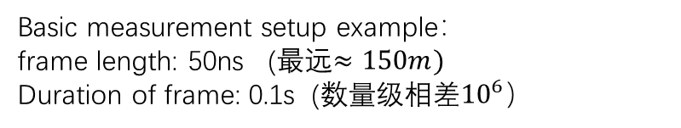
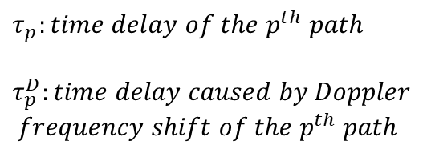
03
vital signals
$Ts:$Pulse Repetition Interval (PRI)
Impulse response $h_{k}(t)$
Basic measurement setup example：
frame length: 50ns (最远$≈150m)$
Duration of frame: 0.1s (数量级相差${10}^{6}）$
$$τ_{p}:time delay of the p^{th} path$$
$$τ_{p}^{D}:time delay caused by Doppler$$
$frequency shift of the{ p}^{th} path$
Fast time: time delay of range distance
Slow time: estimate Doppler effect by observing over a long time span
6

Slide 7
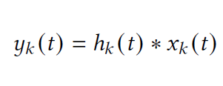
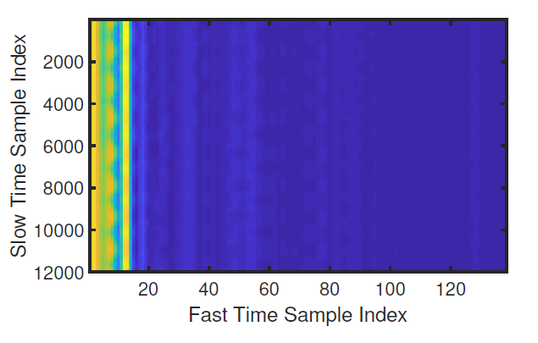
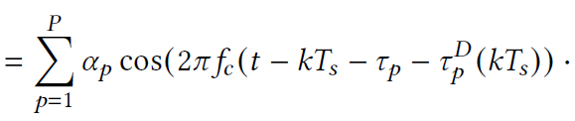

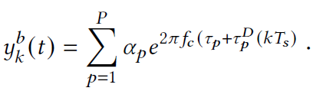

03
vital signals
Received baseband signals
an example of real received signals from UWB radio
7

Slide 8
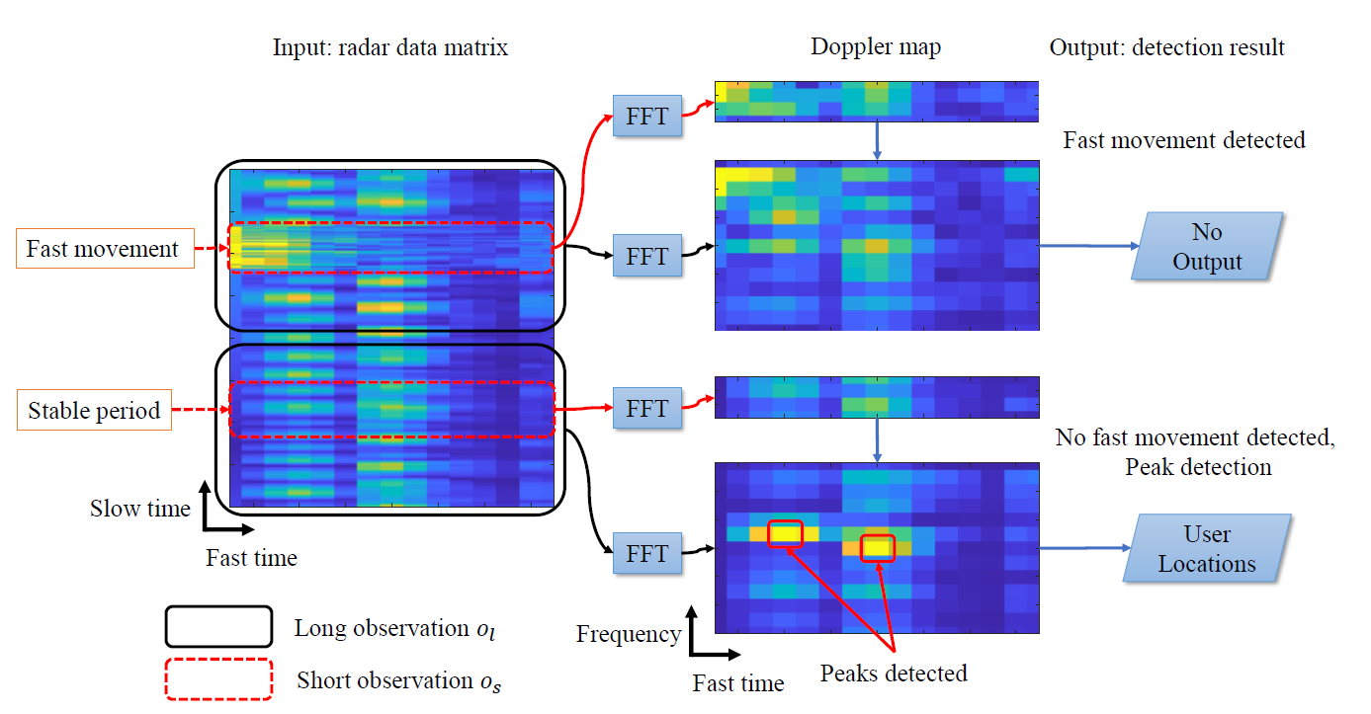


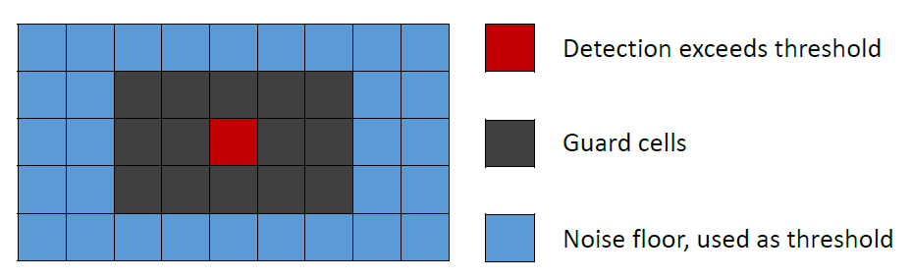


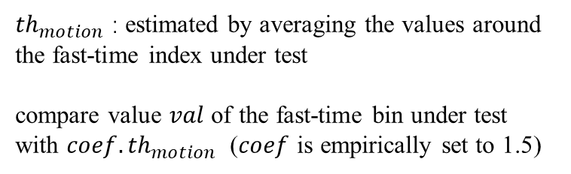
03
vital signals
$$(c=1.2)$$
Window size is set to $60cm×0.16Hz$
${th}_{motion}$ : estimated by averaging the values around the fast-time index under test
compare value $val$ of the fast-time bin under test with $coef.{th}_{motion}$ ($coef$ is empirically set to 1.5)
8

Slide 9
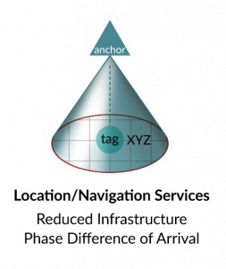
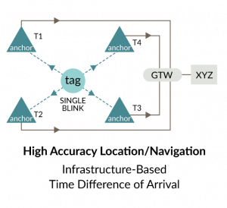
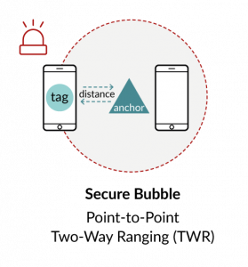
04
Other Application
核心定位原理：ToA(Time of Arrival)
Examples (from Decawave)
TDoA:
Time Difference of Arrival
TWR:
Two-Way Ranging
PDoA:
Phase Difference of Arrival
9

Slide 10
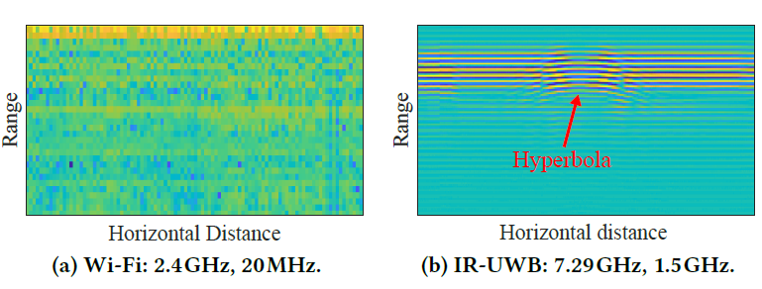
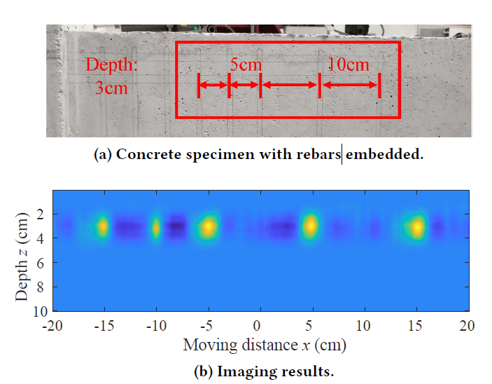
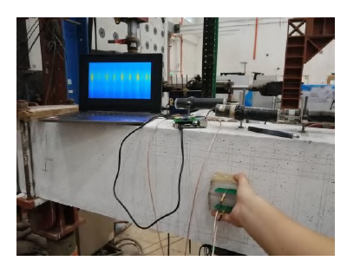
04
Other Application
SIWA
It analyzes the reflected signals to synthesize an image and also to identify the material status.
Embing a rebar into a concrete wall at a depth of 5cm and swipe these devices over the wall surface
device
10

Slide 11
Thanks
11

