Slide 1




ICDAR
汇报人：王碧
2022/4/22

Slide 2

ICDAR
2
Notes:
CCF C、Core A、两年一次

Slide 3
ICDAR2021
Task 1 - Single Document VQA: Is a typical VQA style task, where natural language questions are defined over single documents, and an answer needs to be generated by interpreting the document image. No list of pre-defined responses will be given, hence the problem cannot be easily treated as an n-way classification task.
Task 2 - Document Collection VQA: Is a retrieval-style task where given a question, the aim is to identify and retrieve all the documents in a large document collection that are relevant to answering this question as well as the answer.
Task 3 - Infographics VQA (NEW!): This is a new task introduced as part of the 2021 challenge (ICDAR 2021 edition). The task is similar to the task1 where questions are posed on Infographic images instead of business and industry documents. More details of the task can be found under "Tasks" tab.
3

Slide 4
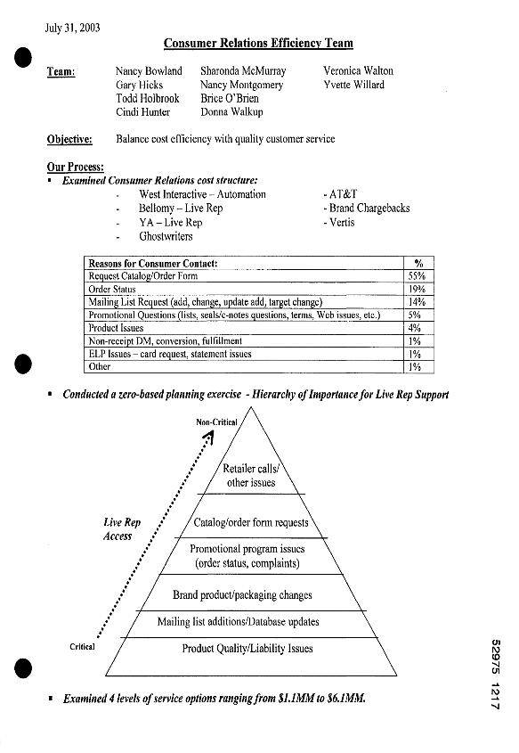

ICDAR2021
What is the issue at the top of the pyramid? Retailer calls/ other issues
Which is the least critical issue for live rep support? Retailer calls/other issues
Which is the most critical issue for live rep support? Product quality/liability issues
​​​How many females are affected by diabetes 3.6%
What percentage of cases can be prevented 60%
What could lead to blindness or stroke diabetes
Task1
Task2
4

Slide 5
Text Detection
T. Guan et al., "Industrial Scene Text Detection with Refined Feature-attentive Network," in IEEE Transactions on Circuits and Systems for Video Technology, doi: 10.1109/TCSVT.2022.3156390.
M. Cao, C. Zhang, D. Yang and Y. Zou, "All You Need Is a Second Look: Towards Arbitrary-Shaped Text Detection," in IEEE Transactions on Circuits and Systems for Video Technology, vol. 32, no. 2, pp. 758-767, Feb. 2022, doi: 10.1109/TCSVT.2021.3068133.
M. Liao, Z. Zou, Z. Wan, C. Yao and X. Bai, "Real-Time Scene Text Detection with Differentiable Binarization and Adaptive Scale Fusion," in IEEE Transactions on Pattern Analysis and Machine Intelligence, doi: 10.1109/TPAMI.2022.3155612.
X. Rong, C. Yi and Y. Tian, "Unambiguous Text Localization, Retrieval, and Recognition for Cluttered Scenes," in IEEE Transactions on Pattern Analysis and Machine Intelligence, vol. 44, no. 3, pp. 1638-1652, 1 March 2022, doi: 10.1109/TPAMI.2020.3018491.
C. Yang, M. Chen, Z. Xiong, Y. Yuan and Q. Wang, "CM-Net: Concentric Mask Based Arbitrary-Shaped Text Detection," in IEEE Transactions on Image Processing, vol. 31, pp. 2864-2877, 2022, doi: 10.1109/TIP.2022.3141844.
5

Slide 6
谢谢

