Slide 1




MoRe-Fi: Motion-robust and Fine-grained Respiration
Monitoring via Deep-Learning UWB Radar
汇报人：赵鹏、章翔、颜焕
2022/4/24

Slide 2
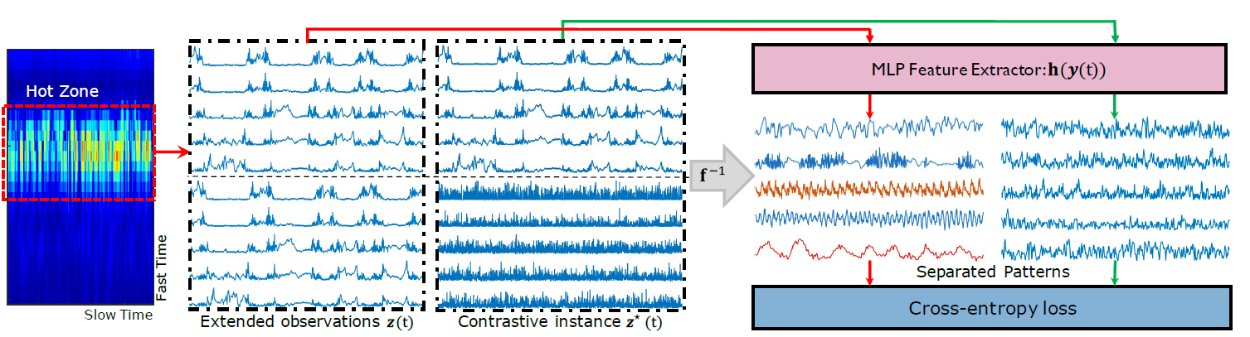
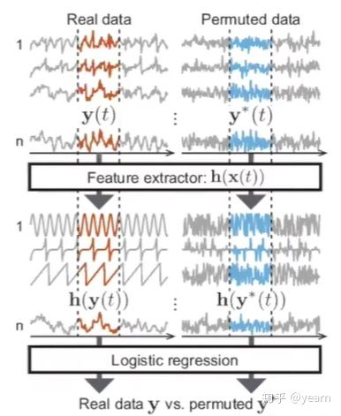
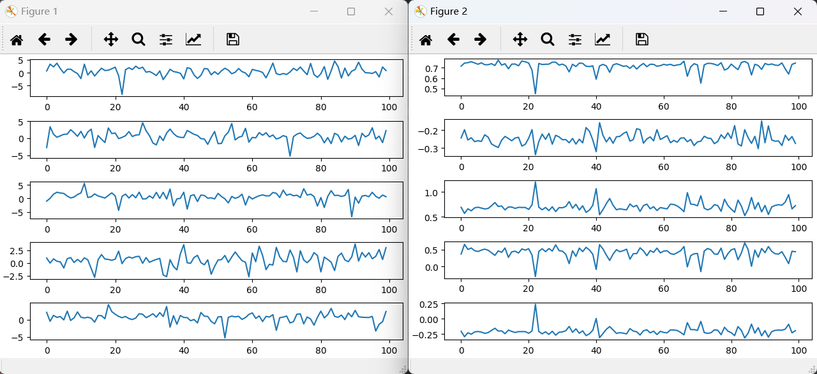
01
PCL
PCL
原始信号
恢复的信号

Slide 3
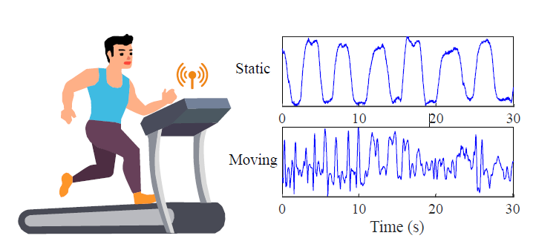
02
MoRe-Fi
Design a fine-grained respiration monitoring system working on subjects with body movements(SenSys’21)
process radar signal in its complex I/Q domain
propose IQ-VED for recovering and refining
respiratory waveform
We conduct extensive evaluations on MoRe-Fi with a 66-hour dataset
Lack sufficient generalization ability
Handle complex I/Q signals
IQ-VED performs a bivariate analysis of I/Q signal
3

Slide 4
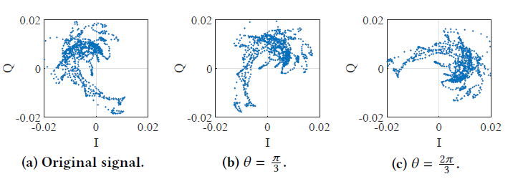
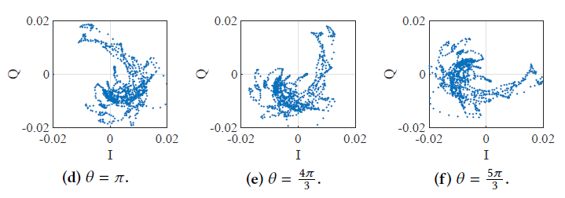
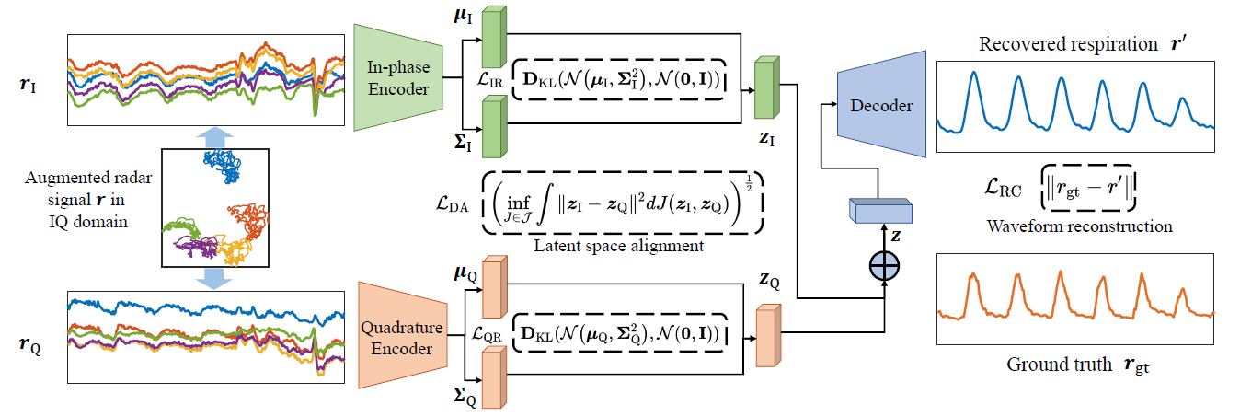
02
MoRe-Fi
Data Augmentation

Slide 5
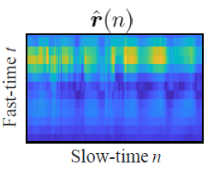
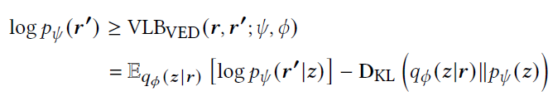

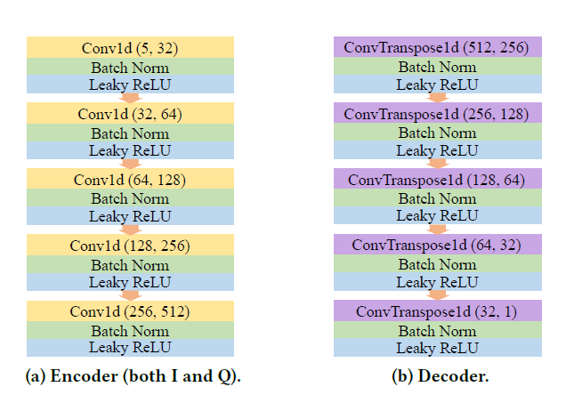
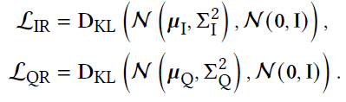

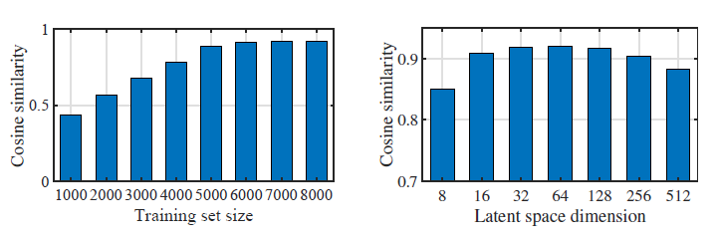
02
MoRe-Fi
最大化其变分下限

Slide 6
Thanks
6

