Slide 1




工作报告
Hefei University of Technology, China
报告人：章翔
12/26/2021

Slide 2
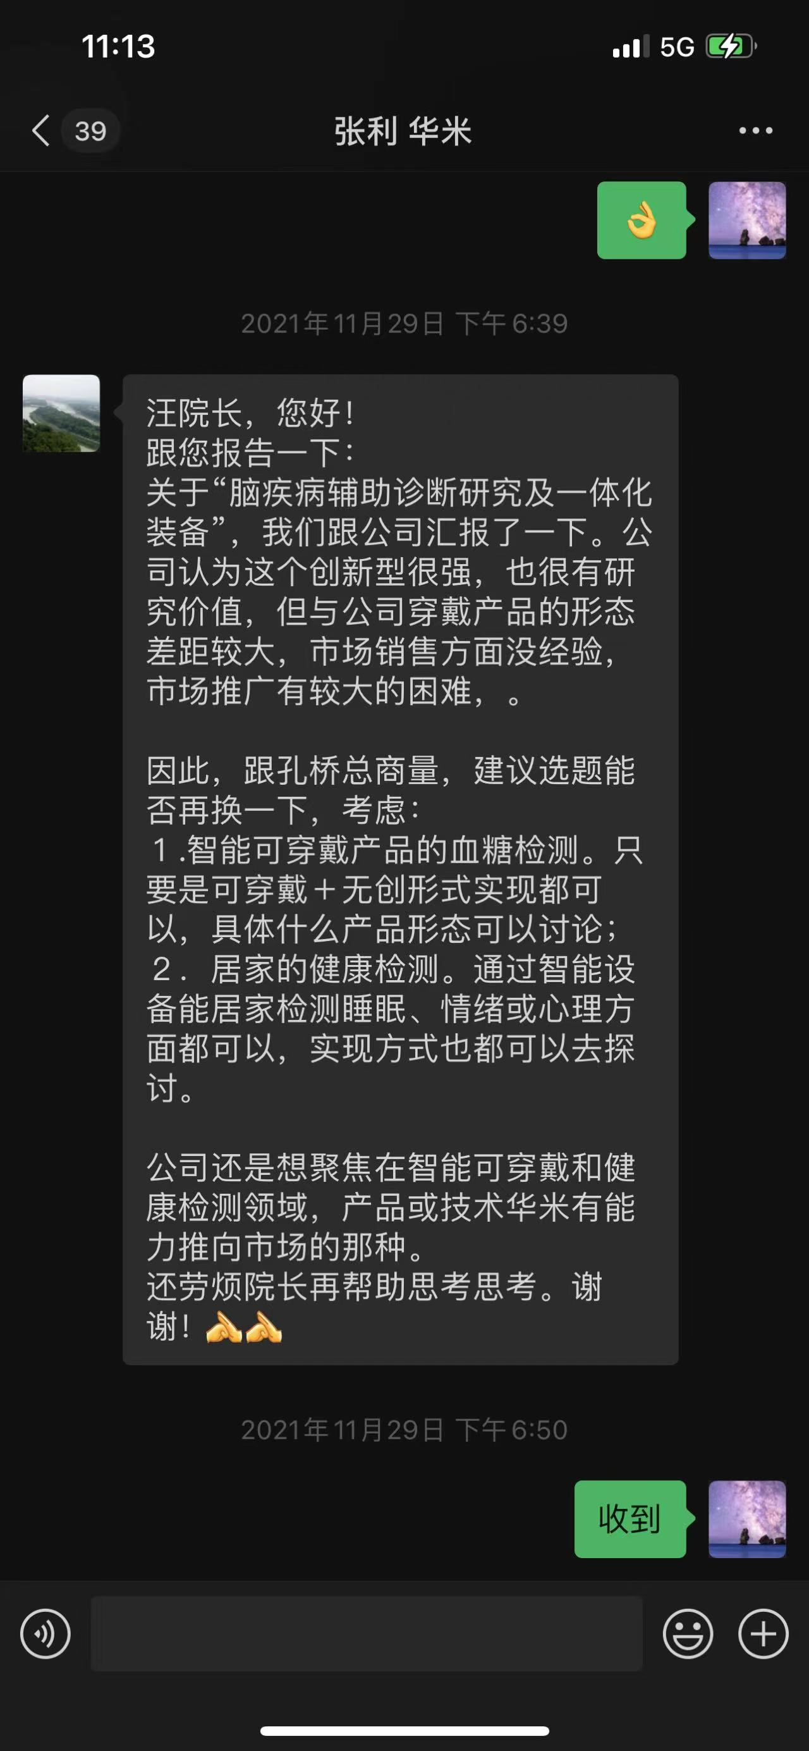
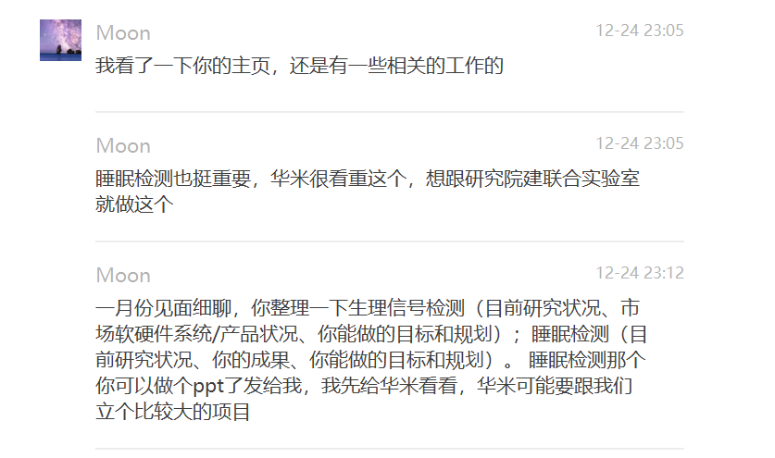
未来研究规划
2

Slide 3
Thank You for Watching
12/26/2021

