Slide 1

Do You Hear What I’m Typing? Using Acoustic Patterns to Detect Keyboard Input
DSS-4, Lab, Tutors : Irina Diaconita and Frank Englert
Pascal Granier
William Cibille
Source : www.scientificamerican.com

Slide 2
Plan
1) Motivation
2) Idea of the project and goals
3) Technical concept
4) Current state of our work
5) Evaluation Methods
6) Time plan and next steps
Conclusion & Questions

Slide 3


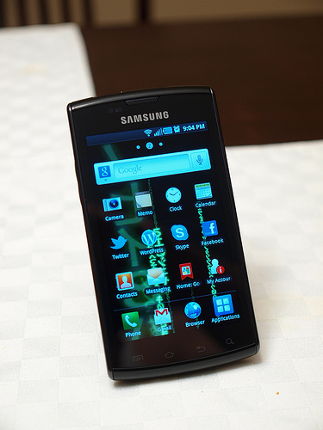
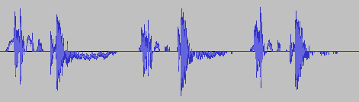
1. Motivation
Multimedia
Machine Learning
Mobile Sensing
Sound Processing

Slide 4

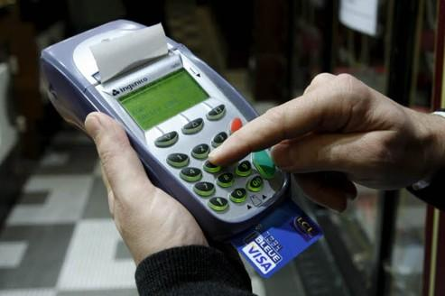
2. Idea of the project and goals
Keyboard Input detection :
For text and code multiple recording
By sound recording and treatment on a mobile device
Machine Learning
Ten keys prototype (numbers)
Aim : application optimization
Increase the accuracy (now is 36%)
Adapt the audio classifier to this special application domain
Collect audio samples & train the classifier

Slide 5
3. Technical concept
Audio
Keystrokes
Classification
Characteristics
Audio:
An audio input file
Keystroke:
An audio feature extracted from the input stream
Characteristics:
The results of an audio analysis
Classification:
Learning mode
Prediction mode
Measure accuracy (10 classes so it must be at least 10 % !)
Notes:
Now we will describe what we have and what we have planned to improve. Our improvements will concern each step, in particular the feature extraction and analysis (stereo audio => phase shift).
We will record our own audio files for further testing.

Slide 6
3.a) Technical concept: Step 1/3
Audio
Keystrokes
Characteristics
Classification
Windowing
How do we cut the keystrokes out?
Now: a fixed-size window moves along the audio stream
Our work: determine when a keystroke begins (peak detection)
Filtering the keystrokes
Drop extracts with silence
Now: a threshold based on decimal Manhattan Norm
Ideas of improvement:
Test other norms
Reconsider the windowing mechanism

Slide 7
3.b) Technical concept: Step 2/3
Audio
Keystrokes
Characteristics
Classification
Feature extraction
Algorithm based on voice analysis
Our ideas:
Test other parameters
Enlarge the recordings bandwidth

Slide 8
3.c) Technical concept: Step 3/3
Audio
Keystrokes
Characteristics
Classification:
Learn
Predict
Machine learning
Multiple algorithms from Scikit, including:
Gaussian Naive Bayes
Decision Tree
K-Nearest neighbors
Random Forest
Our work:
Determine which filter gives the best results
Test the implementation of Scikit Neural Networks
Find the most significant parameters

Slide 9
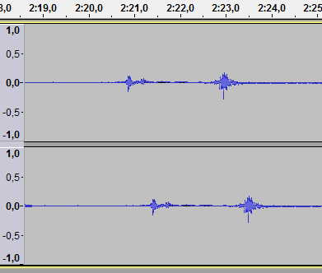
3.d) Technical concept: stereo audio
Audio
Keystrokes
Characteristics
Classification
Stereo sound: the phase shift
Significant parameter
Calculates the source position
Our work:
Record new sound samples
Create an algorithm to analyze the phase shift
Add this parameter to the characteristics vector
Notes:
Need to adapt the feature extraction program and adds a new characteristic.

Slide 10
4. Current state of our work
Preparation of laboratory
Software installation
Python training
Reading and global understanding of the code
Drawing of first ideas of improvements
Start of tests on parameters (feature & classifiers)

Slide 11
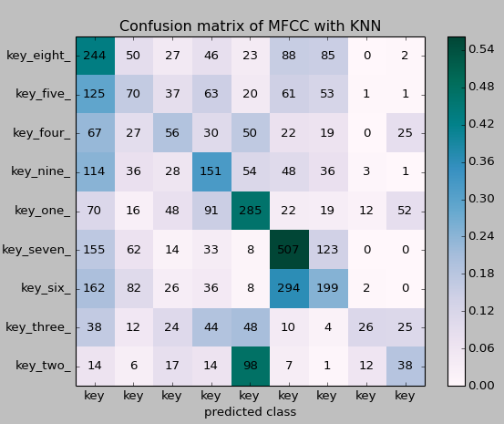
5. Evaluation Methods
Accuracy :
Precision calculated by the program
Confusion Matrix
Improve the UI
Mode selection menus
Graphic axis
Measure efficiency on other recordings

Slide 12
6. Time plan and next steps
Week 1 : Test program parameters
Feature extraction : windows (length, type of window, length of step Size...)
Improvement of the threshold filter (use of logarithmic scale, extraction of the signal in keystrokes
Further improvement of feature extraction algorithm
Week 2 :
Record our own samples
Find high-frequency recording material (microphone & sound card upper than 44kHz)
Find stereo microphones

Slide 13
6. Time plan and next steps (2/2)
Week 3 :
Adapt feature extraction
Classifier modification
Week 4 : Further modifications according new ideas and issues
Week 5 (End of June) :
Phase shift classification with stereo microphone
Week 6 : Summary & conclusion of our work

Slide 14


Conclusion
Keyboard Input detection is a rich and interesting project
Mobile Sensing
Sound Processing
Machine Learning
Work is in progress
Current program works
Tests with modified program
Ideas of improvements
News ideas will come with further work and best mastery

Slide 15

Questions ?

Slide 16
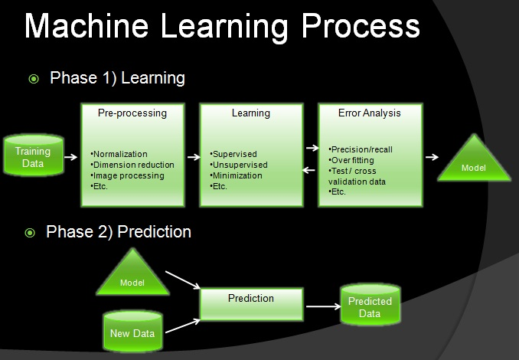
Appendix

