Slide 1

Do You Hear What I’m Typing? Using Acoustic Patterns to Detect Keyboard Input
DSS-4, Lab, Tutors : Irina Diaconita and Frank Englert
Final presentation
Pascal Granier
William Cibille
Source : www.scientificamerican.com

Slide 2
Plan
Our subject
Our work & axis & results
The windowing algorithm
The stereo recording solution
Our conclusions
Questions

Slide 3

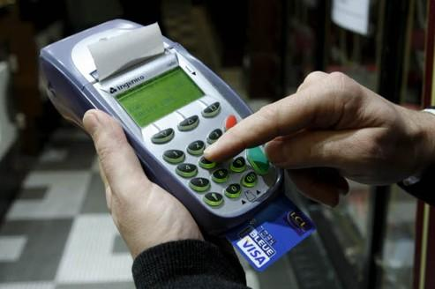
1. Our subject
Keyboard Input detection :
Recognize keyboard input
With audio recording
Show it is technically possible
Aim : application optimization
Increase the accuracy (was 36%)
Adapt the audio classifier to this special application domain
Collect audio samples & train the classifier

Slide 4
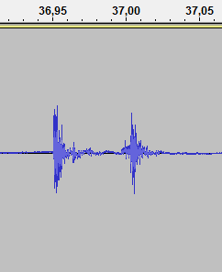
2. Our work
Windowing algorithm
Detect a peak
Then take the surrounding signal
Fixed window size
keystroke
peak

Slide 5
2. Working conditions
Strict, experimental conditions
Same keyboard, same user
Maximum key rate of 140 cpm
Recording conditions
Silent environment
Room & echo
Microphone position (image)

Slide 6
2. Our work
Parameter adjustments
New windowing function
Classifier:
Threshold for the peak: (needs to be adapted to the lowest peak)
Number of MEL coefficients: 25
Our results
95 % accuracy (matrix image)

Slide 7
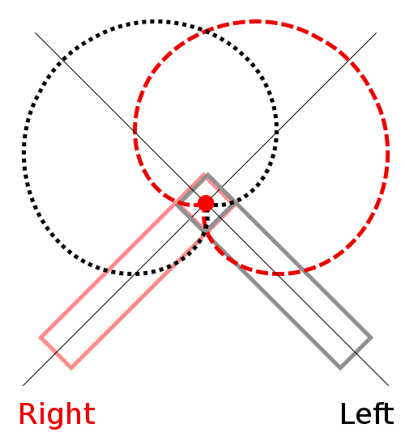
2. Our work
Stereo recording
AB microphone
2 directional microphones
No phase shift
Amplitude difference
Recording the new samples
Results
Poorer results
A
B

Slide 8
3. Our conclusions

Slide 9

Questions ?

Slide 10
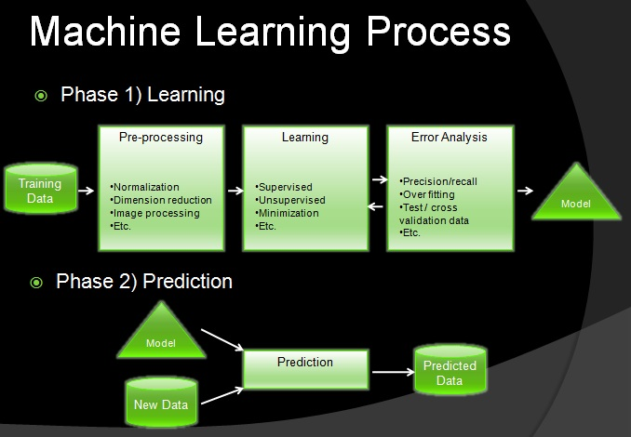
Appendix

