Slide 1

Beyond Accuracy
What Language-Subspace Interventions Capture, Remove, and Improve
Shaanil Punglia · Dadhichi Telwadkar · Vaibhav Rathore · Siddharth Sureka · Neha Bhargava
Multi-LLL 2026 workshop · Paper Session 2 · 9 November 2026
Code and released results: github.com/pungyman/BeyondAccuracy
Notes:
TIME: 0:20 on this slide | ends at 0:20 | 41 words = ~18 s of speech at 140 wpm; the rest of the budget is pauses and pointing
SAY:
Good afternoon. I'm Shaanil Punglia, and this is joint work with Dadhichi Telwadkar, Vaibhav Rathore, Siddharth Sureka and Neha Bhargava. The paper is called "Beyond Accuracy". By the end I hope it's clear why accuracy alone was not enough for us.
SETUP: 17 min talk + 2 min Q&A (Paper Session 2, 16:40-17:00 Beijing time, Room MR8M). Target delivery 16:40, which leaves ~20 s of slack.

Slide 2
Better multilingual reasoning, without new weights?
MOTIVATION
89.2%
English
20.8%
Swahili
Same problems, same model.
Only the language changes.
Could an edit to activations at inference time, with no weight changes, close part of this gap?
Lower-resource pool used by Zhao et al.: Bengali, Swahili, Telugu, Thai
Qwen2.5-7B-Instruct · MGSM, 250 problems per language · native 8-shot prompt · greedy · 1,024-token cap
Notes:
TIME: 0:50 on this slide | ends at 1:10 | 103 words = ~44 s of speech at 140 wpm; the rest of the budget is pauses and pointing
SAY:
Let me start with the question behind this work. Can we make a multilingual model reason better without fine-tuning it, without changing a single weight?
Here is why it matters. This is Qwen2.5-7B on MGSM: the same 250 math problems in eleven languages. English is at 89 percent. Swahili is at 21 and Telugu at 27, on identical mathematics. The dark bars are the lower-resource pool used in the work we build on; Thai is in it and does fine here.
Fine-tuning for each language costs data and compute. So: could an edit to activations, at inference time, close part of this gap?
IF ASKED (Q&A, not timed):
- Telugu: 21.6% of its responses hit the 1,024-token cap even here, so part of its low score is truncation, not reasoning.
- Why this model? Qwen2.5-7B-Instruct is the model of the 37-configuration intervention grid later in the talk.
- These are the native-prompt baselines of our prompt-control runs (1,024-token cap). The edit grid uses a 512-token cap, where Telugu and Bengali baselines are lower (13.6% and 52.8%) because of truncation.
SOURCES:
results/E8/promptctl_agg_Qwen2.5-7B-Instruct.csv (cond = clean). Lower-resource pool definition: Zhao et al. (2025); paper Appendix A.

Slide 3
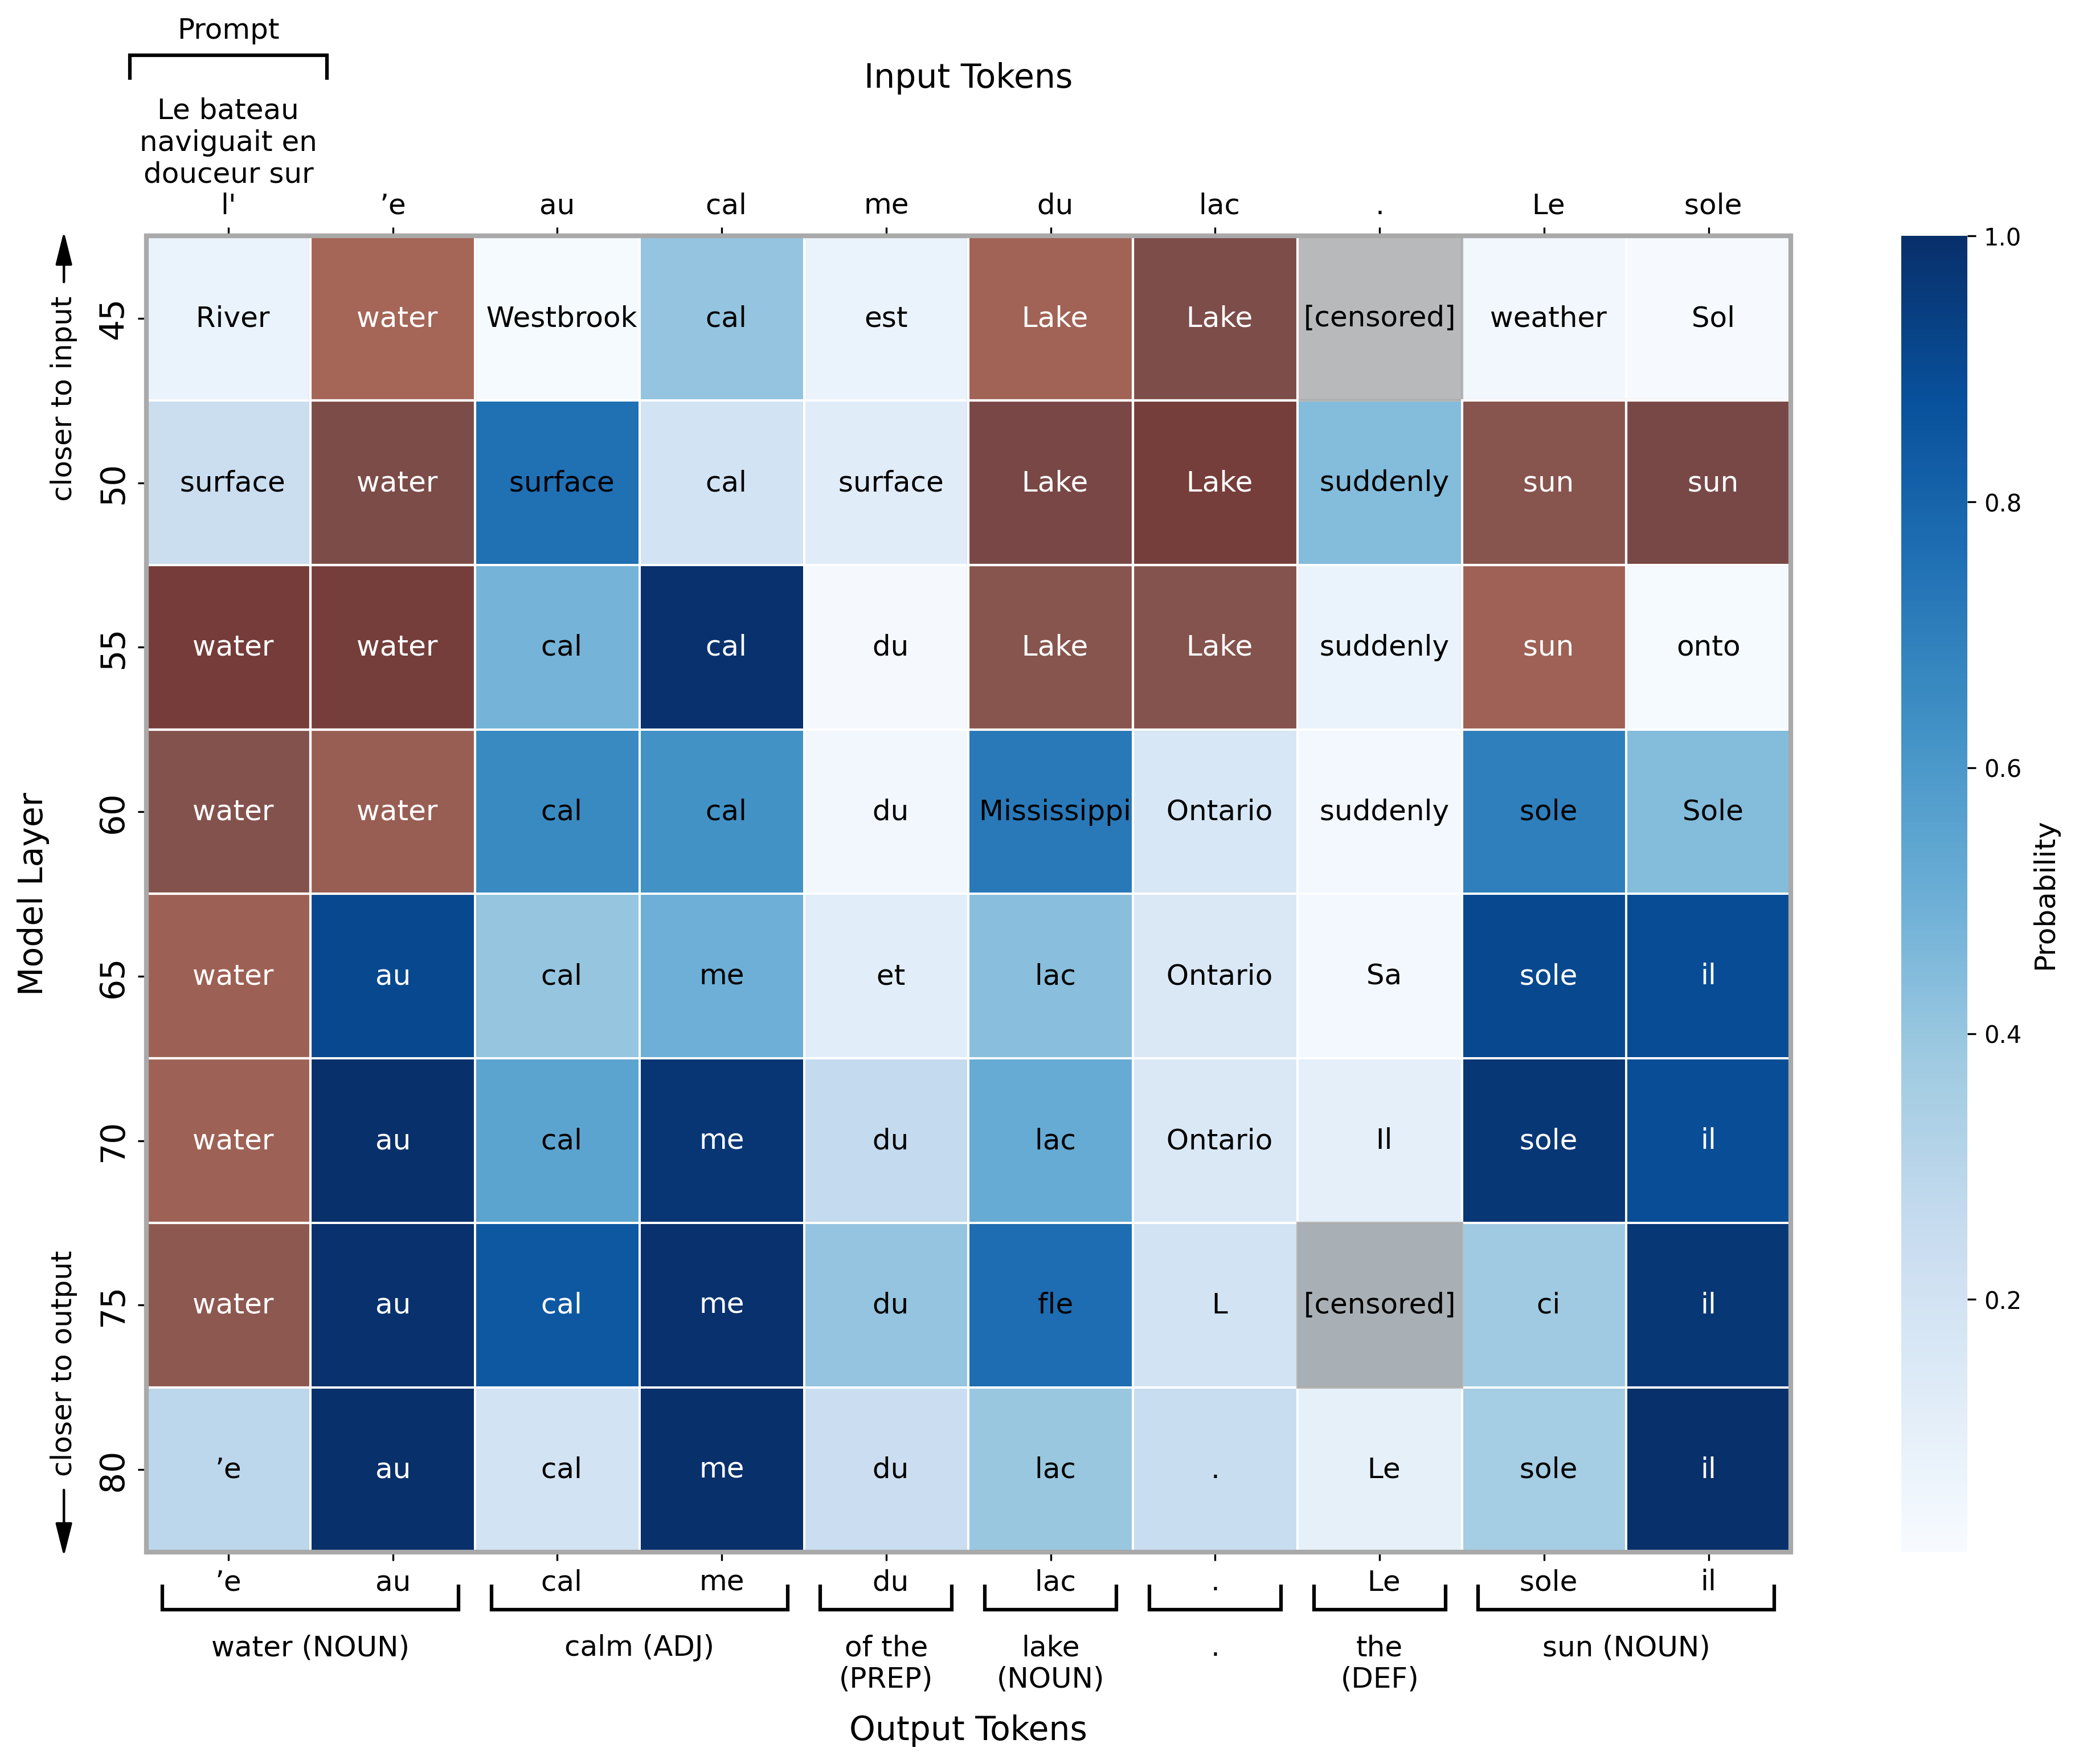
Language at the edges, reasoning in the middle
MOTIVATION · PRIOR WORK
Early layers
process the input language
Intermediate layers
make key decisions in a space close to English
Late layers
produce the output language
depth
Wendler et al. 2024 · Y. Zhao et al. 2024 · Dumas et al. 2025 · Schut et al. 2025
Close to English is not language-free. We test this directly (Q2).
Nouns surface in English (water, lake, sun) before turning French.
Logit lens on Llama-3.1-70B, layers 45–80 of 80. Reproduced from Schut, Gal & Farquhar (2025), "Do Multilingual LLMs Think In English?", Fig. 1.
Notes:
TIME: 1:05 on this slide | ends at 2:15 | 117 words = ~50 s of speech at 140 wpm; the rest of the budget is pauses and pointing
SAY:
Why might that be possible? Zhao, Schut and others suggest a division of labor across depth. Early layers process the input language, late layers produce the output language, and the intermediate layers do the core work in a space close to English.
This figure from Schut and colleagues makes it vivid. It is a logit lens on Llama-3.1-70B reading a French sentence, from layer 45 down to the output. The nouns surface first as English words, water, lake, sun, in red, and only near the output turn into French. Wendler and colleagues, and Yiran Zhao and colleagues, report a similar picture.
One careful point: close to English does not mean language-free, and that distinction comes back later.
IF ASKED (Q&A, not timed):
- What the figure shows, precisely: decoding intermediate states with the output unembedding (logit lens). Schut et al. find that semantically loaded words (here nouns) are selected in English before being translated, while other parts of speech are not; they also find steering works better with vectors computed in English.
- The layer-wise picture: Wendler et al. (2024) describe an input space, an English-like "concept" space in the middle, then the output language; Y. Zhao et al. (2024) propose understand / solve in an English-like space / generate; Dumas et al. (2025) use activation patching to separate concept from output language.
- Schut et al. weigh three hypotheses for the latent space: English-centric, language-agnostic, or set by the input language. Their multi-token evidence favours English-centric; Wendler et al.'s single-token experiments had favoured language-agnostic.
- Schut et al. also find that steering vectors built in English steer non-English prompts better, and that facts interpolated between languages keep the answer while only the output language changes.
- This is evidence about representations, not proof that reasoning happens in the middle layers. That stronger reading is what the intervention assumes.
- Two Zhaos: Yiran Zhao et al. (2024) is the layer-wise account; Weixiang Zhao et al. (2025) is the intervention we study.
FIGURE RIGHTS: Schut et al. is on arXiv under the default non-exclusive licence, so the authors hold copyright. Reproducing a figure with full citation in a conference talk is common scholarly practice; if the slides will be posted publicly, consider a courtesy note to the authors.
SOURCES:
Schut, Gal & Farquhar (2025), arXiv:2502.15603, Fig. 1 (figures/logit_lens/fig1.png in the arXiv source). Wendler et al. (ACL 2024); Y. Zhao et al. (NeurIPS 2024); Dumas et al. (ACL 2025): all in paper/references.bib except Schut et al.

Slide 4
If the middle is shared, remove language there
MOTIVATION · THE INTERVENTION
Zhao et al. (2025): reasoning and language are separable, and language-specific signal in the middle layers interferes with reasoning. Remove it there; restore it at the upper layers.
Applying the edit
small, at every prompt
suppress the language component
amplify it again
One low-rank projection per edited layer. No gradients, no weight updates.
prompt
answer
0
10
20
27
Qwen2.5-7B-Instruct, layers 0–27
Estimating the directions
Reported on MGSM: gains in accuracy and in response-language fidelity
paid once per model
+0.94
accuracy
(points)
+4.69
language
fidelity (pts)
Needs parallel translations: 7,500 MATH problems × 11 languages = 82,500 forward passes, then one factorization per layer.
Their claim: gains across 10 LLMs, 11 languages and 3 benchmarks, and results comparable to SFT and RL post-training on Qwen2.5-3B. Numbers above: Qwen2.5-7B, MGSM, 11-language averages from their Table 1, coefficients tuned per language.
Notes:
TIME: 1:10 on this slide | ends at 3:25 | 163 words = ~70 s of speech at 140 wpm; the rest of the budget is pauses and pointing
SAY:
Weixiang Zhao and colleagues turned this into an intervention. Their hypothesis, inspired by cognitive neuroscience, is that reasoning and language are separable, and that language-specific signal in the middle layers interferes with reasoning. So estimate a low-rank language subspace, suppress it in the middle layers, here layers ten to nineteen of Qwen2.5, and amplify it again near the output, so the model still answers in the right language. They report gains in both accuracy and language fidelity on MGSM: for Qwen2.5, about one point of accuracy and almost five of fidelity. On a 3B model, they report results comparable to fine-tuning with SFT or RL.
The cost profile is the appeal. Applying the edit is one low-rank projection per layer, with no gradients and no weight updates. The work is up front: parallel translations and forward passes to estimate the directions, paid once per model.
Notice one risk already. Pushing activations toward an English-like regime might pull the output language along with it.
IF ASKED (Q&A, not timed):
- Their numbers come from their own protocol: coefficients tuned per language under a composite objective, and a different language-ID metric. Ours are fixed configurations scored with a strict per-response metric, so our numbers do not reinterpret theirs (paper Section 6.2 and Appendix C).
- Cost of the projection: for rank r it is two thin matrix products (r x 3,584) per edited layer per prompt token; negligible next to the layer itself.
- The 82,500 is 7,500 MATH training problems x 11 languages, one activation per layer at the last prompt token.
- Their own paper chose the middle layers empirically: ablating upper layers hurt output fidelity, and they note fidelity falls as ablation gets stronger ("models increasingly default to English"), most in low-resource languages.
- Their motivation cites neuroscience: the human language network is largely inactive during reasoning (Monti et al.; Fedorenko et al., 2024).
SOURCES:
Zhao et al. (2025), arXiv:2505.15257, Sections 1, 2 and 4. Table 1, Qwen-2.5-Instruct-7B averages: accuracy 69.82 -> 70.76, fidelity 79.75 -> 84.44 (paper/workshop/numbers/zhao2025_mgsm_table1.json). Premise: paper Section 7. Layer bands: paper Appendix C.

Slide 5
Taking Zhao et al.’s approach apart, on math
OUR STUDY
We break down its design space, test the interpretability claims behind it, and examine its practical utility.
1
Capture
2
Remove
3
Improve
INTERPRETABILITY
INTERPRETABILITY
PRACTICAL UTILITY
Does the subspace follow how activations move when we translate a problem?
After projecting it out, can the language still be read from the activation?
Do edited generations give more answers that are correct and in the problem’s language?
Geometry · 4 models
Language probes · 4 models
Generation · Qwen2.5-7B · 37 configs
Why math?
Parallel translations keep the content fixed, so what differs between versions is the language.
Answers are numbers, so correctness is checked the same way in every language.
Notes:
TIME: 0:55 on this slide | ends at 4:20 | 123 words = ~53 s of speech at 140 wpm; the rest of the budget is pauses and pointing
SAY:
This was Zhao's approach, and we take it apart in three ways. We break down its design space, test the interpretability claims behind it, and examine its practical utility. Capture: does the subspace follow how activations move when we translate a problem? Remove: once we project it out, is the language really gone? Improve: do edited generations give more answers that are correct and in the problem's language?
Math is a great testbed for this. With parallel translations the content is fixed, so the only thing that differs between versions is the language. And the answer is a number, so correctness is checked the same way in every language. That makes language and reasoning easier to pull apart here than almost anywhere else.
IF ASKED (Q&A, not timed):
- Why not other tasks? Zhao et al. also report XWinograd and M-MMLU; we stay on MATH and MGSM, which keeps translations parallel and scoring language-independent. Generalizing beyond math is a stated limitation.
- The 37 configurations vary estimator, operator, rank and dose around the reference schedule (paper Section 6.1).
SOURCES:
Paper Sections 1 and 3; Limitations.

Slide 6
Steering vectors: a contrast becomes a direction
METHOD · BACKGROUND
Activation space at one layer
1
Collect inputs that differ in one property.
steering vector
v = mean h(A) − mean h(not A)
2
Their activation difference is a direction for that property.
inputs with property A
3
Add it, or remove it, to change what the model does.
inputs without it
For language, the cleanest contrast pair is a translation.
Same problem, same content: only the language changes.
Steer: h ← h + α · v
ActAdd (Turner et al., 2023): one contrast pair. CAA (Rimsky et al., 2024): averaged over many pairs.
Notes:
TIME: 0:55 on this slide | ends at 5:15 | 107 words = ~46 s of speech at 140 wpm; the rest of the budget is pauses and pointing
SAY:
So how do you construct a language subspace? It helps to start from steering vectors. Turner and colleagues showed that if you take two prompts that differ in one property, say positive and negative sentiment, the difference between their activations is a direction for that property. Add it back into the residual stream and you steer what the model generates. Rimsky and colleagues made this robust by averaging the difference over many contrast pairs.
The lesson: a contrast between inputs becomes a direction in activation space. And for language we have the cleanest contrast pair there is, a translation. Same problem, same content; only the language changes.
IF ASKED (Q&A, not timed):
- ActAdd: Turner et al. (2023), "Activation Addition: Steering Language Models Without Optimization" (single prompt pairs such as "Love" vs "Hate"). CAA: Rimsky et al. (2024), "Steering Llama 2 via Contrastive Activation Addition" (mean difference over many contrastive pairs).
- Removing a direction (projection) is the subtractive counterpart of adding one; the language-subspace edit is that, generalized from one direction to a low-rank span.
SOURCES:
Paper Section 2 (related work); paper/references.bib: turner2023steering, rimsky2024steering. The schematic is illustrative, not data.

Slide 7
Translating a problem moves its activation
METHOD · TRANSLATION VECTORS
EN
A robe takes 2 bolts of blue fiber and half that much white fiber. How many bolts in total does it take?
Activation at the last prompt token, layer k
Swahili
translation vector
v = h(SW) − h(EN)
SW
Joho hutumia komeo 2 za ufumwele wa buluu na nusu ya kiasi hicho cha ufumwele mweupe. Huwa inatumia jumla ya komeo ngapi?
BN
একটি পোশাক তৈরি করতে 2 রিল নীল সুতো এবং তার অর্ধেক সাদা সুতো লাগে। এটি তৈরি করতে মোট কতগুলি রিল লাগবে?
English
Bengali
Answer: 3 in every language. MGSM item 1 (Shi et al., 2023), verbatim.
Schematic: a 2-D sketch of a 3,584-dimensional space (Qwen2.5-7B).
Notes:
TIME: 0:55 on this slide | ends at 6:10 | 104 words = ~45 s of speech at 140 wpm; the rest of the budget is pauses and pointing
SAY:
Here is one, a real MGSM item shown verbatim: a robe takes two bolts of blue fiber and half that much white fiber; how many bolts in total? The answer is three, in every language.
We read the activation at the last prompt token, at some layer k, and each version lands at a different point. This is a two-dimensional sketch of 3,584 dimensions. Since the content is fixed, the translation vector between two points should carry language variation. Not purely language, because wording and tokenization change too, so we call it language-associated. With eleven languages, every problem gives us 55 of these vectors.
IF ASKED (Q&A, not timed):
- Why the last prompt token? It is where the model has read the whole problem before generating; following Zhao et al., all representation analyses use it.
- "Associated with language", not "pure language": translation also changes tokenization and wording, so we never assume the vector is purely linguistic (paper Section 3.2).
SOURCES:
MGSM test item index 1 in en/sw/bn (juletxara/mgsm), answer_number = 3. Hidden size 3,584 = Qwen2.5-7B config. 55 = 11 choose 2 language pairs.

Slide 8
From translation vectors to a language subspace
METHOD · ESTIMATING THE SUBSPACE
DiffPCA our construction
Mean-SVD Zhao et al.’s construction
Swahili mean
problem 3
shared anchor
problem 1
English mean
problem 2
Bengali mean
Center each problem’s 11 translations; normalize each direction.
Fit the subspace that best explains these directions, pooled over 7,500 problems.
Rank can exceed 10.
Average each language over 7,500 problems first.
Factorize the offsets of the 11 language means.
At most 10 directions; problem identity is averaged away.
Controls at the same rank: Pooled (top-variance directions, no language labels) · Random span
Notes:
TIME: 1:05 on this slide | ends at 7:15 | 134 words = ~58 s of speech at 140 wpm; the rest of the budget is pauses and pointing
SAY:
With many translation vectors in hand, how do we turn them into a subspace? Our construction, DiffPCA, follows the steering logic directly. For each problem, take its eleven translations, subtract their average, and normalize what is left: one direction per language, for that very problem. Then fit the subspace that best explains all those directions, pooled over 7,500 MATH problems. It finds the directions translation traverses again and again, and it can have more than ten.
Zhao and colleagues' construction, Mean-SVD, averages first. Each language collapses to one mean over all problems, and a factorization finds the directions that separate those eleven means, at most ten. It keeps the stable offsets between languages and throws away problem identity.
At every rank we also compare with two controls: unlabeled high-variance directions, and a random span.
IF ASKED (Q&A, not timed):
- Mean-SVD is the common-specific low-rank decomposition in Zhao et al.'s released code (paper Table 4a); we reproduce it.
- DiffPCA normalizes each residual to unit norm before PCA, so a few large activations cannot dominate (paper Appendix B.1).
- Fitting uses residuals from the problem's mean; the capture test then uses held-out pairwise translation vectors, so DiffPCA is not guaranteed to win it.
- Both are fitted independently at every layer.
SOURCES:
Paper Section 3.2 and Appendix B.

Slide 9
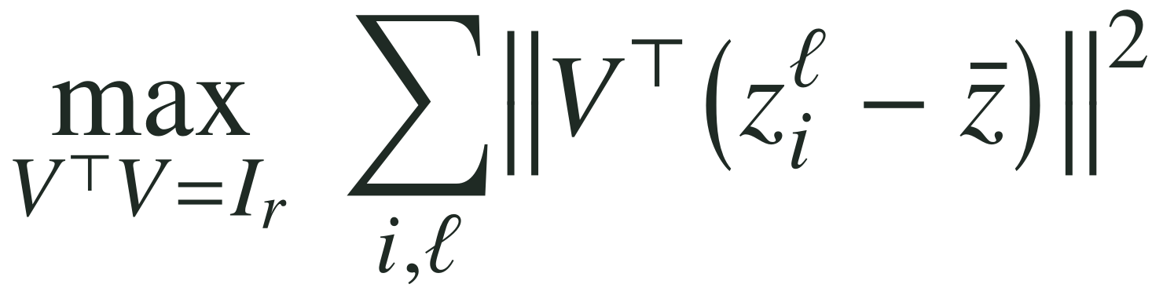
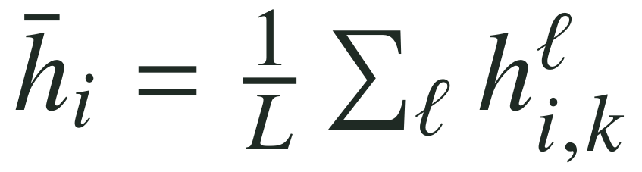
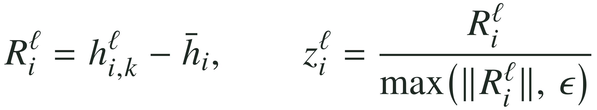
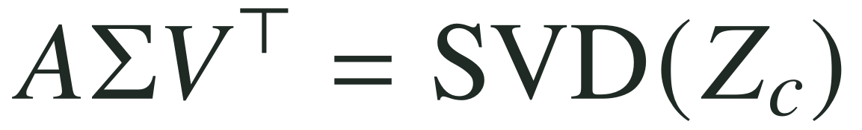
DiffPCA: keep the problem, fit the translations
METHOD · DERIVATION · DIFFPCA (OURS)
GOAL
the r directions that best fit the normalized within-problem directions
Remove each problem’s mean and normalize its translation residuals
1
The problem’s centre across its 11 translations.
2
Each language’s deviation for this problem, scaled to unit length (ε: a numerical floor).
Fit centered PCA to the normalized residuals
3
Stack all 7,500 × 11 directions; center them.
4
Ordinary PCA.
5
Any rank: up to 100 in geometry, 32 in the generation grid.
Notes:
TIME: 1:10 on this slide | ends at 8:25 | 125 words = ~54 s of speech at 140 wpm; the rest of the budget is pauses and pointing
SAY:
Here is the derivation, starting with ours. At a fixed layer k we have activations for n problems in L languages.
Step one: for each problem, average its eleven translations. That is the problem's centre. Step two: subtract it, so each language gets a residual, its deviation for this very problem, and scale each residual to unit length.
Then it is ordinary PCA. Step three stacks all of them, 7,500 problems times eleven languages, and centres them. Steps four and five take the top r principal directions.
Written as an objective, at the top: the r-dimensional subspace that captures the most of these normalized directions. Nothing caps the rank at ten. Why fit residuals rather than the translation vectors themselves? That is the next slide.
IF ASKED (Q&A, not timed):
- Fitting is per layer, on all 7,500 MATH training problems (3,750 for the held-out capture test).
- The unit-norm step makes the fit angular: every (problem, language) residual counts once, whatever its activation norm. epsilon only guards against division by zero.
- Output: an orthonormal translation-residual basis V_r in R^{d x r} (d = 3,584 for Qwen2.5-7B).
SOURCES:
Paper Section 3.2 and Table 3(b) (arXiv:2611.05278); src/subspace.py in the release.

Slide 10
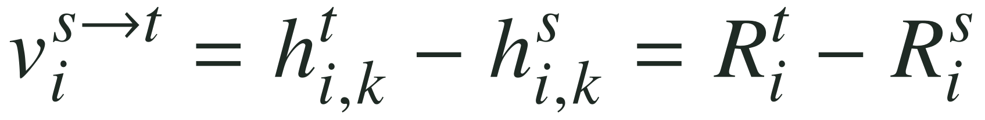
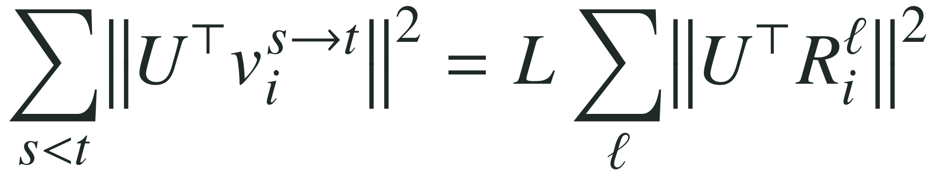
Residuals contain every translation vector
METHOD · DERIVATION · WHY RESIDUALS
A translation vector is the difference of two residuals of the same problem: the problem’s centre cancels.
For any subspace U, summed over all 55 language pairs: the translation energy it captures is exactly L times the residual energy it captures.
So PCA on residuals finds the subspace that captures the most translation movement, without enumerating all 55 pairs for each problem.
With each residual normalized (step 2), the fit becomes angular: every problem–language pair counts once, however large its activation. The identity is then approximate rather than exact.
Notes:
TIME: 1:00 on this slide | ends at 9:25 | 109 words = ~47 s of speech at 140 wpm; the rest of the budget is pauses and pointing
SAY:
Here is why residuals are the right thing to fit. Any translation vector, the difference between two renderings of the same problem, is a difference of two residuals: the problem's centre cancels.
And it goes further. Sum over all 55 language pairs, and the energy any subspace captures from the translation vectors is exactly L times the energy it captures from the residuals. So fitting PCA to the residuals is the same as finding the subspace that captures the most translation movement, without ever enumerating the pairs.
Normalizing each residual makes the fit angular, so a few large activations cannot dominate; the identity then holds approximately rather than exactly.
IF ASKED (Q&A, not timed):
- The identity is the standard one for pairwise differences: for vectors x_1..x_L with mean x-bar and any linear map P, sum over s<t of ||P(x_t - x_s)||^2 = L * sum over l of ||P(x_l - x-bar)||^2. We checked it numerically.
- This is also why the capture test on held-out translation vectors is a fair test of DiffPCA: it is fitted on residuals but evaluated on pairwise differences, and the two are tied by this identity only on the fitting problems.
SOURCES:
Derivation from the definitions in paper Section 3.2 (Eq. 1 and the DiffPCA residuals).

Slide 11
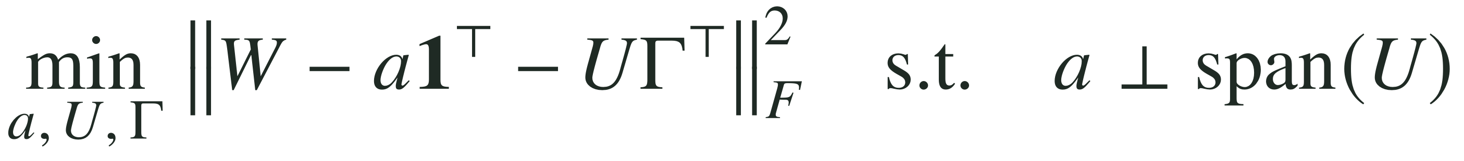
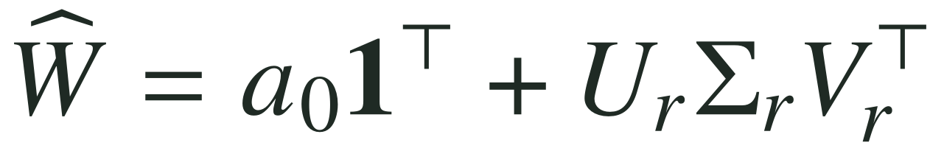
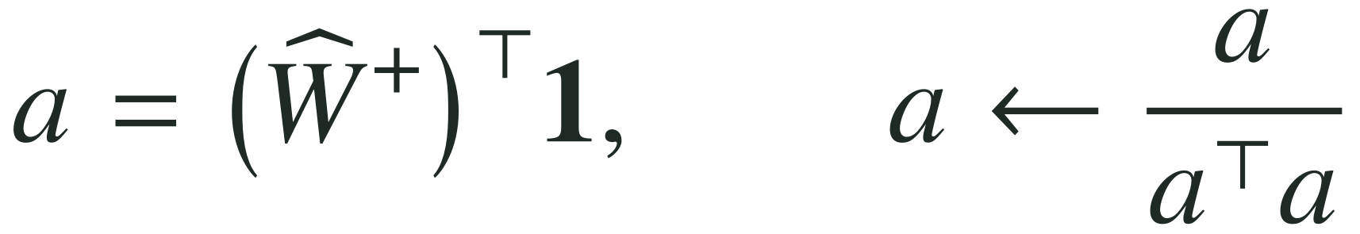
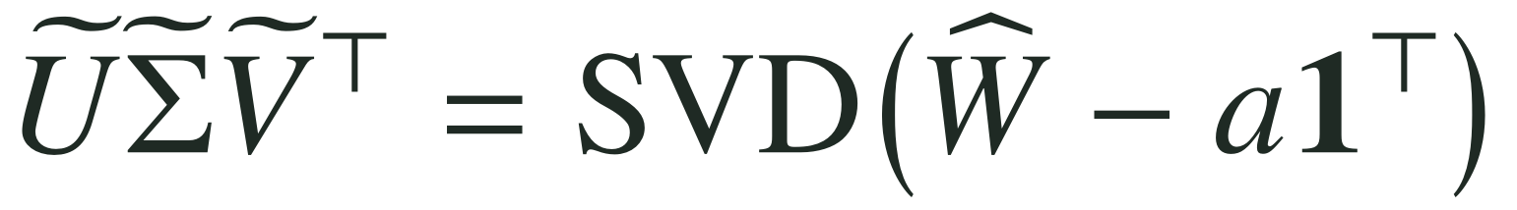
Mean-SVD: average first, then factorize
METHOD · DERIVATION · MEAN-SVD (ZHAO ET AL.)
GOAL
a shared anchor a, plus r language directions orthogonal to it
Approximate the language means at rank r
1
One mean per language over 7,500 problems: problem identity is averaged away.
2
Center the 11 means; factorize their offsets.
3
Keep a rank-r approximation of the means.
Refine the shared anchor and recover the language basis
4
The anchor: every language mean has the same coordinate along a.
5
Subtract it; what remains is orthogonal to a.
6
The language basis. With L = 11 means, r ≤ 10.
Notes:
TIME: 1:10 on this slide | ends at 10:35 | 134 words = ~58 s of speech at 140 wpm; the rest of the budget is pauses and pointing
SAY:
Now the contrast, Zhao et al.'s Mean-SVD. The goal is a common-specific decomposition: write the matrix of language means as a shared anchor plus r language directions orthogonal to it.
Step one averages each language over all 7,500 problems, giving eleven mean vectors, the columns of W. Problem identity is gone at this point. Steps two and three centre those means and keep a rank-r approximation of their offsets.
Step four is the clever part. The pseudoinverse finds the direction along which every language mean has exactly the same coordinate. That shared component is the language-agnostic anchor. Step five subtracts it and factorizes what is left, which is orthogonal to the anchor by construction. The top r left singular vectors are the language basis, and with only eleven means, r is at most ten.
IF ASKED (Q&A, not timed):
- Why a / (a^T a)? a* = (W-hat^+)^T 1 is the minimum-norm solution of W-hat^T a* = 1, so every mean has the same coordinate 1/||a*|| along a*. Rescaling to a*/||a*||^2 makes a exactly that shared component, so W-hat - a 1^T has zero component along it. We verified this numerically.
- This is the decomposition Zhao et al. take from common-specific low-rank work (Piratla et al., 2020; Xie et al., 2022); we reproduce their released implementation.
- The output is the language basis U-tilde_r, not the anchor a.
SOURCES:
Paper Table 3(a) (arXiv:2611.05278); Zhao et al. (2025), Section 2.1 and Algorithm 1.

Slide 12
Subspaces transfer to MGSM, but capture only part
Q1 · CAPTURE
Share of an MGSM translation vector inside a rank-10 span fitted on MATH (%)
Mean-SVD
DiffPCA
trough
Qwen2.5-7B
Qwen3-8B
R1-Distill-7B
GLM-Z1-9B
relative depth: first layer (0) to last layer (1)
24–46%
41–61%
≈ 0.3%
of an MGSM translation vector inside the MATH-fitted span, at the trough
on held-out MATH problems, the fitting corpus
for a random rank-10 span at the same layer
Notes:
TIME: 1:10 on this slide | ends at 11:45 | 142 words = ~61 s of speech at 140 wpm; the rest of the budget is pauses and pointing
SAY:
First question. Having learned a subspace on 7,500 MATH problems, does it generalize? We take translation vectors from MGSM, a different corpus with professional translations, and ask what share of each lies inside a rank-ten span. Each panel is one model; the x-axis is depth; blue is Mean-SVD, orange dashed is DiffPCA.
Three things. The span transfers: far above the 0.3 percent a random span gets. The two constructions trace almost the same curve. And capture varies with depth the same way in all four models: it falls through the middle of the network and rises toward the output, with a trough, the circles, about half to two-thirds of the way through.
At the trough, a rank-ten span holds 24 to 46 percent of an MGSM translation vector, and 41 to 61 on held-out MATH. Structured, but far from all of it.
IF ASKED (Q&A, not timed):
- MATH and MGSM levels are not directly comparable: fitting size and evaluation corpus both change (paper Figure 1 shows both rows; this slide shows the MGSM row).
- Similar curves do not mean the two constructions find the same directions.
- Rank: DiffPCA at Qwen2.5's layer-18 MATH trough rises from 47.9% (rank 10) to 74.0% (rank 100); random rank 100 is 2.8%. More coverage, but less selectivity.
- Trough = interior minimum of the Mean-SVD curve over 15-95% depth. MGSM: layers 18 (Qwen2.5), 21 (Qwen3), 17 (R1-Distill), 20 (GLM-Z1); 51-67% of depth.
- The trough sits in the band the intervention edits (layers 10-19 for Qwen2.5): translation movement is least concentrated in the span exactly where it is removed.
- MGSM vectors: 250 problems x 55 language pairs, zero-shot prompts; subspaces fitted on all 7,500 MATH problems.
SOURCES:
results/E3/<model>/E3_rank_sweep_mgsm_<model>_n7500.csv (rank 10, rho_perprompt); MATH figures from the _math_ files. Paper Figure 1, Table 5.

Slide 13
The edit: subtract the part inside the subspace
METHOD · EDITING
h′ = h − λ · UU^{T}h
One edit, two uses
Probing (Q2)
λ = 1 at a single layer: remove the span completely, then train language probes on what is left.
h
subspace U
h′ (λ = 1)
Generation (Q3)
Suppress the span in the middle layers and re-amplify it near the output, on the prompt tokens.
UU^{T}h the language part
λ = 1 removes it (probe tests) · 0 < λ < 1 shrinks it · λ < 0 amplifies it
Notes:
TIME: 0:50 on this slide | ends at 12:35 | 93 words = ~40 s of speech at 140 wpm; the rest of the budget is pauses and pointing
SAY:
To ask what removing the span does, we need the edit itself. Given a basis U, it is simple: subtract lambda times the part of the activation that lies inside U. Lambda one removes it completely, a smaller lambda shrinks it, and a negative lambda amplifies it.
We use this one edit in two ways. To probe, we set lambda to one at a single layer and ask what language information is left. To generate, we follow Zhao et al.: suppress in the middle layers and re-amplify near the output. Probing comes first.
IF ASKED (Q&A, not timed):
- In generation, edits act on prompt tokens during prefill and are removed before decoding begins.
- Other operators (oblique LEACE-style, Wiener-style shrinkage) replace UU^T h with a different removal; they come up with the 37-configuration design.
SOURCES:
Paper Sections 5 and 6.1.

Slide 14
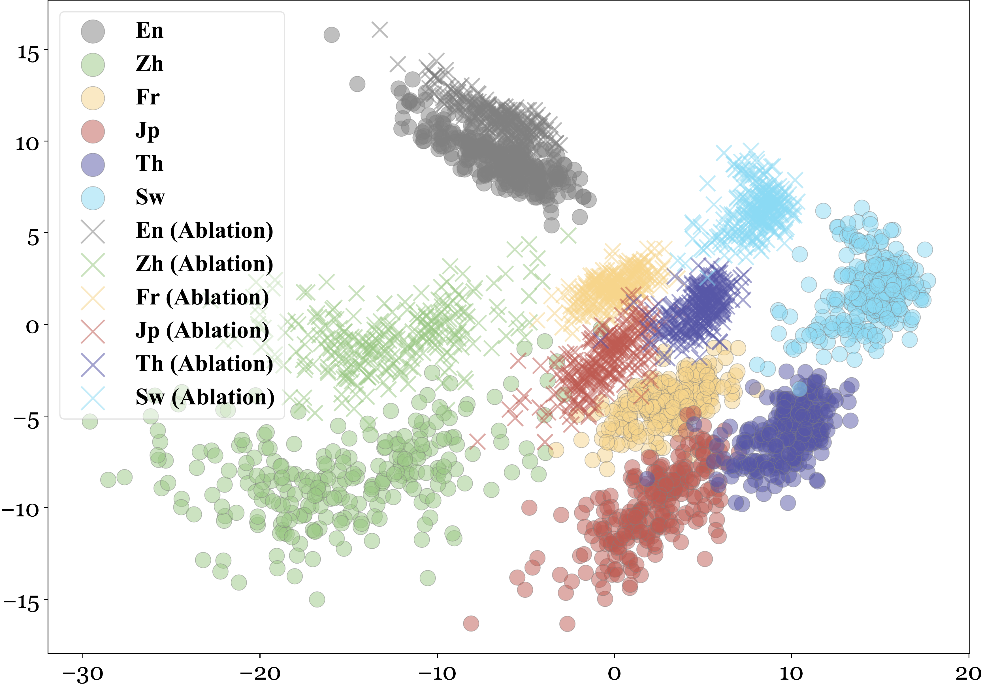
After ablation, do the languages collapse?
Q2 · REMOVE
What Zhao et al. show
After ablation, non-English languages move toward English and the clusters tighten.
But this view is 2 of 3,584 dimensions, and even here the crosses still sit apart by language.
collapsed: no linear boundary
still separable by a line
Our question: in the full space, can a linear probe still tell the languages apart?
PCA of final-token states, Qwen2.5-7B-Instruct, middle layer: circles before, crosses after ablation. Reproduced from Zhao et al. (2025), "When Less Language is More", Fig. 2.
Notes:
TIME: 0:55 on this slide | ends at 13:30 | 103 words = ~44 s of speech at 140 wpm; the rest of the budget is pauses and pointing
SAY:
Second question. Zhao and colleagues checked that their ablation removes language with this picture: a PCA of final-token states in Qwen2.5-7B's middle layer. Circles are before ablation, crosses after. After ablation the non-English languages move toward English and the clusters tighten. It looks as if language has been removed.
But this is two dimensions out of 3,584, and even here the crosses still sit apart by language. So our question: after projecting out the subspace, do all the languages land in one place, where no linear boundary can separate them? Or is enough language identity left over for a probe to find it?
IF ASKED (Q&A, not timed):
- Zhao et al. pair this figure with language fidelity: stronger ablation makes models "increasingly default to English", especially in low-resource languages. They report that trade-off themselves; our joint accuracy scores it on the same responses.
- Their PCA uses their own ablation (Mean-SVD subspace) and shows six of the eleven languages.
FIGURE RIGHTS: Zhao et al. is on arXiv under the default non-exclusive licence, so the authors hold copyright. Same practice as slide 3: full citation on the slide; consider a courtesy note to the authors if the slides are posted publicly.
SOURCES:
Zhao et al. (2025), arXiv:2505.15257, Section 2.3 and Fig. 2 (figs/visualization/visual_mid_qwen25.pdf in the arXiv source).

Slide 15
No collapse: language is still linearly decodable
Q2 · REMOVE
Frozen, Mean-SVD span
Frozen, DiffPCA span
Retrained, either span
Chance
≥ 99.7%
retrained-probe accuracy at every tested layer, rank and strength, in all four models
Frozen probe: the old boundary, which breaks.
Retrained probe: a new linear boundary still separates the languages.
Decodable is not the same as used. Language survives projection; this does not show how generation uses it.
Language-ID accuracy (%), 11 classes · rank-10 span fully projected out (λ = 1) at each model’s trough
Notes:
TIME: 1:10 on this slide | ends at 14:40 | 118 words = ~51 s of speech at 140 wpm; the rest of the budget is pauses and pointing
SAY:
We tested it directly. We project out a rank-ten span completely at each model's trough and train an eleven-way language classifier. The frozen probe keeps its old decision boundary: in blue and orange, projection breaks it, down to 24 to 49 percent for three of four models, against about 9 percent chance. The retrained probe fits a new boundary after projection: the dark bars, at 100 percent. Across every layer, rank and strength, in all four models, it never drops below 99.7, including the middle layers that looked language-shared.
So no collapse: the languages stay linearly separable outside the span. But decodable is not the same as used; this shows the information survives, not how generation uses it.
IF ASKED (Q&A, not timed):
- The Pooled control (no language labels) disrupts the frozen probe about as much (36% / 19% / 29% on Qwen2.5 / Qwen3 / GLM), while a random span leaves it at 100%. So frozen-probe sensitivity reflects structured variance, not necessarily language-specific content.
- The strongest frozen-probe failures are at layers 0-1, not at the capture trough: geometric alignment and readout sensitivity do not pick out the same layer.
- Protocol: logistic regression (C = 1.0), 5-fold GroupKFold over the 250 MGSM problems with all 11 translations kept together; subspaces fit on all 7,500 MATH problems.
- This is a containment test, not concept erasure in the LEACE sense.
SOURCES:
results/E10/<model>/E10_probe_erasure_<model>.csv. Paper Section 5, Figure 2, Appendix D.

Slide 16
Suppress mid-network, amplify late: does it help?
Q3 · IMPROVE · THE DESIGN
Zhao et al.’s schedule, on the prompt tokens during generation
What we vary: 37 configurations
suppress (λ = +0.3)
amplify (λ = −0.3)
How is the subspace built?
Mean-SVD · DiffPCA
prompt
answer
0
10
20
27
How many directions?
Qwen2.5-7B-Instruct, layers 0–27
rank 1 · 4 · 10 · 32
Operating point: Qwen2.5-7B-Instruct on MGSM, 11 languages × 250 problems, greedy decoding, 512-token cap.
How is it edited?
projection · oblique (LEACE-style) · Wiener-style
Are gains coincidental, or do they survive with a pattern across choices?
How hard?
dose 0.5× · 1× · 1.5× · 2× the reference
A cross around Zhao et al.’s reference (Mean-SVD, rank 10, projection, 1×): rank varies at 1×, dose at rank 10. Doses calibrated on MATH.
Notes:
TIME: 1:00 on this slide | ends at 15:40 | 121 words = ~52 s of speech at 140 wpm; the rest of the budget is pauses and pointing
SAY:
Finally, the third question. Does suppressing language in the middle layers and re-amplifying it near the output actually improve performance? Any single configuration could win or lose by chance, so we vary the choices and look for gains that survive with a pattern.
How do you construct the subspace? We try both, DiffPCA and Mean-SVD, at ranks from one to 32. How do you edit the activations? We try three operators: plain projection, an oblique LEACE-style removal, and a Wiener-style shrinkage. And we vary the dose from half to twice the reference. That is 37 configurations around Zhao et al.'s reference setting.
Our operating point is Qwen2.5-7B-Instruct on MGSM, and the question is whether these edits give gains of practical utility.
IF ASKED (Q&A, not timed):
- Why 37 and not a full factorial? It is a cross around the reference: rank varies at the reference dose, dose varies at rank 10. Mean-SVD stops at rank 10, and Mean-SVD Wiener has no rank knob: 6 + 6 + 4 + 7 + 7 + 7 = 37 (paper Appendix B.2).
- "Reference" means our single fixed +0.3 / -0.3 schedule for every language, one point inside Zhao et al.'s coefficient grid; it is not a universal setting they report.
- Operators: projection removes UU^T h; the oblique operator whitens with the pooled covariance before removing the span (LEACE-style); the Wiener-style operator shrinks each direction by its estimated language signal-to-noise ratio.
- Doses target 0.5x, 1.5x and 2x the reference edit energy on MATH activations; no MGSM outcome was seen.
- Edits act on prompt tokens during prefill and are removed before decoding.
SOURCES:
Paper Section 6.1, Appendix B.2 and C; src/e9_grid.py in the release.

Slide 17
Right answer, wrong language: did the task succeed?
Q3 · IMPROVE · THE METRIC
ILLUSTRATIVE RESPONSES, WRITTEN FOR THIS TALK (NOT MODEL OUTPUTS)
SW
The robe problem, asked in Swahili
Correct
Swahili
Joint
Joho hutumia komeo 2 za ufumwele wa buluu na nusu ya kiasi hicho cha ufumwele mweupe. Huwa inatumia jumla ya komeo ngapi?
2 + 2 = 4. Jibu ni 4.
A
✗
✓
✗
in Swahili
B
2 + 1 = 3. The answer is 3.
✓
✗
✗
Correct answer: 3
in English
C
2 + 1 = 3. Jibu ni 3.
✓
✓
✓
Accuracy counts B as a success.
Joint accuracy does not.
in Swahili
Accuracy
correct answer
Fidelity
in the problem’s language
Joint
both, on the same response
Notes:
TIME: 0:55 on this slide | ends at 16:35 | 112 words = ~48 s of speech at 140 wpm; the rest of the budget is pauses and pointing
SAY:
Before the generation results, one metric. Here is the robe problem again, now asked in Swahili. These three responses are illustrative: I wrote them for this talk, and they are not model outputs.
Response A stays in Swahili but gets the arithmetic wrong. Response B gets three, the right answer, but answers in English. Response C gets three, in Swahili.
Standard accuracy counts both B and C as successes. But a Swahili speaker asked in Swahili. If the system answers in English, it has quietly changed the task. So we score joint accuracy: a response counts only if the answer is correct and it stays in the problem's language. Only C passes.
IF ASKED (Q&A, not timed):
- Answer extraction: after any visible reasoning block, native digits mapped to ASCII, last localized answer-field number compared numerically.
- Language ID after stripping math: Unicode script for script-distinct languages (kana -> Japanese; Han, Cyrillic, Bengali, Telugu, Thai); langdetect (seed 0) among de/en/es/fr/sw for Latin script, minimum 8 letters. Unidentifiable responses count as failures (strict).
- Swahili text of A and C: "Jibu ni 4/3" = "The answer is 4/3". Problem text is MGSM item 1, verbatim.
NOTE FOR THE NEXT PASS: real per-response outputs are not in the public release (it ships aggregates only), so this example is invented and labeled as such. Swap in a real response pair only if one is released with the paper.
SOURCES:
Paper Section 6.3 and Appendix C.1.

Slide 18
Most accuracy gains come with language drift
Q3 · IMPROVE
Change in accuracy (points)
12 of 37
Highest accuracy
+2.95 acc · −19.2 fidelity
Best joint
+1.67 acc · −0.5 fid.
configurations raise accuracy
3 of 37
raise joint accuracy, all of them rank 1, the smallest edits
no accuracy gain
accuracy gain only
joint gain
Up = more correct answers
Left = more answers leave the problem’s language
Change in response-language fidelity (points)
Each point: one configuration, Qwen2.5-7B-Instruct on MGSM, averaged over 11 languages × 250 problems, change vs. no intervention. Not shown: 3 DiffPCA rank-32 configurations (accuracy −40 to −52 pts).
Notes:
TIME: 1:10 on this slide | ends at 17:45 | 139 words = ~60 s of speech at 140 wpm; the rest of the budget is pauses and pointing
SAY:
Now the generation grid. Each point is one of the 37 configurations on Qwen2.5, averaged over eleven languages and 250 problems each, plotted as a change from no intervention. Up means more correct answers. Left means more responses leave the problem's language.
Twelve of the 37 configurations raise accuracy: the amber and green points. Many of the amber ones sit far to the left. They gain accuracy while losing ten, twenty, even forty points of language fidelity. The configuration with the highest accuracy, labeled here, gains about three points of accuracy and loses nineteen points of fidelity.
Only three configurations raise joint accuracy, the green triangles, and they all sit in the narrow corner near zero fidelity change. All three are rank one: the smallest edits in the grid.
Three rank-32 configurations fall off the bottom of the chart.
IF ASKED (Q&A, not timed):
- Across the 407 configuration-language cells, 152 have positive accuracy changes and 110 positive joint changes; pooled over languages that is 12 and 3 of 37.
- Truncation: the grid uses a 512-token cap. Baseline Telugu and Bengali responses hit it 78.8% and 36.8% of the time; 112 of 407 cells change truncation by more than 5 points vs. baseline (a sensitivity flag, not a correction).
- Paper Figure 4 gives joint accuracy for all 37 configurations: all three nominal gains are rank 1, and losses grow with rank and with dose.
SOURCES:
results/E9/joint_pooled_Qwen2.5-7B-Instruct.csv (pool = all11; d_correct_vs_clean, d_fid_strict_vs_clean, d_joint_vs_clean). Paper Figure 3.

Slide 19
The only pattern: bigger edits cost more
Q3 · IMPROVE · ACROSS CHOICES
Change in joint accuracy (pts) | rank 1 | rank 4 | rank 10 (ref.) | rank 32 | 0.5× dose | 1.5× dose | 2× dose
Mean-SVD · projection | +1.6 | −15.2 | −12.5 | — | −8.8 | −15.5 | −17.8
Mean-SVD · oblique | −0.3 | −2.8 | −7.3 | — | −2.6 | −7.0 | −7.3
Mean-SVD · Wiener | — | — | −6.7 | — | −3.3 | −6.4 | −6.9
DiffPCA · projection | +0.3 | −26.7 | −25.5 | −57.0 | −19.0 | −30.2 | −35.4
DiffPCA · oblique | +0.3 | −6.7 | −14.6 | −52.5 | −3.4 | −30.7 | −41.3
DiffPCA · Wiener | −0.1 | −11.4 | −14.2 | −45.4 | −5.9 | −20.5 | −26.9
Change in joint accuracy vs. no intervention (points). Rank columns use the reference dose; dose columns use rank 10 ("rank 10 (ref.)" is the 1× dose). Green: above no intervention. Dashes: configurations that do not exist. Qwen2.5-7B-Instruct, MGSM, 11 languages × 250 problems.
Notes:
TIME: 0:55 on this slide | ends at 18:40 | 106 words = ~45 s of speech at 140 wpm; the rest of the budget is pauses and pointing
SAY:
Are the gains a pattern or a coincidence? Here is the whole grid as the change in joint accuracy. Each row is one construction and operator; the columns raise the rank, then the dose.
The one pattern that holds is that bigger edits cost more. Broadly, joint accuracy falls as rank grows and as dose grows, for every construction and operator, down to minus 57 for DiffPCA at rank 32. The only green cells are at rank one, the smallest edits, and two of the three are about a quarter of a point. So the losses follow a pattern you could predict; the gains do not.
IF ASKED (Q&A, not timed):
- "Broadly": a few neighbours are out of order (Mean-SVD projection is -15.2 at rank 4 but -12.5 at rank 10), but every row ends far below where it starts.
- Rank 1 is a near-minimal edit; the five rank-1 configurations change accuracy with SD 0.76 points, a rough noise floor for this grid.
SOURCES:
results/E9/joint_pooled_Qwen2.5-7B-Instruct.csv (pool all11, d_joint_vs_clean). Paper Figure 4; b8_grid.json (rank-1 noise floor).

Slide 20
The top accuracy edit loses on joint accuracy
Q3 · IMPROVE
% | Accuracy | Fidelity | Joint
No intervention | 62.80 | 99.82 | 62.62
Highest-accuracy edit | 65.75 | 80.58 | 53.82
Best joint edit | 64.47 | 99.31 | 64.22
How many of 37 beat no intervention on joint accuracy?
Three, nominally: +1.60, +0.29, +0.25 points.
Only +1.60 has a 95% CI above zero [+0.44, +2.76] and survives Holm correction (p = 0.045).
All were chosen and scored on the same 250 problems: descriptive, not independently confirmed.
Change vs. no intervention, points · both edits are Mean-SVD projections
Highest accuracy: rank 10, half the reference dose. Best joint: rank 1, reference dose.
Notes:
TIME: 1:10 on this slide | ends at 19:50 | 143 words = ~61 s of speech at 140 wpm; the rest of the budget is pauses and pointing
SAY:
Let me put the two labeled configurations side by side. Both are Mean-SVD projections.
The highest-accuracy edit, rank ten at half the reference dose, gains 2.95 points of accuracy. But it loses 19 points of fidelity, so joint accuracy falls by 8.8 points. It produces fewer answers that satisfy the task as posed.
The best joint edit is the simplest one: rank one, plain projection. It gains 1.7 points of accuracy, barely moves fidelity, and improves joint accuracy by 1.6 points.
How many configurations beat no intervention on joint accuracy? Three of 37, by 1.6, 0.29 and 0.25 points. Only the 1.6 has a confidence interval that excludes zero, and it survives Holm correction across the grid. But to be precise: it was selected inside this same grid, on the same 250 problems. It is a descriptive result that still needs independent confirmation.
IF ASKED (Q&A, not timed):
- "The abstract says only one intervention improves joint accuracy": read that as "only one improves it significantly". The released CSV has three nominally positive deltas (+1.60, +0.29, +0.25); the two small ones are DiffPCA rank-1 configurations (oblique and projection) whose 95% intervals include zero and which do not survive Holm.
- Lower-resource languages only (bn, sw, te, th): the same edit gives +1.40 joint, 95% CI [-0.80, +3.60], Holm p = 1.0. Higher-resource seven: +1.71 [+0.34, +3.09], Holm p = 0.068.
- Statistics: 4,000 paired bootstrap replicates over the 250 problem indices; pointwise 95% intervals; Holm across the 37 arms per metric and pool.
- Noise: the five rank-1 configurations are near-minimal edits; their accuracy changes have SD 0.76 points, and the bootstrap over problems does not capture greedy-decode reshuffling. Another reason to want held-out confirmation.
- Absolute numbers: no intervention 62.80 / 99.82 / 62.62; highest-accuracy 65.75 / 80.58 / 53.82; best joint 64.47 / 99.31 / 64.22 (accuracy / fidelity / joint, %).
SOURCES:
results/E9/joint_pooled_Qwen2.5-7B-Instruct.csv: e9_alg1_proj_r10_d050 and e9_alg1_proj_r1_d100 vs clean (pool all11; also high, low). Noise floor: paper/workshop/numbers/b8_grid.json (rank1_noise_floor). Paper Table 1, Appendix C.2-C.3.

Slide 21
Prompt language alone reproduces the trade-off
CONTROL · NO ACTIVATION EDIT
Native prompt
8 worked examples in Swahili
Test problem in Swahili
Answer cue in Swahili
English switch
8 worked examples in English
Test problem in Swahili (unchanged)
Answer cue in English
English switch vs. each model’s native prompt, points, averaged over nine languages (all but English and Chinese)
Generation settings differ from the edit grid: compare within a model only. A similar trade-off does not imply a shared mechanism.
Notes:
TIME: 1:15 on this slide | ends at 21:05 | 174 words = ~75 s of speech at 140 wpm; the rest of the budget is pauses and pointing
SAY:
This trade-off shows up again without any activation edit. To see whether accuracy gains and answering in English go together, we nudge the model toward English through the prompt. We keep the test problem in its original language, but switch the eight worked examples and the answer cue to English.
On the right, for each model, amber is the change in accuracy and green the change in joint accuracy, averaged over nine languages. Accuracy goes up a little in every model: one to two points, and six and a half for GLM. Joint accuracy collapses: minus 40 for Qwen2.5, minus 53 to 65 for Qwen3, minus 56 for GLM. R1-Distill moves least, about minus seven. The answers follow the prompt's language.
So a modest accuracy gain that comes with a shift away from the problem's language can arise from context alone, without touching activations.
Two caveats. These runs use different generation settings from the grid, so compare each model only with its own baseline. And a similar trade-off does not mean a shared mechanism.
IF ASKED (Q&A, not timed):
- Chinese switch, same nine languages: accuracy +3.4 / -1.7 / +0.4 / +2.6 / -0.3 and joint -58 / -63 / -38 / -9 / -53 (Qwen2.5, Qwen3 think, Qwen3 no-think, R1-Distill, GLM).
- Fidelity under the English switch: -65 (Qwen2.5), -80 / -72 (Qwen3), -22 (R1-Distill), -77 (GLM).
- Translate-test (the problem itself in English) adds 14-33 accuracy points, but nearly every answer then leaves the problem's language.
- Changing only the answer cue (examples already in English) adds 2.2 points of accuracy on Qwen2.5.
- Protocols: Qwen2.5 greedy at 1,024 tokens; Qwen3, R1-Distill and GLM sampled at 16,384 tokens; GLM shown at seed 0 (paper Appendix E also reports seed 1).
- Paper Table 2 sets these beside Zhao et al.'s reported gains (+0.94 to +2.40 accuracy). That comparison is diagnostic, not a leaderboard.
SOURCES:
paper/workshop/numbers/intervention_prompt_comparison.json (nine-language pivots; joint from results/E8/promptctl_joint_* and recovered Qwen3 files). Paper Section 7, Table 2, Appendix E.

Slide 22
Asking for the target language restores fidelity
CONTROL · PROMPT ENGINEERING
English switch
8 worked examples in English
Test problem in Swahili
Answer cue in English
English switch + instruction
“Answer in the problem’s language”
8 worked examples in English
Test problem in Swahili
Answer cue in English
GLM-Z1-9B, % over nine languages (all but English and Chinese), mean of two sampling seeds
Tested on GLM-Z1 only. Fidelity and joint accuracy return to native levels; the accuracy gain over native does not hold across seeds.
Notes:
TIME: 0:55 on this slide | ends at 22:00 | 115 words = ~49 s of speech at 140 wpm; the rest of the budget is pauses and pointing
SAY:
However, this loss is not inevitable. On GLM-Z1 we kept the English switch and added a single instruction at the start: answer in the problem's language.
Fidelity, in violet, collapses under the English switch to about 18 percent, and the instruction brings it back to 97, slightly above the native prompt. Joint accuracy, in green, goes from 15 back to 72, level with native. So the language used to elicit the computation and the language used to answer can be partly decoupled with one sentence of prompting.
Two caveats: we tested this on GLM-Z1 only, and it restores fidelity rather than adding accuracy. The accuracy gain over native does not hold across our two seeds.
IF ASKED (Q&A, not timed):
- Per seed (seed 0 / seed 1), nine languages: accuracy native 70.8 / 74.0, English switch 77.3 / 78.0, with instruction 74.6 / 73.9; fidelity 94.5 / 96.3, 17.8 / 18.9, 97.0 / 97.3; joint 70.4 / 73.8, 14.7 / 15.5, 72.5 / 72.0.
- Chinese switch with the same instruction recovers most but not all of the loss: joint 59.7 / 57.6 against native 70.4 / 73.8.
- Two seeds describe sampling stability; they are not a well-powered uncertainty estimate. We did not optimize the instruction; that would turn the analysis into prompt engineering.
SOURCES:
results/E8/promptctl_joint_GLM-Z1-9B-0414_glm-v2-seed{0,1}.csv (clean, en_cot, en_cot_target; nine languages). Paper Section 7 and Appendix E.

Slide 23
Limits, and a different way to edit
LIMITATIONS AND FUTURE DIRECTIONS
Limitations
Future directions
The full exploratory grid used one model, Qwen2.5-7B-Instruct
Math only: MATH and MGSM
Four models, all 7–9B parameters; whether this holds at larger scale is unclear
Configurations chosen and scored on the same 250 problems
Activation editing looks like a bleak prospect here, and LoRA fine-tuning may still be the most reliable route in most settings.
Weight-space programming Takehi, Teoh, Zhang & Khattab (2026)
A frontier LLM reads a model’s weights, diagnoses a failure, and edits the weights directly: no gradients, no new training data.
7.9% → 48.1%
MATH-500, Qwen3.5-0.8B, after removing one diagnosed direction (0.016% of weights)
Their caveat: the edit removed an obstacle (reasoning loops); it could not add an ability the model lacked.
Could a diagnosed, targeted edit lift multilingual reasoning in small models, without new data?
Blog post, 2 November 2026: rikiyat.github.io/blog/weight-space-programming (early results, not peer reviewed)
Notes:
TIME: 1:15 on this slide | ends at 23:15 | 159 words = ~68 s of speech at 140 wpm; the rest of the budget is pauses and pointing
SAY:
Let me end with limitations and where this could go. Our full exploratory grid used one model, Qwen2.5-7B, and everything here is math, on 7-to-9-billion-parameter models. Whether these results hold at larger scale is unclear.
On this evidence, activation editing may look like a bleak prospect, and LoRA fine-tuning may still be the most reliable way to raise performance in most settings. But one recent result is striking. Takehi and colleagues at MIT let a frontier LLM read a small model's weights and edit them directly, with no gradients and no training data. On Qwen3.5-0.8B, it traced reasoning loops to one direction and removed it, touching 0.016 percent of the weights, and MATH-500 rose from 8 to 48 percent. Their own caveat matches ours: the edit removed an obstacle; it could not add an ability the model lacked. Whether a diagnosed, targeted edit can lift multilingual reasoning in small models, without new data, is a question we find exciting.
IF ASKED (Q&A, not timed):
- What exactly they did (Experiment 8): GPT-6 "Astra" worked in a Python session over Qwen3.5-0.8B's weights, with at most 50 forward passes on GSM8K and MATH training problems and no gradients. It traced looping to a direction written by the MLPs of layers 15 and 19 and subtracted it from 64 output columns in each (131,072 weights). MATH-500 7.9 -> 48.1, GSM8K 13.8 -> 67.1, IFEval 21.0 -> 62.3; answers hitting the token limit fell from 93% to 33%.
- Their counter-example: Gemma 3 270M, which rarely loops, did not improve (MATH-500 moved by about a point at most).
- The link to our results: their edit also removes a single direction, but one diagnosed as the cause of a failure, chosen with feedback, and made in the weights. Our language subspace is a generic removal chosen in advance. Note that long or truncated answers are a big part of the low-resource failures we saw (78.8% of baseline Telugu answers hit our 512-token cap), though we have not checked whether those are loops.
- We did not run LoRA or any fine-tuning in this paper; the LoRA remark is a judgement, not a result.
SOURCES:
Takehi, Teoh, Zhang & Khattab (MIT CSAIL), "Sparks of Weight-Space Programming: LLMs can natively read & write neural network weights", blog post, 2 November 2026, https://rikiyat.github.io/blog/weight-space-programming/ (Experiment 8 and the Gemma 3 270M follow-up). Limitations: paper Limitations section.

Slide 24
Thank you
Questions welcome.
Code, released results and reproduction guide
github.com/pungyman/BeyondAccuracy
Shaanil Punglia · Dadhichi Telwadkar · Vaibhav Rathore · Siddharth Sureka · Neha Bhargava
Notes:
TIME: 0:05 on this slide | ends at 23:20 | 16 words = ~7 s of speech at 140 wpm; the rest of the budget is pauses and pointing
SAY:
Thank you. The code and released results are at this link. I'm happy to take questions.

