Slide 1
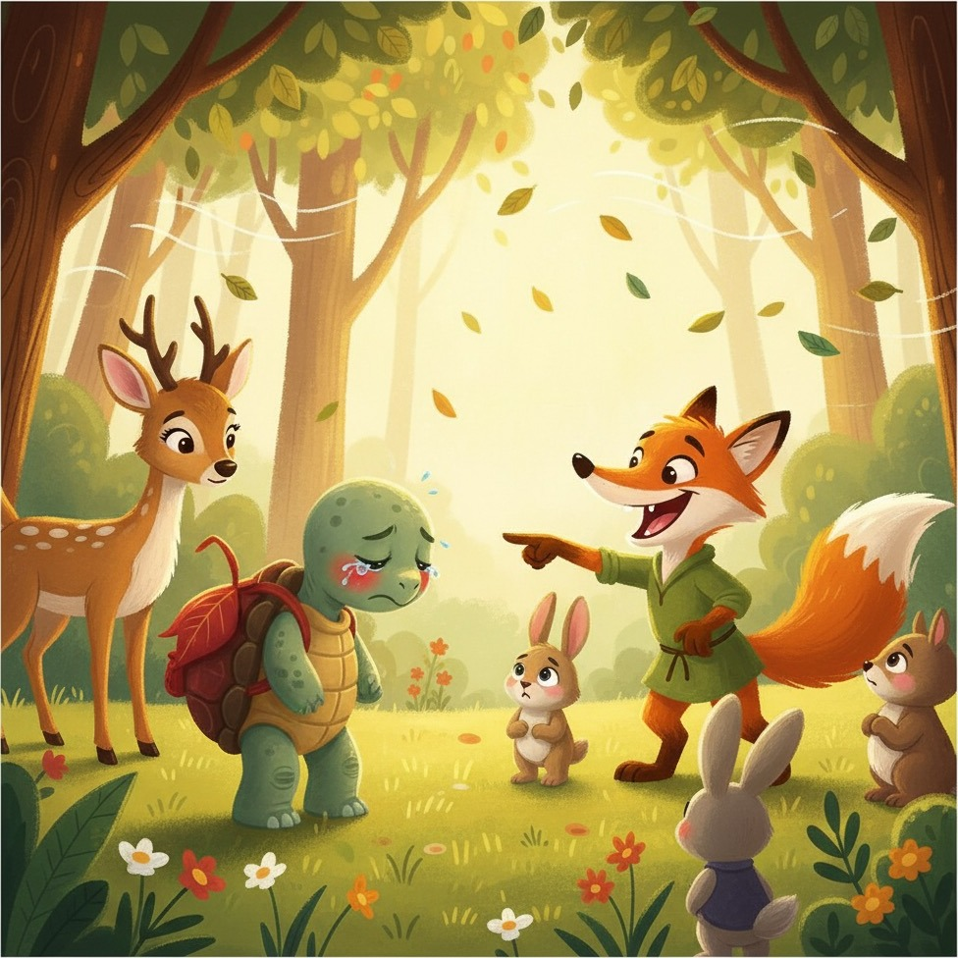
A Multi-Modal Interactive
Narrative Game
for French-Speaking Primary School Learners
Qiao Wang¹, Adnan Labib², Thierry Geoffre³, Yixuan Huang⁴, Zheng Yuan⁵
¹ Hosei University, Japan ² King’s College London, UK ³ University of Luxembourg
⁴ Waseda University, Japan ⁵ University of Sheffield, UK
Notes:
Introduce the system and the classroom feasibility study. The participants were French-speaking primary pupils, so frame this talk around French literacy.
Source: supplied manuscript main.tex, title and abstract. Figures and numerical results come from the supplied LaTeX archive.
References used in this deck: [1] https://arxiv.org/abs/2412.10582
[2] https://arxiv.org/abs/2601.18785
[3] https://aclanthology.org/2025.emnlp-demos.31/
[4] https://doi.org/10.1007/s10648-023-09842-1
[5] https://doi.org/10.1145/361598.361623
[6] https://doi.org/10.2307/249008
[8] https://doi.org/10.1145/3641519.3657430
[9] https://doi.org/10.1609/aaai.v39i7.32728

Slide 2
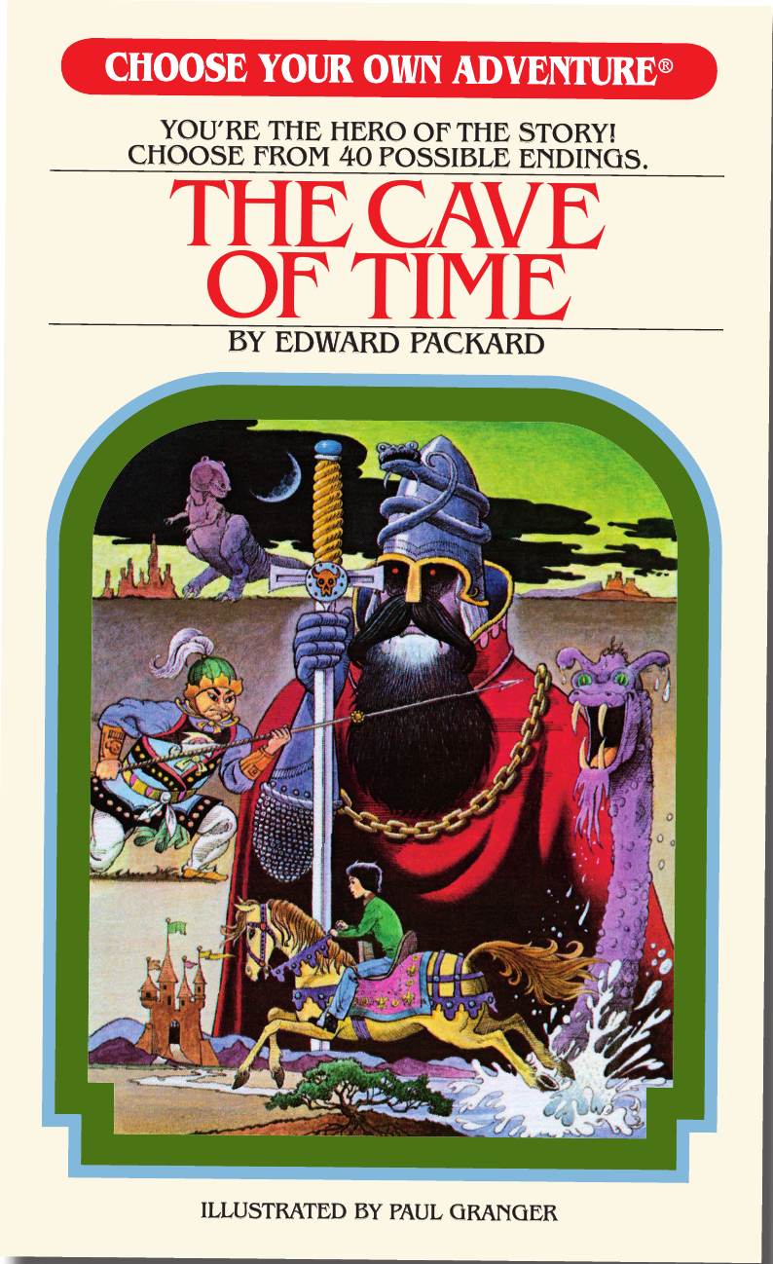
INTERACTIVE NARRATIVE
Stories shaped by reader choices
Scene 1
Choice A
Choice B
Interactive narrative
A narrative unfolds in response to the reader’s decisions.
Choices influence plot progression and possible outcomes.
Scene 2A
Scene 2B
A1
A2
B1
B2
Ending 1
Ending 2
Ending 3
Ending 4
Branching story flow
↓
Illustrative structure, based on [1]
Traditional example: Choose Your Own Adventure
The author pre-writes the available branches, which limits the available story paths.
Cover: E. Packard, The Cave of Time.
Chooseco, 2025. Publisher sell sheet.
Notes:
Explain the distinction between a fixed reading sequence and choice-based storytelling. Traditional branches remain limited by what the author has written.
Source: supplied manuscript main.tex, Introduction. Figures and numerical results come from the supplied LaTeX archive.
References used in this deck: [1] https://arxiv.org/abs/2412.10582
[2] https://arxiv.org/abs/2601.18785
[3] https://aclanthology.org/2025.emnlp-demos.31/
[4] https://doi.org/10.1007/s10648-023-09842-1
[5] https://doi.org/10.1145/361598.361623
[6] https://doi.org/10.2307/249008
[8] https://doi.org/10.1145/3641519.3657430
[9] https://doi.org/10.1609/aaai.v39i7.32728
Added visual credits: Branching diagram is an illustrative schematic based on Huang, Martin, and Callison-Burch (2024), WHAT-IF, https://arxiv.org/abs/2412.10582. It does not reproduce the plot of The Cave of Time. Book cover: Edward Packard, The Cave of Time, illustrated by Paul Granger, Chooseco, 2025 edition, ISBN 9781933390796. Original cover image extracted from the publisher sell sheet: https://www.penguinrandomhouseretail.com/wp-content/uploads/2025/03/CYOA_The_Cave_of_Time_SellSheet_2025.pdf. Publisher page: https://www.cyoa.com/books/the-cave-of-time/.

Slide 3

LLM-POWERED NARRATIVES
Story continuations on demand
LLMs generate the next scene in response to player input
WHAT-IF [1]
Source story
Meta-prompting creates alternative trajectories at key decisions in an existing linear plot: Iron Man
Dramamancer [2]
Author-created schema
An LLM turns defined characters, events, and constraints into player-driven playthroughs.
Both reduce the need to pre-write every branch
A dedicated venue: the Wordplay workshop at EMNLP 2025
Wordplay: When Language Meets Games · wordplay-workshop.github.io
Notes:
LLMs reduce the need to pre-write every branch. WHAT-IF still needs a source text, while schema-driven systems require authoring. Avoid implying that every prior system has identical limitations. References: WHAT-IF and Dramamancer as cited in mybibliography.bib.
Source: supplied manuscript main.tex, Introduction and Related Work. Figures and numerical results come from the supplied LaTeX archive.
References used in this deck: [1] https://arxiv.org/abs/2412.10582
[2] https://arxiv.org/abs/2601.18785
[3] https://aclanthology.org/2025.emnlp-demos.31/
[4] https://doi.org/10.1007/s10648-023-09842-1
[5] https://doi.org/10.1145/361598.361623
[6] https://doi.org/10.2307/249008
[8] https://doi.org/10.1145/3641519.3657430
[9] https://doi.org/10.1609/aaai.v39i7.32728
LLM-powered interactive narrative now has its own research venue: the 5th Wordplay: When Language Meets Games workshop at EMNLP 2025 (Suzhou, 9 Nov 2025), https://wordplay-workshop.github.io/

Slide 4



LIMITATIONS OF PRIOR SYSTEMS
Gaps for young language learners
01 Requires existing stories
WHAT-IF branches from a pre-written source story [1].
02 Requires authoring
Authors or players must first define characters and scenes [2, 3].
03 Not designed for language learning
No proficiency alignment and no built-in language-learning features.
Notes:
Three gaps motivate GenQuest. First, branching systems such as WHAT-IF presuppose a high-quality pre-written source story. Second, schema-driven systems such as Dramamancer ask authors to define characters, events, and constraints, and Open-Theatre asks players to configure story settings and character profiles before typing to drive the plot. Third, these systems are not designed around pedagogical goals: they do not align generated language with the player's proficiency, and they lack learning features such as language support.
Source: supplied manuscript main.tex, Related Work.

Slide 5



GENQUEST
Pedagogical design for French literacy
Story genre
Fables
Accessible narrative structure, conventional roles, and an explicit moral.
Proficiency setting
French reading
Five curriculum-informed bands condition the generated language.
Language scaffolds
Assistant + quiz
A language assistant explains selected text and creates a recall quiz.
A modular design may extend to other genres and language contexts
Notes:
Use GenQuest as the system label from the handwritten outline. The current evaluation concerns French fables. Extension to other languages or proficiency frameworks remains a proposal requiring validation.
Source: supplied manuscript main.tex, System Design and Development. Figures and numerical results come from the supplied LaTeX archive.
References used in this deck: [1] https://arxiv.org/abs/2412.10582
[2] https://arxiv.org/abs/2601.18785
[3] https://aclanthology.org/2025.emnlp-demos.31/
[4] https://doi.org/10.1007/s10648-023-09842-1
[5] https://doi.org/10.1145/361598.361623
[6] https://doi.org/10.2307/249008
[8] https://doi.org/10.1145/3641519.3657430
[9] https://doi.org/10.1609/aaai.v39i7.32728

Slide 6
Five curriculum-informed proficiency bands
GENQUEST · READING LEVEL
Band | Language target
1 | Very short sentences and concrete, frequent words
2 | Basic subordination and explicit cause and effect
3 | Participial structures and more varied vocabulary
4 | Fluent narration with light abstract language
5 | Condensed literary language and richer vocabulary
Learners compare five samples and choose a comfortable level
Notes:
A certified French teacher helped develop the bands and annotated fable examples. Prompts use these examples to condition subsequent generation. The participating Grade 4 pupils corresponded to band 3. Generated scenes were not audited independently for compliance.
Source: supplied manuscript main.tex, Pedagogical Features, System Architecture, and Appendix Five proficiency bands. Figures and numerical results come from the supplied LaTeX archive.
References used in this deck: [1] https://arxiv.org/abs/2412.10582
[2] https://arxiv.org/abs/2601.18785
[3] https://aclanthology.org/2025.emnlp-demos.31/
[4] https://doi.org/10.1007/s10648-023-09842-1
[5] https://doi.org/10.1145/361598.361623
[6] https://doi.org/10.2307/249008
[8] https://doi.org/10.1145/3641519.3657430
[9] https://doi.org/10.1609/aaai.v39i7.32728

Slide 7
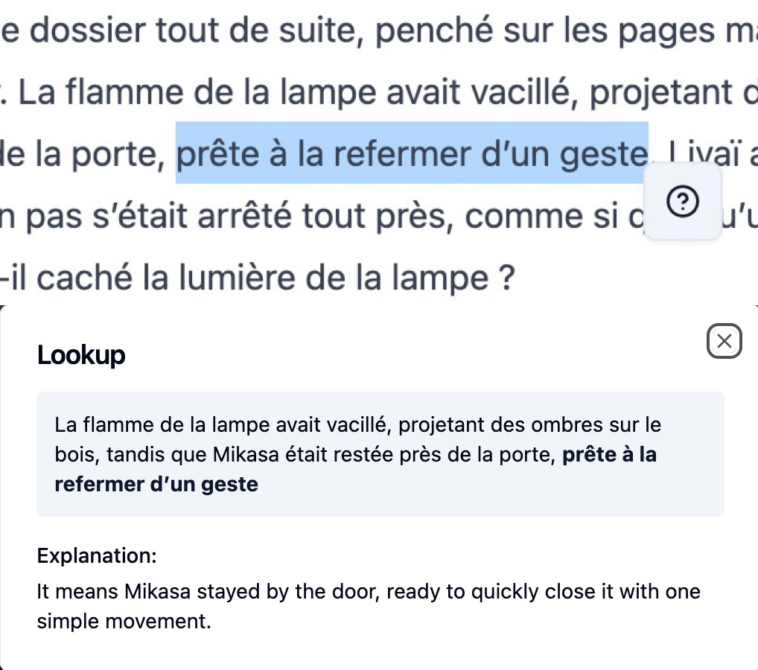
GENQUEST · LANGUAGE SCAFFOLDING
Language support during and after reading
1 Select text
A word, phrase, or sentence in the story.
↓
2 Read an explanation
A contextual explanation in French or English.
↓
3 Recall queried items
Saved queries form an optional recall quiz.
Notes:
Demonstrate selecting a word, phrase, or sentence and clicking the question mark. At least one query is required for the quiz. The LLM awards 0, 0.5, or 1 per response, and the system divides the total by the number of attempted questions. These are automated scores, not validated learning measures. Figure: languagequery.JPG.
Source: supplied manuscript main.tex, Pedagogical Features and System Architecture. Figures and numerical results come from the supplied LaTeX archive.
References used in this deck: [1] https://arxiv.org/abs/2412.10582
[2] https://arxiv.org/abs/2601.18785
[3] https://aclanthology.org/2025.emnlp-demos.31/
[4] https://doi.org/10.1007/s10648-023-09842-1
[5] https://doi.org/10.1145/361598.361623
[6] https://doi.org/10.2307/249008
[8] https://doi.org/10.1145/3641519.3657430
[9] https://doi.org/10.1609/aaai.v39i7.32728

Slide 8
MULTI-MODAL GENERATION · STORY
A story skeleton guides scene generation
1 Story skeleton
Design inspiration: Detroit: Become Human and Heavy Rain
Main characters, milestone events, and a few possible endings.
↓
2 Iterative scene generation
The skeleton, selected reading band, and running story summary.
Each player choice updates the summary used to generate the next scene
Notes:
Separate the planned structure from the generated prose. A summarizer records each scene and decision. After the final decision, an ending generator produces one of the planned conclusions. Model names describe the study configuration.
Source: supplied manuscript main.tex, Multi-Modal Story Generation and System Architecture. Figures and numerical results come from the supplied LaTeX archive.
References used in this deck: [1] https://arxiv.org/abs/2412.10582
[2] https://arxiv.org/abs/2601.18785
[3] https://aclanthology.org/2025.emnlp-demos.31/
[4] https://doi.org/10.1007/s10648-023-09842-1
[5] https://doi.org/10.1145/361598.361623
[6] https://doi.org/10.2307/249008
[8] https://doi.org/10.1145/3641519.3657430
[9] https://doi.org/10.1609/aaai.v39i7.32728

Slide 9
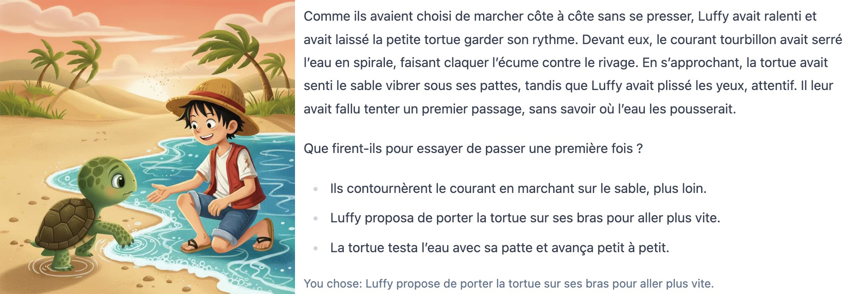
Illustrations follow the narrative context [4]
MULTI-MODAL GENERATION · ILLUSTRATIONS
Inputs to image generation
Current scene description + Story summary + Previous illustration
Notes:
The study used Gemini 2.5 Flash for illustrations. This actual gameplay example shows a pair personalizing a fable with Luffy from One Piece. It illustrates the free-text customization used in class, not a standard character required by the system. Figure: sceneexample.jpeg.
Source: supplied manuscript main.tex, Multi-Modal Story Generation and Experimental Procedures. Figures and numerical results come from the supplied LaTeX archive.
References used in this deck: [1] https://arxiv.org/abs/2412.10582
[2] https://arxiv.org/abs/2601.18785
[3] https://aclanthology.org/2025.emnlp-demos.31/
[4] https://doi.org/10.1007/s10648-023-09842-1
[5] https://doi.org/10.1145/361598.361623
[6] https://doi.org/10.2307/249008
[8] https://doi.org/10.1145/3641519.3657430
[9] https://doi.org/10.1609/aaai.v39i7.32728

Slide 10
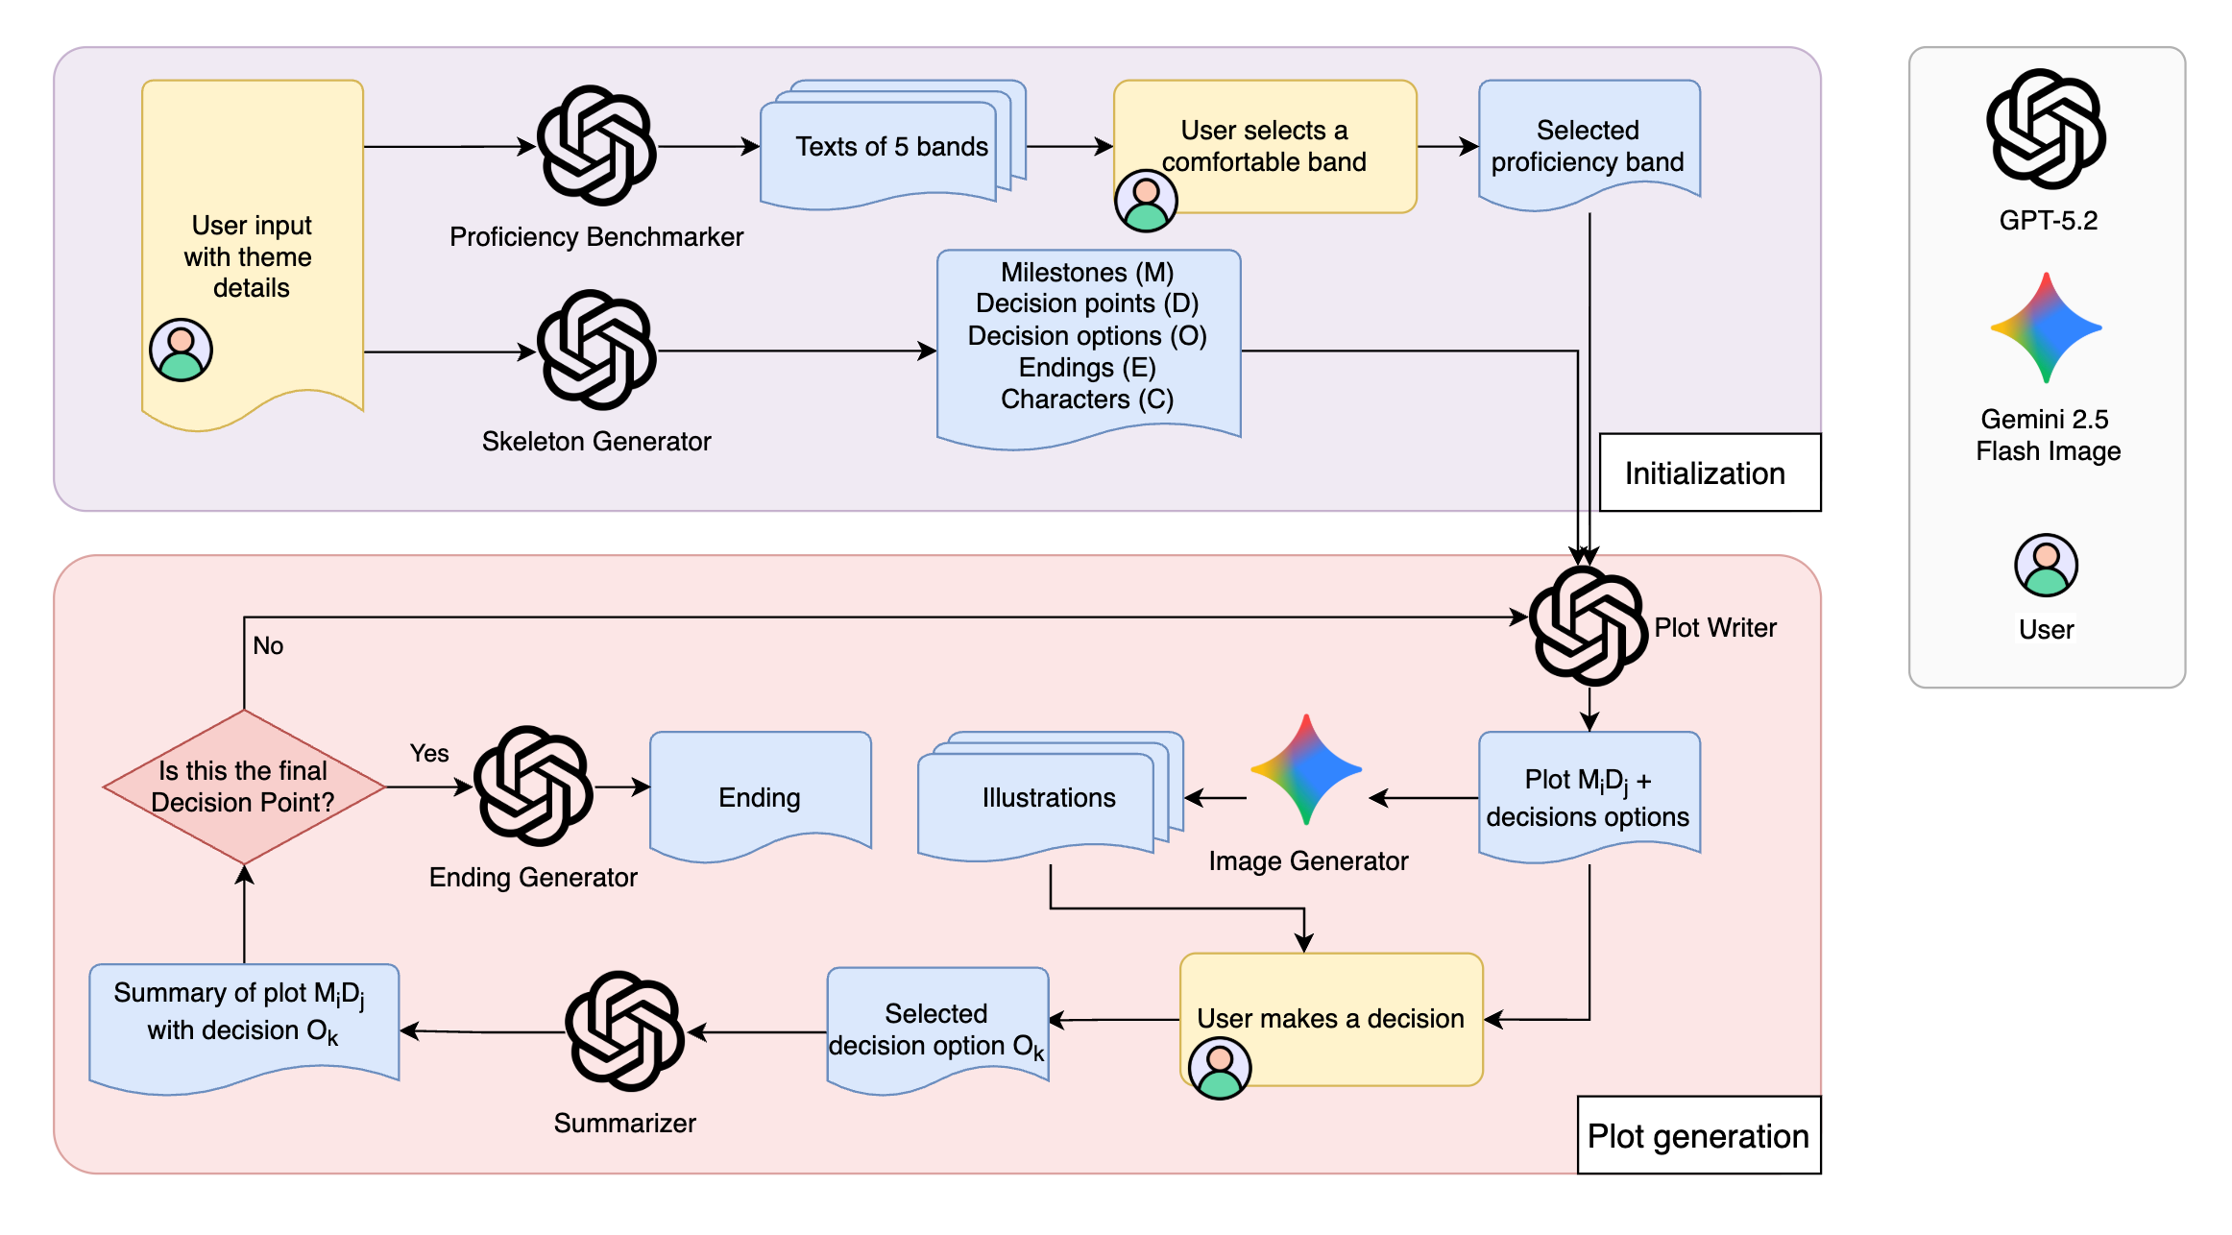
GENQUEST · SYSTEM ARCHITECTURE
The language-scaffolding module runs alongside story generation [5]
Notes:
Walk through the diagram: user input initializes proficiency sampling and the story skeleton. Plot Writer generates a scene, Image Generator adds an illustration, and the learner selects an option. Summarizer updates the context until Ending Generator closes the story. The separate language assistant logs queries and generates the optional quiz. Frontend: Vue.js. Backend: Django. Figure: storygenerator.png.
Source: supplied manuscript main.tex, System Architecture. Figures and numerical results come from the supplied LaTeX archive.
References used in this deck: [1] https://arxiv.org/abs/2412.10582
[2] https://arxiv.org/abs/2601.18785
[3] https://aclanthology.org/2025.emnlp-demos.31/
[4] https://doi.org/10.1007/s10648-023-09842-1
[5] https://doi.org/10.1145/361598.361623
[6] https://doi.org/10.2307/249008
[8] https://doi.org/10.1145/3641519.3657430
[9] https://doi.org/10.1609/aaai.v39i7.32728

Slide 11
USER STUDY
Participants and classroom procedure
Classroom context
35 pupils, ages 9–10
Grade 4, expected band 3
2 teachers at 2 schools
French-speaking Switzerland
Native speakers or educated in French since Grade 1
One 50-minute session per class
1 Teacher introduces the game and pairs pupils on shared accounts.
2 Pairs test a story, personalize the context, and complete a fable.
3 Pupils answer a TAM-based user survey, then the teacher completes a survey.
Notes:
Teachers had more than 15 years of primary teaching experience. Pairing reduced simultaneous live-generation requests. Teachers encouraged theme and scene-detail customization. This was a feasibility evaluation, with no baseline, comparison group, or delayed assessment.
Source: supplied manuscript main.tex, System Validation, Participants, and Experimental Procedures. Figures and numerical results come from the supplied LaTeX archive.
References used in this deck: [1] https://arxiv.org/abs/2412.10582
[2] https://arxiv.org/abs/2601.18785
[3] https://aclanthology.org/2025.emnlp-demos.31/
[4] https://doi.org/10.1007/s10648-023-09842-1
[5] https://doi.org/10.1145/361598.361623
[6] https://doi.org/10.2307/249008
[8] https://doi.org/10.1145/3641519.3657430
[9] https://doi.org/10.1609/aaai.v39i7.32728

Slide 12
DATA ANALYSIS
Evidence sources and analysis
Evidence | Analysis | Unit
TAM-based student items [6] | Cronbach’s alpha Item means and SDs | Individual pupil
Open responses and drawings | Thematic coding by two coders | Pupil / teacher
Vocabulary-query and quiz logs | Query counts and automated quiz scores | Shared account
Student survey: 3 usefulness + 3 ease-of-use items on a 1–7 scale
Notes:
The study collected individual pupil survey responses, two teacher surveys, and backend logs. Six accounts completed the optional quiz, so the manuscript reports descriptive statistics without inferential tests. TAM reference: Davis (1989), as cited in the manuscript.
Source: supplied manuscript main.tex, Survey Instruments and Data Collection and Analysis. Figures and numerical results come from the supplied LaTeX archive.
References used in this deck: [1] https://arxiv.org/abs/2412.10582
[2] https://arxiv.org/abs/2601.18785
[3] https://aclanthology.org/2025.emnlp-demos.31/
[4] https://doi.org/10.1007/s10648-023-09842-1
[5] https://doi.org/10.1145/361598.361623
[6] https://doi.org/10.2307/249008
[8] https://doi.org/10.1145/3641519.3657430
[9] https://doi.org/10.1609/aaai.v39i7.32728

Slide 13
High ease of use, moderate perceived usefulness
RESULTS · STUDENT SURVEY
N = 35. Scale: 1 = strongly disagree, 7 = strongly agree
PU reliability: α = 0.77 PEOU reliability: α = 0.69 [7]
Notes:
These are shortened item labels. PU1: Using the game in my French class may enable me to learn to better read and understand texts. PU2: Using the game may improve my French performance. PU3: I find the game useful in learning French. PEOU1: Learning to play the game was easy for me. PEOU2: My interaction with the game was clear and understandable. PEOU3: I found the game clear and understandable. Marginal consistency for PEOU supports an item-level interpretation. These are perceptions, not learning gains.
Source: supplied manuscript main.tex, Result, Player Survey, Table Descriptive statistics for the TAM questionnaire items. Figures and numerical results come from the supplied LaTeX archive.
References used in this deck: [1] https://arxiv.org/abs/2412.10582
[2] https://arxiv.org/abs/2601.18785
[3] https://aclanthology.org/2025.emnlp-demos.31/
[4] https://doi.org/10.1007/s10648-023-09842-1
[5] https://doi.org/10.1145/361598.361623
[6] https://doi.org/10.2307/249008
[8] https://doi.org/10.1145/3641519.3657430
[9] https://doi.org/10.1609/aaai.v39i7.32728
Standard deviations (shown in the manuscript table): PU1 1.75, PU2 1.79, PU3 2.08, PEOU1 1.57, PEOU2 1.53, PEOU3 1.64.

Slide 14
RESULTS · THEME 1
Student reactions to the stories
Coded open responses about the stories
24
positive responses
3
negative views
2
reports of technical problems
Technical qualification
One pupil saw “only the beginning of a story”. Two games froze during live generation.
Notes:
The counts summarize coded responses and do not account for every student or form mutually exclusive exhaustive categories. The manuscript connects the beginning-only comment with the two observed freezes. Keep this as an operational limitation.
Source: supplied manuscript main.tex, Result, Player Survey, Open-ended questions and Discussion. Figures and numerical results come from the supplied LaTeX archive.
References used in this deck: [1] https://arxiv.org/abs/2412.10582
[2] https://arxiv.org/abs/2601.18785
[3] https://aclanthology.org/2025.emnlp-demos.31/
[4] https://doi.org/10.1007/s10648-023-09842-1
[5] https://doi.org/10.1145/361598.361623
[6] https://doi.org/10.2307/249008
[8] https://doi.org/10.1145/3641519.3657430
[9] https://doi.org/10.1609/aaai.v39i7.32728

Slide 15
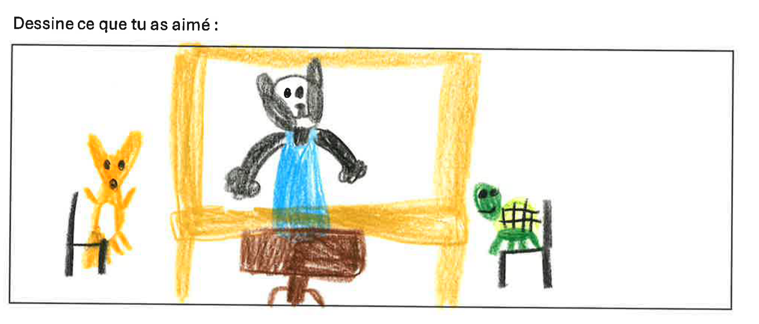
Illustrations attracted positive responses
RESULTS · THEME 2
Reactions to illustrations
23 positive responses, 5 neutral
3 pupils reported inconsistent characters.
1 noted similar images across scenes.
A pupil’s drawing of a favorite illustration
Notes:
The right-hand image is a student drawing of a favorite illustration. Counts represent coded responses and should not be added into a denominator. One mismatch comment described asking for a hare and receiving a goat. Figure: studentillustration.png.
Source: supplied manuscript main.tex, Result, Player Survey, Open-ended questions and Appendix Example of students’ favorite illustrations. Figures and numerical results come from the supplied LaTeX archive.
References used in this deck: [1] https://arxiv.org/abs/2412.10582
[2] https://arxiv.org/abs/2601.18785
[3] https://aclanthology.org/2025.emnlp-demos.31/
[4] https://doi.org/10.1007/s10648-023-09842-1
[5] https://doi.org/10.1145/361598.361623
[6] https://doi.org/10.2307/249008
[8] https://doi.org/10.1145/3641519.3657430
[9] https://doi.org/10.1609/aaai.v39i7.32728

Slide 16
RESULTS · THEME 3
Reading difficulty and selected level
Student perceptions
14 described the stories as easy or too easy.
9 described the difficulty as fair.
Reading band (1 = easiest, 5 = hardest)
Band 1
Band 2
Band 3
Band 4
Band 5
Most gameplay
Expected for Grade 4
Self-selection often produced a lower level of challenge
Notes:
Treat the proposed explanation as an interpretation, not a tested causal claim. The manuscript gives no complete distribution of selected bands or challenge ratings, so do not convert these counts to percentages.
Source: supplied manuscript main.tex, Result, Player Survey and Discussion. Figures and numerical results come from the supplied LaTeX archive.
References used in this deck: [1] https://arxiv.org/abs/2412.10582
[2] https://arxiv.org/abs/2601.18785
[3] https://aclanthology.org/2025.emnlp-demos.31/
[4] https://doi.org/10.1007/s10648-023-09842-1
[5] https://doi.org/10.1145/361598.361623
[6] https://doi.org/10.2307/249008
[8] https://doi.org/10.1145/3641519.3657430
[9] https://doi.org/10.1609/aaai.v39i7.32728

Slide 17
RESULTS · TEACHER SURVEY
The game as a starting point for literacy lessons
Comprehension activities
Read and predict
Use cause-and-consequence chains to anticipate outcomes.
Discuss and justify
Support interpretations of character feelings with textual evidence.
Writing activities
Write and revise
Create alternative endings or transform narration into dialogue.
Improve the draft
Add vivid description and humor to a flat or repetitive style.
Teachers described the text as a “base draft” for further classroom work
Notes:
Both teachers mentioned using the text as a base draft. One highlighted anticipation and textual justification. One described the literary style as flat and repetitive, which could support struggling readers while also providing material for revision by stronger readers. These are teacher perceptions, not measured pedagogical effects.
Source: supplied manuscript main.tex, Teacher Survey. Figures and numerical results come from the supplied LaTeX archive.
References used in this deck: [1] https://arxiv.org/abs/2412.10582
[2] https://arxiv.org/abs/2601.18785
[3] https://aclanthology.org/2025.emnlp-demos.31/
[4] https://doi.org/10.1007/s10648-023-09842-1
[5] https://doi.org/10.1145/361598.361623
[6] https://doi.org/10.2307/249008
[8] https://doi.org/10.1145/3641519.3657430
[9] https://doi.org/10.1609/aaai.v39i7.32728

Slide 18
Exploratory quiz use in six shared accounts
RESULTS · VOCABULARY QUIZ
17 total queries
Mean 0.682
Median 0.67
Range 0.50–0.875
Notes:
Only six self-selected shared accounts used the query function and completed a quiz. Quiz lengths and content varied. The automated grader awarded 0, 0.5, or 1 per item and was not validated against human ratings. Scores cannot establish mastery, gains, retention, or a causal relationship between query frequency and performance. Values follow the manuscript’s reported rounded scores.
Source: supplied manuscript main.tex, Vocabulary Quiz Results and Limitations and Ethical Considerations. Figures and numerical results come from the supplied LaTeX archive.
References used in this deck: [1] https://arxiv.org/abs/2412.10582
[2] https://arxiv.org/abs/2601.18785
[3] https://aclanthology.org/2025.emnlp-demos.31/
[4] https://doi.org/10.1007/s10648-023-09842-1
[5] https://doi.org/10.1145/361598.361623
[6] https://doi.org/10.2307/249008
[8] https://doi.org/10.1145/3641519.3657430
[9] https://doi.org/10.1609/aaai.v39i7.32728

Slide 19



DISCUSSION · OVERALL
Well-received by pupils and teachers
Easy to use
5.7–5.8 out of 7
Ease-of-use items were the highest-rated in the student survey.
Engaging stories
24 positive responses
Open responses about the stories were mostly positive.
Appealing illustrations
23 positive responses
Pupils responded well to the scene-by-scene illustrations.
Teachers saw the generated stories as a base draft for literacy lessons
Notes:
Overall, the validation study suggests that the game was well received by pupils and teachers, particularly because of its engaging stories and illustrations. Ease-of-use items averaged 5.66 to 5.80 on the 7-point scale. In the open responses, 24 comments about the stories were positive and 23 about the illustrations were positive (5 neutral). Both teachers described the generated text as a base draft for further classroom work. The next slide turns to the four main limitations.
Source: supplied manuscript main.tex, Result and Discussion.

Slide 20
DISCUSSION · SYSTEM LIMITATIONS
Four limitations of the system
1 Illustration inconsistency
3 pupils saw characters change between scenes; 1 noticed repeated images.
2 Moderately useful for French learning
Usefulness rated 4.1–4.6 of 7, below ease of use at 5.7–5.8.
3 Vocabulary quiz
Only 6 accounts took it, and the automated grading was not validated.
4 Low uptake of word queries
17 queries in total; pupils picked easy text and rarely asked for help.
The next slides discuss design responses to these limitations
Notes:
Start the discussion with the four main limitations, then discuss the design responses on the following slides.
1. Illustration inconsistency: in the open-ended survey, 3 pupils reported characters that changed between scenes and 1 noted similar images across scenes.
2. Moderately useful for French learning: perceived usefulness items averaged 4.09 to 4.60 on the 7-point scale, compared with 5.66 to 5.80 for ease of use. These are perceptions, not learning gains.
3. Vocabulary quiz: only six self-selected shared accounts completed the optional quiz. The LLM grader awarded 0, 0.5, or 1 per item and was not validated against human ratings.
4. Low uptake of the query function: 17 queries in total across those accounts. Many pupils chose an easier reading level, so they may have needed little vocabulary support; low visibility and avoiding interruptions are other possible explanations.
Source: supplied manuscript main.tex, Result (Player Survey, Vocabulary Quiz Results) and Discussion.

Slide 21
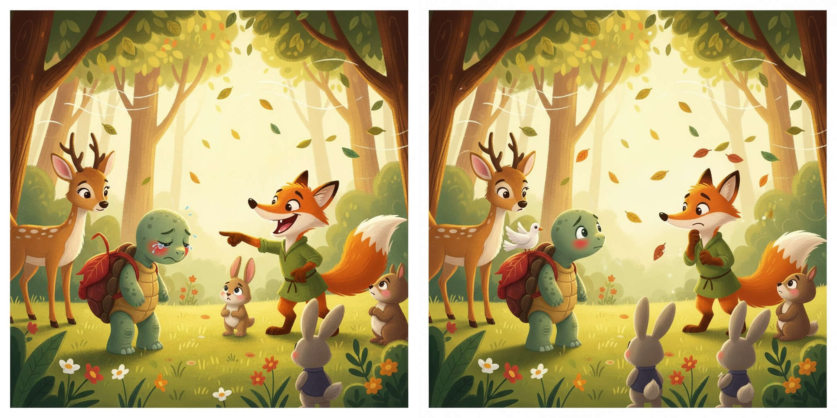
Visual consistency and classroom reliability
DISCUSSION · SYSTEM LIMITATIONS
Observed limitation
Character inconsistency and repeated compositions remain concerns [8, 9].
Proposed response
Track location changes in the skeleton. Cache teacher-reviewed assets and add fallback scenes.
Notes:
The manuscript proposes location tracking and richer transitions to reduce visually repetitive scenes. A hybrid deployment could pre-generate and teacher-vet common stories and illustrations, cache assets, and reserve live calls for constrained personalization and contextual explanations. These changes have not been tested in this study. Figure: similarity.JPG.
Source: supplied manuscript main.tex, Discussion. Figures and numerical results come from the supplied LaTeX archive.
References used in this deck: [1] https://arxiv.org/abs/2412.10582
[2] https://arxiv.org/abs/2601.18785
[3] https://aclanthology.org/2025.emnlp-demos.31/
[4] https://doi.org/10.1007/s10648-023-09842-1
[5] https://doi.org/10.1145/361598.361623
[6] https://doi.org/10.2307/249008
[8] https://doi.org/10.1145/3641519.3657430
[9] https://doi.org/10.1609/aaai.v39i7.32728

Slide 22
DISCUSSION · SYSTEM LIMITATIONS
Reading challenge and uptake of word support
Observed pattern
Many pupils selected easier text. Only six accounts completed a query-based quiz.
↓
Possible explanations
Limited vocabulary need, low feature visibility, or disruption to the story.
↓
Design and evaluation response
Guide the starting level, integrate retrieval prompts, and log each stage of feature use.
Notes:
Possible explanations for low query uptake include easy text, poor discoverability, avoiding interruptions, and the extra effort of a separate quiz. The present study cannot distinguish them. Future logs should record whether pupils see, open, and complete the feature. Delayed quizzes and repeated encounters would enable stronger evaluation.
Source: supplied manuscript main.tex, Discussion. Figures and numerical results come from the supplied LaTeX archive.
References used in this deck: [1] https://arxiv.org/abs/2412.10582
[2] https://arxiv.org/abs/2601.18785
[3] https://aclanthology.org/2025.emnlp-demos.31/
[4] https://doi.org/10.1007/s10648-023-09842-1
[5] https://doi.org/10.1145/361598.361623
[6] https://doi.org/10.2307/249008
[8] https://doi.org/10.1145/3641519.3657430
[9] https://doi.org/10.1609/aaai.v39i7.32728

Slide 23
DISCUSSION · STUDY LIMITATIONS
Limits of the classroom evidence
What the study measured
One session in each of two intact classes.
Short-term feasibility and perceptions.
No baseline, control group, or delayed assessment.
What needs further validation
Generated French and reading-band compliance.
Automated quiz grading and individual learning.
Reliability, moderation, and age-appropriate safeguards.
Learning gains and usefulness for L2 learners remain untested
Notes:
Participants were native French speakers or had French-medium schooling. The study did not systematically evaluate grammaticality, age appropriateness, coherence, harmful content, or model bias. The manuscript describes consent, voluntary participation, data minimization, teacher presence, and disclosure of AI generation. Teacher supervision does not substitute for technical safeguards.
Source: supplied manuscript main.tex, Limitations and Ethical Considerations. Figures and numerical results come from the supplied LaTeX archive.
References used in this deck: [1] https://arxiv.org/abs/2412.10582
[2] https://arxiv.org/abs/2601.18785
[3] https://aclanthology.org/2025.emnlp-demos.31/
[4] https://doi.org/10.1007/s10648-023-09842-1
[5] https://doi.org/10.1145/361598.361623
[6] https://doi.org/10.2307/249008
[8] https://doi.org/10.1145/3641519.3657430
[9] https://doi.org/10.1609/aaai.v39i7.32728

Slide 24
CONCLUSIONS
Interactive fables for French primary literacy
Classroom finding
Positive usability and engagement in a feasibility study
System contribution
A story skeleton combines with reading-level targets, illustrations, and contextual language support.
Pedagogical implication
Teachers can use generated stories as a starting point for wider literacy activities.
Notes:
Close with the distinction between a usable and engaging platform and demonstrated instructional effectiveness. Priorities include reading-level calibration, reliable generation, visual variation, discoverable scaffolding, and longitudinal evaluation. The modular architecture may support other genres and languages after appropriate validation.
Source: supplied manuscript main.tex, Conclusion and Discussion. Figures and numerical results come from the supplied LaTeX archive.
References used in this deck: [1] https://arxiv.org/abs/2412.10582
[2] https://arxiv.org/abs/2601.18785
[3] https://aclanthology.org/2025.emnlp-demos.31/
[4] https://doi.org/10.1007/s10648-023-09842-1
[5] https://doi.org/10.1145/361598.361623
[6] https://doi.org/10.2307/249008
[8] https://doi.org/10.1145/3641519.3657430
[9] https://doi.org/10.1609/aaai.v39i7.32728

Slide 25
REFERENCES
References
[1] R. Huang, L. J. Martin, and C. Callison-Burch, “WHAT-IF: Exploring Branching Narratives by Meta-Prompting Large Language Models,” arXiv:2412.10582, 2024.
[2] T. Wang et al., “Design Techniques for LLM-Powered Interactive Storytelling: A Case Study of the Dramamancer System,” arXiv:2601.18785, 2026.
[3] T. Xu, H. Wu, W. Wu, and H. Zhao, “Open-Theatre: An Open-Source Toolkit for LLM-based Interactive Drama,” in Proc. EMNLP: System Demonstrations, 2025, pp. 453–460.
[4] R. E. Mayer, “The Past, Present, and Future of the Cognitive Theory of Multimedia Learning,” Educational Psychology Review, vol. 36, art. 8, 2024.
[5] D. L. Parnas, “On the Criteria To Be Used in Decomposing Systems into Modules,” Communications of the ACM, vol. 15, no. 12, pp. 1053–1058, 1972.
[6] F. D. Davis, “Perceived Usefulness, Perceived Ease of Use, and User Acceptance of Information Technology,” MIS Quarterly, vol. 13, no. 3, pp. 319–340, 1989.
[7] J. C. Nunnally and I. H. Bernstein, Psychometric Theory, 3rd ed. New York: McGraw-Hill, 1994.
[8] O. Avrahami et al., “The Chosen One: Consistent Characters in Text-to-Image Diffusion Models,” in ACM SIGGRAPH Conference Papers, 2024, pp. 1–12.
[9] F. Shen et al., “Boosting Consistency in Story Visualization with Rich-Contextual Conditional Diffusion Models,” in Proc. AAAI, vol. 39, no. 7, 2025, pp. 6785–6794.
Notes:
Numbered bibliography corresponding to citations [1]–[10] throughout the presentation. Entries use a compact IEEE-style format. Source metadata: supplied mybibliography.bib. https://arxiv.org/abs/2412.10582
https://arxiv.org/abs/2601.18785
https://aclanthology.org/2025.emnlp-demos.31/
https://doi.org/10.1007/s10648-023-09842-1
https://doi.org/10.1145/361598.361623
https://doi.org/10.2307/249008
https://doi.org/10.1145/3641519.3657430
https://doi.org/10.1609/aaai.v39i7.32728

Slide 26

Thank you
Questions welcome
Play the game
atg-fr.judywang.jp
Source code
github.com/judywq/interactive-narrative-game
Notes:
Thank the students and teachers who participated. Invite questions. The repository URL is the source-code link supplied by the manuscript.
Source: supplied manuscript main.tex, Introduction and Acknowledgments. Figures and numerical results come from the supplied LaTeX archive.
References used in this deck: [1] https://arxiv.org/abs/2412.10582
[2] https://arxiv.org/abs/2601.18785
[3] https://aclanthology.org/2025.emnlp-demos.31/
[4] https://doi.org/10.1007/s10648-023-09842-1
[5] https://doi.org/10.1145/361598.361623
[6] https://doi.org/10.2307/249008
[8] https://doi.org/10.1145/3641519.3657430
[9] https://doi.org/10.1609/aaai.v39i7.32728

