Slide 1

Development of an Intelligent Essay-Correction System for International Chinese Language Education
Dan Yuan
dyuan@hanyu.ecnu.edu.cn
School of International Chinese Studies, East China Normal University

Slide 2
1. Introduction
★ Current status of intelligent Chinese essay correction:
(1) Intelligent correction platforms and tools are mainly concentrated in the field of essays written by native-speaking primary and secondary school students. e.g.
“IN Classroom” intelligent education platform (the Intelligent Research Center of the State Language Commission)
“Haoweilai Chinese Essay Correction” (Beijing Century Haoweilai Education Technology Co., Ltd. )
“Xiaohuashi” (East China Normal University);
“Wubi” (a start-up team in Hong Kong, China)
They focus on evaluating essay content, rhetoric and central idea,
but perform poorly in syntactic error correction

Slide 3
(2) Large language models :ChatGPT, iFlytek Spark, ERNIE Bot and DeepSeek can also be used for correction, but they have the following two problems :
A. their so-called correction is in fact polishing, which tends to over-modify sentence patterns and paragraph structure;
B. their performance still depends heavily on user instructions.
Therefore, the market still lacks a high-accuracy, fine-grained online intelligent essay-correction tool for essays written by Chinese-as-a-foreign-language (CFL) learners.

Slide 4

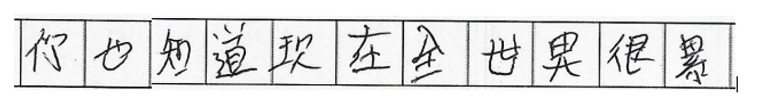
★ Existing datasets for automatic Chinese correction have two major defects:
(1) They rely on a single text modality only, ignoring that in real teaching or examinations the essays by international students are usually handwritten images.
They cannot reflect wrongly written characters, character deformation or connected strokes.
Figure 1: Chinese essay examples from the VisCGEC dataset

Slide 5
(2) Existing datasets are still inadequate in fine-grained annotation of grammatical errors.
They ignore the difficulty level of grammatical annotation, while “considering the level of complexity” is crucial in NLP tasks (Du et al., 2023). e.g.
adverbs of degree (basic,Level 1) : “很”、“非常”
models can process them with relatively high accuracy
conditional complex sentences (advanced,Level 5): 除非……否则/不然……
require models to have higher grammatical comprehension abilities.

Slide 6
This paper mainly covers the following four aspects:
(1) functional requirements and overall architecture;
(2) construction of annotation standards for errors in Chinese essays;
(3) construction of the (VisCGEC) dataset and model-selection strategy;
(4) visual interface design and functional demonstration of the correction and annotation tool. (See Appendix)

Slide 7
the system should integrate teaching management with proficiency development.
2. Functional Requirement Analysis and Overall Architecture Design of the Intelligent Essay-Correction System
2.1 Functional requirement analysis
(1) essay correction and data processing must be deeply integrated。
(2) the system should integrate teaching management with proficiency development.
(3) An interactive experience that reproduces real handwritten correction
(4) Precise and personalized correction feedback
(5) A correction mode that values both intelligence and interactivity
(6) Visualized and convenient correction annotation
(7) Multi-dimensional corpus retrieval and research analysis

Slide 8
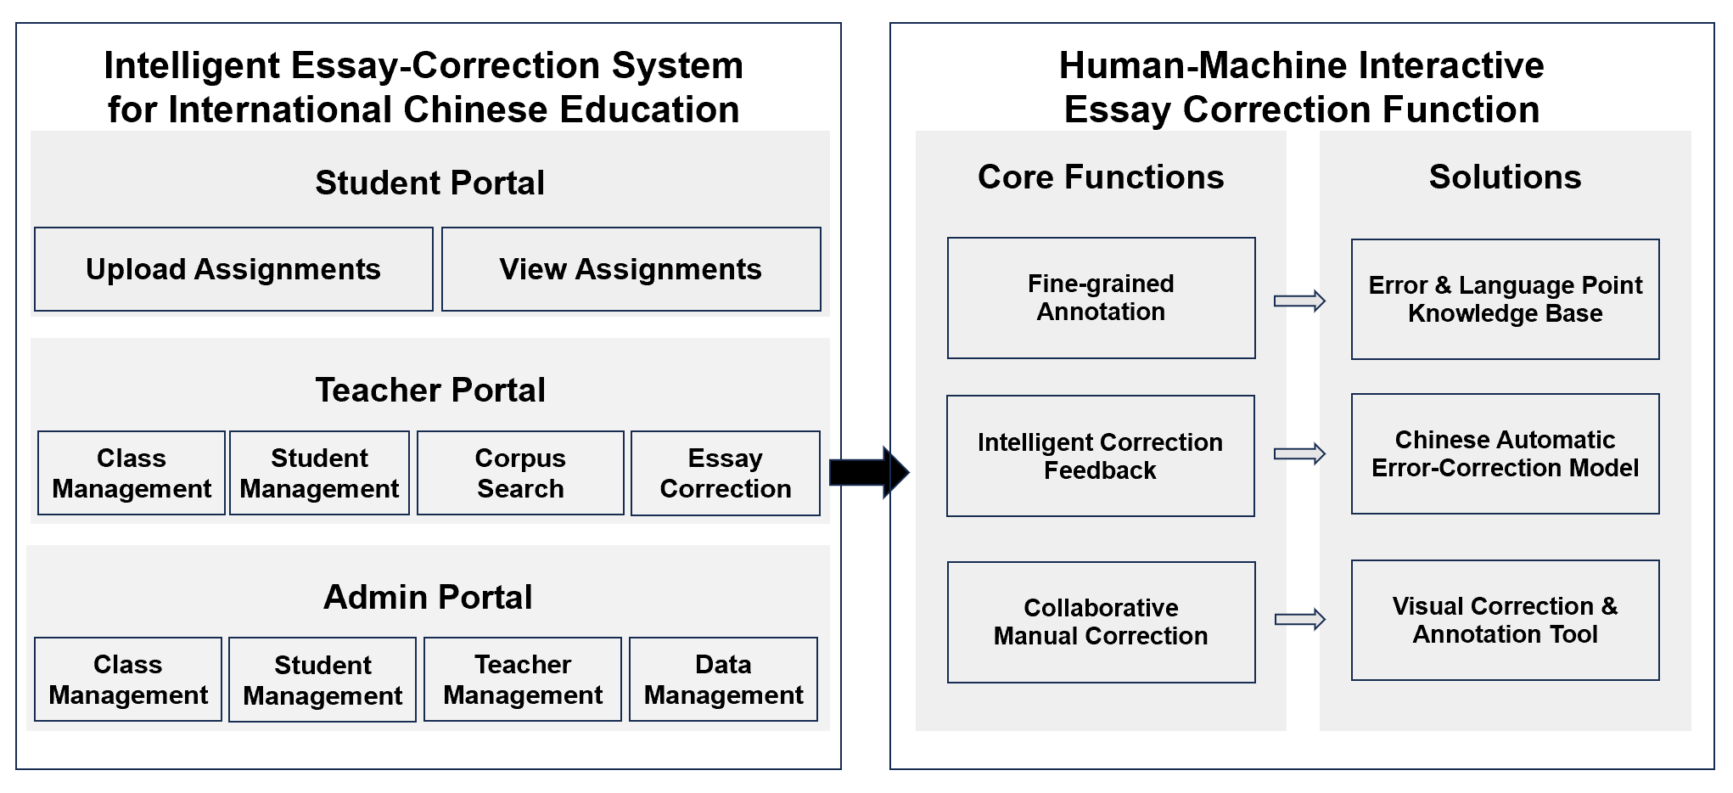
2.2 Overall system design
.

Slide 9
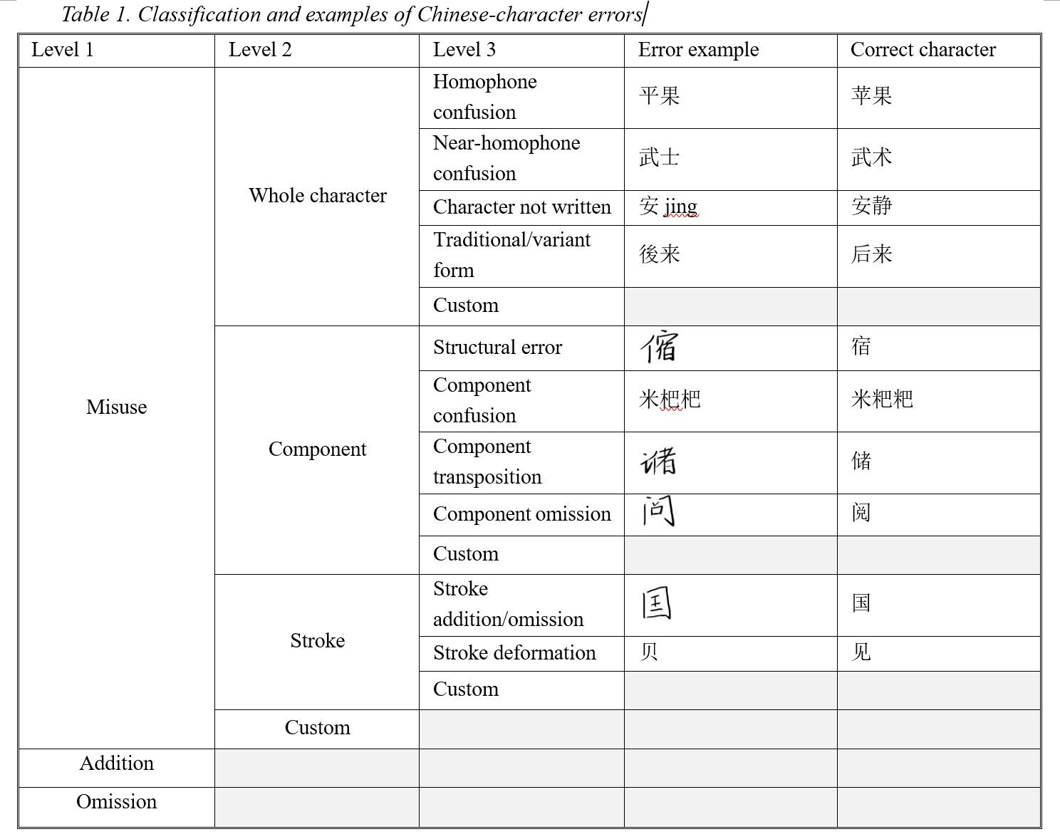
3. Construction of the Annotation Standard System for Chinese Essay Errors
3.1 Character correction
Based on Du Tonghui (1993)
and Zhang Baolin (2011),
and the training needs of
machine correction models

Slide 10
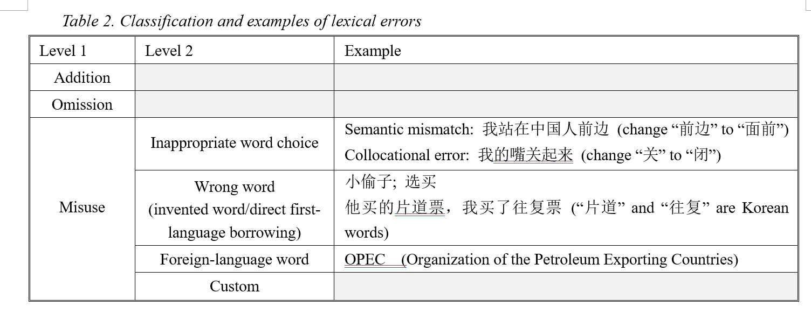
3.2 Lexical correction
Based on Zhang Bo (2008)
and Zhang Baolin (2011),
and the training needs of
machine correction models

Slide 11
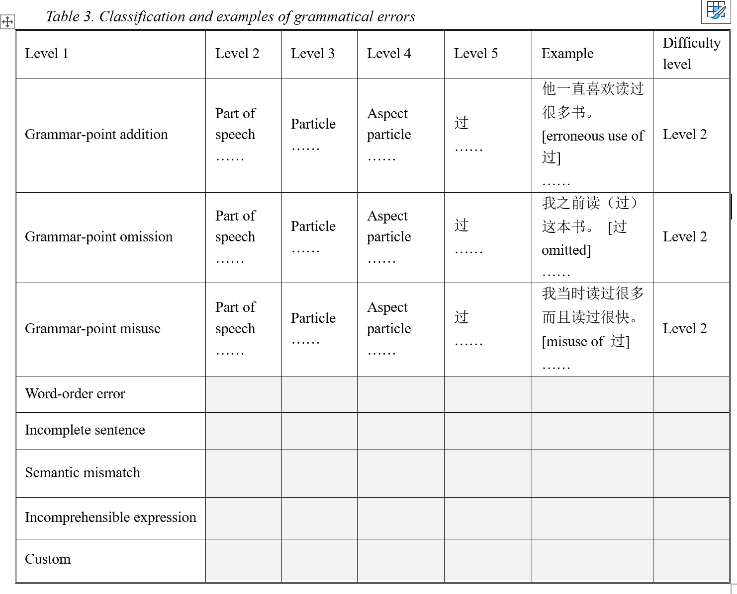
3.3 Grammar correction
“The Standard for Chinese
Proficiency in International
Chinese Language Education”
《国际中文教育中文水平等级标准》
Appendix A (Normative) Outline for
Grammar Points of Each Band
“语法等级大纲” (572 points)
“Three levels and nine bands”

Slide 12
4. Construction of the VisCGEC Dataset and Model Selection
4.1 Construction of the VisCGEC dataset
★ The raw data are 581 handwritten essay images by Chinese learners
★ A professional annotation team of 18 university teachers and students with linguistic backgrounds and experience in teaching Chinese as a foreign language
★ Annotation strictly followed the four basic error types: overuse (delete), omission (insert), misuse (replace) and word order (reorder)
★ All raw essays were segmented at sentence level, yielding 2,451 image segments
★ To facilitate character recognition, the bounding box of every character was also annotated.

Slide 13
4.2 Model selection
Automatic correction of handwritten images involves two tasks: text recognition in images and Chinese grammatical error correction.
(1) The “end-to-end” approach, which uses general multimodal large language models (such as ChatGPT-4o or DeepSeek V12) to perform Chinese grammatical error correction;
(2) The “two-stage pipeline” approach, which first performs text recognition and then Chinese grammatical error correction.

Slide 14
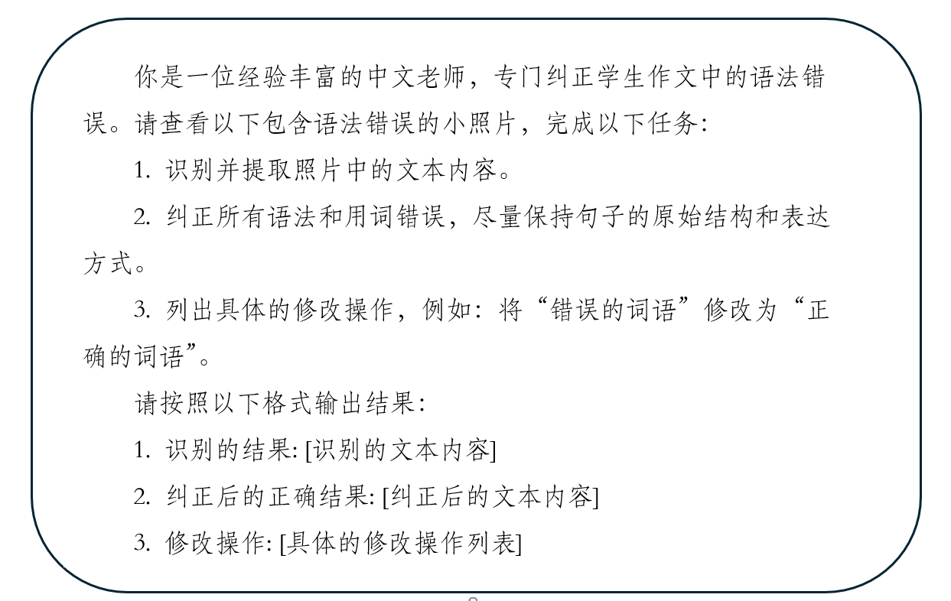
4.2.1 The “end-to-end” approach
Instructions for text recognition and error correction prompt the MLLMs.

Slide 15
4.2.2 The “two-stage pipeline” approach
The “two-stage pipeline” approach consists of two stages: character recognition and Chinese grammatical error correction.
Stage 1: recognition module
OCR-based recognition
CLIP-based recognition. A target-detection model segments a sentence image into individual character images, and the extracted character images are fed into a model composed of a text encoder and an image encoder, which needs to be fine-tuned on the VisCGEC dataset.

Slide 16
Stage 2: correction module
Seq2Seq — SynGEC model
Seq2Edit — GECToR model
Large languagee model (LLM) fine-tuning — Qwen
Wang, X. M., Yuan, D., Liu, X., et al.（2025）VisCGEC: Benchmarking the Visual Chinese Grammatical Error Correction. In Proceedings of the 2025 Conference of the North American Chapter of the Association for Computational Linguistics.

Slide 17
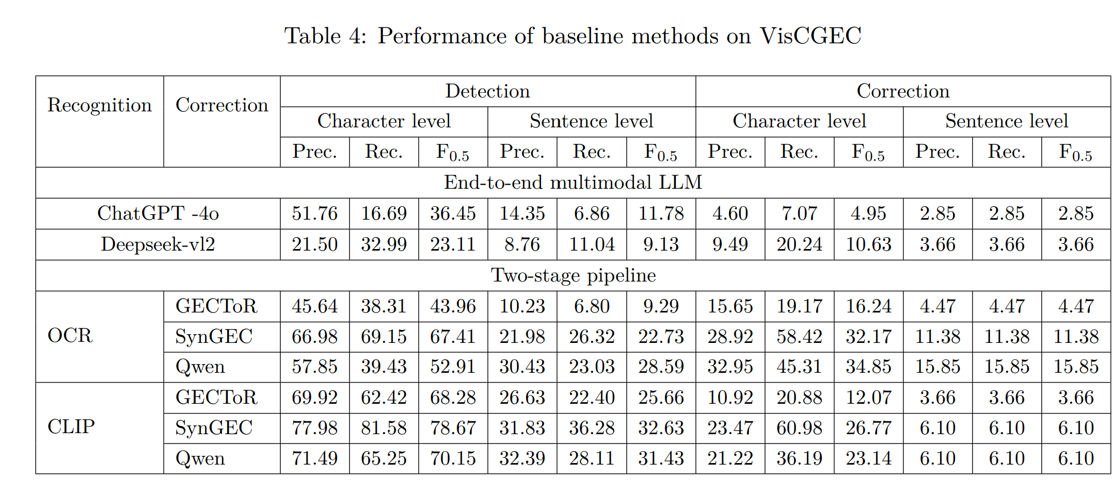
4.3 Pre-training results of different models on the VisCGEC dataset
the two-stage pipeline outperformed the multimodal end-to-end method.
among two-stage methods, OCR combined with fine-tuned Qwen performed best for sentence-level correction, whereas CLIP combined with fine-tuned SynGEC performed best for character-level correction.
Finally, with the same recognition module, fine-tuned Qwen generally outperformed SynGEC and GECToR in precision and F0.5.

Slide 18
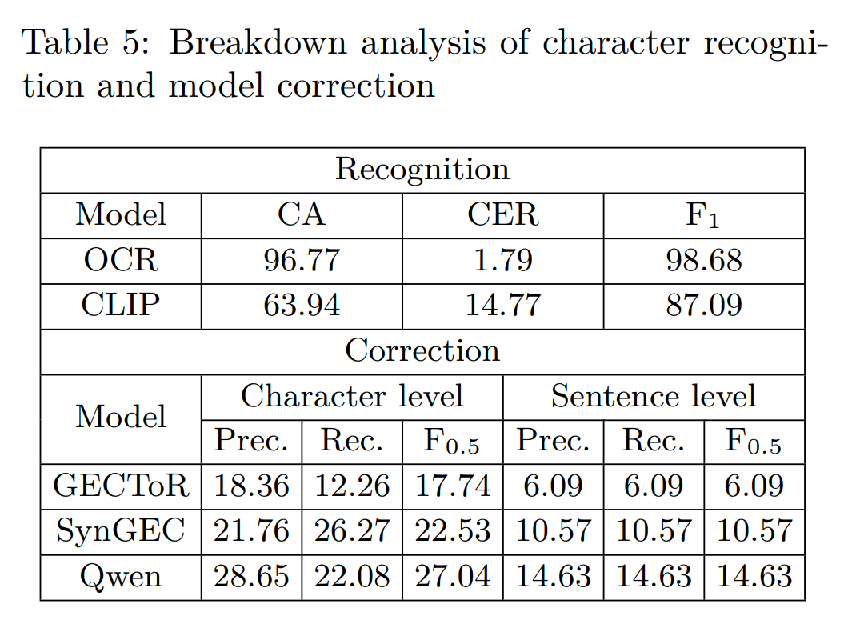
OCR performed very strongly in the recognition module, and CLIP also performed well.
Qwen consistently outperformed the other two models in both character- and sentence-level correction,

Slide 19
4.5 Summary
(1) The “end-to-end” approach of multimodal large language models such as GPT-4 or DeepSeek performs poorly in correcting handwritten image text, while the “two-stage pipeline” approach shows clearly better performance.
(2) Among the recognition models, both OCR and CLIP show good recognition ability. OCR performs better but cannot localize, whereas CLIP can localize.
(3) Among the correction models, the fine-tuned Qwen large language model significantly outperforms the traditional GECToR and SynGEC methods.
Finally, the combination of “CLIP image recognition + Qwen large language model” was determined as the core correction model architecture of the intelligent correction system.

Slide 20
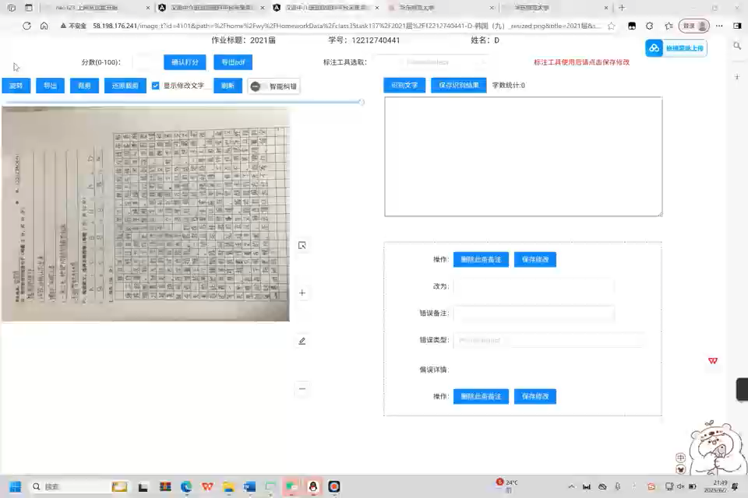
5. Visual Interface Design and Function Demonstration of the Correction Annotation Tool

Slide 21
Author emails: Yuan Dan, dyuan@hanyu.ecnu.edu.cn

Slide 22
Thank you!

