Slide 1


Large Language Models for Figurative Language
From Text to Multi-modality and Cross-lingual Inspirations
Zhongqing Wang, Soochow University
SudaNLP
Notes:
Good morning everyone. I am Zhongqing Wang from Soochow University. Today I will talk about how large language models handle figurative language. We will go from text to multi-modality and cross-lingual views.

Slide 2
Figurative Language
Figurative language (metaphor, synaesthesia) pose major challenges in language learning.
Language learners need to master not only literal text, but also non-literal, cognition-driven language such as figurative comparisons.
Pain point in language learning: Second-language learners struggle to identify metaphors; literal translation leads to complete semantic loss.
Notes:
Figurative language like metaphor and synaesthesia is hard for language learners. Students need to understand not only literal words, but also non-literal meanings. This is a big pain point in second language learning.

Slide 3
Example of Figurative Language
Metaphor:
Synaesthesia:
Time is a river.
a cold voice
Notes:
Let me show you two examples. A metaphor is like saying 'Time is a river.' A synaesthesia example is 'a cold voice.' Here, a touch word 'cold' is used to describe hearing.

Slide 4
Outline
Textual Metaphor Analysis
Chinese Synaesthesia Analysis
Notes:
Here is today's outline. I will first talk about textual metaphor analysis. Then I will move on to Chinese synaesthesia analysis.

Slide 5
Textual Metaphor Analysis
Notes:
Now let us start with the first part: textual metaphor analysis.

Slide 6
What Is a Metaphor
Unlike a simile, a metaphor does not use markers such as “like” or “as”; instead, it performs an implicit comparison as a rhetorical device.
Similes have explicit comparison markers
“
The city is like a jungle.
Metaphors have no explicit comparison markers
“
Her smile is sunshine.
Notes:
What is a metaphor? A metaphor does not use words like 'like' or 'as.' It directly compares two things. For example, 'Her smile is sunshine' is a metaphor, not a simile.

Slide 7
What Is a Metaphor
Essence: understanding one thing in terms of another.
Categories:
  Orientational metaphor
  Ontological metaphor
  Structural metaphor
——《Metaphors We Lived by》（Lakson & John, 1980）
Notes:
According to Lakoff and Johnson, metaphors have three categories: orientational, ontological, and structural. Understanding one thing in terms of another is the key idea.

Slide 8
Orientational Metaphors
Orientational metaphors involve spatial directions, conceptualizing things as “up” and “down”, or “front” and “back”.
Humans and other primates lie down when sleeping, but stand upright when awake.
“
  Wake up
  Slow down
Many expressions that do not seem metaphorical at first glance actually contain metaphors.
Notes:
Orientational metaphors use space directions like 'up' and 'down.' For example, 'wake up' and 'slow down.' We stand up when awake and lie down when we sleep. Many everyday expressions are actually metaphors.

Slide 9
Ontological Metaphors
Ontological metaphors treat abstract experiences—time, events, emotions, and ideas—as tangible entities and substances to facilitate understanding.
“
Inflation is lowering our standard of living.
    We need to fight inflation.
Conceptualizing the abstract concept of "inflation" as a concrete entity.
Notes:
Ontological metaphors treat abstract ideas as real objects. For example, we say 'fight inflation.' Here inflation becomes something we can fight. This makes abstract ideas easier to talk about.

Slide 10
Structural Metaphors
Structural metaphors structure one concept in terms of another, applying vocabulary from one domain to talk about another, giving rise to polysemy.
“
Time is money
Since the source domain MONEY has a well-defined structure, mapping it onto the target domain TIME helps us conceptualize TIME more clearly.
Notes:
Structural metaphors use one concept to understand another. 'Time is money' is a classic example. We spend time, save time, or waste time. This shows how money words shape how we think about time.

Slide 11
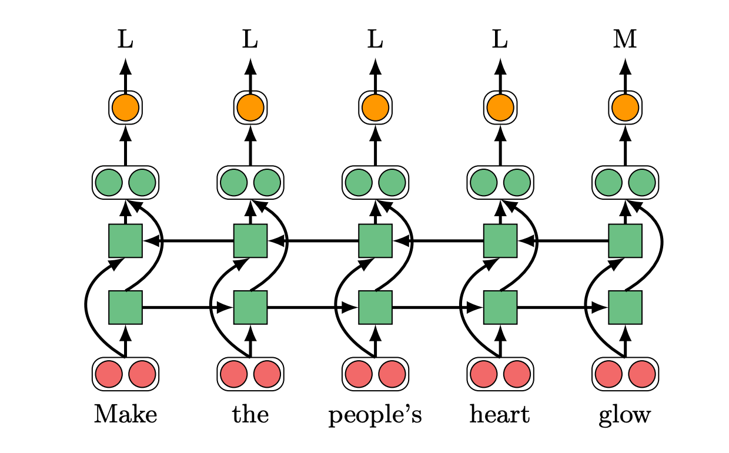
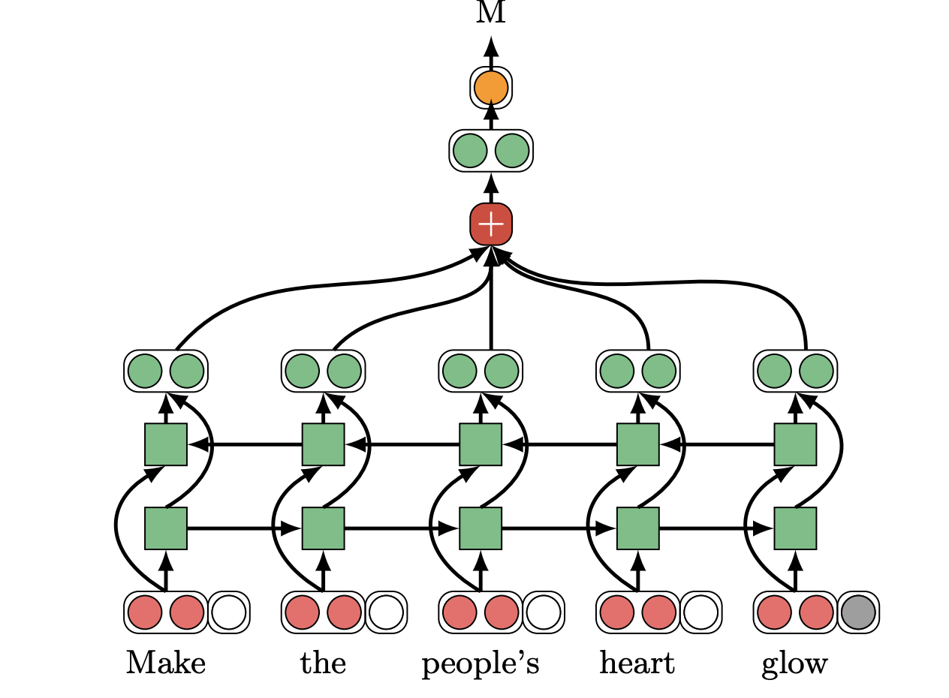
Traditional Text Metaphor Detection Models
  Combines GloVe and ELMo embeddings to enhance word representations, and uses a BiLSTM encoder to produce text representations for output.
Classification Model (Determining Whether a Candidate Word Is Metaphorical)
Sequence Labeling Model
  Gao et al., Neural Metaphor Detection in Context. In EMNLP 2018
Notes:
Now let us look at traditional models. This early model uses GloVe and ELMo embeddings, plus a BiLSTM encoder. It decides whether a word is metaphorical or not. This is from Gao et al. at EMNLP 2018.

Slide 12
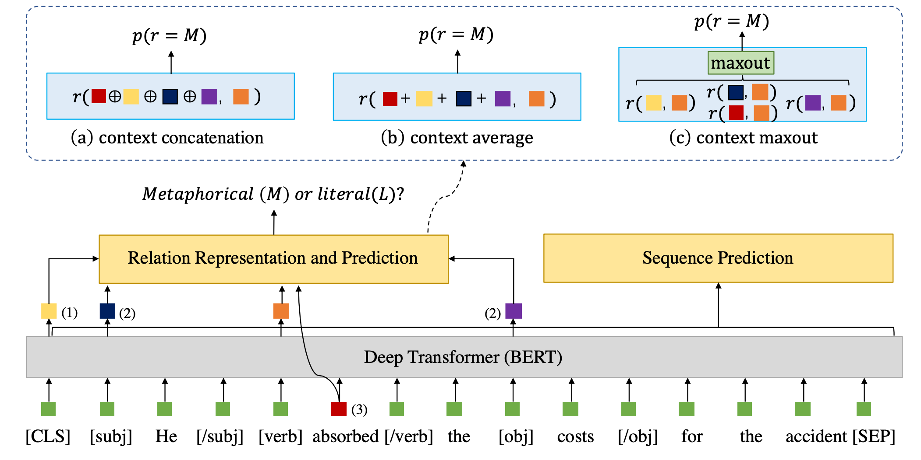
Traditional Text Metaphor Detection Models
  Explicitly incorporates subject, object, and verb information. Uses BERT to build text representations conditioned on subject, object, and verb for metaphor detection.
The overall model is a classification model.
Three different connection methods
Auxiliary Task
Subject
Candidate Word
Object
Notes:
This next model uses BERT. It takes subject, object, and verb information together. There are three ways to connect them. The model is still a classifier at heart. This is from later work.

Slide 13
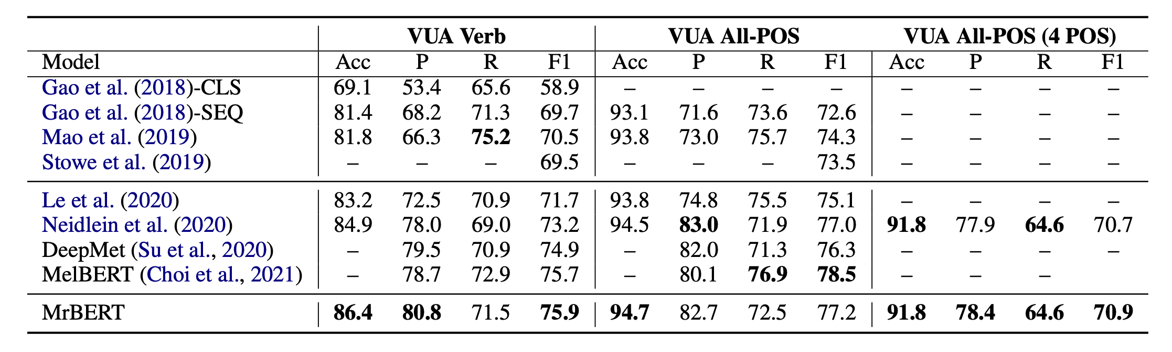
Experimental Results
Verbs Only
All Parts of Speech
  Song et al., Verb Metaphor Detection via Contextual Relation Learning. In ACL 2021.
Notes:
Here are the experimental results. We test on verbs only and on all parts of speech. Our model performs better than baseline methods. This is from Song et al. at ACL 2021.

Slide 14
Text+Image: Better Understanding of Metaphor
Notes:
Now we move to the next step: using both text and images to better understand metaphor.

Slide 15
Chain-of-Thought Multimodal Metaphor Detection
Multimodal Metaphor Detection
  Input:
    Images
    Text after OCR
How can we effectively connect images and text within a single model?
Xu et al. Exploring Chain-of-Thought for Multi-modal Metaphor Detection. ACL 2024: 91-101
Notes:
This is our multimodal metaphor detection work. We feed both images and OCR text into a model. The key question is: how to connect images and text well inside one model? This is from Xu et al. at ACL 2024.

Slide 16
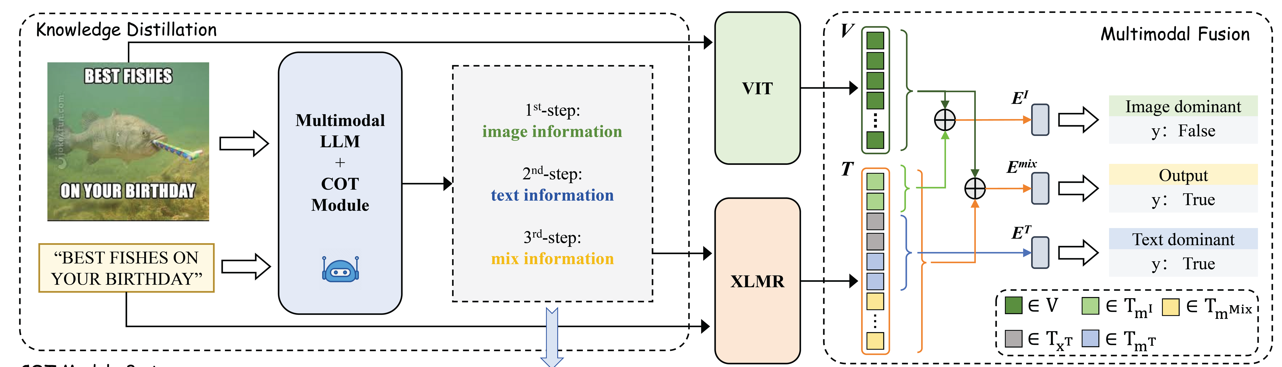
Architecture: CoT-Enhanced Multimodal Metaphor Detection
Multimodal Large Language Model + Chain-of-Thought (CoT)
Notes:
The architecture combines a multimodal large language model with Chain-of-Thought. CoT helps the model reason step by step before making a decision.

Slide 17
Constructing the Chain-of-Thought
Image
Text
Image
Text
Notes:
Here we construct the chain of thought. The model looks at the image and text, then builds a reasoning chain to detect the metaphor. This helps explain why a word is metaphorical.

Slide 18
Experimental Results
Text Models
Image Models
Multimodal Models
Notes:
These are the results. Text models alone do well, image models add value, and multimodal models perform the best. The CoT design gives a clear boost.

Slide 19
Chinese Synaesthesia Analysis
Notes:
Now let us move to the second part: Chinese synaesthesia analysis.

Slide 20
The Senses
Touch: sharp, cold
Smell: fragrant
Taste: sweet, salty
Sight: bright, dark
Hearing: noisy, quiet
Notes:
We have five senses: touch, smell, taste, sight, and hearing. Each sense has its own words, like 'sharp' for touch or 'bright' for sight.

Slide 21
通感（Synesthesia）
Syn esthesia
together
共同
sensory
感觉
通 感
Jiang et al., Chinese Synesthesia Detection: New Dataset and Models. In ACL-2022.
Notes:
Synaesthesia means sensing across. The word comes from Greek: 'syn' means together, and 'aesthesia' means sensing. In short, one sense is described using another sense.

Slide 22
Synesthesia
The phenomenon of one sense being transferred into another
Synesthesia is a metaphor involving sensory perception.
“
她用甜蜜蜜[taste]的语调[hearing]说：那是我教他的喔！
She said in a sweet [taste] tone [hearing], “That’s what I taught him!”
Notes:
Synaesthesia is a special kind of metaphor. For example, 'a sweet tone' uses a taste word to describe hearing. Here, 'sweet' belongs to taste but describes sound.

Slide 23
Why Study Synesthesia
Address deep semantic and cognitive problems
  Understanding figurative language and human cognitive habits; solving NLU from a cognitive science perspective
Challenges
  Lack of large-scale datasets
  Limited attention in computational linguistics
  How to extend the rich research in neuroscience and linguistics
Notes:
Why study synaesthesia? It helps us understand deep semantic and cognitive problems. But there are challenges: we lack large datasets and it has not received much attention.

Slide 24
Chinese Synesthesia Dataset
Annotation Process
  Extract sensory words from text
  Determine the word’s original modality
  Determine the modality expressed in context
  Check whether the original and contextual modalities differ: if so, it expresses synesthesia
sensory word: 甜蜜蜜(sweet)
她用甜蜜蜜的语调说：那是我教他的喔！
(She said in a sweet tone, “That’s what I taught him!”)
original modality: taste
synesthetic modality: hearing
Notes:
This is our Chinese synaesthesia dataset. The annotation process has three steps: find sensory words, decide their original sense, and check if the context uses a different sense. If yes, it is synaesthesia.

Slide 25
Data Selection
Linguistic experts manually curated a candidate sensory word list
Extracted sentences containing exactly one sensory word from the corpus
Three graduate students performed the annotation
Notes:
For data selection, linguistic experts built a list of sensory words. We extracted sentences with one sensory word. Three graduate students did the annotation.

Slide 26
Data Distribution
A total of 7,217 sentences containing synesthesia were annotated
Sensory word distribution:
Sense | Count
touch | 69
taste | 20
vision | 92
hearing | 4
smell | 2
Notes:
In total, we annotated 7,217 sentences. This slide shows the distribution of sensory words across different categories.

Slide 27
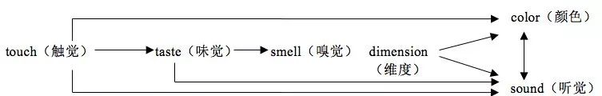
Transfer Probabilities Between Senses
touch
62.6%
73.0%
hearing
vision
100.0%
taste
84.0%
smell
72.4%
Chinese
English
Notes:
This chart shows transfer probabilities between senses. For example, taste words often transfer to hearing. Chinese and English show similar patterns but with different strengths.

Slide 28
Annotation Examples
“
cold _{[touch]}colors _{[vision]}
bitter _{[taste]} facial expression _{[vision]}
big _{[vision]}shout _{[hearing]}
clear _{[vision]}voice _{[hearing]}
smell _{[smell]}that is cloyingly sweet _{[taste]}
Notes:
Here are some annotation examples. 'Cold colors' is touch to sight. 'Bitter expression' is taste to sight. 'Big shout' is sight to hearing. Each example crosses two senses.

Slide 29
Synesthesia Detection Task
Extraction：identify sensory words in text
Detection：classify the original and contextual modalities of sensory words
Extraction: 甜蜜蜜(sweet)
她用甜蜜蜜的语调说：那是我教他的喔！
(She said in a sweet tone, “That’s what I taught him!”)
Detection:
original modality: taste,
synesthetic modality: hearing
Notes:
The synaesthesia detection task has two steps. First, extract sensory words. Second, classify their original and contextual senses. This example shows how it works on a real sentence.

Slide 30
Joint Extraction Model
start
end
0 | 0 | 1 | 0 | 0 | 0 | 0 | 0 | 0
0 | 0 | 0 | 0 | 1 | 0 | 0 | 0 | 0
她 | 用 | 甜 | 蜜 | 蜜 | 的 | 语 | 调 | 说
Identify the Original and Contextual Sensory Modalities
Synesthetic Word Extraction
original
synesthetic
Taste
Hearing
(She said in a sweet tone)
Sensory Word Extraction via Boundary Detection
Joint Sensory Modality Detection
BERT
BERT
word
radical
她 | 用 | 甜 | 蜜 | 蜜 | 的 | 语 | 调 | 说
女 | 用 | 舌 | 虫 | 虫 | 白 | 讠 | 讠 | 讠
她 | 用 | 甜 | 蜜 | 蜜
女 | 用 | 舌 | 虫 | 虫
甜 | 蜜 | 蜜 | 的 | 语 | 调 | 说
舌 | 虫 | 虫 | 白 | 讠 | 讠 | 讠
Incorporate radical features into the model, as many Chinese radicals convey sensory information.
tongue
(taste)
speak
(hearing)
preceding
following
Notes:
Our joint extraction model uses BERT. We also add Chinese radical features, because many radicals carry sensory meaning. The model finds the word boundaries and classifies senses at the same time.

Slide 31
Experimental Results
Results: synesthetic word extraction
Traditional
Sequence Labeling or Classification Models
SOTA Metaphor Detection Models
Notes:
These are the extraction results. Our model beats traditional sequence labeling and strong metaphor detection baselines. The radical features help a lot.

Slide 32
Experimental Results
Results: sensory modality classification
Notes:
These are the sensory modality classification results. The model can correctly tell which sense a word originally belongs to and which sense it transfers to.

Slide 33
Case Study
Notes:
Let us look at some case studies. These real examples show where the model works well and where it makes mistakes.

Slide 34
LLM-based Synesthesia Detection
Factors affecting synesthesia:
  Sensory word
  Original modality
  Synesthetic modality
  Trigger (cue, stimulus)
Notes:
Now we try using LLMs for synaesthesia detection. We look at four factors: the sensory word, its original sense, the synesthetic sense, and the trigger word.

Slide 35
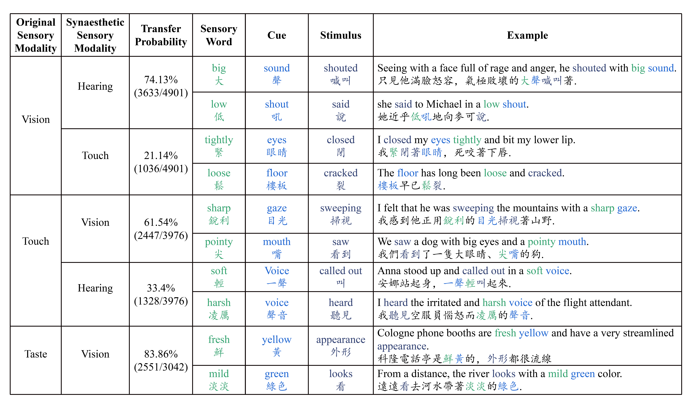
Impact of Different Factors on Synesthesia
Notes:
This slide shows how each factor affects the result. Some factors matter more than others when detecting synaesthesia.

Slide 36
Modeling relationships between elements via tree structures
Notes:
We model the relationships between these elements using tree structures. A tree helps show which word connects to which sense.

Slide 37
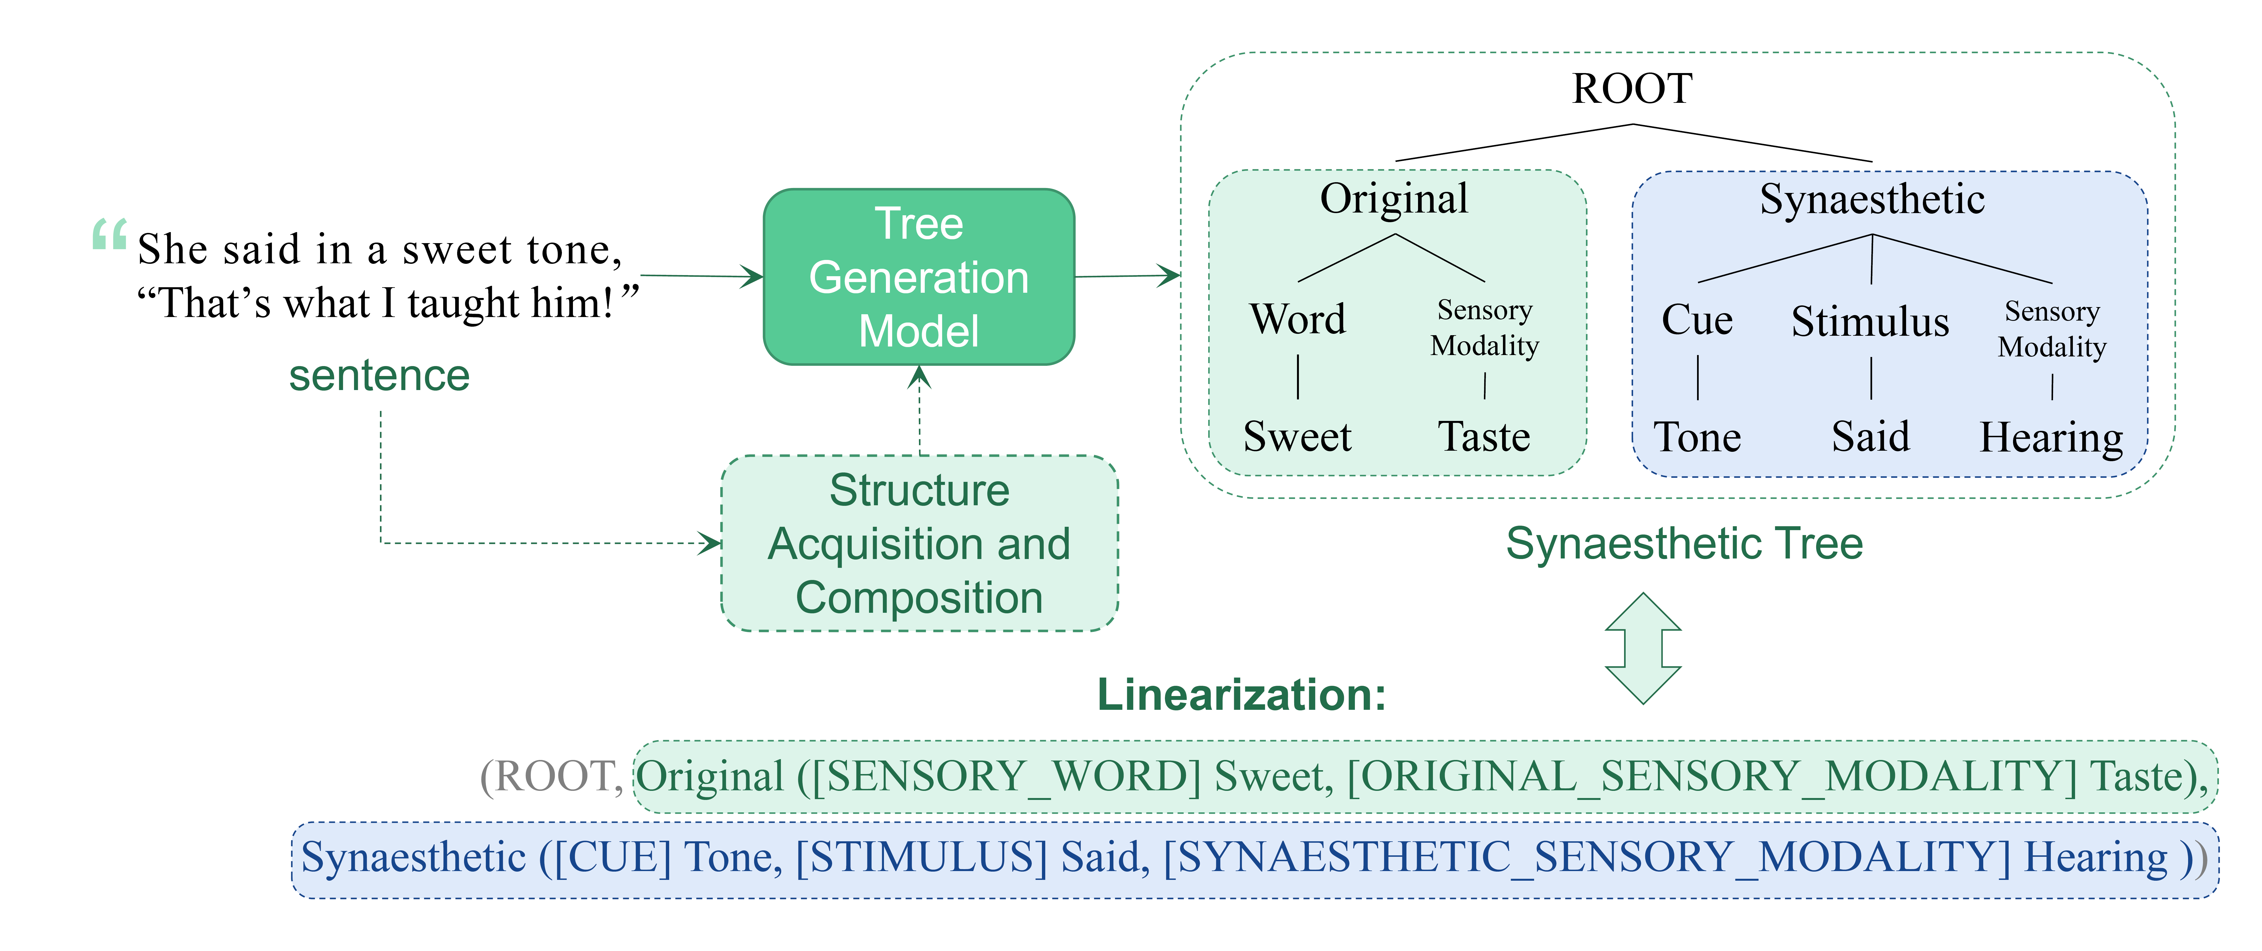
Generative Model-based Synesthesia Detection
Formulating synesthesia detection and element extraction as tree structure construction
Notes:
Our generative model turns synaesthesia detection into a tree construction task. Instead of classifying, the model generates the tree directly.

Slide 38
Experimental Results
Classification
Models
Generative
Models
Notes:
These are the final results. Generative models outperform traditional classification models. The tree-based approach is more effective.

Slide 39
Impact of Different Elements on Results
w：Sensory Word
o：Original Sensory Modality
s：Synesthetic Sensory Modality
t： trigger
c：sitmulus
Notes:
This slide breaks down the impact of each element. The sensory word and original sense are the most important. The trigger and stimulus also play a role.

Slide 40

Q&A
wangzq@suda.edu.cn
Notes:
That is all for my talk. Thank you for listening. If you have questions, please ask. You can also reach me by email at wangzq@suda.edu.cn.

