Slide 1
Ground Before
Correcting
Evidence-Guided Visual Chinese Grammatical Error Correction at Multi-LLL 2026
Xiaochuan Xie and Keran Huang
Chongqing University of Posts and Telecommunications
Notes:
Slide 1. Suggested time: 30 seconds.
ENGLISH
Good morning everyone. Today I will present Ground Before Correcting, a paper on visual Chinese grammatical error correction at Multi-LLL 2026. The proposed system is called GroundCorrect. It reads handwritten Chinese, corrects grammatical errors, and identifies where the edits belong in the image. I will focus on the system design, the controlled experimental evidence, and a failure mode that explains why correct text alone is insufficient.
中文
大家好，今天汇报的论文是《Ground Before Correcting》，研究 Multi-LLL 2026 中的视觉中文语法纠错任务。系统名为 GroundCorrect，需要识别中文手写文本、纠正语法，并在图像中定位修改位置。下面重点介绍系统设计、受控实验，以及一个能够说明“文本正确仍然不够”的失败现象。
Source: Xie and Huang, Ground Before Correcting: Evidence-Guided Visual Chinese Grammatical Error Correction at Multi-LLL 2026. Title and abstract, p. 1. Supplied PDF.

Slide 2
The task requires text and spatial edits
Input: an image of a handwritten Chinese sentence
Output: corrected text + operation, replacement, and pixel box
Internal candidate: q = (recognized source, target, edits)
Released labels: INSERT, DELETE, SUBSTITUTE
Source: Sections 1 and 3.1, pp. 1–2
02
Notes:
Slide 2. Suggested time: 55 seconds.
ENGLISH
Let us first define the task. In ordinary grammatical error correction, the input is a text sequence. Here, the input is a handwritten sentence image, so the system must also recognize what the learner actually wrote. The final answer contains corrected text and spatially grounded edits. Each edit specifies an operation, replacement text, and a bounding box in pixel coordinates. Internally, GroundCorrect keeps a complete candidate consisting of the recognized source, target, and edit list. This source field matters because the edits come from differences between source and target. The schema also allows word-order operations, but the released sentence annotations contain insertion, deletion, and substitution only.
中文
先明确任务。普通语法纠错的输入是文本，而这里的输入是手写句子图像，因此系统还要识别学习者实际写了什么。最终输出不仅包含纠正后的句子，也包含带空间位置的编辑，每条编辑需要给出操作类型、替换文本和像素坐标框。系统内部保留“识别原文、目标句子、编辑列表”这一完整候选记录。原文字段非常关键，因为编辑是通过比较原文和目标文本得到的。输出格式也允许语序操作，但公开的句子级标注只包含插入、删除和替换。
Source: Xie and Huang, Ground Before Correcting: Evidence-Guided Visual Chinese Grammatical Error Correction at Multi-LLL 2026. Sections 1 and 3.1, pp. 1–2. Supplied PDF.

Slide 3
Why a single VLM pass is fragile
Long, narrow images lose character detail after resizing
Fluent corrections can contain unreliable coordinates
Extra rewriting can alter facts or hide necessary edits
Source: Introduction, p. 1; Section 4.7, p. 7
03
Notes:
Slide 3. Suggested time: 50 seconds.
ENGLISH
Three difficulties motivate the design. First, sentence images can be very long and narrow. Resizing the whole line may obscure differences between visually similar characters. Second, a vision-language model can generate a fluent correction while assigning inaccurate coordinates to the edit. Third, additional correction can introduce unsupported rewriting. There is also a more subtle problem: if recognition silently repairs a learner error, that error disappears from the source-to-target difference. The final sentence may be correct, but its required edit is missing. These problems motivate a pipeline that uses local evidence for verification and a separate mechanism for spatial grounding.
中文
方法主要针对三个问题。第一，句子图像通常很长、很窄，整体缩放后，相似汉字之间的细节可能丢失。第二，视觉语言模型可以生成流畅的修改，却给出不准确的坐标。第三，进一步纠错可能引入没有依据的改写。还有一个更隐蔽的问题：如果识别阶段已经悄悄修正了学习者的错误，后续比较原文与目标文本时，就看不到这处差异。最终句子虽然正确，必要的编辑却没有输出。因此，作者用局部证据核验文字，并通过独立机制完成空间定位。
Source: Xie and Huang, Ground Before Correcting: Evidence-Guided Visual Chinese Grammatical Error Correction at Multi-LLL 2026. Introduction, p. 1; Section 4.7, p. 7. Supplied PDF.

Slide 4
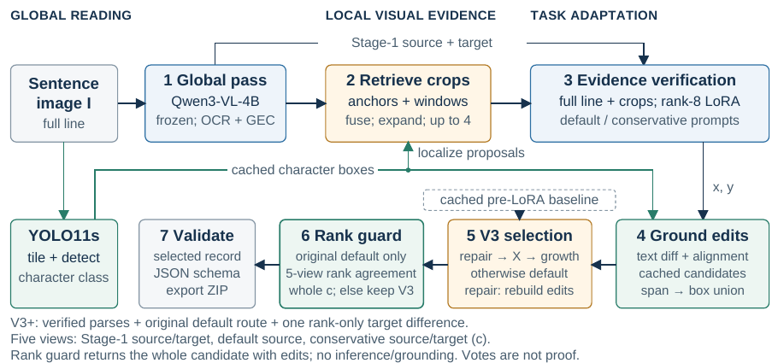
GroundCorrect pipeline
Rank guard: post-submission V3+ only
Source: Figure 1 and Section 3, pp. 2–4
04
Notes:
Slide 4. Suggested time: 65 seconds.
ENGLISH
This figure summarizes the pipeline. A frozen Qwen3-VL-4B model first proposes a recognized source and a corrected target. These hypotheses guide retrieval of local image crops. A second pass receives both the whole line and the crops, and a LoRA adapter helps it verify the source and target. In parallel, a single-class YOLO11s detector supplies character boxes. Text differencing and monotonic alignment convert the verified text changes into spatial edits. A finalizer then selects or repairs candidates and checks the output schema. Only the second-stage adapter and detector are trained. The base model and visual encoder stay frozen. The rank-guard block shown here belongs to the later V3+ extension and was not part of the official V3 submission.
中文
这张图概括了整体流程。冻结的 Qwen3-VL-4B 先输出识别原文和暂定纠正结果，再根据这些假设检索局部图像区域。第二阶段同时接收整行图像和局部裁剪，并通过 LoRA 适配器核验原文与目标文本。与此同时，单类别 YOLO11s 检测器提供字符框。系统通过文本差分和单调对齐，把文本修改映射成空间编辑。最后，规则模块选择或修复候选，并检查输出格式。训练的只有第二阶段适配器和字符检测器，基座模型与视觉编码器保持冻结。图中的名次检查模块属于提交后的 V3+，并非官方 V3 提交的一部分。
Source: Xie and Huang, Ground Before Correcting: Evidence-Guided Visual Chinese Grammatical Error Correction at Multi-LLL 2026. Figure 1 and Section 3, pp. 2–4. Supplied PDF.

Slide 5
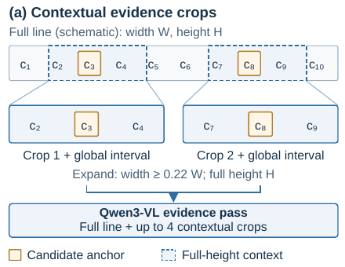
Contextual crops preserve local evidence
Anchors: source–target differences and VLM proposals
Merge proposals and add overlapping coverage windows
At most 4 crops, full height, width ≥ 22% of the line
Test-time retrieval uses no gold target or gold edit boxes
Source: Section 3.2 and Figure 2(a), pp. 3–4
05
Notes:
Slide 5. Suggested time: 65 seconds.
ENGLISH
The retrieval step looks for regions that deserve closer inspection. It uses two test-time signals: differences between the provisional source and target, and coordinates proposed by the vision-language model. Nearby or overlapping proposals merge, while deterministic coverage windows supplement a short list. The system keeps at most four regions. Each region expands to the full image height and at least twenty-two percent of its width, so the crop includes neighboring characters rather than an isolated symbol. The second-stage prompt explicitly treats these regions as evidence, not as guaranteed errors. Importantly, retrieval does not use reference targets or gold edit boxes at test time. The purpose is to preserve visual detail while retaining enough sentence context for grammatical decisions.
中文
检索阶段寻找需要进一步观察的区域。它使用两种测试时可获得的信号：暂定原文与目标之间的差异，以及视觉语言模型提出的坐标。相近或重叠的候选区域会合并；候选不足时，使用固定的重叠窗口补充。系统最多保留四个区域，每个区域扩展到整张图像的高度，宽度至少为整行的百分之二十二，避免只看到孤立字符而失去上下文。第二阶段提示词明确说明，这些区域只是证据，并不一定存在错误。测试时不使用参考目标文本或金标准编辑框。这样既能保留局部笔画细节，也能结合整句语法做判断。
Source: Xie and Huang, Ground Before Correcting: Evidence-Guided Visual Chinese Grammatical Error Correction at Multi-LLL 2026. Section 3.2 and Figure 2(a), pp. 3–4. Supplied PDF.

Slide 6
Format-matched LoRA verification
Input: full line, crops, coordinates, Stage-1 source and target
Training answer: source_text + target_text JSON
Rank 8, alpha 16, 16.52M trainable parameters (0.371%)
Assistant-only token loss; base model and vision encoder frozen
Invalid or empty output falls back to the Stage-1 hypothesis
Source: Section 3.2, p. 3; Appendix A.1, p. 10
06
Notes:
Slide 6. Suggested time: 75 seconds.
ENGLISH
The key adaptation choice is to match the training format to inference. Stage two sees the full image, local crops, their global coordinates, and the first-stage source and target. During training, the assistant answer contains only two JSON fields: source text and target text. Prompt tokens receive no direct prediction loss. The adapter has rank eight and scaling alpha sixteen, with about sixteen point five million trainable parameters, or zero point three seven one percent of the model. It adapts attention and feed-forward projections while keeping the base model and visual encoder frozen. Training uses one epoch on 1,746 examples. A conservative inference prompt generates an alternative candidate using the same adapter. If parsing fails or either output string is empty, the system falls back to the cached first-stage hypothesis and rebuilds its edits.
中文
这里的关键是让训练输入输出格式与推理保持一致。第二阶段看到整图、局部裁剪、全局坐标，以及第一阶段的原文和目标。训练时，助手答案只包含 source_text 和 target_text 两个 JSON 字段，提示词部分不直接计算预测损失。LoRA 的秩为八，alpha 为十六，可训练参数约一千六百五十二万，占模型的百分之零点三七一。适配范围包括注意力与前馈投影，基座和视觉编码器保持冻结。训练在一千七百四十六个样本上进行一轮。推理时还使用保守提示词生成替代候选，但共享同一个适配器。如果解析失败或文本为空，就回退到缓存的第一阶段结果，并重新构造编辑。
Source: Xie and Huang, Ground Before Correcting: Evidence-Guided Visual Chinese Grammatical Error Correction at Multi-LLL 2026. Section 3.2, p. 3; Appendix A.1, p. 10. Supplied PDF.

Slide 7
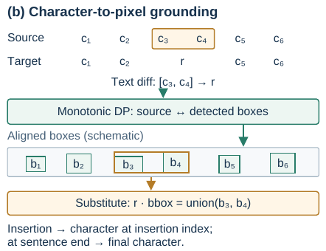
Deterministic character-to-pixel grounding
Text differences determine edit spans
YOLO11s supplies boxes sorted from left to right
Monotonic DP aligns source characters to boxes
A non-insertion edit uses the union of available aligned boxes
Source: Section 3.3 and Figure 2(b), pp. 3–4
07
Notes:
Slide 7. Suggested time: 50 seconds.
ENGLISH
Grounding separates the linguistic edit from its coordinates. The system first compares the predicted source and target to identify insertion, deletion, and substitution spans. YOLO11s detects characters without predicting their identities. A dynamic program aligns the source characters with detected boxes in left-to-right order. It can match a character and box, skip a character, or skip a box. The cost uses their relative horizontal positions, and the algorithm takes O of n times m time and space. A non-insertion edit receives the union of available boxes in its source span. This is deterministic geometric alignment, but its optimality does not guarantee correct recognition or correct boxes.
中文
定位过程将语言编辑与坐标分开。系统先比较预测原文和目标文本，确定插入、删除与替换的区间。YOLO11s 只检测字符位置，不识别字符身份。动态规划按照从左到右的顺序，将原文字符与检测框对齐，允许匹配二者、跳过字符或跳过检测框。代价来自相对水平位置，时间和空间复杂度都是 O(nm)。对于非插入编辑，系统使用对应原文区间内可用字符框的并集。需要注意，这种最优性只针对定义的几何代价，并不能保证识别或检测结果本身正确。
Source: Xie and Huang, Ground Before Correcting: Evidence-Guided Visual Chinese Grammatical Error Correction at Multi-LLL 2026. Section 3.3 and Figure 2(b), pp. 3–4. Supplied PDF.

Slide 8
V3 finalization follows a fixed priority
1 Narrow consistency repair: rebuild the edited record
2 Newly introduced uppercase X: choose a safer candidate
3 Target growth ≥ 3 characters: choose a safer candidate
4 Otherwise retain the default candidate
Selection copies the complete source, target, and edit list
Source: Section 3.4, p. 4; Appendix B.1–B.3, pp. 11–12
08
Notes:
Slide 8. Suggested time: 60 seconds.
ENGLISH
The V3 finalizer applies rules in a fixed first-match order. It first checks two narrow repairs: restoring a comma at a preserved if-clause boundary and completing a specific asymmetric comparison. A repair rebuilds edits using the default source and cached detector boxes. Otherwise, it checks for a newly introduced uppercase X, then checks whether the target grows by at least three characters relative to its own source. If a rule triggers, the conservative candidate is selected when it removes that specific trigger. Otherwise, the retained baseline is selected. These branches copy complete candidate records. They never combine one target sentence with another candidate's edit list. Length growth is only a risk signal, and the two additional repair rules have no measured benefit on the labeled splits.
中文
V3 按固定顺序执行规则，命中后立即返回。首先检查两类范围很窄的修复：恢复特定条件从句边界的逗号，以及补全特定不对称比较。修复后，用默认候选的原文和缓存检测框重建编辑。否则，先检查目标中是否新引入大写 X，再检查目标是否比自身原文增长至少三个字符。如果触发风险规则，就在保守候选消除该触发条件时选用它，否则选择保留的基线。选择时复制完整记录，不会把一个候选的目标文本与另一个候选的编辑列表拼接。长度增长只是风险信号，而两条额外修复规则在有标签数据上没有测得收益。
Source: Xie and Huang, Ground Before Correcting: Evidence-Guided Visual Chinese Grammatical Error Correction at Multi-LLL 2026. Section 3.4, p. 4; Appendix B.1–B.3, pp. 11–12. Supplied PDF.

Slide 9
Data use limits the evaluation scope
Subset | Images | LoRA fit | Detector fit
LoRA training | 1,746 | Yes | Yes
Internal selection | 214 | No | Yes
Development | 245 | No | Validation
Hidden test | 246 | No | No
233 / 245 dev sentences share essay groups with training
Neither local split is an untouched end-to-end test.
Source: Table 1 and Section 4.1, pp. 4–5
09
Notes:
Slide 9. Suggested time: 55 seconds.
ENGLISH
Before looking at scores, we need to understand how the data are used. The released dataset contains 1,960 training images, 245 development images, and 246 test images. The authors reserve 214 training examples from fifty-five essay groups for internal selection and use the other 1,746 for LoRA fitting. However, the detector trains on the complete released training split, including those 214 images. The selection set is therefore held out only from LoRA fitting. Development also overlaps training at the essay-group level: 233 of its 245 sentences belong to essay groups present in training. Both local splits help select configurations. Consequently, these experiments support conditional comparisons, not independent end-to-end generalization claims.
中文
看结果之前，需要先了解数据使用方式。公开数据包含一千九百六十张训练图像、二百四十五张开发图像和二百四十六张测试图像。作者从训练集中保留五十五个作文组、共二百一十四个样本用于内部选择，其余一千七百四十六个用于 LoRA 训练。但检测器使用全部训练图像，因此也见过这二百一十四个样本。内部保留集仅对 LoRA 训练隔离。开发集还有作文组层面的重叠：二百四十五个句子中，二百三十三个来自训练集中已有的作文组。两个本地集合还参与配置选择，因此结果适合解释条件固定下的比较，不能视为独立的端到端泛化评估。
Source: Xie and Huang, Ground Before Correcting: Evidence-Guided Visual Chinese Grammatical Error Correction at Multi-LLL 2026. Table 1 and Section 4.1, pp. 4–5. Supplied PDF.

Slide 10
The local proxy scores text and grounded edits
Sproxy = mean over sentences of (text F0.5 + edit F0.5) / 2
Text match: operation, source span, replacement string
Grounded match: operation + replacement + box IoU ≥ 0.5
F0.5 emphasizes precision; both components are macro-averaged
The private official evaluator is unavailable
Source: Section 4.1 and Equation 6, p. 5
10
Notes:
Slide 10. Suggested time: 55 seconds.
ENGLISH
The authors cannot run the private competition evaluator, so they define a local proxy. For each sentence, they calculate text F-zero-point-five and grounded-edit F-zero-point-five, average those two scores, and then average across sentences. Text scoring requires an exact match of edit type, source span, and replacement. Grounded scoring requires the same operation and replacement, plus bounding-box intersection over union of at least zero point five. Predictions match references greedily, with each reference used once. F-zero-point-five puts more emphasis on precision than recall. A crucial distinction is that text evaluation derives edits from the gold source transcription, whereas inference grounding uses the predicted source. This difference helps explain why text and grounding scores can diverge.
中文
作者无法使用官方私有评测器，因此定义了本地代理指标。对每个句子分别计算文本 F0.5 和定位编辑 F0.5，将二者平均，再对所有句子取宏平均。文本评分要求编辑类型、原文区间和替换字符串完全一致。定位评分要求类型和替换文本一致，并且框的交并比至少为零点五；匹配采取贪心方式，每个参考编辑最多使用一次。F0.5 更强调精确率。一个关键区别是：文本评分从金标准原文提取编辑，而推理定位使用预测原文。这正是文本分数与定位分数可能不一致的重要原因。
Source: Xie and Huang, Ground Before Correcting: Evidence-Guided Visual Chinese Grammatical Error Correction at Multi-LLL 2026. Section 4.1 and Equation 6, p. 5. Supplied PDF.

Slide 11
Controlled adapter gains under fixed inputs
Fixed configuration | Text F0.5 | Edit F0.5 | Composite
Dev: adapter OFF | 0.2047 | 0.0460 | 0.1254
Dev: adapter ON | 0.2770 | 0.1699 | 0.2234
Holdout: OFF | 0.2034 | 0.0473 | 0.1253
Holdout: ON | 0.2661 | 0.1585 | 0.2123
Dev gain +0.0981 95% interval [0.0621, 0.1337]
Same inputs, prompt, decoding, and grounding. No guard.
Gain uses unrounded scores. Intervals condition on one trained adapter.
Source: Table 3 and Section 4.3, p. 6
11
Notes:
Slide 11. Suggested time: 105 seconds.
ENGLISH
This is the paper's primary evidence for the adapter. The authors freshly generate two arms using the same model inputs, cached first-stage outputs and crops, text-only prompt, greedy decoding, and grounding confidence of zero point five. They toggle only the adapter and apply no finalization guards. On development data, the composite rises from zero point one two five four to zero point two two three four. Both text and grounding improve, with a particularly large increase in grounded-edit F-zero-point-five. The paper reports a gain of zero point zero nine eight one from unrounded values. Fifty-nine examples improve, sixteen worsen, and one hundred seventy tie. A paired bootstrap over essay groups gives a ninety-five percent interval from zero point zero six two one to zero point one three three seven. The holdout shows a similar direction, rising from zero point one two five three to zero point two one two three. All responses parse successfully in both arms, so fallback behavior does not explain the difference. Still, the intervals are conditional on a single trained adapter and fixed predictions. They do not measure training-seed variability, an official-score gain, or improvement over the best possible frozen prompt.
中文
这是论文证明适配器效果的主要证据。作者重新生成两组结果，固定模型输入、第一阶段缓存与裁剪、纯文本输出提示词、贪心解码，以及零点五的定位置信度，只切换 LoRA 开关，并且不使用最终规则。在开发集上，综合分数从零点一二五四提升到零点二二三四。文本与定位指标都提高，定位编辑 F0.5 的提升尤其明显。论文根据未四舍五入的数值报告增益为零点零九八一。五十九个样本改善、十六个变差、一百七十个持平。以作文组为单位进行配对自举，百分之九十五区间为零点零六二一到零点一三三七。内部保留集也呈现相同方向，综合分数从零点一二五三提升到零点二一二三。两组响应都成功解析，所以差异不能归因于回退机制。但是，这些区间只针对一个训练好的适配器和固定预测，不代表多随机种子稳定性，也不是官方分数增益，更不能等同于优于最佳冻结提示词。
Source: Xie and Huang, Ground Before Correcting: Evidence-Guided Visual Chinese Grammatical Error Correction at Multi-LLL 2026. Table 3 and Section 4.3, p. 6. Supplied PDF.

Slide 12
Official outcome and local progression
Official V3: 2nd place, score 0.5114 (retained team record)
Local reconstruction is not guaranteed byte-identical
Cached dev progression: 0.1641 → 0.2233 → 0.2243
That progression changes configurations, including the prompt
V3+ has no official hidden-test score
Source: Sections 4.2–4.4 and Table 2, p. 6
12
Notes:
Slide 12. Suggested time: 45 seconds.
ENGLISH
The official outcome and local development record must remain separate. According to the retained team record, the August twenty-ninth V3 submission placed second with a score of zero point five one one four. Original weights and the complete run directory were not preserved, so the later reconstruction is not guaranteed to match the scored archive byte for byte. The cached development progression goes from zero point one six four one for frozen stage two, to zero point two two three three with LoRA, and zero point two two four three with V3. That first step also changes the output prompt. It is a system-development comparison, not the adapter-only control we just saw.
中文
官方成绩和本地开发记录必须分开。根据保留的团队记录，八月二十九日提交的 V3 获得第二名，官方分数为零点五一一四。由于原始权重和完整运行目录没有保留，后续复现不能保证与被评分的提交逐字节一致。缓存的开发集结果依次为：冻结第二阶段零点一六四一、LoRA 零点二二三三、V3 零点二二四三。但第一步同时改变了输出提示词，因此这是系统开发记录，不能当作刚才那种只改变适配器的受控实验。V3+ 没有官方隐藏测试分数。
Source: Xie and Huang, Ground Before Correcting: Evidence-Guided Visual Chinese Grammatical Error Correction at Multi-LLL 2026. Sections 4.2–4.4 and Table 2, p. 6. Supplied PDF.

Slide 13
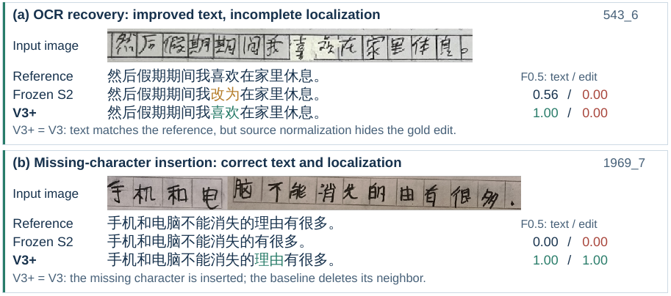
Correct text can still miss the required edit
Faithful source recognition is necessary for complete grounding
Source: Figure 3(a,b) and Section 4.7, pp. 7–8
13
Notes:
Slide 13. Suggested time: 70 seconds.
ENGLISH
These two selected examples reveal what aggregate scores can hide. In the upper example, the system recovers the reference phrase about resting at home. However, it has already normalized the erroneous character in its predicted source. The source-to-target comparison therefore emits no necessary edit. Text F-zero-point-five reaches one, but grounded-edit F-zero-point-five remains zero. In the lower example, the system inserts the missing character in the word meaning reason and correctly locates that insertion. Both scores reach one. The distinction is important: spatial grounding depends not only on a good target and detector, but also on faithfully transcribing the erroneous source. These are selected illustrative cases, so they explain behavior rather than estimate average accuracy or isolate the adapter's effect.
中文
这两个案例说明了平均分数容易掩盖的问题。上面的例子中，系统恢复了关于“在家休息”的正确表达，但预测原文已经把错误字符规范化了，所以原文与目标比较时，没有产生必要的修改。文本 F0.5 达到一，定位编辑 F0.5 却仍然是零。下面的例子中，系统补上了“理由”中缺失的字符，并且正确定位插入位置，两个分数都达到一。这说明完整定位不仅依赖正确目标句和检测框，还依赖对错误原文的忠实转写。这些案例是人工选择的解释性例子，用来理解系统行为，不能作为平均准确率估计，也不能单独证明适配器的效果。
Source: Xie and Huang, Ground Before Correcting: Evidence-Guided Visual Chinese Grammatical Error Correction at Multi-LLL 2026. Figure 3(a,b) and Section 4.7, pp. 7–8. Supplied PDF.

Slide 14
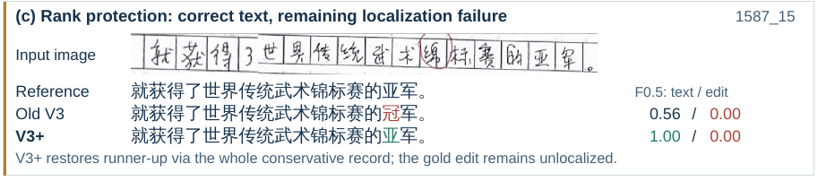
V3+ is a targeted rank-correction case study
Only an original default route may switch to the whole conservative record
1 of 245 dev examples changes; 214 holdout records stay identical
Dev gain: +0.000907; grounded-edit score stays unchanged
Source: Sections 3.5, 4.5, 4.7; Figure 3(c), pp. 4, 7–8
14
Notes:
Slide 14. Suggested time: 65 seconds.
ENGLISH
V3+ investigates one known development error after submission. Old V3 changes runner-up to champion, which does not trigger either a length-growth or placeholder rule. The extension compares five existing prediction views. If their rank expressions agree, parsing is verified, and the default and conservative targets differ only in one rank value, it may select the complete conservative record. Earlier repair and fallback routes remain untouched. In the reported experiment, exactly one of 245 development examples changes, and all 214 holdout records remain identical. The development composite increases by only zero point zero zero zero nine zero seven. Grounded-edit performance does not change because another source-normalization error still hides a necessary edit. These are correlated predictions and a known-error-driven rule, so the result supports a narrow case study rather than general factual reliability.
中文
V3+ 是提交后针对一个已知开发集错误进行的探索。旧 V3 把“亚军”改成“冠军”，字数没有变化，也没有新引入占位符，因此原有规则无法发现。扩展模块比较五个已有预测视角：如果名次表达一致、解析通过核验，并且默认与保守目标只在一个名次值上不同，就可以选择完整的保守候选。此前的修复和回退分支不受影响。实验中，二百四十五个开发样本只有一个发生变化，二百一十四个内部保留样本全部不变。开发集综合指标仅增加零点零零零九零七，定位编辑分数没有改善，因为另一处原文规范化仍然隐藏了必要编辑。这些预测相互关联，规则又针对已知错误设计，因此只能支持一个范围很窄的案例研究，不能证明普遍的事实可靠性。
Source: Xie and Huang, Ground Before Correcting: Evidence-Guided Visual Chinese Grammatical Error Correction at Multi-LLL 2026. Sections 3.5, 4.5, 4.7; Figure 3(c), pp. 4, 7–8. Supplied PDF.

Slide 15
Takeaways and open questions
Local evidence verification and separate grounding offer a clear task decomposition
The controlled comparison supports an adapter effect under the tested configuration
Recognition can hide edits even when the target is correct
Next tests: fully separated data, repeated seeds, and source-faithfulness checks
Source: Conclusion and Limitations, pp. 7–8
15
Notes:
Slide 15. Suggested time: 55 seconds.
ENGLISH
To conclude, GroundCorrect offers a clear decomposition of visual grammatical error correction. Global reading supplies context, local verification revisits uncertain details, and deterministic grounding assigns coordinates to text differences. The controlled comparison provides the strongest evidence for the adapter under the tested configuration. At the same time, the paper demonstrates that a correct target does not guarantee a complete grounded correction. Recognition can erase the evidence of an error before differencing begins. My main follow-up questions are how the system performs on fully separated end-to-end evaluation data, how stable the gains are across training seeds, and how recognition can preserve learner errors without silently correcting them. These are proposed next steps, not results established by this paper. Thank you.
中文
最后总结。GroundCorrect 对视觉语法纠错进行了清晰分工：全局识别提供上下文，局部核验重新观察不确定细节，确定性定位把文本差异映射到坐标。受控对比为适配器在当前配置下的效果提供了最有力的证据。同时，论文也揭示了一个重要问题：目标文本正确，并不保证定位编辑完整，因为识别阶段可能已经抹去了错误。我的后续关注包括：在完全隔离的端到端数据上效果如何，不同训练随机种子下增益是否稳定，以及如何让识别忠实保留学习者错误，而不是提前纠正。这些是我提出的后续方向，并非论文已经证明的结论。谢谢大家。
Source: Xie and Huang, Ground Before Correcting: Evidence-Guided Visual Chinese Grammatical Error Correction at Multi-LLL 2026. Conclusion and Limitations, pp. 7–8. Supplied PDF.

