Slide 1
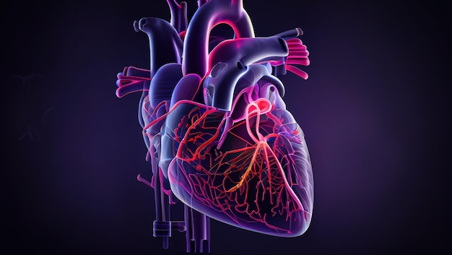
Comprehensive Health Analysis
Presented by:
Ashutosh Das
Karan Duhoon
Sukrutha Gowda
Shubham Solanki

Slide 2

Sleep Well, Live Well: Our Aim in Health Analysis
IF ?
What?

Slide 3

Sleep quality is one of the main products of a healthy lifestyle. We spend about a third of our lives sleeping or at least we should. Unfortunately, many of us fall short of that goal. According to the National Institutes of Health, insomnia affects about one-third of the general population, making it the most common sleep disorder in the United States.
Problem
Statement
Cardiovascular health is crucial for overall well-being, yet a considerable portion of the U.S. population faces challenges. According to the American Heart Association, heart diseases, including coronary artery disease and heart failure, remain prevalent. Ensuring awareness and preventive measures are vital for a healthier society.

Slide 4
Data Collection Pointers
Clearly Define Objectives
Ensure Ethical Compliance
Maintain Data Quality

Slide 5
Data Source
KAGGLE
01
Sleep health and lifestyle.csv
03
Uncleaned Heart Data.csv
02
Heart.csv
04

Slide 6
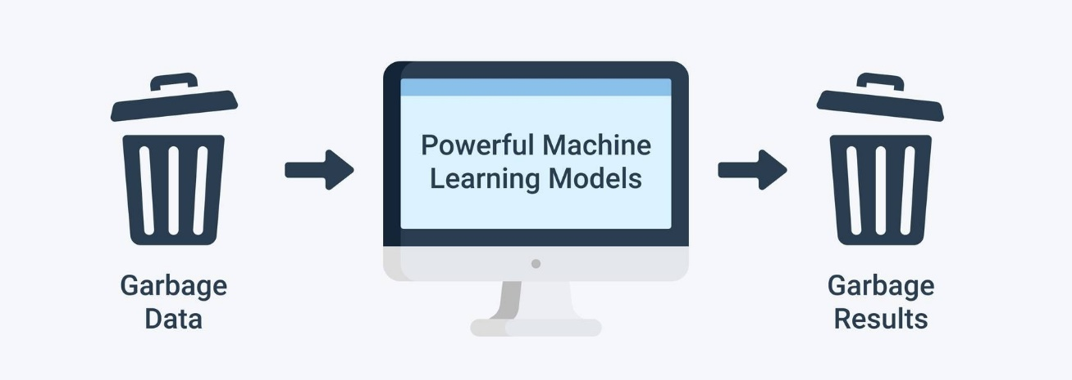
Data Preprocessing Techniques
1. Data cleaning
2. Elimination of Duplicates
3. Uniformity, Ensuring that each variable has the same format and measurement unit.
4. Encoding of Categorical Variables
5. Scaling and Normalization of Features
6. Recognition and Management of Outliers

Slide 7
Feature to predict Sleep Disorders
Predictable attribute:
Sleep Disorder: The presence or absence of a sleep disorder in the person (No Sleep Disorder, Insomnia, Sleep Apnea).
Input attributes:
Person ID , Gender ,Age ,Occupation, Sleep Duration (hours)
Quality of Sleep (scale: 1-10)
Physical Activity Level (minutes/day)
Stress Level
(scale: 1-10)
BMI Category
Blood Pressure (systolic/diastolic)
Heart Rate (bpm)
Daily Steps

Slide 8
Predictable attribute:
Target: field refers to the presence of heart disease in the patient. It is integer valued 0 = no disease and 1 = disease
Features to predict Heart Data (Balanced data)
Input attributes:
age
sex
chest pain type (4 values)
resting blood pressure
serum cholesterol in mg/dl
fasting blood sugar > 120 mg/dl
resting electrocardiographic results (values 0,1,2)
maximum heart rate achieved.
oldpeak = ST depression induced by exercise relative to rest
the slope of the peak exercise ST segment.
exercise induced angina.
number of major vessels (0-3) colored by fluoroscopy.
thal: 0 = normal; 1 = fixed defect; 2 = reversable defect

Slide 9
Predictable attribute:
HadHeartAttack; refers that if the person has ever had heart attack. It is integer valued 0 = No possibility of heart attack and 1 = Possibility of Heart attack.
Features to predict Heart Data
(Imbalanced data)
Input attributes:
SmokerStatus (Yes/No)
AlcoholDrinkers
HadStroke
DifficultyWalking
Sex
AgeCategory (18-80+)
RaceEthnicityCategory
HadDiabetes (Yes/No)
PhysicalHealthDays
GeneralHealth
(Excellent, Very good, Good, Fair, Poor)
HadAsthma
HadKidneyDisease
HadSkinCancer

Slide 10
Model Development
Logistic Regression
Decision Tree
Random Forest
Support Vector Machine
Extreme Gradient Booster
Neural Networks
Naive Bayes
KNN
XGBoost

Slide 11
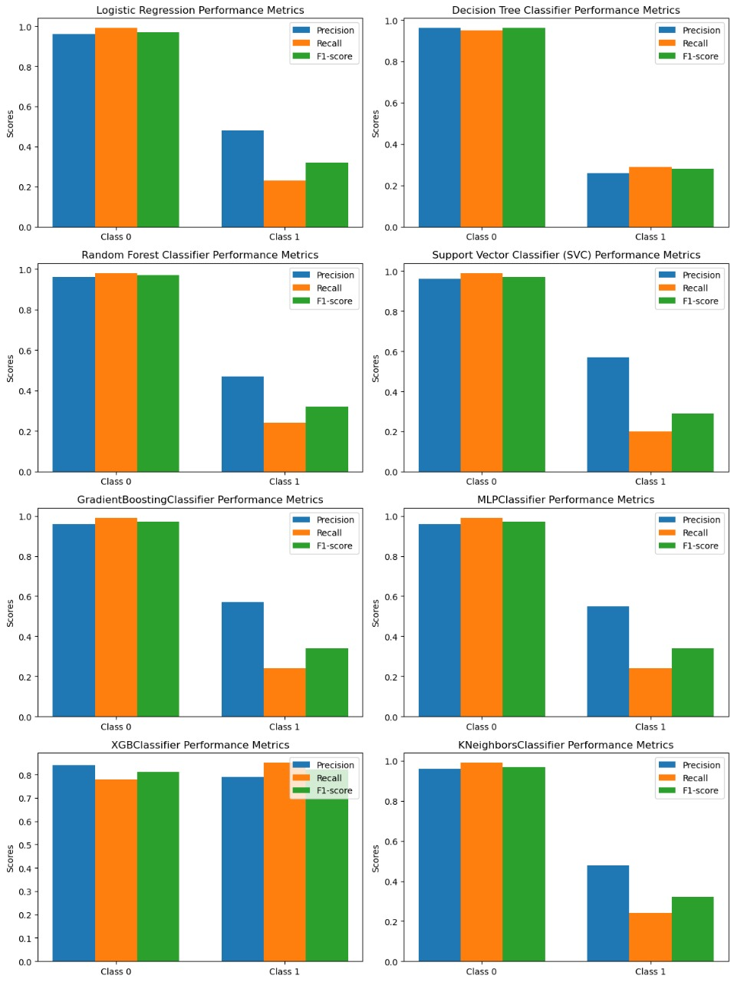
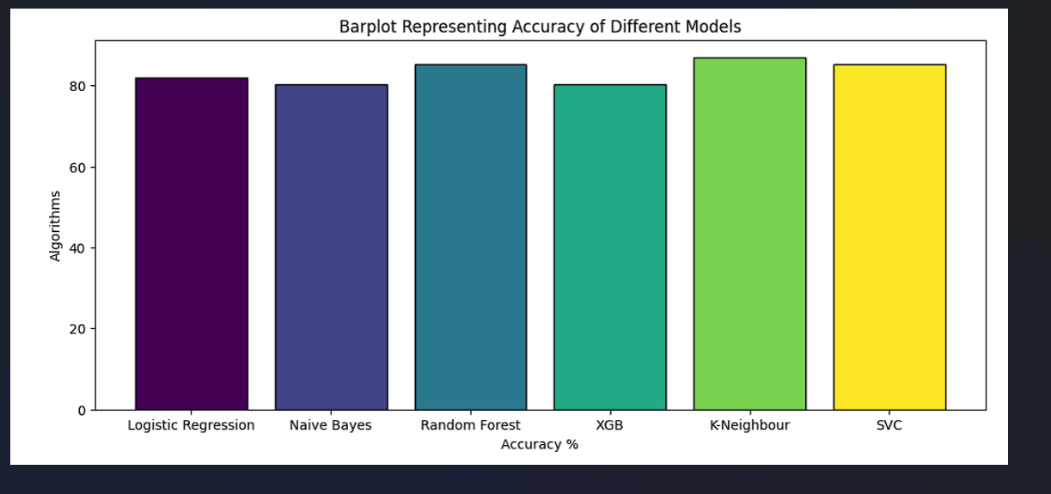
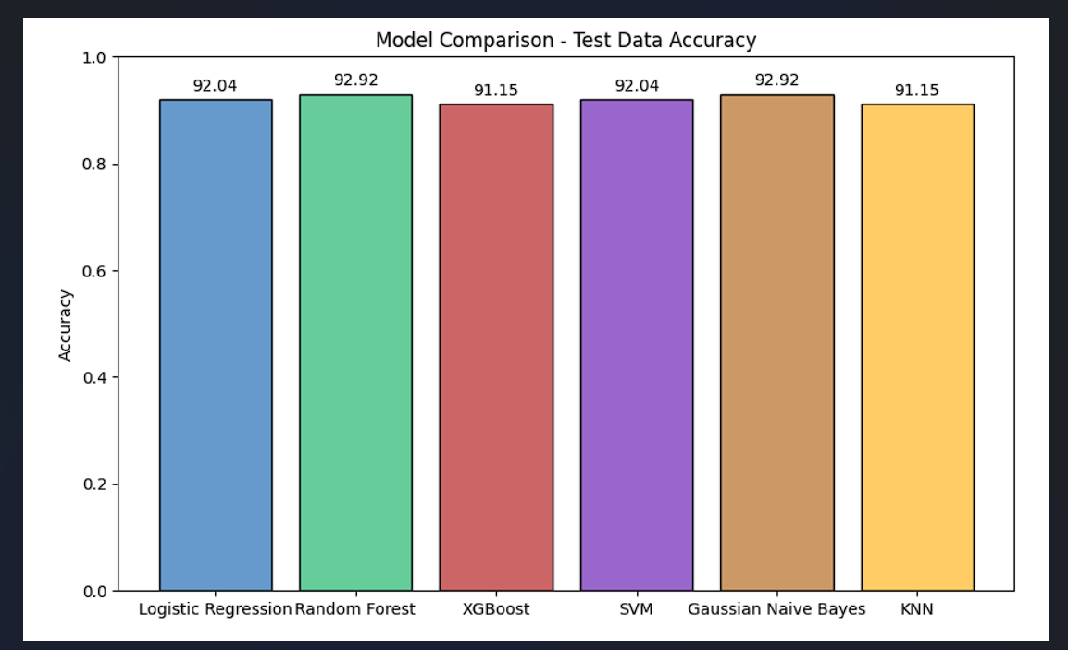

Slide 12
https://github.com/RACERXNOX/Comprehensive-Health-Analysis-.git
Thank You !!

