Slide 1
QNX - Neutrino RTOS
System Architecture

Slide 2
The Philosophy of QNX

Slide 3
Design Goals
Primary goal: Deliver open systems POSIX API in scalable form
  suitable for wide range of systems:
    Tiny resource-constrained systems
    High end distributed computing environments

Slide 4
mission-critical applications:
  robust architecture is fundamental:
    flexible and complete use of MMU hardware

Slide 5
An embeddable POSIX OS?
The myth:
    “if you scratch a POSIX operating system, you’ll find UNIX beneath the surface!”
    A POSIX OS is therefore too large and unsuitable for embedded systems.

Slide 6
The fact:
  POSIX is not UNIX
    POSIX standards are rooted in existing UNIX practice…
    POSIX working groups explicitly defined the standards in terms of “interface, not implementation.”

Slide 7
nontraditional OS architectures can provide a POSIX API without adopting the traditional UNIX kernel.
  POSIX systems look very much alike
    many of the same functions, utilities, etc
    differences in performance or reliability
    Architecture makes the difference

Slide 8
Product scaling
  including or omitting the particular processes that provide the functionality required
  use a single microkernel OS for a much wider range of applications than a realtime executive

Slide 9
advantages to scalable approach include:
  portable application code (between product-line members)
  common tools used to develop the entire product line
  portable skill sets of development staff
  reduced time-to-market.

Slide 10
Why POSIX for embedded systems?
  Problem with realtime application development: each realtime OS comes equipped with its own proprietary API
    realtime marketplace show heavy use of inhouse proprietary operating systems
  POSIX represents a chance to unify this marketplace

Slide 11
Many POSIX standards.
  Most interest to embedded systems developers:
    1003.1 —defines the API for process management, device I/O, filesystem I/O, and basic IPC
    Realtime Extensions— defines a set of realtime extensions.
      Consist of semaphores, prioritized process scheduling,…
    Threads—further extends the POSIX environment to include the creation and management of multiple threads of execution within a given address space.

Slide 12
    Additional Realtime Extensions—defines further extensions to the realtime standard.
      Facilities such as attaching interrupt handlers are described.
    Application Environment Profiles— defines several AEPs (Realtime AEP, Embedded Systems AEP, etc.) of the POSIX environment to suit different embedded capability sets.
      Represent embedded OSs with/without filesystems and other capabilities.

Slide 13
Specific advantages to applying POSIX:
  Multiple OS sources
    Hardware manufacturers don’t choose a single-sourced hardware component: risks if that source discontinues production
    Manufacturers shouldn’t be tied to a single-sourced, proprietary OS simply because their application source code isn’t portable to other OSs

Slide 14
    By building applications to the POSIX standards, developers can use OSs from multiple vendors.
      Application source code can be readily ported from platform to platform and from OS to OS, provided that developers avoid using OS-specific extensions.

Slide 15
  Portability of development staff
    Using a common API, programmers experienced with one realtime OS can directly apply their skill to other projects involving other processors and operating systems
    Programmers with UNIX or POSIX experience can easily work on embedded realtime systems, since the nonrealtime portion of the realtime OS’s API is already familiar territory

Slide 16
  Development environment: native and cross development
    With the addition of interface hardware similar to the target system, a workstation running a POSIX OS can become a functional superset of the embedded system
      Result: the application can be developed on the self-hosted desktop system
        the programmer doesn’t need to worry about platform-specific endian, alignment, or I/O issues.

Slide 17
Why QNX for embedded systems?
Main responsibility of an operating system: manage a computer’s resources
  All activities in the system— scheduling application programs, writing files to disk, sending data across a network, and so on —should function together as seamlessly and transparently as possible

Slide 18
  Some environments call for more rigorous resource management and scheduling than others.
    E.g. Realtime applications depend on the OS to handle multiple events and to ensure that the system responds to those events within predictable time limits.
      The more responsive the OS, the more “time” a realtime application has to meet its deadlines.

Slide 19
  QNX for embedded realtime applications
    Can be scaled to small sizes and provides
      multitasking
      threads
      priority-driven preemptive scheduling
      fast context-switching
    QNX delivers these capabilities with a POSIX-standard API; there’s no need to forgo standards in order to achieve a small OS

Slide 20
  QNX is also flexible:
    Developers can easily customize the OS to meet the needs of their applications
    From a “bare-bones” configuration of a microkernel with a few small modules to a full-blown network-wide system equipped to serve hundreds of users
    QNX lets you set up your system to use only those resources you require to tackle the job at hand

Slide 21
QNX achieves its degree of efficiency, modularity, and simplicity through two fundamental principles:
  microkernel architecture
  message-based interprocess communication

Slide 22
Microkernel Architecture
Microkernel:
  A microkernel OS is structured as a tiny kernel that provides the minimal services used by a team of optional cooperating processes, which in turn provide the higher-level OS functionality.
  The microkernel itself lacks filesystems and many other services normally expected of an OS —those services are provided by optional processes.

Slide 23
  The real goal in designing a microkernel OS is not simply to “make it small.”
    A microkernel OS embodies a fundamental change in the approach to delivering OS functionality
    Modularity is the key, size is but a side effect.
    To call any kernel a “microkernel” simply because it happens to be small would miss the point entirely

Slide 24
Since the IPC services provided by the microkernel are used to “glue” the OS itself together, the performance and flexibility of those services govern the performance of the resulting OS
  With the exception of those IPC services, a microkernel is roughly comparable to a realtime executive, both in terms of the services provided and in their realtime performance

Slide 25
  The microkernel differs from an executive in how the IPC services are used to extend the functionality of the kernel with additional, service-providing processes
    OS is implemented as a team of cooperating processes managed by the microkernel
    User-written processes can serve both as applications and as processes that extend the underlying OS functionality
      The OS itself becomes “open” and easily extensible
      user-written extensions to the OS won’t affect the fundamental reliability of the core OS.

Slide 26
  Difficulty for many realtime executives implementing the POSIX 1003.1 standard:
    their runtime environment is typically a single-process, multiple-threaded model, with unprotected memory between threads
    This is a subset of the multi-process model POSIX assumes and cannot support the fork() function
    QNX fully utilizes an MMU to deliver the complete POSIX process model in a protected environment

Slide 27
As the following diagrams show, a true microkernel offers complete memory protection, not only for user applications, but also for OS components (device drivers, filesystems, etc.)

Slide 28
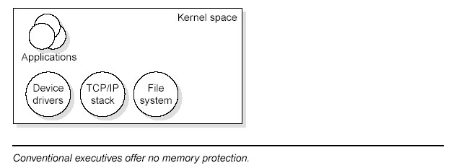
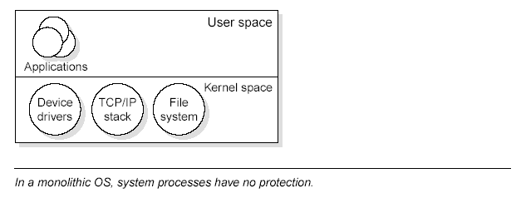

Slide 29
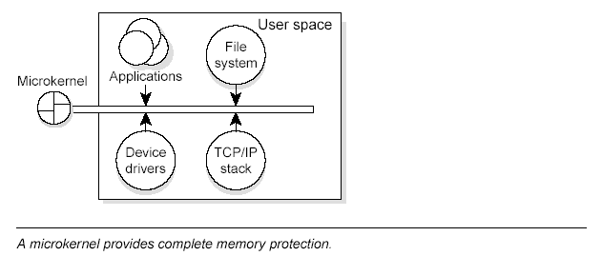

Slide 30
The OS as a team of processes
  The OS consists of the small Neutrino microkernel managing a group of cooperating processes
As the following illustration shows, the structure looks more like a team than a hierarchy, as several “players” of equal rank interact with each other through the coordinating kernel.

Slide 31
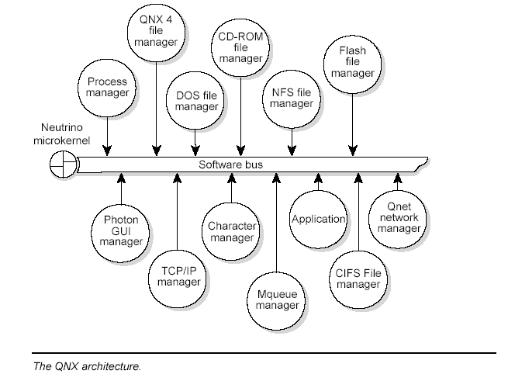

Slide 32
A true kernel
  The kernel is the heart of any operating system. In some systems, the “kernel” comprises so many functions that for all intents and purposes it is the entire operating system!
  Neutrino is truly a kernel.
    First of all, like the kernel of a realtime executive, Neutrino is very small
    Secondly, it’s dedicated to only a few fundamental services:

Slide 33
  thread services—Neutrino provides the POSIX thread-creation primitives.
  signal services—Neutrino provides the POSIX signal primitives.
  message-passing services—Neutrino handles the routing of all messages between all threads throughout the entire system.
  synchronization services— Neutrino provides the POSIX thread synchronization primitives.

Slide 34
  scheduling services—Neutrino schedules threads for execution using the various POSIX realtime scheduling algorithms.
  timer services—Neutrino provides the rich set of POSIX timer services.
  process management services—the Neutrino microkernel and the process manager together form a unit (called procnto). The process manager portion isresponsible for managing processes, memory, and the pathname space.

Slide 35
Unlike threads, Neutrino itself is never scheduled for execution. The processor executes code in the kernel only as the result of an explicit kernel call, an exception, or in response to a hardware interrupt.

Slide 36
System processes
  All OS services, except those provided by the procnto, are handled via standard processes.
  A richly configured system could include the following:
    filesystem managers (e.g. fs-dos.so, fs-qnx4.so)
    character device managers (e.g. devc-con)
    graphical user interface (Photon)
    native network manager (npm-qnet.so)
    TCP/IP (npm-tcpip.so)

Slide 37
System processes vs user-written processes
  System processes are essentially indistinguishable from any user-written program— they use the same public API and kernel services available to any (suitably privileged) user process.
  It is this architecture that gives the OS unparalleled extensibility. Since most OS services are provided by standard system processes, it’s very simple to augment the OS itself:
      just write new programs to provide new OS services.

Slide 38
Device drivers
  Device drivers allow the OS and application programs to make use of the underlying hardware in a generic way (e.g. a disk drive, a network interface).
  Unlike OSs that require device drivers to be tightly bound into the OS itself, device drivers for QNX can be started and stopped as standard processes.
  As a result, adding device drivers doesn’t affect any other part of the OS —drivers can be developed and debugged like any other application.

Slide 39
Interprocess Communication

Slide 40
  When several threads run concurrently, as in typical realtime multitasking environments, the operating system must provide mechanisms to allow them to communicate with each other.
  Interprocess communication (IPC) is the key to designing an application as a set of cooperating processes in which each process handles one well-defined part of the whole.
  The OS provides a simple but powerful set of IPC capabilities that greatly simplify the job of developing applications made up of cooperating processes.

Slide 41
QNX as a message-passing operating system
  In QNX, a message is a parcel of bytes passed from one process to another. The OS attaches no special meaning to the content of a message—the data in a message has meaning for the sender of the message and for its receiver, but for no one else.

Slide 42
  Message passing not only allows processes to pass data to each other, but also provides a means of synchronizing the execution of several processes.
  As they send, receive, and reply to messages, processes undergo various “changes of state” that affect when, and for how long, they may run.
  Knowing their states and priorities, the Neutrino microkernel can schedule all processes as efficiently as possible to make the most of available CPU resources.

Slide 43
The Neutrino Microkernel

Slide 44
Introduction
  Neutrino is a microkernel implementation of the core POSIX features used in embedded realtime systems, along with the fundamental QNX message-passing services.
  The POSIX features that aren’t implemented in the microkernel (file and device I/O, for example) are provided by optional processes and shared libraries.

Slide 45
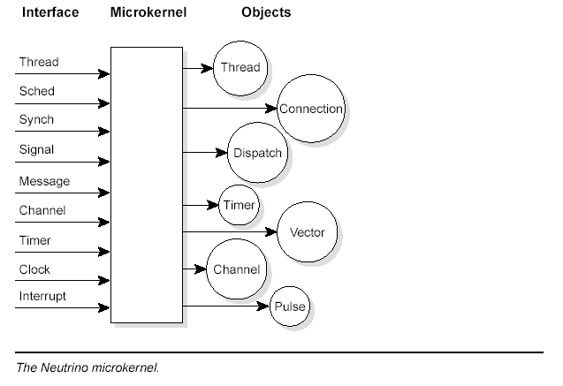
At its lowest level, Neutrino contains a few fundamental objects and the highly tuned routines that manipulate them.

Slide 46
Neutrino services
  The Neutrino microkernel has kernel calls to support the following:
    message passing
    threads
    signals
    clocks
    timers
    interrupt handlers
    semaphores
    mutual exclusion locks (mutexes)
    condition variables (condvars)
    barriers.

Slide 47
The entire OS is built upon these calls.
Neutrino is fully preemptable, even while passing messages between processes;
  it resumes the message pass where it left off before preemption.
The minimal complexity of the Neutrino microkernel helps place an upper bound on the longest nonpreemptable code path through the kernel
The small code size makes addressing complex multiprocessor issues a tractable problem.

Slide 48
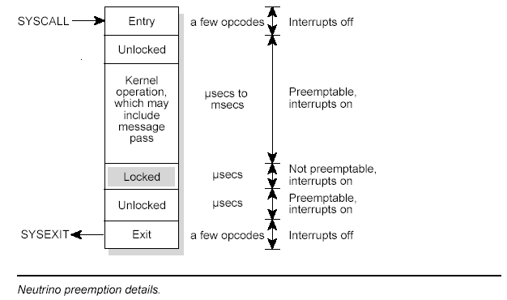
The following diagram shows the preemption details for the non-SMP kernel (x86 implementation). The SMP version of the kernel has more opcodes.

Slide 49
Threads and processes
  When building an application (realtime, embedded, graphical, or otherwise), the developer may want several algorithms within the application to execute concurrently.
  Within Neutrino, this concurrency is achieved by using the POSIX thread model, which defines a process as containing one or more threads of execution.

Slide 50
A thread:
  can be thought of as the minimum “unit of execution,” the unit of scheduling and execution in the microkernel
A process:
  can be thought of as a “container” for threads, defining the “address space” within which threads will execute
  A process will always contain at least one thread

Slide 51
Neutrino provides a rich variety of IPC and synchronization services.
The following pthreads (POSIX Threads) library calls don’t involve any microkernel thread calls:
pthread_attr_destroy()
pthread_attr_getdetachstate()
pthread_attr_getinheritsched()
pthread_attr_getschedparam()
pthread_attr_getschedpolicy()
pthread_attr_getscope()
…

Slide 52
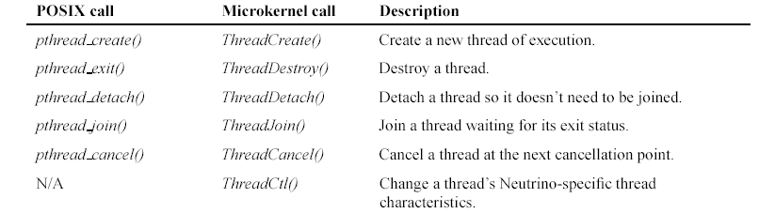
The following table lists the POSIX thread calls that have a corresponding microkernel thread call, allowing you to choose either interface:

Slide 53
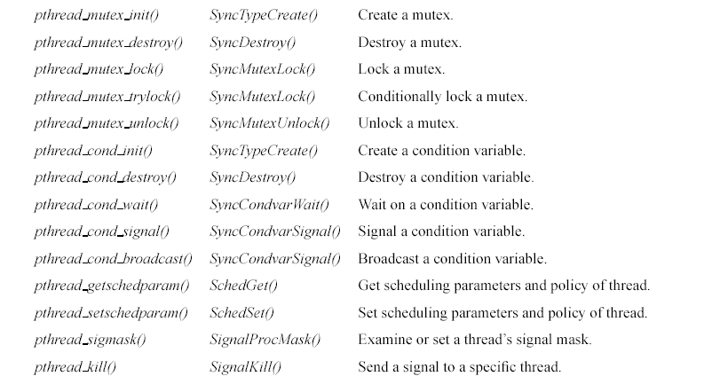

Slide 54
Thread attributes
  Although threads within a process share everything within the process’s address space, each thread still has some “private” data.
  In some cases, this private data is protected within the kernel (e.g. the tid or thread ID), while other private data resides unprotected in the process’s address space (e.g. each thread has a stack for its own use).

Slide 55
Some of the more noteworthy thread-private resources are:
  tid Each thread is identified by an integer thread ID, starting at 1. The tid is unique within the thread’s process.
  register set Each thread has its own instruction pointer (IP), stack pointer (SP), and other processor-specific register context.
  stack Each thread executes on its own stack, stored within the address space of its process.
  signal mask Each thread has its own signal mask.
  thread local storage A thread has a system-defined data area called “thread local storage” (TLS). The TLS is used to store “per-thread” information (such as tid, pid, stack base, errno, and thread-specific key/data bindings). The TLS doesn’t need to be accessed directly by a user application. A thread can have user-defined data associated with a thread-specific data key.
  cancellation handlers Callback functions that are executed when the thread terminates.

Slide 56
Thread-specific data, implemented in the pthread library and stored in the TLS, provides a mechanism for associating a process global integer key with a unique per-thread data value. To use thread-specific data, you first create a new key and then bind a unique data value to the key (per thread).
The data value may, for example, be an integer or a pointer to a dynamically allocated data structure. Subsequently, the key can return the bound data value per thread.
A typical application of thread-specific data is for a thread-safe function that needs to maintain a context for each calling thread.

Slide 57
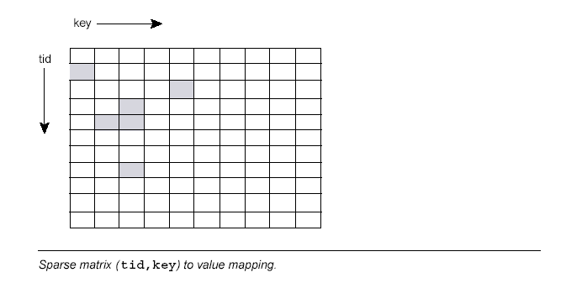
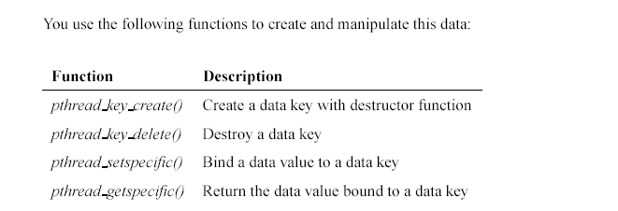

Slide 58
Thread life cycle
The number of threads within a process can vary widely, with threads being created and destroyed dynamically.
Thread creation (pthread create()) involves allocating and initializing the necessary resources within the process’s address space (e.g. thread stack) and starting the execution of the thread at some function in the address space.
Thread termination (pthread exit(), pthread cancel()) involves stopping the thread and reclaiming the thread’s resources. As a thread executes, its state can generally be described as either “ready” or “blocked.”
More specifically, it can be one of the following:

Slide 59
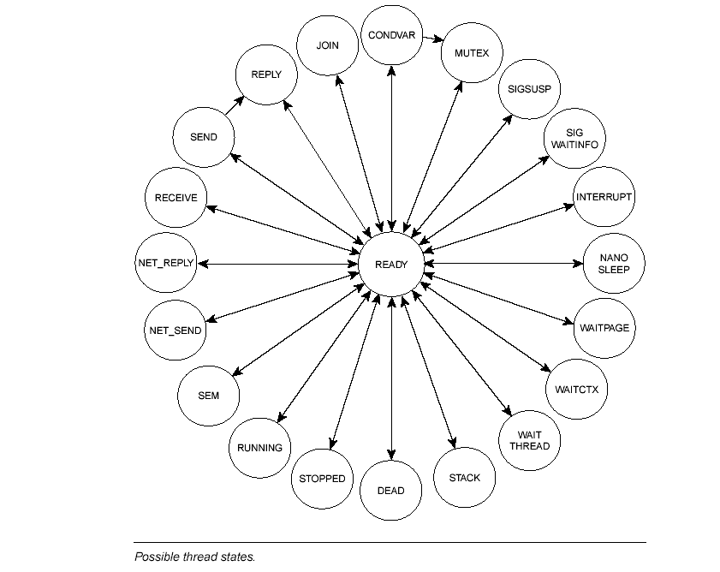

Slide 60
CONDVAR The thread is blocked on a condition variable (e.g. it called pthread condvar wait()).
DEAD The thread has terminated and is waiting for a join by another thread.
INTERRUPT The thread is blocked waiting for an interrupt (i.e. it called InterruptWait()).
JOIN The thread is blocked waiting to join another thread (e.g. it called pthread join()).
MUTEX The thread is blocked on a mutual exclusion lock (e.g. it called pthread mutex lock()).
NANOSLEEP The thread is sleeping for a short time interval (e.g. it called nanosleep()).
NET REPLY The thread is waiting for a reply to be delivered across the network (i.e. it called MsgReply*()).
NET SEND The thread is waiting for a pulse or signal to be delivered across the network (i.e. it called MsgSendPulse(), MsgDeliverEvent(), or SignalKill()).
READY The thread is waiting to be executed while the processor executes another thread of equal or higher priority.

Slide 61
RECEIVE The thread is blocked on a message receive (e.g. it called MsgReceive()).
REPLY The thread is blocked on a message reply (i.e. it called MsgSend(), and the server received the message).
RUNNING The thread is being executed by a processor.
SEM The thread is waiting for a semaphore to be posted (i.e. it called SyncSemWait()).
SEND The thread is blocked on a message send (e.g. it called MsgSend(), but the server hasn’t yet received the message).
SIGSUSPEND The thread is blocked waiting for a signal (i.e. it called sigsuspend()).
SIGWAITINFO The thread is blocked waiting for a signal (i.e. it called sigwaitinfo()).
STACK The thread is waiting for the virtual address space to be allocated for the thread’s stack (parent will have called ThreadCreate()).
STOPPED The thread is blocked waiting for a SIGCONT signal.
WAITCTX The thread is waiting for a noninteger (e.g. floating point) context to become available for use.

Slide 62
WAITPAGE The thread is waiting for physical memory to be allocated for a virtual address.
WAITTHREAD The thread is waiting for a child thread to finish creating itself (i.e. it called ThreadCreate()).

Slide 63
Thread scheduling
The execution of a running thread is temporarily suspended whenever the microkernel is entered as the result of a kernel call, exception, or hardware interrupt.
A scheduling decision is made whenever the execution state of any thread changes—it doesn’t matter which processes the threads might reside within.
Threads are scheduled globally across all processes.

Slide 64
Normally, the execution of the suspended thread will resume, but the scheduler will perform a context switch from one thread to another whenever the running thread:
  is blocked
  is preempted
  yields.

Slide 65
When thread is blocked
  The running thread blocks when it must wait for some event to occur (response to an IPC request, wait on a mutex, etc.). The blocked thread is removed from the ready queue and the highest priority ready thread is then run. When the blocked thread is subsequently unblocked, it is placed on the end of the ready queue for that priority level.

Slide 66
When thread is preempted
  The running thread is preempted when a higher-priority thread is placed on the ready queue (it becomes READY, as the result of its block condition being resolved). The preempted thread remains at the start of the ready queue for that priority and the higher-priority thread runs.

Slide 67
When thread yields
  The running thread voluntarily yields the processor (sched yield()) and is placed on the end of the ready queue for that priority. The highest-priority thread then runs (which may still be the thread that just yielded).

Slide 68
Scheduling priority
  Every thread is assigned a priority. The scheduler selects the next thread to run by looking at the priority assigned to every thread that is READY (i.e. capable of using the CPU). The thread with the highest priority is selected to run.
  The following diagram shows the ready queue for six threads (A-F) that are READY. All other threads (G-Z) are BLOCKED. Thread A is currently running. Thread A, B, and C are at the highest priority, so they’ll share the processor based on the running thread’s scheduling algorithm.

Slide 69
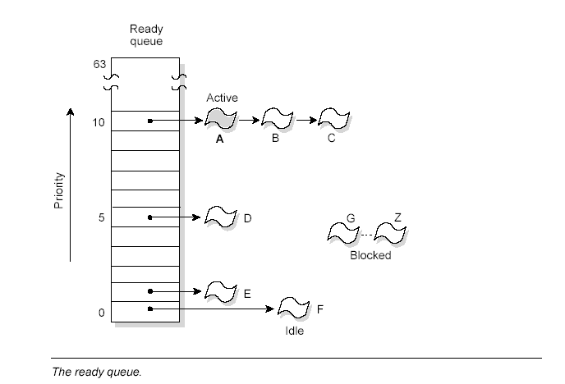

Slide 70
Each thread can have a scheduling priority ranging from 1 to 63 (the highest priority), independent of the scheduling policy. The special idle thread (in the process manager) has priority 0 and is always ready to run.
A thread inherits the priority of its parent thread by default.
A thread has both a real priority and an effective priority, and is scheduled in accordance with its effective priority. The thread itself can change both its real and effective priority together, but the effective priority may change because of priority inheritance or the scheduling policy.
Normally, the effective priority is the same as the real priority.
The threads on the ready queue are ordered by priority. The ready queue is actually implemented as 64 separate queues, one for each priority.
Threads are queued in FIFO order in the queue of their priority. The first thread in the highest priority queue is selected to run.

Slide 71
Scheduling algorithms
  To meet the needs of various applications, QNX provides these scheduling algorithms:
    FIFO scheduling
    round-robin scheduling
    adaptive scheduling
    sporadic scheduling.

Slide 72
Each thread in the system may run using any method. They are effective on a per-thread basis, not on a global basis for all threads and processes on a node.
Remember that the FIFO and round-robin scheduling algorithms apply only when two or more threads that share the same priority are READY (i.e. the threads are directly competing with each other).
The adaptive and sporadic methods, however, employ a “budget” for a thread’s execution.
In all cases, if a higher-priority thread becomes READY, it immediately preempts all lower-priority threads.

Slide 73
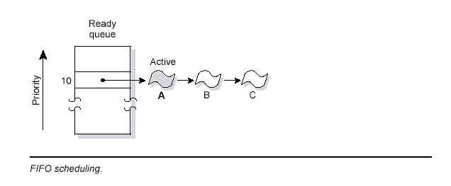
FIFO scheduling
  In FIFO scheduling, a thread selected to run continues executing until it:
    voluntarily relinquishes control (e.g. it blocks)
    is preempted by a higher-priority thread.

Slide 74
Round-robin scheduling
  In round-robin scheduling, a thread selected to run continues executing until it:
    voluntarily relinquishes control
    is preempted by a higher-priority thread
    consumes its timeslice.

Slide 75
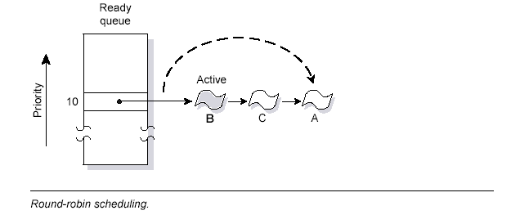
As the following diagram shows, Thread A ran until it consumed its timeslice; the next READY thread (Thread B) now runs:

Slide 76
A timeslice is the unit of time assigned to every process.
Once it consumes its timeslice, a thread is preempted and the next READY thread at the same priority level is given control.
A timeslice is 4 the clock period.

Slide 77
Adaptive scheduling
  In adaptive scheduling, a thread behaves as follows:
    If the thread consumes its timeslice (i.e. it doesn’t block), its priority is reduced by 1. This is known as priority decay. Note that a “decayed” thread won’t continue decaying, even if it consumes yet another timeslice without blocking—it will drop only one level below its original priority.
    If the thread blocks, it immediately reverts to its original priority.

Slide 78
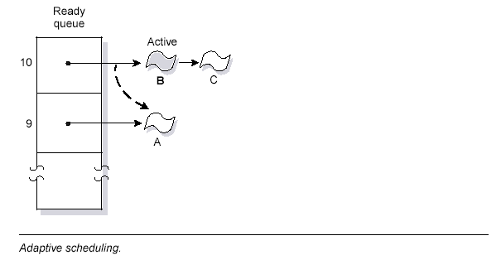
As the following diagram shows, Thread A consumed its timeslice; its priority was then dropped by 1. The next READY thread (Thread B) runs.

Slide 79
Adaptive scheduling can be used in environments where potentially compute-intensive background threads are sharing the computer with interactive users.
You should find that adaptive scheduling gives the compute-intensive threads sufficient access to the CPU, yet retains fast interactive response for other threads.
It is rarely used for most realtime control systems.

