Slide 1
Amazon Multi-Domain
Review Sentiment Analysis
A TF-IDF + classical ML pipeline for automated review sentiment classification
and customer-complaint keyword extraction across product categories
Nguyễn Thị Việt Thương | Machine Learning Portfolio Project 2/2

Slide 2
MOTIVATION
Why sentiment analysis for review data?
An online retailer receives thousands of product reviews every month. No team can read every one — but every one carries a signal about product quality, shipping, or customer expectations.
1
Can review sentiment be predicted from text alone, with an interpretable, low-cost pipeline?
2
Which keywords are most characteristic of negative vs. positive reviews — and does this differ by category?
3
Which product category is hardest to understand from review text, and what should a business team do about it?
2

Slide 3
DATA & METHOD
From raw reviews to a trained classifier
Dataset
Pipeline
11,267 English-language Amazon reviews
3 categories, balanced: book, electronics, beauty (3,756 each)
3-class label: negative / neutral / positive (from 1★–5★ rating)
Source: goosmanlei/amazon_reviews_multi (Hugging Face), pre-cleaned
EDA
→
Text cleaning
(stopwords + stemming)
→
TF-IDF
vectorization
→
Model training
(Logistic Reg. + Boosted Trees)
→
Evaluation
& insight
TF-IDF: term × inverse-document-frequency — weighs words that are frequent in one review but rare across all reviews. Chosen over embeddings (Word2Vec/BERT) for interpretability, low compute cost, and fit with a first NLP project — a deliberate scope decision, not a knowledge gap.
All modeling patterns (stratified split, Logistic Regression / Boosted Tree Classifier, ML.EVALUATE, ML.WEIGHTS) follow the BigQuery ML workflow used throughout the Data Analytics coursework.
3

Slide 4
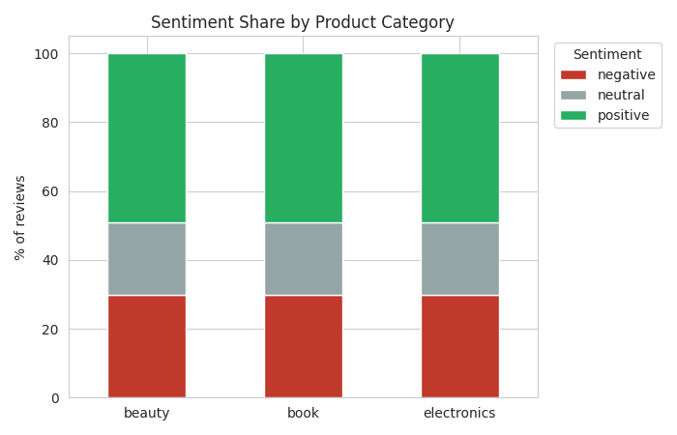
EXPLORATORY ANALYSIS
Sentiment is balanced — but identical across categories
Key finding
Every category shows the exact same split: 29.8% negative / 21.1% neutral / 49.1% positive.
This is a byproduct of how the dataset was pre-balanced — it means "negative rate" cannot distinguish categories.
The real differentiator has to come from what reviews actually say, and how well a model can classify each category (next slides).
4

Slide 5
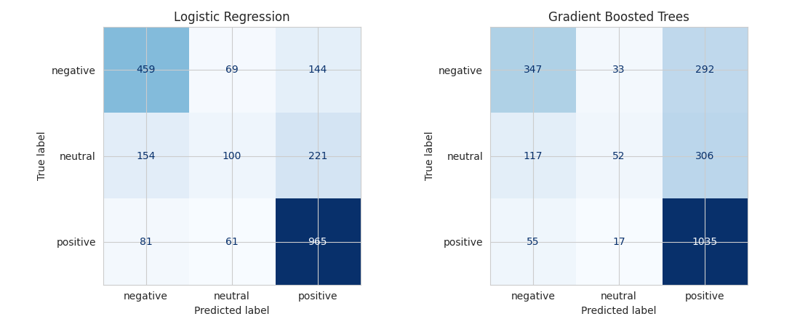
MODEL RESULTS
Logistic Regression outperforms Boosted Trees
Sentiment | F1 (LogReg) | F1 (Boosted Trees)
Negative | 0.672 | 0.583
Neutral | 0.284 | 0.180
Positive | 0.792 | 0.755
Overall accuracy: 67.6% (Logistic Regression) vs. 63.6% (Boosted Trees)
The neutral class is consistently the hardest to classify — it sits between negative and positive vocabulary and gets confused with both, visible directly in the confusion matrices.
5

Slide 6
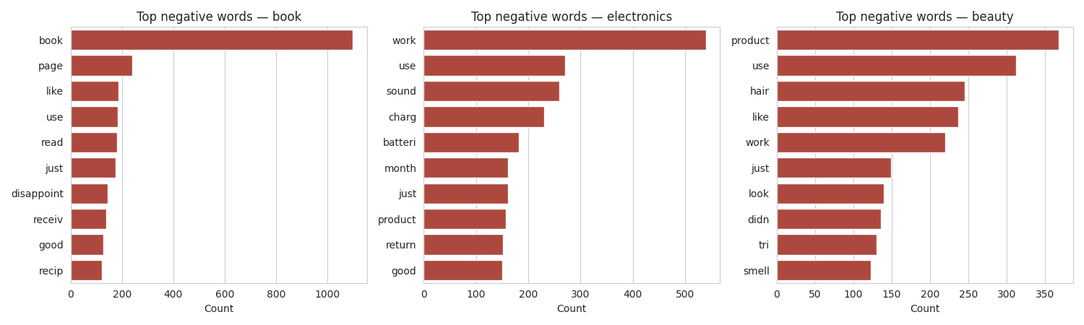
BUSINESS INSIGHT
What each category's negative reviews say
Category | Model accuracy | Negative reviews signal… | Suggested action
Book | 69.9% (best) | Condition on arrival, content mismatch | Review packaging & listing accuracy
Electronics | 67.8% | Functional failure (charging, sound, battery) | Flag to supplier QC — most actionable
Beauty | 65.3% (hardest) | Subjective/sensory (smell, feel, look) | Treat predictions with more caution
6

Slide 7
CONCLUSION
What this shows — and its honest limits
Takeaway
Limitations
A classic TF-IDF + classical-ML pipeline classifies review sentiment with useful, interpretable accuracy.
Every prediction traces back to specific words via model coefficients — no black box.
Cheap to train and run: no GPU, no fine-tuning required.
TF-IDF has no semantic/contextual understanding (mitigated partly by bigrams).
Only 3 categories — not representative of the full retail market.
Dataset was pre-filtered/balanced by a third party before I received it.
Possible extensions
Experiment with word embeddings for semantic understanding · extend to the other languages already present in the source multilingual dataset · incorporate additional product categories
7

