Slide 1
🧸
ABC TOYS
Strategic Analysis 2022–2023
Executive Presentation to the Board
Data Analyst Team | Q4 2023

Slide 2
Context & Objectives
Why we're here today
Who we are
7 Questions we'll answer
50 stores across 29 cities, offering 35 products in 5 categories.
1. Are we growing? What does the trend look like?
2. How does 2023 compare to 2022?
3. Which category is most profitable?
4. Which products are stars, cash cows, or dogs?
5. Which store locations are most efficient?
6. Are we too dependent on certain cities?
7. Do we have inventory problems?
Our mission today
Distill 829,262 transactions from 21 months of operations into 3 strategic priorities for 2024.
ABC Toys — Strategic Analysis 2023
2 / 14

Slide 3
Executive Summary
21 months at a glance
$14.4M
$4.0M
27.8%
1.09M
Total Revenue
Total Profit
Overall Margin
Units Sold
Bottom line
ABC Toys is growing strongly — but revenue (+30.9%) outpaced profit (+16.0%) in 2023, signaling margin compression. We see clear opportunities in product mix, location strategy, and inventory.
ABC Toys — Strategic Analysis 2023
3 / 14

Slide 4
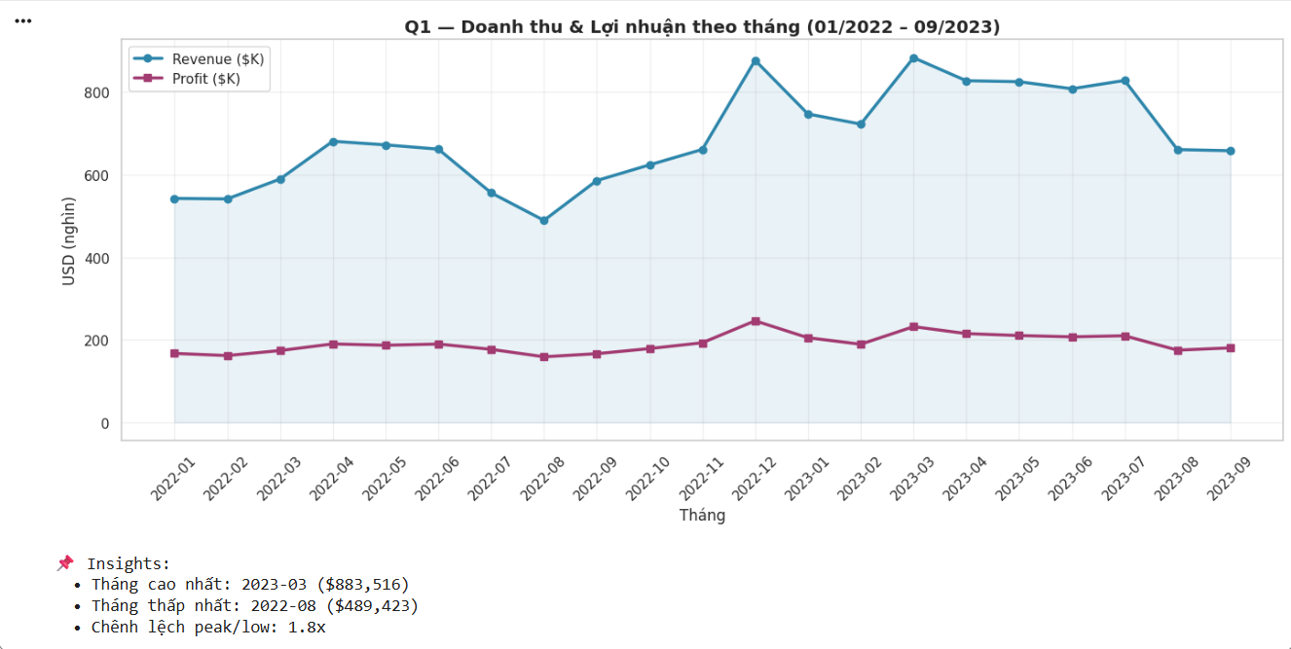
Q1 — Are we growing?
Revenue and profit over 21 months
Key insights
Strong upward trend
Both revenue and profit are growing month-over-month.
Two seasonal peaks
May (Children's Day) and Nov–Dec (Holidays) consistently spike.
Profit lags revenue
The gap is widening — a margin warning sign.
ABC Toys — Strategic Analysis 2023
4 / 14

Slide 5
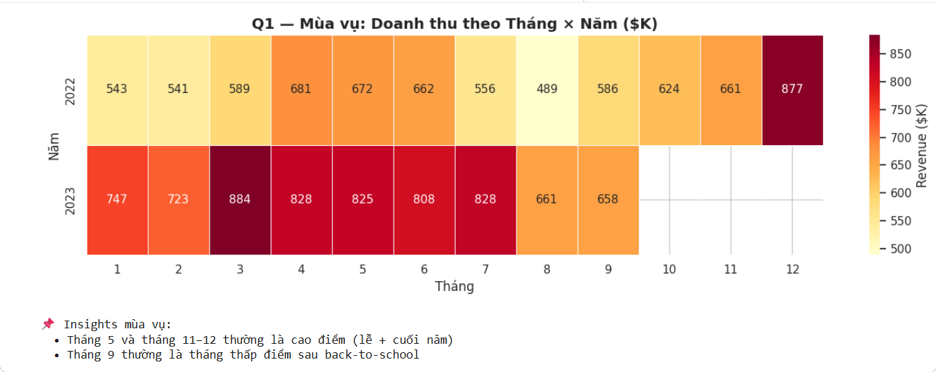
Seasonality matters
Revenue ($K) by month × year
What we see
M
May = Children's Day peak
D
Nov–Dec = Holiday surge
↑
2023 lifts the baseline
Both years see strong May sales — a key promotional window.
End-of-year shopping drives 25%+ of annual revenue.
Even off-peak months in 2023 exceed 2022 peaks.
ABC Toys — Strategic Analysis 2023
5 / 14

Slide 6
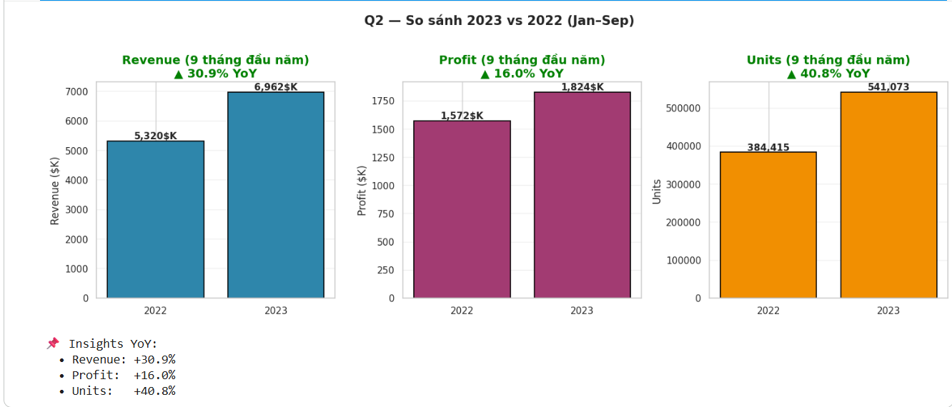
Q2 — 2023 vs 2022
First 9 months comparison (apples-to-apples)
▲ 30.9%
Revenue YoY growth
▲ 40.8%
Units YoY growth
▲ 16.0%
Profit YoY growth
⚠️ Units grew +40.8% but profit only +16.0% — average selling price and/or margin is slipping.
ABC Toys — Strategic Analysis 2023
6 / 14

Slide 7
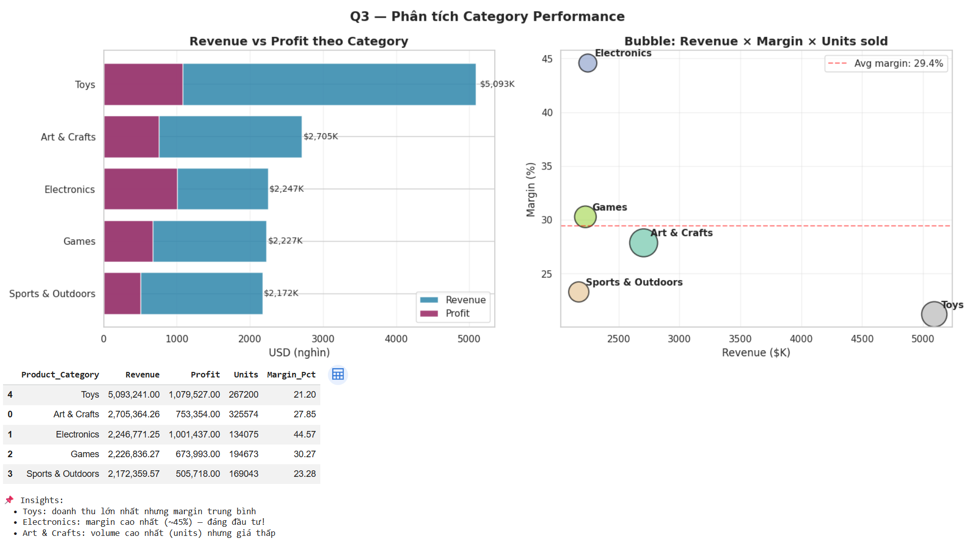
Q3 — Which category is most profitable?
Revenue vs Margin trade-off
Margin by category
Category | Margin
Electronics | 44.6%
Games | 30.3%
Art & Crafts | 27.8%
Sports & Outdoors | 23.3%
Toys | 21.2%
💡 Insight
Electronics delivers the highest margin (~45%) but only the #3 in revenue. Room to grow.
ABC Toys — Strategic Analysis 2023
7 / 14

Slide 8
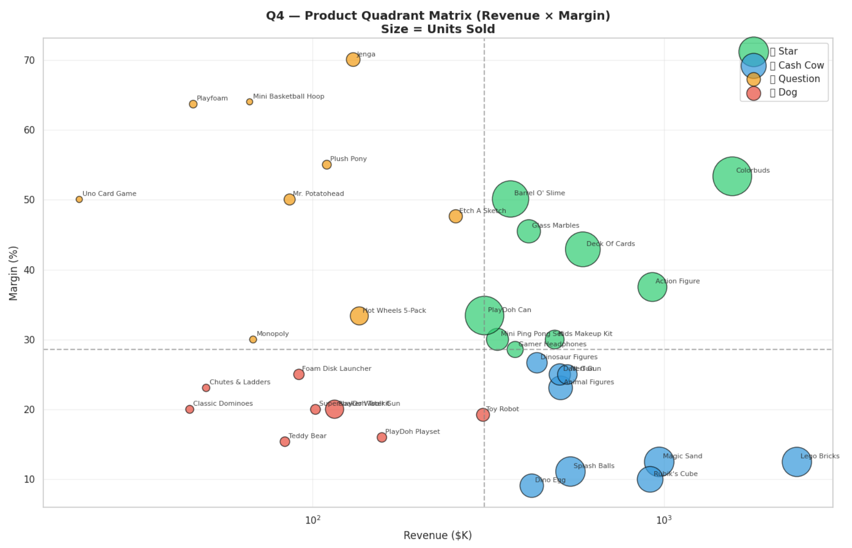

Slide 9
Q4 — Stars, Cash Cows, Question Marks, Dogs
Classifying 35 products by Revenue × Margin
⭐ STARS
🐄 CASH COWS
High Revenue + High Margin
High Revenue + Low Margin
• Colorbuds
• Action Figure
• Deck Of Cards
• Lego Bricks
• Magic Sand
• Rubik's Cube
→ Invest aggressively
→ Optimize pricing / sourcing
❓ QUESTION MARKS
🐕 DOGS
Low Revenue + High Margin
Low Revenue + Low Margin
• Jenga
• Playfoam
• Mini Basketball Hoop
• Uno Card Game
• Classic Dominoes
• Chutes & Ladders
→ Test & scale winners
→ Consider delisting
ABC Toys — Strategic Analysis 2023
8 / 14

Slide 10
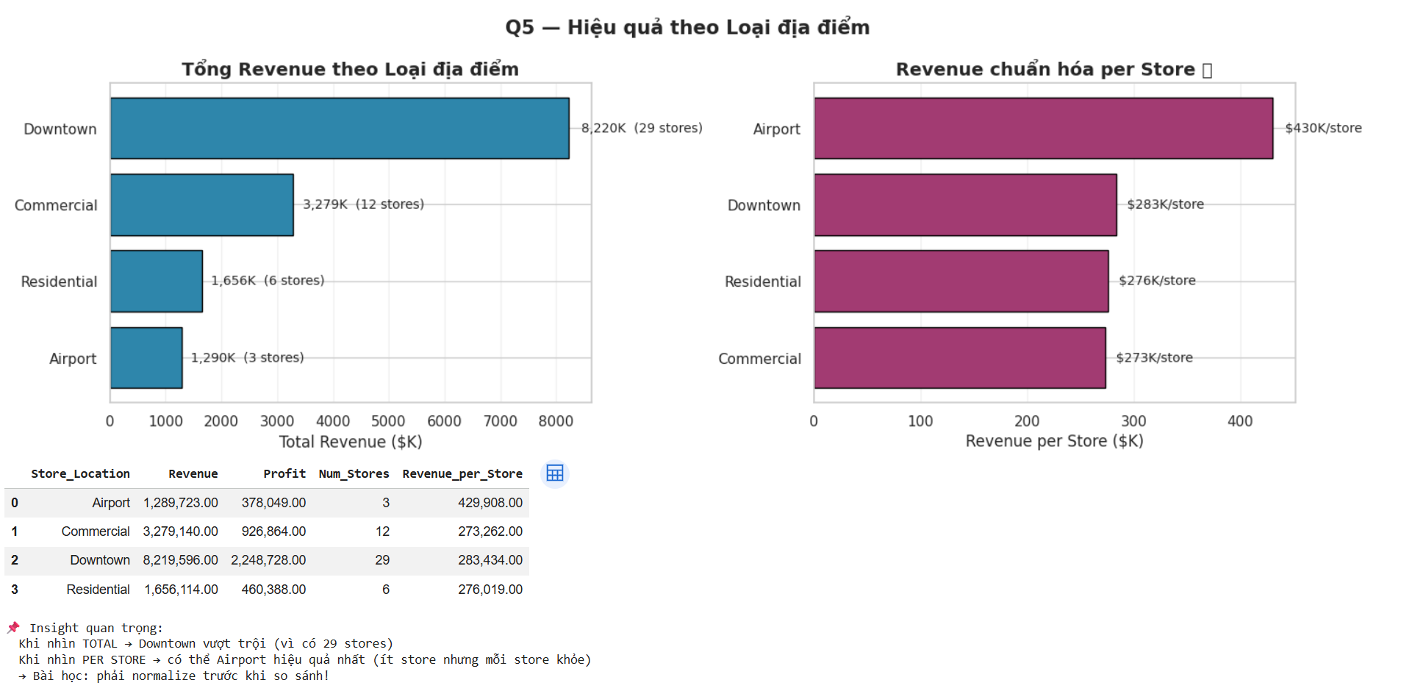

Slide 11
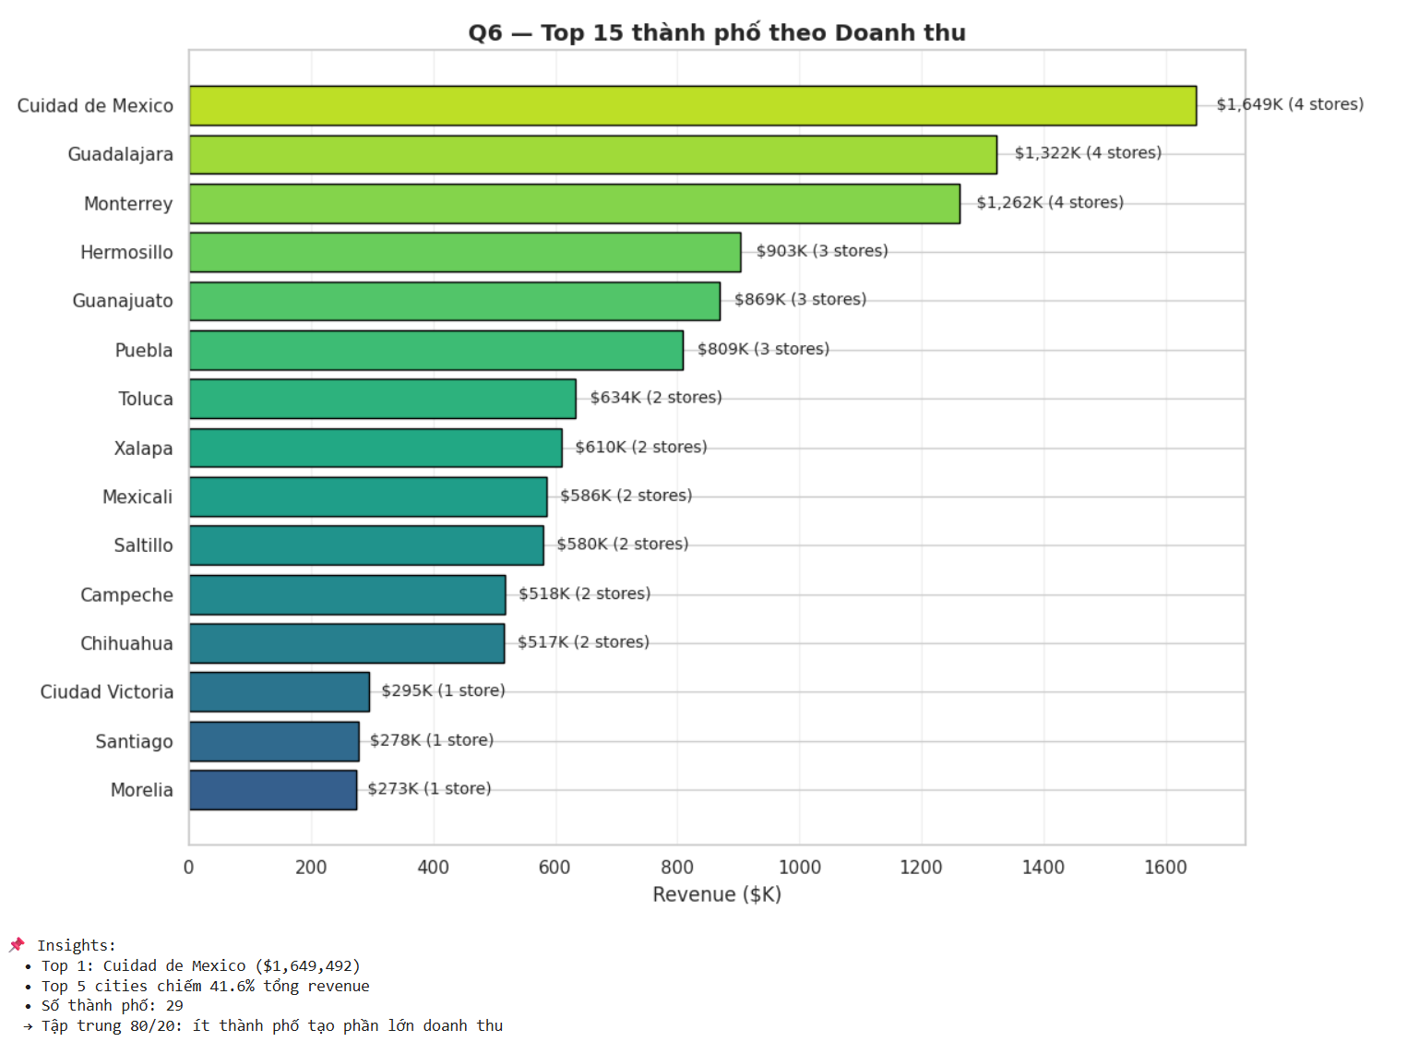
Q6 — How concentrated is our revenue?
Top 10 cities by total revenue
42%
of total revenue
comes from top 5 cities
⚠️ Concentration risk
29 cities total, but heavy dependence on a handful. Diversifying secondary markets would protect against local economic shocks.
ABC Toys — Strategic Analysis 2023
10 / 14

Slide 12
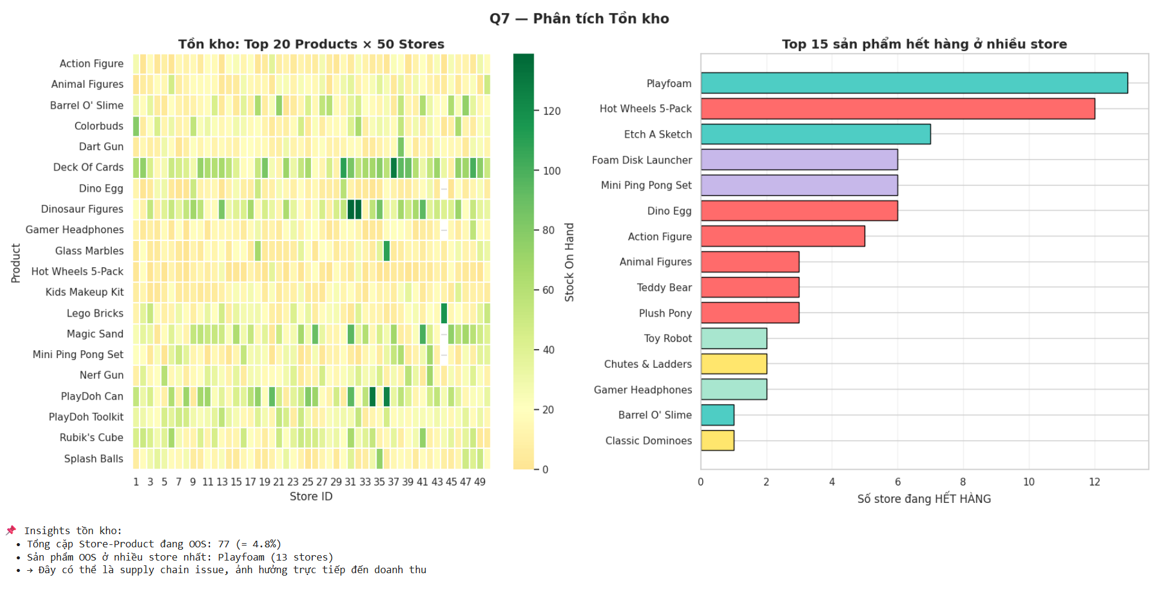
Q7 — Are we losing sales to stockouts?
Top 10 products out-of-stock in the most stores
77
store-product combinations
currently OUT OF STOCK
💸 Estimated impact
4.8% of total inventory slots are empty. Many of these are popular SKUs — direct lost revenue if customers walk away.
ABC Toys — Strategic Analysis 2023
11 / 14

Slide 13
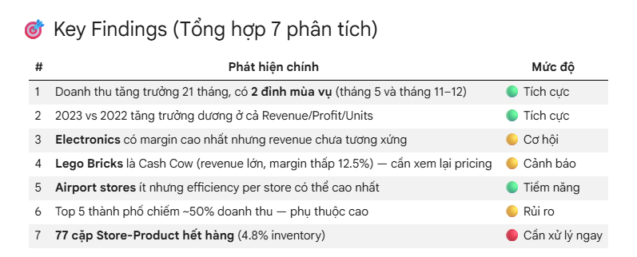
Key Findings
Synthesizing 7 analyses

Slide 14
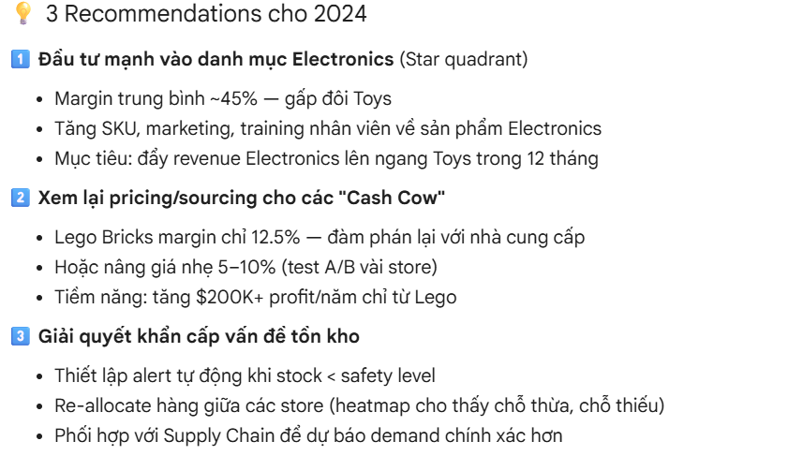
3 Strategic Priorities for 2024
Where to invest, what to fix, what to protect
ABC Toys — Strategic Analysis 2023
13 / 14

Slide 15
Thank you
Questions & Discussion
Data Analyst Team | ABC Toys

