Slide 1

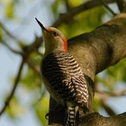
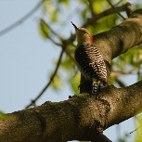

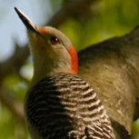
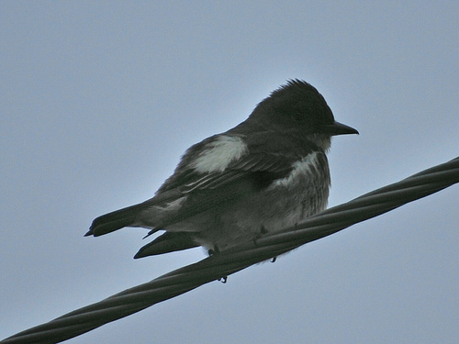


Time
Step
Input Image
CNN Features
Attention Localization
Networks
Resized Attention Region
CNN
Features
Softmax
Output
Final
Prediction
Testing Stage
Training Stage
Input Image
CNN Features
Attention Localization
Networks
Sampled Attention
Softmax
Output
Model
Average
Label
Reward
Time
Step
Part Localization Component
Classification Component

Slide 2
Testing Stage
Time
Step
Input Image
CNN Features
Attention Networks
Crop Images
Feature
Softmax
Average
Label
Input Image
CNN Features
Attention Networks
Crop Features
Feature
Softmax
Average
Label
Reward
Time
Step
Training Stage
Feature Extraction
Part Attention
Classification

