Slide 1
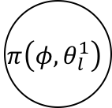
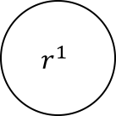


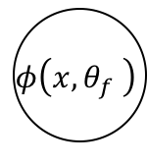



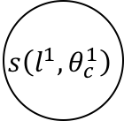
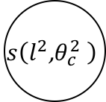
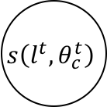
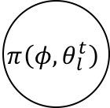
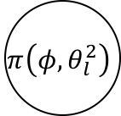
$$π\left(φ, θ_{l}^{1}\right)$$
$$l^{1}$$
$$s\left(l^{1},θ_{c}^{1}\right)$$
$$r^{1}$$
$$φ\left(x,θ_{f} \right)$$
$$π\left(φ, θ_{l}^{2}\right)$$
$$l^{2}$$
$$s\left(l^{2}\text{,}θ_{c}^{2} \right)$$
$$r^{2}$$
$$π\left(φ,θ_{l}^{t}\right)$$
$$l^{t}$$
$$s\left(l^{t},θ_{c}^{t}\right)$$
$$r^{t}$$
Convolution feature
Confidence map
Attention region
Classification
result
Reward

Slide 2
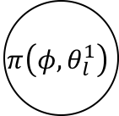



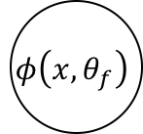


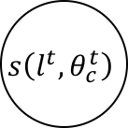
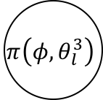
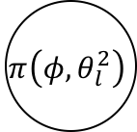
$$π\left(φ,θ_{l}^{1}\right)$$
$$l^{1}$$
$$s\left(l^{1},θ_{c}^{1}\right)$$
$$r^{1}$$
$$φ\left(x,θ_{f}\right)$$
$$π\left(φ,θ_{l}^{2}\right)$$
$$l^{2}$$
$$s\left(l^{2},θ_{c}^{2}\right)$$
$$r^{2}$$
$$π\left(φ,θ_{l}^{3}\right)$$
$$l^{t}$$
$$s\left(l^{t},θ_{c}^{t}\right)$$
$$r^{t}$$
Convolution feature
Confidence map
Attention region
Classification
result
Reward

