Slide 1
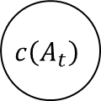
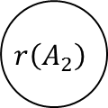
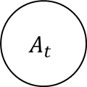
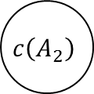
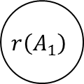
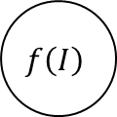
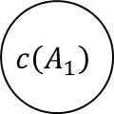
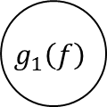
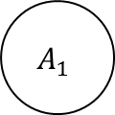

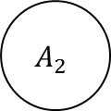

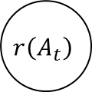
$$g_{1}\left(f\right)$$
$$A_{1}$$
$$c\left(A_{1}\right)$$
$$r\left(A_{1}\right)$$
$$f\left(I\right)$$
$$g_{2}\left(f\right)$$
$$A_{2}$$
$$c\left(A_{2}\right)$$
$$r\left(A_{2}\right)$$
$$g_{t}\left(f\right)$$
$$A_{t}$$
$$c\left(A_{t}\right)$$
$$r\left(A_{t}\right)$$
conv feature
confidence map
attention region
Classification
result
reward

Slide 2
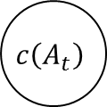
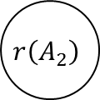
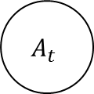


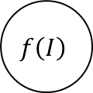

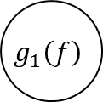

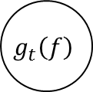
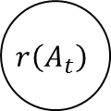
$$g_{1}\left(f\right)$$
$$A_{1}$$
$$c\left(A_{1}\right)$$
$$r\left(A_{1}\right)$$
$$f\left(I\right)$$
$$g_{2}\left(f\right)$$
$$A_{2}$$
$$c\left(A_{2}\right)$$
$$r\left(A_{2}\right)$$
$$g_{t}\left(f\right)$$
$$A_{t}$$
$$c\left(A_{t}\right)$$
$$r\left(A_{t}\right)$$
conv feature
confidence map
attention region
Classification
result
reward

