Slide 1
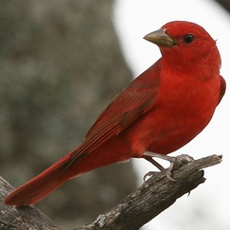
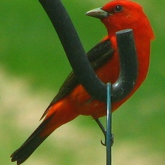
Summer Tanager
has wing color gray:
has wing color red:
has breast pattern solid:
has head pattern eyeline:
has head pattern plain:
has tail shape notched:
No
yes
yes
no
yes
yes
Scarlet Tanager
has wing color gray:
has wing color red:
has breast pattern solid:
has head pattern eyeline:
has head pattern plain:
has tail shape notched:
yes
no
yes
yes
no
yes

