Slide 1






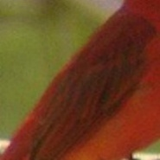

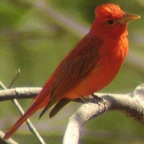
Input Image
Conv Maps
Part Localizers
Attributes Predictors
Multi-task loss
Head:
has color red,
has pattern plain …
Multi-task loss
Breast:
has pattern solid,
has color red …
Multi-task loss
Wing:
has color black,
has color red …
Training Stage
Multi-task loss
Tail:
has color black,
fan-shaped …
Testing Stage
Input Image
Conv Maps
Part Localizers
Joint Representation
Prediction
Local Feature
Global Feature

