Slide 1
Predator-Prey Model
Connor Hann, Xiaomeng Jia, Peifan Liu, and Xinyu Wu¹
¹ Physics Department, Duke University

Slide 2
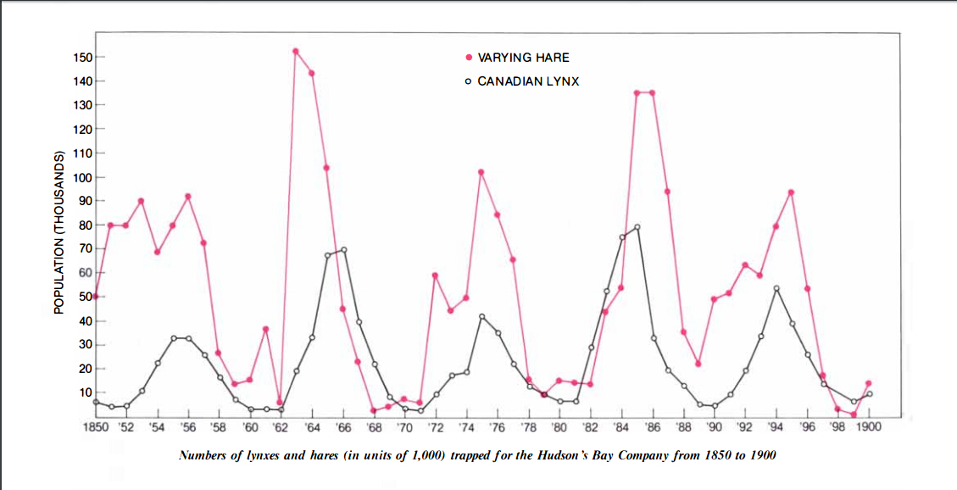
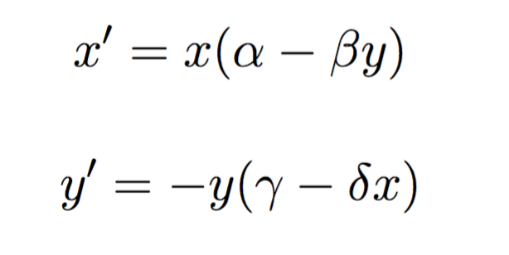
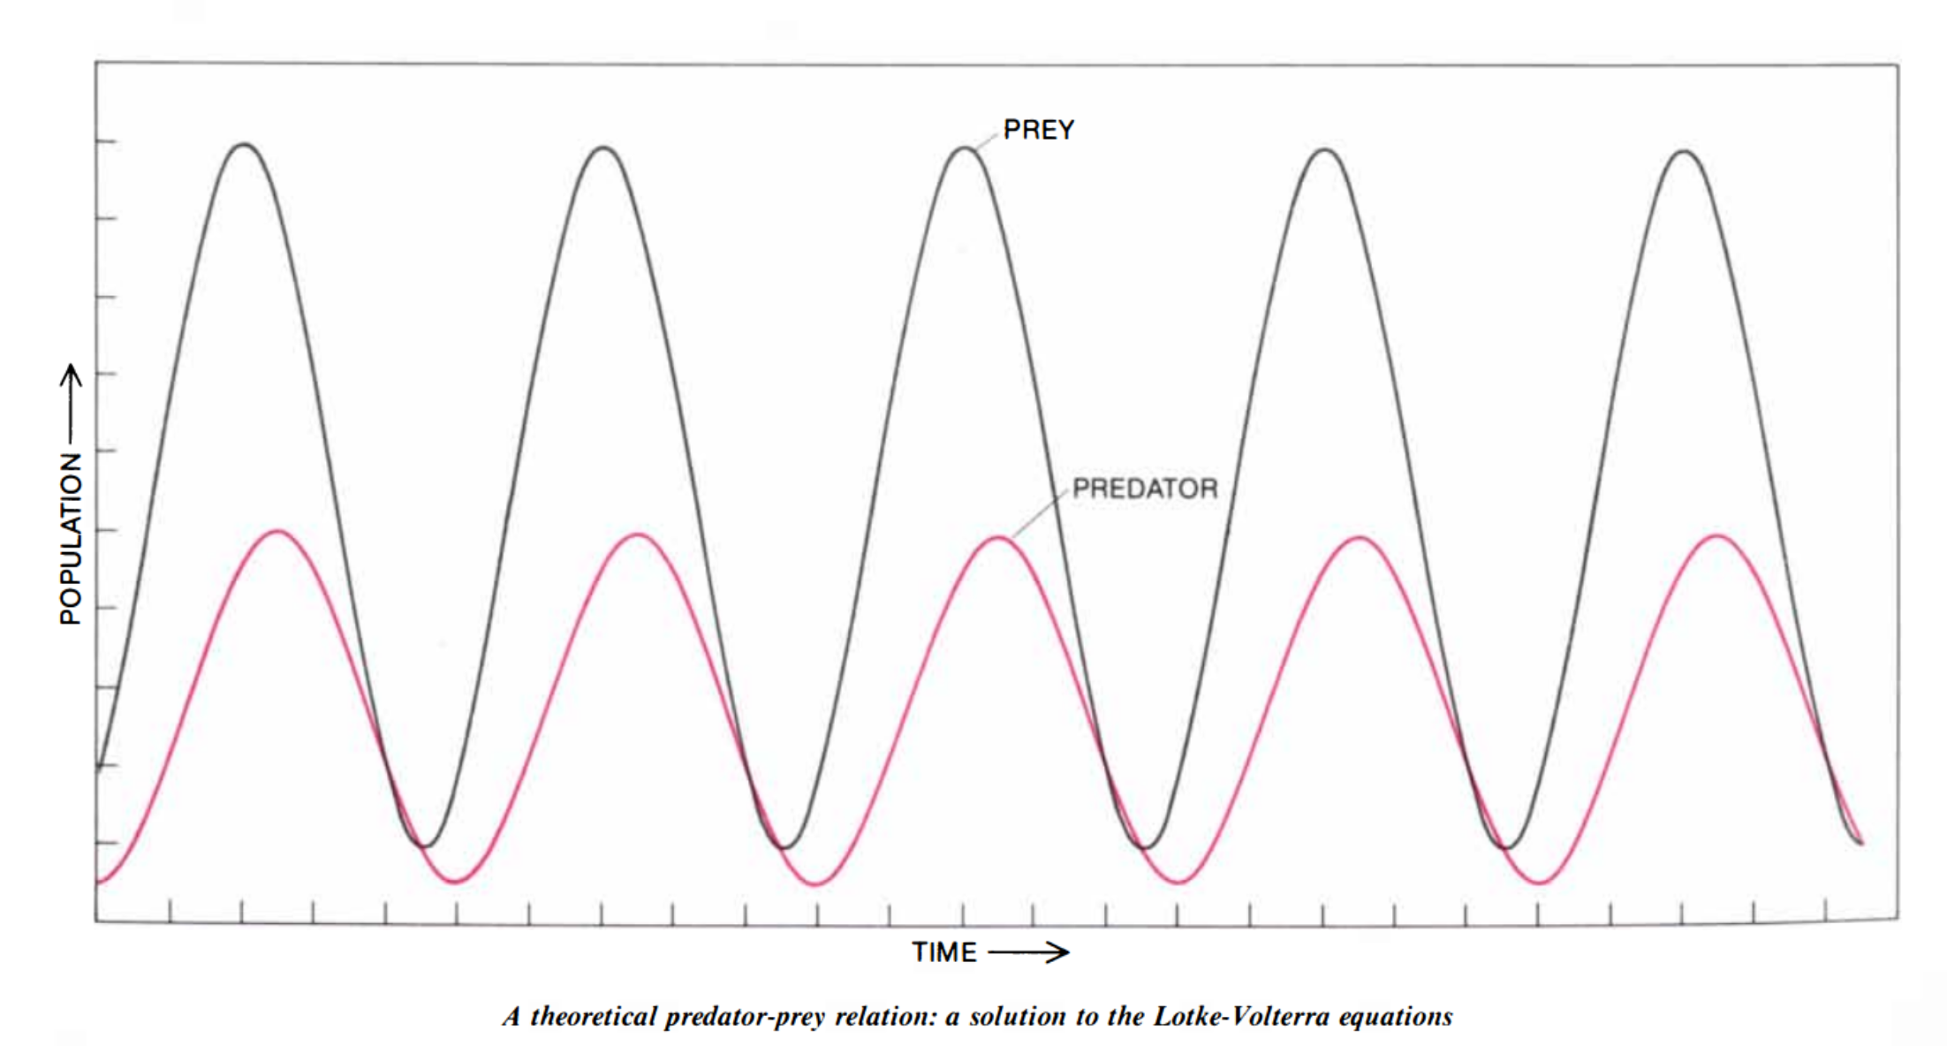
Predator-Prey Models
Lotkka-Voltera Model
Simple models can have strong predictive power!

Slide 3
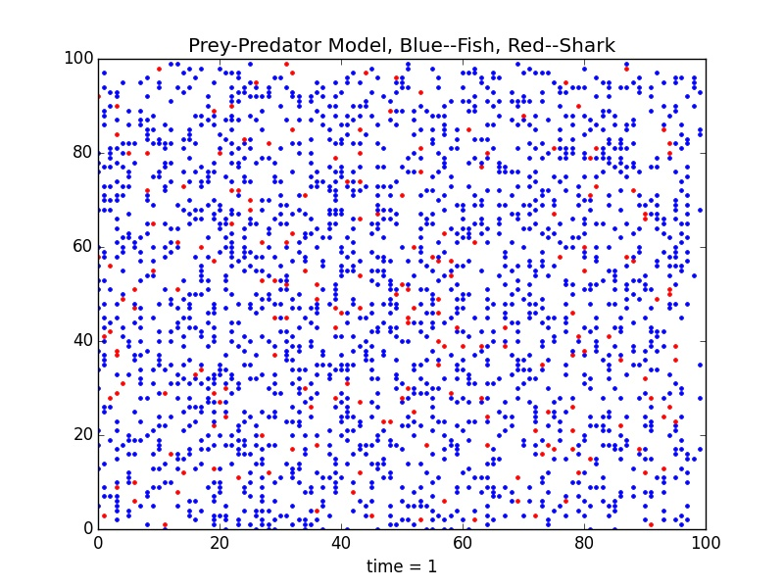
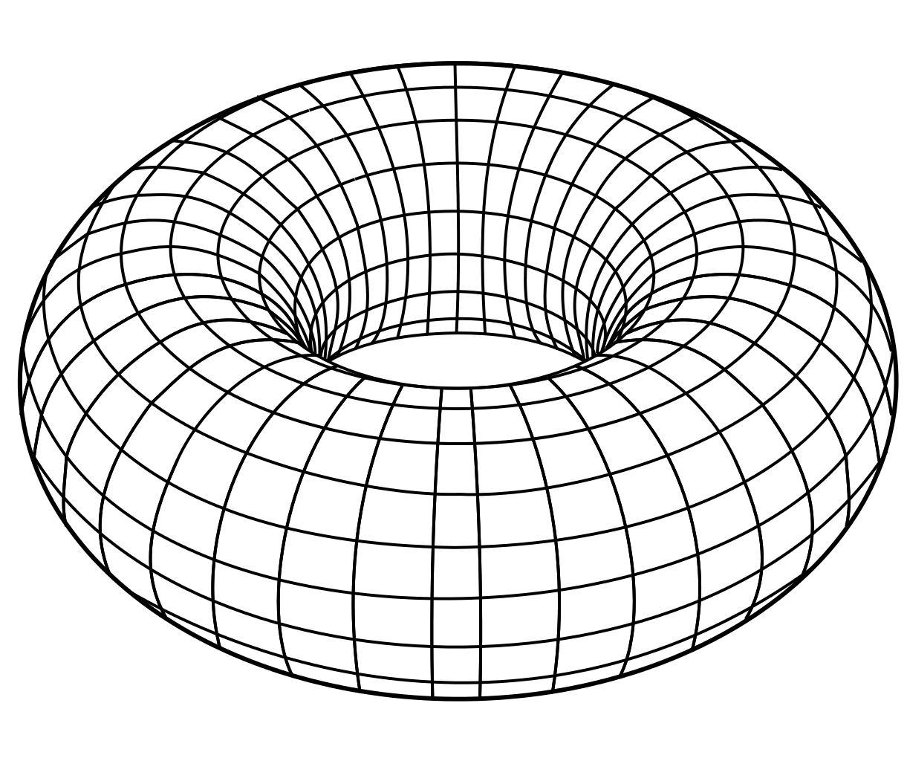
Our Model: Fish and Sharks
Program parameters:
Initial number of fish n0_fish
Initial number of sharks n0_sharks
Time for fish to breed breed_age_fish
Time for sharks to breed breed_age_sharks
Time for sharks to starve starve_time
Two-dimensional periodic N x N grid

Slide 4
Shark and Fish Movement
Lotkka-Voltera Model
Simple models can have strong predictive power!

