Slide 1

SEEMless: Secure End-to-End Encrypted Messaging with less Trust (Melissa Chase , Apoorvaa Deshpande , Esha Ghosh , Harjasleen Malvai ) (CCS 2019)
西安邮电大学
XI'AN UNIVERSITY OF POSTS
& TELECOMMUNICATIONS

Slide 2
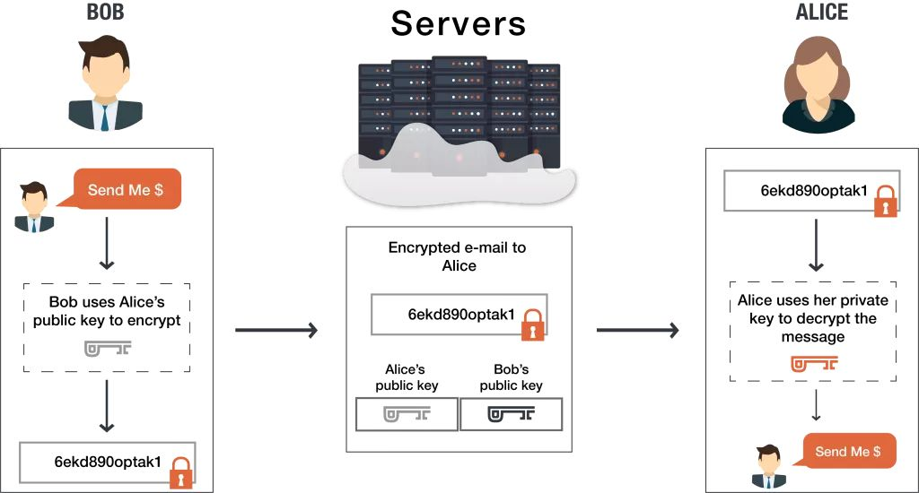
西安邮电大学
XI'AN UNIVERSITY OF POSTS
& TELECOMMUNICATIONS
End-to-End Encrypted

Slide 3

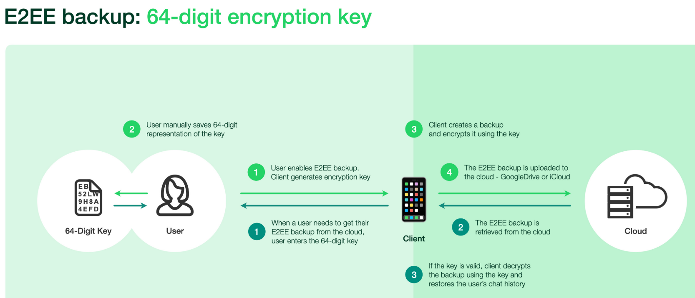
西安邮电大学
XI'AN UNIVERSITY OF POSTS
& TELECOMMUNICATIONS
Introduction
WhatsApp

Slide 4
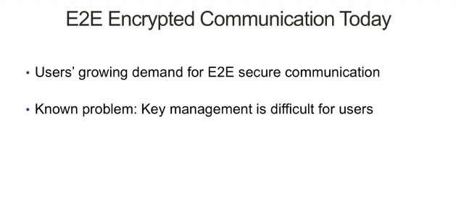
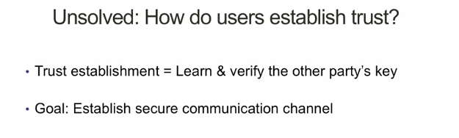
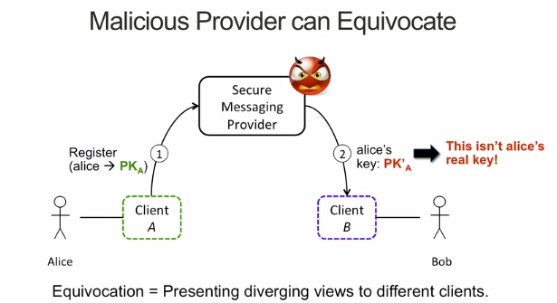
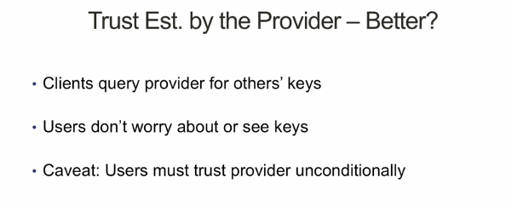
西安邮电大学
XI'AN UNIVERSITY OF POSTS
& TELECOMMUNICATIONS
Introduction

Slide 5
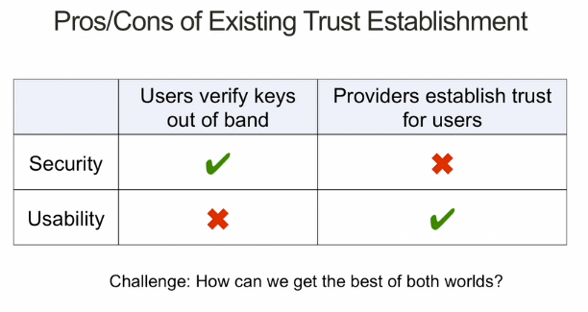
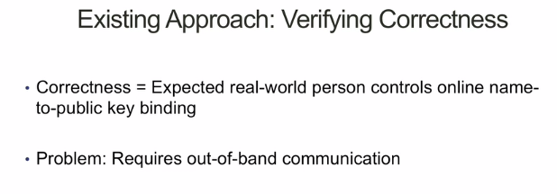
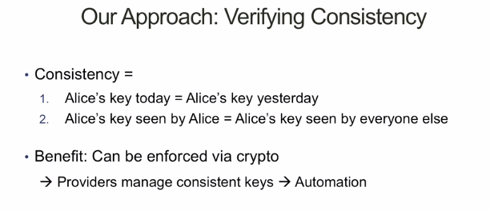
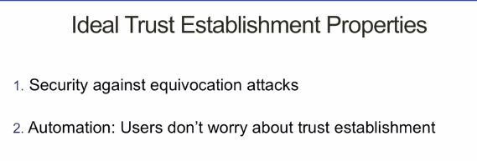
西安邮电大学
XI'AN UNIVERSITY OF POSTS
& TELECOMMUNICATIONS
Introduction

Slide 6
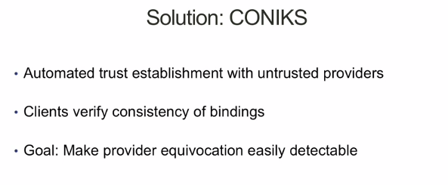
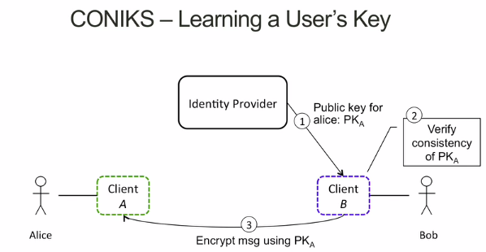
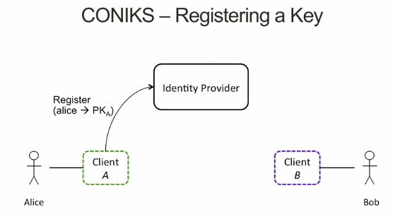
西安邮电大学
XI'AN UNIVERSITY OF POSTS
& TELECOMMUNICATIONS
Introduction

Slide 7
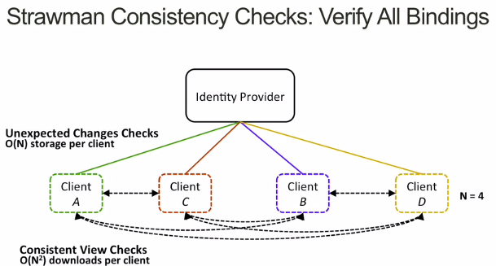
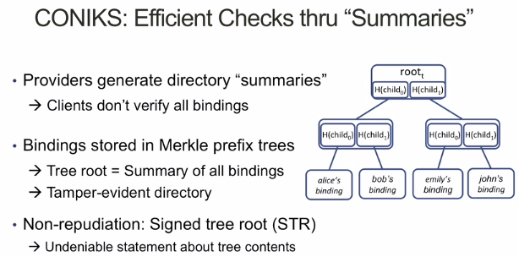
西安邮电大学
XI'AN UNIVERSITY OF POSTS
& TELECOMMUNICATIONS
Introduction

Slide 8
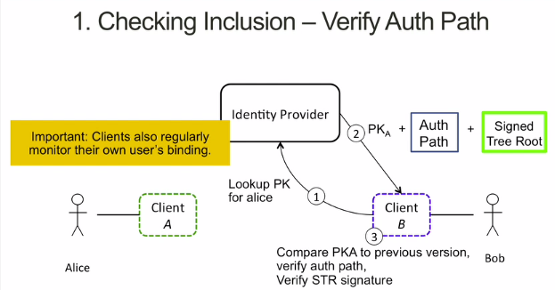
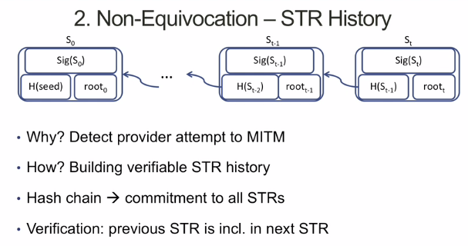
西安邮电大学
XI'AN UNIVERSITY OF POSTS
& TELECOMMUNICATIONS
Introduction

Slide 9
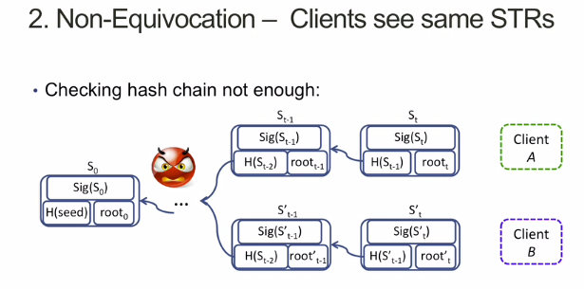
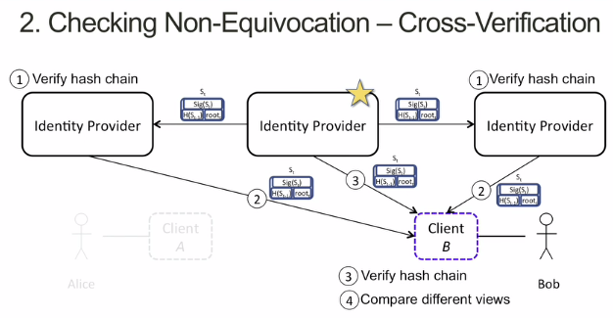
西安邮电大学
XI'AN UNIVERSITY OF POSTS
& TELECOMMUNICATIONS
Introduction

Slide 10
西安邮电大学
XI'AN UNIVERSITY OF POSTS
& TELECOMMUNICATIONS
VKD
VERIFIABLE KEY DIRECTORY (VKD)
VKD由三种类型的各方组成：身份提供者或服务器、客户端或用户和外部审计员。服务器存储一个目录Dir，其中包含用户的名称（我们称之为标签）及其对应的公钥（与标签对应的值）。为了便于说明，让Alice和Bob成为两个用户。VKD为用户提供了以下查询界面。
1)Alice可以将她（用户名，键），即(标签=用户名，val=键)添加到Dir。
2)Alice可以更新她的键，并要求用新的键值更新Dir。
3)她可以定期查询服务器，以获得她的密钥更新的历史记录(VKD。KeyHistory)。
4)Bob还可以查询对应于用户名Alice(VKD。查询)在当前的时间

Slide 11
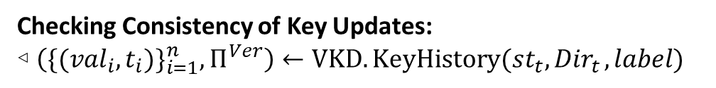
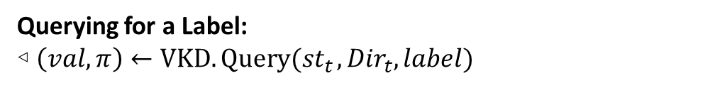

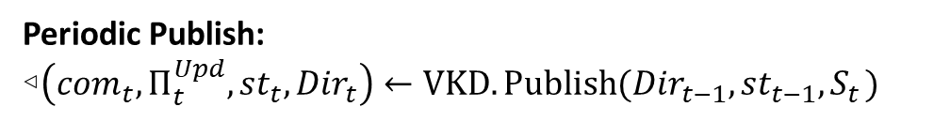

西安邮电大学
XI'AN UNIVERSITY OF POSTS
& TELECOMMUNICATIONS
VKD
VERIFIABLE KEY DIRECTORY (VKD) $(VKD.Publish，VKD.Query，VKD.QueryVer，VKD.KeyHistory，VKD.HistoryVer，VKD.Audit)$
Periodic Publish:
◃$\left({com}_{t},Π_{t}^{Upd},{st}_{t},{Dir}_{t}\right)←VKD.Publish({Dir}_{t−1}, {st}_{t−1}, S_{t} )$
Querying for a Label:
◃ $\left(val, π\right)←VKD.Query({st}_{t} ,{Dir}_{t}, label)$
(username, key)
◃ $1/0 ←VKD.QueryVer (com, label, (val, π))$
Checking Consistency of Key Updates:
◃ $\left({\{({val}_{i}, t_{i})\}}_{i=1}^{n},Π^{Ver}\right)←VKD.KeyHistory({st}_{t}, {Dir}_{t} , label)$
(label, val)
◃ $1/0 ←VKD.HistoryVer({com}_{t}, label, {\{({val}_{i}, t_{i})\}}_{i=1}^{n}, Π^{Ver})$
Auditing the VKD:
◃$1/0←VKD.Audit(t_{1}, t_{n}, {\{({com}_{t}, Π_{t}^{Upd})\}}_{t =t_{1}}^{t_{n}})$
$$S_{t}$$

Slide 12
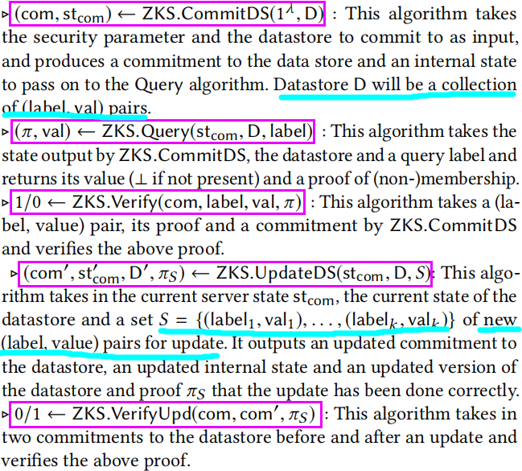

西安邮电大学
XI'AN UNIVERSITY OF POSTS
& TELECOMMUNICATIONS
aZKS
APPEND-ONLY ZERO KNOWLEDGE SET (aZKS)
$(ZKS.CommitDS，ZKS.Query， ZKS.Verify， ZKS.UpdateDS，ZKS.VerifyUpd )$
◃ $(com, {st}_{com}) ←ZKS.CommitDS(1^{λ}, D)$
◃ $(π, val) ←ZKS.Query({st}_{com}, D, label)$
◃ $1/0 ←ZKS.Verify(com, label, val, π)$
$$\text{◃} (com′,{st}_{com}, D′, πS ) ←ZKS.UpdateDS({st}_{com}, D, S)$$
◃ $0/1 ← ZKS.VerifyUpd(com, com′, πS )$

Slide 13
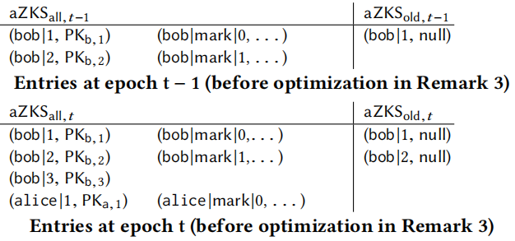
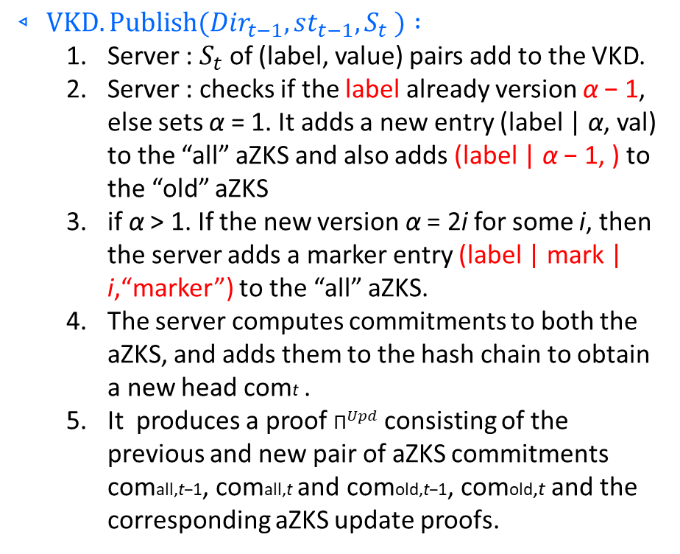
西安邮电大学
XI'AN UNIVERSITY OF POSTS
& TELECOMMUNICATIONS
SEEMLESS
$$◃ VKD.Publish({Dir}_{t−1}, {st}_{t−1}, S_{t} ) :$$
Server : $S_{t}$ of (label, value) pairs add to the VKD.
Server : checks if the label already version α − 1, else sets α = 1. It adds a new entry (label | α, val) to the “all” aZKS and also adds (label | α − 1, ) to the “old” aZKS
if α > 1. If the new version α = 2i for some i, then the server adds a marker entry (label | mark | i,“marker”) to the “all” aZKS.
The server computes commitments to both the aZKS, and adds them to the hash chain to obtain a new head comt .
It produces a proof ${\text{Π}}^{Upd}$ consisting of the previous and new pair of aZKS commitments comall,t−1, comall,t and comold,t−1, comold,t and the corresponding aZKS update proofs.

Slide 14
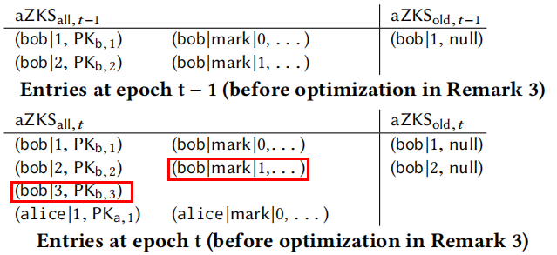



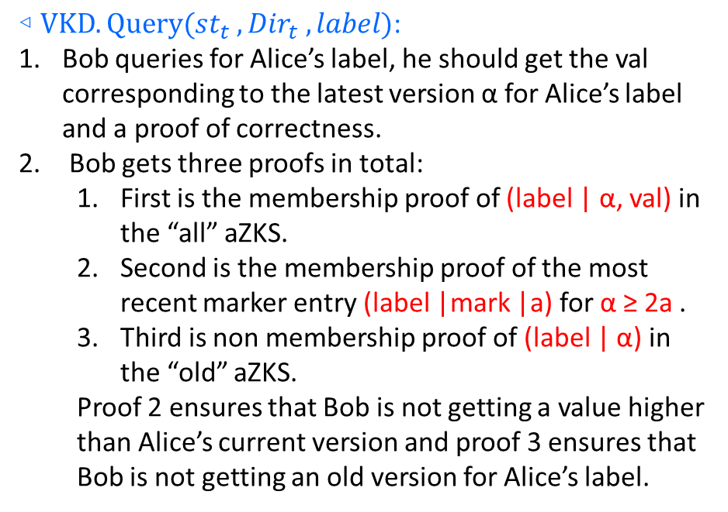
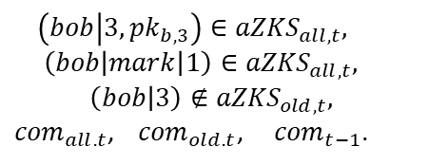
西安邮电大学
XI'AN UNIVERSITY OF POSTS
& TELECOMMUNICATIONS
SEEMLESS
$$\text{◃} VKD.Query({st}_{t} , {Dir}_{t} , label) \text{: }$$
Bob queries for Alice’s label, he should get the val corresponding to the latest version α for Alice’s label and a proof of correctness.
Bob gets three proofs in total:
First is the membership proof of (label | α, val) in the “all” aZKS.
Second is the membership proof of the most recent marker entry (label |mark |a) for α ≥ 2a .
Third is non membership proof of (label | α) in the “old” aZKS.
Proof 2 ensures that Bob is not getting a value higher than Alice’s current version and proof 3 ensures that Bob is not getting an old version for Alice’s label.
bob’s public
key at epoch t
$$\left(bob | 3,{pk}_{b,3}\right)∈{aZKS}_{all,t}, \left(bob\left|mark\right|1\right)∈{aZKS}_{all,t},$$
$$\left(bob | 3\right)∉{aZKS}_{old,t},$$
${com}_{all.t}$, ${com}_{old.t}$, ${com}_{t−1}$.

Slide 15
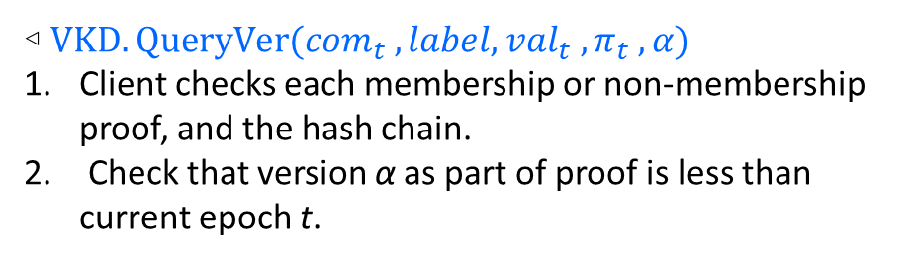
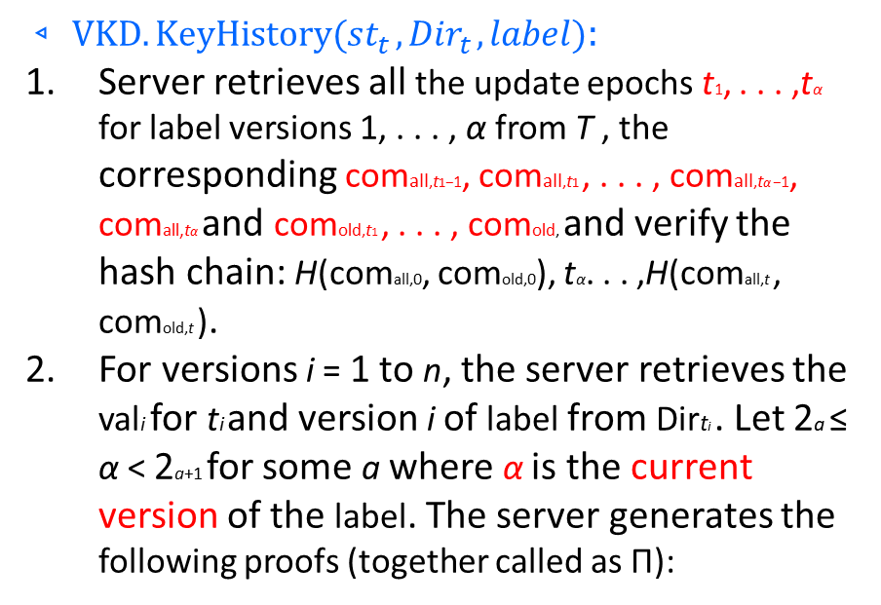
西安邮电大学
XI'AN UNIVERSITY OF POSTS
& TELECOMMUNICATIONS
SEEMLESS
(1) Correctness of comti and comti−1: For each i, output comti comti-1. Also output the values necessary to verify the hash chain: H(comall,0, comold,0), . . . ,H(comall,t , comold,t ).
(2) Correct version i is set at epoch ti : For each i: Membership
proof for(label| i) with value vali in the “all” aZKS with respect
to comti.
(3) Server couldn’t have shown version i − 1 at or after ti :
For each i: Membership proof in “old” aZKS with respect to comti for (label| i − 1)
(4) Server couldn’t have shown version i before epoch ti : For
each i: Non membership proof for (label| i) in “all” aZKS with
respect to comti−1
(5) Server can’t show any version from α + 1 to 2a+1 at
epoch t or any earlier epoch: Non membership proofs in
the “all” aZKS with respect to comt for (label| i +1), (label| i +
2), . . . , (label| 2a+1 − 1).
(6) Server can’t show any version higher than 2a+1 at epoch
t or any earlier epoch: Non membership proofs in “all” aZKS
with respect to comt for marker nodes (label| mark| a + 1) up
to (label| mark| log t).
◃ $VKD.QueryVer({com}_{t} , label, {val}_{t} , π_{t} , α)$
Client checks each membership or non-membership proof, and the hash chain.
Check that version α as part of proof is less than current epoch t.
$$◃ VKD.KeyHistory({st}_{t} , {Dir}_{t} , label):$$
Server retrieves all the update epochs t1, . . . ,tα for label versions 1, . . . , α from T , the corresponding comall,t1−1, comall,t1 , . . . , comall,tα −1, comall,tα and comold,t1 , . . . , comold, and verify the hash chain: H(comall,0, comold,0), tα. . . ,H(comall,t , comold,t ).
For versions i = 1 to n, the server retrieves the vali for ti and version i of label from Dirti . Let 2a ≤ α < 2a+1 for some a where α is the current version of the label. The server generates the following proofs (together called as Π):

Slide 16
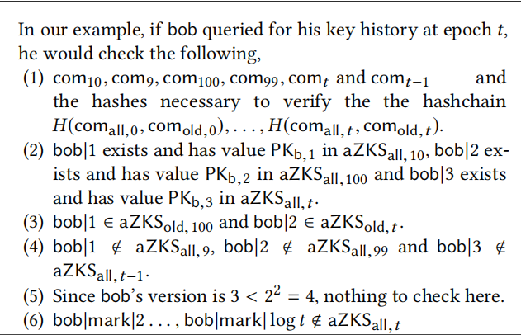
西安邮电大学
XI'AN UNIVERSITY OF POSTS
& TELECOMMUNICATIONS
SEEMLESS
◃ $VKD.HistoryVer({com}_{t}, label,{\{({val}_{i}, t_{i})\}}_{i=1}^{n},Π^{Ver}):$Verify each of the above proofs.

Slide 17
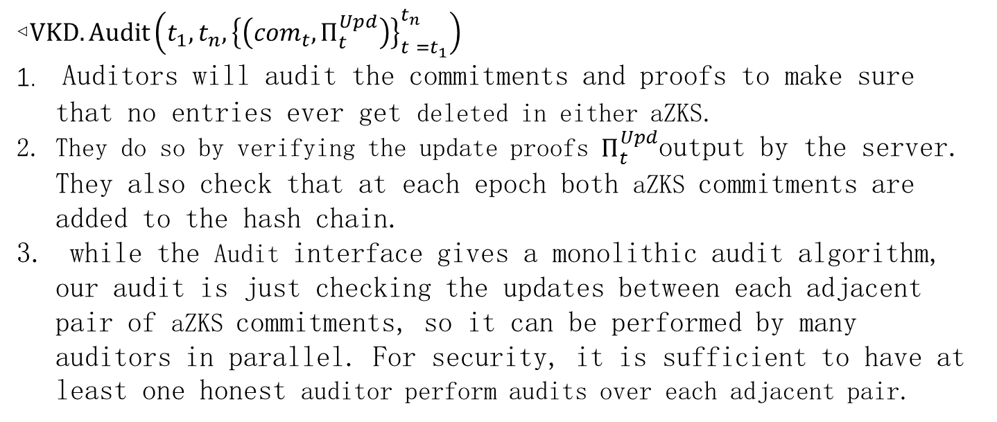
西安邮电大学
XI'AN UNIVERSITY OF POSTS
& TELECOMMUNICATIONS
SEEMLESS
◃$VKD.Audit\left(t_{1}, t_{n}, {\left\{\left({com}_{t}, Π_{t}^{Upd}\right)\right\}}_{t =t_{1}}^{t_{n}}\right)$
Auditors will audit the commitments and proofs to make sure that no entries ever get deleted in either aZKS.
They do so by verifying the update proofs $Π_{t}^{Upd}$output by the server. They also check that at each epoch both aZKS commitments are added to the hash chain.
while the Audit interface gives a monolithic audit algorithm, our audit is just checking the updates between each adjacent pair of aZKS commitments, so it can be performed by many auditors in parallel. For security, it is sufficient to have at least one honest auditor perform audits over each adjacent pair.

Slide 18


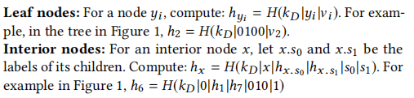










西安邮电大学
XI'AN UNIVERSITY OF POSTS
& TELECOMMUNICATIONS
aZKS INSTANTIATIONS
Append-Only Strong Accumulator (aSA) Construction
$$h_{ε}$$
$$ε$$
$$h_{6}$$
$$h_{8}$$
0
1
$$h_{1}$$
$$h_{7}$$
$$h_{4}$$
$$h_{5}$$
0010
01
1000
1100
$$h_{2}$$
$$h_{3}$$
0100
0111

Slide 19
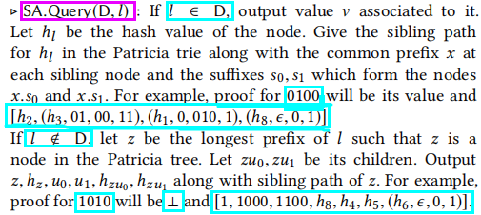











西安邮电大学
XI'AN UNIVERSITY OF POSTS
& TELECOMMUNICATIONS
aZKS INSTANTIATIONS
Append-Only Strong Accumulator (aSA) Construction
$$h_{ε}$$
$$ε$$
$$h_{6}$$
$$h_{8}$$
0
1
$$h_{1}$$
$$h_{7}$$
$$h_{4}$$
$$h_{5}$$
0010
01
1000
1100
$$h_{2}$$
$$h_{3}$$
1
0100
0111
$$1010$$

Slide 20
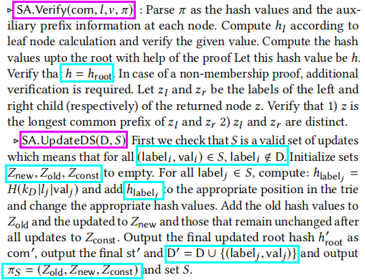
西安邮电大学
XI'AN UNIVERSITY OF POSTS
& TELECOMMUNICATIONS
aZKS INSTANTIATIONS
Append-Only Strong Accumulator (aSA) Construction
$$h_{ε}$$
$$ε$$
$$h_{6}$$
$$h_{8}$$
0
1
$$h_{1}$$
$$h_{7}$$
$$h_{4}$$
$$h_{5}$$
0010
01
1000
1100
$$h_{2}$$
$$h_{3}$$
0100
0111

Slide 21
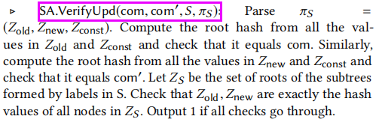
西安邮电大学
XI'AN UNIVERSITY OF POSTS
& TELECOMMUNICATIONS
aZKS INSTANTIATIONS
Append-Only Strong Accumulator (aSA) Construction
$$h_{ε}$$
$$ε$$
$$h_{6}$$
$$h_{8}$$
0
1
$$h_{1}$$
$$h_{7}$$
$$h_{4}$$
$$h_{5}$$
0010
01
1000
1100
$$h_{2}$$
$$h_{3}$$
0100
0111

