Slide 1
Advanced Chooser Option Pricing Model with Real-World Data and Machine Learning
Final Project Presentation
Baseline BSM chooser pricing, ML volatility forecasting, and interactive prototype development.
Sigma-only ML enhancement is not enough
Core empirical lesson
Advanced Chooser Option Pricing Model
1

Slide 2
WHY THIS PROJECT
Project Objective and Motivation
• Chooser options let the holder choose later between call-like and put-like exposure.
• They matter in structured products, hedging, and volatility-sensitive trading.
• BSM gives a transparent baseline but depends heavily on the sigma input.
• The project tests whether ML volatility forecasts improve pricing outcomes.
Improve forward-looking sigma
Objective
Does better volatility improve pricing?
Test
Interactive local pricing prototype
Deliverable
Advanced Chooser Option Pricing Model
2

Slide 3
BASELINE + CONTROLLED ML ENHANCEMENT
Pricing Framework
• Baseline: BSM chooser pricing with fixed strike, maturity, and chooser decision time.
• Market inputs: risk-free rate, dividend yield, JPM price level, and volatility.
• Baseline sigma uses historical-volatility style estimates.
• ML improves sigma only; it does not replace the pricing formula.
Market data
→
Baseline / ML sigma
→
BSM chooser engine
→
Price comparison
Advanced Chooser Option Pricing Model
3

Slide 4
REAL-WORLD DATA PIPELINE
Data and Feature Construction
JPM · VIX · Treasury · option marks
• Realized and rolling stock volatility
• VIX returns and market-risk signals
• Treasury-rate changes and momentum
• Rolling JPM-VIX correlation features
Sources
Future 20D realized volatility
Target
Train / validation / test workflow
Split
Processed CSV outputs connect feature construction, ML training, pricing, diagnostics, and the prototype.
Advanced Chooser Option Pricing Model
4

Slide 5
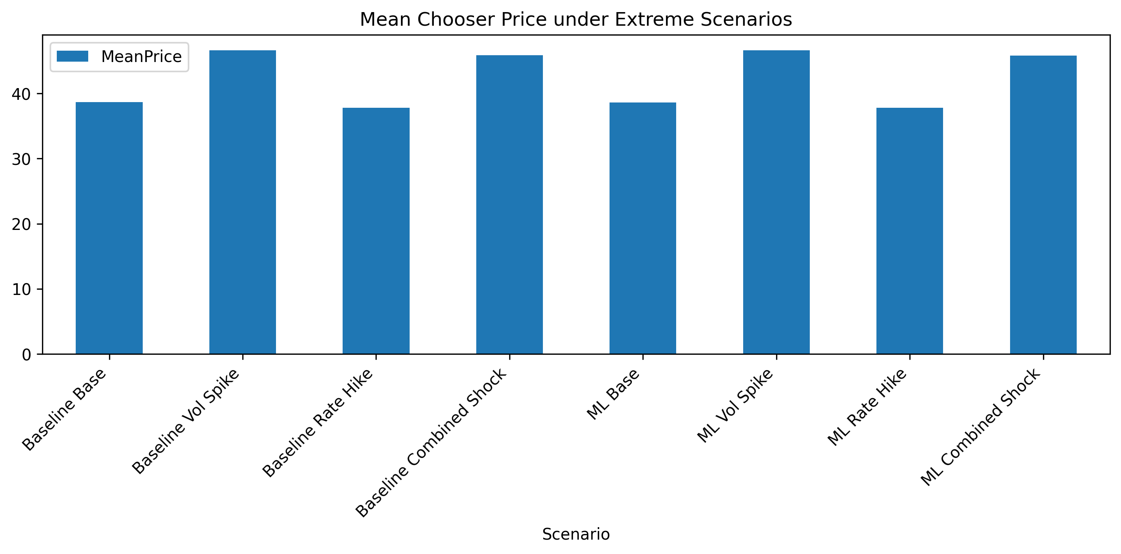
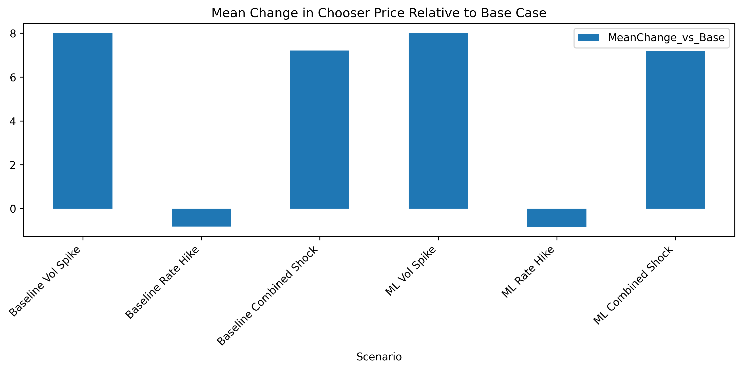
BASELINE ROBUSTNESS
Extreme-Scenario Summary
• Volatility shock creates the largest price increase.
• Rate-hike effect is smaller and negative.
• Combined shock remains volatility-dominated.
Takeaway: chooser value is highly sensitive to volatility shocks.
Advanced Chooser Option Pricing Model
5

Slide 6
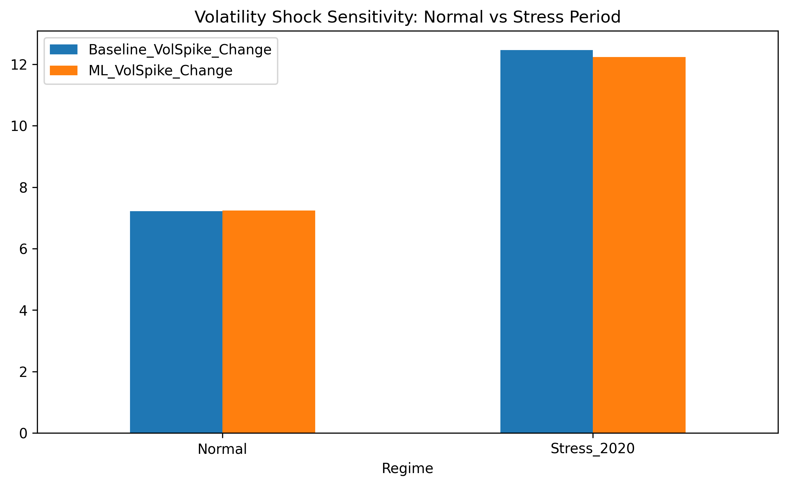
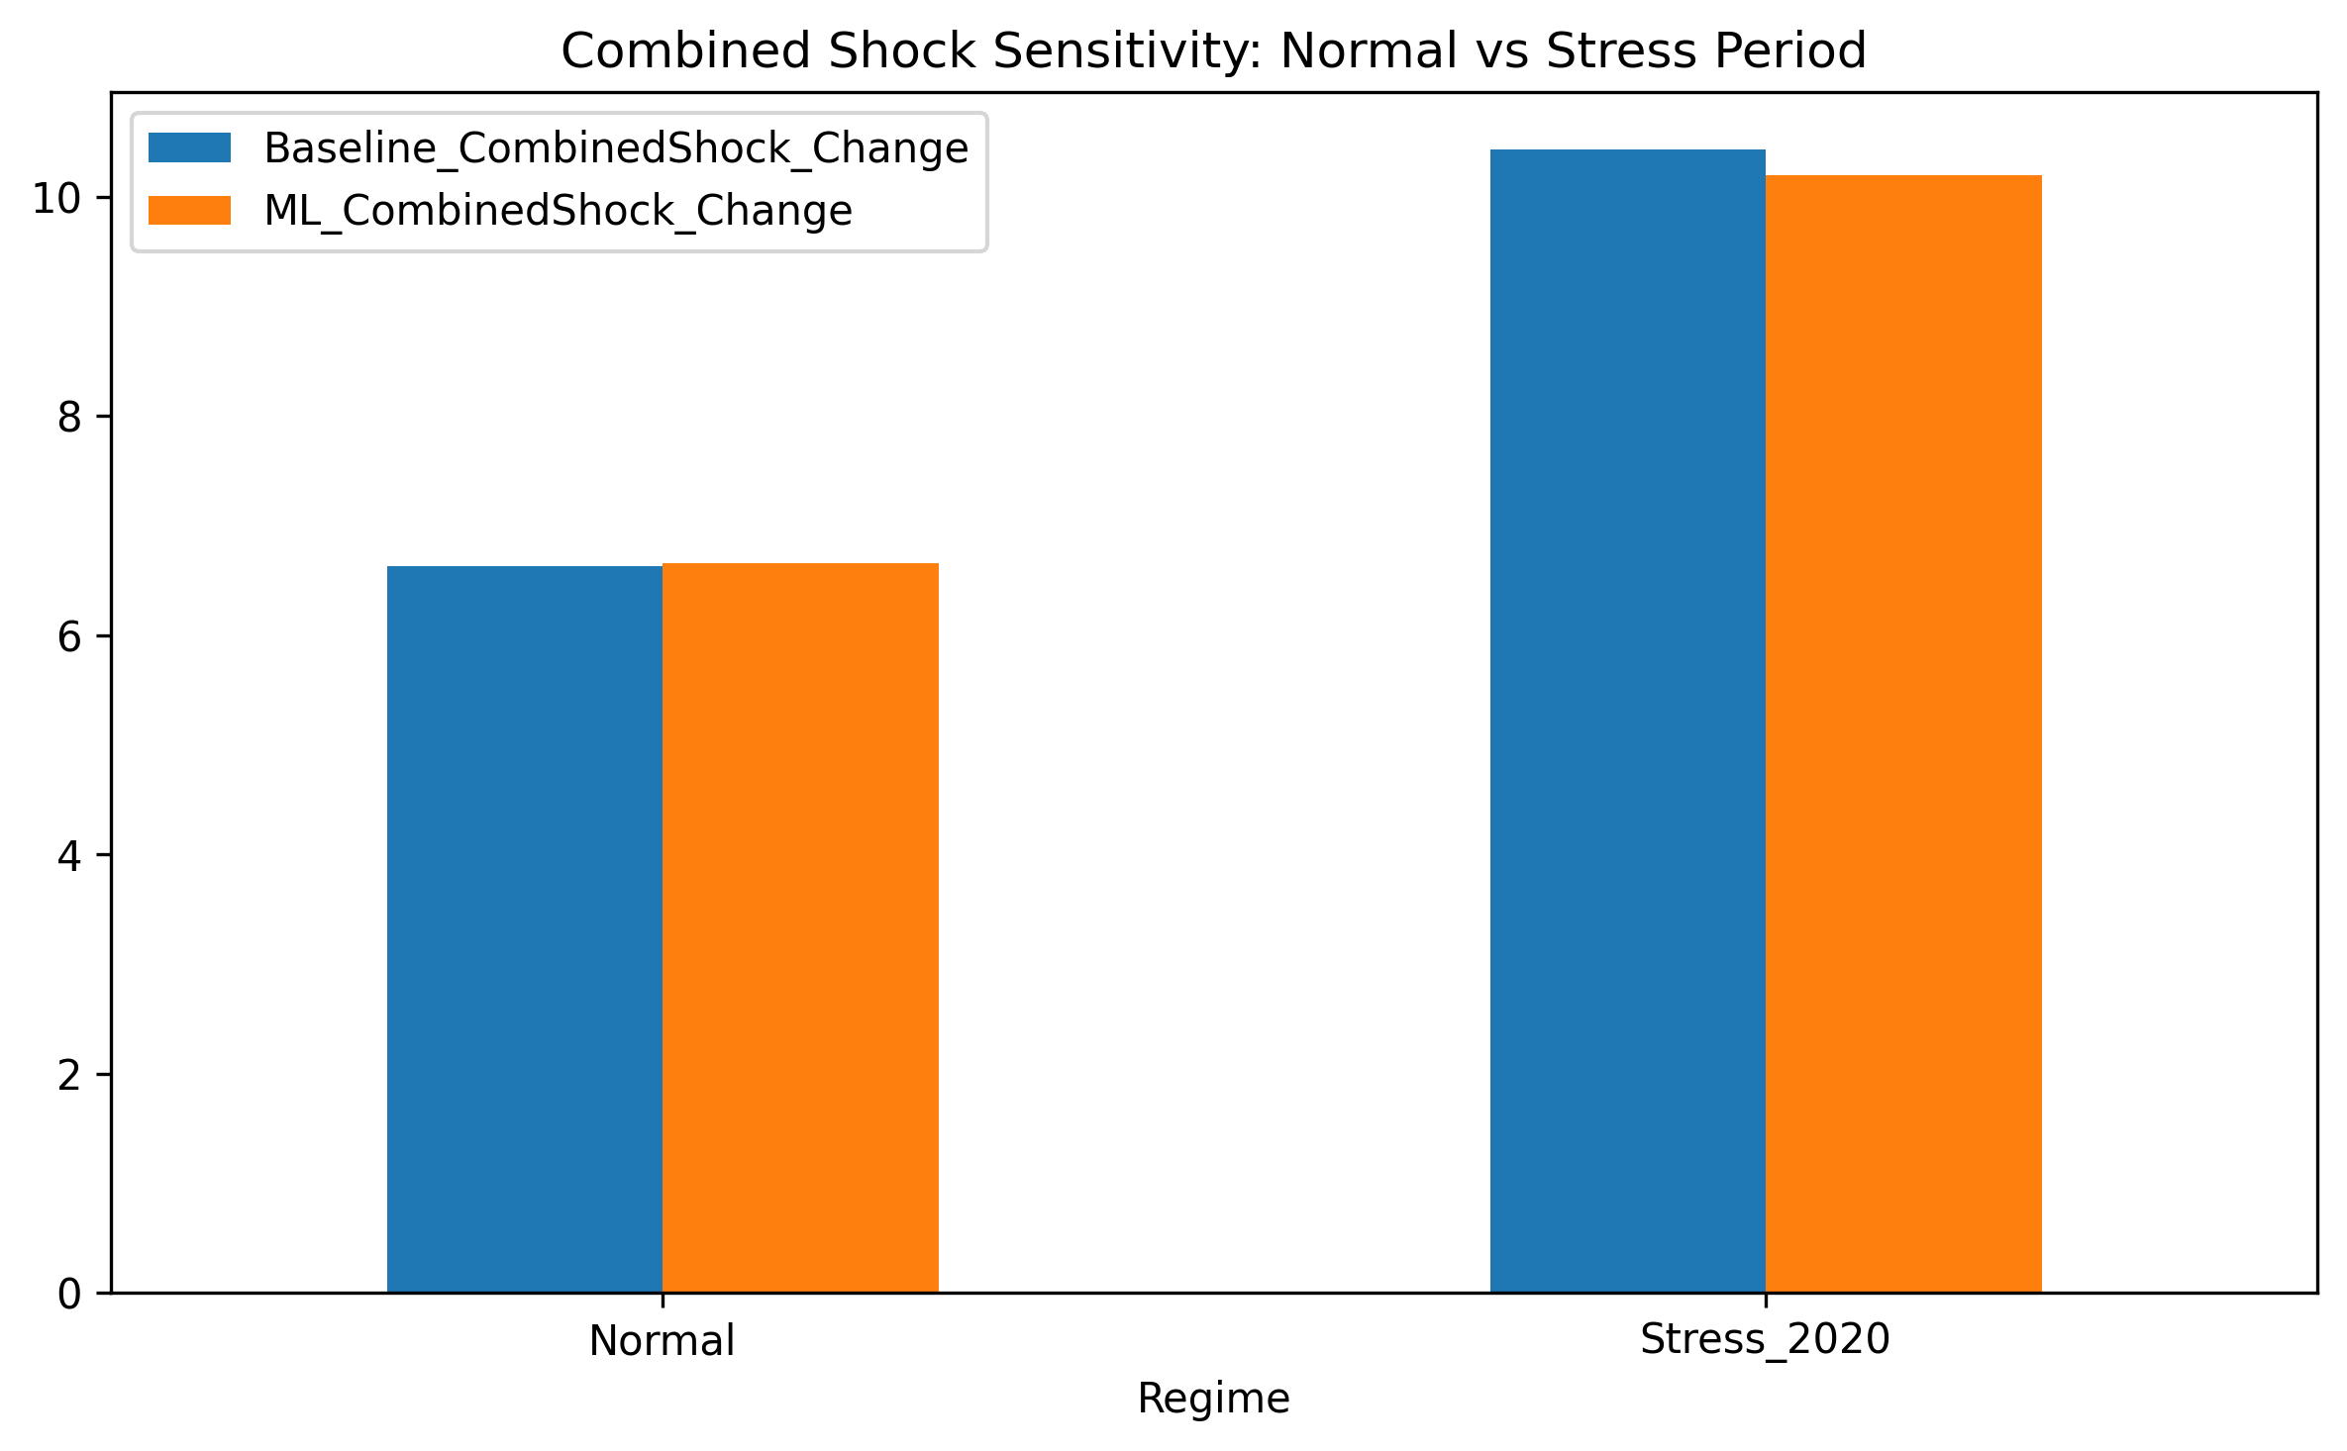
NORMAL VS STRESS PERIODS
Regime Sensitivity
• Stress regimes amplify shock sensitivity.
• Volatility remains the main repricing channel.
• Baseline and ML-enhanced responses are structurally similar.
Takeaway: stress conditions raise both price levels and sensitivity.
Advanced Chooser Option Pricing Model
6

Slide 7
MODEL SELECTION
Machine Learning Volatility Model
Tuned volatility model comparison
Final model
Model
Test RMSE
Test R2
Gradient Boosting
Best Random Forest
0.007784
0.8940
• Predict future realized volatility.
• Use predicted sigma inside BSM.
• Keep pricing formula interpretable.
Best Gradient Boosting
0.007206
0.9091
Takeaway: ML improves the volatility input, not the pricing formula itself.
Advanced Chooser Option Pricing Model
7

Slide 8
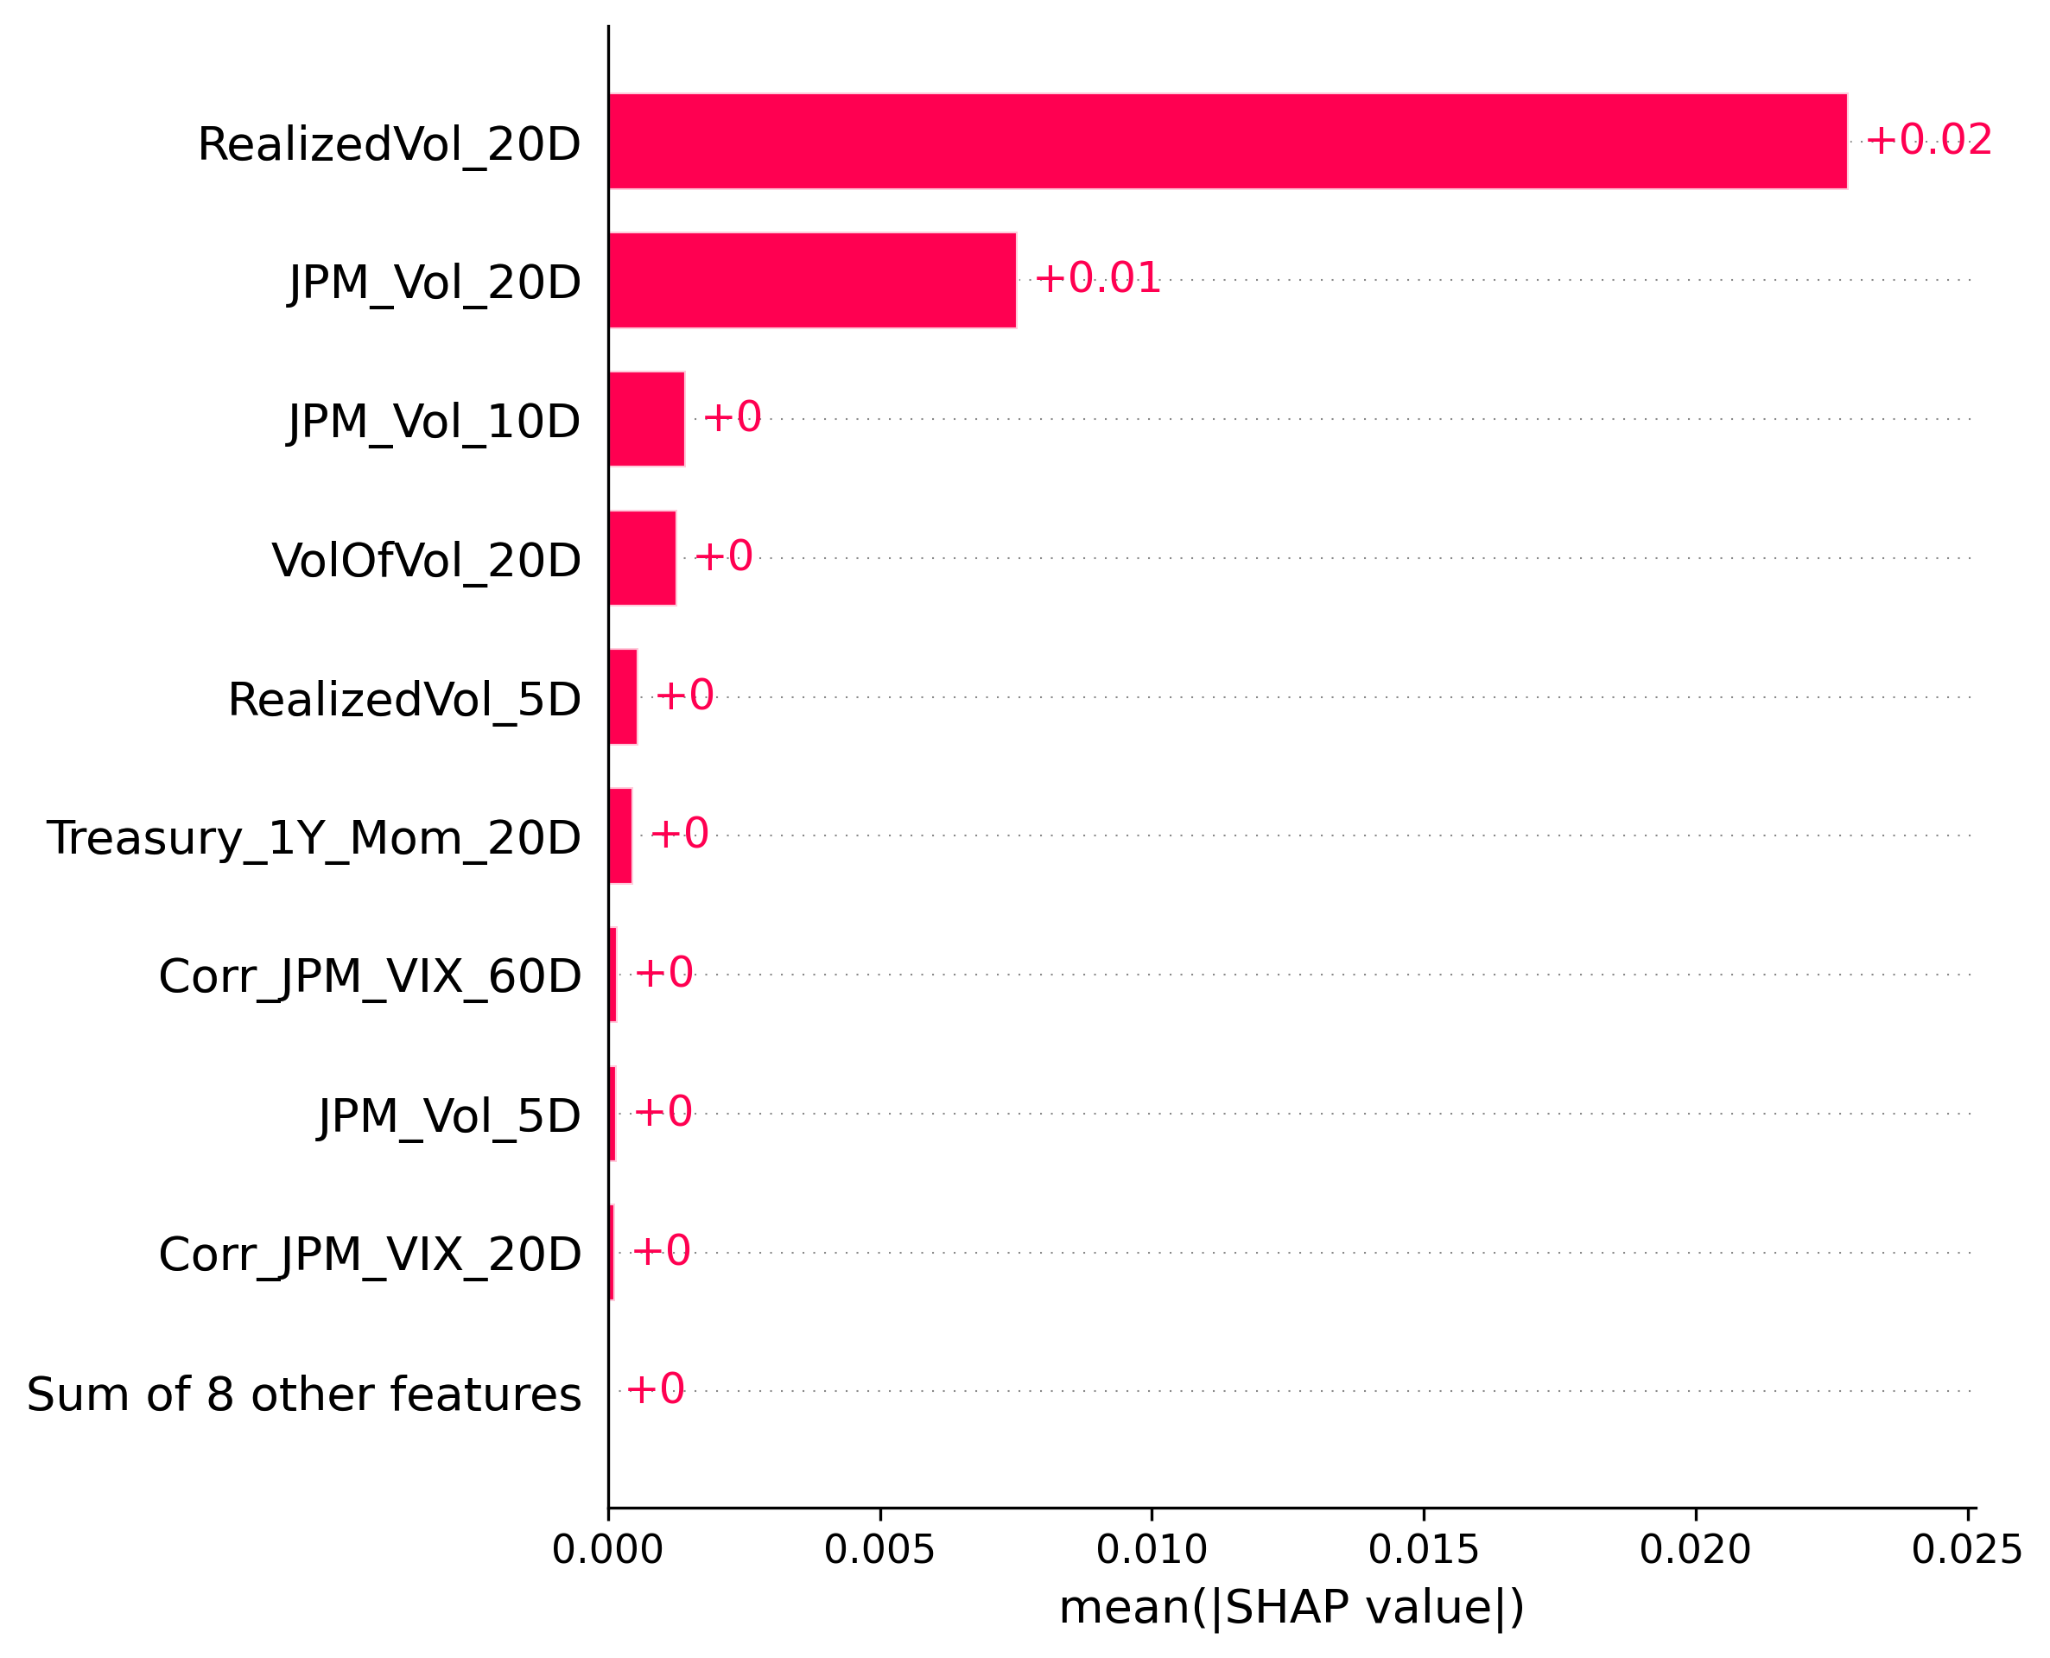
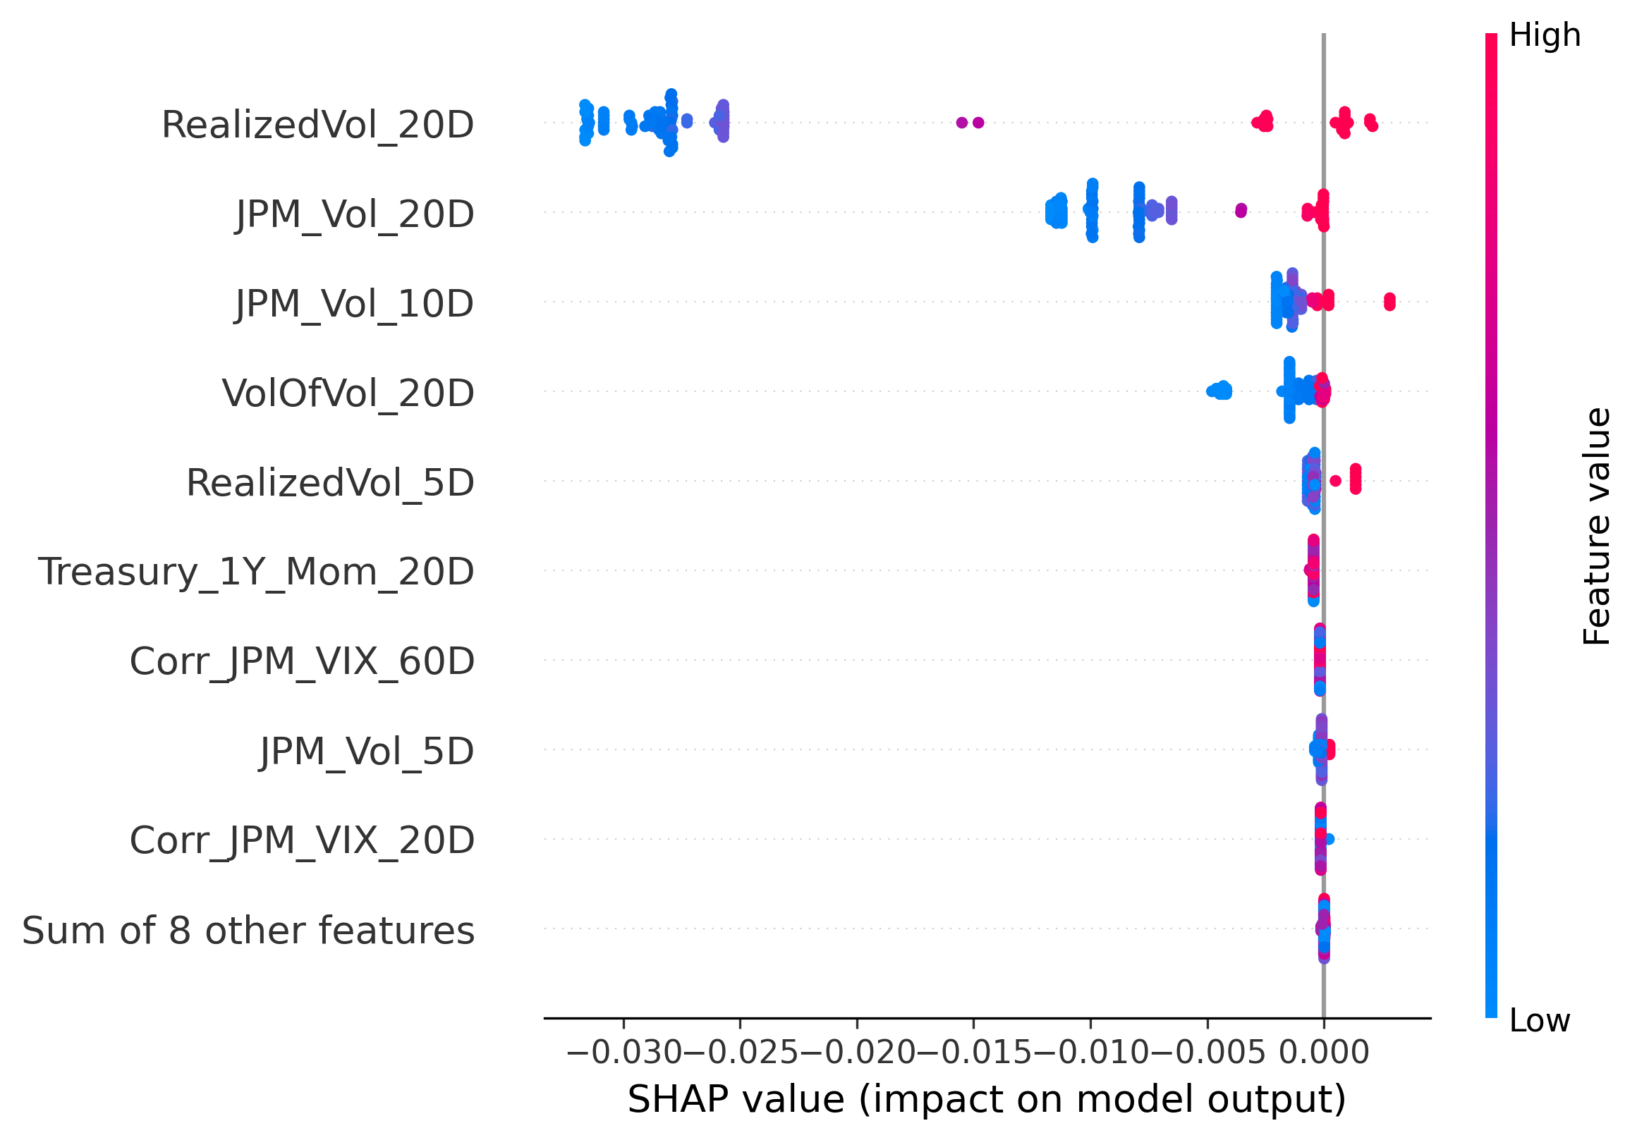
WHAT THE MODEL LEARNED
SHAP Model Interpretation
Takeaway: recent volatility-related variables dominate predictive power.
Advanced Chooser Option Pricing Model
8

Slide 9
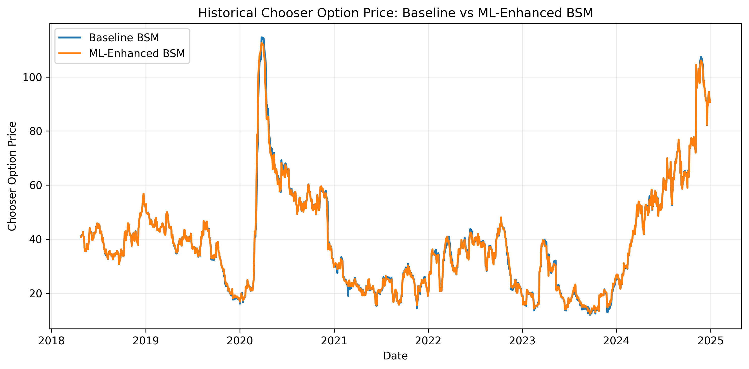
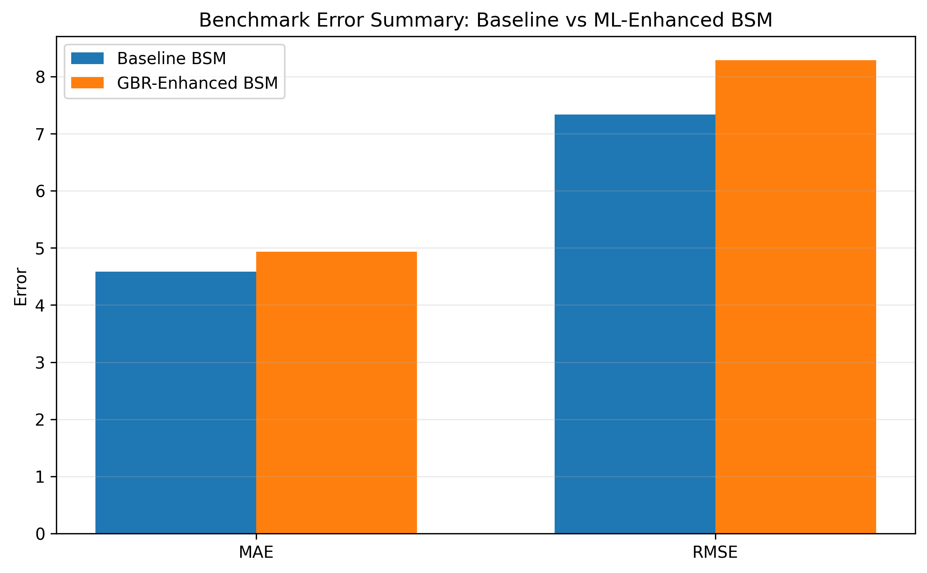
ML-ENHANCED BSM RESULTS
Benchmark Pricing Comparison
• ML-enhanced sigma changes prices only modestly.
• Benchmark error does not materially improve.
• Pricing gap reflects more than realized-volatility forecasting.
Takeaway: better volatility forecasts do not automatically create better option prices.
Advanced Chooser Option Pricing Model
9

Slide 10
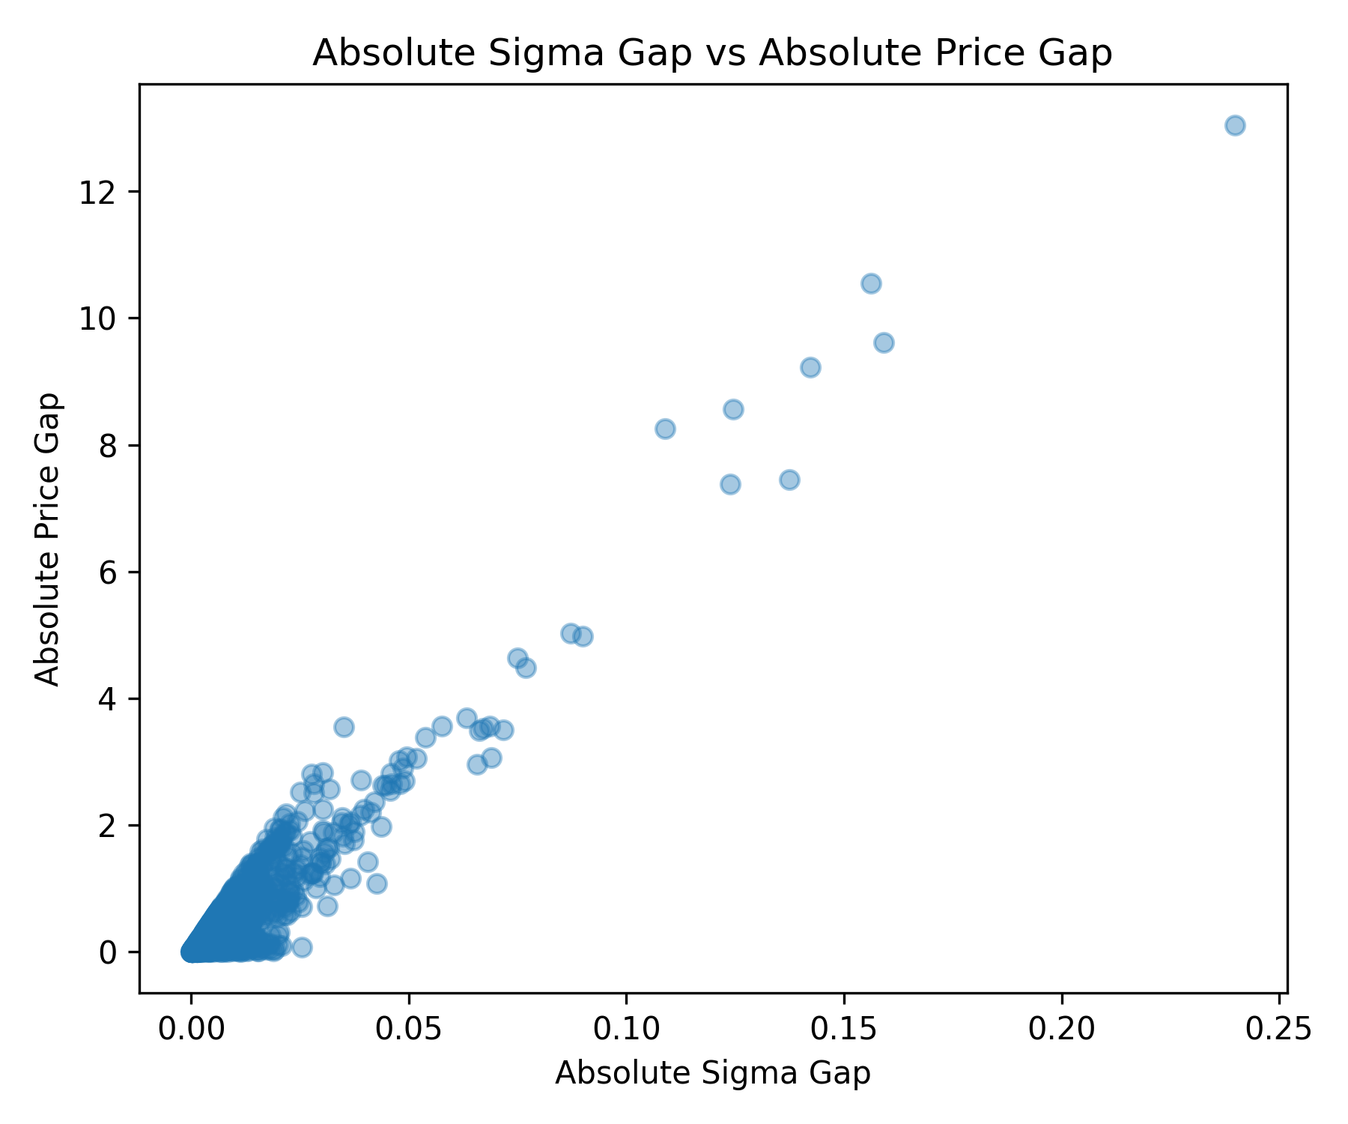
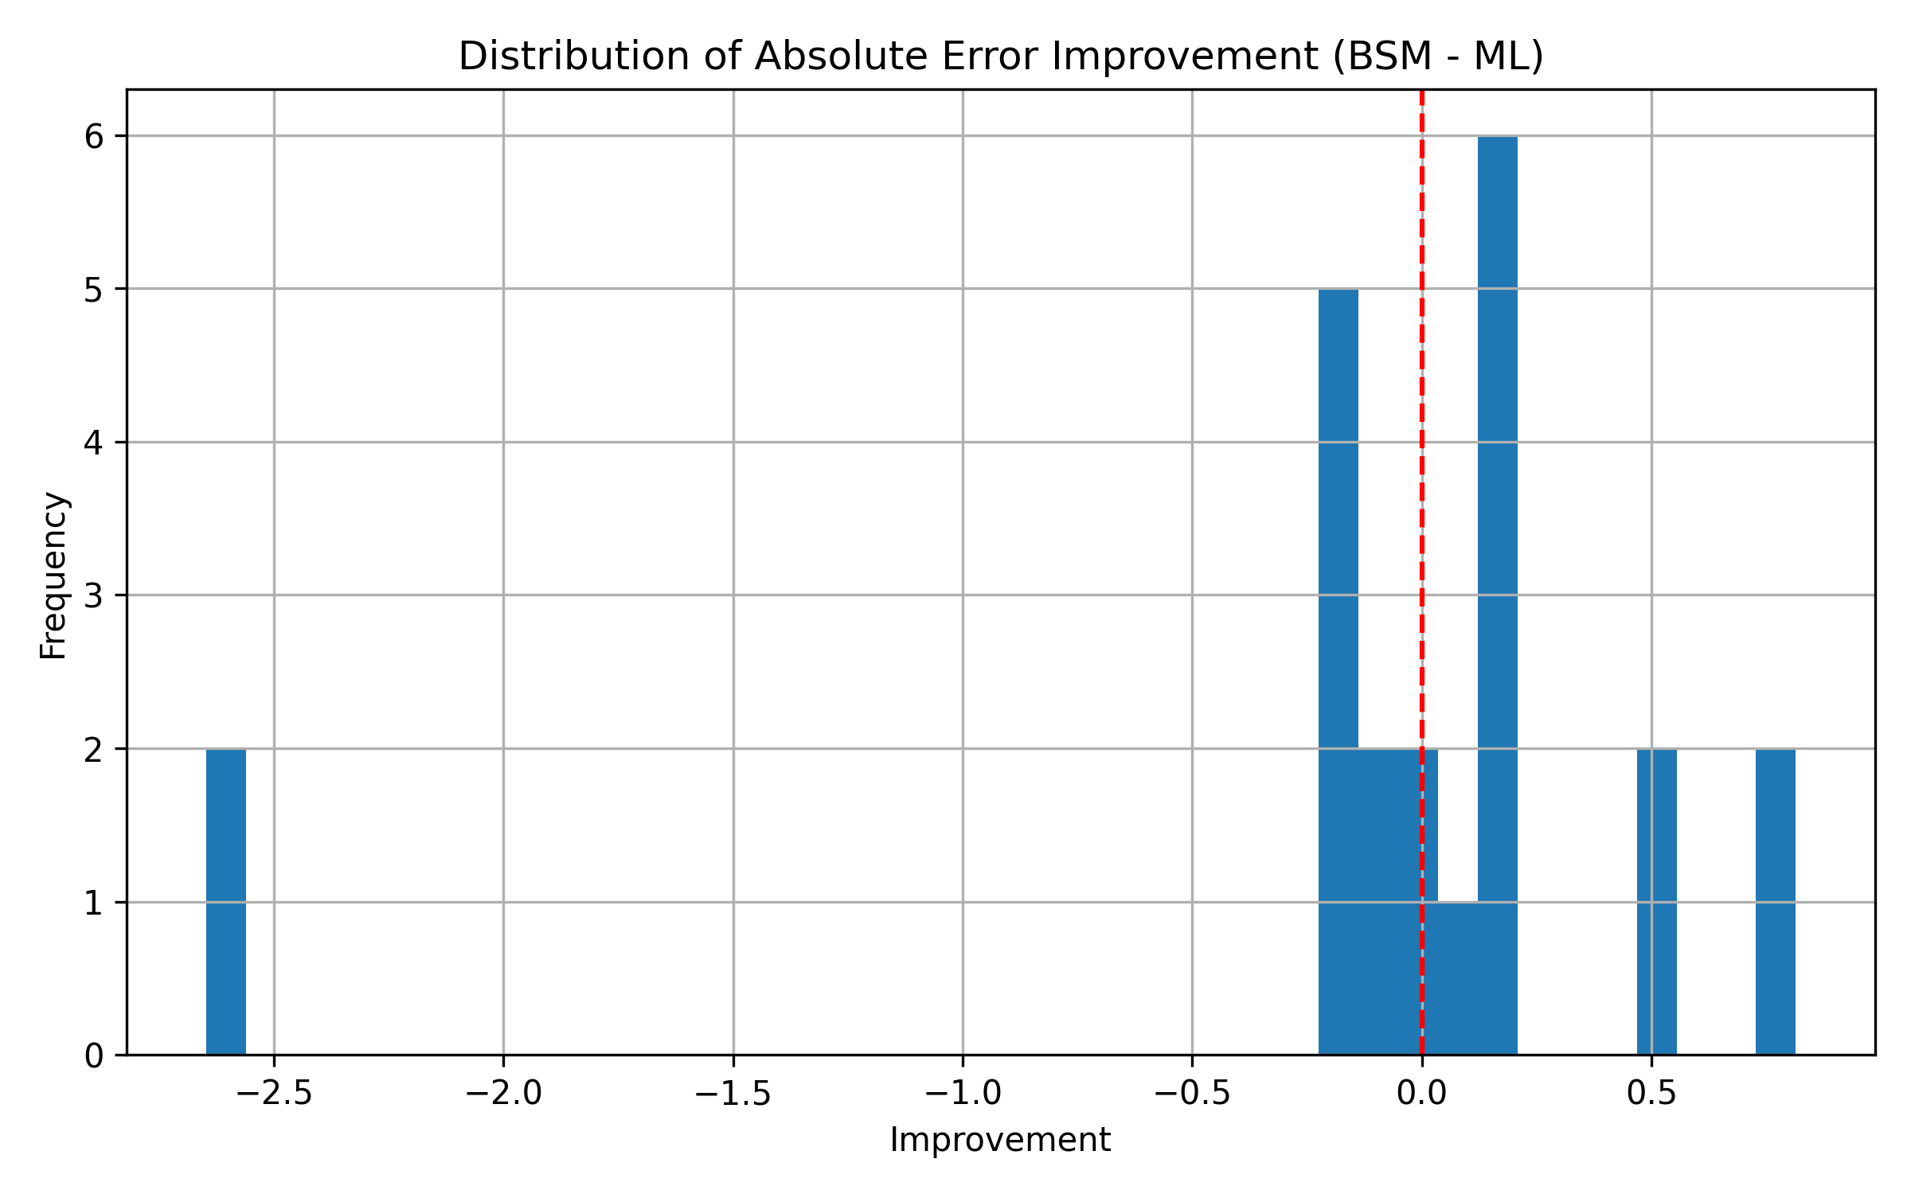
WHY PRICING GAINS ARE LIMITED
Pricing Diagnostics
• Pricing improvements are mixed across observations.
• Sigma gaps map mechanically into price gaps.
• Most sigma adjustments are economically small.
Takeaway: sigma-only enhancement is too narrow for market pricing.
Advanced Chooser Option Pricing Model
10

Slide 11
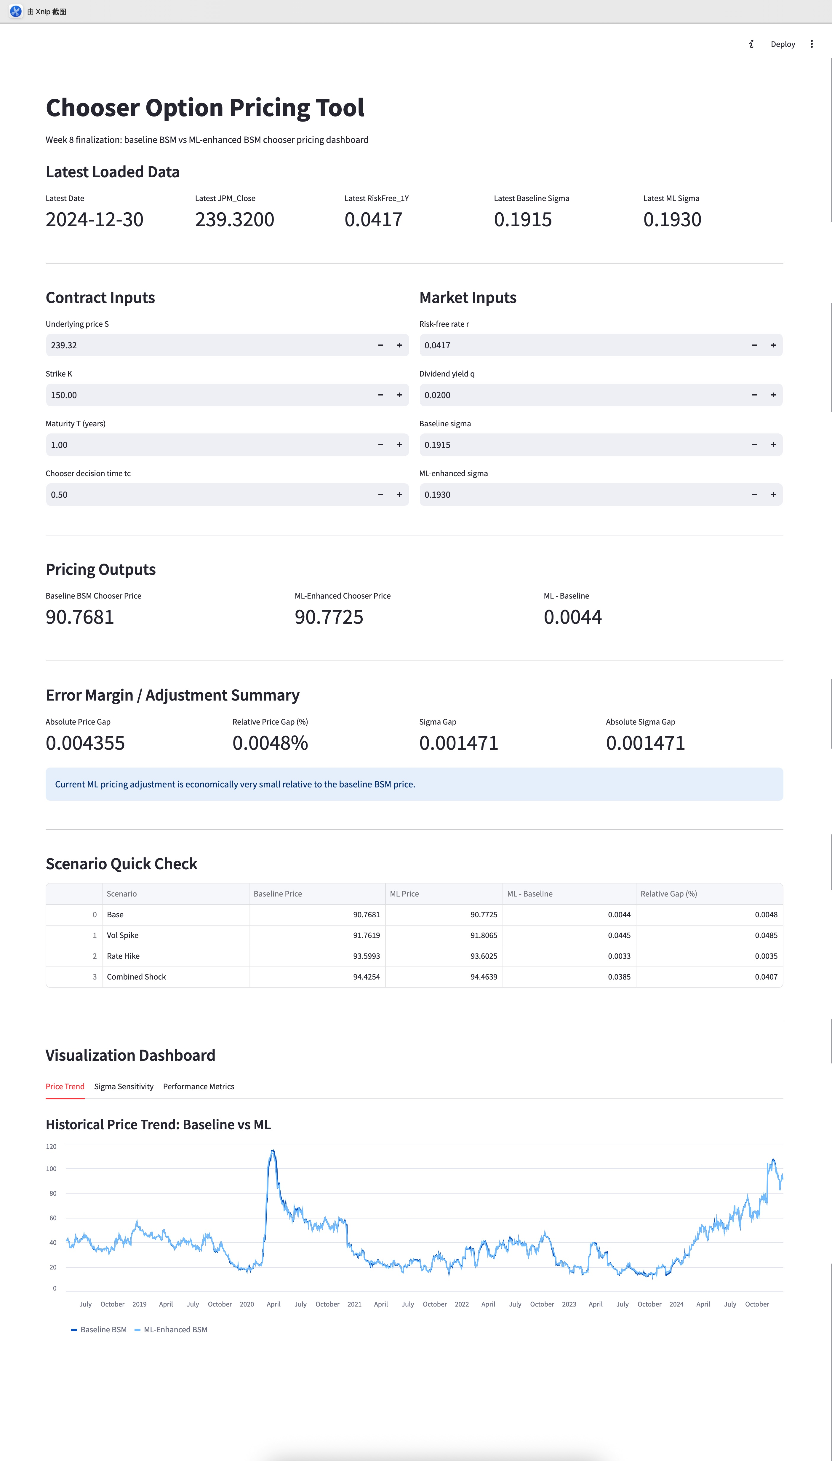
INTERACTIVE PRICING WORKFLOW
Prototype Tool
• Latest loaded data
• Dual baseline + ML pricing
• Error margin summary
• Scenario checks + visualization dashboard
A usable prototype bridges analysis and applied decision support.
Advanced Chooser Option Pricing Model
11

Slide 12
WHAT THE PROJECT SHOWS
Final Conclusions and Future Work
• Baseline chooser pricing workflow works.
• Chooser value is strongly volatility-sensitive.
• Gradient Boosting is the best volatility model.
• ML sigma does not materially improve benchmark pricing.
Future work
Implied-volatility features
Liquidity + microstructure
Hybrid correction models
Live-data integration
Central lesson: ML is useful, but sigma-only enhancement is too narrow.
Advanced Chooser Option Pricing Model
12

