Slide 1
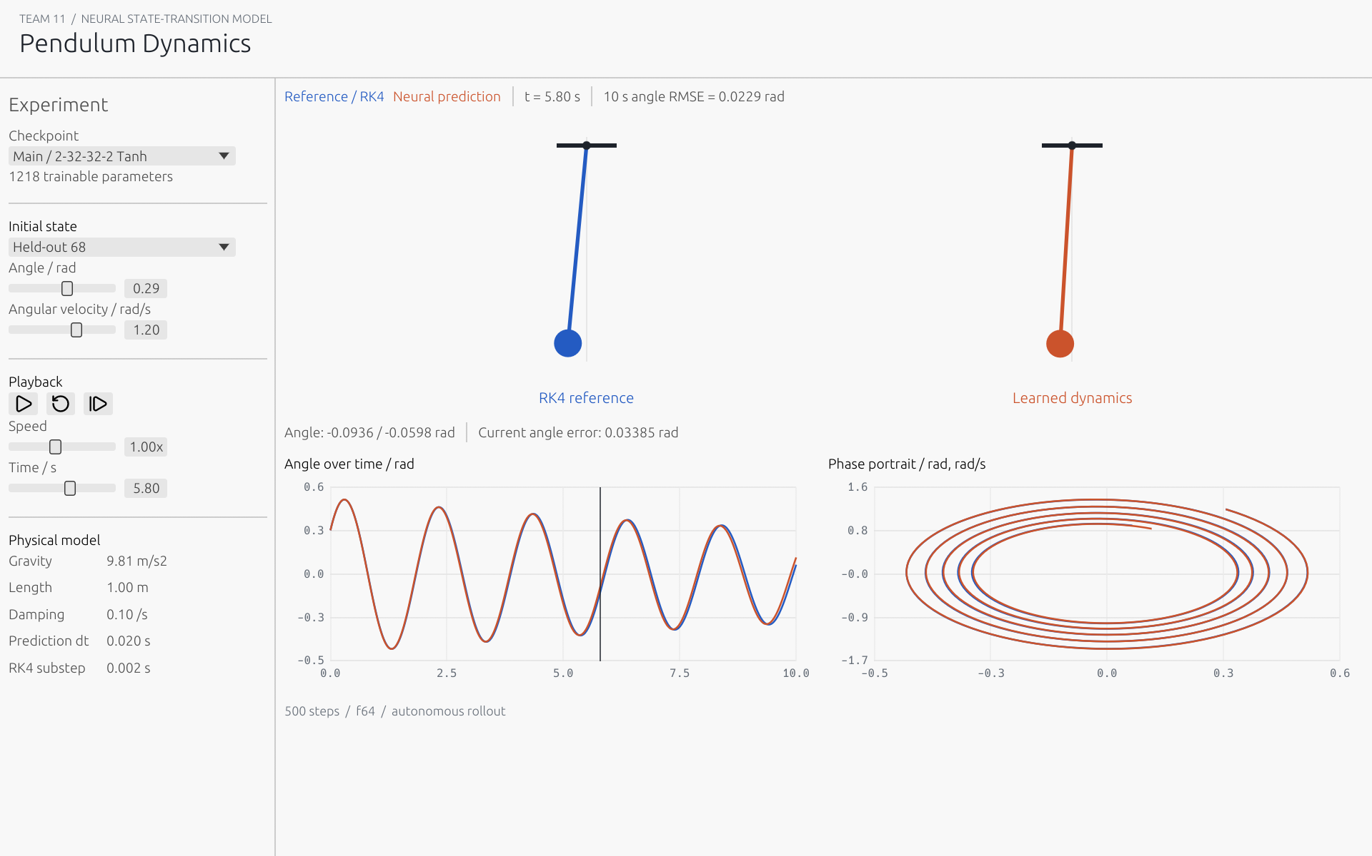
Neural Network from Scratch
for ODE Solving
Team 11
Course 35-380
99.10%
lower one-step standardized RMSE
than predicting no motion
Manual gradients and an offline pendulum comparison.
Notes:
Hello, we are Team 11. Our project asks whether a small neural network, implemented from first principles in Rust, can learn the motion of a pendulum. We wrote the dense layers, activations, loss, gradients and training loop ourselves. The main result is a large reduction in one-step prediction error compared with predicting no movement. However, we also show accumulated error and an unfamiliar initial condition, because a good local fit alone does not establish a reliable dynamical model.
Source: results/evaluation.json. Screenshot: native eframe framebuffer, results/figures/gui_native.png.

Slide 2
Physical System
State: angle and angular velocity
theta′ = omega
omega′ = -(g / L) sin(theta) - beta omega
g | L | beta | Prediction dt | RK4 substep
9.81 m/s2 | 1.0 m | 0.1 /s | 0.02 s | 0.002 s
Reference labels use ten RK4 substeps per prediction interval.
Tests: equilibrium, fourth-order convergence, small-angle limit and damped energy.
Notes:
We use a damped nonlinear pendulum with angle and angular velocity as its two state coordinates. Gravity is 9.81, length is one metre, and damping is 0.1 per second. The network predicts the state after 0.02 seconds. To generate labels, our fourth-order Runge-Kutta implementation takes ten smaller steps of 0.002 seconds. We call this the numerical reference rather than an exact truth. Equilibrium, convergence, the small-angle analytical limit and decreasing damped energy are checked independently.
Sources: Project 11 assignment brief and the repository experiment files. Dataset and models: results/dataset.json and models/*.json. Raw evaluation: results/evaluation.json, results/rollouts.csv. Timing: results/benchmark_rust.json and results/benchmark_numpy.json. API references: https://docs.rs/ndarray/0.17.2/ndarray/ ; https://docs.rs/eframe/0.33.3/eframe/ ; https://numpy.org/doc/stable/reference/global_state.html

Slide 3
Dataset Design
80 initial conditions produce 40,000 transitions.
Partition | Trajectories | Transitions
Training | 56 | 28,000
Validation | 12 | 6,000
Test | 12 | 6,000
Initial angle: [-1.5, 1.5] rad
Initial velocity: [-2, 2] rad/s
Split complete trajectories.
Fit normalization on training data only.
Seed 42. 500 transitions per trajectory. No row-level shuffle across splits.
Notes:
A fixed seed generates eighty initial conditions. Each produces five hundred transitions over ten seconds, giving forty thousand samples. We split by complete trajectory: fifty-six for training, twelve for validation and twelve for final testing. Randomly splitting individual rows would leak almost neighbouring states between partitions. Input and target means and standard deviations are therefore fitted on training trajectories only. The output target is the next-state increment. The stored checkpoint includes every normalization statistic needed to convert its predictions back to physical units.
Sources: Project 11 assignment brief and the repository experiment files. Dataset and models: results/dataset.json and models/*.json. Raw evaluation: results/evaluation.json, results/rollouts.csv. Timing: results/benchmark_rust.json and results/benchmark_numpy.json. API references: https://docs.rs/ndarray/0.17.2/ndarray/ ; https://docs.rs/eframe/0.33.3/eframe/ ; https://numpy.org/doc/stable/reference/global_state.html

Slide 4
Handwritten Neural Network
Dense layers, activations, MSE, backpropagation and SGD
Model | Architecture | Activation | Parameters
Main | 2-32-32-2 | Tanh | 1,218
Small baseline | 2-3-2 | Sigmoid | 17
ReLU is also implemented and gradient-checked.
next state = current state + learned increment
ndarray supplies linear algebra only. No autodiff or high-level ML framework.
Notes:
The main architecture has two inputs, two hidden layers with thirty-two Tanh neurons each, and two linear outputs. It contains 1,218 trainable parameters. We also retain a deliberately small two-three-two Sigmoid baseline with seventeen parameters, following the assignment's suggested starting point. ReLU is implemented and tested as well. ndarray performs matrix arithmetic only. There is no automatic differentiation or high-level training framework. At inference, the learned increment is decoded and added to the network's current state, without calling the pendulum equation.
Sources: Project 11 assignment brief and the repository experiment files. Dataset and models: results/dataset.json and models/*.json. Raw evaluation: results/evaluation.json, results/rollouts.csv. Timing: results/benchmark_rust.json and results/benchmark_numpy.json. API references: https://docs.rs/ndarray/0.17.2/ndarray/ ; https://docs.rs/eframe/0.33.3/eframe/ ; https://numpy.org/doc/stable/reference/global_state.html

Slide 5
Backpropagation
J = mean((prediction - target)^2)
delta_output = 2 (prediction - target) / (B D)
dW = A_previous^T delta db = sum_rows(delta)
Compute all gradients before updating any weights.
Independent check | Acceptance
Central differences, all small-network parameters | Absolute error < 1e-7
Rust and NumPy forward, gradients and update | Absolute difference < 1e-10
Notes:
Our loss averages squared error over both samples and output coordinates. That makes its output derivative two times the residual divided by batch size times output width. We propagate this derivative through activation functions and transposed weight matrices. Weight gradients are the previous activations transposed times the local derivative; bias gradients sum over samples. We compute all gradients before changing any weights. Central differences check every parameter of a small network, and an independent NumPy implementation checks forward values, gradients and one update.
Sources: Project 11 assignment brief and the repository experiment files. Dataset and models: results/dataset.json and models/*.json. Raw evaluation: results/evaluation.json, results/rollouts.csv. Timing: results/benchmark_rust.json and results/benchmark_numpy.json. API references: https://docs.rs/ndarray/0.17.2/ndarray/ ; https://docs.rs/eframe/0.33.3/eframe/ ; https://numpy.org/doc/stable/reference/global_state.html

Slide 6
Training and Validation
200 epochs Batch 128 Learning rate 0.01
Checkpoint choice uses validation loss only. Test data remain held out.
Notes:
Both models use mini-batch gradient descent with batch size 128, learning rate 0.01 and two hundred epochs. The checkpoint with the lowest validation loss is retained. The test partition never enters this selection. This plot shows the base-ten logarithm of validation MSE, so changes across several orders of magnitude remain visible. The larger model achieves a much lower validation error. We did not use the proposed fallback hyperparameter sweep, because the default configuration already passed the predefined acceptance condition.
Sources: Project 11 assignment brief and the repository experiment files. Dataset and models: results/dataset.json and models/*.json. Raw evaluation: results/evaluation.json, results/rollouts.csv. Timing: results/benchmark_rust.json and results/benchmark_numpy.json. API references: https://docs.rs/ndarray/0.17.2/ndarray/ ; https://docs.rs/eframe/0.33.3/eframe/ ; https://numpy.org/doc/stable/reference/global_state.html

Slide 7
One Step Results
6,000 held-out transitions. Errors remain in their physical units.
Method | Angle RMSE / rad | Velocity RMSE / rad/s
Persistence | 2.948e-2 | 8.717e-2
Euler | 8.720e-4 | 2.616e-3
RK4 | 3.344e-9 | 8.211e-9
Tiny NN | 2.316e-3 | 3.489e-3
NN | 2.744e-4 | 7.648e-4
99.10% lower standardized error than persistence.
RK4 is substantially more accurate. It directly uses the known governing equation.
Notes:
The frozen main model is evaluated on six thousand held-out transitions. Its angle RMSE is about 0.000274 radians and velocity RMSE about 0.000765 radians per second. Standardized error improves by 99.10 percent over persistence, exceeding our fifty-percent target. The main network also improves on Euler for this experiment. Nevertheless, RK4 is much more accurate, because it directly uses the known physical equation. These are local predictions from the real current state, so we must still test an autonomous rollout.
Sources: Project 11 assignment brief and the repository experiment files. Dataset and models: results/dataset.json and models/*.json. Raw evaluation: results/evaluation.json, results/rollouts.csv. Timing: results/benchmark_rust.json and results/benchmark_numpy.json. API references: https://docs.rs/ndarray/0.17.2/ndarray/ ; https://docs.rs/eframe/0.33.3/eframe/ ; https://numpy.org/doc/stable/reference/global_state.html

Slide 8
Autonomous Rollouts
The NN uses only its own previous output for 500 steps.
Trajectory 74 angle RMSE
0.0814 rad
OOD angle RMSE
0.4989 rad
Notes:
In these plots the network receives the same initial state as the reference, then uses only its own previous output for five hundred steps. There is no teacher forcing or hidden reset. The left plot shows an unseen test trajectory within the initial-condition range. The right starts at 2.5 radians, outside that range. Its larger phase and amplitude discrepancy is a genuine failure of generalization. The GUI preserves this error and labels the unfamiliar initial state rather than correcting the model using reference physics.
Sources: Project 11 assignment brief and the repository experiment files. Dataset and models: results/dataset.json and models/*.json. Raw evaluation: results/evaluation.json, results/rollouts.csv. Timing: results/benchmark_rust.json and results/benchmark_numpy.json. API references: https://docs.rs/ndarray/0.17.2/ndarray/ ; https://docs.rs/eframe/0.33.3/eframe/ ; https://numpy.org/doc/stable/reference/global_state.html

Slide 9
Rust and Python Benchmark
Same f64 data
Same initial weights
Same batch permutations
50 epochs per run
1 warmup + 5 timed runs
Single-thread configuration
No startup, I/O or validation
Backend-specific result on this machine. Numerical parity passes near roundoff.
Notes:
For the timing comparison, Rust and NumPy share the same float64 dataset, initial parameters and every batch permutation for fifty epochs. Each process warms up once, then runs five timed trials. Startup, data loading and validation are excluded. Median times are 1.056 seconds for Rust and 2.469 seconds for NumPy on this machine. Numerical parity agrees near floating-point roundoff. We report backend differences explicitly, including NumPy's OpenBLAS implementation, so this result is specific to the workload and does not prove a universal language-speed advantage.
Sources: Project 11 assignment brief and the repository experiment files. Dataset and models: results/dataset.json and models/*.json. Raw evaluation: results/evaluation.json, results/rollouts.csv. Timing: results/benchmark_rust.json and results/benchmark_numpy.json. API references: https://docs.rs/ndarray/0.17.2/ndarray/ ; https://docs.rs/eframe/0.33.3/eframe/ ; https://numpy.org/doc/stable/reference/global_state.html

Slide 10
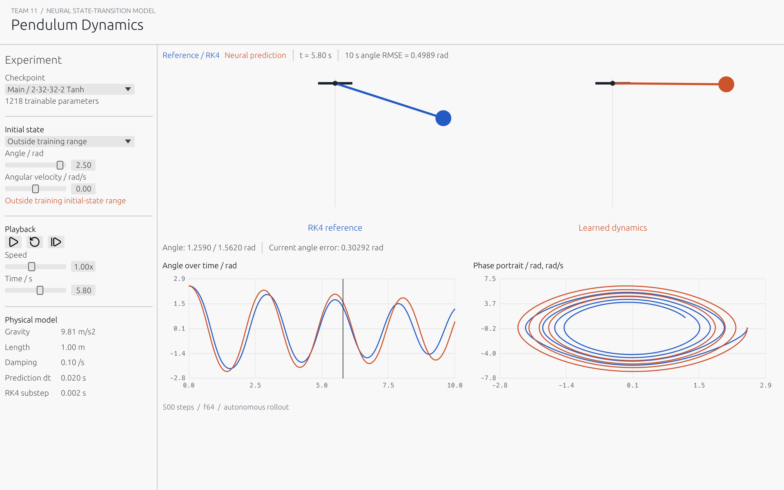
Live Demonstration
Held-out initial state
Pause and single-step
Small-network comparison
Unfamiliar high angle
Useful local transition model. Long-horizon and range limits remain visible.
Notes:
We will now demonstrate the offline desktop lab. We will begin with a held-out initial state, pause and step through the motion, and inspect the time and phase plots. Next we will switch to the smaller network and compare its error. Finally, the high-angle preset shows where generalization deteriorates. Our conclusion is that a handwritten Rust network can learn a useful local transition map, while classical numerical solvers and explicit long-horizon tests remain essential. The next three minutes show these comparisons directly.
Sources: Project 11 assignment brief and the repository experiment files. Dataset and models: results/dataset.json and models/*.json. Raw evaluation: results/evaluation.json, results/rollouts.csv. Timing: results/benchmark_rust.json and results/benchmark_numpy.json. API references: https://docs.rs/ndarray/0.17.2/ndarray/ ; https://docs.rs/eframe/0.33.3/eframe/ ; https://numpy.org/doc/stable/reference/global_state.html

Slide 11
Appendix A Gradient Details
Quantity | Shape
A(l-1) | B x n(l-1)
W(l) | n(l-1) x n(l)
delta(l) | B x n(l)
dW(l) | n(l-1) x n(l)
delta(l) =
(delta(l+1) W(l+1)^T)
.* phi′(Z(l))
Central difference
[J(w + eps) - J(w - eps)] / (2 eps)
eps = 1e-6. Check weights and biases. Avoid the ReLU kink.
Notes:
Use this appendix for questions about shapes and loss scaling. Samples are rows. The factor 2/(B D) normalizes all scalar outputs. ReLU uses derivative zero at zero and is checked away from the kink. Both weights and biases pass central differences with epsilon 1e-6 and absolute tolerance 1e-7.
Sources: Project 11 assignment brief and the repository experiment files. Dataset and models: results/dataset.json and models/*.json. Raw evaluation: results/evaluation.json, results/rollouts.csv. Timing: results/benchmark_rust.json and results/benchmark_numpy.json. API references: https://docs.rs/ndarray/0.17.2/ndarray/ ; https://docs.rs/eframe/0.33.3/eframe/ ; https://numpy.org/doc/stable/reference/global_state.html

Slide 12
Appendix B Reproducibility and Limits
cargo run --release --bin project11 -- reproduce --out experiment
cargo run --release --bin project11 -- benchmark --out experiment
python scripts/benchmark_numpy.py --root experiment
Fixed time step and physical parameters
One training seed and one OOD case
No measured inference-speed advantage over RK4
Discrete transition surrogate, not a PINN
Notes:
Use this appendix for reproduction and scope questions. The model is a fixed-step discrete state-transition surrogate, not a PINN or a continuous learned vector field. Physical parameters are fixed. One seed and one OOD example do not establish broad generalization. No inference-speed advantage over RK4 was measured.
Sources: Project 11 assignment brief and the repository experiment files. Dataset and models: results/dataset.json and models/*.json. Raw evaluation: results/evaluation.json, results/rollouts.csv. Timing: results/benchmark_rust.json and results/benchmark_numpy.json. API references: https://docs.rs/ndarray/0.17.2/ndarray/ ; https://docs.rs/eframe/0.33.3/eframe/ ; https://numpy.org/doc/stable/reference/global_state.html
Related primary research: Lagaris et al. (1998), doi:10.1109/72.712178; Chen et al. (2018), https://arxiv.org/abs/1806.07366 . These are distinct approaches, not the method implemented here.

