Slide 1
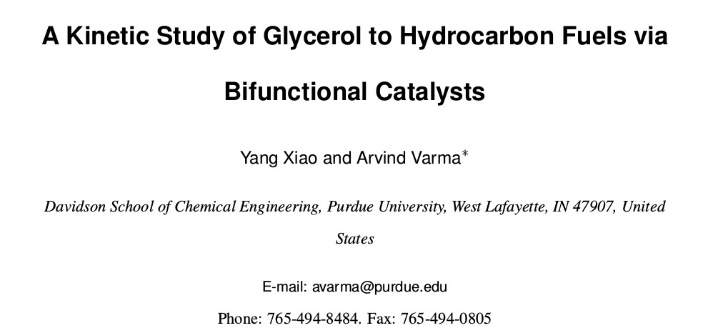
Six figures and one Table

Slide 2

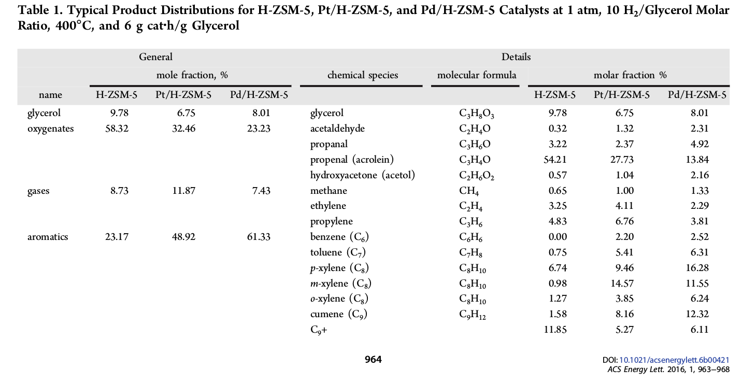

Slide 3
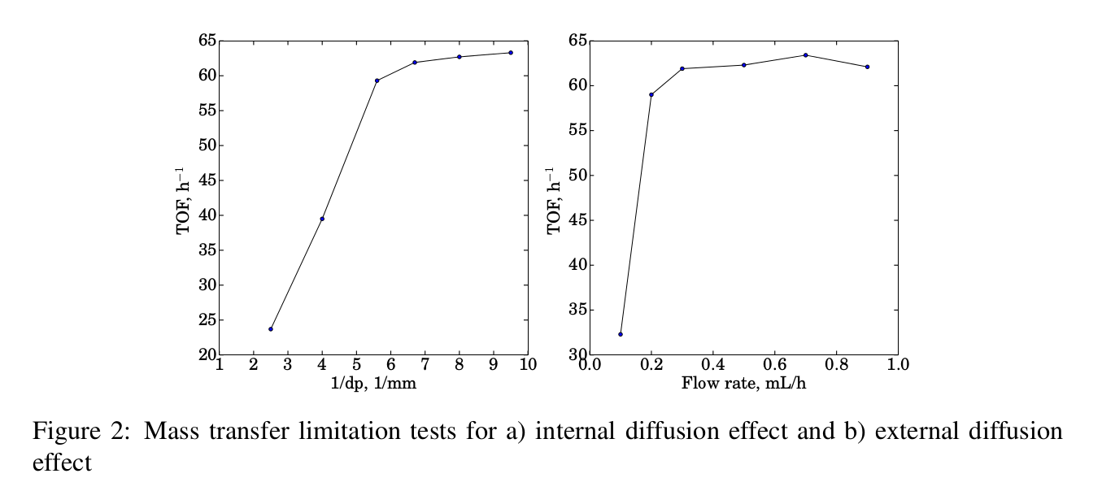
Differenital Reaction when feediing glycerol

Slide 4
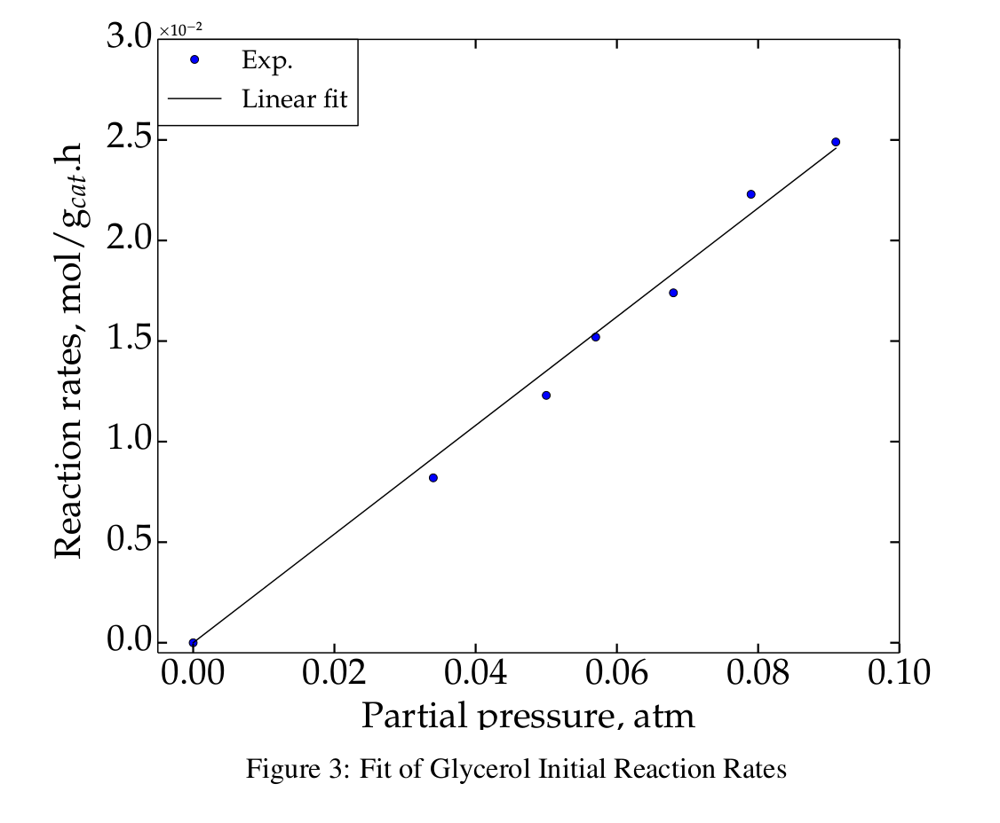


Differenital Reaction when feediing Glycerol

Slide 5
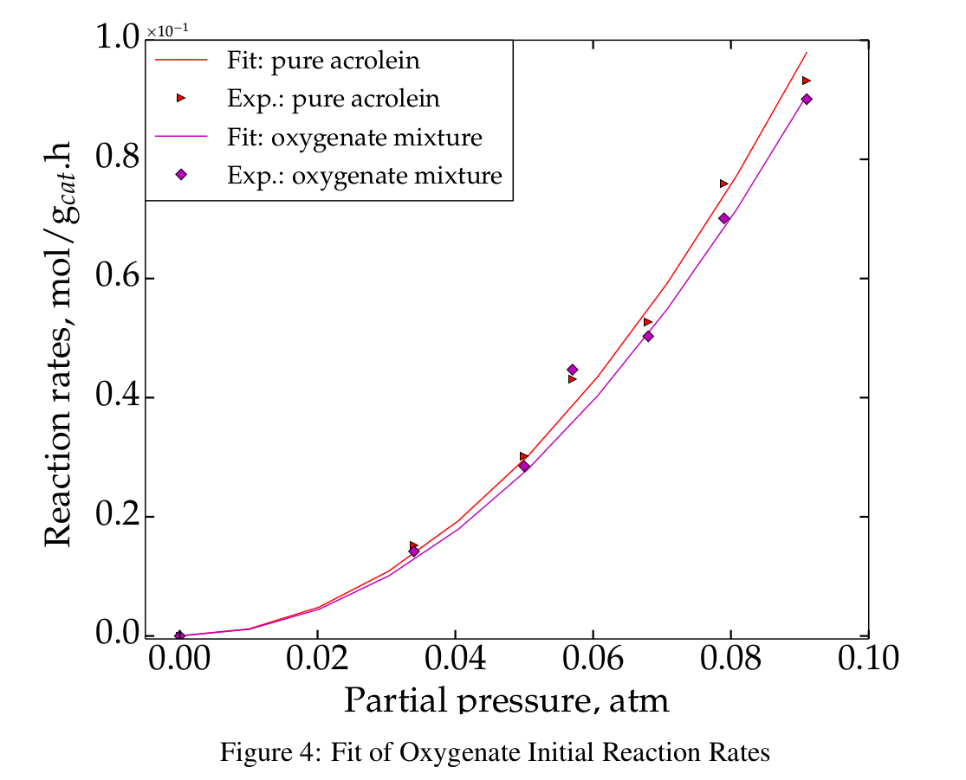
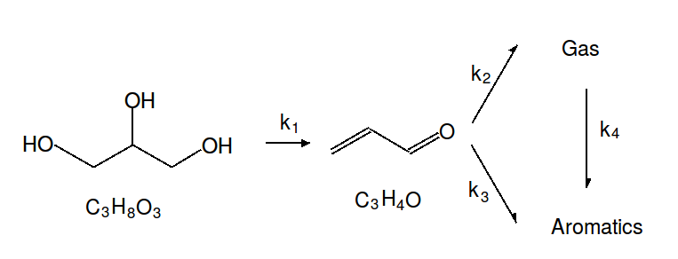
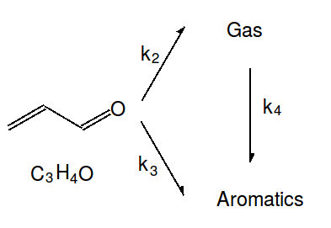


Differenital Reaction when feediing Oxygenates and Acrolein

Slide 6


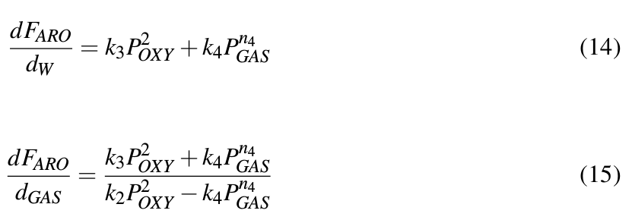
n3=n2=2, then what is n4 ?

Slide 7


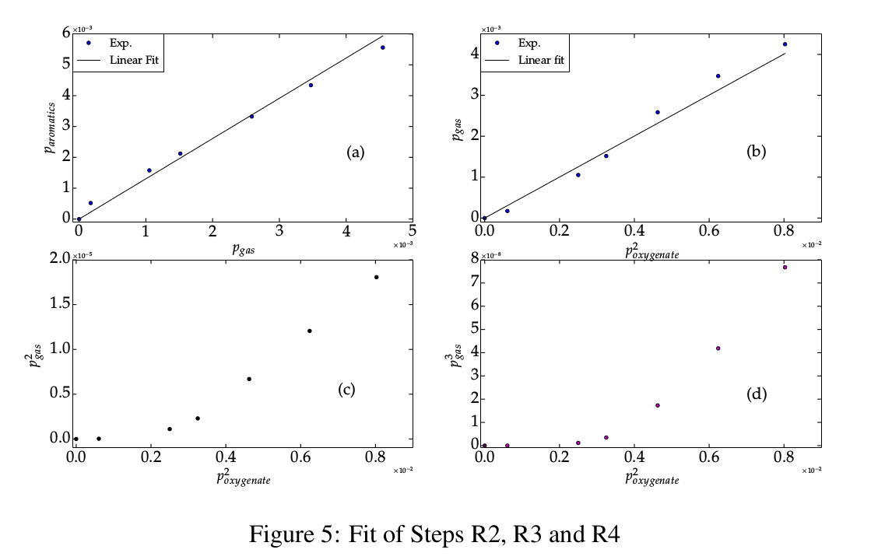
n3=n2=2, then what is n4 ?
Eq. (15) is linear, then

Slide 8


Slide 9
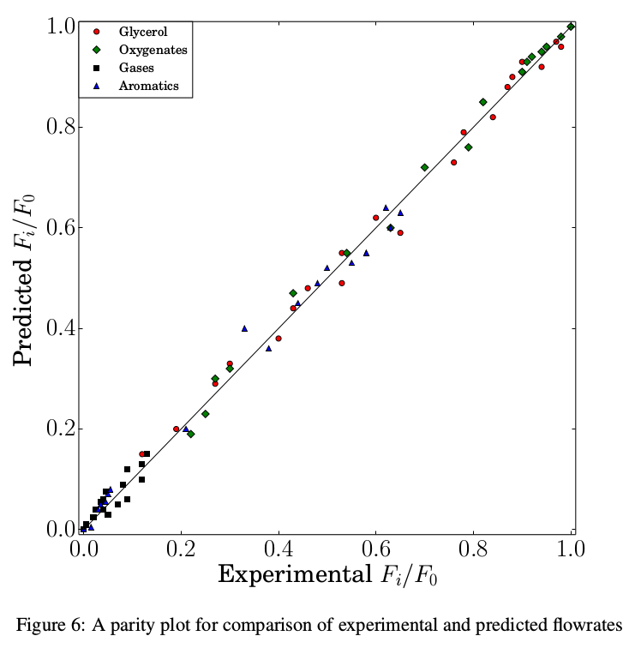

Slide 10
