Slide 1

lzr/quailty/Gromah/葫芦

Slide 2
A-Alive Fossils
签到题，按照题意模拟即可。

Slide 3
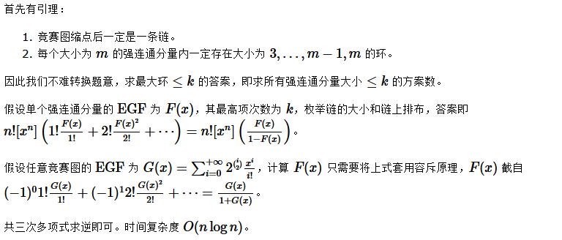
B-Bloodline Counter

Slide 4
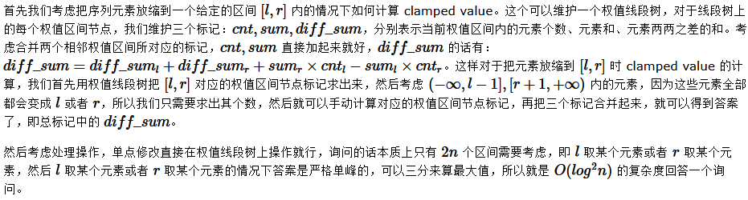
C-Clamped Sequence II

Slide 5
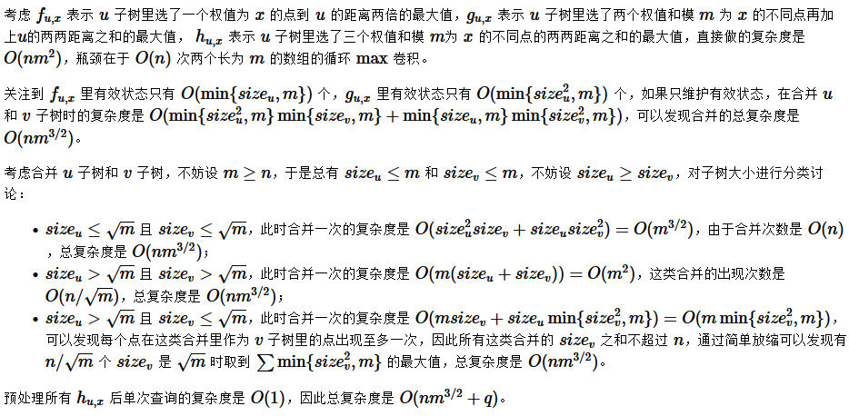
D-Distance on Tree

Slide 6
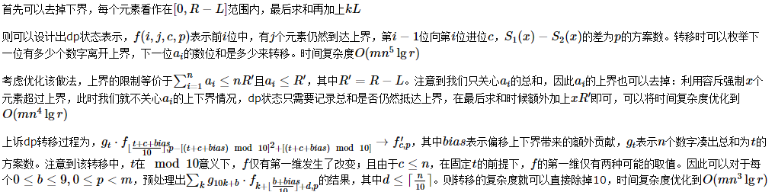
E-Educational Problem I

Slide 7
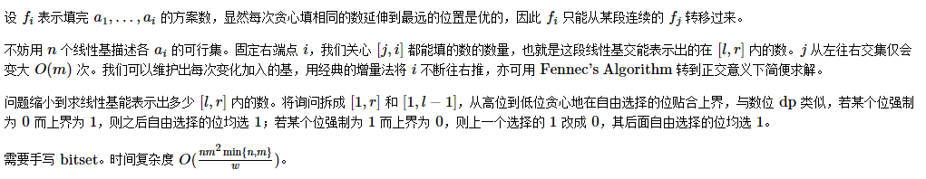
F-Educational Problem II

Slide 8
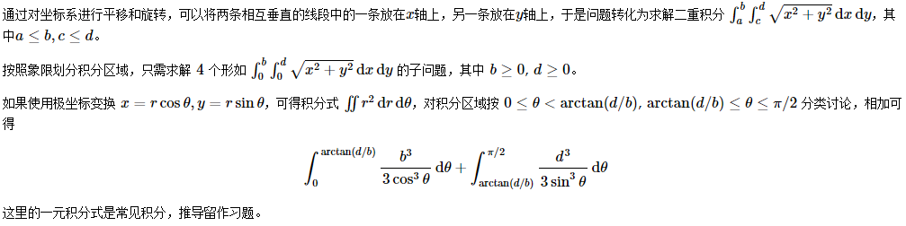
G-Expected Distance

Slide 9
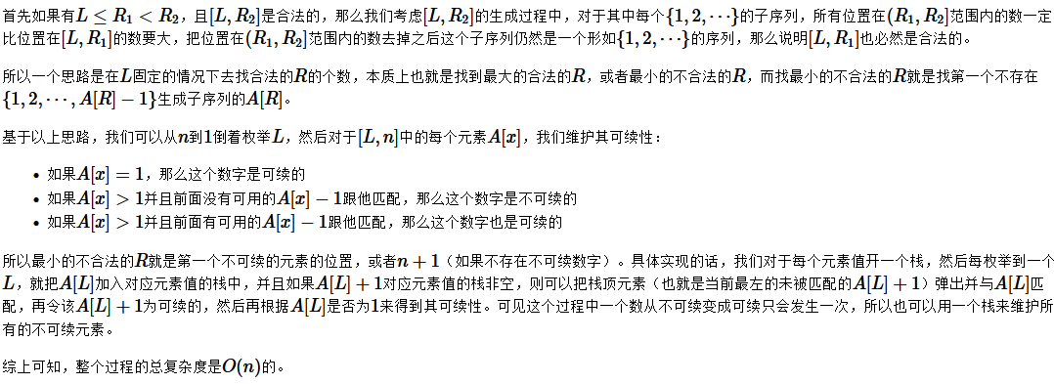
H-Insert 1,Insert 2,Insert 3, ...

Slide 10
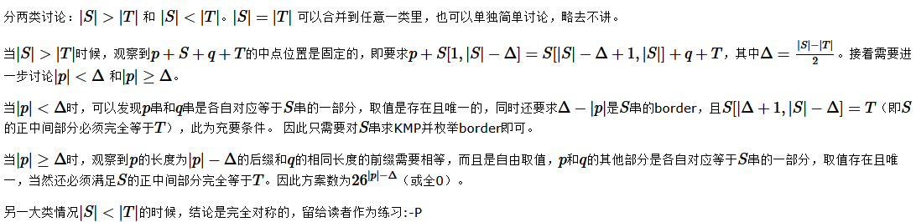
I-Make It Square

Slide 11
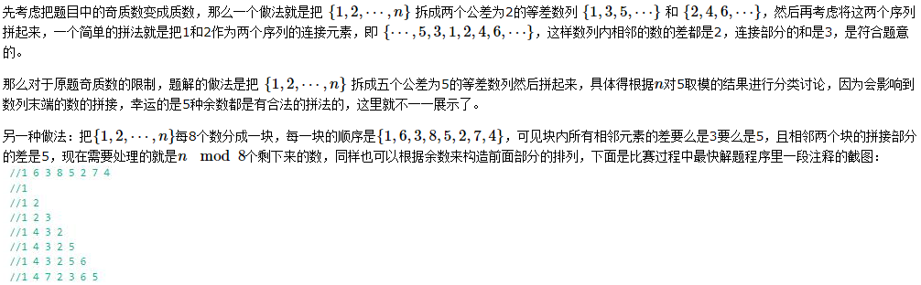
J-Permutation and Primes

Slide 12
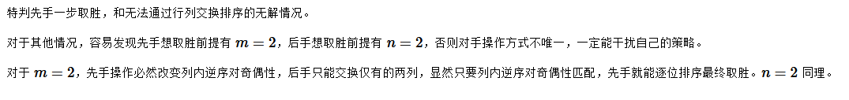
K-Scheming Furry

Slide 13

THANKS
AC.NOWCODER.COM

