Slide 1
Example exam questions
Truncation error, time integration ODE, coding/programming, nonlinear equations, differentiation and integration, linear algebra, statistics

Slide 2
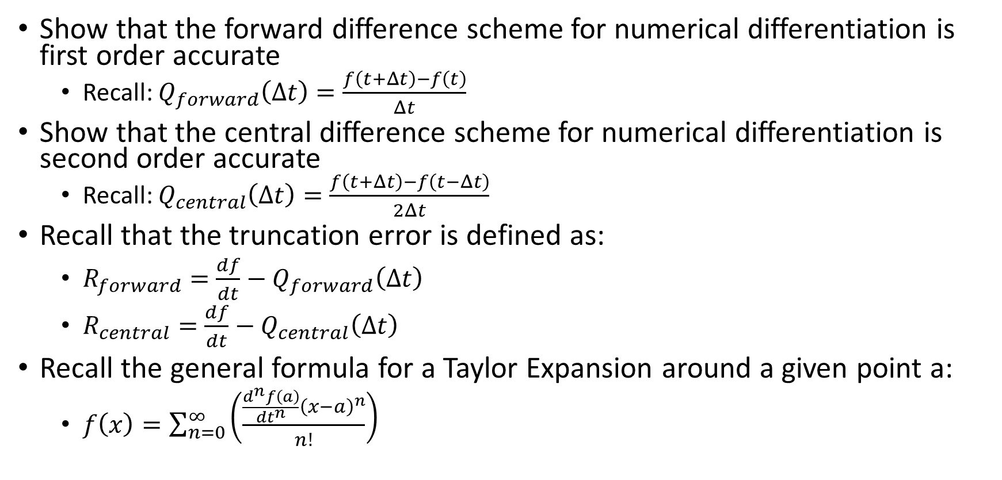
Numerical differentiation
Show that the forward difference scheme for numerical differentiation is first order accurate
Recall: $Q_{forward}\left(Δt\right)=\frac{f\left(t+Δt\right)−f\left(t\right)}{Δt}$
Show that the central difference scheme for numerical differentiation is second order accurate
Recall: $Q_{central}\left(Δt\right)=\frac{f\left(t+Δt\right)−f\left(t−Δt\right)}{2Δt}$
Recall that the truncation error is defined as:
${R_{forward}=\frac{df}{dt}−Q}_{forward}\left(Δt\right)$
${R_{central}=\frac{df}{dt}−Q}_{central}\left(Δt\right)$
Recall the general formula for a Taylor Expansion around a given point a:
$f\left(x\right)=\sum_{n=0}^{∞}{\left(\frac{\frac{d^{n}f\left(a\right)}{dt^{n}}{\left(x−a\right)}^{n}}{n!}\right)}$

Slide 3
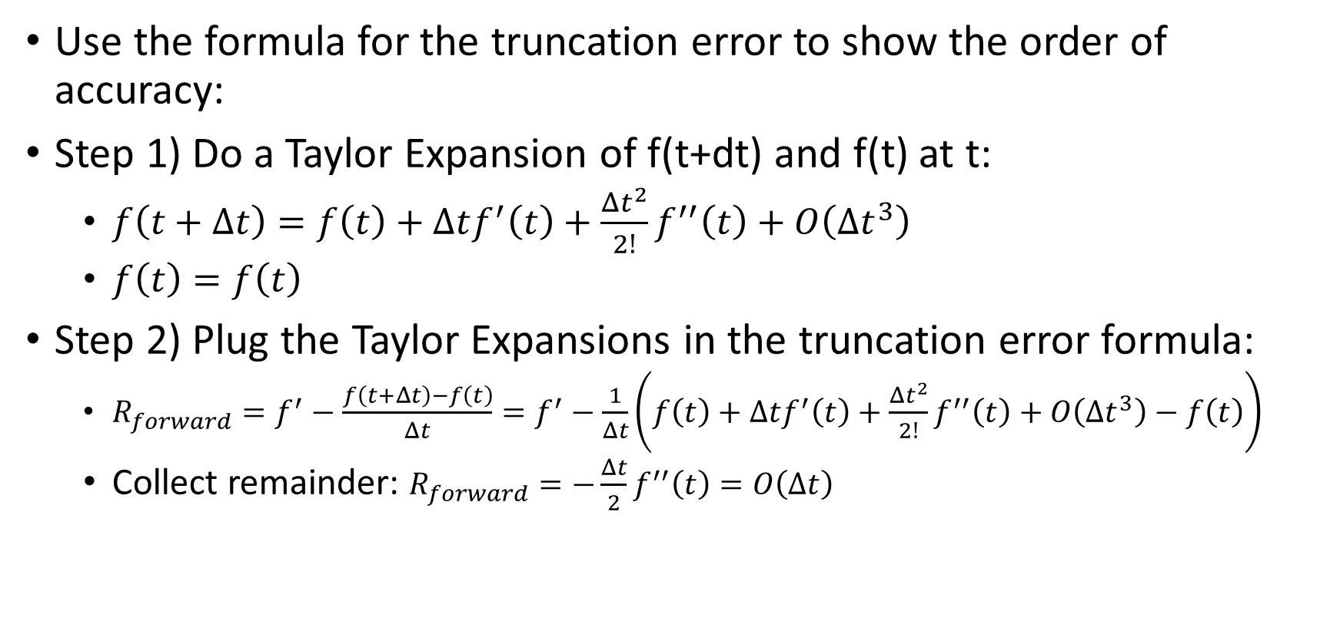
Answer: Forward difference
Use the formula for the truncation error to show the order of accuracy:
Step 1) Do a Taylor Expansion of f(t+dt) and f(t) at t:
$f\left(t+Δt\right)=f\left(t\right)+Δtf^{′}\left(t\right)+\frac{Δt^{2}}{2!}f^{′′}\left(t\right)+O\left(Δt^{3}\right)$
$f\left(t\right)=f\left(t\right)$
Step 2) Plug the Taylor Expansions in the truncation error formula:
$R_{forward}=f^{′}−\frac{f\left(t+Δt\right)−f\left(t\right)}{Δt}=f^{′}−\frac{1}{Δt}\left(f\left(t\right)+Δtf^{′}\left(t\right)+\frac{Δt^{2}}{2!}f^{′′}\left(t\right)+O\left(Δt^{3}\right)−f\left(t\right)\right)$
Collect remainder: $R_{forward}=−\frac{Δt}{2}f^{′′}\left(t\right)=O\left(Δt\right)$

Slide 4
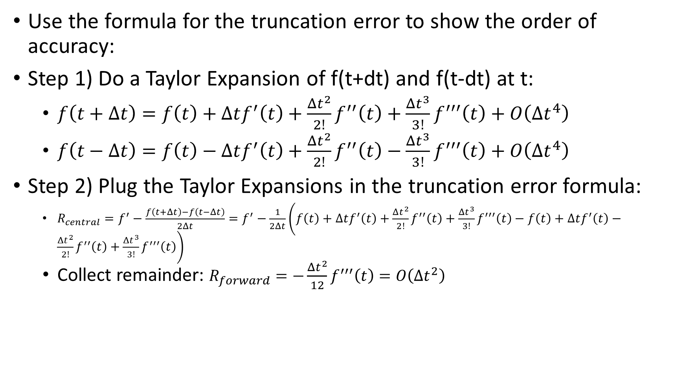
Answer: Central difference
Use the formula for the truncation error to show the order of accuracy:
Step 1) Do a Taylor Expansion of f(t+dt) and f(t-dt) at t:
$f\left(t+Δt\right)=f\left(t\right)+Δtf^{′}\left(t\right)+\frac{Δt^{2}}{2!}f^{′′}\left(t\right)+\frac{Δt^{3}}{3!}f^{′′′}\left(t\right)+O\left(Δt^{4}\right)$
$f\left(t−Δt\right)=f\left(t\right)−Δtf^{′}\left(t\right)+\frac{Δt^{2}}{2!}f^{′′}\left(t\right)−\frac{Δt^{3}}{3!}f^{′′′}\left(t\right)+O\left(Δt^{4}\right)$
Step 2) Plug the Taylor Expansions in the truncation error formula:
$R_{central}=f^{′}−\frac{f\left(t+Δt\right)−f\left(t−Δt\right)}{2Δt}=f^{′}−\frac{1}{2Δt}\left(f\left(t\right)+Δtf^{′}\left(t\right)+\frac{Δt^{2}}{2!}f^{′′}\left(t\right)+\frac{Δt^{3}}{3!}f^{′′′}\left(t\right)−f\left(t\right)+Δtf^{′}\left(t\right)−\frac{Δt^{2}}{2!}f^{′′}\left(t\right)+\frac{Δt^{3}}{3!}f^{′′′}\left(t\right)\right)$
Collect remainder: $R_{forward}=−\frac{Δt^{2}}{12}f^{′′′}\left(t\right)=O\left(Δt^{2}\right)$

Slide 5
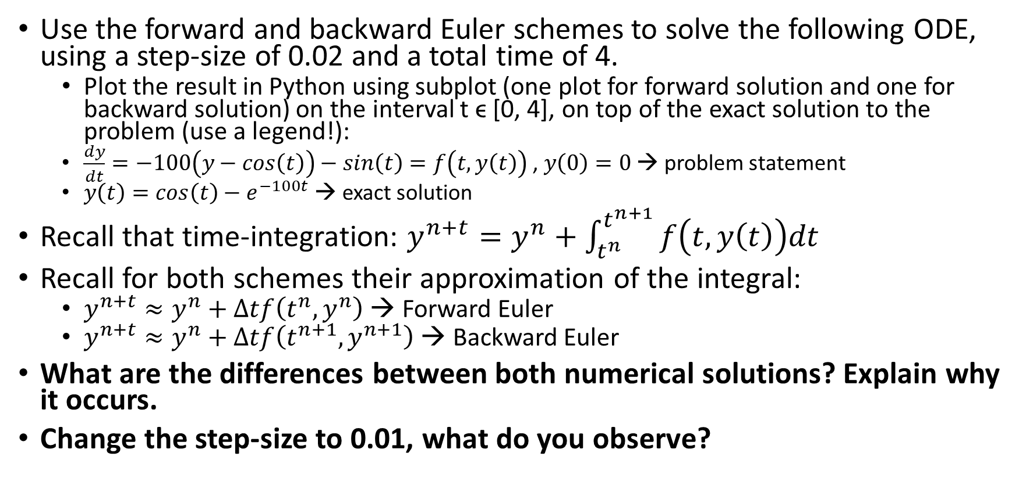
Numerical time integration
Use the forward and backward Euler schemes to solve the following ODE, using a step-size of 0.02 and a total time of 4.
Plot the result in Python using subplot (one plot for forward solution and one for backward solution) on the interval t ϵ [0, 4], on top of the exact solution to the problem (use a legend!):
$\frac{dy}{dt}=−100\left(y−cos\left(t\right)\right)−sin\left(t\right)=f\left(t,y\left(t\right)\right)$ , $y\left(0\right)=0$ → problem statement
$y\left(t\right)=cos\left(t\right)−e^{−100t}$ → exact solution
Recall that time-integration: $y^{n+t}=y^{n}+\int_{t^{n}}^{t^{n+1}}{f\left(t,y\left(t\right)\right)dt}$
Recall for both schemes their approximation of the integral:
$y^{n+t}≈y^{n}+Δtf\left(t^{n},y^{n}\right)$ → Forward Euler
$y^{n+t}≈y^{n}+Δtf\left(t^{n+1},y^{n+1}\right)$ → Backward Euler
What are the differences between both numerical solutions? Explain why it occurs.
Change the step-size to 0.01, what do you observe?

Slide 6
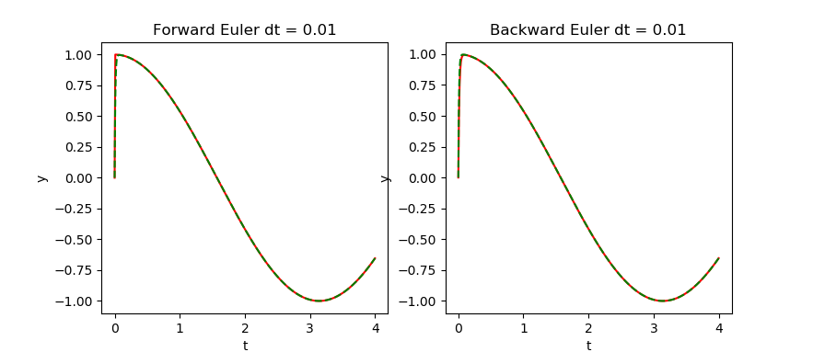
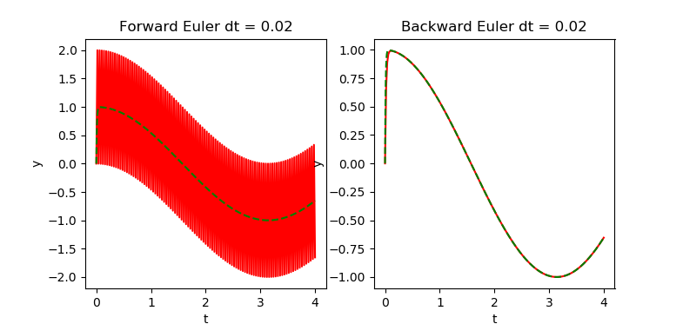
Solution:
""" Problem statement: y' = -100(y - cos(t)) - sin(t) y(0) = 0 Solve with Forward and Backward Euler schemes, stepsize of 0.2 for a total time of 4. Plot both solutions on the interval [0, 4], on top of the exact solution which is given by: y(t) = -*e^(-100t) + cos(t) Forward Euler: y_n+1 = y_n + dt*f(t_n, y_n) Backward Euler: y_n+1 = y_n + dt*f(t_n+1, y_n+1) """ import numpy as np from math import e, cos, sin, ceil import matplotlib.pyplot as plt dt = 0.01 tot_time = 4 num_steps = ceil(tot_time / dt) time_vec = np.linspace(0, tot_time, num_steps+1) exact_steps = min(50000, 100 * num_steps) time_vec_exact = np.linspace(0, tot_time, exact_steps+1) sol_forward = np.zeros((num_steps+1,)) sol_backard = np.zeros((num_steps+1,)) # Perform time-integration for ii in range(1, num_steps+1): # Forward Euler: sol_forward[ii] = sol_forward[ii - 1] - 100 * dt * (sol_forward[ii - 1] - cos(time_vec[ii - 1])) - \ dt * sin(time_vec[ii - 1]) # Backward Euler: sol_backard[ii] = (sol_backard[ii - 1] + 100 * dt * cos(time_vec[ii]) - dt * sin(time_vec[ii])) / (1 + 100 * dt) # Calculate exact solution: sol_exact = np.zeros((exact_steps+1,)) for ii in range(exact_steps+1): sol_exact[ii] = -e**(-100*time_vec_exact[ii]) + cos(time_vec_exact[ii]) import matplotlib.pyplot as plt # plot with various axes scales plt.figure() # Forward Euler plt.subplot(121) plt.plot(time_vec, sol_forward, 'r', time_vec_exact, sol_exact, 'g--') plt.title('Forward Euler dt = ' + str(dt)) plt.xlabel('t') plt.ylabel('y') plt.subplot(122) plt.plot(time_vec, sol_backard, 'r', time_vec_exact, sol_exact, 'g--') plt.title('Backward Euler dt = ' + str(dt)) plt.xlabel('t') plt.ylabel('y') plt.show()

Slide 7
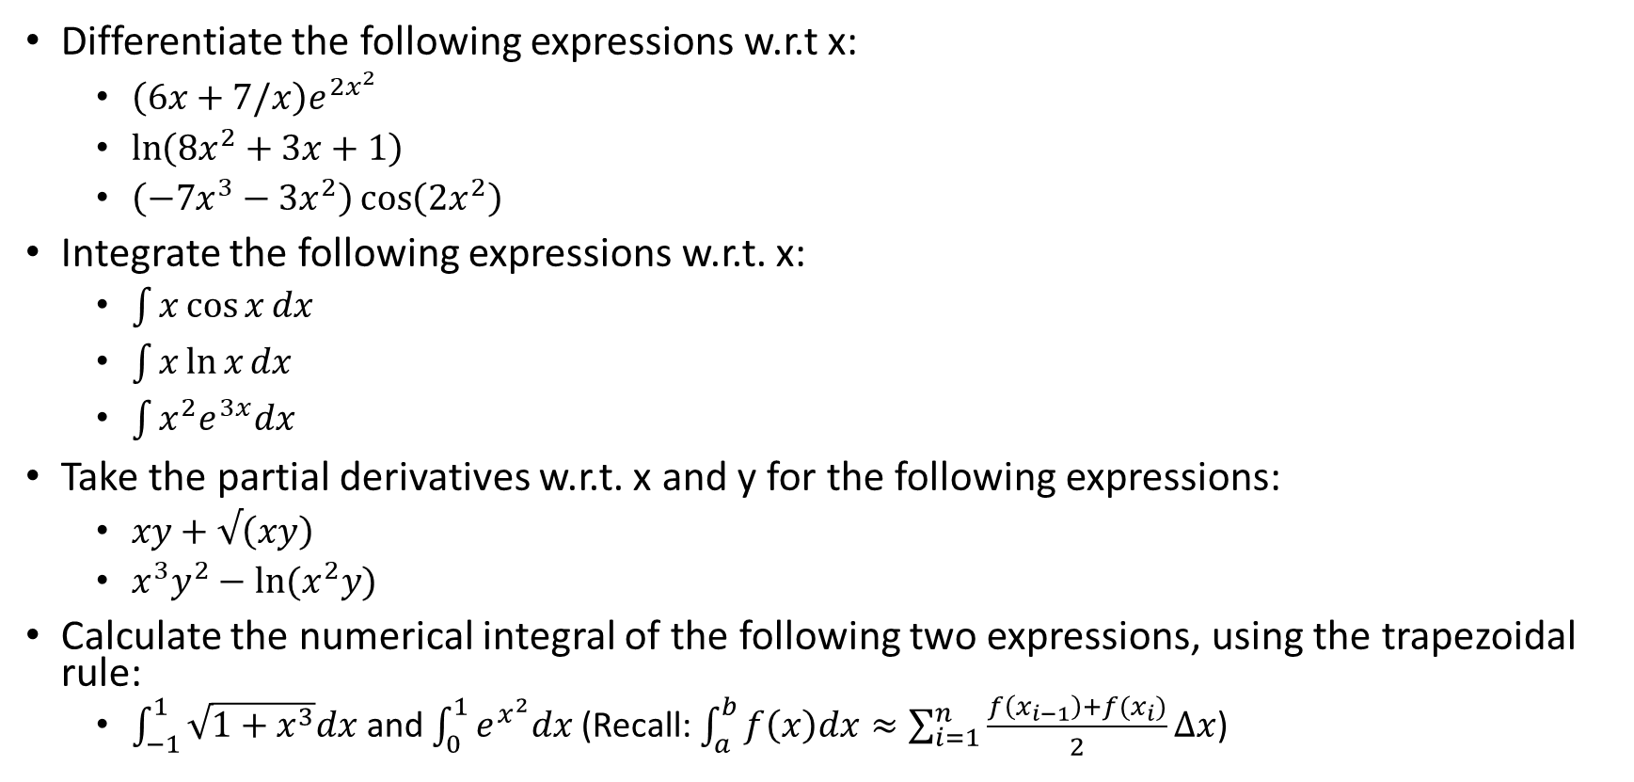
Differentiation and Integration
Differentiate the following expressions w.r.t x:
$\left(6x+7/x\right)e^{2x^{2}}$
$\ln\left(8x^{2}+3x+1\right)$
$\left(−7x^{3}−3x^{2}\right)\cos\left(2x^{2}\right)$
Integrate the following expressions w.r.t. x:
$\int{x\cos{x}dx}$
$\int{x\ln{x}dx}$
$\int{x^{2}e^{3x}dx}$
Take the partial derivatives w.r.t. x and y for the following expressions:
$xy+√\left(xy\right)$
$x^{3}y^{2}−ln(x^{2}y)$
Calculate the numerical integral of the following two expressions, using the trapezoidal rule:
$\int_{−1}^{1}{\sqrt{1+x^{3}}dx}$ and $\int_{0}^{1}{e^{x^{2}}dx}$ (Recall: $\int_{a}^{b}{f\left(x\right)dx≈\sum_{i=1}^{n}{\frac{f\left(x_{i−1}\right)+f(x_{i})}{2}}}Δx$)

Slide 8
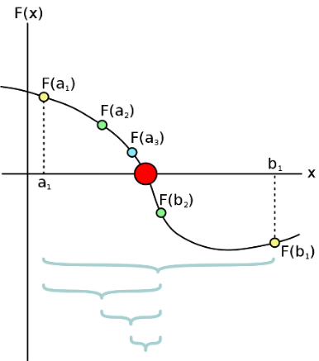
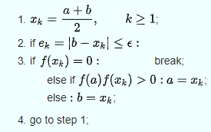
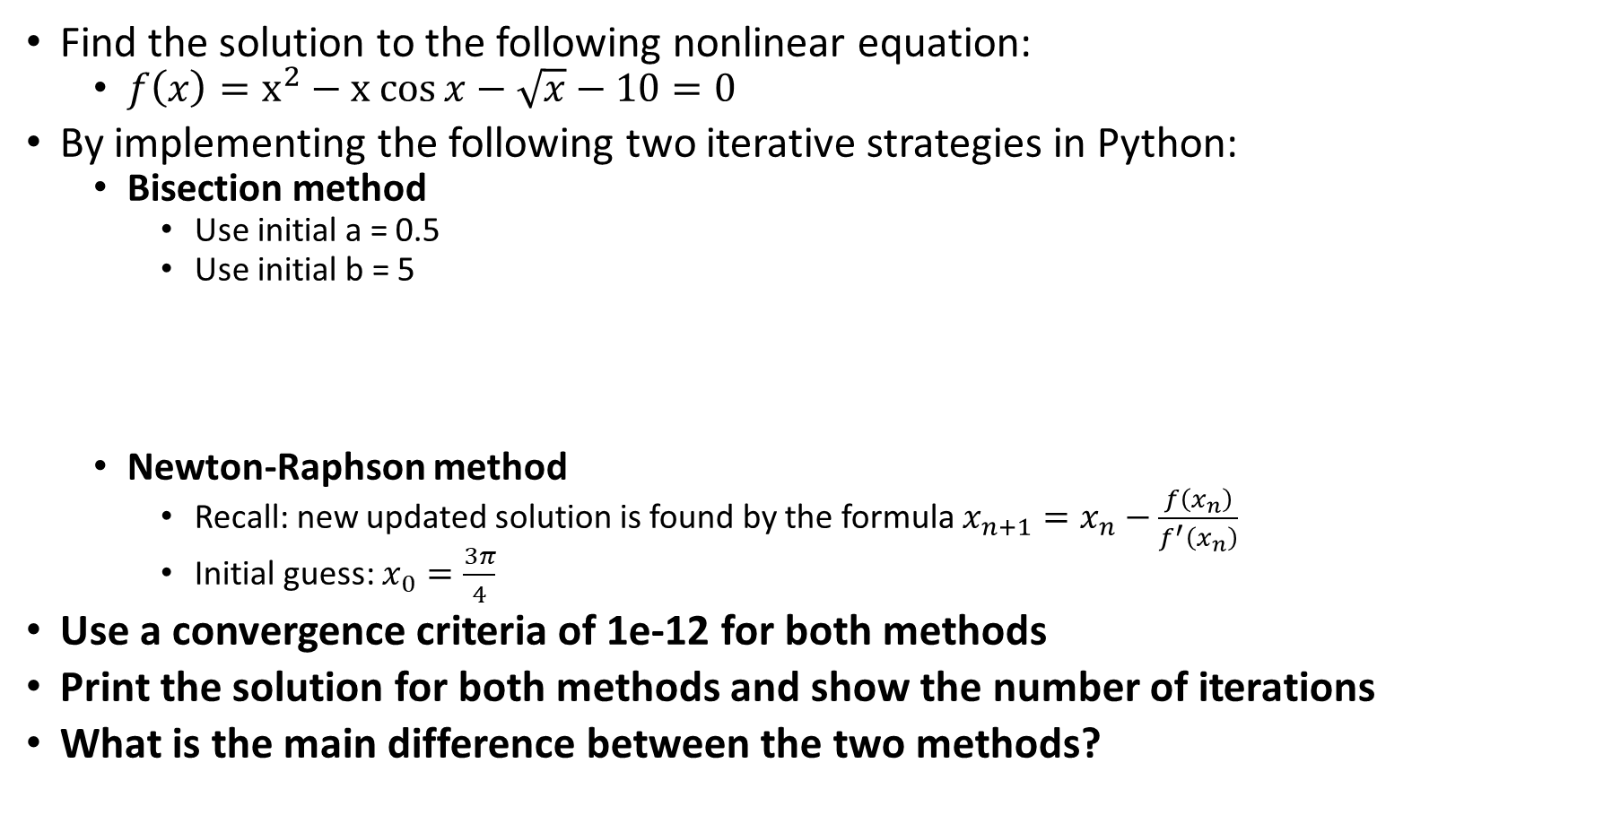
Nonlinear equations
Find the solution to the following nonlinear equation:
$f\left(x\right)=x^{2}−x cos{x}−\sqrt{x}−10=0$
By implementing the following two iterative strategies in Python:
Bisection method
Use initial a = 0.5
Use initial b = 5
Newton-Raphson method
Recall: new updated solution is found by the formula $x_{n+1}=x_{n}−\frac{f\left(x_{n}\right)}{f^{′}\left(x_{n}\right)}$
Initial guess: $x_{0}=\frac{3π}{4}$
Use a convergence criteria of 1e-12 for both methods
Print the solution for both methods and show the number of iterations
What is the main difference between the two methods?

Slide 9
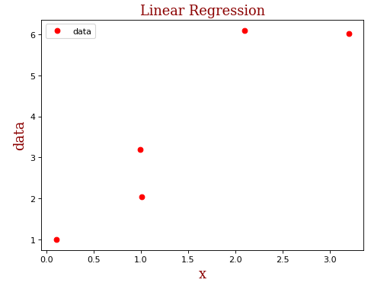

Linear algebra
Consider the following data:
NOTE: Data is already in Jupyter Notebook file (see data_record and data_location variables)!
We want to find the linear line that is “closest” to all the points in our data set (i.e. perform a linear regression on the data). This means: For the following equation: $y=c_{0}+c_{1}x$ , find the coefficients c₀ and c₁ such that the misfit (i.e. error is minimized). In other words, y(x)≈b(x).
Recall: This results in 5 equations (one for each data point) with two unknowns (the coefficients c₀ and c₁). The resulting linear system, Ac=b is unsolvable, however, we can find an orthogonal projection that will minimize the least square error, given by the normal equations.
We also want to do the same for a 3th order polynomial, i.e. fit y = c₀ + c₁x + … + c₃x³ to the data. This also in finding coeficients c₀, …, c₃ from the linear system Ac = b (which is unsolvable)
QUESTION: Find the coefficients for both the curve fitting (regression) problems, i.e. find the linear line and 3th order polynomial that fit the data (using least squares)

Slide 10
Statistics
Cover these topics:
Variance and covariance (simple example should suffice)
Linear regression (covered in previous example)
Simple Kriging (not gonna cover in the exam?)
Random variable (“ “)
Probability Density Function (simple example should suffice)
Variogram (not going to cover in the exam?)

Slide 11
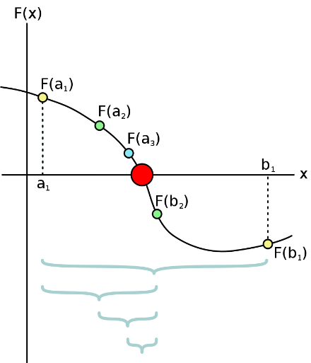
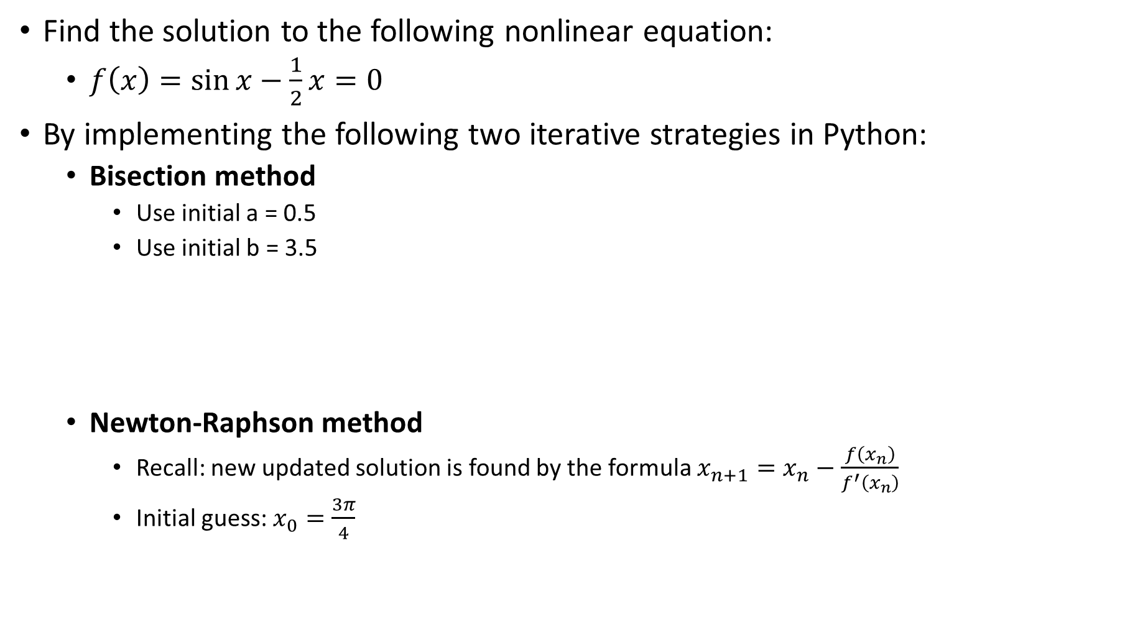
Find the solution to the following nonlinear equation:
$f\left(x\right)=\sin{x−\frac{1}{2}x}=0$
By implementing the following two iterative strategies in Python:
Bisection method
Use initial a = 0.5
Use initial b = 3.5
Newton-Raphson method
Recall: new updated solution is found by the formula $x_{n+1}=x_{n}−\frac{f\left(x_{n}\right)}{f^{′}\left(x_{n}\right)}$
Initial guess: $x_{0}=\frac{3π}{4}$

Slide 12
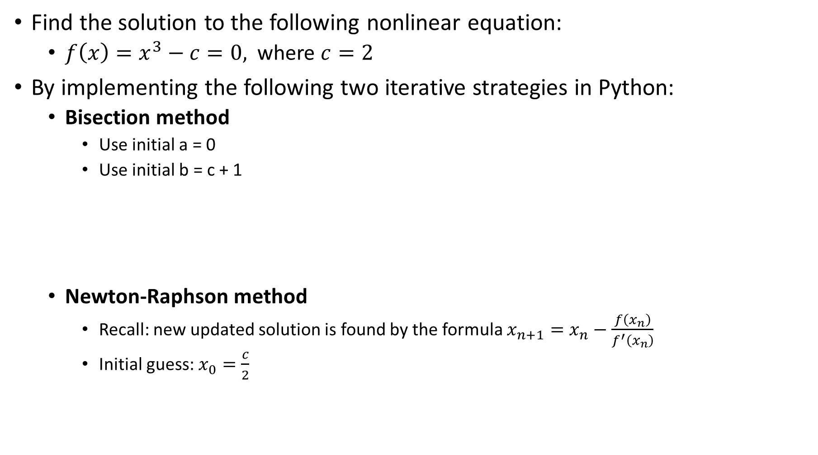
Find the solution to the following nonlinear equation:
$f\left(x\right)=x^{3}−c=0,$ where $c=2$
By implementing the following two iterative strategies in Python:
Bisection method
Use initial a = 0
Use initial b = c + 1
Newton-Raphson method
Recall: new updated solution is found by the formula $x_{n+1}=x_{n}−\frac{f\left(x_{n}\right)}{f^{′}\left(x_{n}\right)}$
Initial guess: $x_{0}=\frac{c}{2}$

Slide 13
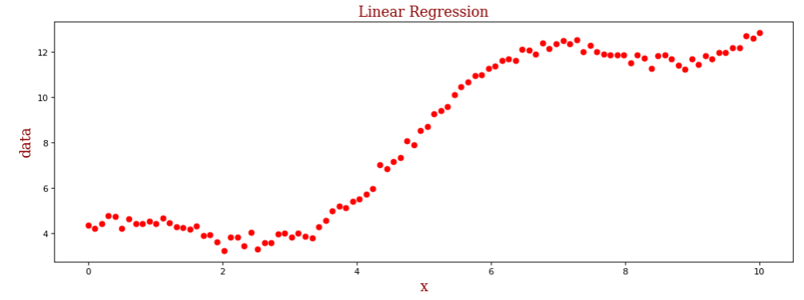
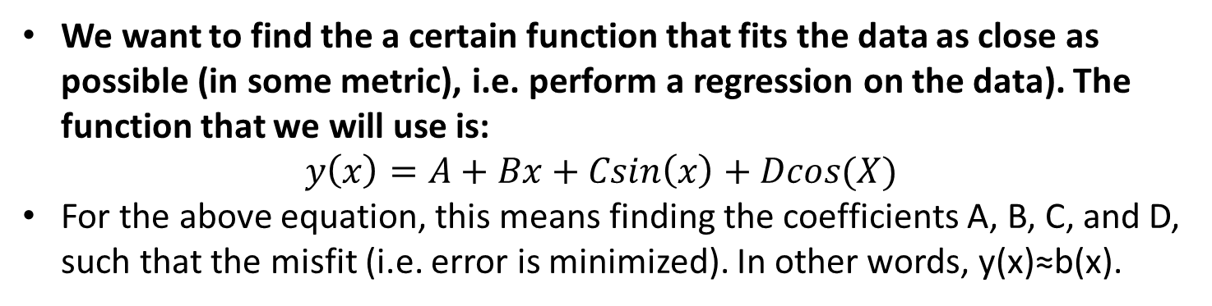
Linear algebra
We want to find the a certain function that fits the data as close as possible (in some metric), i.e. perform a regression on the data). The function that we will use is:
$$y\left(x\right)=A+Bx+Csin\left(x\right)+Dcos(X)$$
For the above equation, this means finding the coefficients A, B, C, and D, such that the misfit (i.e. error is minimized). In other words, y(x)≈b(x).
NOTE: Data is already in Jupyter Notebook file (see data_rec and data_loc variables)!

Slide 14
Problem: Given a list of positive numbers, return the largest number on the list.
Input: A list “L” of positive numbers. Must contain at least one number. “L” is a finite set of length “N”.
Output: A number “max_L”, which is the largest number of the list “L”.
Algorithm:
Set max_L = 0;
For each number x in L, compare it to max_L. If x > max_L, set max_L to x (loop)
max_L is now set to the largest number in L.
Start
List of number “L”
Set “max_L” to 0 and “count” to 0
YES
count < N
NO
Legend:
count = count + 1
x = L(count)
return max_L
Process
Start/End
YES
x > max_L
NO
Data
Decision
max_L = x

Slide 15
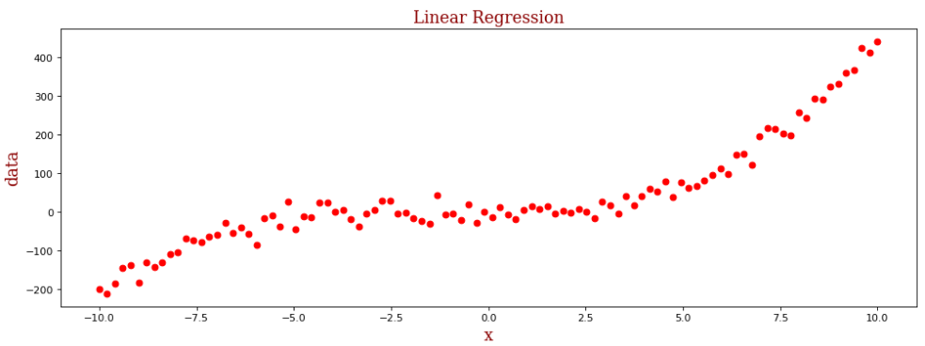
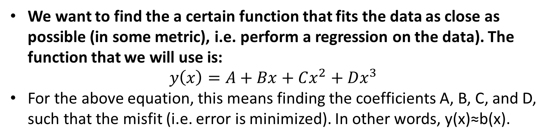
Linear algebra
We want to find the a certain function that fits the data as close as possible (in some metric), i.e. perform a regression on the data). The function that we will use is:
$$y\left(x\right)=A+Bx+Cx^{2}+Dx^{3}$$
For the above equation, this means finding the coefficients A, B, C, and D, such that the misfit (i.e. error is minimized). In other words, y(x)≈b(x).
NOTE: Data is already in Jupyter Notebook file (see data_rec and data_loc variables)!

Slide 16
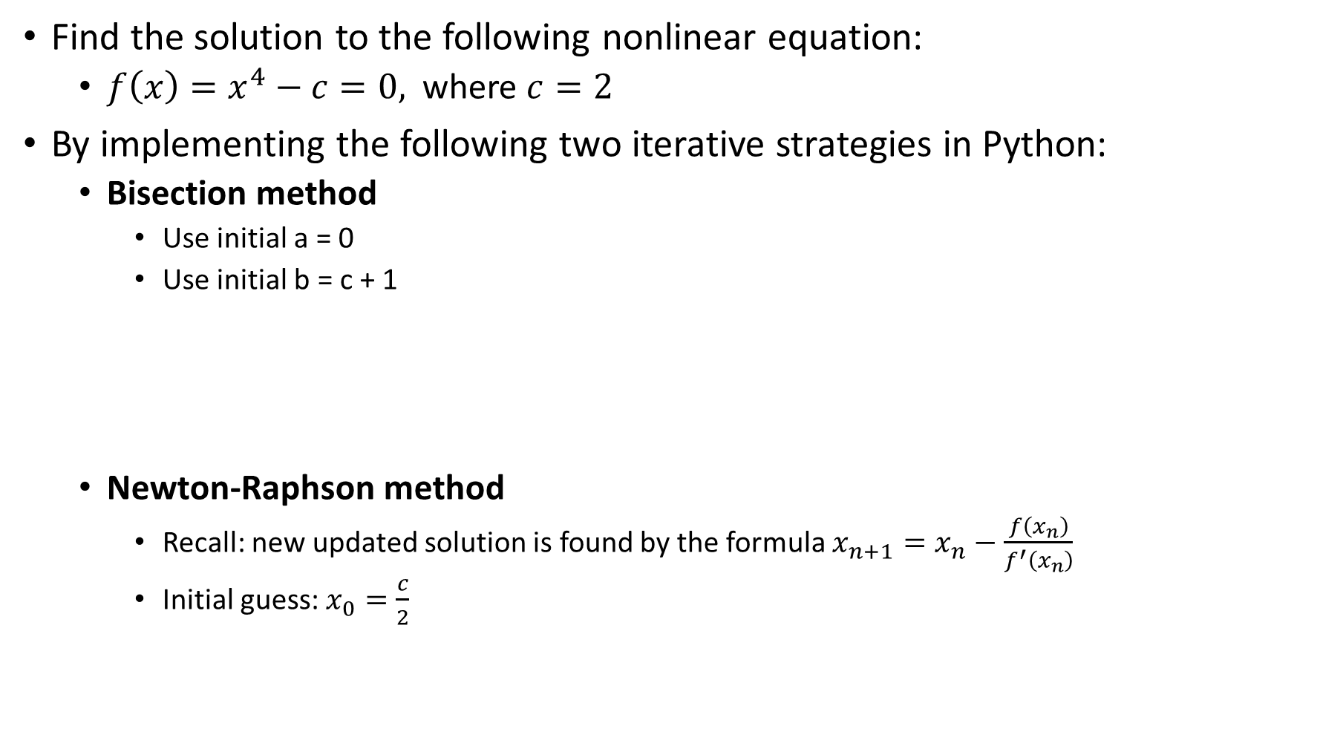
Find the solution to the following nonlinear equation:
$f\left(x\right)=x^{4}−c=0,$ where $c=2$
By implementing the following two iterative strategies in Python:
Bisection method
Use initial a = 0
Use initial b = c + 1
Newton-Raphson method
Recall: new updated solution is found by the formula $x_{n+1}=x_{n}−\frac{f\left(x_{n}\right)}{f^{′}\left(x_{n}\right)}$
Initial guess: $x_{0}=\frac{c}{2}$

Slide 17
Problem: Given a list of numbers, return the smallest number on the list.
Input: A list “L” of numbers. Must contain at least one number. “L” is a finite set of length “N”.
Output: A number “min_L”, which is the smallest number of the list “L”.
Algorithm:
Set min_L = inf;
For each number x in L, compare it to min_L. If x < min_L, set min_L to x (loop)
min_L is now set to the smallest number in L.
Start
List of number “L”
Set “min_L” to inf and “count” to 0
YES
count < N
NO
Legend:
count = count + 1
x = L(count)
return min_L
Process
Start/End
YES
x < min_L
NO
Data
Decision
min_L = x

Slide 18
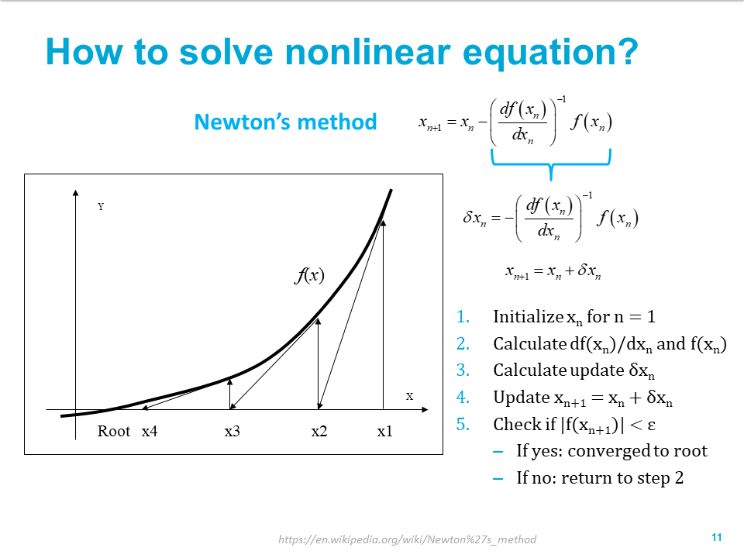

Slide 19
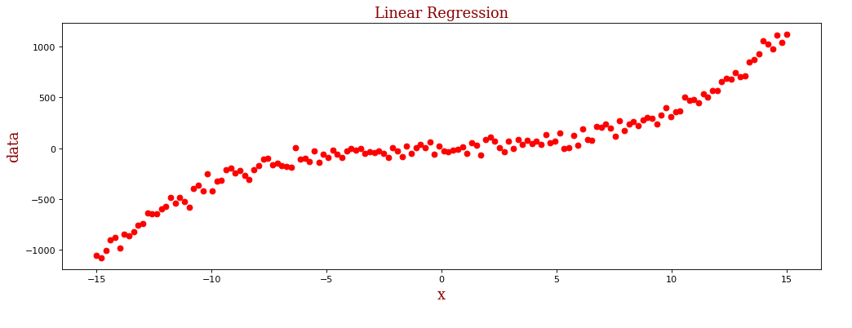
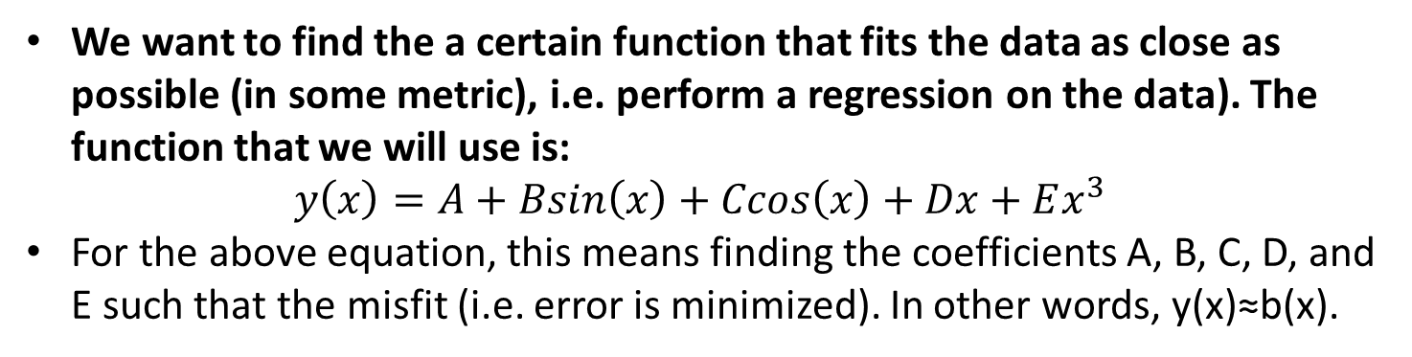
Linear algebra
We want to find the a certain function that fits the data as close as possible (in some metric), i.e. perform a regression on the data). The function that we will use is:
$$y\left(x\right)=A+Bsin\left(x\right)+Ccos\left(x\right)+Dx+Ex^{3}$$
For the above equation, this means finding the coefficients A, B, C, D, and E such that the misfit (i.e. error is minimized). In other words, y(x)≈b(x).
NOTE: Data is already in Jupyter Notebook file (see data_rec and data_loc variables)!

