Slide 1

Introduction To Shiny
The R Web Framework

Slide 2
About
Me
Dai ZJ
BSc (Maths) & M. Stats
Risk Analytics
Cantonese speaking Australian-Chinese
Credit Scoring & Basel II Specialist
Software
Consulting
Training

Slide 3


Shiny
What?
R package for building “live” web apps
Allows you to make web apps entirely* with R
Great presenting dynamic analysis
Pedigree RStudio
Why?
UX - for user experience
Interactivity
Shine Get!
install.packages("shiny")

Slide 4
A tales of two files
A typical Shiny app consists of two files
ui.R
User Interface
Translates to HTML
server.R
data analysis
computation
To run a Shiny app
shiny::runApp(path)
path is the path that contains ui.R and server.R

Slide 5
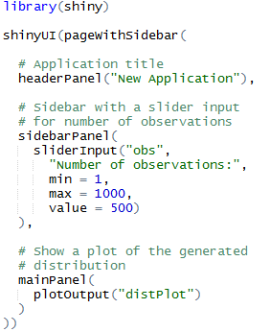
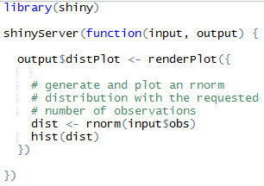
First Example
ui.R
server.R

Slide 6
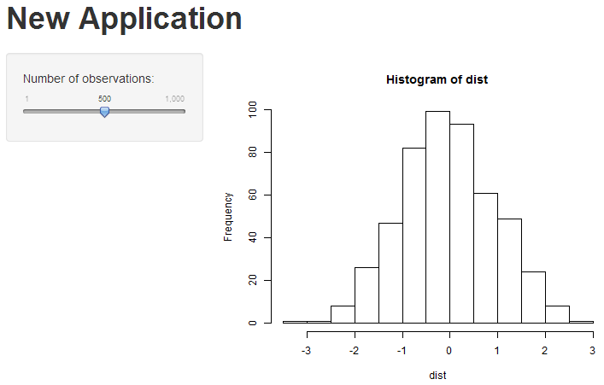
First Example - ui.R

Slide 7
First Example
ui.R
server.R

Slide 8

Reactive Programming
What is NOT reactive programming?
Most R code is not reactive
Reactive programming is...
if the value of c changed with a
Shiny

Slide 9

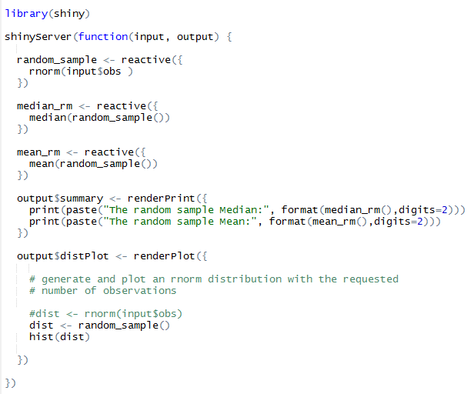
reactive()
server.R
ui.R

Slide 10
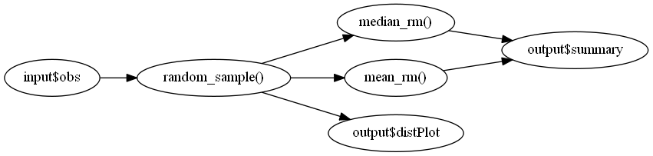
reactive()

Slide 11
actionButton
When you want the output to change based on button press
e.g. the computation can take too long
Syntax
actionButton("id", label)
Initiallly input$id will be equal zero
Every time it is pressed input$id increments by 1

Slide 12
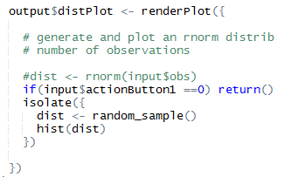
actionButton - isolate
server.R
isolate()
the output will NOT react to components wrapped inside it
Common Mistake: omitting it

Slide 13
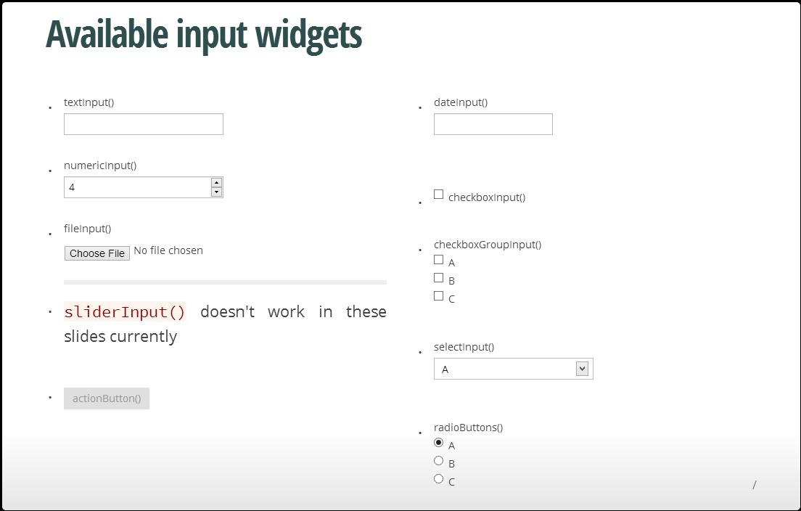

Slide 14
What next?
Official Tutorial
http://rstudio.github.io/shiny/tutorial/#hello-shiny
Google Shiny Forum (search: google groups shiny)
Cool Packages
rCharts (http://rcharts.io/)
shinyRGL (http://trestletech.github.io/shinyRGL/)
Extend Shiny
Future Shiny workshop?
Need to know Javascript, HTML/CSS

Slide 15
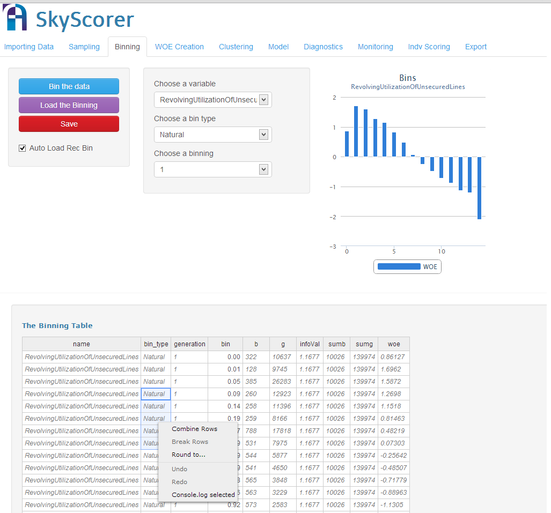
Demo - SkyScorer

Slide 16
Finally
GitHub
https://github.com/xiaodaigh/Intro_to_Shiny
Survey
https://www.surveymonkey.com/s/VKXVDH9

