Slide 1

AIRBNB DATA ANALYSIS IN NEW YORK CITY
By Xiaodan Chen

Slide 2

OBJECTIVE
WITH OVER 30,000 LISTINGS IN NEW YORK CITY, TRY TO INVESTIGATE THE DATA FROM 2008 - 2015
TRY TO FIND ANY PATTERN OR TREND FOR THIS CITY

Slide 3
DATA OVERVIEW & CLEANING
Host data since 2008 until 2015 with 30,478 total listings
Using python first to do the data cleaning
Trying to understand each column’s meaning and representing
Deleting null value and other data analysis

Slide 4
QUESTION IN TABLEAU
The relations between density and price
What type of property is the most popular across the neighbourhood?
The trending and patterns among the neighbourhood, ratings and prices

Slide 5
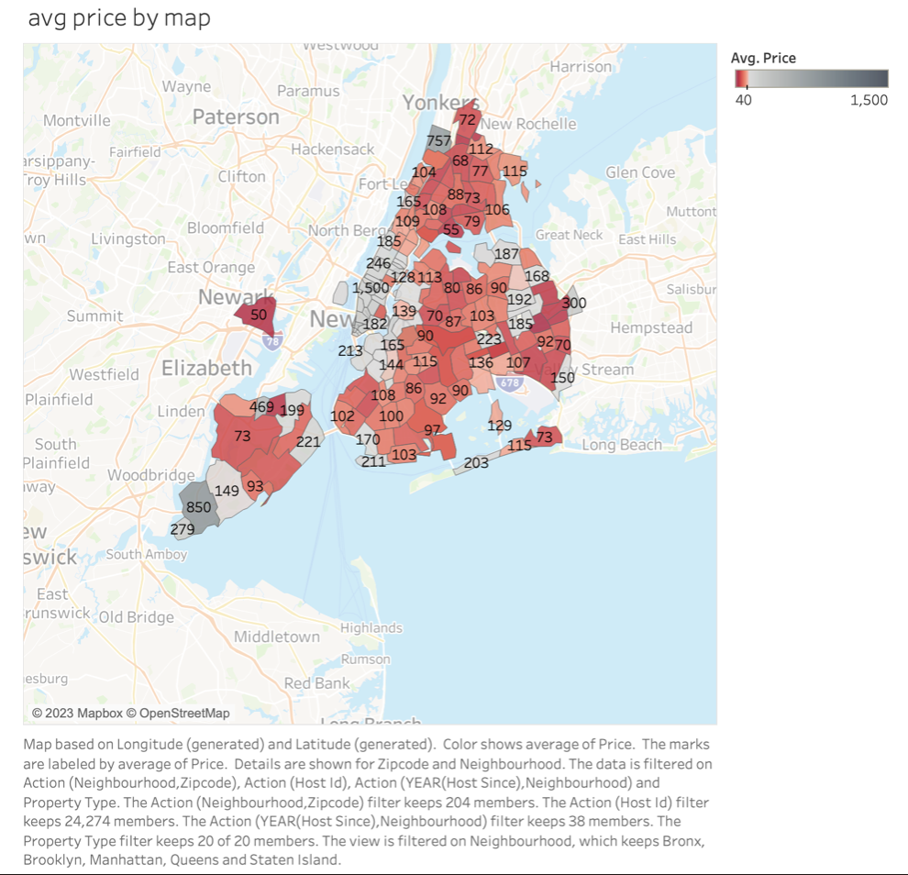
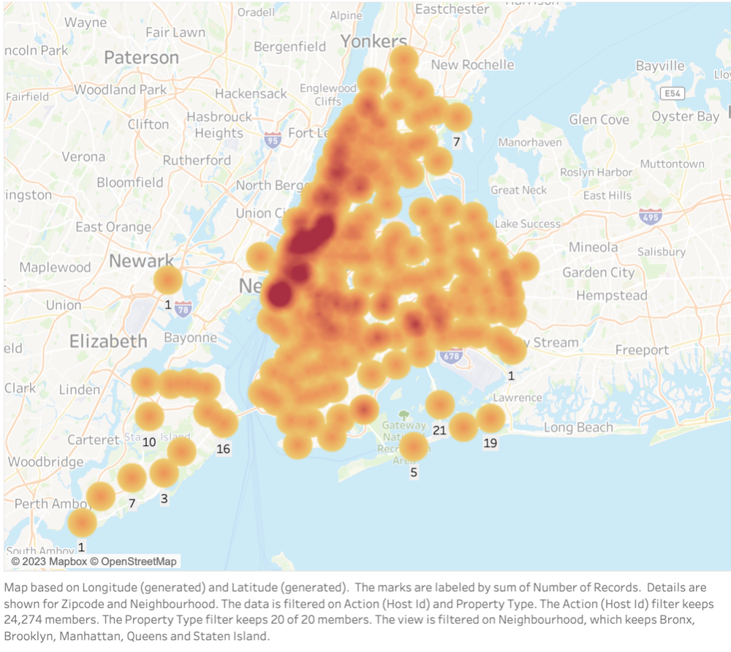

Slide 6
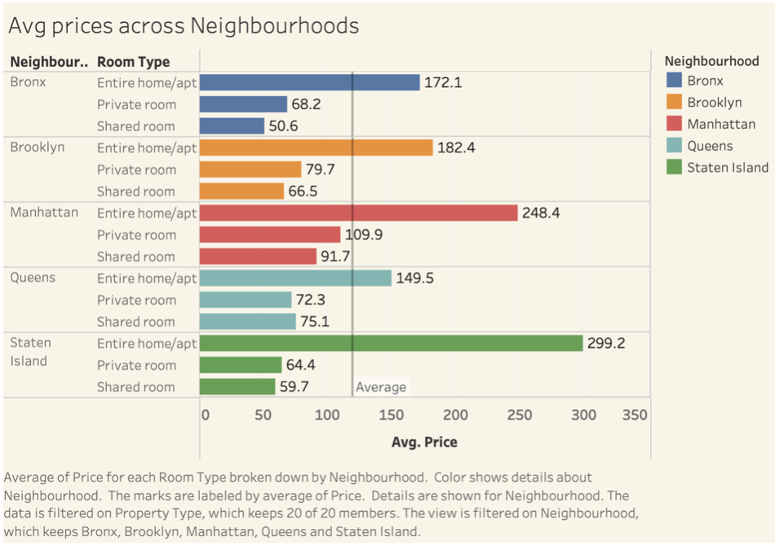
WHAT TYPE OF PROPERTY IS THE MOST POPULAR ACROSS THE NEIGHBOURHOOD?

Slide 7
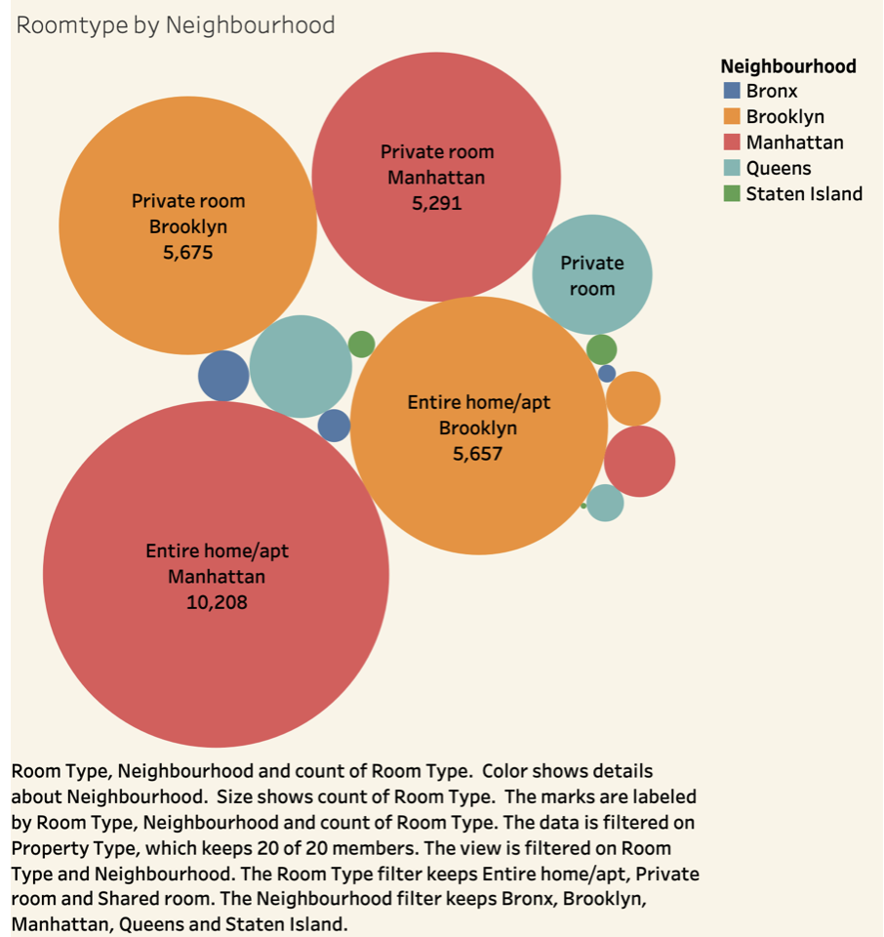

Slide 8
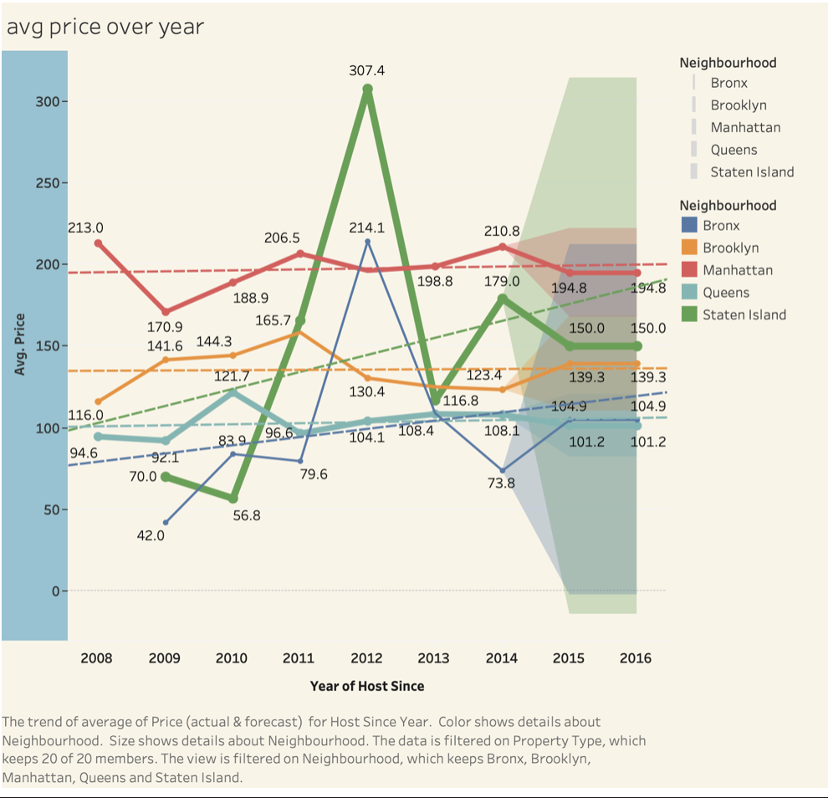

Slide 9
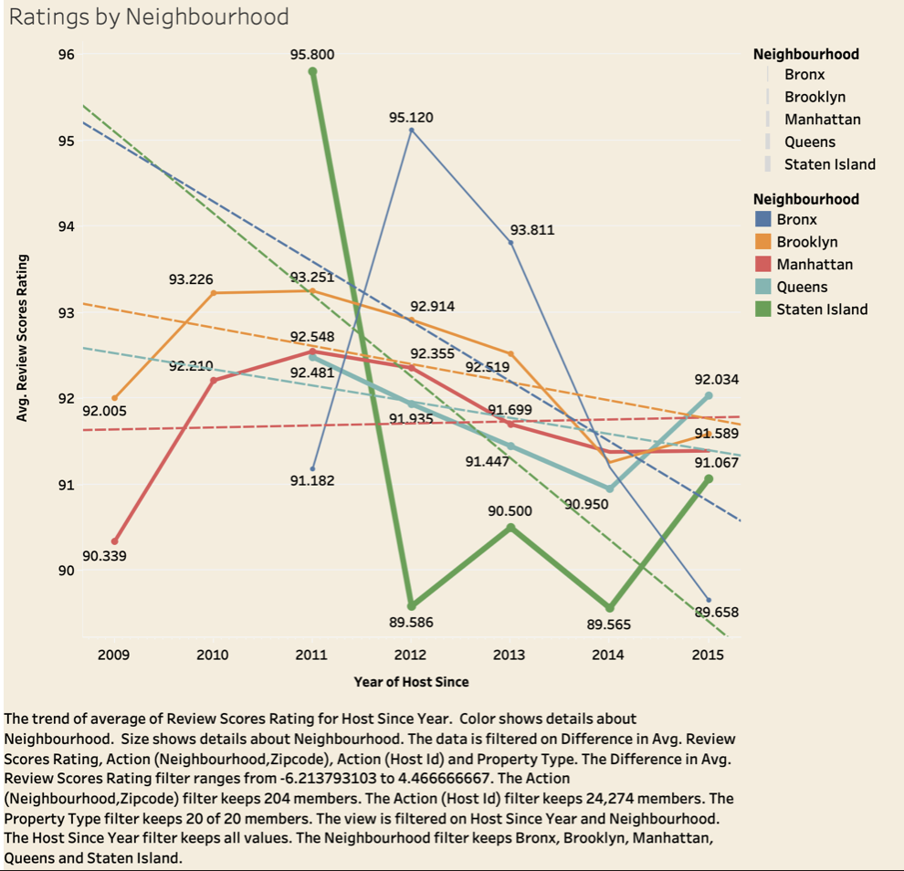

Slide 10
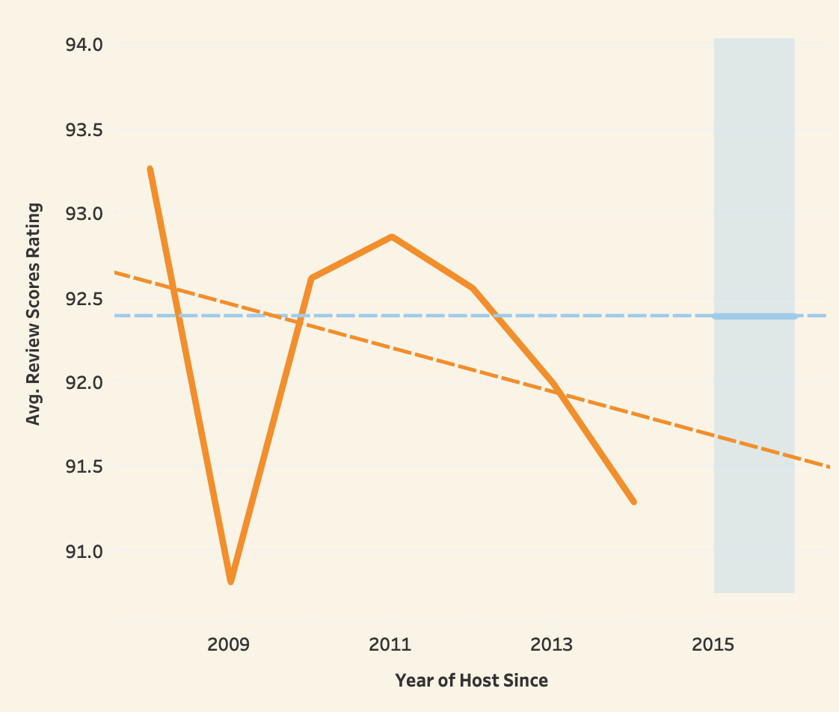
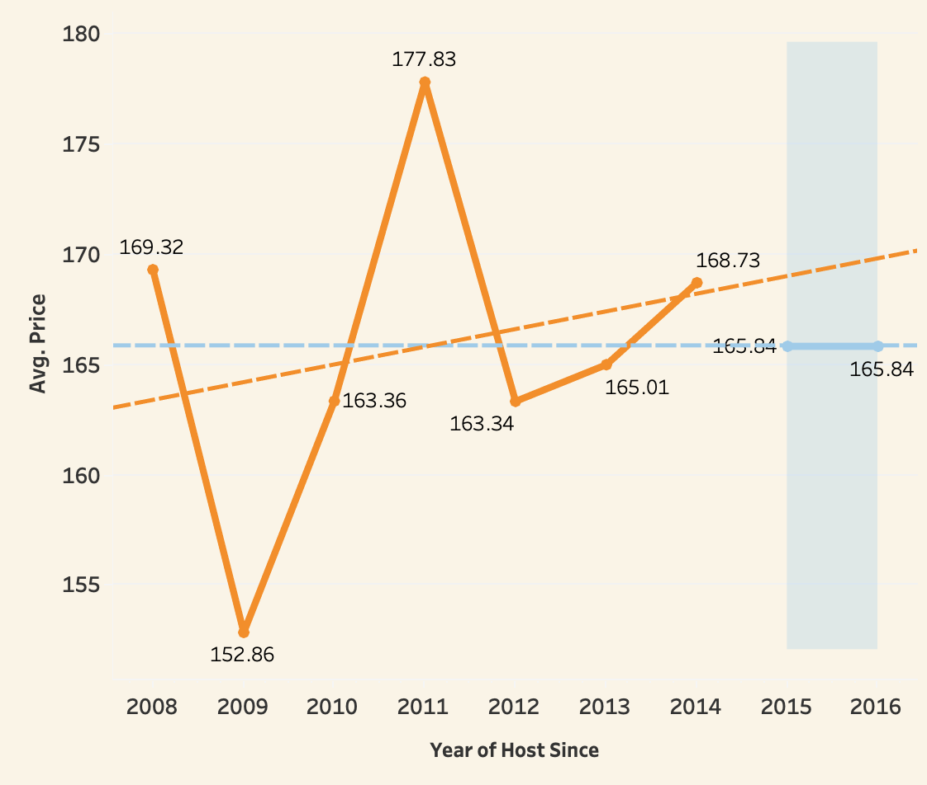

Slide 11
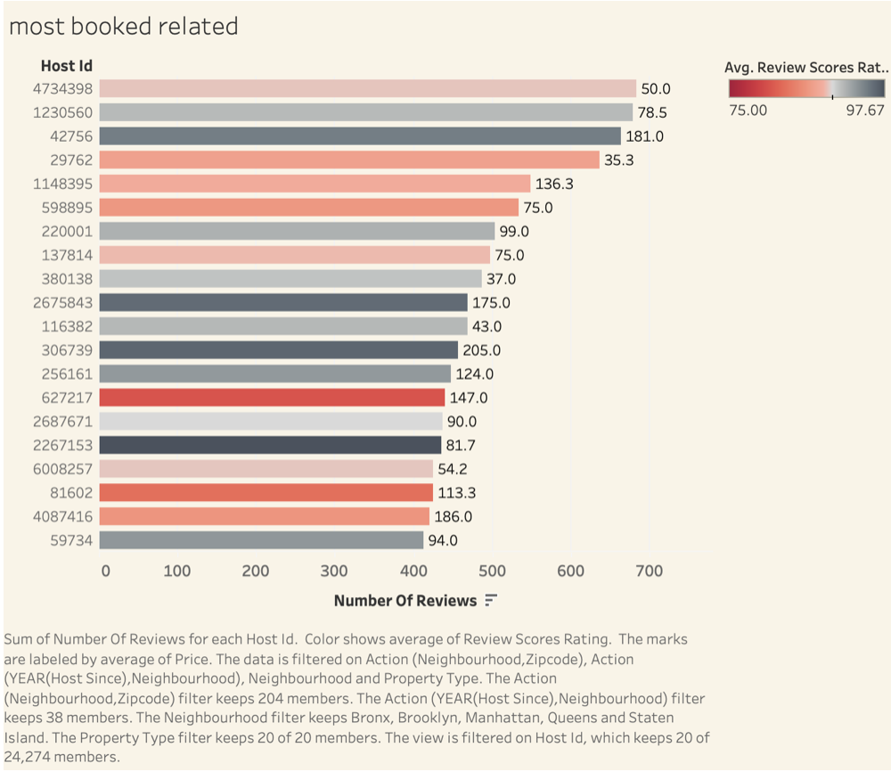
THE PATTERN OF REVIEWS AND PRICE

Slide 12
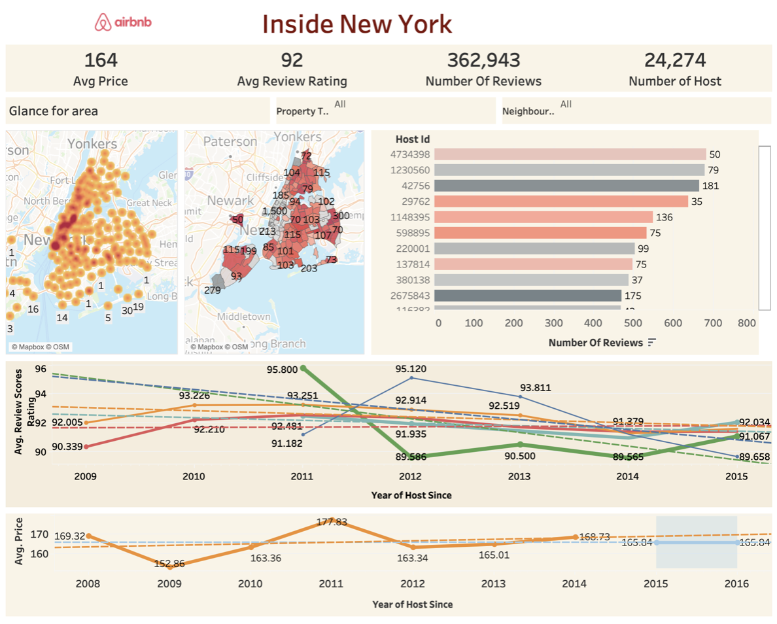

Slide 13
SUMMARY
Dataset need to be improved and updated for more information
Need to familiar and make myself master of the function and features of Tableau
According to these visualizations, some pattern and trend can be displayed very easily and quickly

