Slide 1







BitMatcher: Bit-level Counter Adjustment for Sketches
Qilong Shi*, Chengjun Jia*, Wenjun Li, Zaoxing Liu, Tong Yang, Jianan Ji, Gaogang Xie, Weizhe Zhang, Minlan Yu.
* co-author
Thanks to Tsinghua University’s “Deng Feng Fund” for its support.
2024/5/17
Notes:
Hello everyone! I’m Qilong Shi, from Tsinghua University.
Today I will present our work: BitMatcher: Bit-level Counter Adjustment for Sketches. The collaborators of this paper come from: Tsinghua University, Peking University, Pengcheng Laboratory, University of Maryland, Chinese Academy of Sciences, and Harvard University.
Here we thanks to Tsinghua University`s “Deng Feng Fund” for its support.

Slide 2
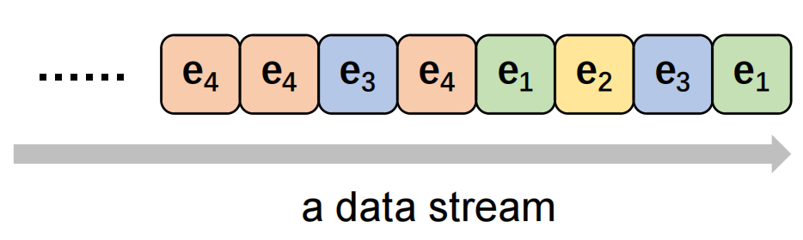
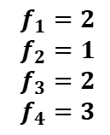
Background
Data stream model
Dedicated Platforms:
Network Switches
FPGA/ASIC
Query Results
$$f_{1}=2$$
$$f_{2}=1$$
$$f_{3}=2$$
$$f_{4}=3$$
Frequency Estimation
Heavy Hitter Detection
Heavy Change Detection
Item Size Distribution
Entropy Estimation
……
Notes:
In this paper, we focus on extremely high-speed data stream processing. For example, the packet stream in the network.
To handle the high-speed stream, we often process the stream in various software/hardware platforms, including Network switches, FPGA and ASIC.
As the latest stream data arrives, at any time, we can query the stream data, and get results for various measurement tasks such as frequency measurement, heavy hitter/heavy change detection, item size distribution and entropy estimation.
For example, in the case of the data stream on the left, we have f1 equal to 2 since it appear twice. And we have f2=1, f3=2 and f4=3.
We will describe these tasks in detail later.

Slide 3
Approximate Algorithms
in data stream processing
Idea: Store all items in the stream and build many indexes.
Weakness: Not practical for dedicated soft/hardware platforms.
Huge data volume (GBs): up to billions of items (network packets) in the 1-second time window.
Small memory size (<30 MB): FPGA, ASIC and Switches.
Exact & nearly-exact solutions
Approximate algorithms
(Sketch)
memory efficient & tolerable errors
Including: CM sketch, Bloom filter and many kinds of sketches……
Notes:
There are two types of related work: exact solutions that can answer the query with no errors, and approximate algorithms that have small and tolerable errors.
The key idea of the exact solution is to store all items in the stream and build many indexes on them.
When the data volume and data speed is relatively small, the exact solutions can work well in CPU platform.
However, in the extremely high speed scenario, it is not practical for real-life software and hardware platforms. For example, in a network switch, there are billions of items to be inserted in one second, but the memory of switch is too small to store all items in a data stream.
Therefore, the high-speed stream processing often chooses the approximate algorithm. Because their memory cost is small enough for various platforms and their errors are tolerable.
The Approximate algorithms for stream processing have a long history. Typical work includes the CM sketch, bloom filter and many kinds of sketches.

Slide 4
Related Work
Common sketch
Prior art --- CM Sketch
Insertion: when a new item e comes
Query: query for the frequency of the item e
Deletion: delete item e
5
7
10
-1
-1
-1
+1
+1
+1
… …
Reported value: 5
e
Notes:
We first introduce the Count-min sketch, which contains many counters and several hash functions.
We first introduce the insertion operation. When a new item e arrives, assuming that the number of hash functions is 3, e will use these three hash functions to find the corresponding three counters and add 1 to them.
The operation of query e is similar, it will report the minimum of the three counters, which is 6. This corresponds to the word "count-min" in the name.
When e is removed, it decrements the corresponding 3 counters by 1.

Slide 5
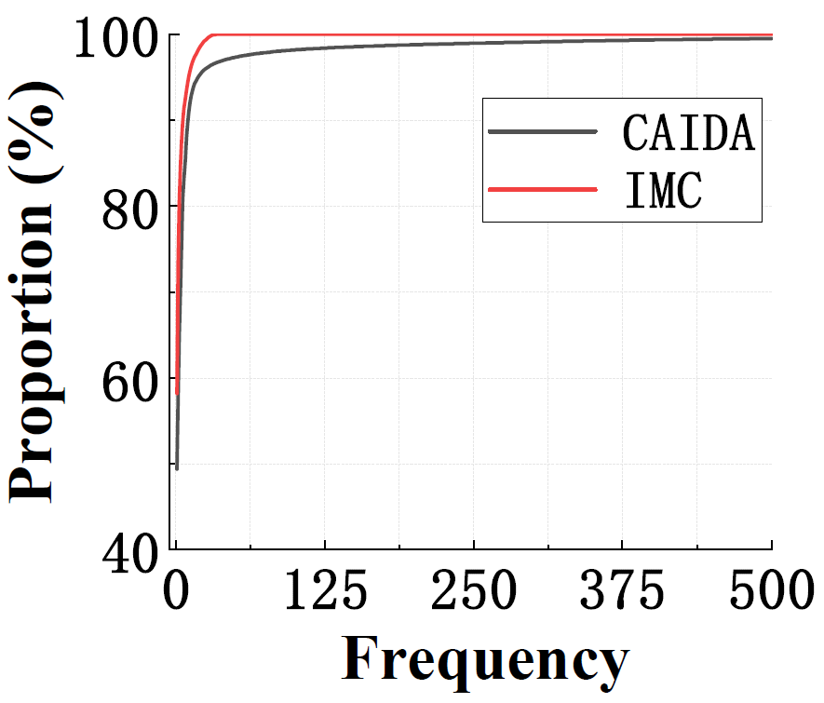
Related Work
Common sketch
Real data streams
Fixed-size counter
High-skewness!
Hot item
Cold item
30k
2
CM Sketch
We have to set a large enough counter (i.e., 32bit)
Memory waste!
Notes:
In fact, real-world data streams are highly skewed, which means that there are many items with very few frequencies, such as 1, and few items with large frequencies. As shown in the cumulative frequency distribution chart below, 95% of the items have frequencies below 10.
This means that in the CMsketch we just mentioned, the value of a few counters will be very large (the hot item enters it), and the value of most of the counters is relatively small (the cold items enters it).
However, in order to store these hot items, we must set a sufficiently large counter value for the CM, such as 32 bits, but most of its high bits of the counter are not used, resulting in a waste of memory.

Slide 6
Related Work
Various improved sketches
Self-adjusting
DHS
SALSA
······
Fixed-size
counter
To better accommodate both hot & cold items
CM-sketch
CU-sketch
Space-saving
······
Hierarchical
Elastic sketch
Augmented sketch
Pyramid sketch
······
Notes:
In order to solve the problem of high skewness of real data streams, the method based on fixed-size counters is improved. In order to better accommodate the hot item and cold item respectively, algorithms based on hierarchical and self-adjusting are proposed.

Slide 7
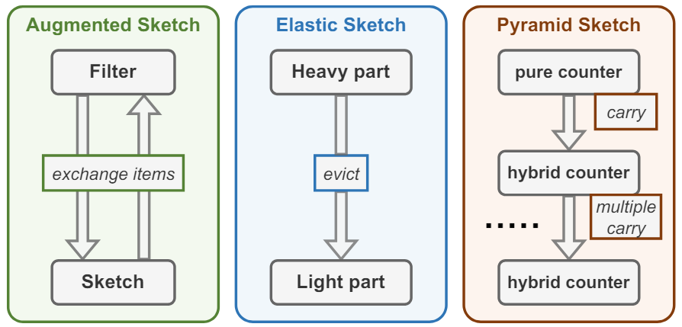
Related Work
Hierarchical
Augmented Sketch
Pros: hot items always in the filter.
Cons: exchange greatly reduce speed.
Elastic Sketch
Pros: No exchange 👉 very high speed.
Cons: hot item may be accidentally expelled.
Pyramid Sketch
Pros: Automatically handle overflow.
Cons: access multiple layers for hot items
👉 unsuitable for tasks with hot items.
Hierarchical sketch
outline
Notes:
Next we introduce some hierarchical sketch. The picture on the right shows three typical hierarchical sketches. It can be found that they all divide their structure into multiple layers, which are used to store hot and cold items respectively, so as to achieve the effect of adapting to the real data stream.
Augmented Sketch (AS) uses an additional filter to aggregate the hot items in advance. This ensures that there are always hot items in the filter. But this exchange process can significantly slow down processing.
Pyramid Sketch divides its structure into a pure counter at the bottom and a mixed counter above it, with a total of 𝜆 layers. It can achieves high throughput. But whenever querying the hot item, it will access multiple layers and thus decreases the speed, making it difficult to perform tasks that focus on hot items.
The state-of-the-art hierarchical algorithm, Elastic Sketch, divides the structure into a heavy part and a light part to accommodate hot items and cold items respectively. Unfortunately, the hot item can be accidentally expelled in the process, resulting in a loss of accuracy.

Slide 8
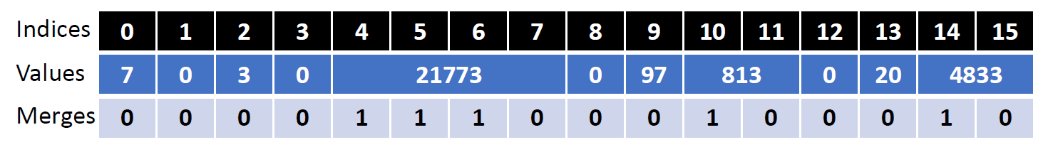
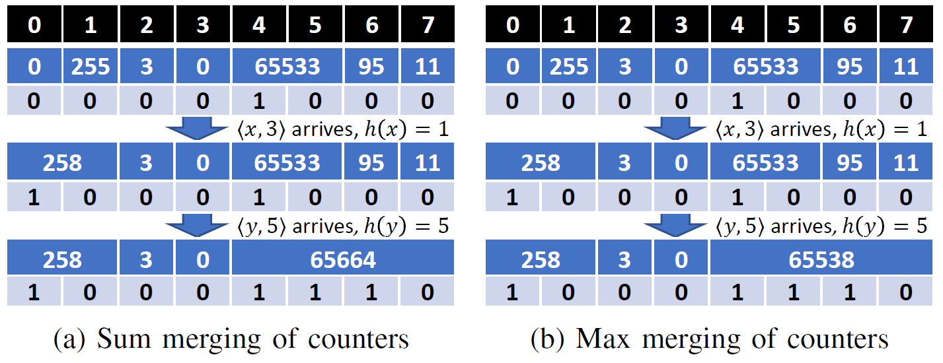
Related Work
Self-adjusting
Prior art --- SALSA
Pros
Finer segmentation inside the counter
👉 high accuracy
Cons
additional bitmaps&complex operations
👉 reduce speed
Notes:
The picture on the right shows the structure of SALSA, a typical self-adjusting sketch. Initially, SALSA uses only one small counter rather than 32-bit counter to make frequency estimation. It establishes an extra bitmap to tag overflowing counters, and merges small neighboring counters to dynamically form a bigger one.
The pros is that it has finer segmentation inside the counter which leads to high accuracy.
But its shortcoming is obvious: The extra bitmap is space consuming and decreases the speed. That is because SALSA looks up the bitmap at every operation, to check if the corresponding counter has merged with others.

Slide 9
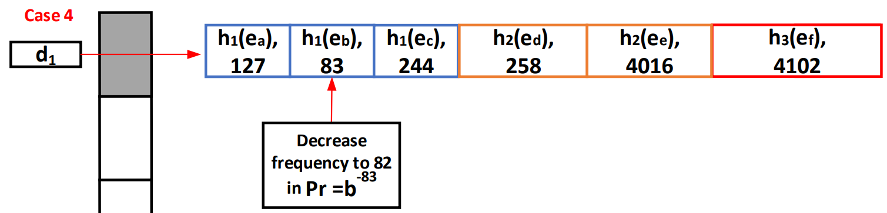
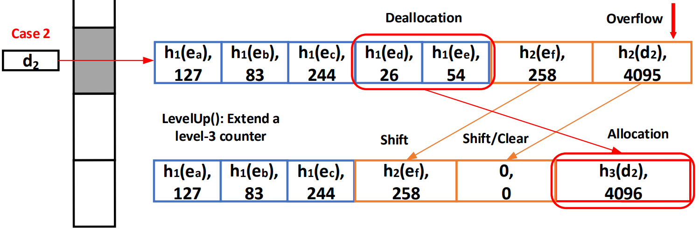
Related Work
Self-adjusting
Prior art --- DHS (Dynamic Hierarchical Sketch)
Pros
Adjustments are limited to a single bucket.
👉 high accuracy and speed
Cons
The adjusting strategy is limited to three types of counters: 8/12/16 bits.
👉 can`t store when the data traffic is heavy.
👉 too large adjustment granularity.
Notes:
Here shows the state-of-the-art self-adjusting algorithm, Dynamic Hierarchical Sketch (DHS for short). It consists of many fixed-size buckets, and the buckets contain 3 kinds of counters (the size are 8, 12, and 16 bits, respectively).
DHS’s counter adjustments are all within a single bucket, which is fast. And because DHS records the item’s fingerprint in the bucket, it has relatively high accuracy.
But its cons are also obvious, the adjusting strategy is limited to three types of counters: 8/12/16 bits. Which means it can`t record items with frequencies greater than 2 to the power 16. If we enlarge the biggest counter size (for example, from 16 to 32 bits), there is much waste for items with frequencies between 2^8 and 2^16. In other words, it has too large adjustment granularity.

Slide 10
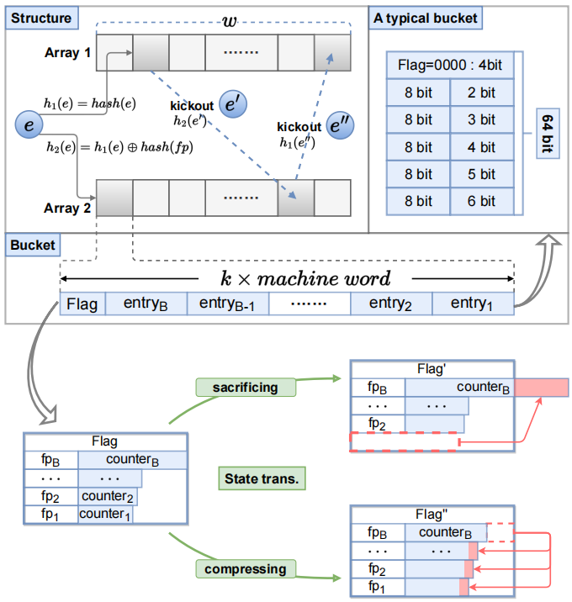
BitMatcher Framework
Data Structure
Notes:
As shown in picture, BitMatcher consists of two arrays, 𝐴1 and 𝐴2. We assume that each array has 𝑤 buckets, and each bucket consists of 𝐵 entries with different sizes: {𝑒𝑛𝑡𝑟𝑦1, 𝑒𝑛𝑡𝑟𝑦2, ..., 𝑒𝑛𝑡𝑟𝑦𝐵} (the size of 𝑒𝑛𝑡𝑟𝑦𝑖 increases as 𝑖 increases, and 𝐵 may change as the data stream comes). An entry is the smallest unit of BitMatcher, and a bucket is the unit of one access. As a result, we want the length of a bucket to be an integer multiple of a machine word (e.g., 64bits, 128bits...) and there will be no waste of memory access.
Each entry consists of two parts, 𝑓𝑖𝑛𝑔𝑒𝑟𝑝𝑟𝑖𝑛𝑡 and 𝑐𝑜𝑢𝑛𝑡𝑒𝑟 . We employ the fingerprint as identification of the item. All fingerprints must occupy the same size space to meet the requirements of our algorithm. Note that the distribution of each entry (or counter) in the bucket will change with the processing of the data stream. We call this the “state” of a bucket. The 𝐹𝑙𝑎𝑔 bit in the bucket shows the state of the bucket at this time. We leave the details of how buckets change between states in the next page. In general, our algorithm will naturally place hot items in larger entries and cold items in smaller entries. Note that we are using two cuckoo hashes for item e. This allows elements kicked in a state transition to find their other corresponding bucket.
The upper right corner is a typical 64-bit size bucket in its initial state.

Slide 11
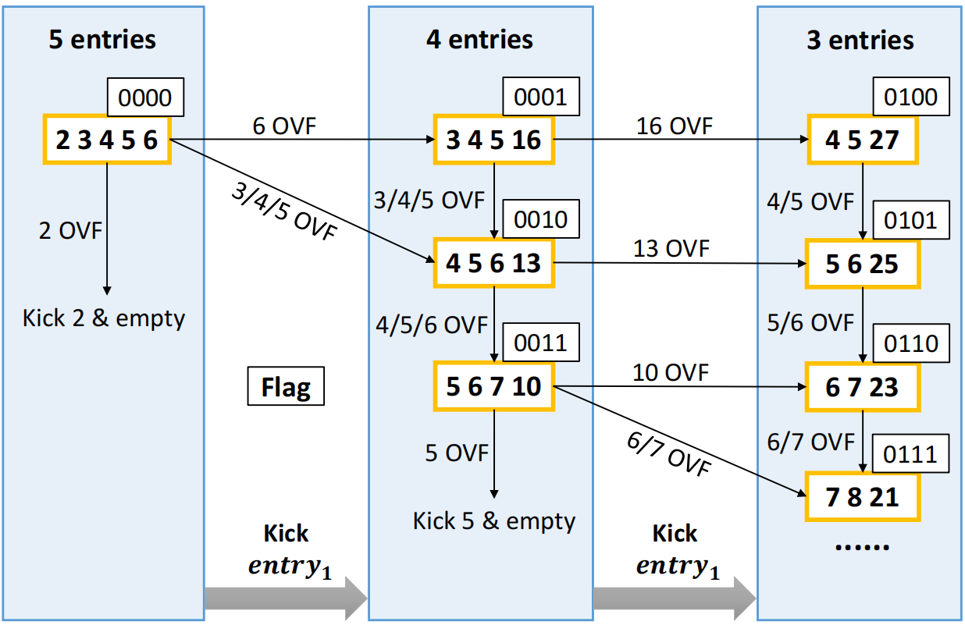

BitMatcher Framework
State transition table
BM: 64-bit bucket & small memory
DHS: bucket size ≠ $64k$ bits
$$Insert(e)$$
maximum overflow
non-maximum overflow
0000
0001
0002
0002
8 bit
2 bit
8 bit
2 bit
compressible
8 bit
4 bit
incompressible
8 bit
4 bit
1
8 bit
3 bit
8 bit
3 bit
1
8 bit
5 bit
8 bit
5 bit
8 bit
4 bit
10 bit
8 bit
4 bit
OVF
1
8 bit
6 bit
OVF
8 bit
6 bit
cuckoo
kick
8 bit
5 bit
8 bit
5 bit
8 bit
13 bit
8 bit
13 bit
8 bit
6 bit
OVF
8 bit
16 bit
Notes:
Next we introduce state transitions. For convenience, we assume that the bucket size is fixed at 64, the fingerprint size is fixed at 8 bits, and the flag bit is 4 bits. As shown in the red part of the figure on the right, the initial state <2 3 4 5 6> represents that there are 5 entries in the bucket at this time while the flag bits are 0000 , and the counter fields occupy 2/3/4/5/6 bits respectively. It can be verified that the fingerprint occupies a total of 8bits*5=40bits, the counter occupies a total of 2+3+4+5+6=20bits, plus the 4 bits of the flag, so the total size is 64 bits.
Let's take an example of an insert operation. This is a bucket in its initial state, assuming that its largest counter (which is 6 bits) overflows, we will assign all the bits of the smallest entry to it,
like this, we will assign all the extra 10 bits to the largest counter, Make its counter field to 16 bits. If the 4-bit counter overflows at this time, it is not the largest counter. At this time, we will try to compress the largest counter by 3 bits and distribute it equally to the non-largest counter.
Like this, the largest counter becomes 13 bits, and the remaining counters are changed from 3/4/5 bits to 4/5/6 bits.If the 6-bit counter overflows at this time, and the largest 13-bit counter can no longer be compressed (which means that the value in it is between 2^10 and 2^13), then we kick out the overflowed item, Place it in another bucket.
Here, the bucket size of BM is 64 bits. In contrast, and the size of DHS is not necessarily a multiple of 64 bits.

Slide 12

BitMatcher Framework
Design ideas
``Cuckoo kick`` are used to balance the load among buckets.
👉 ``Global coordination``
0000
$$Query(e)$$
8 bit
2 bit
Decode with the ``flag bits`` in the bucket.
👉 High processing speed
8 bit
3 bit
traverse
8 bit
4 bit
8 bit
5 bit
8 bit
6 bit
Accurate to 1-bit space allocation.
👉 High accuracy and memory saving
Notes:
For the query operation, we simply traverse the two buckets, and return the corresponding value if the fingerprint matches, and return the smallest value in the bucket if it does not match.
In general, ``Cuckoo kick`` are used to balance the load among buckets leads to ``Global coordination``. The Decode with the ``flag bits`` in the bucket leads to high processing speed. And the accurate to 1-bit space allocation leads to High accuracy and memory saving.

Slide 13
Experimental Results
Settings
Platform
Datasets
CPU
FPGA
CAIDA
IMC
Zipf
(Network traffic):
2.49M items
max_freq=17K
(Network traffic):
19.86M items
max_freq=0.69M
(Synthetic):
32M items
max_freq=123K~18.1M
Software
Hardware
Notes:
Next we present the experimental results. We first introduce the setting. We implemented algorithms on CPU, FPGA and Redis platforms.
We use the following three datasets, the first two are real-world network traffic, and the last one is synthetic, which contains 31 sub-datasets with a skew range of 0~3 and an interval of 0.1.

Slide 14

Experimental Results
Settings
Compared Algorithm
Measurement tasks
CM sketch (CM)
Nitro sketch (NI)
Frequency Estimation
Heavy Hitter Detection
Heavy Change Detection
Item size distribution
Entropy Estimation:
$\sum_{e_{i}∈E}{p_{i}\log_{2}{\frac{1}{p_{i}}}}$ , where $p_{i}$ is $\frac{f_{i}}{N}$ (probability of occurrence of $e_{i}$ ).
Fixed-size counter
Augmented sketch (AS)
Pyramid sketch (PCU)
Elastic sketch (EL)
Hierarchical
Dynamic hierarchical
sketch (DHS)
SALSA
Self-adjusting
Notes:
The algorithms we compare fall into three categories (*/*/*)
We perform five measurement tasks including (/*/*/*). The meaning of entropy here is similar to that in information theory.

Slide 15
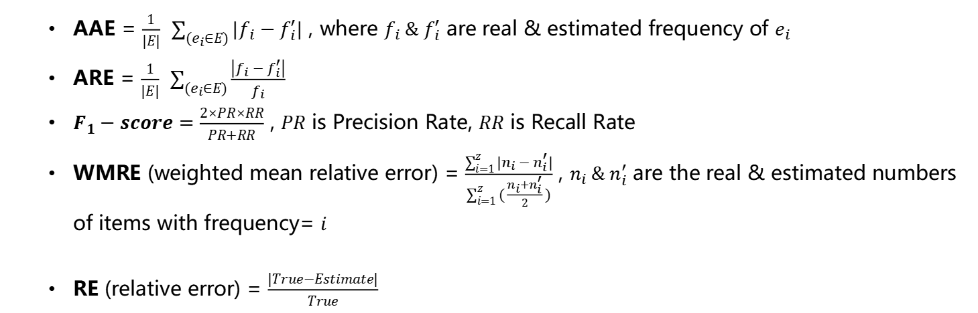
Experimental Results
Settings
Metrics
AAE = $\frac{1}{|E|} \sum_{(e_{i}∈E)}{|f_{i}−f_{i}^{′}|}$ , where $f_{i} \& f_{i}^{′}$ are real & estimated frequency of $e_{i}$
ARE = $\frac{1}{|E|} \sum_{(e_{i}∈E)}{\frac{\left|f_{i}−f_{i}^{′}\right|}{f_{i}}}$
$F_{1}−score=\frac{2×PR×RR}{PR+RR}$ , $PR$ is Precision Rate, $RR$ is Recall Rate
WMRE (weighted mean relative error) = $\frac{\sum_{i=1}^{z}{|n_{i}−n_{i}^{′}|}}{\sum_{i=1}^{z}{(\frac{n_{i}+n_{i}^{′}}{2})}}$ , $n_{i} \& n_{i}^{′}$ are the real & estimated numbers of items with frequency= 𝑖
RE (relative error) = $\frac{|True−Estimate|}{True}$
HH&HC detection
Item size distribution
Entropy estimation
Notes:
We consider the following matrics..
including AAE (average absolute error), ARE (average relative error),
F1-score for HH/HC detection,
WMRE (*/*/*) for item size distribution and
RE (relative error) for entropy estimation.

Slide 16
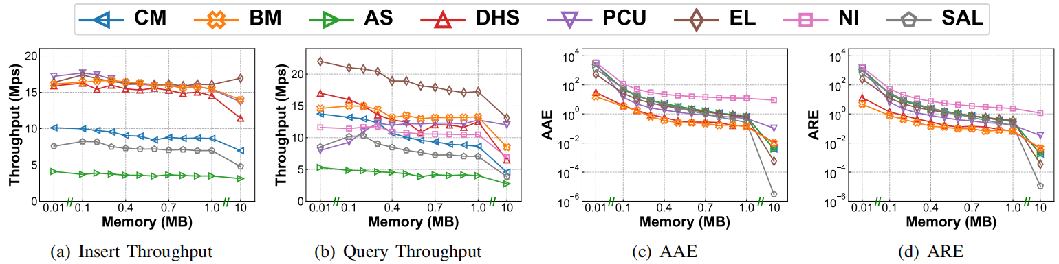
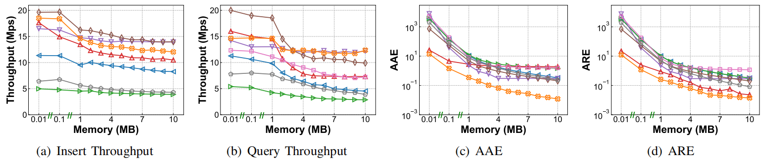
Experimental Results
Frequency Estimation
CAIDA
IMC
Notes:
First we show the results of frequency estimation, here on the CAIDA and IMC datasets.
In terms of insertion throughput, we can find that BM is always in the first tier.
In terms of query throughput, BM is only worse than EL in the average case.
In terms of AAE, BM performs the best, and it slightly leads DHS in the CAIDA dataset, because CAIDA is a small dataset with a small number of items. Under the IMC dataset (large dataset), BM leads EL by more than one order of magnitude on average.
The results for ARE were similar.

Slide 17
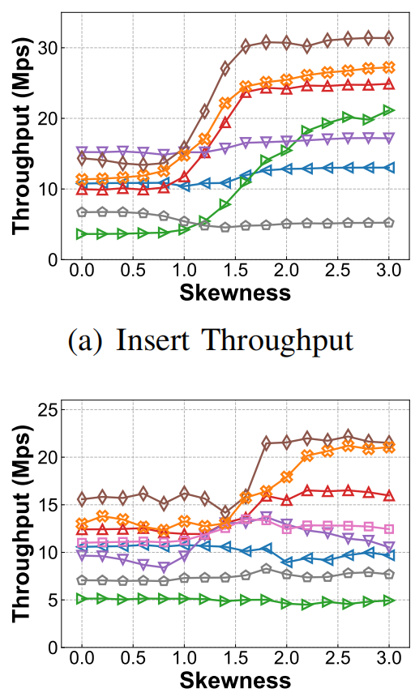
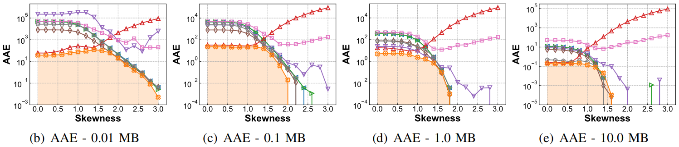
Experimental Results
Frequency Estimation
ZIPF
Key point
 | 0.01 MB | 0.1 MB | 1 MB | 10 MB
BM | √ | 2.0 √ | 1.8 √ | 1.6
EL | —— | 2.3 | 1.8 | 1.6
SALSA | —— | 2.4 | 2.0 | 1.5
AS | —— | 2.7 | 2.0 | 1.4
CM | —— | 2.6 | 2.0 | 1.4
Notes:
We also measure the error line for each memory on the zipf dataset.
We find that the error of most sketches decreases with increasing skewness. This is because the total number of items in each sub-data set is the same, when the skew increases, the hot flow frequency will become larger, so the item types will become less. However, we found that the error of DHS increases with the skewness, because the maximum counter of DHS is only 16 bits, which cannot accommodate the hot flow in the highly skewed dataset.
We note the point in the plot where the error drops to 0. We found that when the memory is small, ie 0.01, 0.1, 1MB, the error of BM is always optimal under various skewness, and it is the fastest to drop to 0. At 10MB it is slightly behind SALSA, AS and CM.

Slide 18
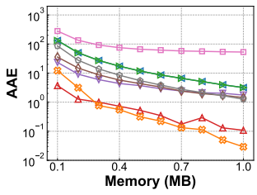
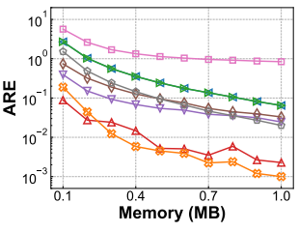
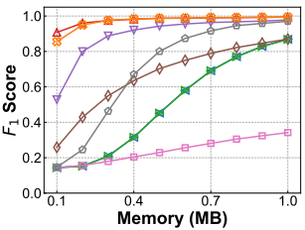
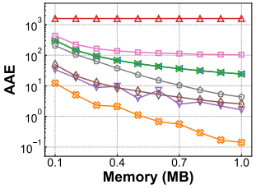
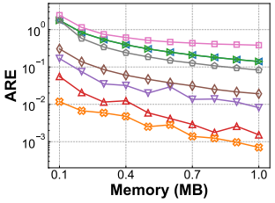
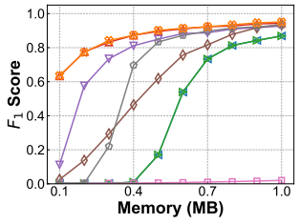
Experimental Results
Heavy Hitter Detection
CAIDA
IMC
Notes:
The results of Heavy Hitter Detection are shown here, and it can be seen that BM beats the state of the arts as well.

Slide 19
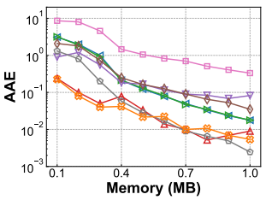
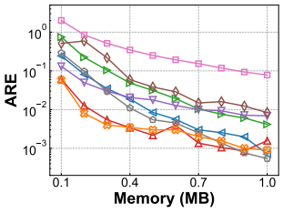
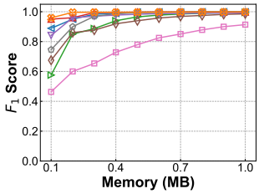
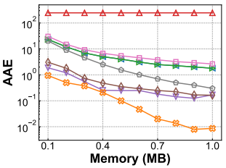
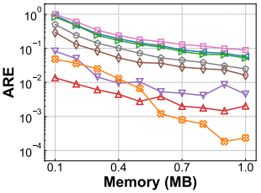
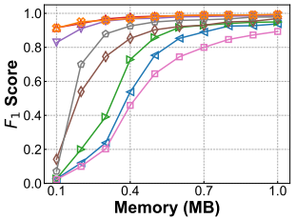
Experimental Results
Heavy Change Detection
CAIDA
IMC
Notes:
The results of Heavy Change were similar to HH, and BM also achieved good results.

Slide 20
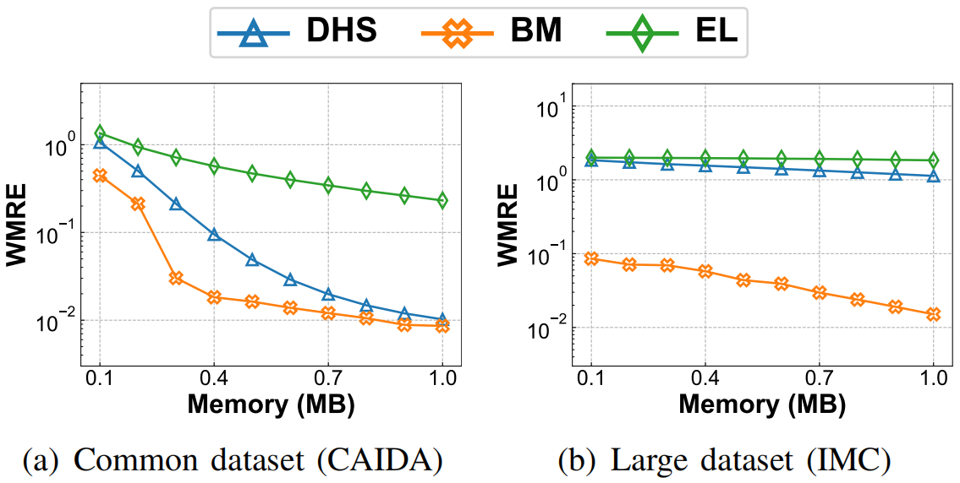
Experimental Results
Item size distribution
Notes:
The results of item size distribution are shown in the figure.

Slide 21
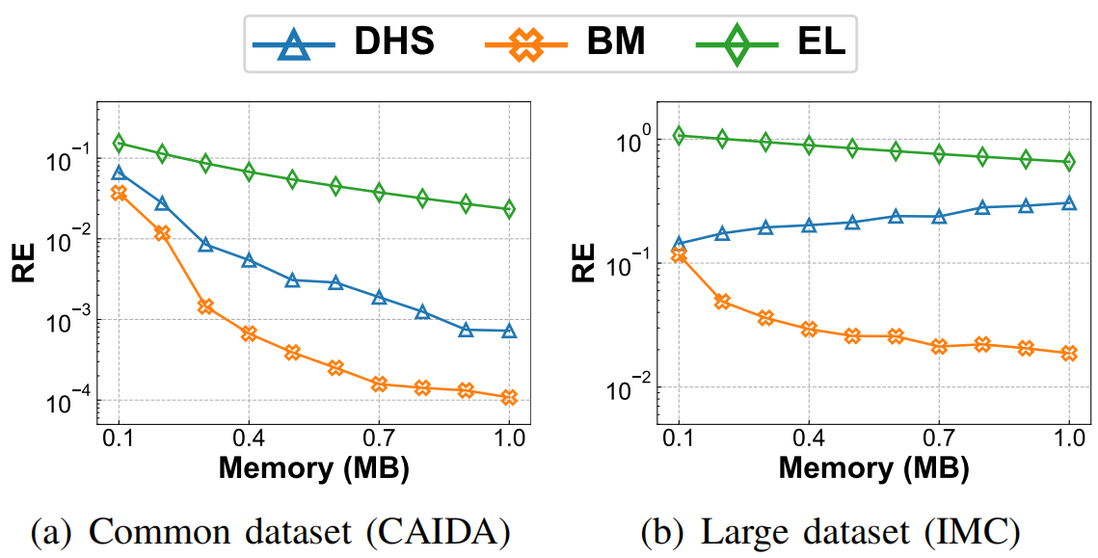
Experimental Results
Entropy Estimation
Notes:
Here are the entropy estimation results.

Slide 22
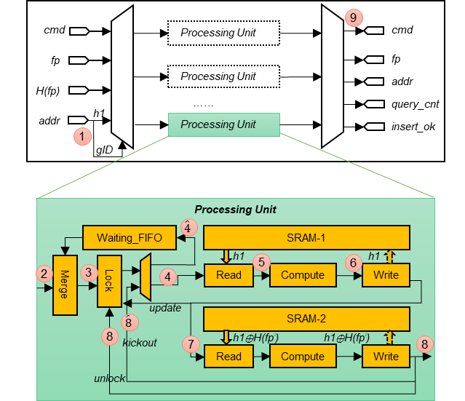
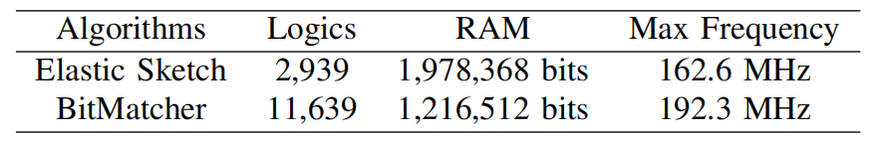
FPGA Implementation
Results
Multi-engine
Parallelism
Pipeline
Solve the dependency
Bitmatcher can achieve 192Mpps at most with 3% FPGA resources.
Notes:
We put all above together and have the final FPGA design, shown in the picture.
[c] We use multi-engine.
[c] We use parallelism and pipeline to achieve high computation capacity.
[c] We also solve the dependency problem.
Bitmatcher can achieve 192Mpps at most with 3% FPGA resources.
The results show that Bitmatcher achieve 192Mpps with only 3% FPGA resources.

Slide 23
Conclusion
1.
BitMatcher：a bit-level counter adjustment that can perfectly match the data stream distribution.
2.
Small memory cost, high speed, high accuracy, and good soft / hardware scalability.
3.
We use BitMatcher to process five typical measurement tasks.
4.
We implemented BitMatcher on CPU and FPGA. All codes are released at Github.
Notes:
In this paper, we propose BitMatcher: a bit-level counter adjustment that can perfectly match the data stream distribution.
It has small memory cost, high speed, high accuracy, and good soft / hardware scalability.
We use BitMatcher to process five typical measurement tasks and implemented it on CPU and FPGA. All codes are released at Github.

Slide 24
Thank you!
Q&A
Notes:
Here are the entropy estimation results.

