Slide 1


VisionEmbedder:
Bit-Level-Compact Key-Value Storage with
Constant Lookup, Rapid Updates, and Rare Failure
Yuhan Wu∗, Feiyu Wang∗, Yifan Zhu∗, Zhuochen Fan∗, Zhiting Xiong†, Tong Yang∗, and Bin Cui∗
∗Peking University, China, †NUDT, China
ICDE 2024, May 13–17, 2024
Utrecht, Netherlands.
Notes:
Hello everyone, I'm Yuhan Wu, a PHD student from Peking University. I am going to share with you my work, visionEmbedder, which is a Key value table. It is extremely compact in size and supports Constant Lookup time, Rapid Dynamic Updates, and Rare update Failure.

Slide 2
Background: Key-Value Table
INPUT: KEY
KEY | VALUE
Alice | 0
Bob | 1
Coco | 0
OUTPUT: VALUE
Notes:
Let's start with the most basic key value table. It is a common data structure, also known as a hash table. It stores many key-value pairs. When a user queries a key, the corresponding value can be quickly retrieved. It has a wide range of applications in computer science.

Slide 3
Background: Key-Value Lookup
INPUT: KEY
KEY | VALUE
Alice | 0
Bob | 1
Coco | 0
OUTPUT: VALUE
VALUE=0
Node 0
Alice
VALUE=1
Directory table
Bob
Node 1
Q: Where is my data?
A: In Node X
Notes:
We mainly focus on the use scenarios where the value is short and the key is long. For example, scenarios where the key-value table is used as a directory. All user data is stored in two nodes in a load-balanced manner. The directory table records the node number where each user's data is stored. In the figure, Alice's data is stored in node 0, and Bob's data is stored in node 1. When they need to access their own data, they will first access the directory table to know which node their data is stored in, and then retrieve the data from the corresponding node. The size of the value domain is equal to the number of nodes, its encoding length may be very short, in this example the length of the value is only 1 bit. However, the length of the KEY field may be very long, such as a string, an IP address, or a 64-bit hash value.

Slide 4
Background
Application Scenarios (Long KEY, short value)
L4 Load Balancing: KEY is a 128-bit IPV6 address, value is 4 bits, recording the 16 backend servers,
Binary Classifier: When Value=1 bit, it implements a binary classification of the key. Such as allowing access or not
......
Scenario Requirements: Space Efficient
Often deployed on network devices with limited space
The space occupied by the Key is too large
Value Only table: Does not directly store the key or its hash value (fingerprint)
KEY | VALUE
Alice | 0
Bob | 1
Coco | 0
Notes:
There are many such scenarios where the key is long and the value is short. For example, in four-tier load balancing, the length of the key is 128 bits, representing the user's IPV6 address, and the value is 4 bits, recording which backend server this user is connected to.
When value=1, the KV table becomes a binary classifier. It can record whether each user is allowed to access.
In the above scenarios, key-value tables are often deployed on network devices with limited space, so they are required to have good space efficiency.
Existing work has found that the key occupies most of the storage space and can be optimized. Hence, Value Only tables were born. They do not directly store the key or its hash value, making the space overhead only related to the length of the Value and the number of KV pairs, greatly improving space efficiency.
So, how is this made possible?

Slide 5
Prior Art: Value Table (Bloomier, IBLT, XOR Filter)
Width w=5 (Columns)
3 Arrays(Rows)
‘L’-bit per integer
Notes:
Represented by Bloomier, existing works widely use a simple and effective value table. We will first introduce its data structure, then how to use it for lookup, and finally how to construct it. It comprises three arrays, each containing multiple integers. It can be viewed as a 3-row and w-column matrix. Its width increases with the number of KV pairs to be stored. The length of each integer is equal to the length of the value to be stored.

Slide 6
Prior Art: Value Table (Bloomier, IBLT, XOR Filter)
Width w=5 (Columns)
5 Columns
1 | 0 | 0 | 1 | 0
3 Arrays(Rows)
3 Rows
0 | 0 | 0 | 0 | 0
0 | 1 | 0 | 0 | 0
‘L’-bit per integer
1 bit per integer
Notes:
When the length of the encoded value is 1, the value table is as shown in the right figure.

Slide 7



Prior Art: Value Table (Bloomier, IBLT, XOR Filter)
$$h_{1}$$
1 | 0 | 0 | 1 | 0
$$h_{2}$$
KEY
0 | 0 | 0 | 0 | 0
VAL：1⊕0⊕0=1
$$h_{3}$$
0 | 1 | 0 | 0 | 0
⊕ denotes Exclusive-OR
0⊕0=0 0⊕1=1
1⊕0=1 1⊕1=0
Notes:
The three arrays of the value table each have a hash function. These three hash functions map each key to three random integers in the three arrays. The way to query the value using it is very direct. For the key to be queried, calculate its hash value according to the three hash functions respectively, and find the corresponding integer. The XOR sum of these three integers is the value to be queried. The XOR sum here is a bit-by-bit binary operation, which is a binary addition without carry. In the example in the above figure, the three integers found by the key are 1 0 0, their XOR sum is 1, which is the value obtained by lookup.

Slide 8
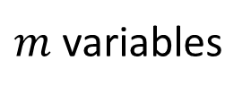
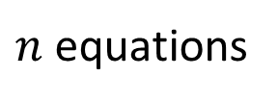
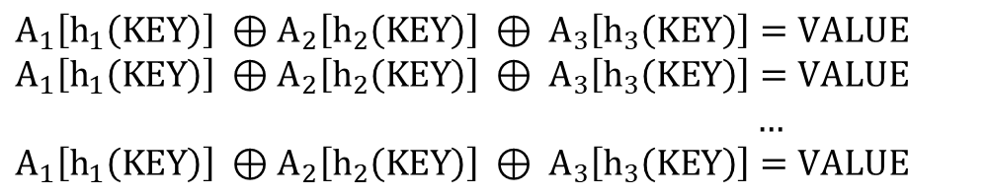
Prior Art: Value Table (Bloomier, IBLT, XOR Filter)
1 | 0 | 0 | 1 | 0
$m$ variables
0 | 0 | 0 | 0 | 0
0 | 1 | 0 | 0 | 0
𝑇ℎ𝑖𝑠 𝑒𝑞𝑢𝑎𝑡𝑖𝑜𝑛 𝑖𝑠 𝑙𝑖𝑘𝑒𝑙𝑦 𝑡𝑜 ℎ𝑎𝑣𝑒 𝑎 𝑠𝑜𝑙𝑢𝑡𝑖𝑜𝑛, 𝑤ℎ𝑒𝑛 𝑚>1.23 𝑛
$A_{1}\left[h_{1}\left(KEY\right)\right] ⊕$ $A_{2}\left[h_{2}\left(KEY\right)\right] ⊕ A_{3}\left[h_{3}\left(KEY\right)\right]=VALUE$
$A_{1}\left[h_{1}\left(KEY\right)\right] ⊕$ $A_{2}\left[h_{2}\left(KEY\right)\right] ⊕ A_{3}\left[h_{3}\left(KEY\right)\right]=VALUE$
…
$A_{1}\left[h_{1}\left(KEY\right)\right] ⊕$ $A_{2}\left[h_{2}\left(KEY\right)\right] ⊕ A_{3}\left[h_{3}\left(KEY\right)\right]=VALUE$
$n$ equations
Notes:
Knowing how to query, it is not difficult to think of how to construct a value table. Given a dataset containing n key-value pairs, we construct n equations, each equation contains three variables, that is, the three integers that each key is hash-mapped to. There are a total of m integers, so there are m variables. Existing theories prove that when the number of variables m is sufficiently large, that is, m is greater than 1.23 times n, this equation is likely to have a solution, and a value table can be successfully constructed.
However, this scheme has a serious problem, it cannot support rapid dynamic updates. This dynamic update refers to temporarily adding a key-value pair, or modifying the value of a key-value pair. Therefore, these schemes are referred to as static schemes, and are only used in scenarios where dynamic data updates are not required.

Slide 9
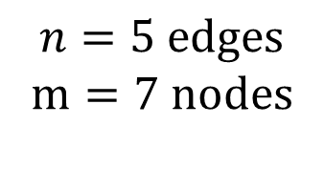
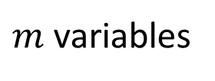
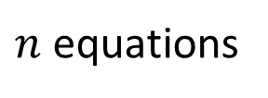
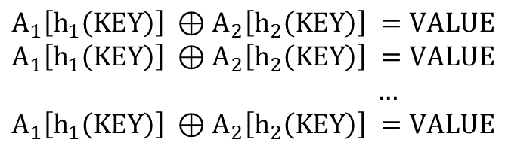
Prior Art: Dynamic Solutions (Othello and Coloring)
$$n=5 edges$$
$$m=7 nodes$$
1 | 0 | 0 | 1 | 0
$m$ variables
0 | 0 | 0 | 0 | 0
$A_{1}\left[h_{1}\left(KEY\right)\right] ⊕$ $A_{2}\left[h_{2}\left(KEY\right)\right] =VALUE$
$A_{1}\left[h_{1}\left(KEY\right)\right] ⊕$ $A_{2}\left[h_{2}\left(KEY\right)\right] =VALUE$
…
$A_{1}\left[h_{1}\left(KEY\right)\right] ⊕$ $A_{2}\left[h_{2}\left(KEY\right)\right] =VALUE$
$n$ equations
Notes:
In order to solve the problem of dynamic updating, existing schemes Othello and Coloring have removed one of the three arrays, making rapid updating possible. We will introduce it with Othello as an example. After removing an array, each equation only has two elements. We can regard variables as points in the graph and equations as edges in the graph, to get a graph with m points and n edges. If there are no cycles formed in the graph, then the equation definitely has a solution. We only need to use depth-first search to traverse each connected block in the graph and assign values in order to complete the construction.

Slide 10

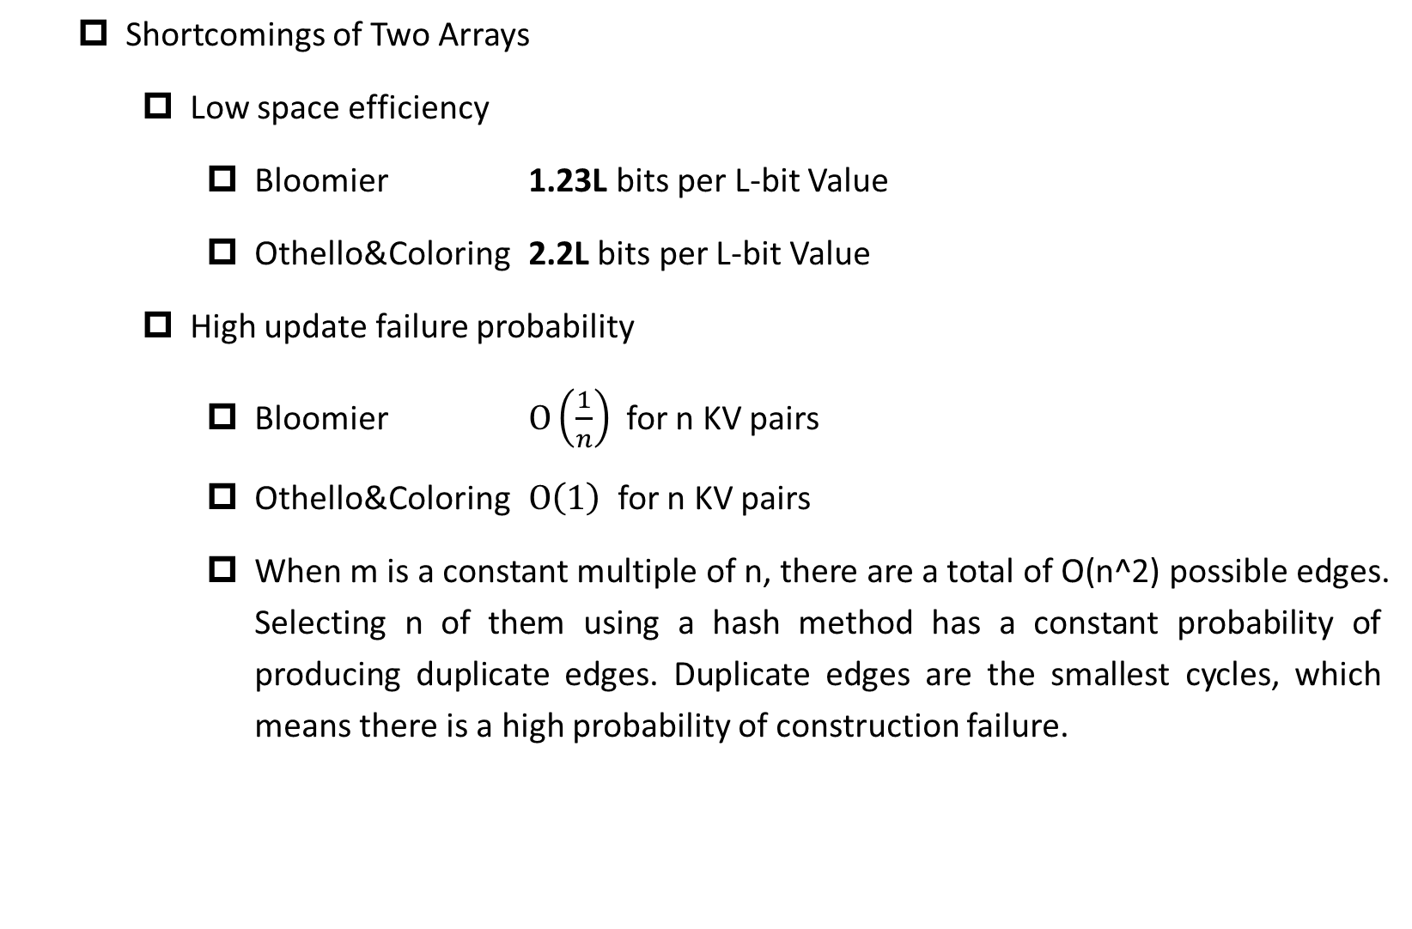
Prior Art: Dynamic Solutions
Shortcomings of Two Arrays
Low space efficiency
Bloomier 1.23L bits per L-bit Value
Othello&Coloring 2.2L bits per L-bit Value
High update failure probability
Bloomier $O\left(\frac{1}{n}\right)$ for n KV pairs
Othello&Coloring $O\left(1\right)$ for n KV pairs
When m is a constant multiple of n, there are a total of O(n^2) possible edges. Selecting n of them using a hash method has a constant probability of producing duplicate edges. Duplicate edges are the smallest cycles, which means there is a high probability of construction failure.
$$重边$$
Notes:
However, removing arrays has two significant impacts that cannot be ignored.
1. Space efficiency decreases. More variables are needed to successfully complete the construction.
2. The probability of construction failure has increased nearly n times. When m is a constant multiple of n, there are a total of O(n^2) possible edges. Selecting n of them using a hash method has a constant probability of producing duplicate edges. Duplicate edges are the smallest cycles, which means there is a high probability of construction failure.

Slide 11
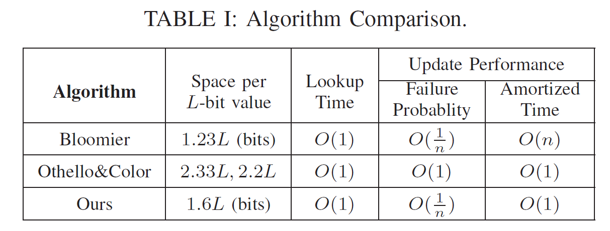
Our Solution
Notes:
We hope to choose another approach, still using three arrays to implement dynamic updates, to overcome the shortcomings of existing works. Fortunately, we succeeded. Compared with static solutions like Bloomier which require O(n) time for updates, we achieved constant average update time. Compared with existing dynamic solutions, we achieved less space overhead and a failure probability that is n times lower. Next, we will introduce our specific solution.

Slide 12
VisionEmbedder Design
1 | 0 | 0 | 1 | 0
$m$ variables
0 | 0 | 0 | 0 | 0
0 | 1 | 0 | 0 | 0
$A_{1}\left[h_{1}\left(KEY\right)\right] ⊕$ $A_{2}\left[h_{2}\left(KEY\right)\right] ⊕ A_{3}\left[h_{3}\left(KEY\right)\right]=VALUE$
$A_{1}\left[h_{1}\left(KEY\right)\right] ⊕$ $A_{2}\left[h_{2}\left(KEY\right)\right] ⊕ A_{3}\left[h_{3}\left(KEY\right)\right]=VALUE$
…
$A_{1}\left[h_{1}\left(KEY\right)\right] ⊕$ $A_{2}\left[h_{2}\left(KEY\right)\right] ⊕ A_{3}\left[h_{3}\left(KEY\right)\right]=VALUE$
$n$ equations
Notes:
In three arrays, we can still regard m variables as points. But what is different is that each equation has become a hyperedge connecting three points.

Slide 13
VisionEmbedder Design
Modification of Adding an Edge
If A ⊕B ⊕C does not equal the target value
You can modify any variable in A B C
Chain reaction affects old edges
If A is modified (XOR Δ), both the values of blue A ⊕D ⊕F and orange A ⊕E ⊕G no longer equal the original value. One of F and D, and one of G and E must be modified (XOR Δ) to ensure the old equations are satisfied.
Algorithm Design
When adding an edge, which one in A B C should be modified? In the chain reaction, modify F or D?
A
B
G
C
F
D
E
Notes:
When adding an edge in a three-array environment, if the XOR sum of A, B, and C does not equal the target value, you can choose to modify any variable among A, B, and C. However, this modification can cause a chain reaction affecting the old edges. For instance, if A is modified through the XOR operation, the values of blue A ⊕D ⊕F and orange A ⊕E ⊕G will no longer equal their original values. To ensure the old equations are satisfied, we must modify either F or D, and either G or E, using the XOR operation. This leads to the key design considerations in our algorithm: When adding an edge, which variable among A, B, and C should we modify? And during the chain reaction, should we modify F or D? These decisions will impact the efficiency of our dynamic update process.

Slide 14
VisionEmbedder Design
Algorithm Design
When adding an edge, which one in A B C should be modified? In the chain reaction, modify F or D?
Good or bad algorithm?
Choosing a good point will result in few affected edges until insertion is complete.
Choosing a bad point will result in an increasing number of affected edges, leading to an infinite loop and insertion failure.
A
B
G
C
F
D
E
Notes:
If we choose a good point for modification when adding an edge, the number of affected edges will be minimal, allowing us to successfully complete the insertion process. However, if we choose a bad point, the number of affected edges will increase, potentially leading to an infinite loop that results in insertion failure. Therefore, the strategy we adopt in choosing which points to modify is critical to the success and efficiency of our dynamic updates.

Slide 15
VisionEmbedder Design
Update Path
If 'a' in a⊕b⊕c has already been modified, to keep the sum constant, continue to modify 'c', then modify 'h'.
Greedy Strategy:
Choose the point with the fewest connected edges to modify.
Drawbacks:
Difficult to judge when equal.
Fewest connected edges does not mean the smallest modification cost.
a
b
c
d
e
f
g
h
i
Notes:
In the process of updating, if 'a' in the equation a⊕b⊕c has already been modified, in order to keep the sum constant, we will continue to modify 'c', then modify 'h'. This is the update path that we follow.
We can adopt a greedy strategy, which is to choose the point with the fewest connected edges for modification. This strategy is based on the assumption that the point with fewer connections is likely to cause less disruption to the overall system, hence reducing the cost of modifications.
However, this strategy has its drawbacks. For instance, it can be difficult to make a decision when there are multiple points with the same number of connections. Furthermore, having the fewest connected edges does not necessarily mean that the cost of modification will be the smallest. There are other factors that could influence the cost, making this a complex problem to solve.

Slide 16
VisionEmbedder Design
Vision Strategy:
Continuously look at 1~3 layers to estimate the modification cost of each path.
Dynamic Depth:
When the graph is dense, look deeper and use more computational overhead to find a better path, ensuring the number of points to be modified converges to 0.
When the graph is sparse, reduce the number of layers to look at, reducing computational overhead.
a
b
c
d
e
f
g
h
i
Notes:
In order to perform a better update, we've developed a "Vision" strategy. This strategy involves continuously observing 1 to 3 layers of the graph to estimate the modification cost of each path. This allows us to make more informed decisions about which points to modify.
We've adopted a dynamic depth approach to balance computational resources and modification costs. For dense graphs, we delve deeper, increasing computation but finding better paths and minimizing modifications. For sparse graphs, we reduce the depth to lower computation, effectively optimizing our algorithm's efficiency.

Slide 17
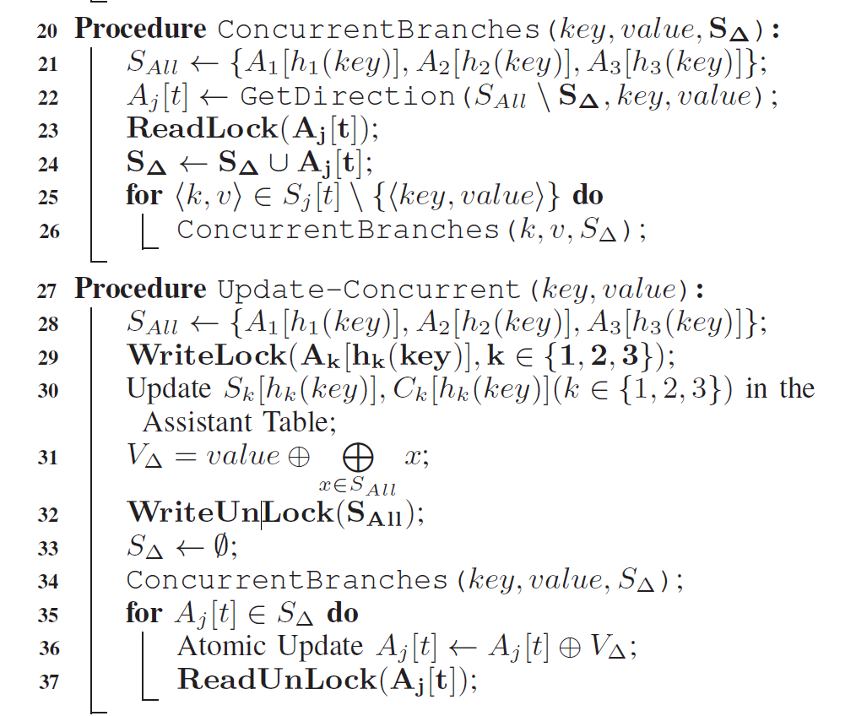
VisionEmbedder Design
Concurrency Issues:
When multiple edges are inserted concurrently, they may conflict and interfere with each other. How can this be resolved?
Solution: Build read-write locks for each point.
Read lock, used when searching for points to modify. After adding a read lock, edges cannot be added to the point.
Reentrant, different insertions can overlap when searching for points to modify.
Write lock, added when actually modifying the value of the point.
Notes:
Another challenge we need to address in our algorithm is the issue of concurrency. When multiple edges are inserted concurrently, they may conflict and interfere with each other. This can disrupt the update process and lead to errors in our data structure.
To resolve this issue, we've come up with a solution of building read-write locks for each point in the graph.
A read lock is used when we are searching for points to modify. Once a read lock is added to a point, no edges can be added to that point. This prevents other processes from modifying the point while we are still determining the changes to be made. Importantly, these read locks are reentrant, meaning that different insertions can overlap when searching for points to modify.
On the other hand, a write lock is added when we are actually modifying the value of a point. This ensures that no other processes can read or write to the point while it's being updated, thereby preventing conflicts and ensuring the integrity of our updates.

Slide 18
Mathematical Analysis
We proved two key conclusions
High Space Efficiency. When the space usage is greater than 1.756L per L-bit value, VisionEmbedder with MaxDepth=1 can successfully perform dynamic updates, i.e., stop in amortized constant time.
Low Failure Rate. For n consecutive insertions, the probability of encountering an update failure is O(1/n).

Slide 19
Evaluation
Existing solutions:
Bloomier, Othello, Coloring Embedder and Ludo. Ludo is an improved version of Othello, with a similar failure probability.
Datasets:
Random dataset (most difficult to encode), MACTable, MachineLearning, DBLP
Key Results:
We can achieve 1.58L bits per L-bit value and a failure probability of O(1/n).
Notes:
In our research, we compared our method with several existing solutions, including Bloomier, Othello, Coloring Embedder, and Ludo. Ludo is an improved version of Othello and has a similar failure probability, making it a relevant benchmark for our comparison. We tested our algorithm on various datasets, including a random dataset which is the most difficult to encode, MACTable, MachineLearning, and DBLP. These datasets represent a wide range of scenarios and help us evaluate the versatility and robustness of our method. The key results of our research are quite promising. We were able to achieve a space usage of just 1.58L bits per L-bit value. Moreover, our method has a low failure probability of O(1/n) （one over n）, which means that the probability of encountering an update failure decreases as the capacity increases. These findings demonstrate the high efficiency and reliability of our dynamic update algorithm.

Slide 20
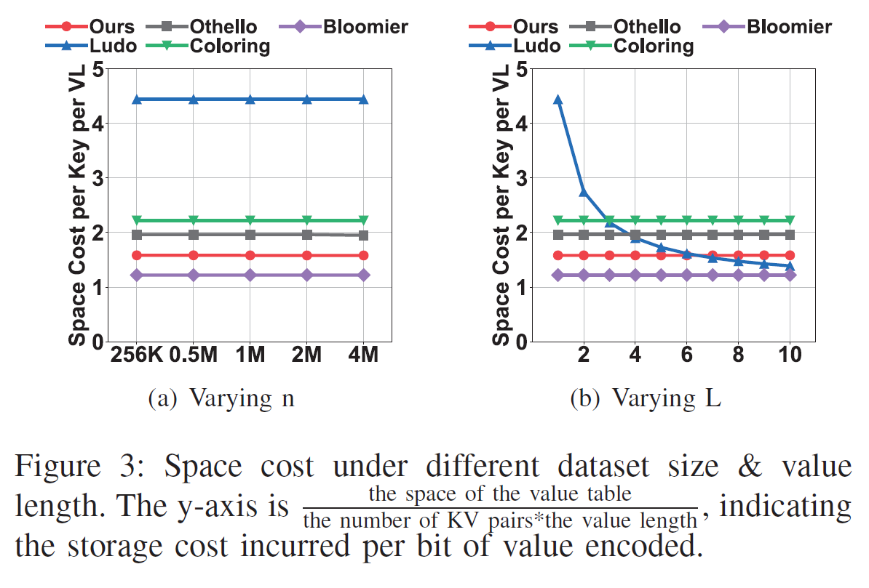
Evaluation
Space Cost
Ours: 1.58L bits per L-bit value
Compared to the existing best Othello (2.2L), we improved it by 50%.
Notes:
In terms of space cost, our method requires only 1.58L bits per L-bit value. When compared to the current best method, Othello, which requires 2.2L bits, we've achieved an improvement of 50%. This is a significant reduction in space cost, making our method much more efficient.
However, when L is greater than 6, our method does not outperform Ludo. This is because Ludo has been specially designed to handle larger L values. But we have a solution for this. By replacing the Othello component in Ludo with our Vision method, we can create a new algorithm that is strictly better than the existing Ludo, even for larger L values. This demonstrates the versatility and adaptability of our Vision method.

Slide 21
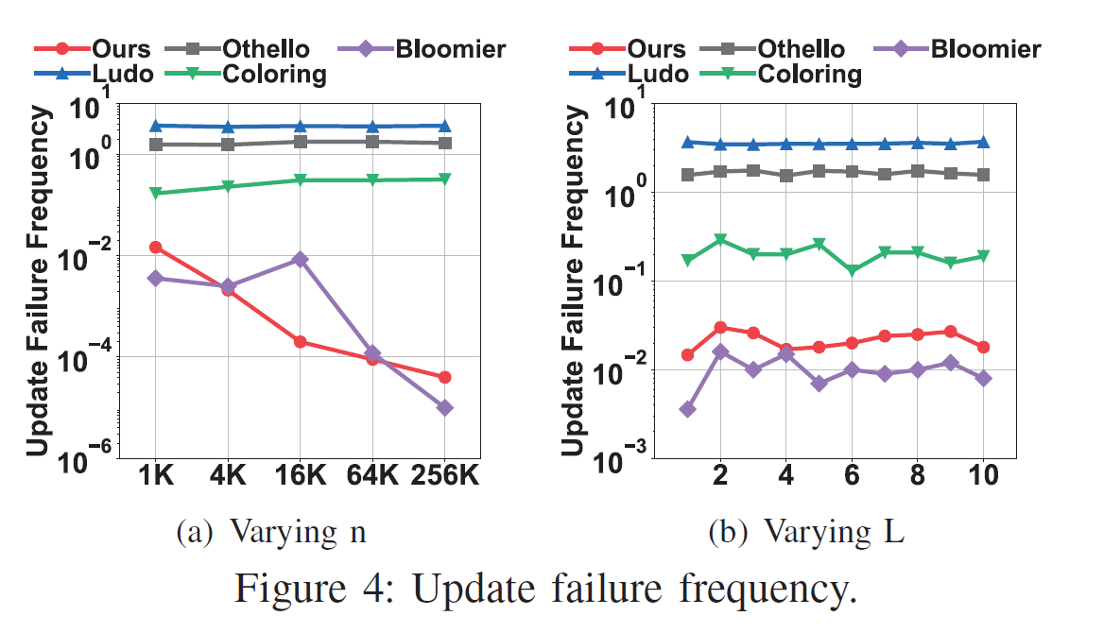
Evaluation
Update Failure Frequency
As can be seen, our algorithm has a failure rate at the O(1/n) level, the same as Bloomier, under different scales of n and L. Meanwhile, the failure rate of other solutions is close to 1.
Notes:
When we look at the frequency of update failures, our algorithm performs exceptionally well across different scales of n and L. Specifically, our algorithm maintains a failure rate at the O(1/n) level, which is the same level as Bloomier.
In contrast, the failure rate of other solutions is close to 1

Slide 22
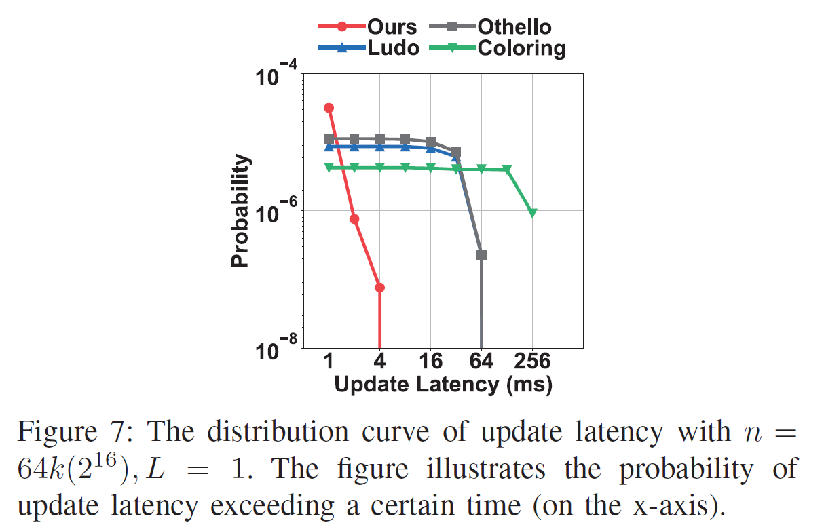
Evaluation
Update Latency Distribution
Due to the extremely low failure rate, the tail latency of our updates is significantly better than other solutions.
Notes:
We've also examined update latency distribution, which measures the time for updates to finish. Due to our notably low failure rate, our updates' tail latency outperforms other solutions.

Slide 23
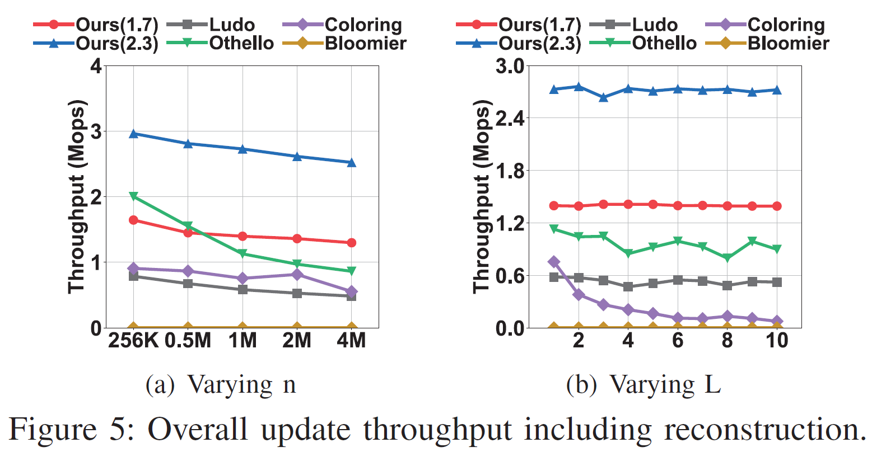
Evaluation
Update Throughput
When we use the same space (2.3) as the comparison solutions, our solution is significantly the fastest.
When using less space (1.7), we are slower than Othello when n is small.
Notes:
In terms of update throughput, our solution stands out. When using the same amount of space (2.3) as other methods, ours is significantly faster, demonstrating superior efficiency. However, when we reduce the space to 1.7, our method is slower than Othello for a small n.

Slide 24
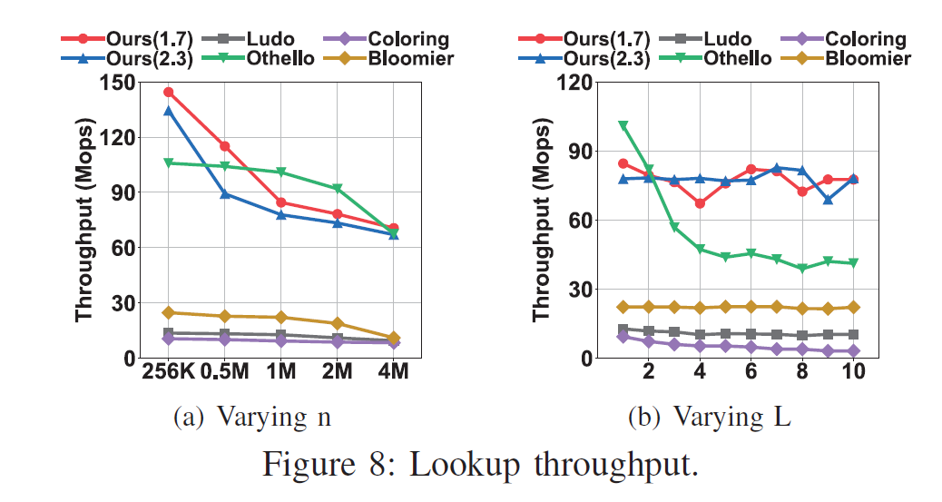
Evaluation
Lookup Throughput
When L=1, our speed is comparable to the fastest, Othello.
When L>1, Othello's speed decreases as L increases, while our speed is less affected by L.
Notes:
Moving on to lookup throughput, which measures the speed of retrieving data.
When L equals 1, our method performs on par with the fastest one, Othello. This means we are able to retrieve data just as quickly as the currently most efficient method.
As the value of L increases, we see a divergence in performance. Othello's speed decreases as L gets larger, whereas our method maintains a relatively stable speed that is less affected by the increase in L. This demonstrates that our method is not only efficient but also more robust to changes in the parameter L, offering consistent performance regardless of its value.

Slide 25
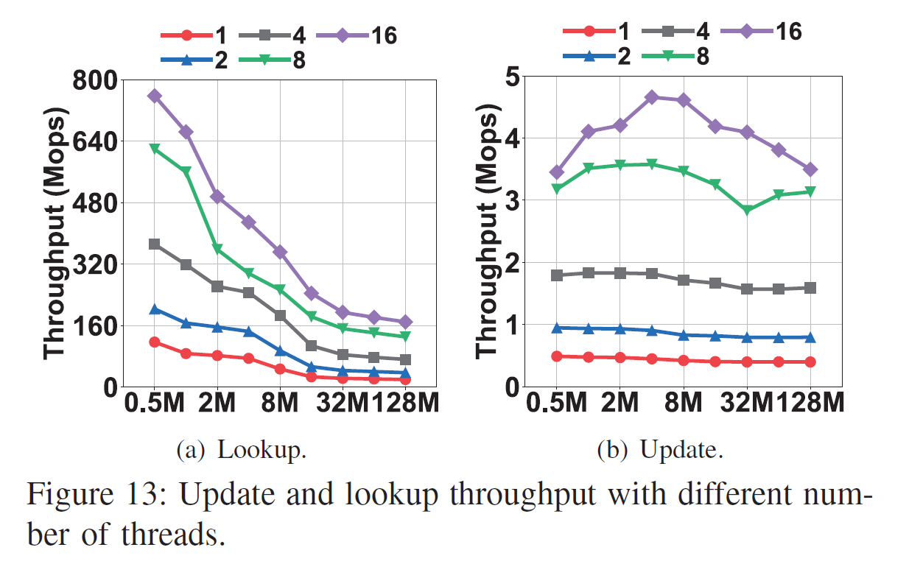
Evaluation
Multi-threading
We tested the speed of 1~16 threads. As can be seen, the acceleration effect is significant.
Notes:
We also evaluated the performance of multi-threaded concurrency.

Slide 26
Evaluation
A large number of other tests are detailed in the paper
Performance under different datasets
Stability of lookup and update speeds
Stability of space cost
Implementation on FPGA
Notes:
For more detailed results, please refer to our paper.

Slide 27
Conclusion
VisionEmbedder: The first value-only key-value lookup solution with amortized constant update time and O(1/n) failure probability.
Comparison: Compared with existing solutions, VisionEmbedder reduces the update failure by n times and saves 50% redundant memory - from 2.2L bits to 1.6L bits.
Validation: Results are proven by rigorous mathematical analysis and extensive experiments.
Notes:
Today, I am excited to introduce you to VisionEmbedder. This is the first value-only key-value lookup solution with amortized constant update time and a failure probability of O(1/n).
When compared with existing solutions, VisionEmbedder dramatically reduces the update failure by n times. Not only that, but it also saves 50% of redundant memory, reducing from 2.2L bits to a mere 1.6L bits.
we've validated our results through rigorous mathematical analysis and extensive experiments.

Slide 28
Q&A
E-mail: yuhan.wu@pku.edu.cn
Wechat ID: yuhanwuuu
Notes:
Thank you for your attention. Now, I would be happy to answer any questions you may have.

