Slide 1
RecallOS
Track
Product Recall for AI Decisions
UiPath Maestro Case
A Maestro Case prototype that finds, replays, remediates, verifies, and certifies historical AI decisions affected by faulty components.
Core artifact
Decision Bill of Materials
Demo case: APP-1042 / DEC-2026-00421
1

Slide 2
RecallOS
UiPath AgentHack | Track 1: Maestro Case
Fixing the agent does not recall the decisions
When a policy, prompt, model, or data source is wrong, the business damage has already propagated.
CRM states
Closed customer records can stay closed.
Emails
Rejected applicants may already have been notified.
Tickets
Support cases can be closed for the wrong reason.
Audit records
Regulators need evidence of corrective action.
2

Slide 3
RecallOS
UiPath AgentHack | Track 1: Maestro Case
Northstar SME Lending finds a faulty policy
Faulty v7.1
Corrected v7.2
If monthly revenue < EUR 5,000, reject automatically.
Low revenue plus approved guarantee goes to manual review.
APP-1042
Revenue: EUR 4,200 | Guarantee: university_startup_fund
Original: rejected -> Replay: manual_review
3

Slide 4
RecallOS
UiPath AgentHack | Track 1: Maestro Case
Maestro is the recall control plane
Trigger
Blast radius
DBOM
Replay
Faulty component detected
64 historical decisions
Evidence per decision
Corrected deterministic policy
Human review
Remediate
Verify
Certificate
Scope and plan approval
API workflows and robot
Test Cloud gate
Audit-ready closure
Coded Agents + Agent Builder + API Workflows + RPA Robot + Test Cloud
4

Slide 5
RecallOS
UiPath AgentHack | Track 1: Maestro Case
DBOM makes every recalled decision inspectable
DEC-2026-00421 evidence chain
Agent
Prompt
Policy
Inputs
Outcome
loan agent v2.3
prompt 2026-05-19
credit-policy-v7.1
Revenue + guarantee + risk
rejected -> manual_review
The recall does not stop at AI trace. It links policy, prompt, model, inputs, retrieved evidence, tool calls, CRM, tickets, email, legacy portal, and audit events.
5

Slide 6
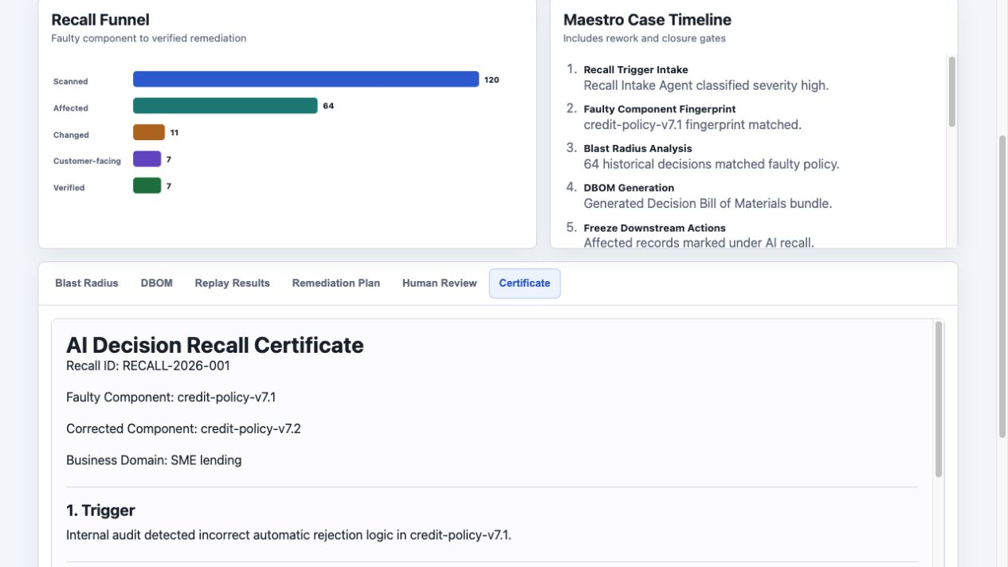
RecallOS
UiPath AgentHack | Track 1: Maestro Case
Running prototype: Recall Control Tower
120
decisions scanned
64
affected by faulty policy
No console errors during browser verification.
6

Slide 7
RecallOS
UiPath AgentHack | Track 1: Maestro Case
Recall narrows the incident to 7 immediate reopens
Stable demo oracle
The exact counts are generated from deterministic seed data and verified by automated tests.
7

Slide 8
RecallOS
UiPath AgentHack | Track 1: Maestro Case
UiPath usage is broad, but each component has a job
Maestro Case
State, stages, rework, SLA, final closure guard
Coded Agents
Blast radius, DBOM, replay, remediation plan
Agent Builder
Intake, impact, customer draft, audit narrative
API Workflows
LoanCore, CRM, Ticket, EmailDraft, AuditRegister
RPA Robot
Legacy portal compliance register update
Test Cloud
Verification gate before case closure
8

Slide 9
RecallOS
UiPath AgentHack | Track 1: Maestro Case
Verification failure re-enters the case instead of closing it
Test fails
Rework
Rerun
Pass
Gate blocks closure
Plan revised
Systems revalidated
Certificate can close
Local run includes an intentional failed gate; final case closes with reentryCount = 1 and verification = passed.
9

Slide 10
RecallOS
UiPath AgentHack | Track 1: Maestro Case
Ready for cloud deployment and Devpost submission
Submission checklist
Product roadmap
1. Publish public GitHub repo
1. DBOM graph exploration
2. Deploy Maestro Case in Automation Cloud
2. More recall domains: HR, grants, insurance
3. Configure Agent Builder prompts
3. Live enterprise connectors
4. Publish API Workflows and coded agents
4. Stronger SLA escalation dashboards
5. Record the under-5-minute demo video
5. Product feedback submission
RecallOS: audit-ready corrective action for AI decisions that already happened.
10

