Slide 1
Welcome!
Download the slide for today’s lab from Canvas → CP6025 → Modules → Week 2 – Research Design → Lab2.zip
Unzip Lab2.zip → Week2_Lab_DataCleaning.pdf
When you are done with today’s lab activity, save your script and keep it for future references
Credit: Bonwoo Koo

Slide 2
Quick Recap from Lab 1
Data type and data structure in R
Data type is the type of a single entry (e.g., 1 is an integer)
Data structure is how data is organized (c(1,2) is a vector)
Helps you read the help document and figure out what data type to put in.
Implies what operations you can do (e.g., you can only add up numbers, such as 1+1, but not strings, such as “1” + “1” or “1” + 1).
Different data type and structures are useful for different types of data storage / operation
Credit: Xiaofan Liang

Slide 3
Quick Recap from Lab 1
Data Type
Number (as.numeric() or as.integer()), e.g., 1.1, 2, 3, 4
Character (as.character()), e.g., “one”, “two”, “1”, “2”, “3”
Factor, e.g., “one”, “two” but “one” < “two”, ordinal data
Logical, e.g., TRUE, FALSE
Data Structure
Vector, e.g., c(1,2,3,4) or c(“one”, “two”, 1, 2)
Matrix, e.g., matrix(1:4, ncol=2, nrow=2)
List, e.g., list(a=1,b=2) or list(1,2)
Data Frame (or table) (will review in this lab)
[,1] [,2]
[1,] 1 3
[2,] 2 4
$a
[1] 1
$b
[1] 2
[[1]]
[1] 1
[[2]]
[1] 2
Credit: Xiaofan Liang

Slide 4
Adv. Planning Methods
Lab 2:
Data Cleaning &
Descriptive Statistics
09.02.2021

Slide 5
Welcome!
1 Lab = 1 document (R markdown or html) + 1 slide
Document contains the complete material prepared for the lab, mostly by Bonwoo Koo.
Slide explains parts of the document that I think are important or can be confusing.
I will go over the slide first. Then, you will have time to read and replicate the document. Once you are done with the document, you can leave!
Google Doc Queue for Q & A during hands-on
3:00-3:30pm is chill time – I will sit outside, come chat
Credit: Bonwoo Koo

Slide 6
Goals for today
Download census data
Working directory
Reading and examining data in R
Calculating the descriptive statistics
Data cleaning with base R
Data cleaning with tidyverse
Commenting on script

Slide 7
Download Census data
We want to download a table called “Ratio of Income to Poverty Level in the Past 12 Months (TableID: C17002)”
from ACS (American Community Survey, updated every year),
for all census tracts (a geographic units)
in the Georgia state.
This data is already downloaded for you as ACSDT5Y2017.C17002-Data.csv in Lab2 folder. The following process shows where the data come from.
Credit: Xiaofan Liang
Notes:
Website for downloading Census data
We’ll look at some of the different data categories.

Slide 8
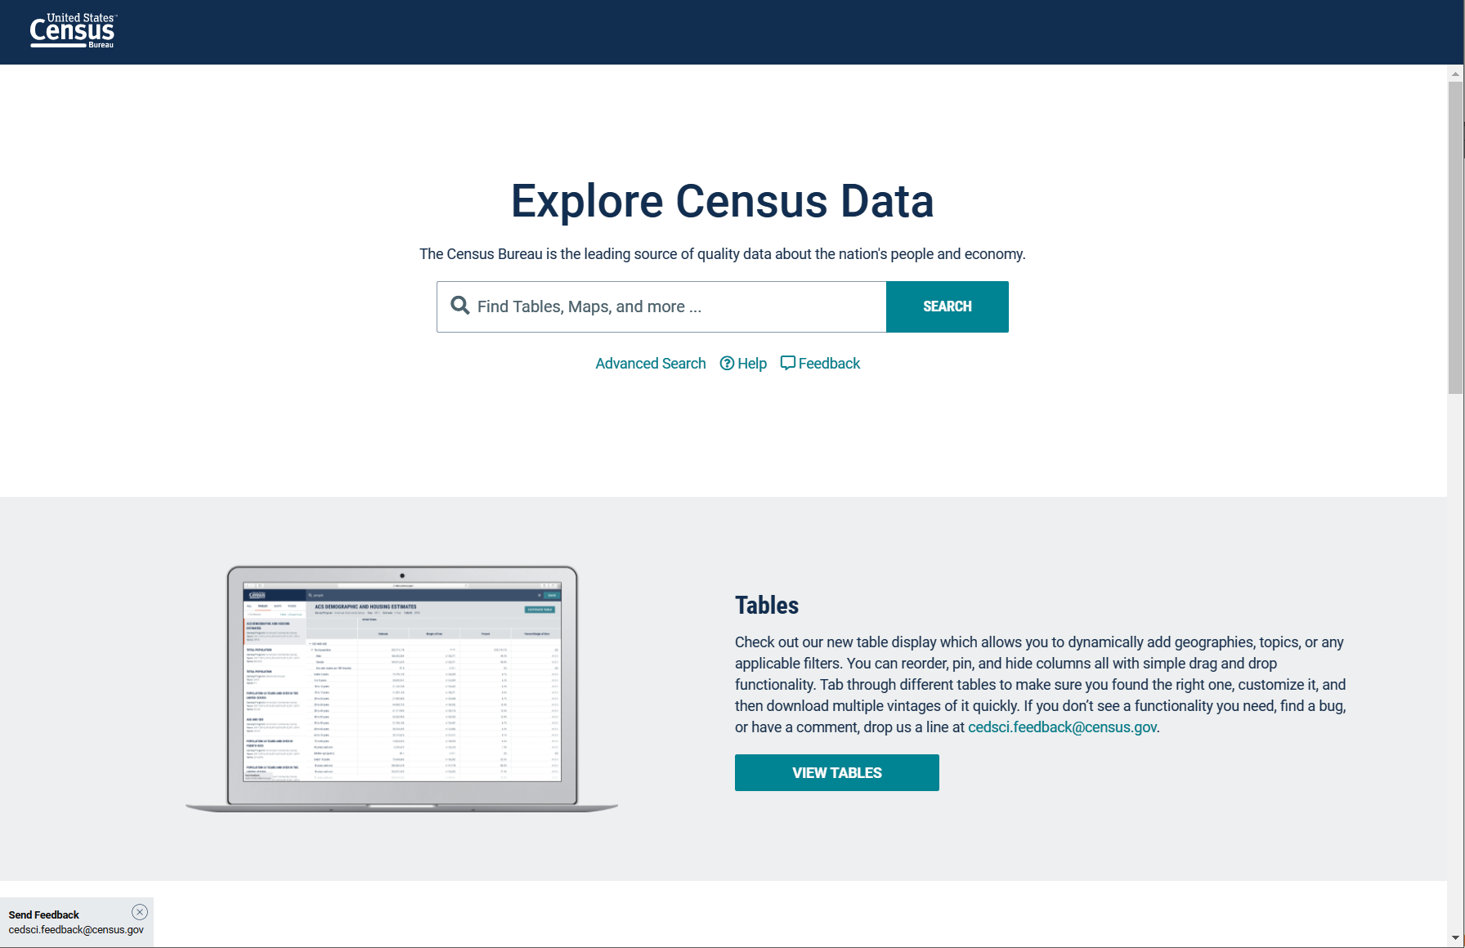
Download Census data
Go to https://data.census.gov/cedsci/ and select “Advanced Search”
Credit: Bonwoo Koo
Notes:
Website for downloading Census data
We’ll look at some of the different data categories.

Slide 9
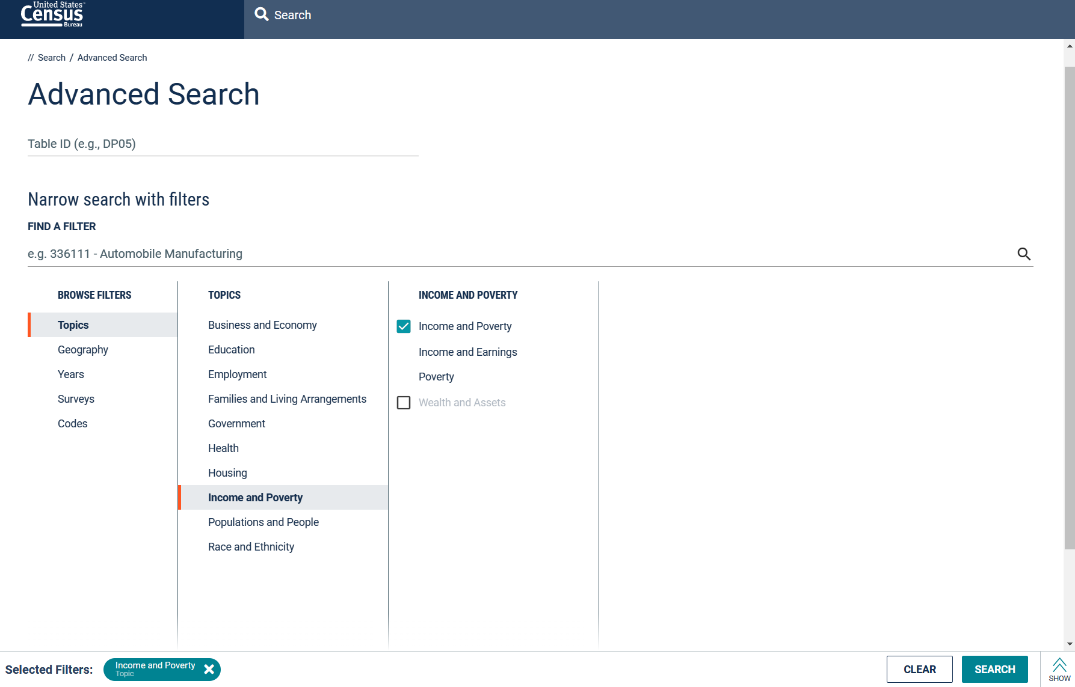
Download Census data
Selecting Topics
Sequentially select from the menu
in the order of:
Topics
Income and Poverty
Income and Poverty (check box).
The selection will add this icon next to Selected Filters:
to indicate that the filter is successfully placed.
Credit: Bonwoo Koo
Notes:
Website for downloading Census data
We’ll look at some of the different data categories.

Slide 10
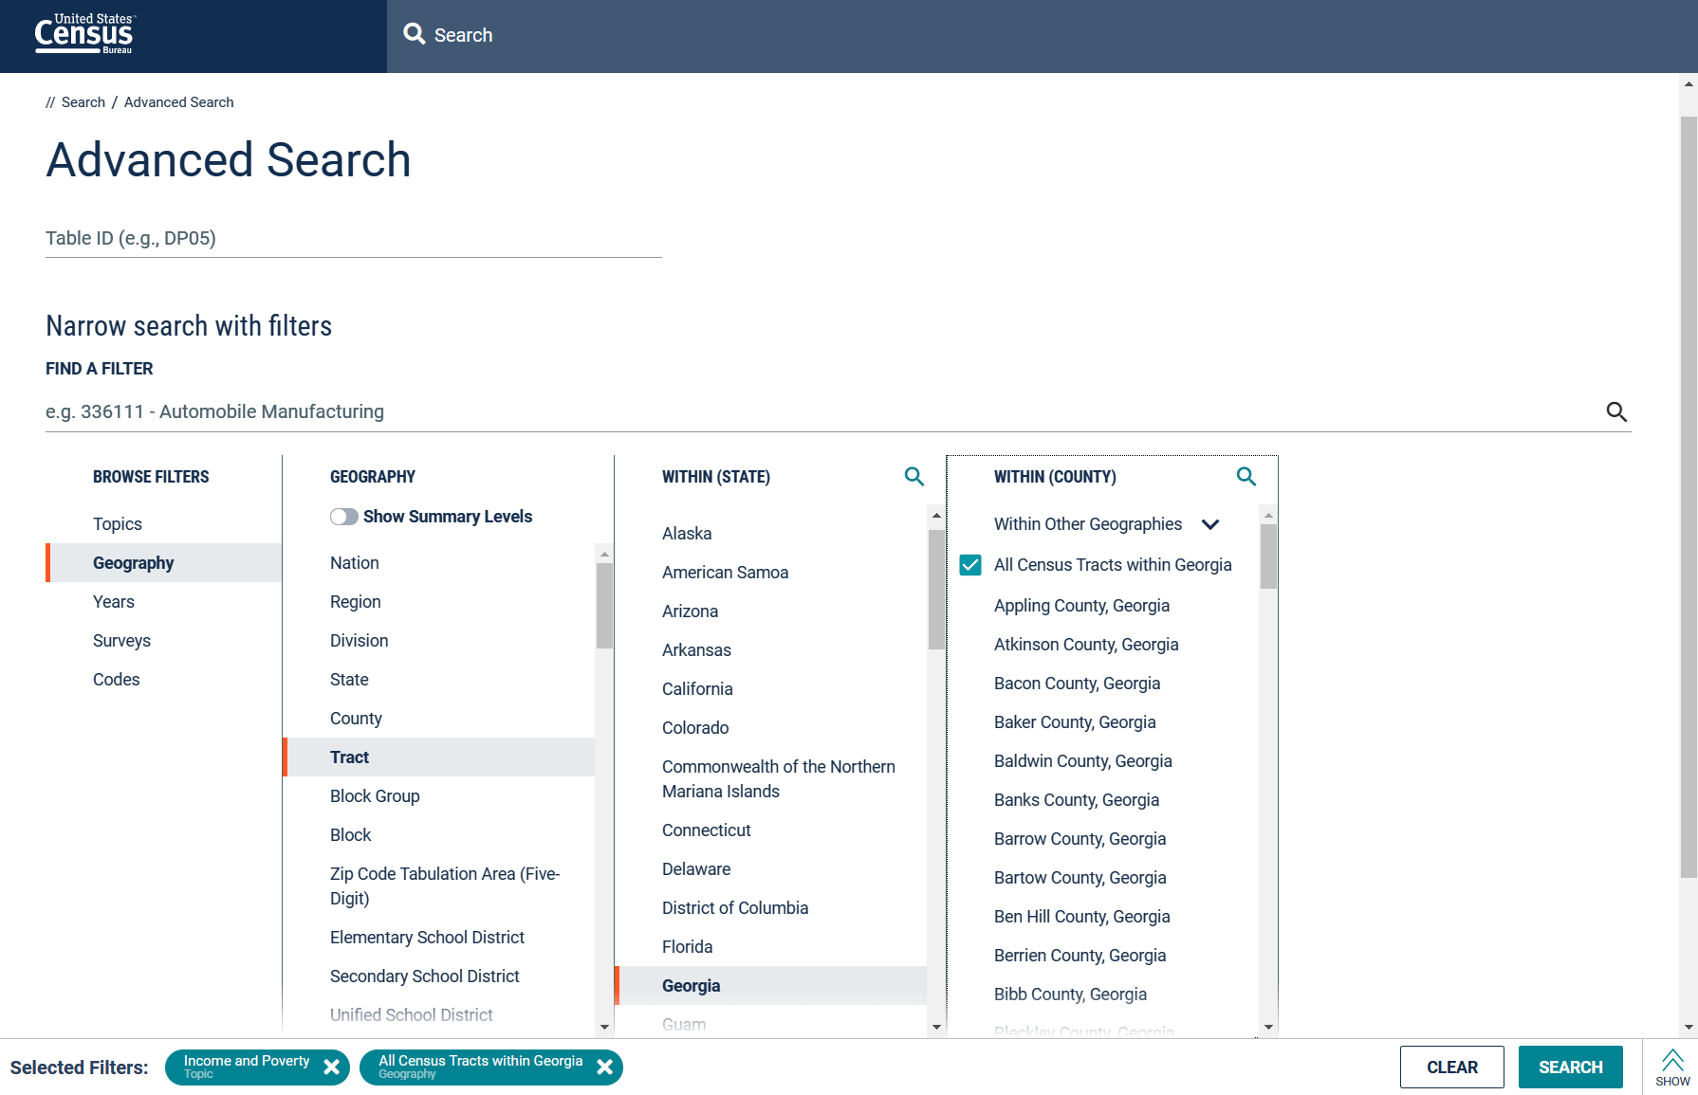
Download Census data
Selecting Geography
Then, select the following items
in the order of:
Geography
Tract
Georgia
All Census Tracts within Georgia
Another filter is added
Credit: Bonwoo Koo
Notes:
Website for downloading Census data
We’ll look at some of the different data categories.

Slide 11
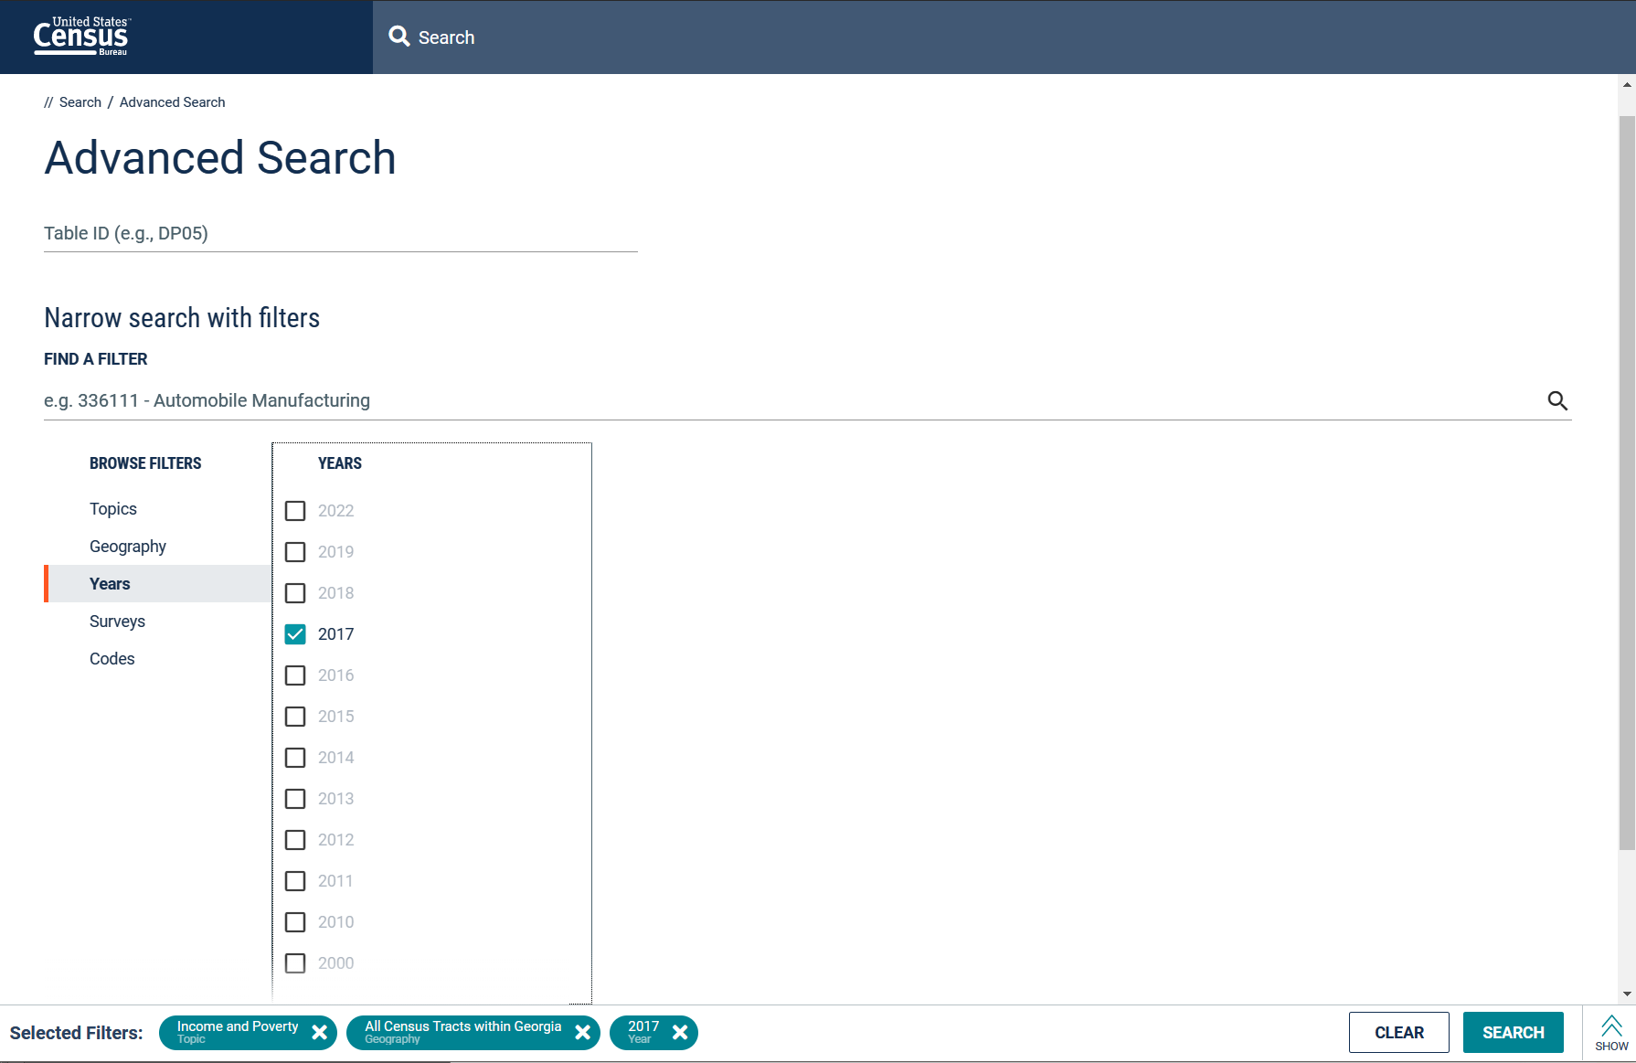
Download Census data
Selecting Years
Then, specify what year you want by selecting
Years
2017
Yet another filter is added
Credit: Bonwoo Koo

Slide 12
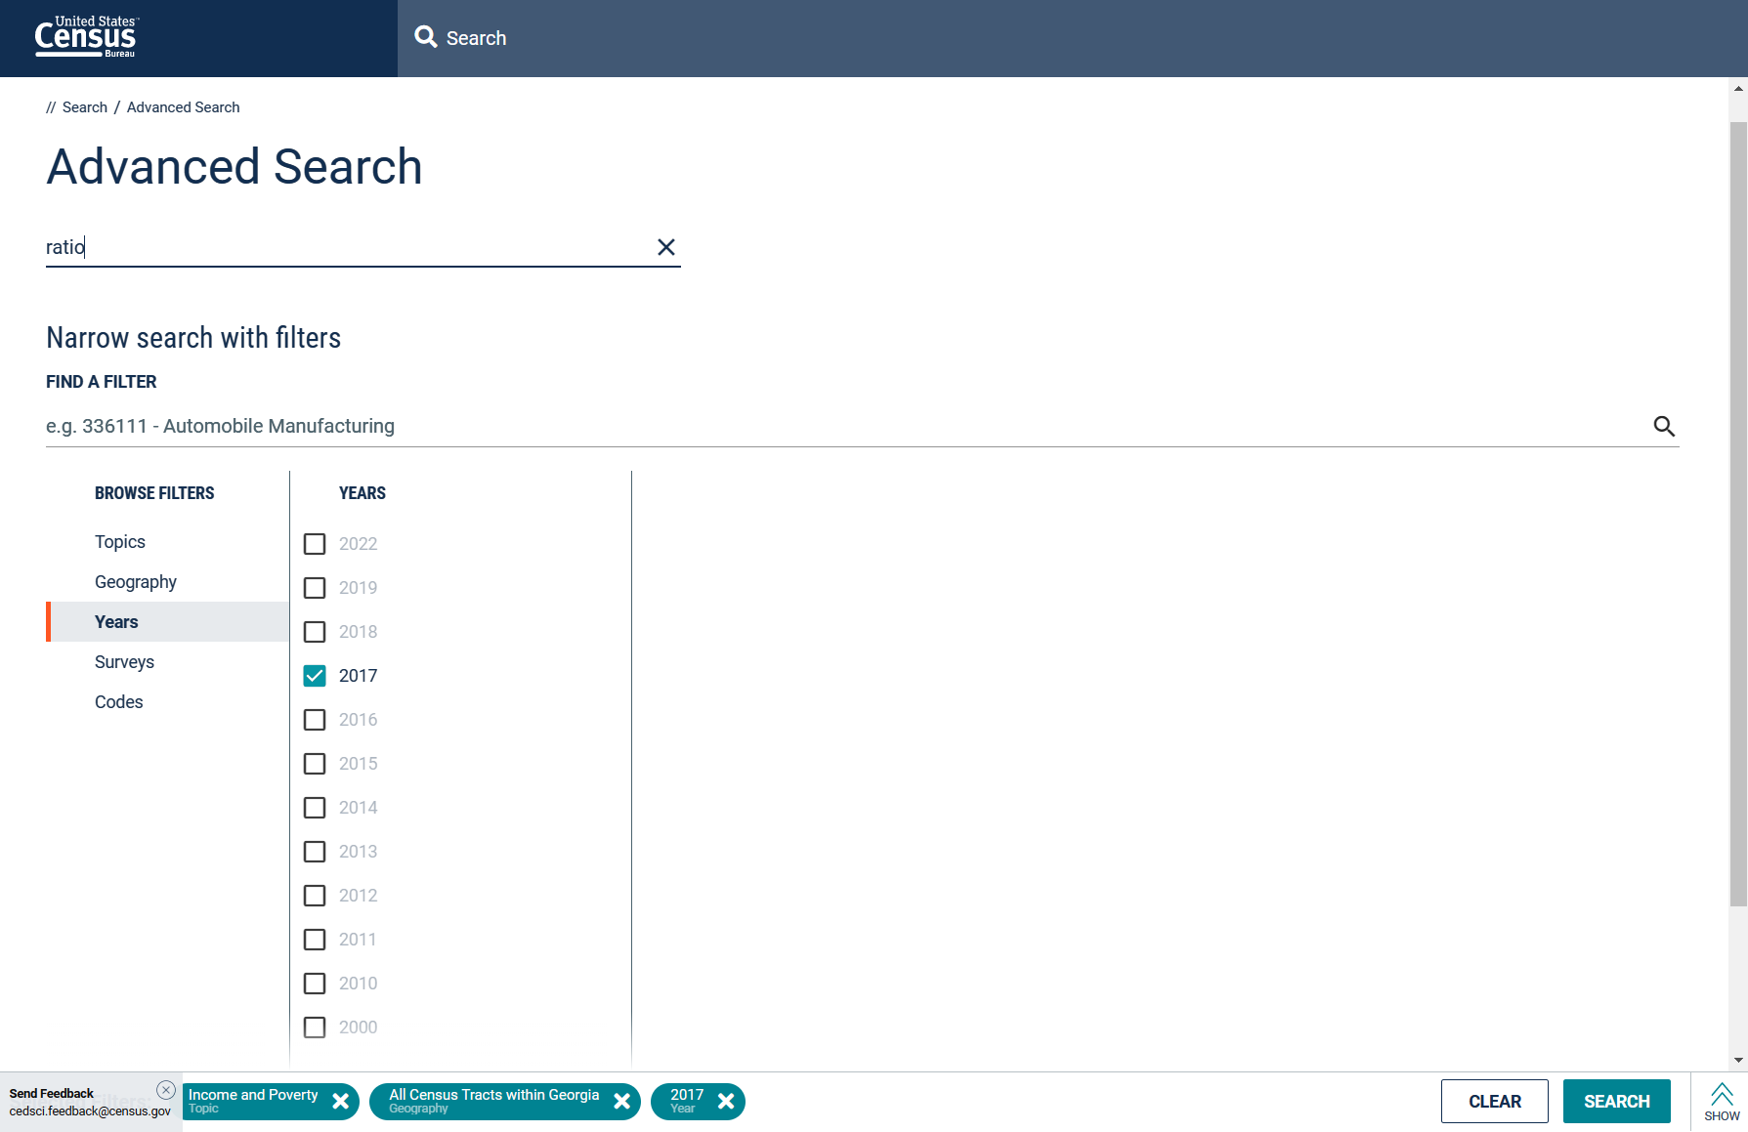
Download Census data
Adding a keyword
Finally, narrow down the search by adding a keyword ratio.
You can do that by typing the word ratio into this search bar.
With the keyword ratio typed in the search bar,
Click SEARCH button.
Credit: Bonwoo Koo

Slide 13
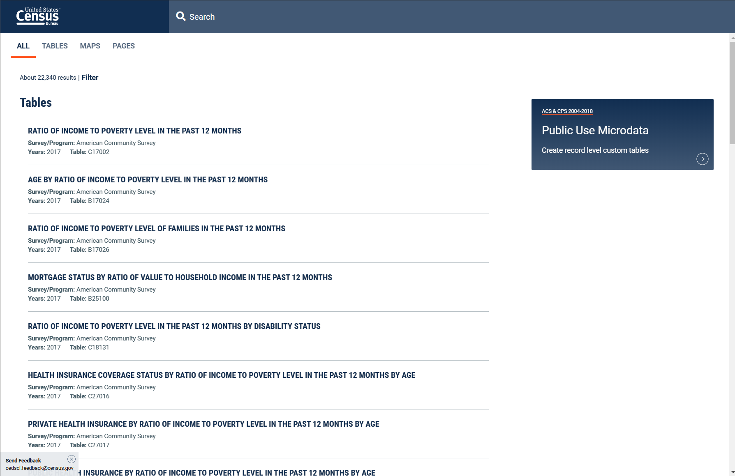
Download Census data
Selecting a table
This is the data table we are looking for. Click it.
Credit: Bonwoo Koo

Slide 14
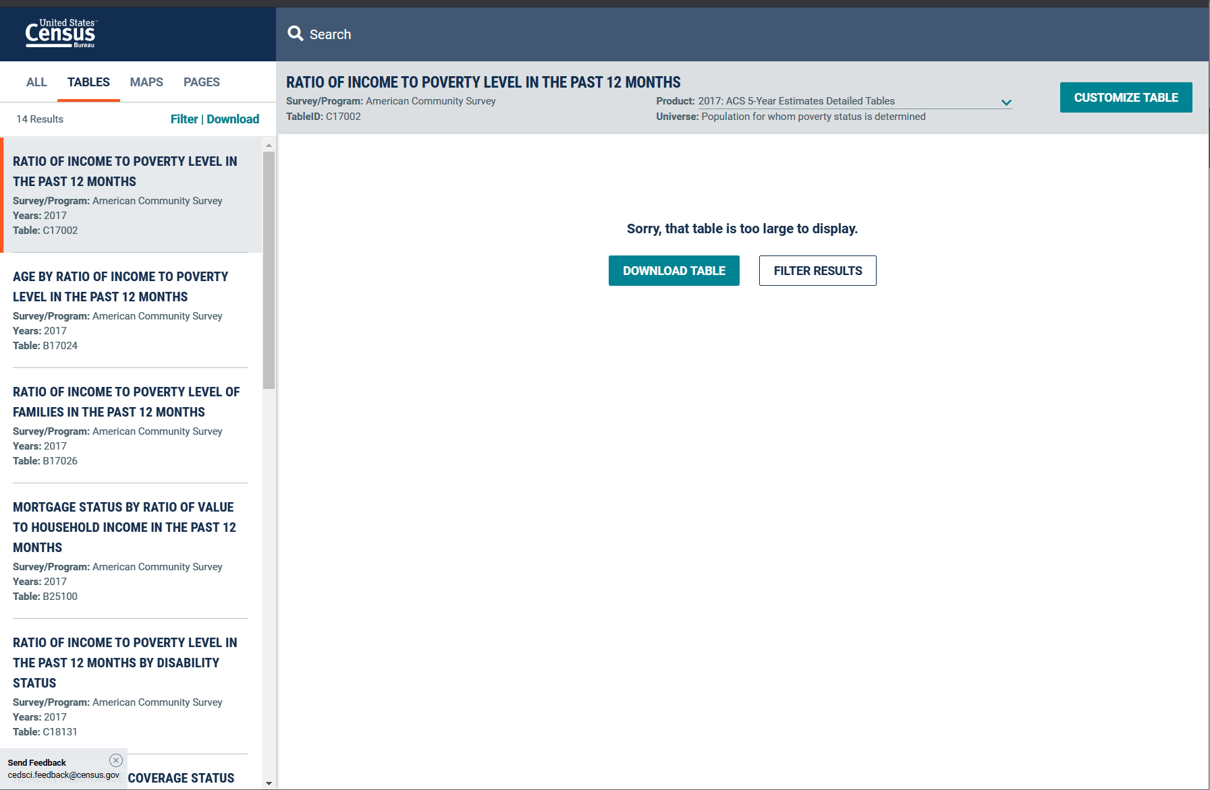
Download Census data
Verifying & downloading
Double-check that the following information are correctly listed in the top panel and click DOWNLOAD TABLE:
Name of the table
Table ID
Survey/Program
Product
Pay extra attention and make sure it is ACS 5-Year Estimates
Credit: Bonwoo Koo

Slide 15
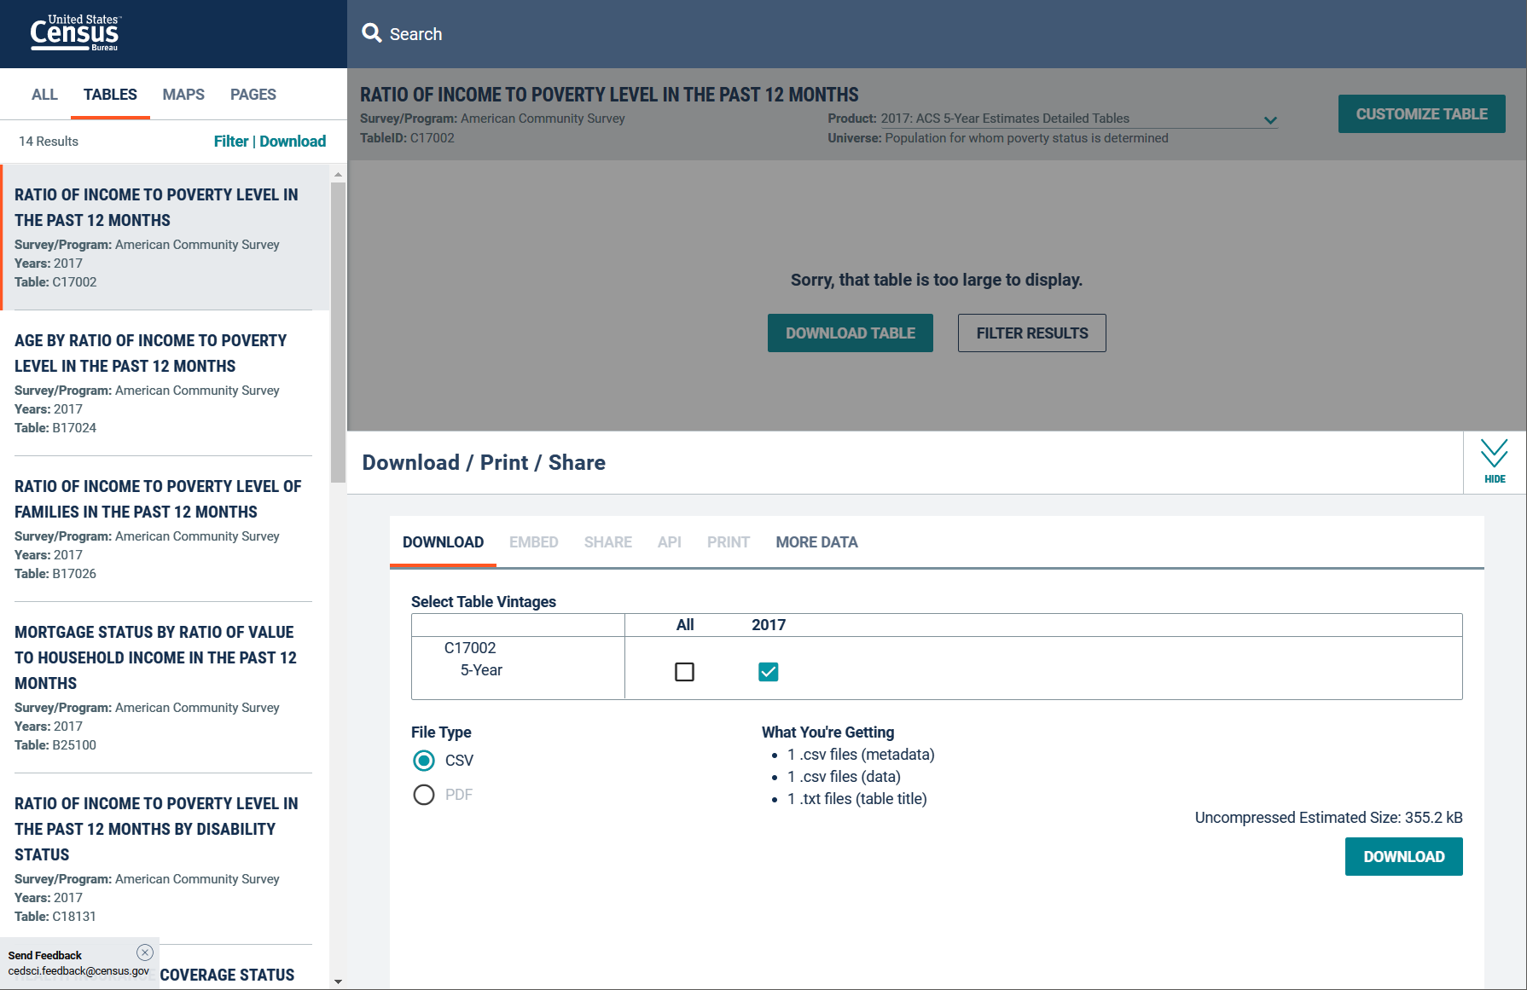
Download Census data
Verifying & downloading
Make sure that 2017 is selected and that File Type is CSV.
Finally, Click DOWNLOAD.
Credit: Bonwoo Koo

Slide 16
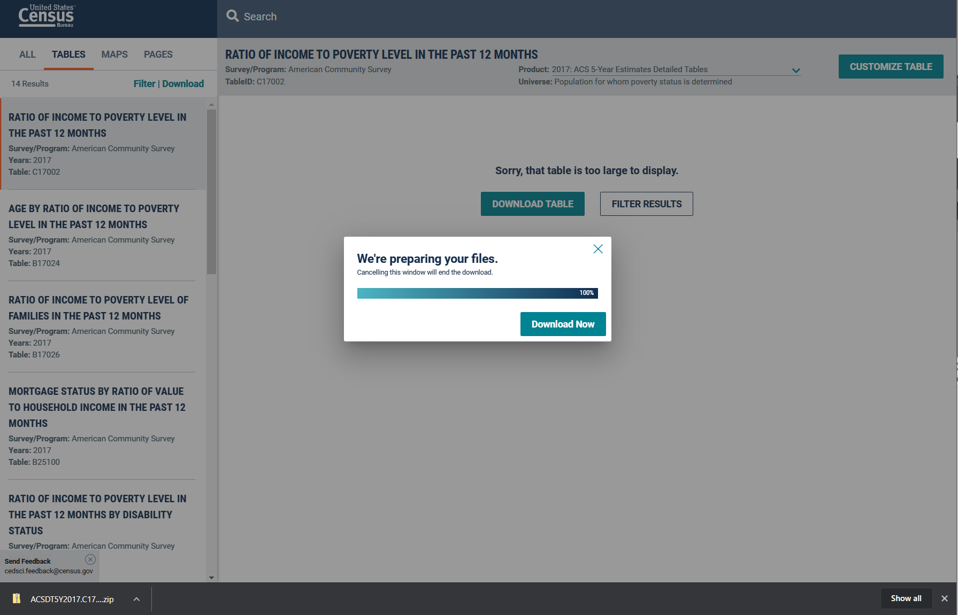
Download Census data
Verifying & downloading
Again… Click DOWNLOAD NOW.
Once it is downloaded, move the file to your desired folder and extract (unzip) it.
Remember where you unzipped the files – you will need to setwd() to this folder.
Credit: Bonwoo Koo

Slide 17
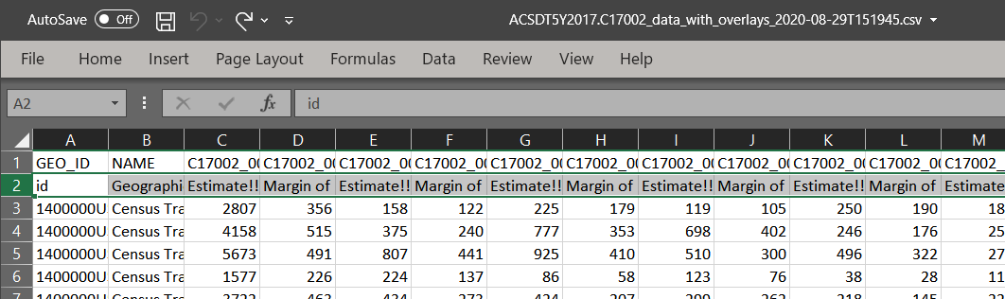
Download Census data
Deleting the second header
Open the file named ACSDT5Y2017.C17002_data_with_overlays_2020-08-29T151945.csv. The exact name may be slightly different due to the date component in the file name. There will be two different headers (i.e., variable names).
Delete the entire second row so that there will be only one row of header remaining. Then, save and close Excel.
First header
Second header
→ Delete this
entire row
Why are we deleting one of the headers?
The Census Bureau (and sometime other entities too) often provides their data with two rows of header.
The first type of the header is more code-like, not human-readable (e.g., `C17002_001E`), and the second type is often more intuitive to human (e.g., `Margin of Error!!Total!!Under .50`).
R users usually prefer the first type. It is because (1) the second type of header often contain spaces and special characters which can cause errors and other difficulties, (2) the second type can be very lengthy (and you will have to type them), and (3) when you join the data with ArcGIS, the long variable names are automatically coerced into shorter but somewhat confusing names.
Credit: Bonwoo Koo

Slide 18
Download via Census API in R
API (Application Programming Interface) is like a chat bot for the database: you tell the API what you want in a specific way, and the API will automatically return you the data.
No more click and find! But usually requires an API Key.
Package tidycensus helps you with Census API in R, e.g.,
We want a 2017 table called “Ratio of Income to Poverty Level in the Past 12 Months (TableID: C17002)” from ACS (American Community Survey, updated every year), for all census tracts (a geographic units) in the Georgia state.
Table <- get_acs(year = 2017, table = “C17002”, geography = “tract”, state = “GA”)
Tidycensus documentation: https://walker-data.com/tidycensus/articles/basic-usage.html
Credit: Xiaofan Liang
Notes:
Website for downloading Census data
We’ll look at some of the different data categories.

Slide 19
Working Directory
We will read in a data file into R for the lab activities to examine Ratio of Income to Poverty Level in the Past 12 Months for all census tracts in Georgia state.
This file is located in:
Canvas → CP6025 → Modules → Lab2 → ACSDT5Y2017.C17002-Data.csv
Keep the Lab2 folder open - we will need it soon.
Credit: Bonwoo Koo

Slide 20
Working Directory
When you open R-studio, your R session is in one of the folders in your computer (usually the Documents folder).
The following function returns the folder your R session is currently in.
getwd()
Is R in the folder where you saved the ACSDT5Y2017.C17002-Data.csv data file?
Type read.csv(‘ACSDT5Y2017.C17002-Data.csv”) in your R script window, what does the error say?
Credit: Bonwoo Koo

Slide 21
Working Directory
R cannot find ACSDT5Y2017.C17002-Data.csv file because R is in a different folder.
You need to tell R to navigate to the folder you save the CSV file using setwd()
Setting directory/path is like pointing directions for R: a path (e.g., C:/Users/xiaofanliang/Dropbox (GaTech)/) tells R to first go to C drive, go to Users folder, then xiaofanliang folder, then Dropbox (GaTech) folder.
21

Slide 22
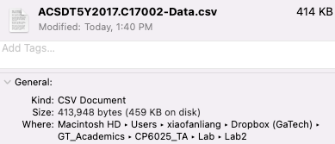
Working Directory
How do I find the path to a file?
Mac: Right click on the file -> get info (No need to include Macintosh HD in the path).
Window: Right click on the file -> Properties (or Copy as Path) or double click on folder directory. Change \ to / in the path.
/Users/xiaofanliang/Dropbox (GaTech)/GT_Academics/CP6025_TA/Lab/Lab2
22
Credit: Xiaofan Liang

Slide 23
Working Directory
The folder that your R session is currently in is called
Working Directory
getwd()
setwd()
“show me the current
working directory”
“Change the working directory
to a different folder”
Credit: Bonwoo Koo

Slide 24
Working Environment
R searches for files and saves outputs in the working directory.
Let’s change your working directory to a folder where you saved the data for today’s lab.
Write the following in your script window and run (hit control + enter):
setwd(“path-to-your-folder”)
e.g., setwd(“C:/Users/bkoo34/Dropbox (GaTech)/CP6025”)
To verify that you are in the folder where our data is located:
dir()
Do you see the CSV you saved (i.e., ACSDT5Y2017.C17002-Data.csv )?
Credit: Bonwoo Koo

Slide 25
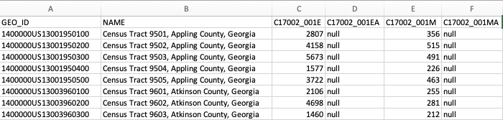
Reading data in R
We are now in the right folder. R can now read the data.
Before using R, let’s first take a look at the data in Excel. Double click “ACSDT5Y2017.C17002-Data.csv” to open it in Excel.
Each row is one Census tract (similar to a neighborhood)
Each column is one variable. C17002 is the table. 001 is variable #1 (total population) in the table. E represents estimate, EA is estimate annotation, M is margin of error, and MA is margin of error annotation.
For example, this cell shows that “the first neighborhood has a total population estimate of 2807”
Credit: Xiaofan Liang

Slide 26
Reading data in R
In R script window, write the following and run it (control + enter)
pov.data <- read.csv(“ACSDT5Y2017.C17002-Data.csv”)
and then,
Notice that this is a relative path, relative to the path that you set in the setwd(). Alternatively, without using the setwd(), you can do
read.csv(“Users/xiaofanliang/Dropbox (GaTech)/GT_Academics/Lab/Lab2/ACSDT5Y2017.C17002-Data.csv”)
head(pov.data)
head() shows the first six rows of the data.
Useful when you want to take a quick glance of your data
Credit: Xiaofan Liang

Slide 27
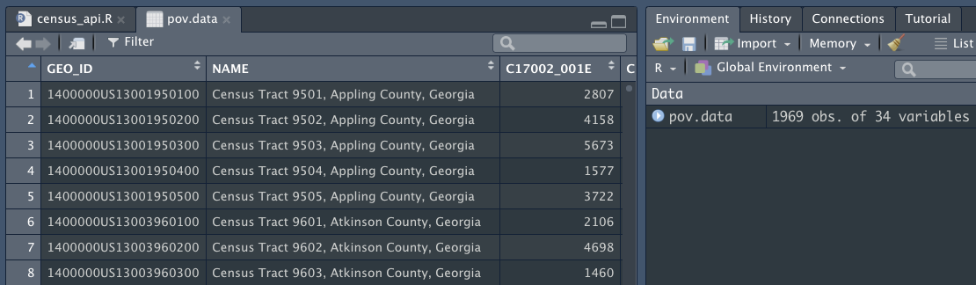
Examining data in R
After read.csv, pov.data shows up in R environment. Click on pov.data, an Excel-like table pops up
pov.data has 1969 observation and 34 variables
Credit: Xiaofan Liang

Slide 28
Calculating the descriptive statistics
Today, we are interested in the mean value of total population, which is the variable named ‘C17002_001E’ in pov.data.
We need to extract only the needed variable from the data.frame
Credit: Bonwoo Koo

Slide 29
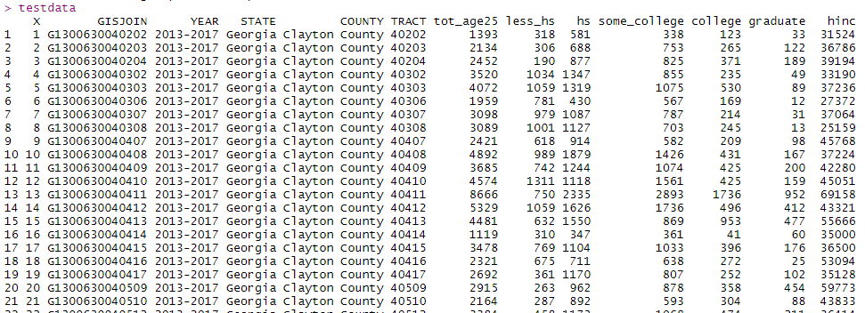
$ operator
pov.data
GEO_ID
NAME
C17002_001E (total population estimate)
YEAR
STATE
+
+
+
+
+
+
…
Credit: Xiaofan Liang; Bonwoo Koo

Slide 30
$ operator
pov.data
pov.data
pov.data$C17002_001E is a R-way of saying: “give me the variable named C17002_001E from the data.frame called pov.data”
NAME
$C17002_001E
GEO_ID
C17002_001E (total population estimate)
YEAR
STATE
+
+
+
+
+
+
…
Name of data.frame
$
Name of variable
Credit: Xiaofan Liang

Slide 31
Descriptive Stats in R
mean(pov.data$C17002_001E)
median(pov.data$C17002_001E)
min(pov.data$C17002_001E)
max(pov.data$C17002_001E)
What is the data type of pov.data$C17002_001E?
Will the function still work if the column has NAs?
Tips: mean(pov.data$C17002_001E, na.rm=T)
Credit: Xiaofan Liang

Slide 32
Data Cleaning with Base R
In a real project or a study, data NEVER come in a neatly cleaned form.
More than 50~60% of my time as a researcher is put into cleaning data.
All the statistical knowledge does not mean much if you don’t know how to clean your data.
Credit: Bonwoo Koo
Notes:
As a researcher/data analyst, 50 to 60% of your time will be spent on data cleaning. All the statistical knowledge does not mean much if you don’t know how to clean your data.

Slide 33
Common Operations in Data Cleaning
Subsetting row/column
Index by position
Index by condition
Index by name
2. Changing variable names
3. Create new variables based on existing ones (see lab)
Credit: Bonwoo Koo
Notes:
We will learn how to change variable names, how to create new variables based on existing ones. We will also learn how to subset row/column of objects (vector, data.frame or matrix) based on index by position, index by condition and index by name

Slide 34
Common Operations
Square brackets [ ] after a vector or data.frame mean you want to subset it or access some parts of it.
If it is a vector (i.e., 1-dimensional), you need one index
vector[index]
Credit: Bonwoo Koo
Notes:
Square brackets [ ] after a vector or data.frame or matrix mean you want to subset\slice\index it or access some parts of it.
If it is a vector (i.e., 1 -dimensional), you need one index

Slide 35
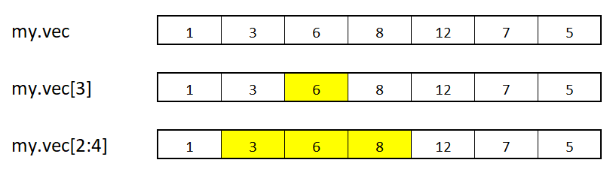
Subsetting
my.vector <- c(1,3,6,8,12,7,5)
my.vector
my.vector[3]
my.vector[2:4]
Credit: Bonwoo Koo
Notes:
So if we create a vector with the c function and called it my.vector we can subset/index/slice it into multiple groups. For instance, if we want the 3rd index. We will write my.vector[3]. If we want index 2 to 4 we will use the colon operator. My.vector[2:4].
You should notice by now that in R the first element is at index 1 while in other languages like python, c, and jave the first element is at index 0.

Slide 36
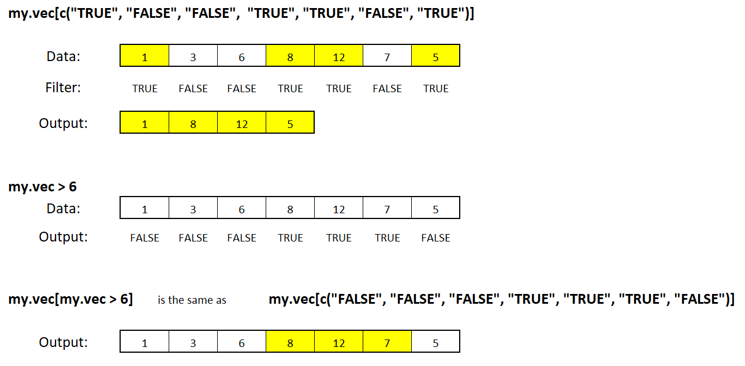
Subsetting
my.vector[c(TRUE, FALSE, FALSE, TRUE, TRUE, FALSE, TRUE)]
my.vector
index
Only those elements in my.vector that are at the same position as TRUE in the index can go through.
Credit: Bonwoo Koo
Notes:
We can also use the Boolean/logical operator to subset a vector. For my.vector[c(T,F,F,T,T,F,T)]
With this script only elements in my.vector that are at the same position as TRUE in the index will be generated as the output when this code is executed.

Slide 37
Subsetting
A vector of TRUEs and FALSEs are very useful because ..
>, < , <=, =>, ==, and %in% are questions.
R answers with TRUEs and FALSEs
E.g., my.vector > 6 is the same as asking,
“are elements in my.vector larger than 6?”
Credit: Bonwoo Koo
my.vec =
my.vec > 6 =
a
Credit: Bonwoo Koo
Notes:
Logical operators such as these are very useful in R. When R execute these scripts with logical operators it returns Trues and False
E.g., my.vector > 6 is the same as asking “are elements in my.vector larger than 6?
So when we run this script we are going to get False, False, False, True, True, True, False

Slide 38
Subsetting
A vector of TRUEs and FALSEs are very useful because ..
>, < , <=, =>, ==, and %in% are questions.
R answers with TRUEs and FALSEs
E.g., my.vector > 6 is the same as asking,
“are elements in my.vector larger than 6?”
my.vector =
a
my.vector > 6 =
Credit: Bonwoo Koo
Notes:
Logical operators such as these are very useful in R. When R execute these scripts with logical operators it returns Trues and False
E.g., my.vector > 6 is the same as asking “are elements in my.vector larger than 6?
So when we run this script we are going to get False, False, False, True, True, True, False

Slide 39
Subsetting
Only those elements in my.vector that are at the same position as TRUE can go through.
my.vector[ my.vector > 6 ]
my.vector
my.vector > 6
output
Credit: Bonwoo Koo
Notes:
If we want the elements that satisfy this argument we would have to put the previous script in square bracket.
my.vector[my.vector > 6]
So the output will be all the elements in my.vector greater than 6.

Slide 40
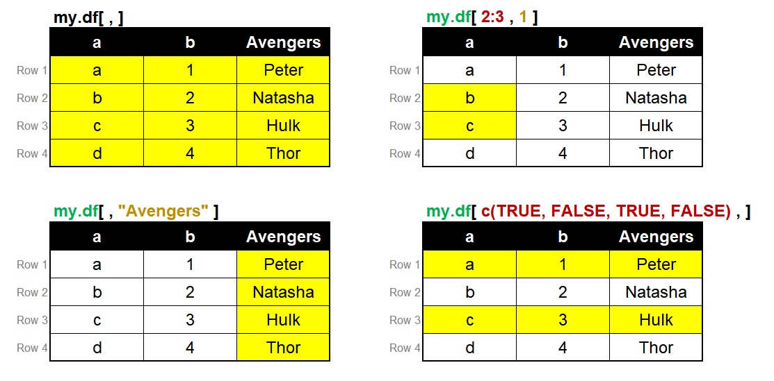
Subsetting
If it is a data.frame, you need two indices.
data.frame[index for rows, index for columns]
Credit: Bonwoo Koo
Notes:
If it is a data.frame, you need two indices.
Data.frame[index for rows, index for columns]
My.df[ , ] This will return all the records for my.df
My.df[2:3,1] This will return row 2 and row 3 in column 1
My.df[ , “Avengers”] This will return all the records under avengers.
my.df[c(TRUE,FALSE,TRUE,FALSE),] This will return the entire of Row 1 and Row 3. Notices that in this script we did not specify any column.

Slide 41
Subsetting + Filtering
Subset dataframe so that it only returns rows when column b <= 2.
data.frame[index for rows, index for columns]
mydf[mydf$b <= 2, ]
mydf$b <= 2
Returns a vector of c(TRUE, FALSE …)
mydf[mydf$b <= 2, ]
Returns rows where row indices are TRUE
Credit: Xiaofan Liang
Notes:
Colnames() function allows you to access column names of a matrix or a data.frame.
Colnames(my.df) : This will give you all the column names of my.df data frame.
Colnames(my.df)[2]: This will return the name of the second column in my.df data frame.
Colnames(my.df)[2] <- “Defenders This will rename the second column name in my.df data frame as Defenders.

Slide 42
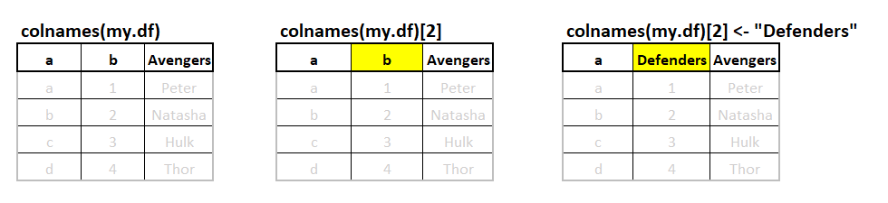
Change column names
colnames() allows you to access column names of a matrix or a data.frame
Inserting a new name, “Defenders”, to the 2nd position of
my.df’s variable names
Credit: Bonwoo Koo
Notes:
Colnames() function allows you to access column names of a matrix or a data.frame.
Colnames(my.df) : This will give you all the column names of my.df data frame.
Colnames(my.df)[2]: This will return the name of the second column in my.df data frame.
Colnames(my.df)[2] <- “Defenders This will rename the second column name in my.df data frame as Defenders.

Slide 43
Data cleaning with Tidyverse
tidyverse is a series of packages that agree to use %>% (pipe syntax) to do data wrangling and cleaning.
install.packages(“tidyverse”) and Library(“tidyverse”) will install and load all affiliated packages
tidyverse packages have other names for base R functions that are more intuitive (e.g., filter).
What is %>% (pipe syntax)?
filter(mydf, b<=2) is equivalent of mydf %>% filter(b<=2)
%>% assumes the first input in the function is in front of the %>%
Credit: Xiaofan Liang

Slide 44
Data cleaning with Tidyverse
Why do people use Tidyverse or %>% (pipe syntax)?
 | Base R | Tidyverse
Subset 1st and 3rd row rows | mydf[c(1,3), ] | mydf %>% slice(1,3)
Rename columns | colnames(mydf)[2] <- “Defenders” | mydf %>% rename(Defenders = b)
Subset and filter by condition | mydf[mydf$b <= 2, ] | mydf %>% filter(Defenders <= 2)
All at once | mydf <- mydf[c(1,3), ] mydf <- mydf[mydf$b <= 2, ] colnames(mydf)[2] <- “Defenders” | mydf <- mydf %>% slice(1,3) %>% rename(Defenders = b) %>% filter(Defenders <= 2)
Tips: you don’t have to remember all the syntax at once!! Go to R cheatsheet: https://www.rstudio.com/resources/cheatsheets/ (e.g., Base R, Advanced R, Data Transformation with dplyr and tidyr (both are included in Tidyverse))
Credit: Xiaofan Liang

Slide 45
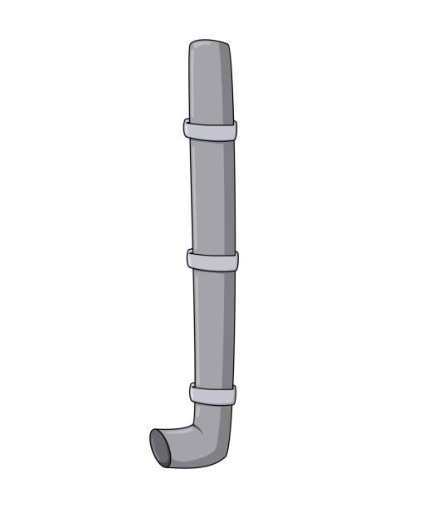
Data cleaning with Tidyverse
mydf
mydf <- mydf %>%
slice(1,3) %>%
rename(Defenders = b) %>%
filter(Defenders <= 2)
slice(1,3)
rename(Defenders = b)
filter(Defenders <= 2)
tidy mydf
Credit: Xiaofan Liang

Slide 46
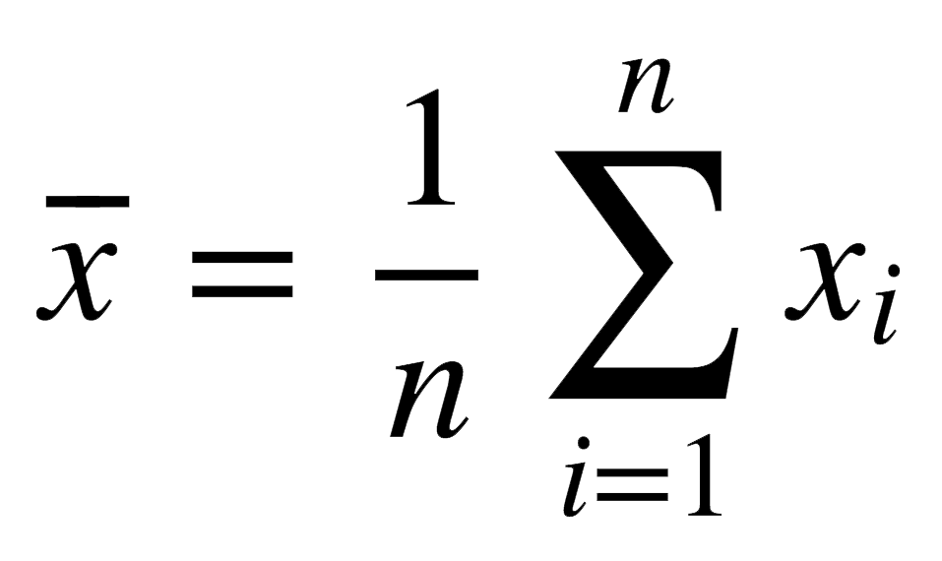
Calculating the mean
Credit: Bonwoo Koo

Slide 47
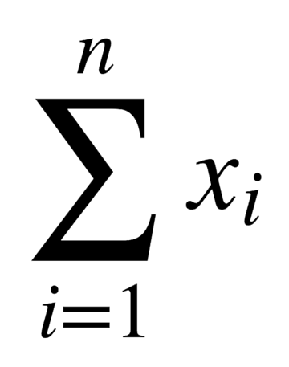
Calculating the mean
Credit: Bonwoo Koo

Slide 48

Calculating the mean
x
Multiply this with $\frac{1}{n}$
Sum up all elements in X
Credit: Bonwoo Koo

Slide 49
Calculating the mean
x
Multiply this with $\frac{1}{n}$
Sum up all elements in X
sum(x)
Credit: Bonwoo Koo

Slide 50
Calculating the mean
x
Multiply this with $\frac{1}{n}$
Sum up all elements in X
1 / length(x)
*
sum(x)
Credit: Bonwoo Koo

Slide 51
Calculating the mean
x
Multiply this with $\frac{1}{n}$
Sum up all elements in X
1 / length(x)
*
sum(x)
e.g., if x = c(3,2,5,6),
length(x) will give you 4
Credit: Bonwoo Koo

Slide 52
Calculating the mean
If you want to calculate the mean for testdata$hinc,
Replace ‘x’ with testdata$hinc
1 / length(x)
*
sum(x)
1 / length(testdata$hinc)*sum(testdata$hinc)
Credit: Bonwoo Koo

Slide 53
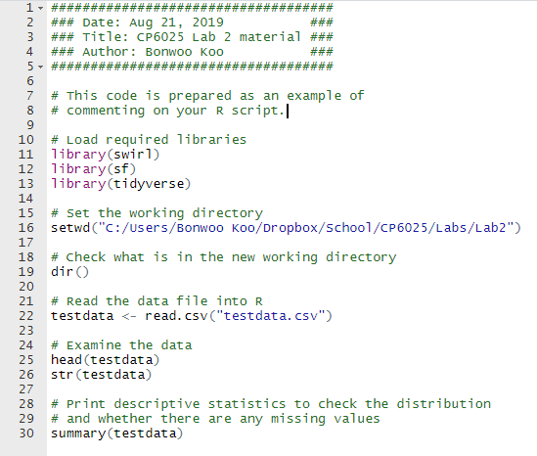
Commenting on script
# is used for documentation.
# makes anything written after it invisible to R.
R will not run anything that is written after #.

Slide 54
Submit assignment R code
When you save your script, it will create a file with .R extension.
In the assignments, you will be asked to submit your code. Submit this .R file.
In the assignments, you will also be asked to submit plots (export or screenshot) in the future. Don’t submit .R file instead.
Credit: Bonwoo Koo

Slide 55
Start working!
Download Modules/Week 2/Lab2.zip →
unzip Lab2.zip → open lab2.html
Start reading through the document and
try to replicate each step in your R-Studio
You don’t need to submit your replication. The lab familiarizes you with basic functions for assignment 1.
Let me know if you have questions

