Slide 1
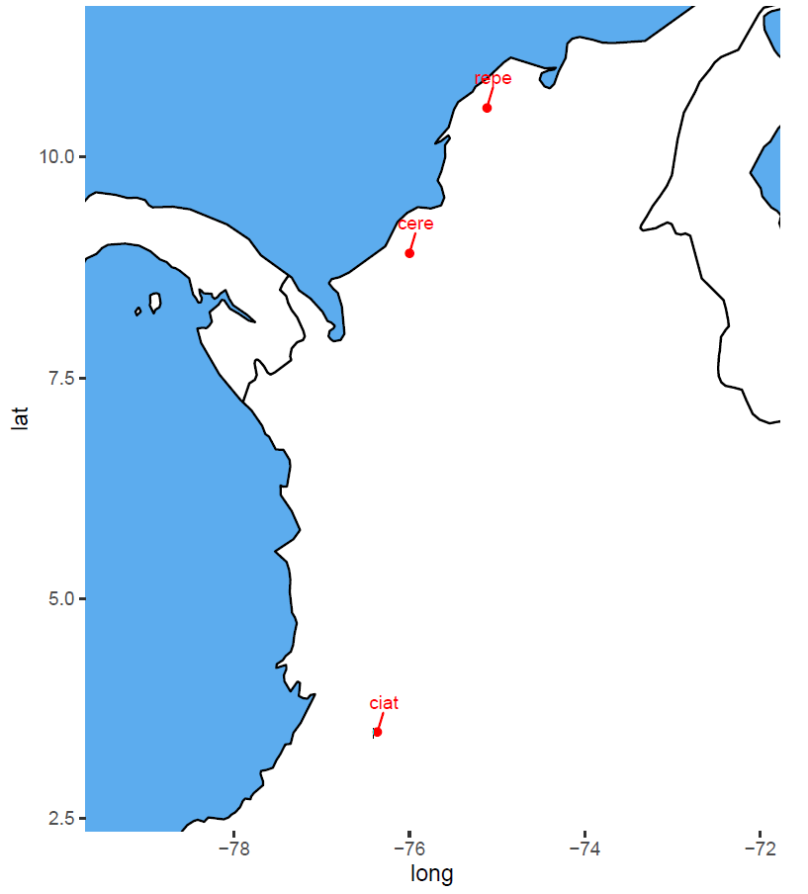
Location

Slide 2
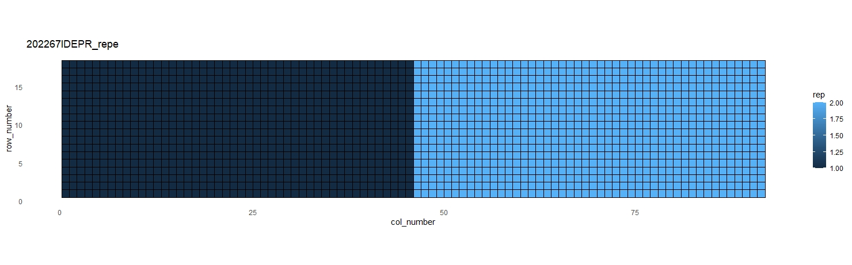
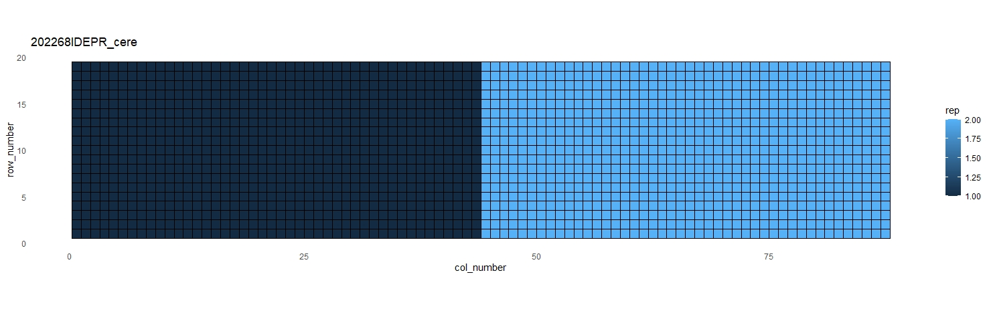

Trial Design
trial_name | rep_number | n
202266IDEPR_ciat | 1 | 960
202267IDEPR_repe | 1 | 828
202267IDEPR_repe | 2 | 828
202268IDEPR_cere | 1 | 836
202268IDEPR_cere | 2 | 836

Slide 3
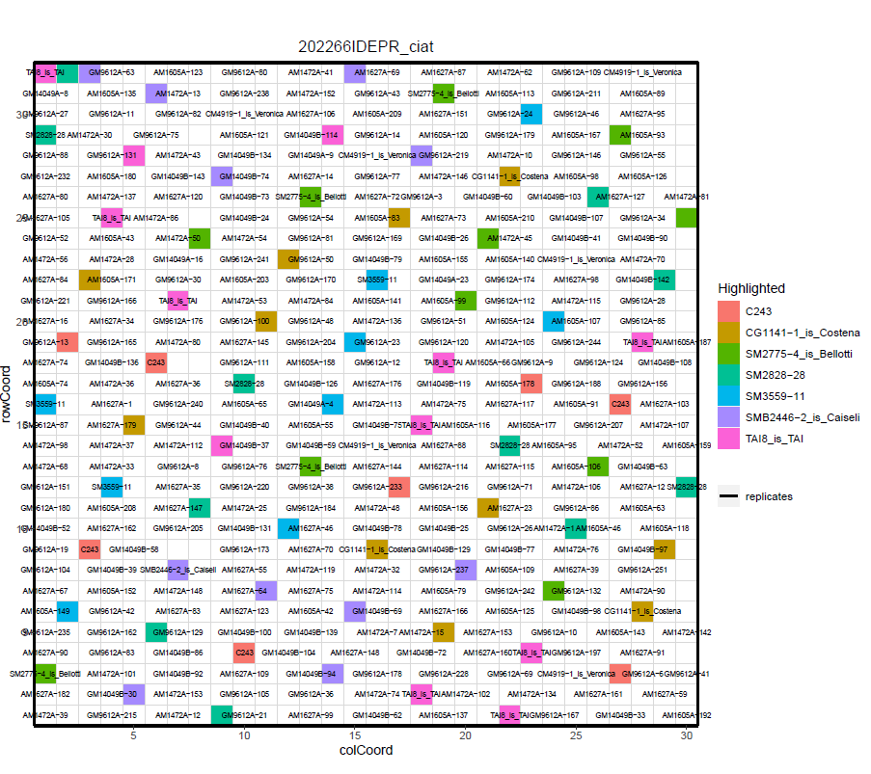
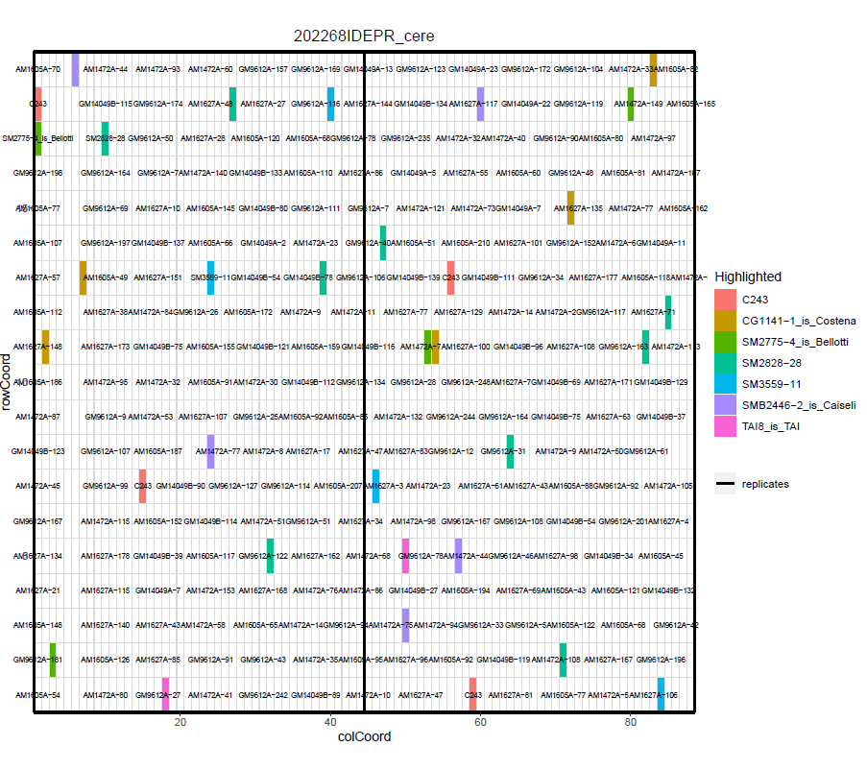
Trial Design

Slide 4
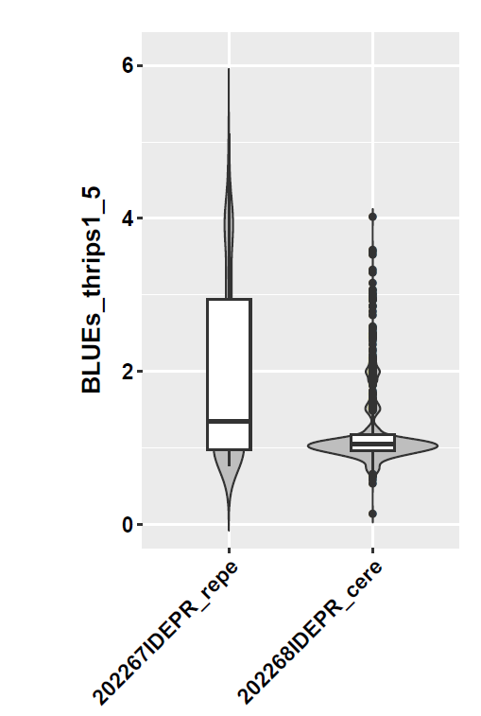
Hertability
trait | trial | heritability | CV | VarGen | VarErr | design
vigor1_5 | 202267IDEPR_repe | 0.66 | 13.02 | 0.18 | 0.17 | res_row_col
vigor1_5 | 202268IDEPR_cere | 0.67 | 17.61 | 0.49 | 0.44 | res_row_col
vigor1_5 | 202266IDEPR_ciat | 0.40 | 21.04 | 0.33 | 0.47 | row_col
thrips1_5 | 202267IDEPR_repe | 0.90 | 26.17 | 1.28 | 0.26 | res_row_col
thrips1_5 | 202268IDEPR_cere | 0.42 | 41.09 | 0.09 | 0.26 | res_row_col
germination_perc | 202267IDEPR_repe | 0.79 | 19.39 | 493.69 | 257.95 | res_row_col
germination_perc | 202268IDEPR_cere | 0.78 | 11.90 | 218.72 | 120.52 | res_row_col
germination_perc | 202266IDEPR_ciat | 0.84 | 4.48 | 124.84 | 22.27 | row_col

Slide 5
Correlation between Locations
$germination_perc$VCOV
 | 202267IDEPR_repe | 202268IDEPR_cere | 202266IDEPR_ciat
202267IDEPR_repe | 500.95 | 298.38 | 71.00
202268IDEPR_cere | 298.38 | 225.74 | 66.62
202266IDEPR_ciat | 71.00 | 66.62 | 132.03
$germination_perc$CORR
 | 202267IDEPR_repe | 202268IDEPR_cere | 202266IDEPR_ciat
202267IDEPR_repe | 1.00 | 0.89 | 0.28
202268IDEPR_cere | 0.89 | 1.00 | 0.39
202266IDEPR_ciat | 0.28 | 0.39 | 1.00
$thrips1_5
$thrips1_5$VCOV
 | 202267IDEPR_repe | 202268IDEPR_cere
202267IDEPR_repe | 1.29 | 0.32
202268IDEPR_cere | 0.32 | 0.10
$thrips1_5$CORR
 | 202267IDEPR_repe | 202268IDEPR_cere
202267IDEPR_repe | 1.00 | 0.90
202268IDEPR_cere | 0.90 | 1.00
$vigor1_5$VCOV
 | 202267IDEPR_repe | 202268IDEPR_cere | 202266IDEPR_ciat
202267IDEPR_repe | 0.19 | 0.25 | 0.17
202268IDEPR_cere | 0.25 | 0.50 | 0.28
202266IDEPR_ciat | 0.17 | 0.28 | 0.43
$vigor1_5$CORR
 | 202267IDEPR_repe | 202268IDEPR_cere | 202266IDEPR_ciat
202267IDEPR_repe | 1.00 | 0.80 | 0.60
202268IDEPR_cere | 0.80 | 1.00 | 0.62
202266IDEPR_ciat | 0.60 | 0.62 | 1.00
trait | h2
vigor1_5 | 0.72
thrips1_5 | 0.78
germination_perc | 0.82

