Slide 1


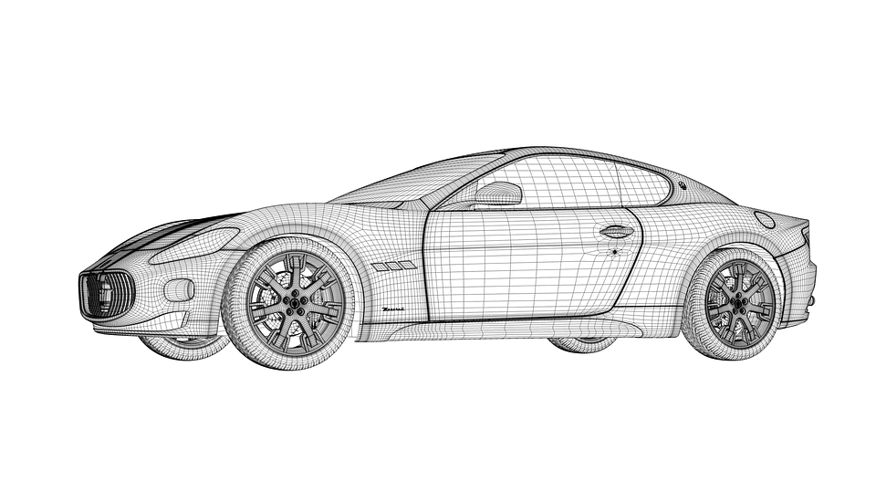
ANNOTATION
HEADS-UP

