Slide 1
GitHub 简介
Author: Xiao Fu Wu
Date: 09-Feb,2015

Slide 2
Agenda
GitHub
如何使用
Samples

Slide 3
Background,Infrasture
１．Background
During development Zurich project, Zurich Insurance project
FFPortal: Fast Flow Portal
Use Git to as SCM tools. This tool is similar with SVN, but it seems more stronger.
２. Infrastructure
GitHub
http://github.com
My GitHub account:
Xiaofuw / Test1234!
Zurich own self GitHub
normally we use GitHub.com
ShareRepository
Git Gui
Git Bash
TortoiseGit
Local Repository Manage Tools

Slide 4
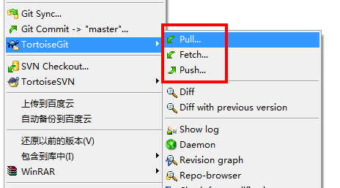
Compare Git,SVN
The most different between Git and SVN is Git in local has a set of repository.
like submit/show logs/revert etc operations
2. If need to share your local repository with others, need to use GitHub.com.or create a yourself GitHub
Need to use below command to sync local repo and GitHub server repository.
Like Push,Fetch,Pull

Slide 5
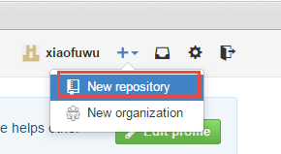
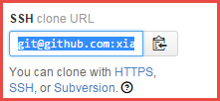
Create a GitHub Account
Open https://github.com/
Register a new yourself account (mine: xiaofuwu/Test1234!)
Login your account.
Create a new repository (public repo, need fee if you want to create private repository)
After create the repository. Can access it by below 3 kinds of way
HTTPS
SSH
Subversion
git@github.com:xiaofuwu/HelloWorld.git

Slide 6
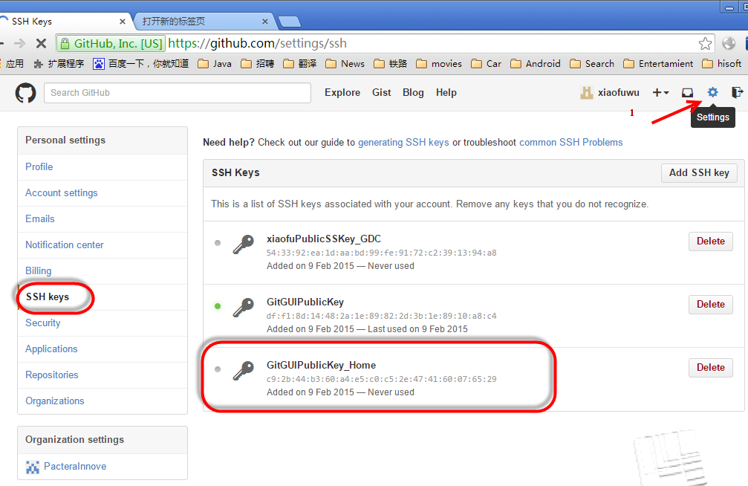
My GitHub
1. first .open http://github.com
2. create a account, like me
Username:xiaofuwu
Password: Test1234!
Email: xiaofu.wu@pactera.com
3. Create a repository, like “helloworld”
Add SSH public key
Git client comminute with GitHub by SSH method,
Store the public key in GitHub, you own private key

Slide 7
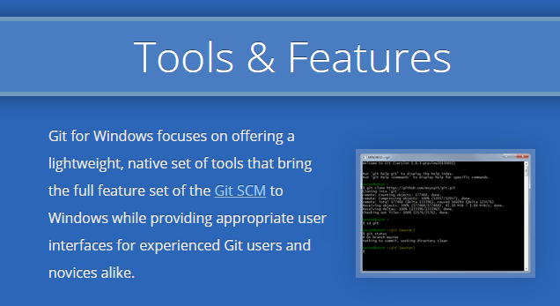
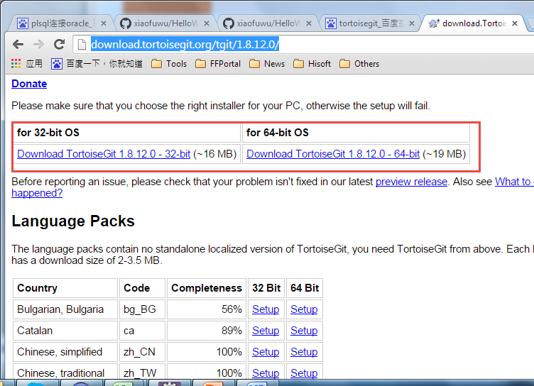
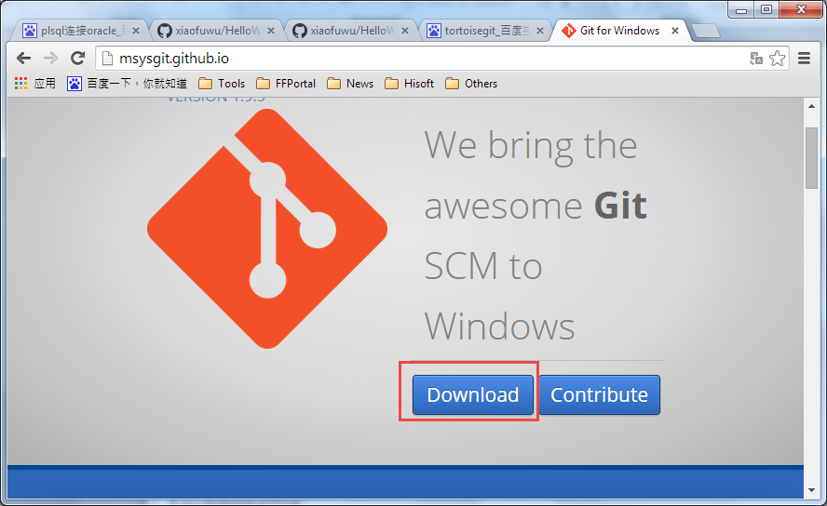
Software installation
Tool | Version | Download Site
TortoiseGit | 1.8.11.0 or above | http://download.tortoisegit.org/tgit/1.8.12.0/
Git for Window | 1.9.4 or above | http://msysgit.github.io/
TortoiseGit: A tool like TortoiseSVN

Slide 8
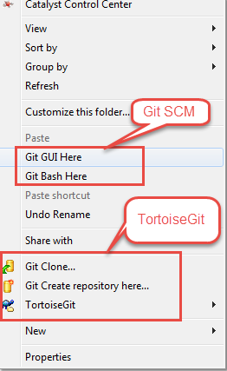
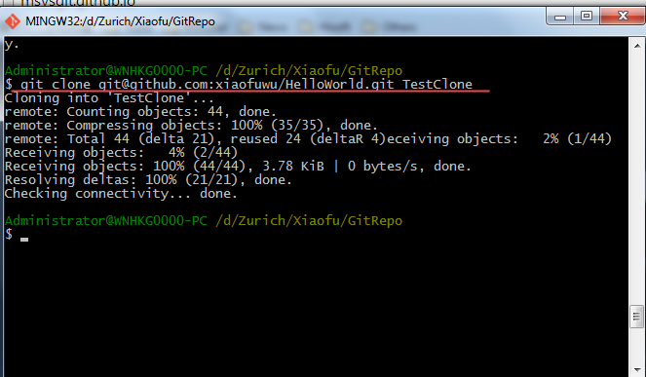
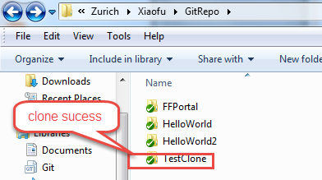
Git GUI and Git Bash
After install Git for window, will see below 2 items in context menu
Git BASH
Git for Windows provides a BASH emulation used to run Git from the command line. *NIX users should feel right at home, as the BASH emulation behaves just like the "git" command in LINUX and UNIX environments.

Slide 9
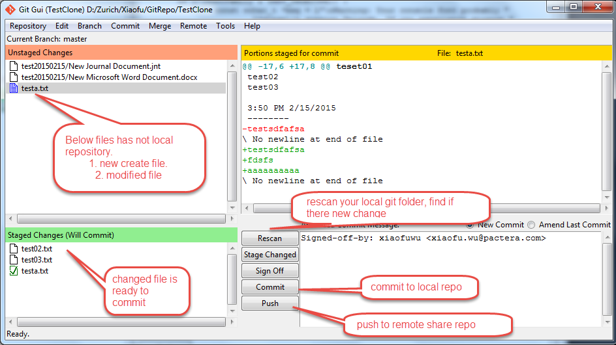
Git GUI and Git Bash
Git GUI
As Windows users commonly expect graphical user interfaces, Git for Windows also provides the Git GUI, a powerful alternative to Git BASH, offering a graphical version of just about every Git command line function, as well as comprehensive visual diff tools.

Slide 10
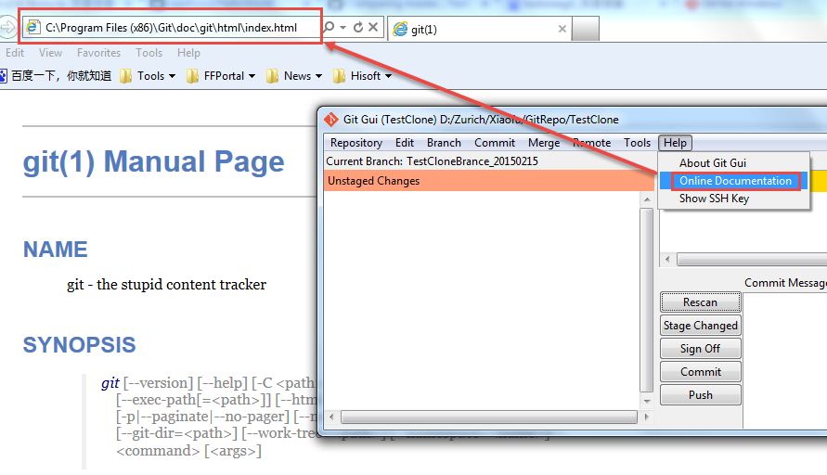
Git GUI and Git Bash
Git online document
From the help document, we can get most of command of Git and know how to use it.
git [--version] [--help] [-C <path>] [-c <name>=<value>] [--exec-path[=<path>]] [--html-path]
[--man-path] [--info-path] [-p|--paginate|--no-pager] [--no-replace-objects] [--bare]
[--git-dir=<path>] [--work-tree=<path>] [--namespace=<name>] <command> [<args>]

Slide 11
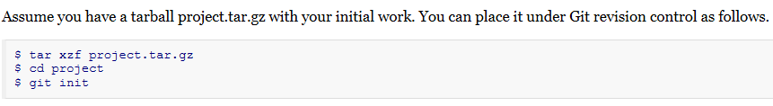
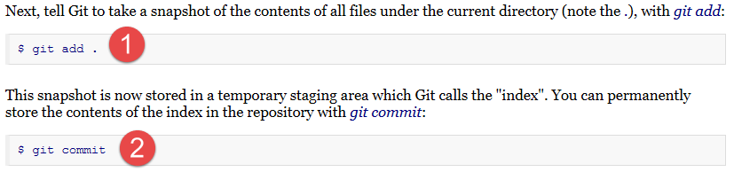
Git tutorial
DESCRIPTION
It is a good idea to introduce yourself to Git with your name and public email address before doing any operation. The easiest way to do so is:
$ git config --global user.name "Your Name Comes Here"
$ git config --global user.email you@yourdomain.example.com
Importing a new project

Slide 12
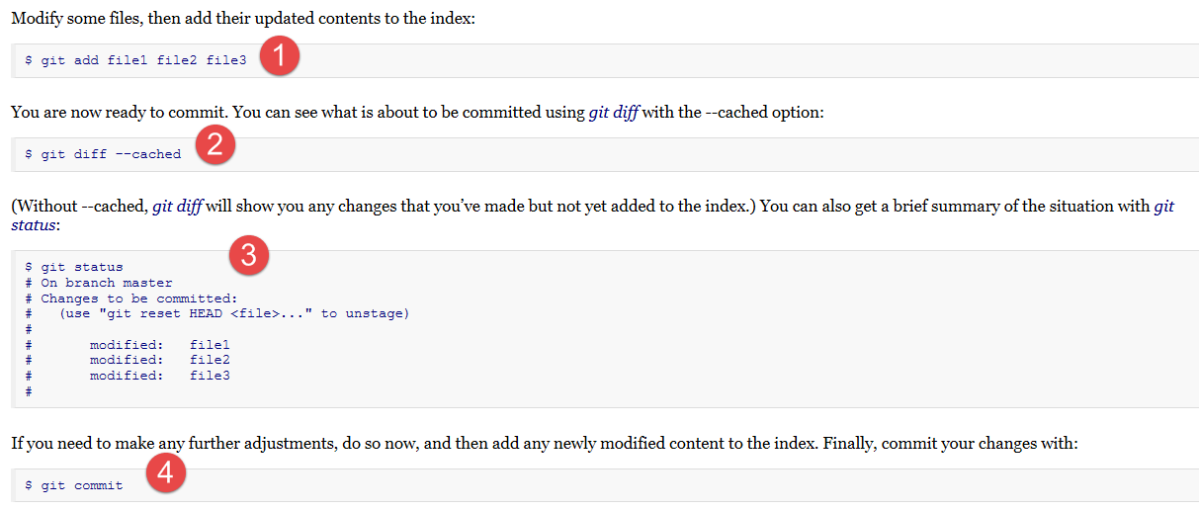
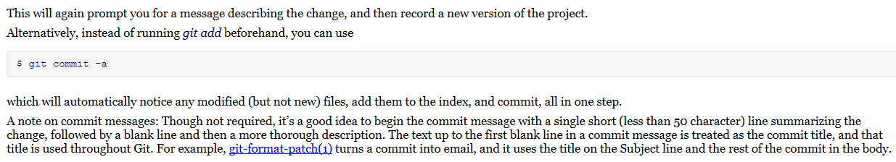
Git tutorial
Making changes

Slide 13
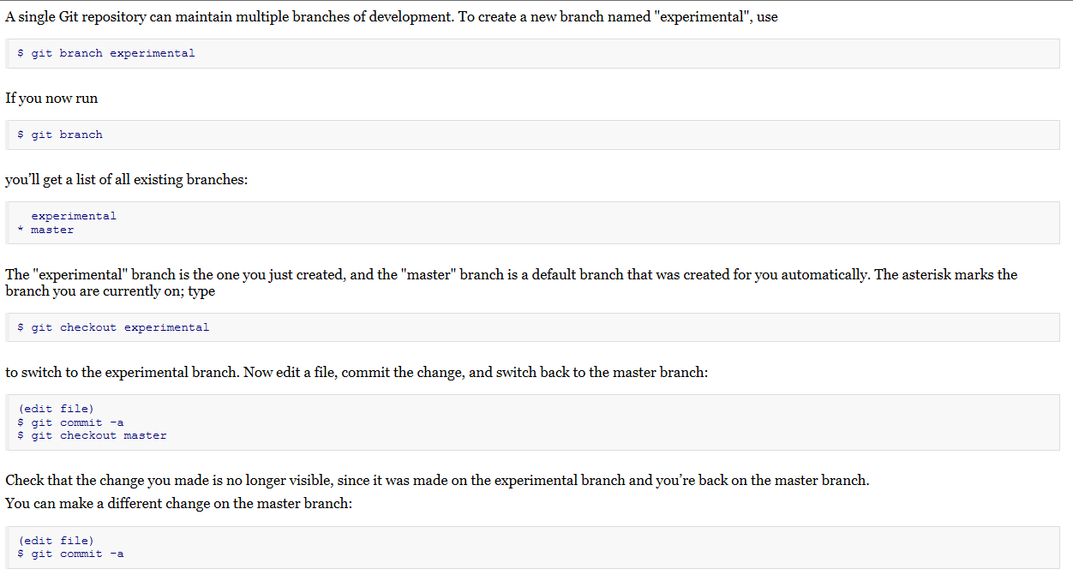
Git tutorial
Managing branches

Slide 14
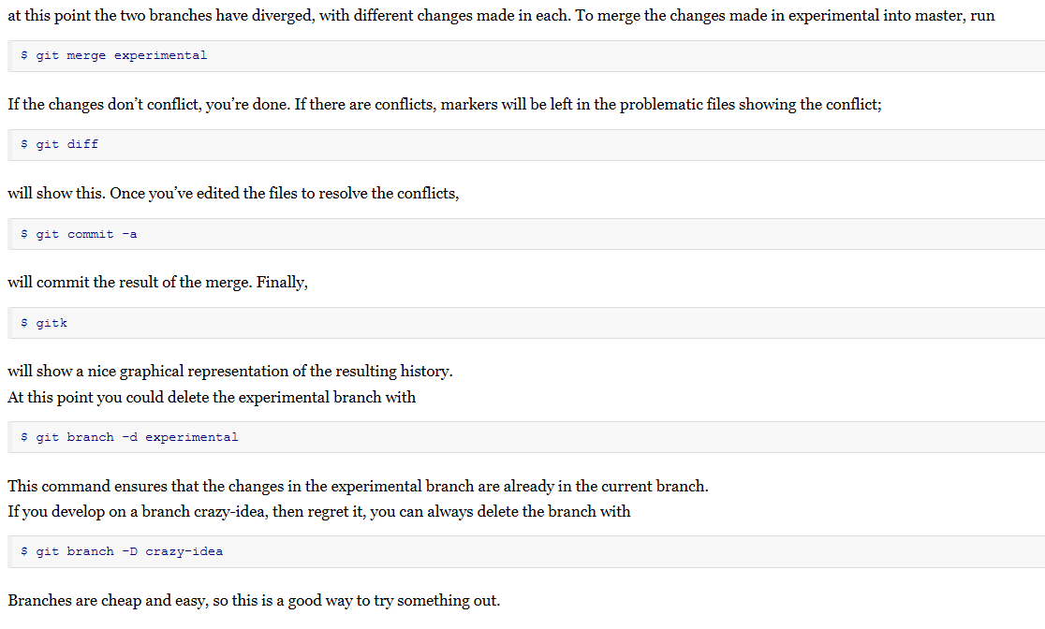
Git tutorial

Slide 15
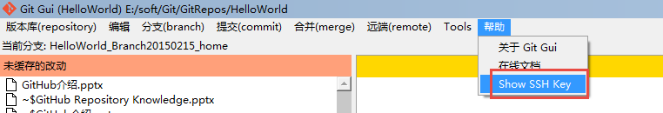
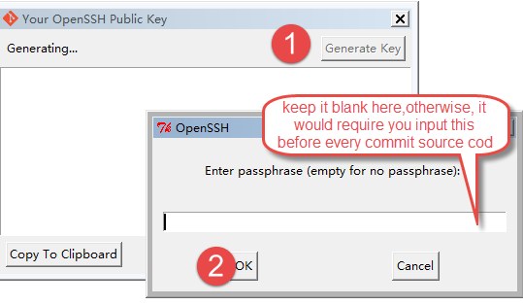
How to generate private key and public key
Step 1: Generate private key and public key
open the Git Gui ->help->show SSH Key

Slide 16
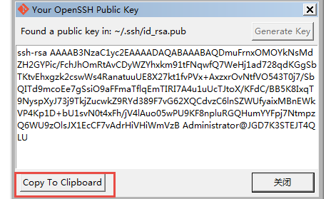
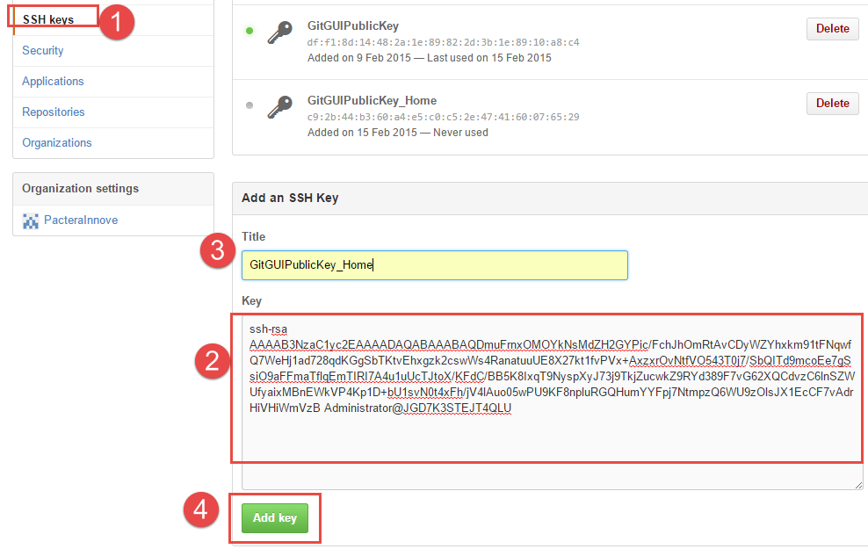
How to generate private key and public key
Step 2: open the Git Gui ->help->show SSH Key
Step 3: Copy the public key to GitHub.com
Setting ->SSH->paste the public key which copy in step1->fill
Title ->click “Apply”

Slide 17
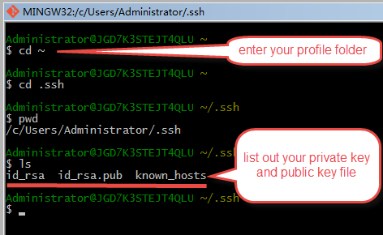
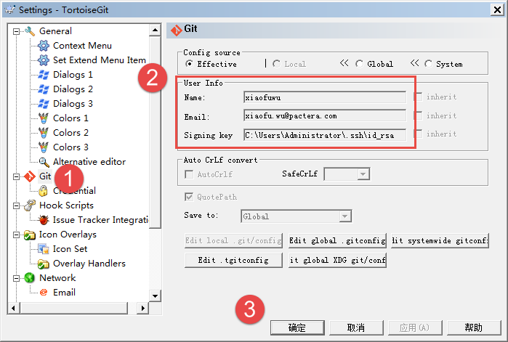
How to generate private key and public key
Step 4: Get your private key file by command in Git Bash
Open Git Bash
cd ~
cd .ssh
li
Step 5: Set TortoiseGit, so that it can communicate with GitHub by SSH

Slide 18
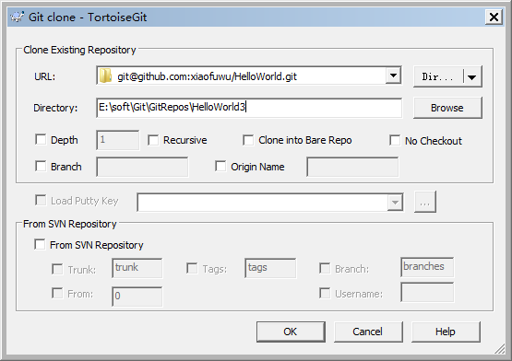

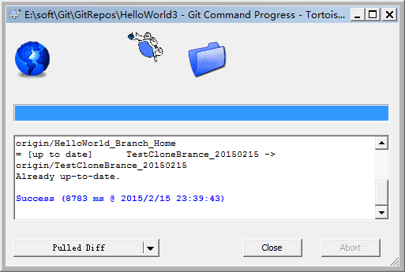
How to generate private key and public key
Step 5: test communicate with GitHub by SSH
Till now, tested pass.

Slide 19
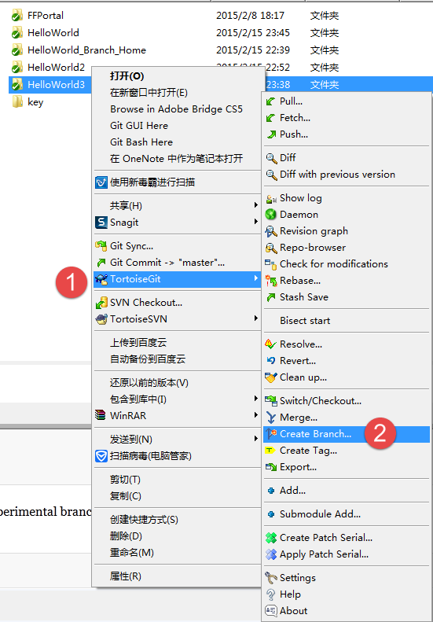
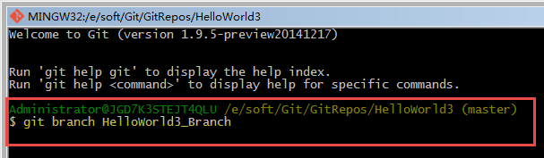
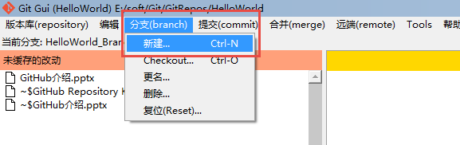
Create Branch
Three ways:
By TortoiseGit, refer to right screenshot
By Git Bash, run below command
By Git UI

Slide 20
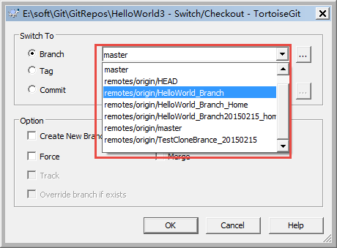
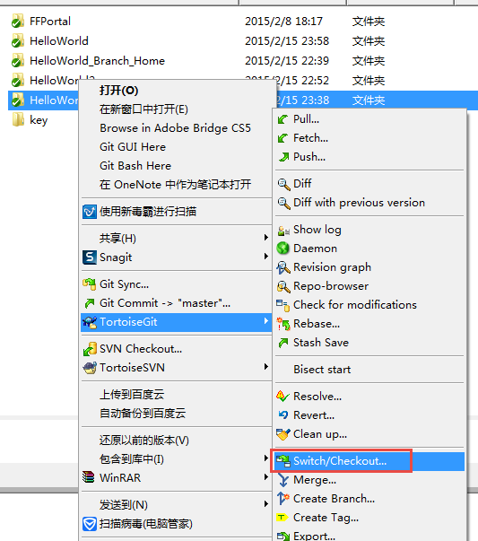
Switch Branch
Notes:
when switch to other branch, probably
Need to do merge operation since the
File is different between two branch

Slide 21
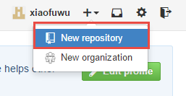
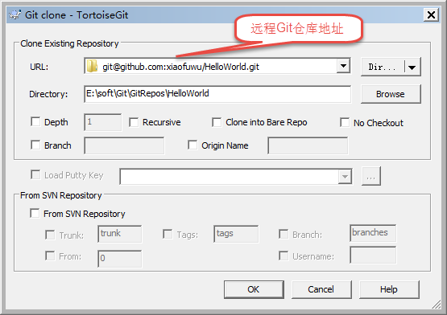
新建代码仓库，同步到本地
1. 在GitHub 创建一个自己的代码仓库
建议一个代码仓库为一个项目
2. 使用Git Clone
This section talks about how to clone a git repository from an existing repository.
Cloning a git repository is very simple. At an empty directory, just use the explorer context menu and select Git Clone... .

Slide 22
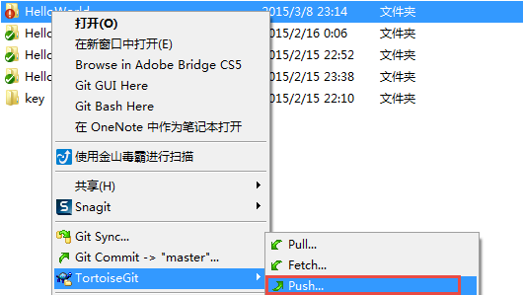
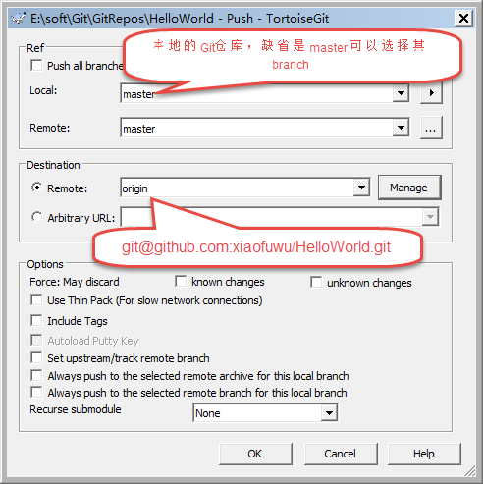
同步本地代码到远程仓库
下载了最新的代码之后，可能会修改，然后如何同步到远程仓库,下面是步骤：
1. TortoiseGit->Push
2. 配置如下

Slide 23
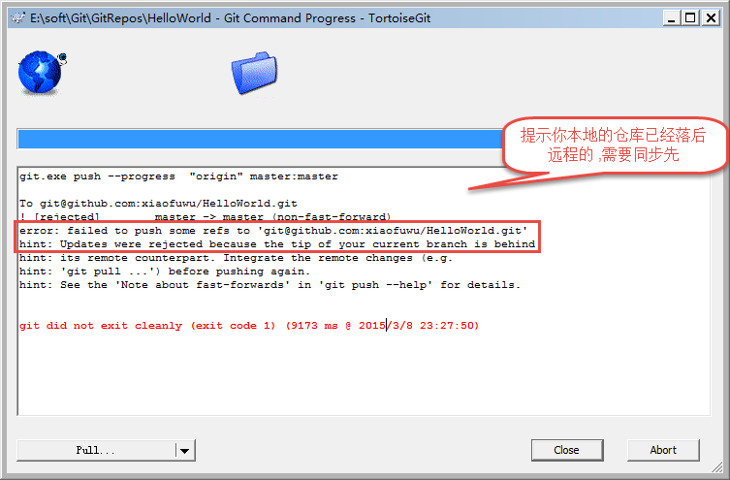
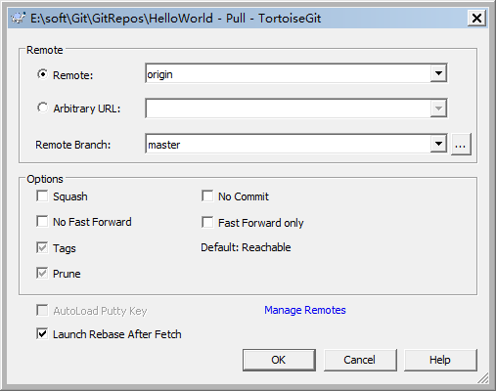
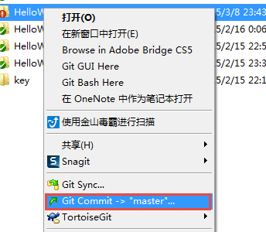
同步本地代码到远程仓库
提交push代码失败，提示如下，如何解决
1. 先备份你修改的文件
2. 点击pull从服务器拉最新的代码下来
Pull will merge remote branch change to local branch which tracked with remote branch. Fetch just get change from remote branch and never merge.
2. Click “ok”
3.重新把备份的文件拷贝回去，重新submit -→ 重新push到

