Slide 1

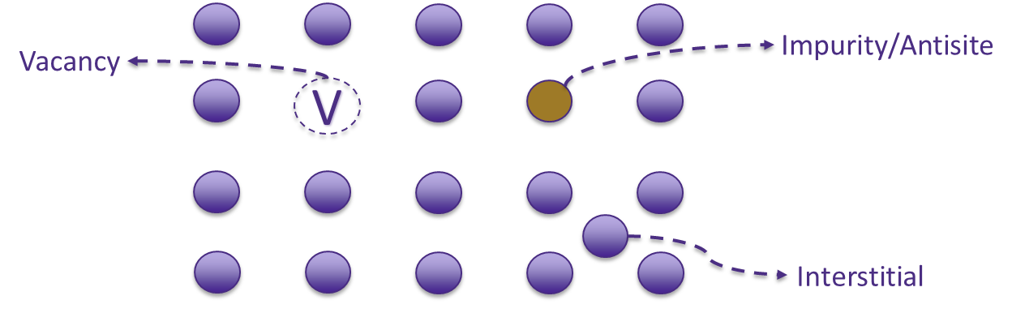
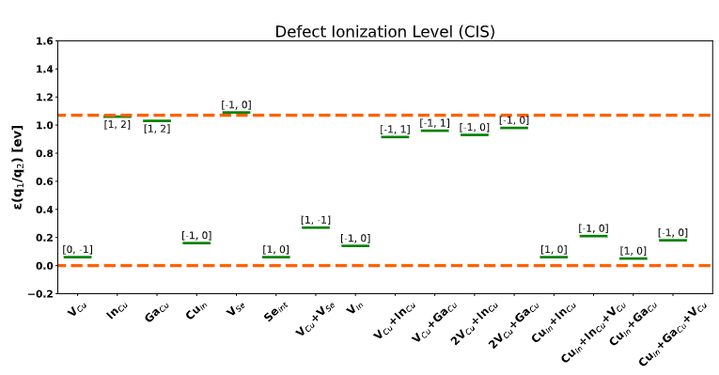
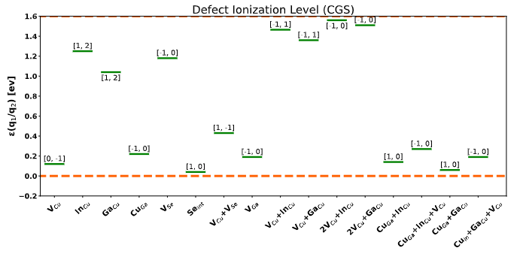
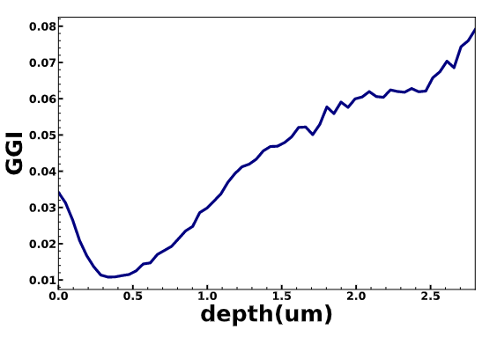
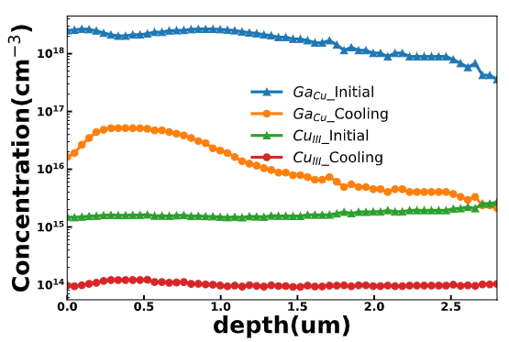
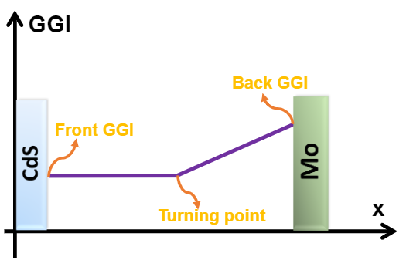
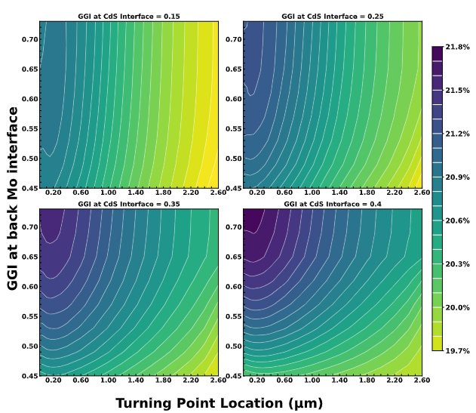
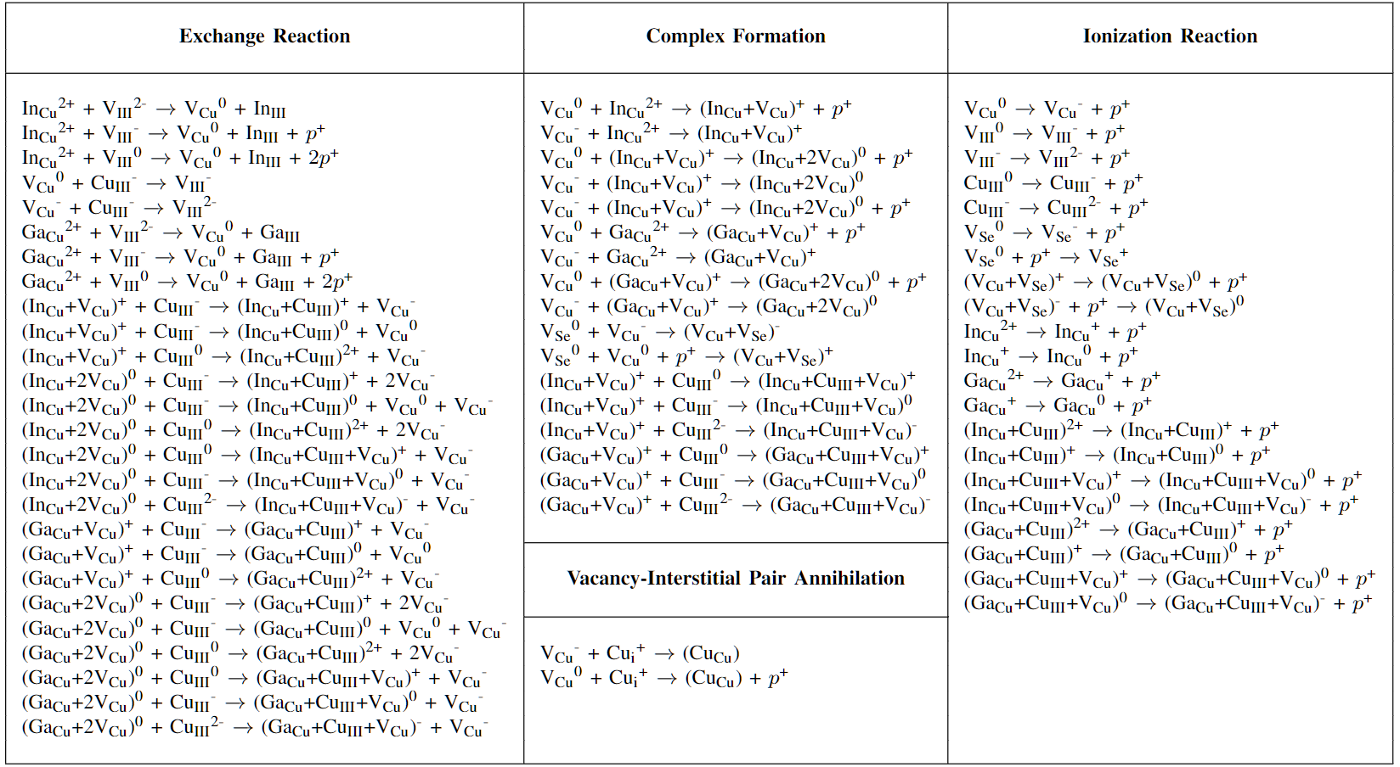



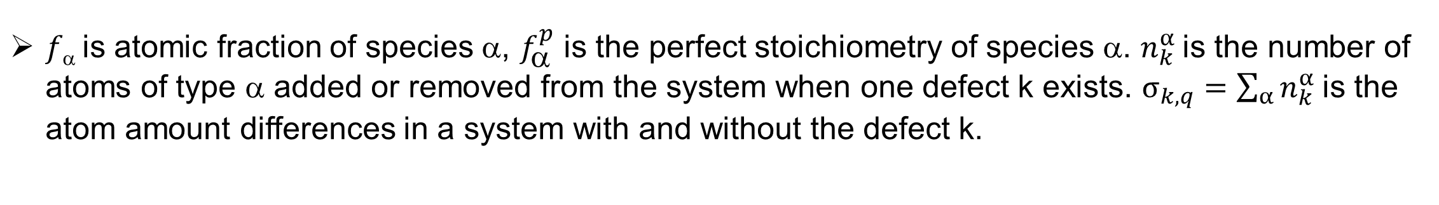


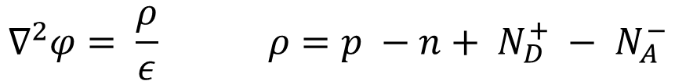
Coupled process/device modeling and point defect engineering of Cu(In,Ga)Se₂ solar cells
Xiaofeng Xiang¹, David E. Sommer², Aaron Gehrke³ and Scott T. Dunham²
¹Department of Molecular Engineering & Sciences, University of Washington
²Department of Electrical Computer & Engineering, University of Washington
³Department of Material Science & Engineering, University of Washington
Abstract
Point defects directly impact solar cell device performance by limiting the carrier lifetime.
Density functional theory calculations are used to determine the formation energy and diffusion energy barriers of dominant defects in Cu(In,Ga)Se₂.
Continuum reaction-diffusion models are developed to analyze the redistribution of defects during manufacturing processes. We estimate defect capture cross sections using a first-principles based approach. These cross sections are combined with our calculated defect profiles and trap energy levels to parameterize a Shockley-Read-Hall (SRH) recombination model.
A predictive Technology Computer Aided Design (TCAD) model is built to predict and optimize the performance of Cu(In,Ga)Se₂ solar cells.
Defect Formation Energy / Transition Level
Device Simulation Model
Software: Sentaurus Device Simulation
Optical properties/electrical properties/bandgap structure are obtained from literature
Carrier Lifetime from SRH recombination (with capture cross section of deep level defects (Ga_{Cu}, Cu_{III}) calculated via NONRAD [2]) and radiative recombination.
Mo
CIGS
CdS
ZnO
AZO
AM1.5 Global
We transform experimental [2] GGI profiles into defect distributions. We also find via continuum model that deep level defects such as Cu_{III} form shallow defect complexes during cooling and annealing, which improves carrier lifetime in solar cells.
MgF₂
GGI Profile -> Defect Distribution (CCT, Continuum Model)
$f$ is atomic fraction of species α, $f_{}^{p}$ is the perfect stoichiometry of species α. $n_{k}^{α}$is the number of atoms of type α added or removed from the system when one defect k exists. $σ_{k,q}=\sum_{α}{n_{k}^{α}}$is the atom amount differences in a system with and without the defect k.
By imposing compositional constraints, we can model the defect thermodynamics in NVT ensemble. Three constraints in our model: Ga/(Ga+In) (GGI), Cu/(In+Ga) (CGI), and Se chemical potential (u_{Se}) (Constant vapor pressure in manufacture, solid/gas/liquid phases coexist).
We can then obtain equilibrium defect distributions under any certain temperature.
Comparison between device simulation and experiment
Continuum Modeling (Sentaurus Process)
We use our TCAD model to simulate the solar cell device in experimental paper and find excellent match between simulation and experiment.
 | JSC(mA) | Voc(V) | η% | FF
Experiment [2] | 35.7 | 0.7113 | 19.0 | 77.1
Sentaurus Device | 34.7 | 0.7146 | 19.3 | 77.6
The continuum model is based on Fick’s first and second law. The aim of this model is to capture non-equilibrium distribution of defects.
The flux of a diffusing species in position x is proportional to the summation of concentration gradient, chemical potential gradient and electric potential gradient at x.
Poisson’s equation is used to derive the electric potential from the charge density.
Reaction rate term R is augmented to incorporate the mass action relations between defects [1].
$$J\left(x\right)=−D\left(x\right)∇C\left(x\right)−C(x)μ(x)∇U(x)$$
$$∇^{2}φ= \frac{ρ}{ε} ρ=p −n+ N_{D}^{+} − N_{A}^{−}$$
GGI gradient optimization
$$∂_{t}C_{k}=−∇∙J_{k} − \sum_{l}{η_{kl}R_{l}}$$
We use our TCAD model to optimize GGI gradient. We notice that the double gradient GGI profile above is the consequence of manufacturing process, but not the most desirable profile. The gradient toward CdS surface can degrade device performance. A flat profile toward CdS is more desirable. Also, a higher GGI toward Mo back layer since it creates an electric field that repels minority carriers. When applying optimized GGI profile, the device efficiency is increased up to 21.8% in device simulation, which is approximately 2% absolute gain.
$$R= k_{f}(\prod_{i=1}^{n}{C_{i}}−\frac{1}{K}×{(\frac{p}{n_{i}})}^{h}\prod_{j=1}^{m}{C_{j}})$$
$$Mass action Relations (\text{Reaction} \text{energy} \text{barriers} \text{are} \text{dependent} \text{on} \text{Ga}\text{/(}\text{In}\text{+}\text{Ga}\text{) (}\text{GGI}\text{) }\text{ratio})$$
Reference
[1] Xiang, Xiaofeng, et al. "Coupled process and device modeling of Cu (In, Ga) Se 2 solar cells." 2021 IEEE 48th Photovoltaic Specialists Conference (PVSC). IEEE, 2021.
[2] Turiansky, Mark E., et al. "Nonrad: Computing nonradiative capture coefficients from first principles." Computer Physics Communications 267 (2021): 108056.
Logos & Acknowledgements
This work supported in part by the U.S. Department of Energy's Office of Energy Efficiency and Renewable Energy (EERE) under the Solar Energy Technology Office Award Number DE-EE0008556. XX would also like to thanks the Clean Energy Institute (CEI) at the University of Washington for fellowship support (2020-2021). This work was facilitated through the use of the Hyak supercomputer system at the University of Washington.

