Slide 1


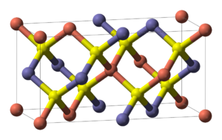
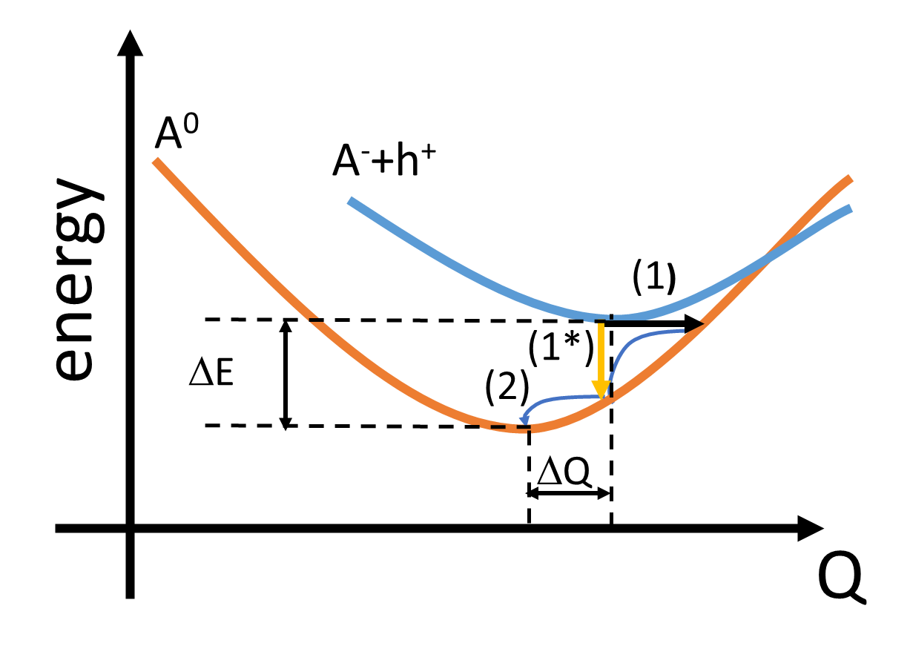
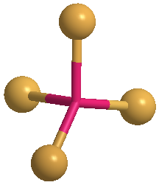
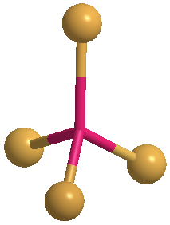
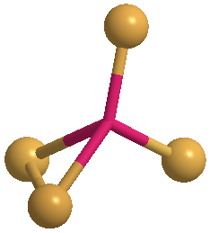
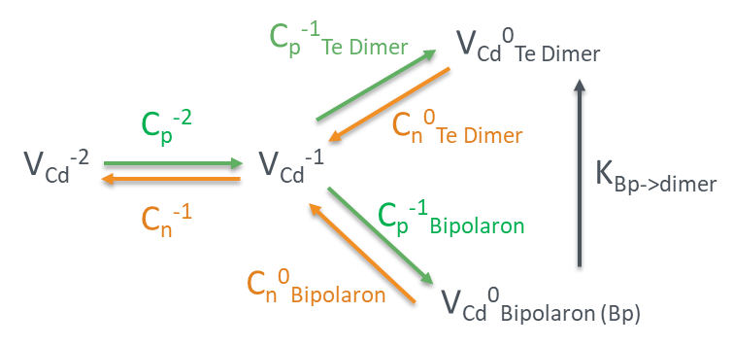
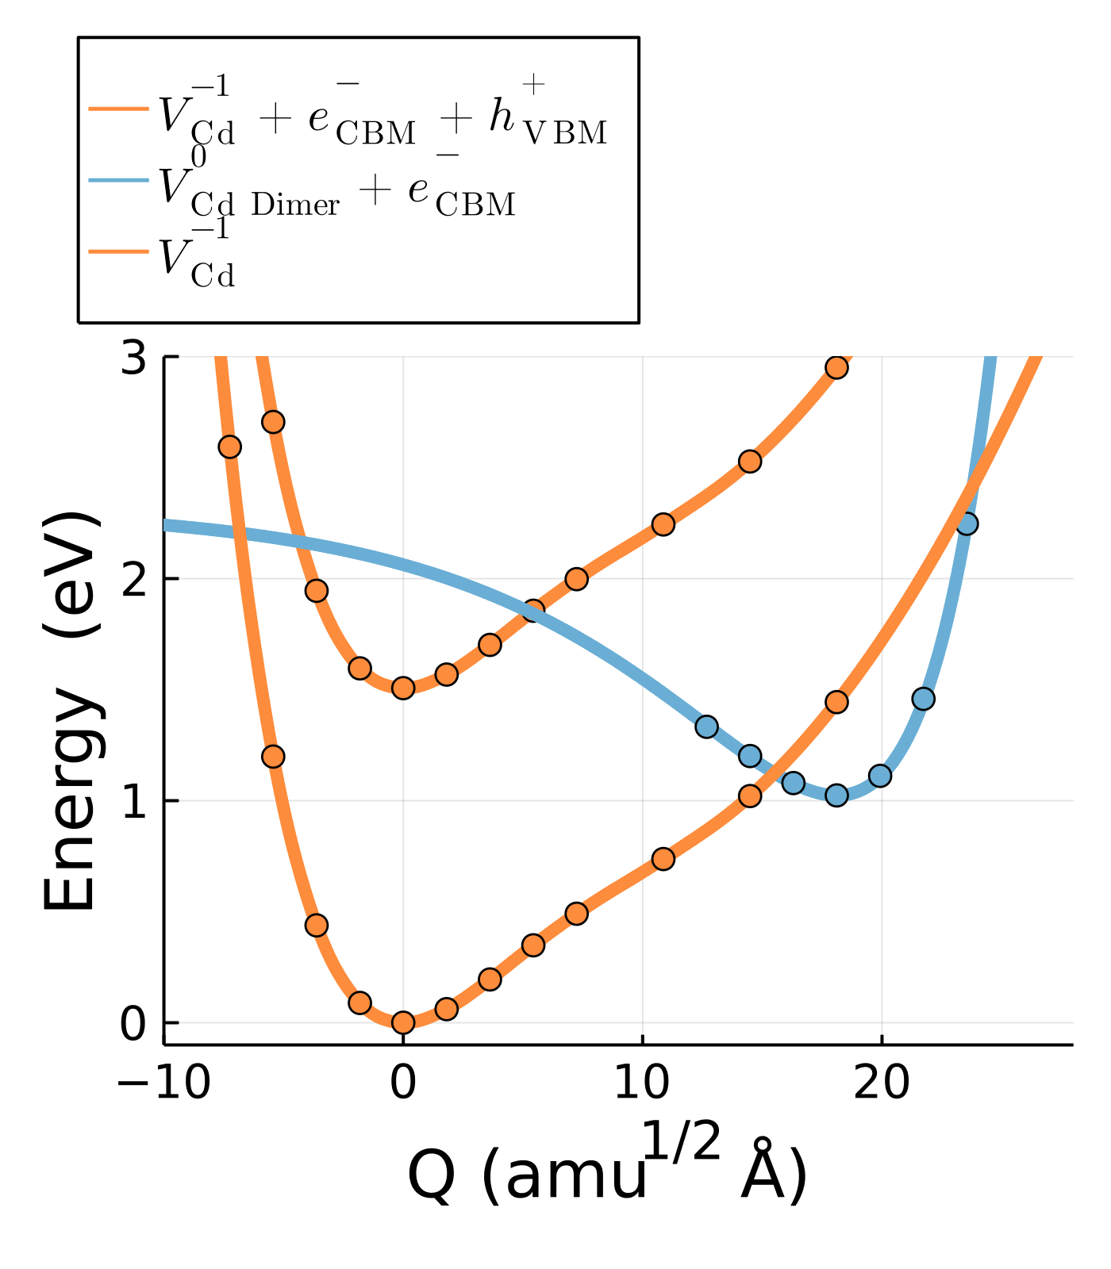
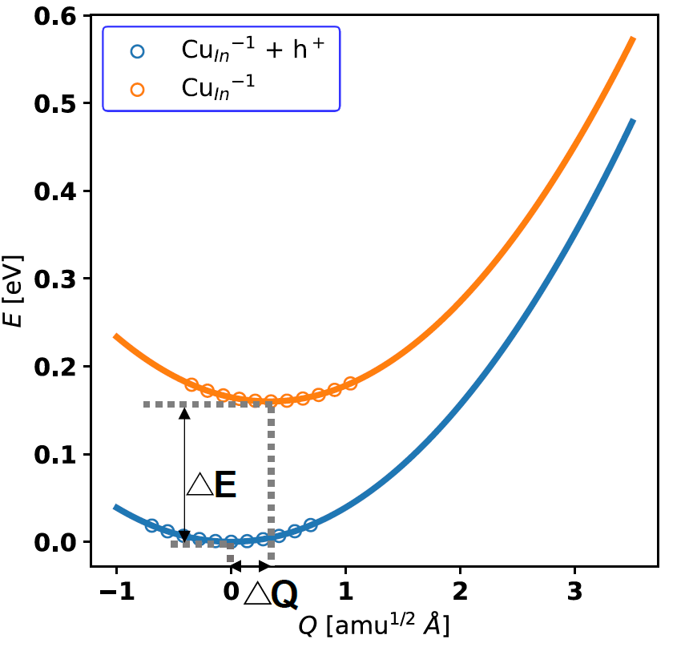
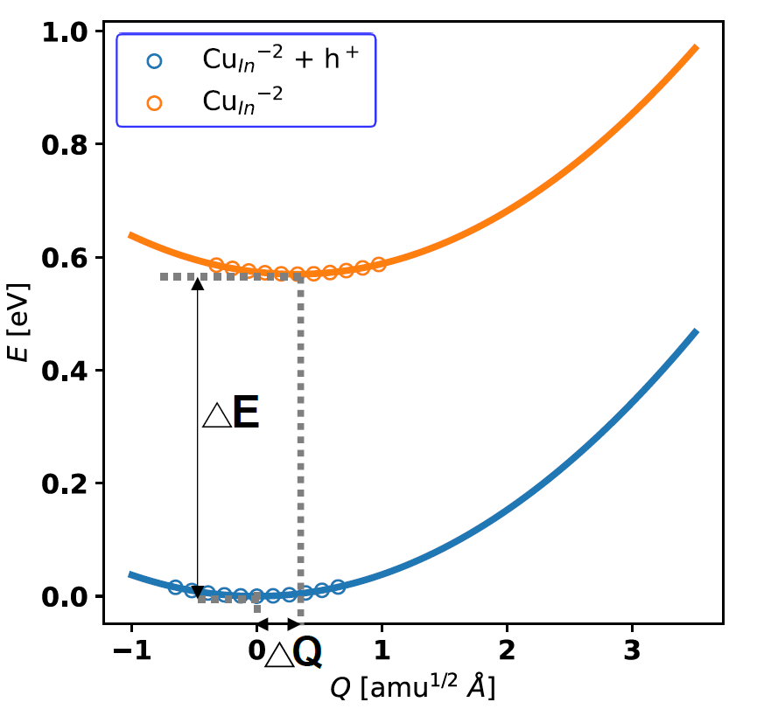






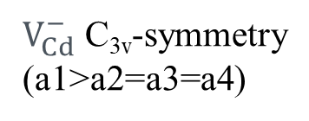

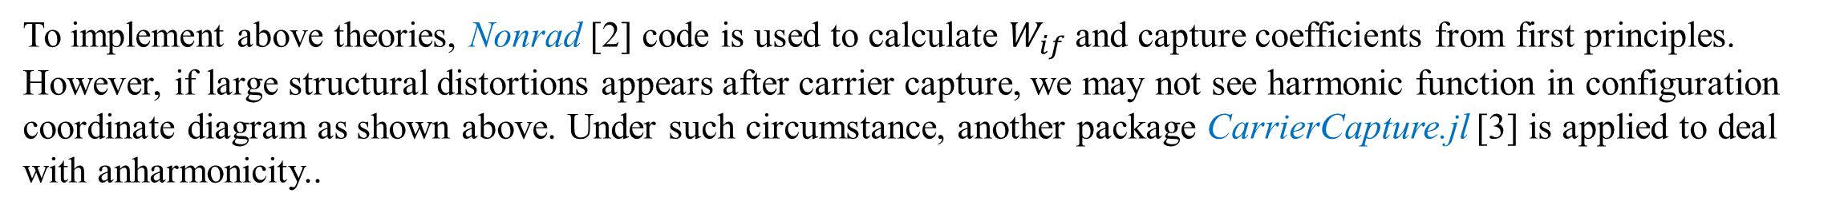


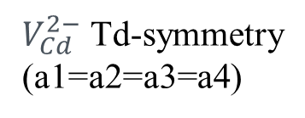

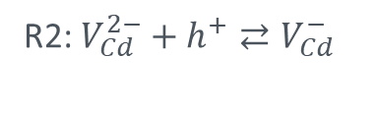
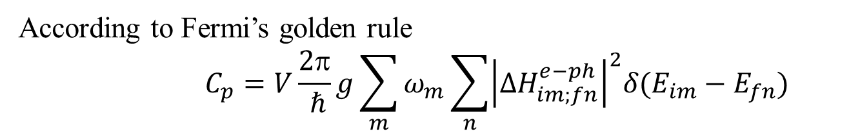
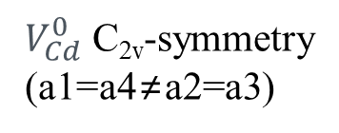



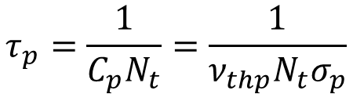
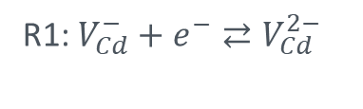


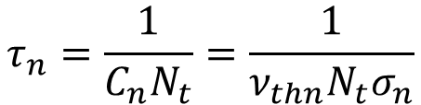
Carrier capture processes in CuIn_{1-x}Ga_{x}Se₂ and CdSe_{1-x}Te_{x} solar cells materials
Xiaofeng Xiang¹ and Scott T. Dunham²
¹Molecular Engineering & Sciences
²Department of Electrical & Computer Engineering
University of Washington, Seattle, WA, 98195
UW Nanotechnology
Modeling Lab
Introduction
Point defects directly impact solar cell device performance by nonradiative recombination and thus limit carrier lifetime and device efficiency.
In this work, density functional theory calculations are used to identify and characterize nonradiative recombination centers and corresponding capture cross sections in CuIn_{1-x}Ga_{x}Se₂ and CdSe_{1-x}Te_{x} solar cell materials.
The calculated defect densities as well as the corresponding capture cross sections and trap energy levels can be implemented into Shockley-Read-Hall (SRH) type recombination models to calculate carrier lifetimes. Modified SRH equations are required for CdSe_{1-x}Te_{x} solar cells due to multiple configurations of metastable deep level defects. These models are implemented into device simulation model to predict and optimize solar cell efficiency.
Radiative/Nonradiative Recombination Mechanism
Nonradiative Recombination in CdTe
Algorithm of Nonradiative/Radiative Recombination [1]
Configuration coordinate diagram (left) and Band diagram (right)
A dominant recombination center identified by researchers is V_{Cd}. V_{Cd} goes through a large structure distortion when the charge state changes from 0 to -2 [5].
Schematic of the non-radiative recombination mechanism of V_{Cd}
CB
R1: $V_{Cd}^{−}+e^{−}⇄V_{Cd}^{2−}$
Te
Te
Te
R2: $V_{Cd}^{2−}+h^{+}⇄V_{Cd}^{−}$
a2
a1
a1
a1
R3: $V_{Cd,Te Dimer}^{0}+e^{−}⇄V_{Cd}^{−}$
E_{g}
$$N_{A}^{−}$$
a3
a4
a2
a4
a2
a4
R4: $V_{Cd}^{−}+h^{+}⇄V_{Cd,Te Dimer}^{0}$
a3
a3
R5: $V_{Cd,Bipolaron}^{0}+e^{−}⇄V_{Cd}^{−}$
$$U_{p}=C_{p}N_{A}^{−}p$$
ΔE
$V_{Cd}^{2−}$ Td-symmetry
(a1=a2=a3=a4)
$V_{Cd}^{−}$ C_{3v}-symmetry
(a1>a2=a3=a4)
$V_{Cd}^{0}$ C_{2v}-symmetry
(a1=a4≠a2=a3)
R6: $V_{Cd}^{−}+h^{+}⇄V_{Cd,Bipolaron}^{0}$
$$p$$
VB
R7: $V_{Cd,Bipolaron}^{0}⇄V_{Cd,Te Dimer}^{0}$
Recombination Rate Comparison under Various Conditions
Step (1) change of the electronic state due to electron-phonon coupling (Nonradiative).
Step (1*) change of the electronic state due to electron-photon coupling (Radiative).
Step (2) vibrational relaxation due to phonon-phonon interactions.
Conducting
edges
In principle, radiative and non-radiative processes are competing. Radiative rate are of the order 10⁻¹⁴ - 10⁻¹³ cm³ s⁻¹. Nonradiative rate are over range of 10⁻¹⁴ - 10⁻⁶ cm³ s⁻¹. In both processes, step (1) is the rate limiting step.
$$Nonradiative Recombination Rate U_{p}=C_{p}N_{A}^{−}p$$
According to Fermi’s golden rule
$$C_{p}=V\frac{2π}{ ℏ}g\sum_{m}{ω_{m}\sum_{n}{{\left|∆H_{im;fn}^{e−ph}\right|}^{2}δ(E_{im}−E_{fn})}}$$
To simplify the problem, only one special phonon mode is used to replace the sum over all vibrational degrees of freedom. Thus,
In n-type, p-type, or nearly intrinsic CdTe, $R3,R4,R6,R7≫R1,R2,R5$. Thus, (-1, 0_dimer) transition is the dominant recombination process.
$\sum_{n}{\left|∆H_{im;fn}^{e−ph}\right|≈<ψ_{i}|∂\hat{H}/∂Q|ψ_{f}>\sum_{n}{\left|<χ_{im}|\hat{Q}−Q_{0}|χ_{fn}>\right|}}$
Electron-phonon coupling matrix element
$$W_{if}$$
Modified SRH Recombination Models for V_{Cd}
To implement above theories, Nonrad [2] code is used to calculate $W_{if}$ and capture coefficients from first principles. However, if large structural distortions appears after carrier capture, we may not see harmonic function in configuration coordinate diagram as shown above. Under such circumstance, another package CarrierCapture.jl [3] is applied to deal with anharmonicity..
When injection level is higher than 10⁷ cm⁻³, R3/R4 becomes a constant value. We can then derive a new SRH model to be implemented into device simulation
Deep Level Defects in Cu(In,Ga)Se₂
$$\frac{R3}{R4}=\frac{k_{3}\left(C^{0,dimer}n−C^{−}n_{2}\right)}{k_{4}\left(C^{−}p−C^{0,dimer}p_{2}\right)}≈\frac{k_{4}p_{2}+k_{7}}{k_{3}p_{3}}=2.75 \left(Injection level>{10}^{7}\text{cm}\text{−3}\right)$$
We applied above method to examine possible deep level defects in CuIn_{1-x}Ga_{x}Se₂, such as antisites (Cu_{III}, Ga_{Cu}, etc) and complexes (In_{Cu}+2V_{Cu}, In_{Cu}+ Cu_{III} +V_{Cu,} etc). We found only Cu_{III} (-1/0) has both large capture coefficient and significant defect concentration in CIGS.
$$New SRH Model for VCd$$
$$U=\frac{2.75\left(np−n_{i}^{2}\right)}{2.75τ_{n}\left(p+p_{2}\right)+τ_{p}\left(n+n_{2}\right)}$$
Configuration coordinate diagram of Cu_{In} (-1/0) (left) and Cu_{In}(-2/-1) (right)
Table of defect capture cross sections in CuIn_{1-x}Ga_{x}Se₂
Next steps: We will keep exploring other possible deep level defects and build coupled materials/process/device models for CdTe_{1-x}Se_{x} photovoltaics.
Defect | σ_{p} (cm²) | σ_{n} (cm²)
In_{Cu}+Cu_{III}+V_{Cu} | 1.14E-25 | 1.01E-27
2V_{Cu}+In_{Cu} | 1.88E-25 | 1.66E-27
Cu_{III} | 7.41E-13 | 2.47E-16
Ga_{Cu} | 1.34E-24 | 3.68E-21
References
[1] Alkauskas, Audrius, Qimin Yan, and Chris G. Van de Walle. Physical Review B 90.7 (2014): 075202.
[2] Turiansky, Mark E., et al. Computer Physics Communications 267 (2021): 108056.
[3] Kim, Sunghyun, et al. Journal of Open Source Software 5.47 (2020): 2102.
[4] Jackson, Philip, et al. Progress in Photovoltaics: Research and Applications 15.6 (2007): 507-519.
[5] Kavanagh, Seán R., Aron Walsh, and David O. Scanlon. ACS energy letters 6.4 (2021): 1392-1398.
$$SRH \left(Shockley−Read−Hall\right) Model:$$
$$U=\frac{np − n_{i}^{2}}{τ_{p}\left(n+n_{1}\right)+τ_{n}(p+p_{1})}$$
The capture coefficient/capture cross section obtained from Nonrad is implemented into SRH model in device simulation. We use such model to compare with experiment and find they have close match.
This work was supported in part by the U.S. Department of Energy's Office of Energy Efficiency and Renewable Energy (EERE) under the Solar Energy Technology Office Award Number DE-EE0008556. The authors would also like to thanks the Clean Energy Institute (CEI) at the University of Washington for fellowship support (2020-2021). This work was facilitated through the use of the Hyak supercomputer system at the University of Washington supported via the Student Technology Fund.
$$τ_{p}=\frac{1}{C_{p}N_{t}}=\frac{1}{ν_{thp}N_{t}σ_{p}}$$
$$τ_{n}=\frac{1}{C_{n}N_{t}}=\frac{1}{ν_{thn}N_{t}σ_{n}}$$
Device schematic of CIGS solar cell
Comparison between device simulation and experiment
Mo
CIGS
CdS
ZnO
AZO
 | J_{SC} (mA) | V_{OC} (V) | η (%) | FF
Experiment [4] | 34.7 | 0.7113 | 19.0 | 77.1
Sentaurus Model | 34.7 | 0.7146 | 19.3 | 77.6
AM1.5 Global
MgF₂

