Slide 1
Analytics Project Presentation
Analytics Project: Job Market Analysis based on bigdata
Team: les Trois Mousquetaires
<Rui Guo, Hao Li, Han Tang >
Abstract: This project explores the Top-Paid Job skills and salary of the New York City job market by predicting using the publicly available NYC Open Data dataset. Many different parametric and non- parametric models have been shown to achieve good levels of accuracy on certain datasets.
1

Slide 2
Job Market Analysis based on bigdata
Background
We attempt to use this open dataset to tailor brand new features and gain a high accuracy in prediction via analyzing the data. We hope to gain insight into e.g. what Job skills have the highest need now and in the near future in the public career of NYC, or which skills will get the highest salary for the fresh graduate, will students graduated in summer get more opportunity than those graduated in winter, And so on.
Motivation
Data means business nowadays, who controls the data, espicailly the information hides from huge amount of data is the key to business.
Also nowadays people kept questioning the problem hide in higher education, find a job is not as easier as before. The researchers in education almost reached a consensus this fact, that education is usually not match for industry needs. So if we can dig into the needs of market and give this information for people who needed it, such as teacher , professor in college, government department, students in college. It will have a huge impact on enprove the quality of education and reduce the employ problem we have nowadays. This result also means a boost for economic situation we have.
2

Slide 3
Job Market Analysis based on bigdata
Data Sources
NYC OPEN DATA
https://nycopendata.socrata.com
NYC Open Data makes the wealth of public data generated by various New York City agencies and other City organizations available for public use.
(Here we got the New York Job posting Data)
Socrata Public Data
http://www.socrata.com/
Socrata provides user-friendly solutions deliver data to governments trying to reduce costs, to citizens who want to understand how their tax dollars are used, and to civic hackers dedicated to creating new apps and improving services.
(Here we got the Texas State Tax Information Data)
3

Slide 4
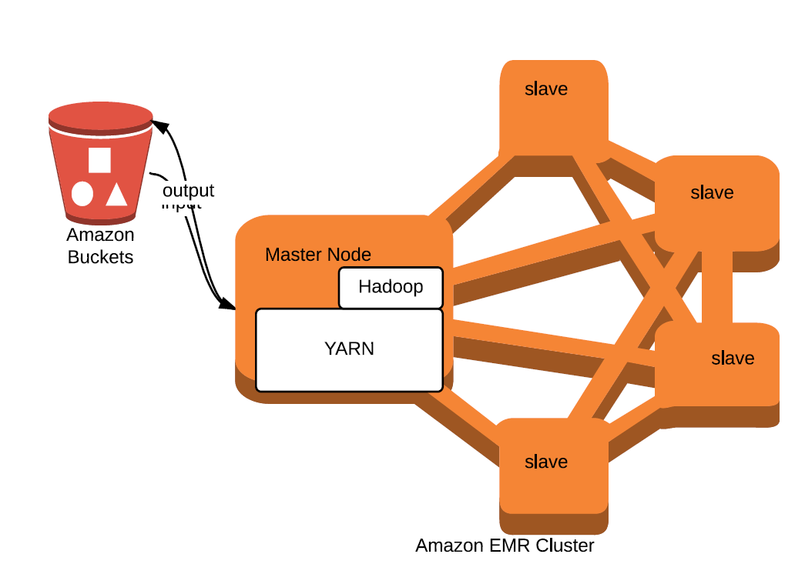
Job Market Analysis based on bigdata
Design Diagram

Slide 5
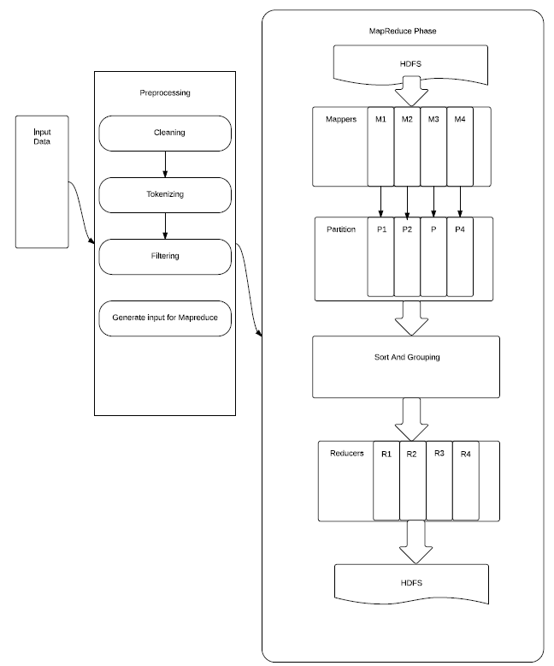
Job Market Analysis based on bigdata
5

Slide 6
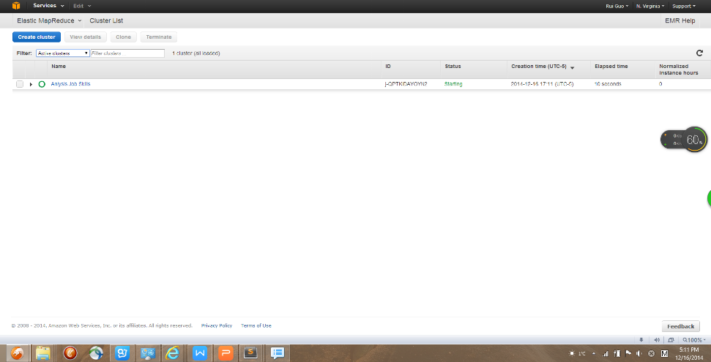
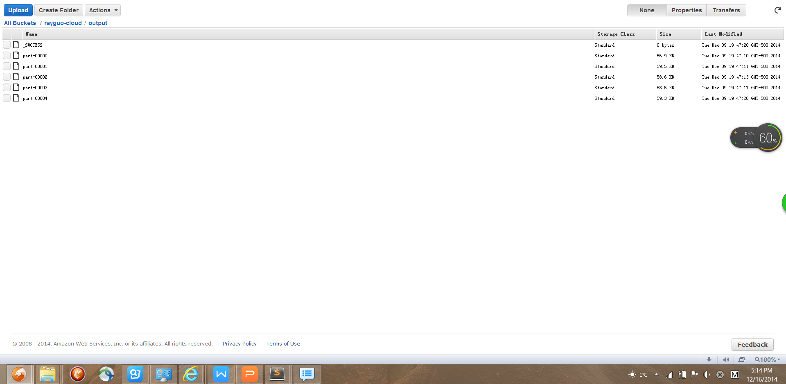
Depolyment
1. We write code locally and test it with some dataset,
then we upload the program and input into EMR
2. we save the MapReduce output into Amazon S3
3. From there we extract file and process for visualize

Slide 7
Job Market Analysis based on bigdata
Results
In NYC Dataset
1.Find out which job skills is mostly demanded or most paid in the market
In Texas Dataset
2. Find out the relation between income and working experience in different job titles ,and the connection between professional level and salary , in this way , we can see a career’s development potential
3. Find out the salary distribution
7

Slide 8
Job Market Analysis based on bigdata
Obstacles
1. hard to get dataset with exposing to personal salary, so we can only try with public and goverment salary
2. the pre-processing of data is a creative job, cause most of data is not structed enough to get into mapreduce clusters to being structed
3. Cause we lack of bussiness and ecnomic backgroud , we spend a long time to figure out what we want from the dataset, and how we figure a way to obtain it.
4. have a hard time deploying our program on AWS EMR.
8

Slide 9
Job Market Analysis based on bigdata
Results:
1. the relation between salary and some Abstract skills or qualifications

Slide 10
Job Market Analysis based on bigdata
Results:
1. the relation between pratical skills and salary
10

Slide 11
Job Market Analysis based on bigdata
Results:
1. the relation between pratical skills and salary
11

Slide 12
Job Market Analysis based on bigdata
Results:
2. the relation between pratical skills and market needs
12

Slide 13
Job Market Analysis based on bigdata
Results:
2. the relation between Abstract skills or qualifications to market needs
13

Slide 14
Job Market Analysis based on bigdata
Results:
3. Personal Income Distribution
income range | people in range(NUMBERS)
0~25k | 101062
25k~50k | 284177
50k~75k | 136347
75k~100k | 23976
>100k | 13992
Income range | Income Sum
0~25k | 1767221322
25k~50k | 10772401123
50k~75k | 8086235520
75k~100k | 2037526624
>100k | 1956339629
14

Slide 15
Job Market Analysis based on bigdata
Results:
2. the relation between salary and working experience
Office Assistant I~IV
15

Slide 16
Job Market Analysis based on bigdata
Teacher Grade 1~12

Slide 17
Job Market Analysis based on bigdata
Systems Analyst I~VII

Slide 18
Job Market Analysis based on bigdata
Program Specialist I~VII

Slide 19
Job Market Analysis based on bigdata
Conclusion
1.From NYC job Dataset , we have get the information about which job skill is hot in market, and which job is highly paid, from dataset we saw is a job skills is highly demanded is usually highly paid, and some job skills is rare is dataset but still highly rewarded.
2.From Texas tax Dataset, we can see a general upward trend for salary in working years in general positions such as teachers , company staff ,managers regardless of their professional level is entry or senior.
However, in the technology-based career, like computer system specialist , there is no such clear trend shows salary rise with working years, it might fall instead. But the in such position clearly shows the trend that the professional level higher rank ,the better paid.
3. From Texas tax Dataset, we know that the distribution of the personal income, for exam 50.79% of people income within range of 25k-50k, and all the people in that range make a 44% of society total income, we can use this data evaluate economy or tax policy.
Acknowledgements
Thanks Amazon for providing Amazon AWS voucher for us to use Amazon cloud services
Thanks NYU OPEN DATA project for their public DataSets
19

Slide 20
References
[1]Wei Tan; Blake, M.B.; Saleh, I.; Dustdar, S., “Social-Network-Sourced Big Data Analytics”, Internet Computing, IEEE (Volume: 17, Issue: 5), p62-69
[2]Hari Arul, Andres Morale, NYC Condo Price Estimation Using NYC Open Data
[3]Michael R. Bloomberg, Open Data Policy and Technical Manual
[4]Manyika, James Big Data: The Next Frontier for Innovation, Competition & Productivity
20

Slide 21
Thank you!
21

