Slide 1

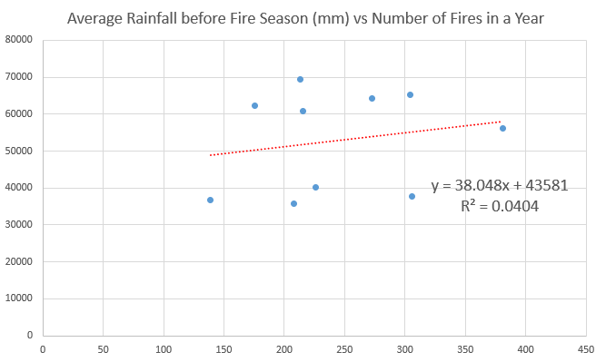
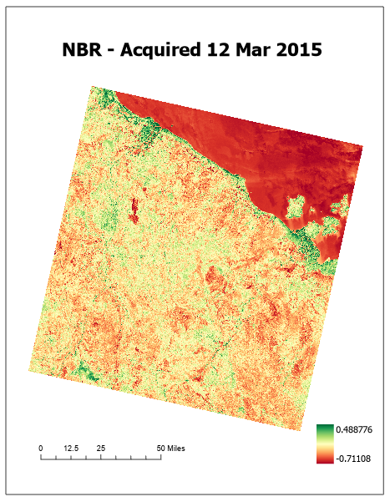
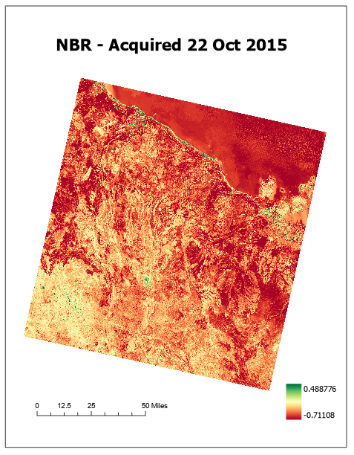
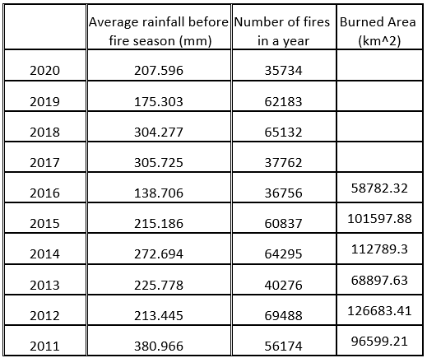
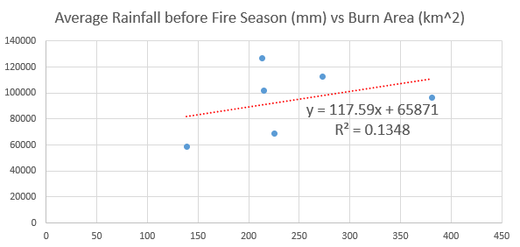
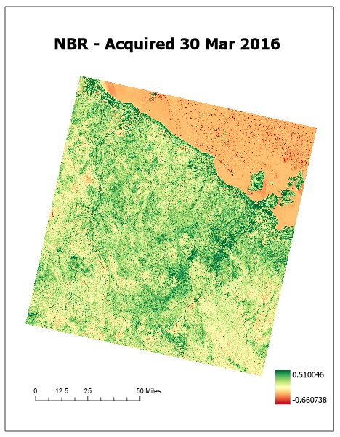
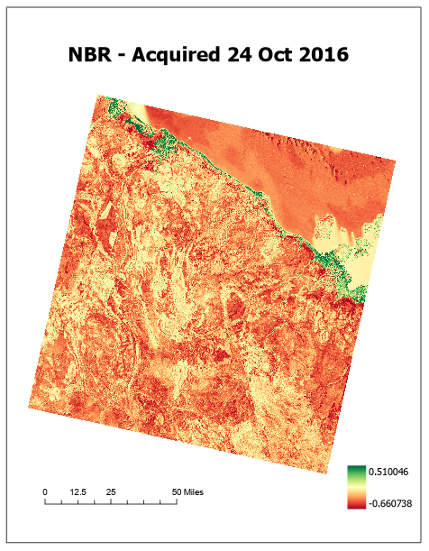
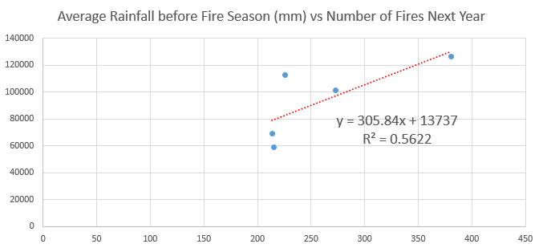
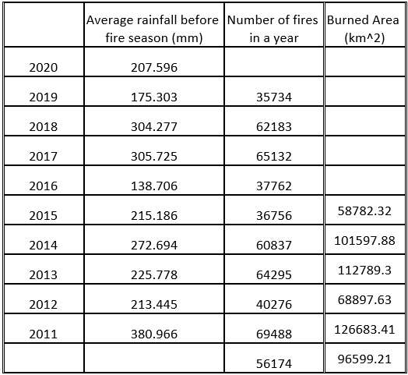
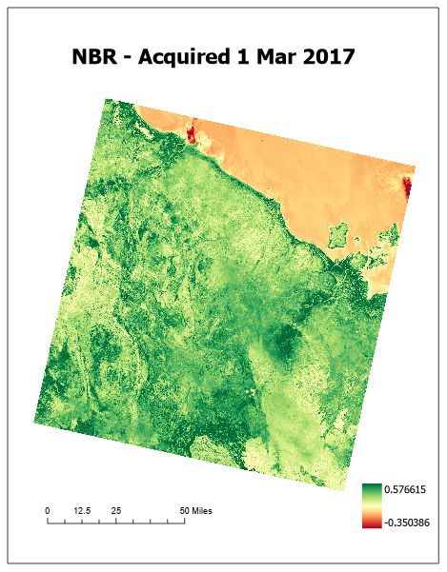
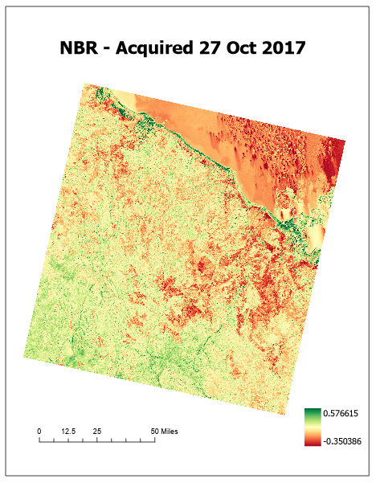
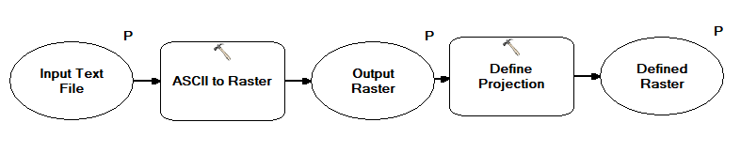
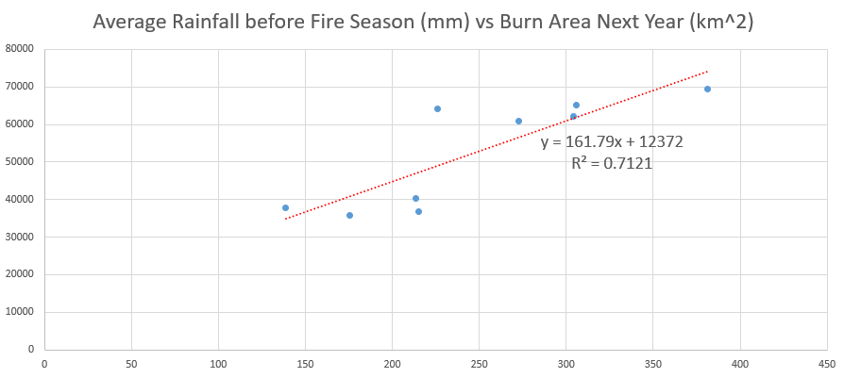
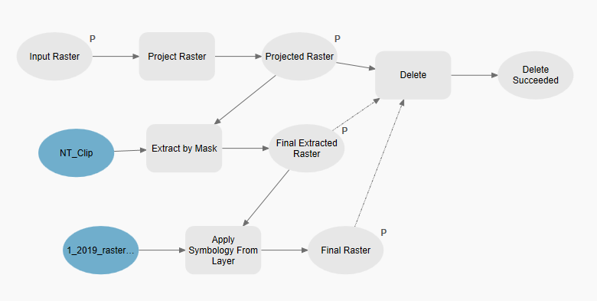
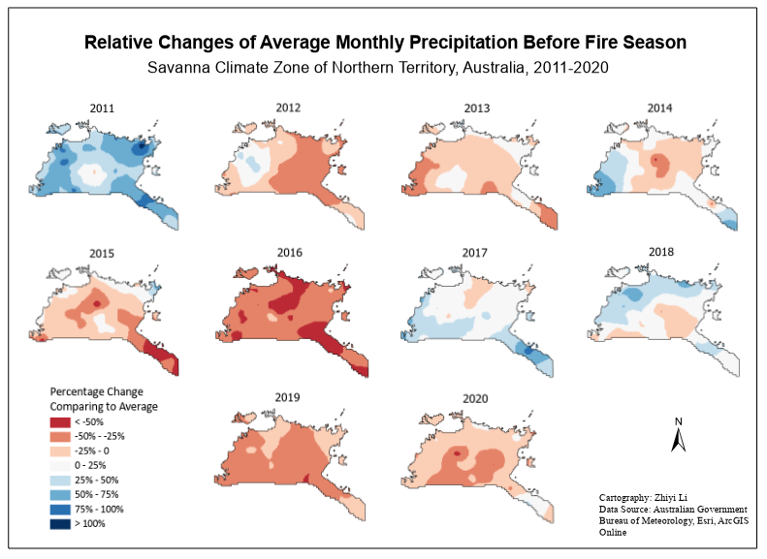
The Precipitation’s Influence on Bushfires in Savanna Climate Zone of Northern Territory, Australia
Department of Geoscience
University of North Alabama
Zhiyi Li, Jian Chen, Ph.D.
Introduction
We plan on studying the precipitation’s influence on bushfires in savanna climate zone of Northern Territory, Australia. Bushfires are frequent wildfires in Australia’s hot, dry season. Every year, large areas of land are destroyed, resulting in property losses and casualties. Bushfires have killed approximately 800 people in Australia since 1851. In addition to the threat to human life and property, Australia’s severe bushfires also have a huge impact on the world’s biodiversity. Such fires lead to the deaths of millions of animals. They can also disrupt the Earth’s weather, which can lead to all sorts of cascading disasters. So we have interests in looking at the empirical pattern of bushfires in Australia. We think of precipitation because water is just the opposite of fire. It is easy to imagine precipitation might have a significant effect on wildfires. Although the triggers of wildfires are usually some human factors like unextinguished cigarette butts, bonfires, or some natural disasters like lightning and thunderstorms, the climate conditions provide ample fuel for the fires to grow and spread and is indispensable. It is our intention to find out how the pre-fire precipitation would influence the bushfires that year.
Results
Pearson coefficient: 0.200940857
Method
Deal with the precipitation data and bushfire data.
Precipitation data analysis: use two models; average.
Bushfire analysis: Select by Attributes tool → acquire the number of fires per year; UFED analysis tool → obtain the burnt area each year.
Pearson coefficient: 0.367154093
Pearson coefficient: 0.74978
Pearson coefficient: 0.843847
Conclusion
There is a weak positive correlation between the pre-fire precipitation and the number of fires or burned areas that year. But there is a strong positive correlation between the pre-fire precipitation and the number of fires or burned areas next year.
Almost every year since 2011 has seen rainfall levels before the fire season below the 30-year average.
Less precipitation before the fire seasons caused more serious fires and resulted in more damage to the land that year.
Find the possible relationships between precipitation and bushfires. Pearson correlation analysis & linear regression analysis. Shapiro-Wilk Test in R.
Find out which years of the 2011-2020 decade had anomalies of precipitation. Calculate the relative change: Relative Change = (p₁ – p₀) / p_{0,}
where p₁ is the average monthly precipitation of a certain year before fire season and p₀ is the average monthly precipitation before fire seasons in the 30-year period.
Calculate NBR and NDVI to estimate the fire damage:
NBR = (NIR - SWIR) / (NIR + SWIR)
NDVI = (NIR – Red) / (NIR + Red)
In Landsat 8, NIR is Band 5, SWIR is Band 7, and Red is Band 4.
References
Hernández Ayala, J. J., Mann, J., & Grosvenor, E. (2021). Antecedent rainfall, excessive vegetation growth and its relation to wildfire burned areas in California. Earth and Space Science, 8, e2020EA001624. https://doi.org/10.1029/2020EA001624
Ehsani MR, Arevalo J, Risanto CB, Javadian M, Devine CJ, Arabzadeh A, Venegas-Quiñones HL, Dell’Oro AP, Behrangi A. 2019–2020 Australia Fire and Its Relationship to Hydroclimatological and Vegetation Variabilities. Water. 2020; 12(11):3067. https://doi.org/10.3390/w12113067
Westerling, A.L., Bryant, B.P. Climate change and wildfire in California. Climatic Change 87 (Suppl 1), 231–249 (2008). https://doi.org/10.1007/s10584-007-9363-z
Collins L., Bradstock R. A., Penman T. D. (2014) Can precipitation influence landscape controls on wildfire severity? A case study within temperate eucalypt forests of south-eastern Australia. International Journal of Wildland Fire 23, 9-20. https://doi.org/10.1071/WF12184
Zachary A. Holden, Alan Swanson, Charles H. Luce, W. Matt Jolly, Marco Maneta, Jared W. Oyler, Dyer A. Warren, Russell Parsons, David Affleck. Decreasing fire season precipitation increased recent western US forest wildfire activity. PNAS, 115 (36) E8349-E8357. https://doi.org/10.1073/pnas.1802316115

